Slide 1
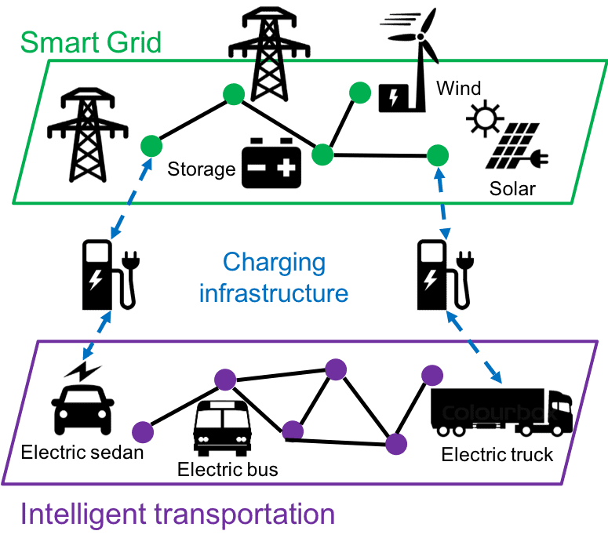
source: SKL-IOTSC

