Slide 1
Robot policy training Pipeline
Kunal Ghosh

Slide 2
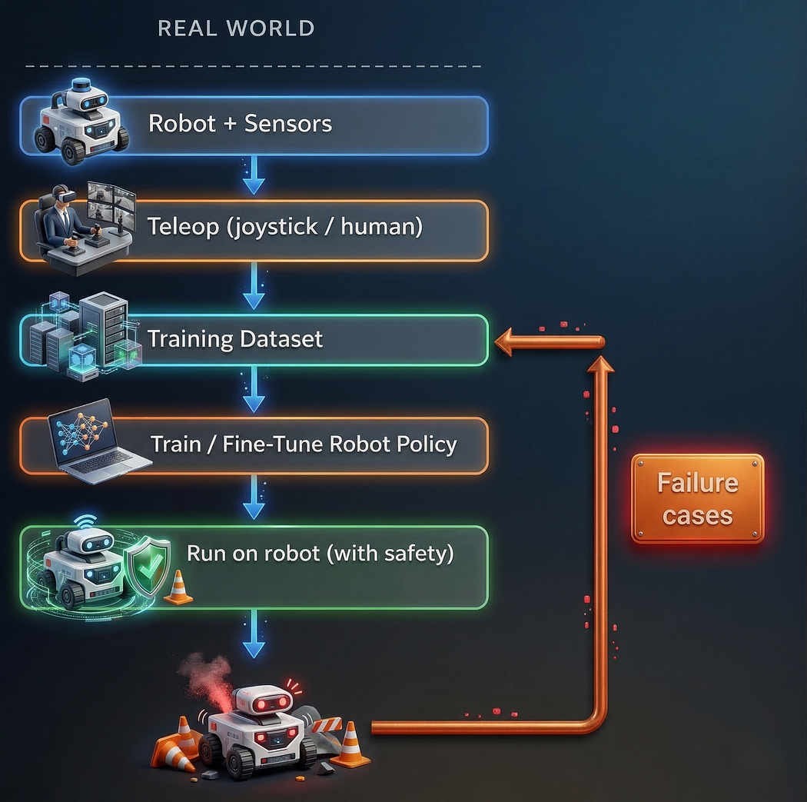
Physical - Robot Policy Training Pipeline
Provision Physical Robot First
Setup Robot with sensors
Teleoperate to gather data
Create Training Data for this specific Robot
Fine Tune Robot Policy
Deploy on Trained Policy on Real Robot
Gather failure dataset and retrain iteratively

Slide 3
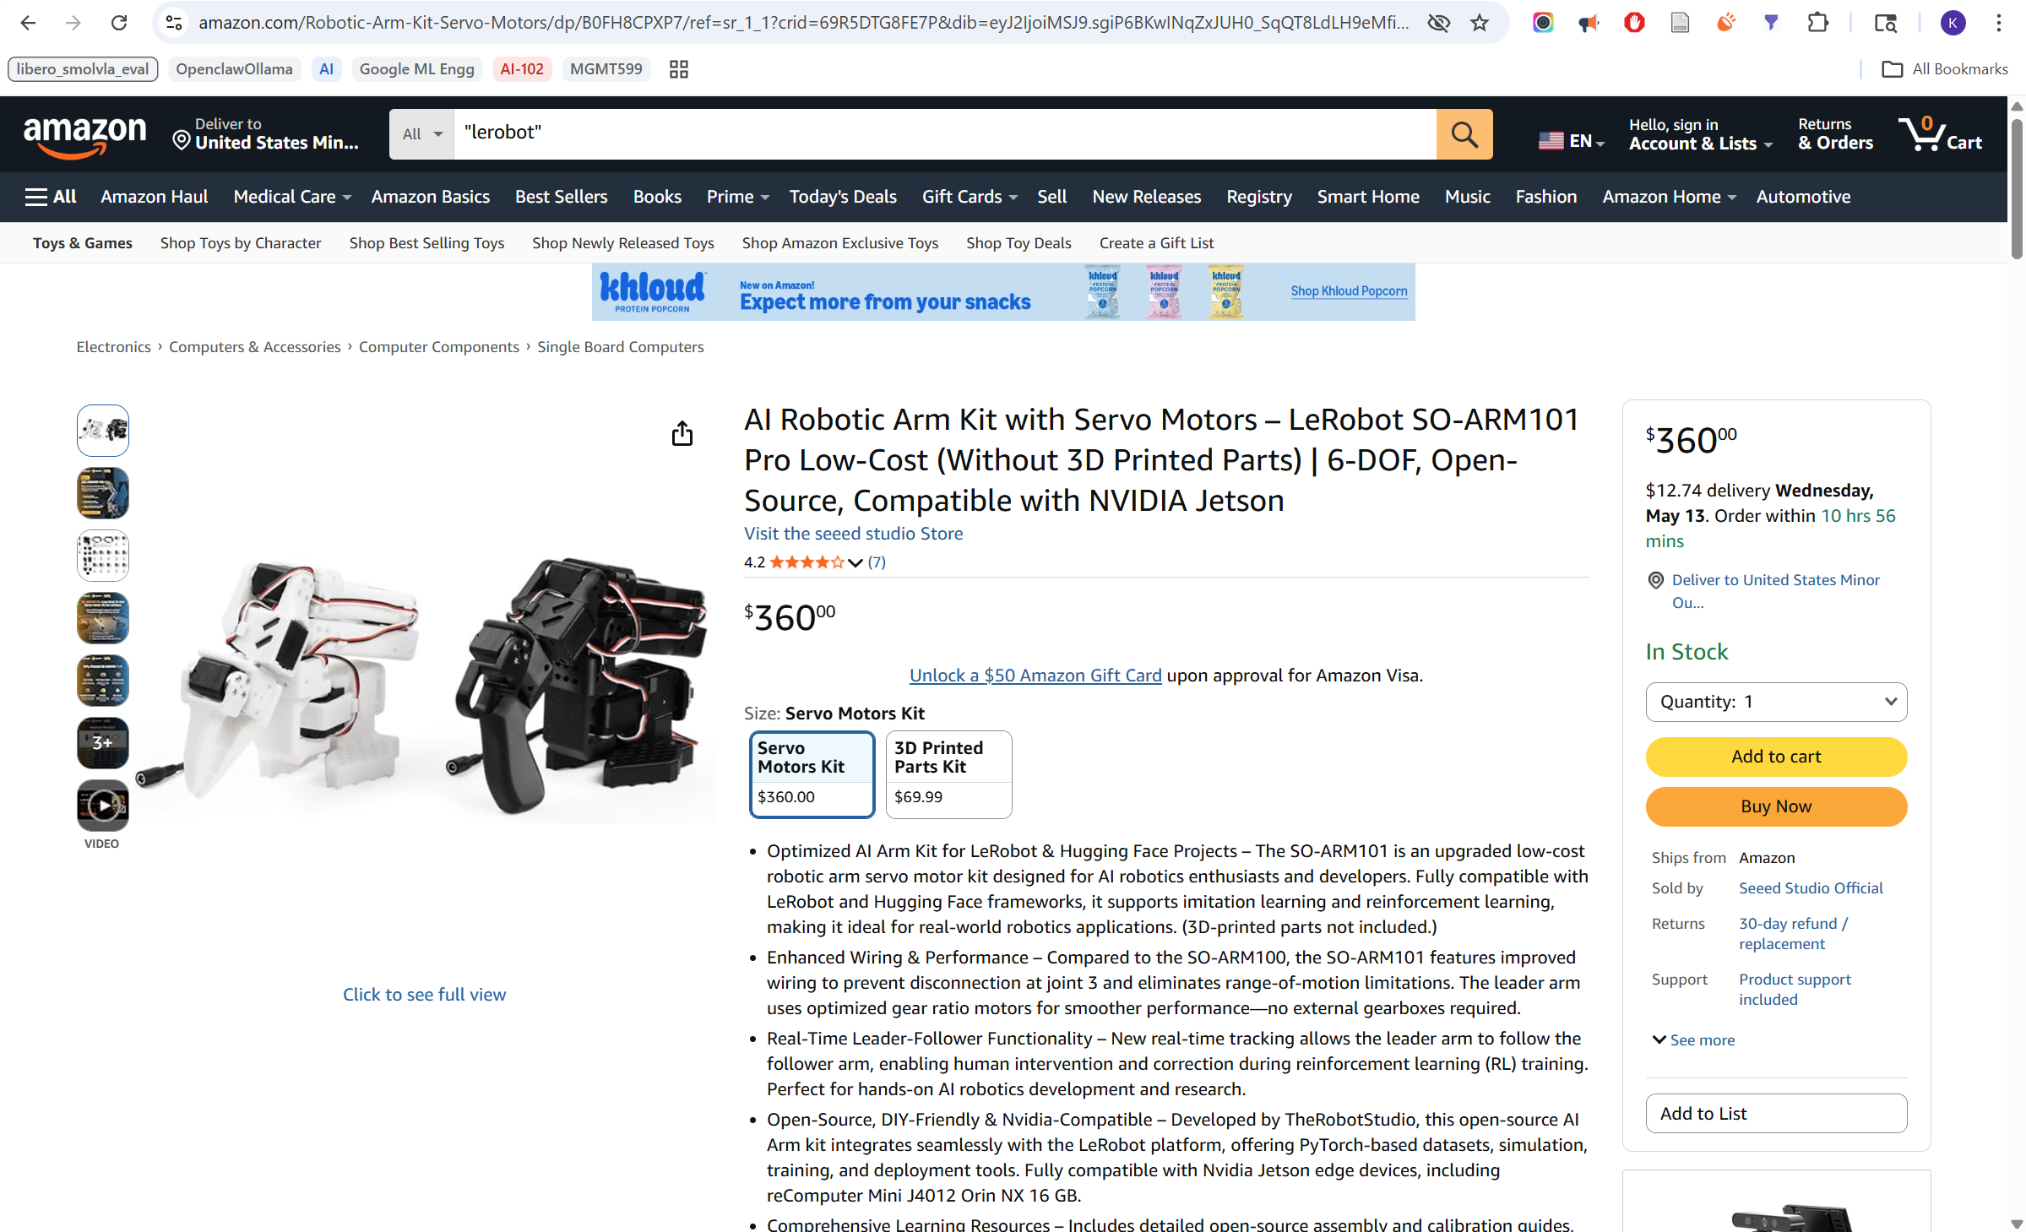
Physical Robot - Price
https://www.amazon.com/Robotic-Arm-Kit-Servo-Motors/dp/B0FH8CPXP7

Slide 4
Physical Robot – Substitution for Cost Control
From | To
Physical robot | Virtual robot
Joystick | Keyboard teleoperation
Physical environment | MuJoCo simulator
Physical Task | LIBERO (A Lifelong Robot Learning Benchmark to Study Knowledge Transfer in Decision-Making and Robotics at Scale)
https://huggingface.co/docs/lerobot/libero

Slide 5
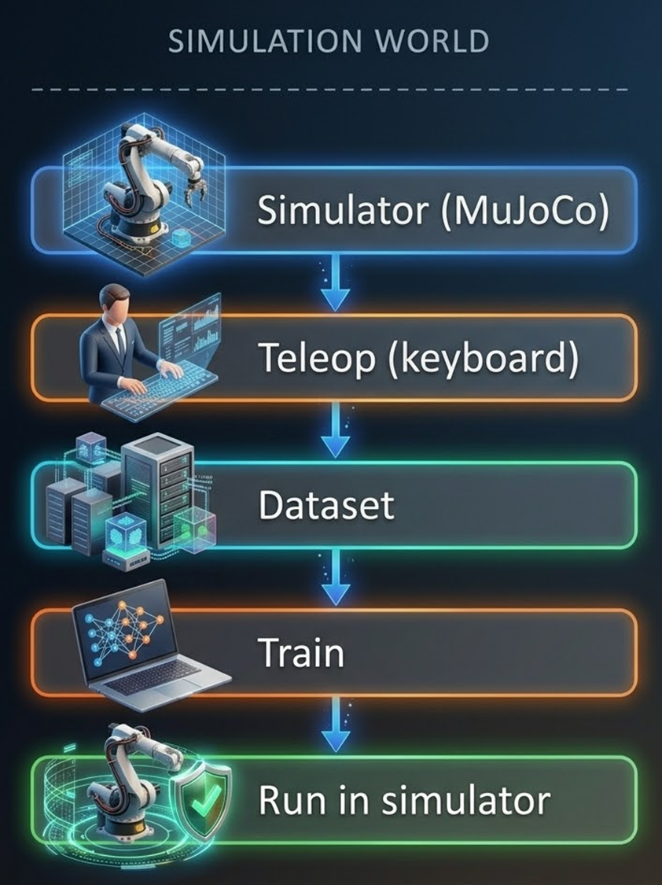
Virtual - Robot Policy Training Pipeline
Set up the simulation environment using MuJoCo + LIBERO
➔ AVOID INITIAL COST OF ROBOT
Collect demonstrations using keyboard teleoperation
Store and structure data locally as HDF5
Convert datasets into the LeRobot format
Upload datasets to a Hugging Face dataset repository
Use the SmolVLA policy model from Hugging Face
Fine-tune SmolVLA on Kaggle using a private or public dataset from Hugging Face
Upload the trained policy back to a Hugging Face model repository
Download the trained policy on the local desktop and run inference in simulation

Slide 6
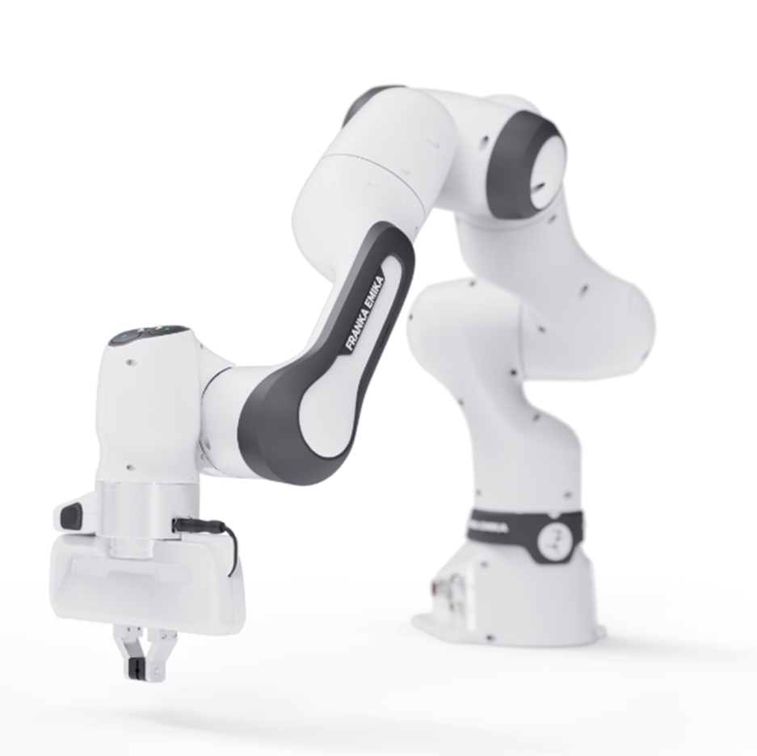
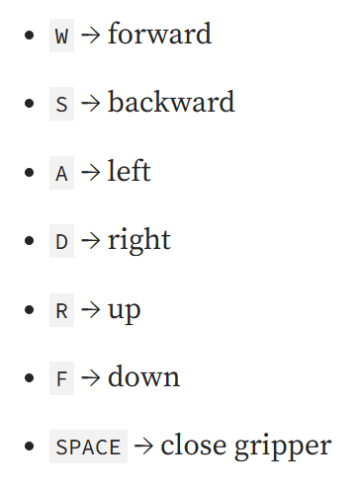
Virtual Robot - Franka Panda Arm
7-DoF robotic arm
two-finger gripper
suited for manipulation Task
desktop keyboard teleoperation:
https://www.wiredworkers.io/cobot/brands/franka-emika/research-3/

Slide 7
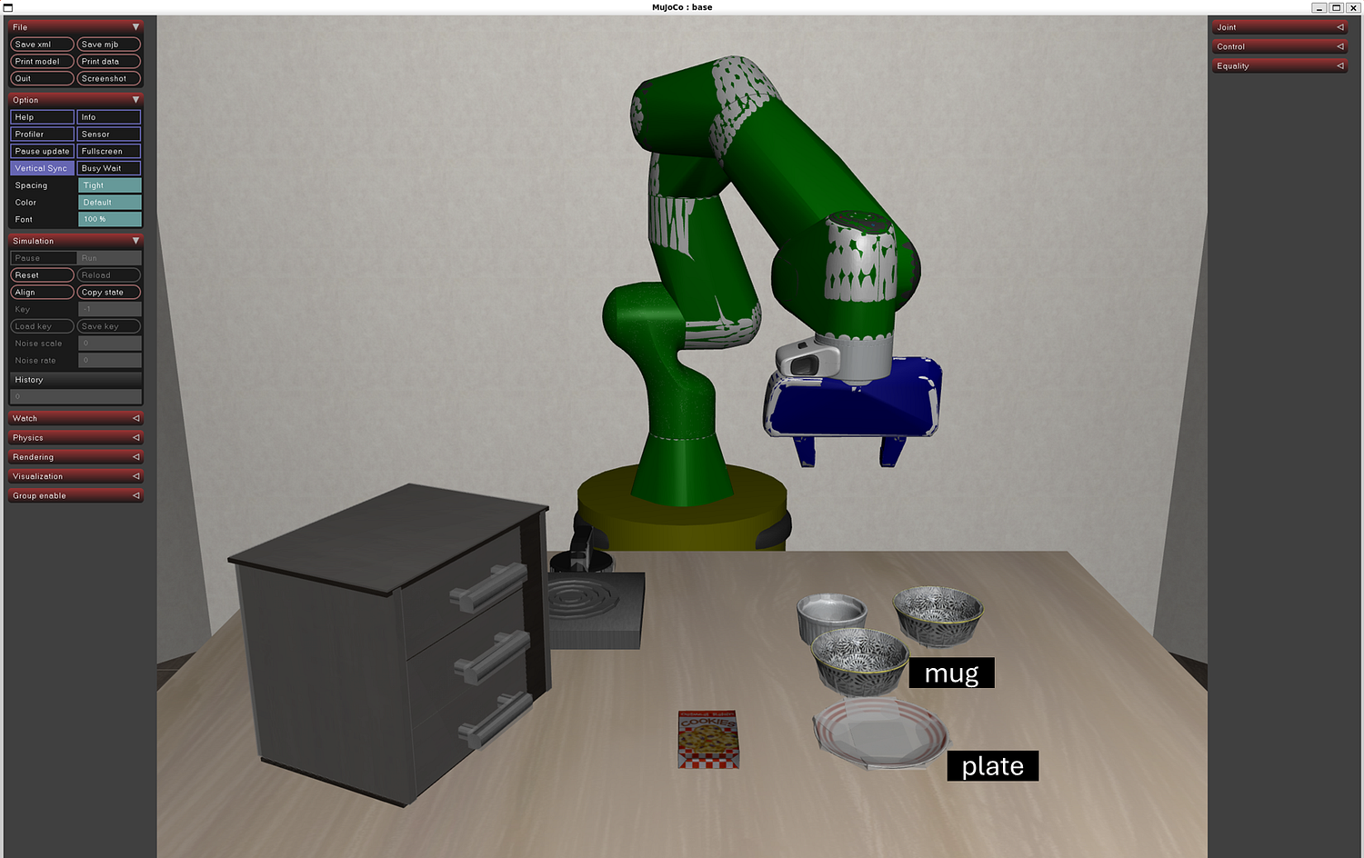
Robot in Simulation
MuJoCo
robot dynamics
contacts
joint motion
Real time interaction
with environment
MuJoCo Native Viewer
rendered the robot and scene state while teleoperation was running
MuJoCo + LIBERO view for Spatial Task 0: pick and place the mug on the plate
Notes:
LIBERO Spatial Task 0 - useful tabletop manipulation task for validating end-effector control, grasp stability, and basic task completion.
LIBERO wraps MuJoCo with task goals, object layouts, and episode logic, so every rollout is evaluated against the same objective. That makes demonstrations task-consistent and easier to reuse for training.
In the final MuJoCo + LIBERO view, the MuJoCo interface renders the scene while LIBERO overlays the task context, such as the instruction to place the mug on the plate. The robot, objects, and target region are all visible together, which makes it easy to verify whether the policy is actually moving toward success.

Slide 8
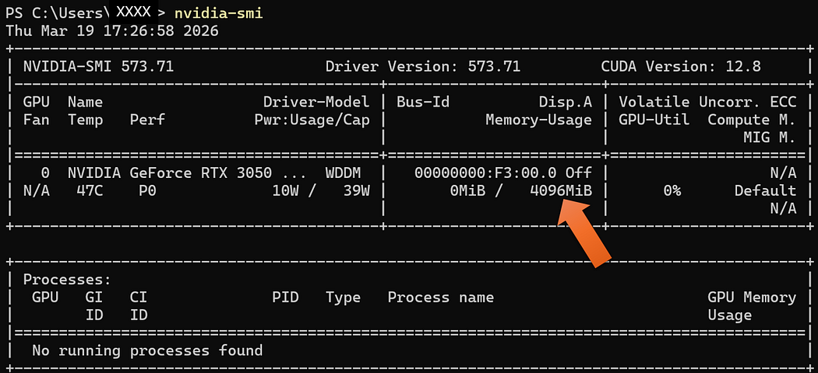
VRAM – Local Desktop
Windows 11 desktop hardware reference from nvidia-smi: NVIDIA GeForce RTX 3050 with 4096 MiB memory

Slide 9
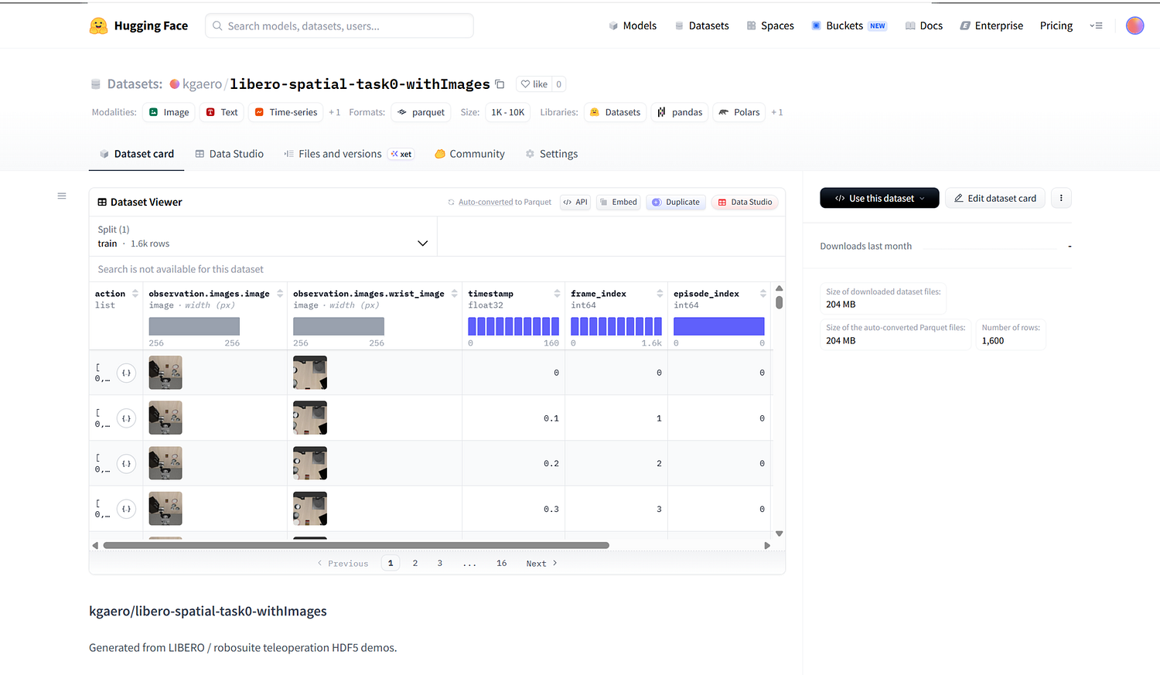
DATASET created by Teleoperation
For LIBERO Task 0, a single teleoperation episode produced around 1,000 records and roughly 235 MB of data due to image and video observations.
Each episode took about 12 minutes total:
around 2 minutes for teleoperation
around 10 minutes for conversion and Hugging Face upload. That makes large-scale manual dataset generation painfully slow.
Hugging Face dataset repository view for teleoperation data exported in LeRobot-style structure
https://huggingface.co/datasets/kgaero/libero-spatial-task0-withImages

Slide 10
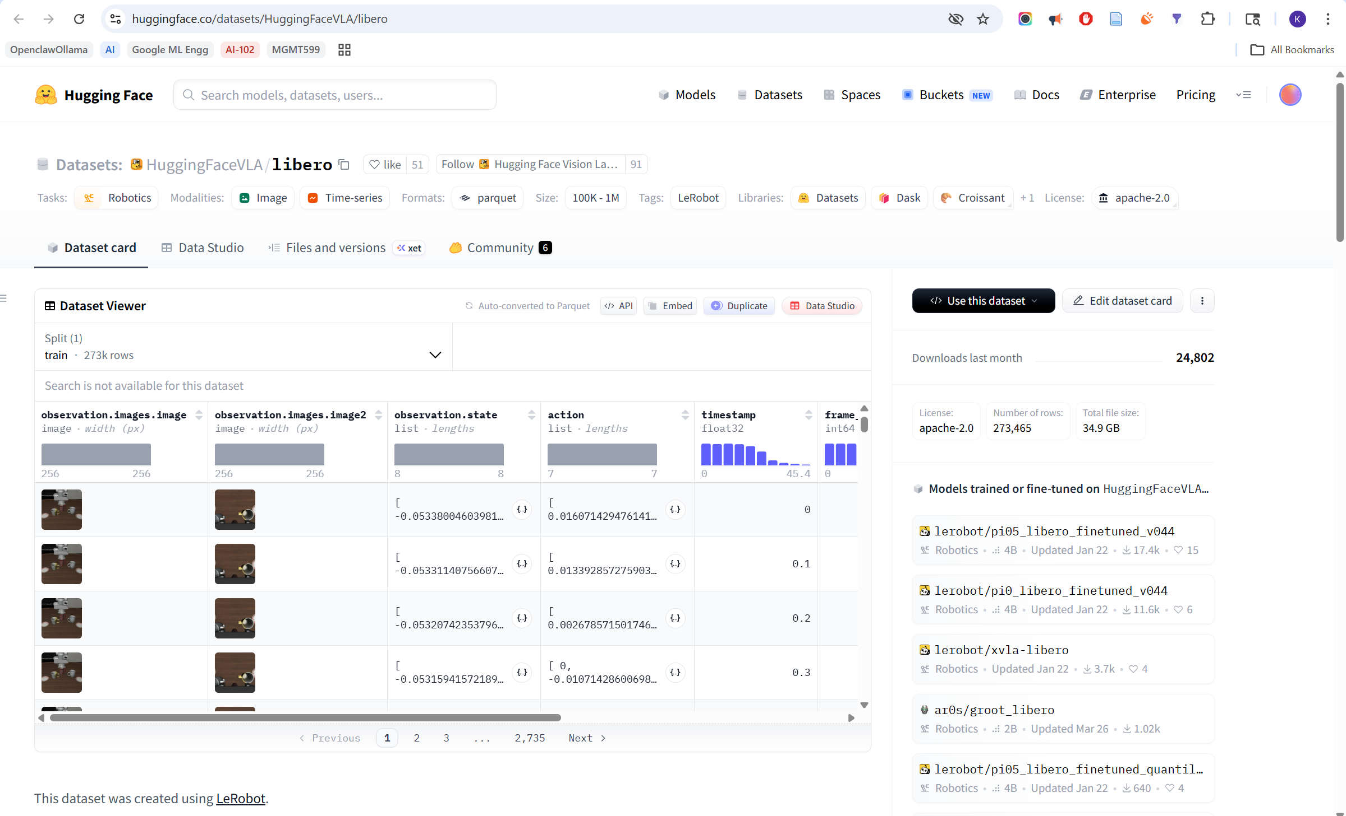
DATASET for Training
Hugging Face model repository view for lerobot/smolvla_base, used as the starting checkpoint for fine-tuning
https://huggingface.co/datasets/HuggingFaceVLA/libero
Notes:
Hugging Face model repository view for lerobot/smolvla_base, used as the starting checkpoint for fine-tuning.

Slide 11
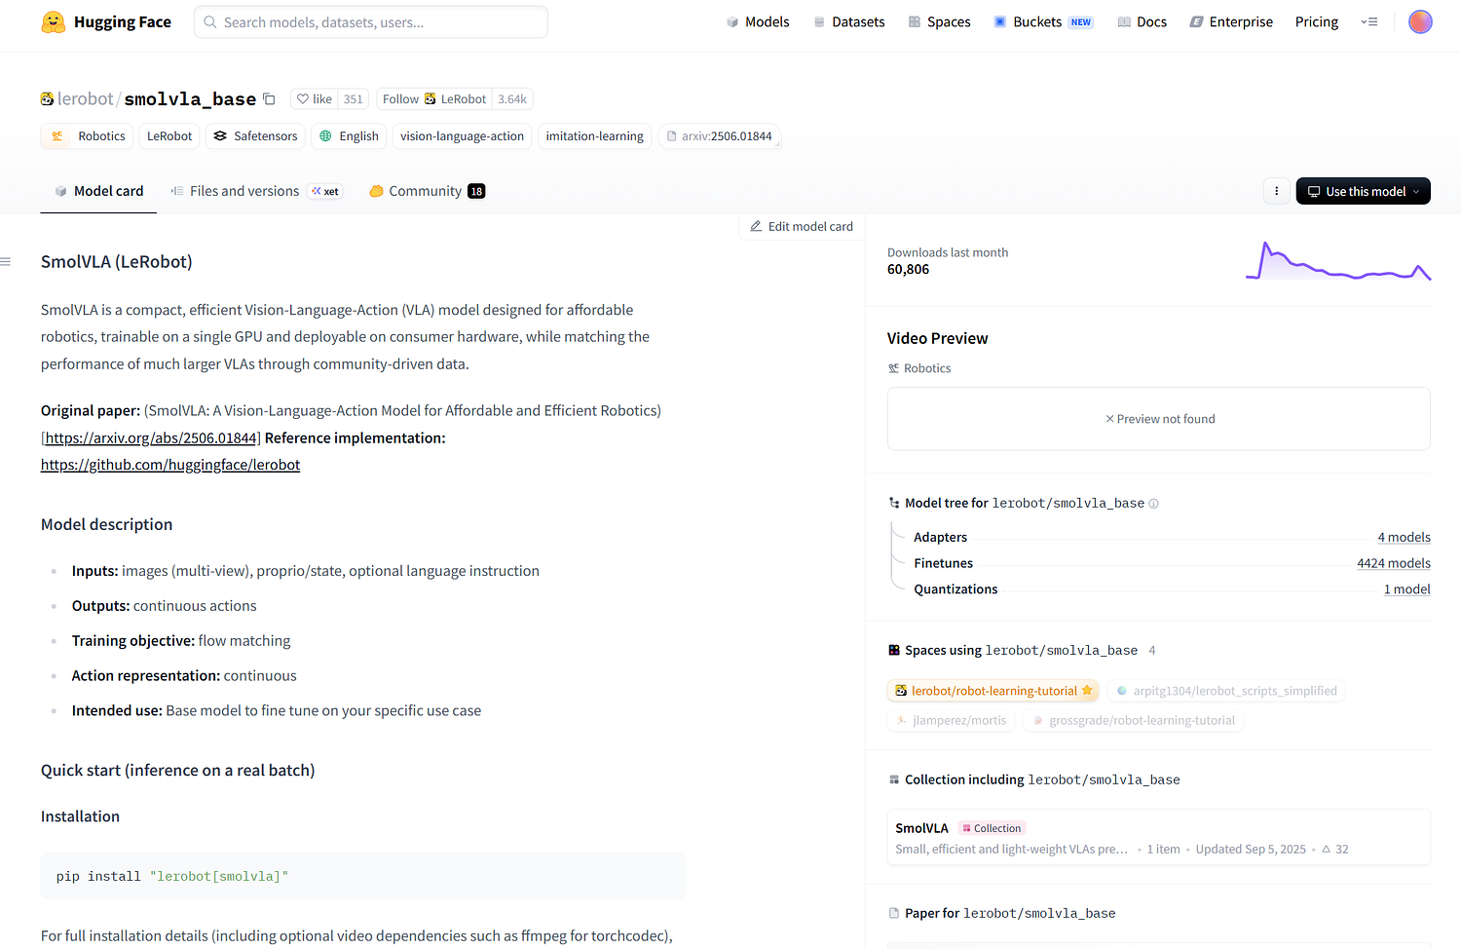
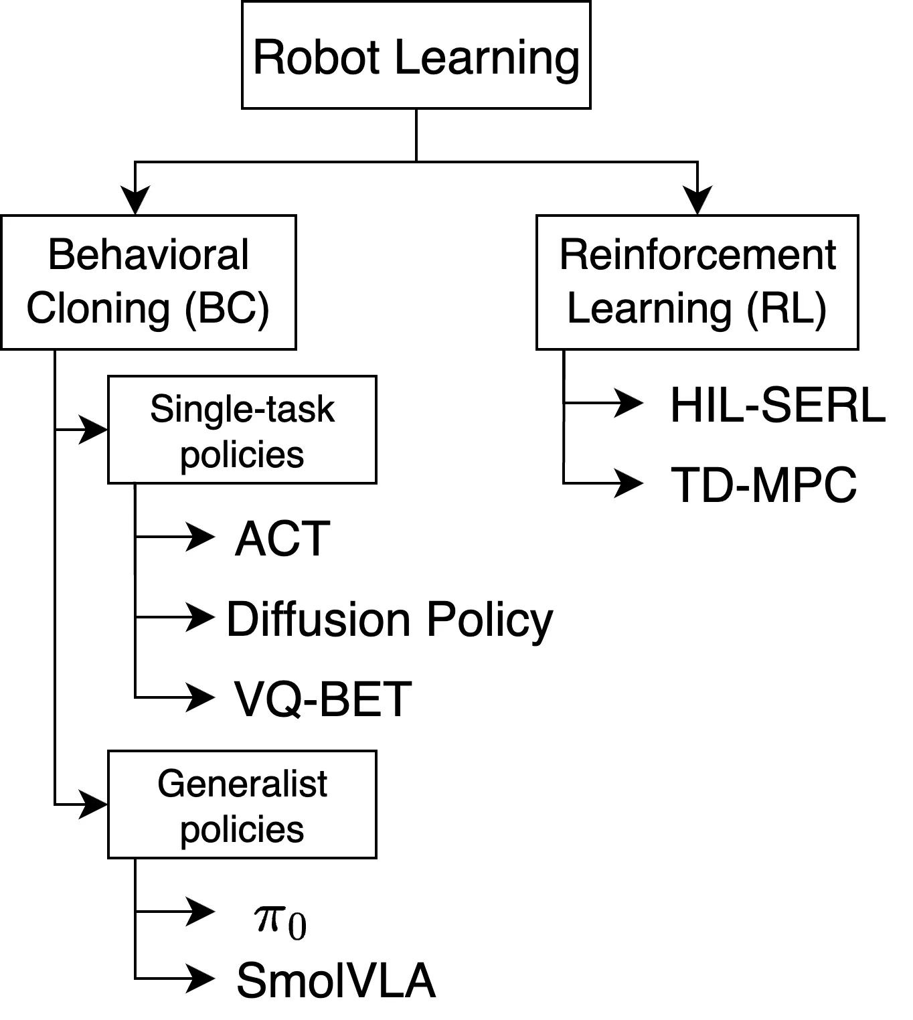
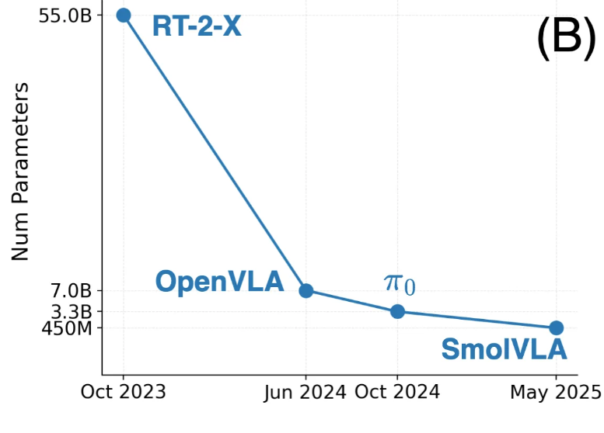
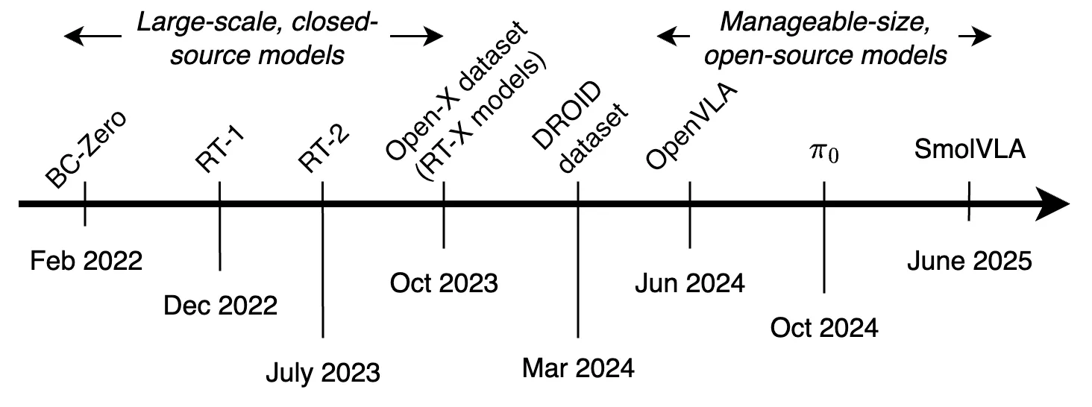
MODEL (VLA) for Robot policy
https://huggingface.co/lerobot/smolvla_base
https://huggingface.co/spaces/lerobot/robot-learning-tutorial

Slide 12
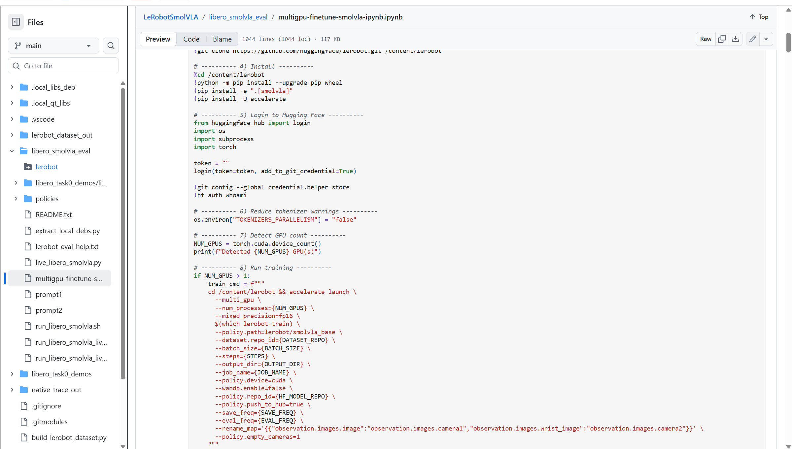
TRAINER
--multi_gpu and --num_processes={NUM_GPUS} allowed training to use both Kaggle T4 GPUs instead of only one.
--policy.path=lerobot/smolvla_base started from a pretrained checkpoint, which is far more data-efficient than training from scratch.
--rename_map fixed image key mismatches between the dataset schema and the model’s expected camera inputs.
--policy.empty_cameras=1 allowed training to continue even when some camera streams were missing.
--mixed_precision=fp16 reduced memory usage and improved throughput on limited hardware.
--policy.push_to_hub=true automatically versioned and uploaded trained checkpoints to Hugging Face.
https://github.com/kgaero/LeRobotSmolVLA/blob/main/libero_smolvla_eval/multigpu-finetune-smolvla-ipynb.ipynb

Slide 13
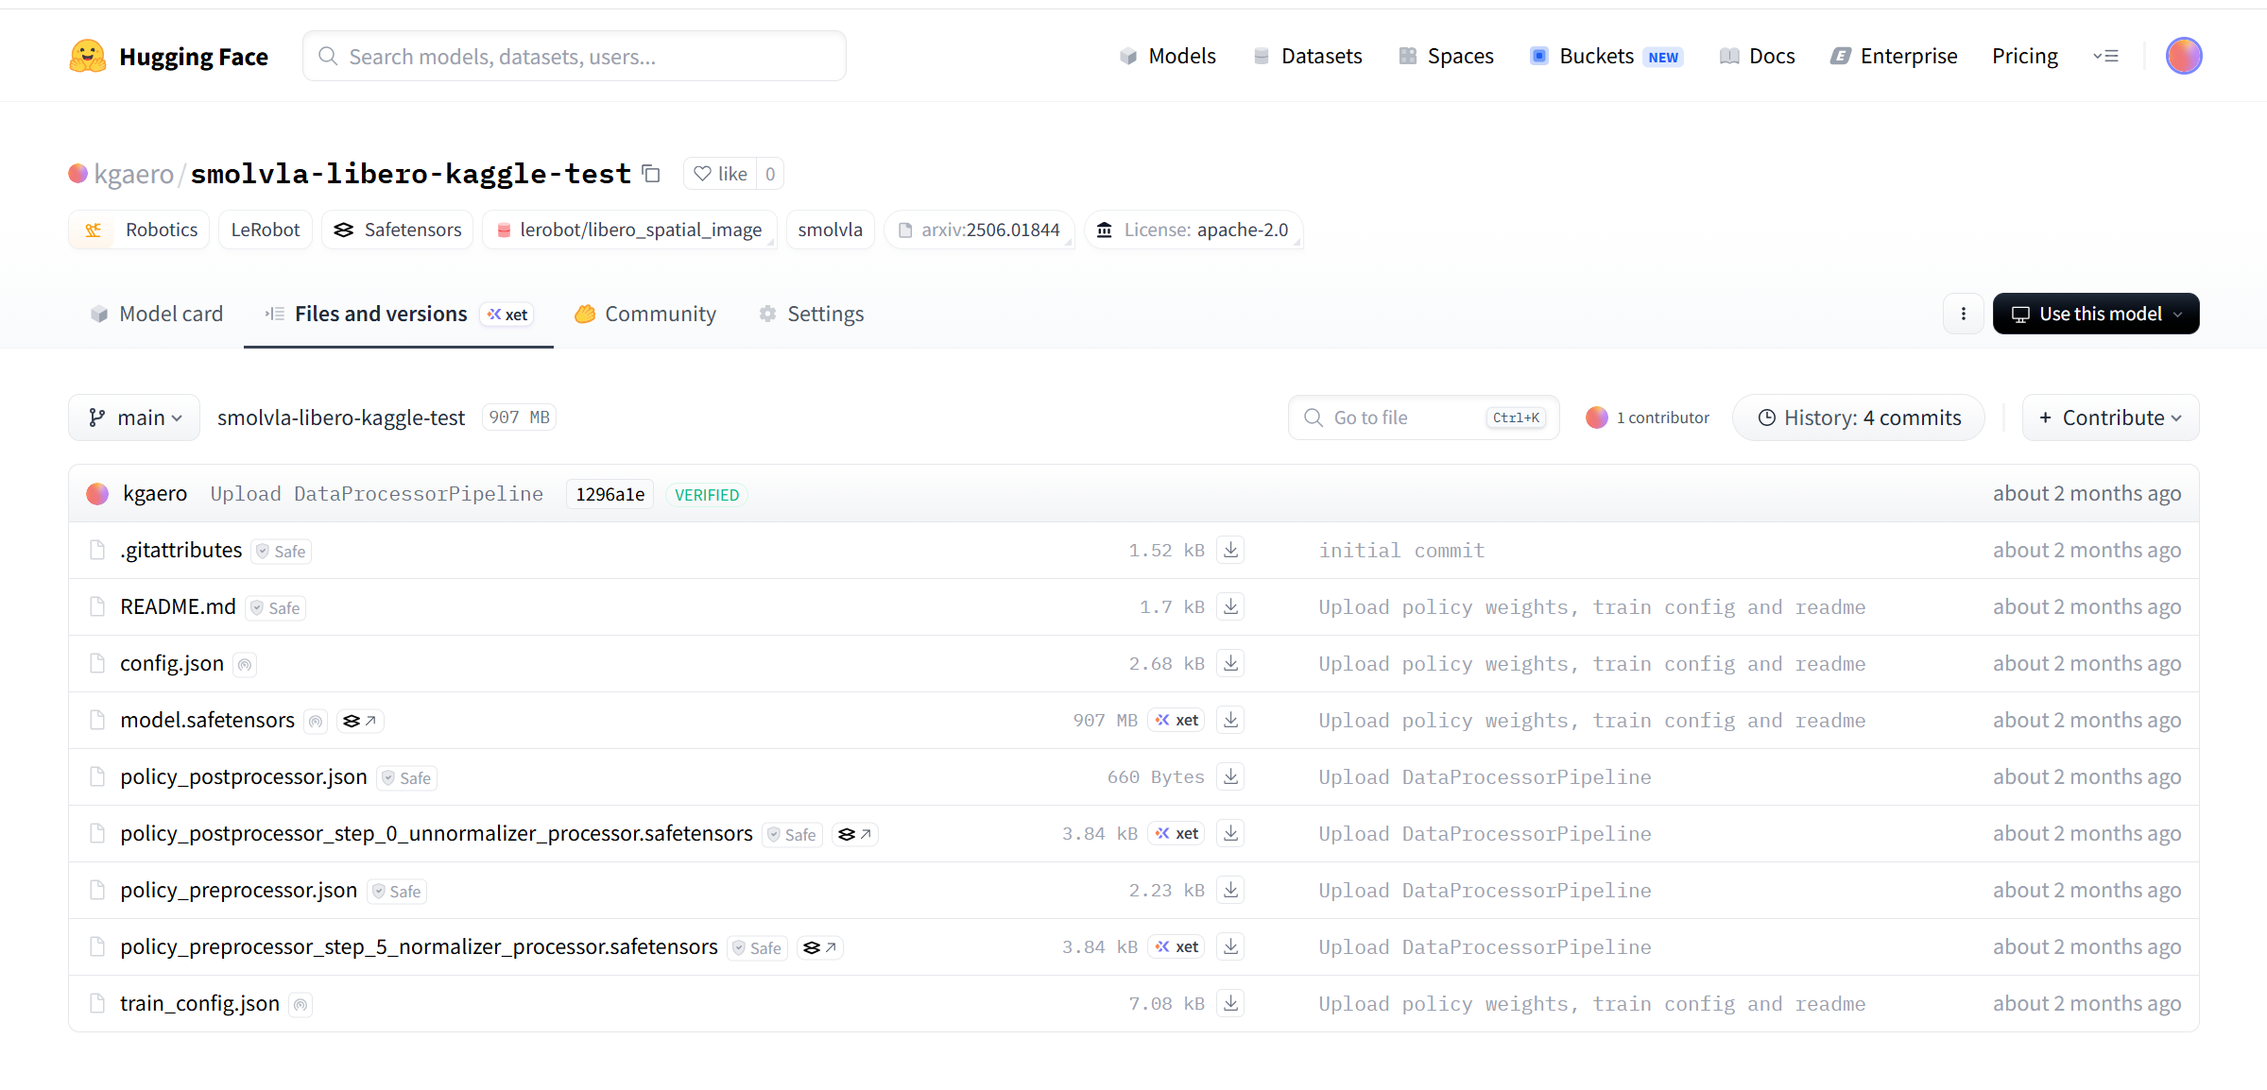
TRAINED MODEL
https://huggingface.co/kgaero/smolvla-libero-kaggle-test/tree/main

Slide 14
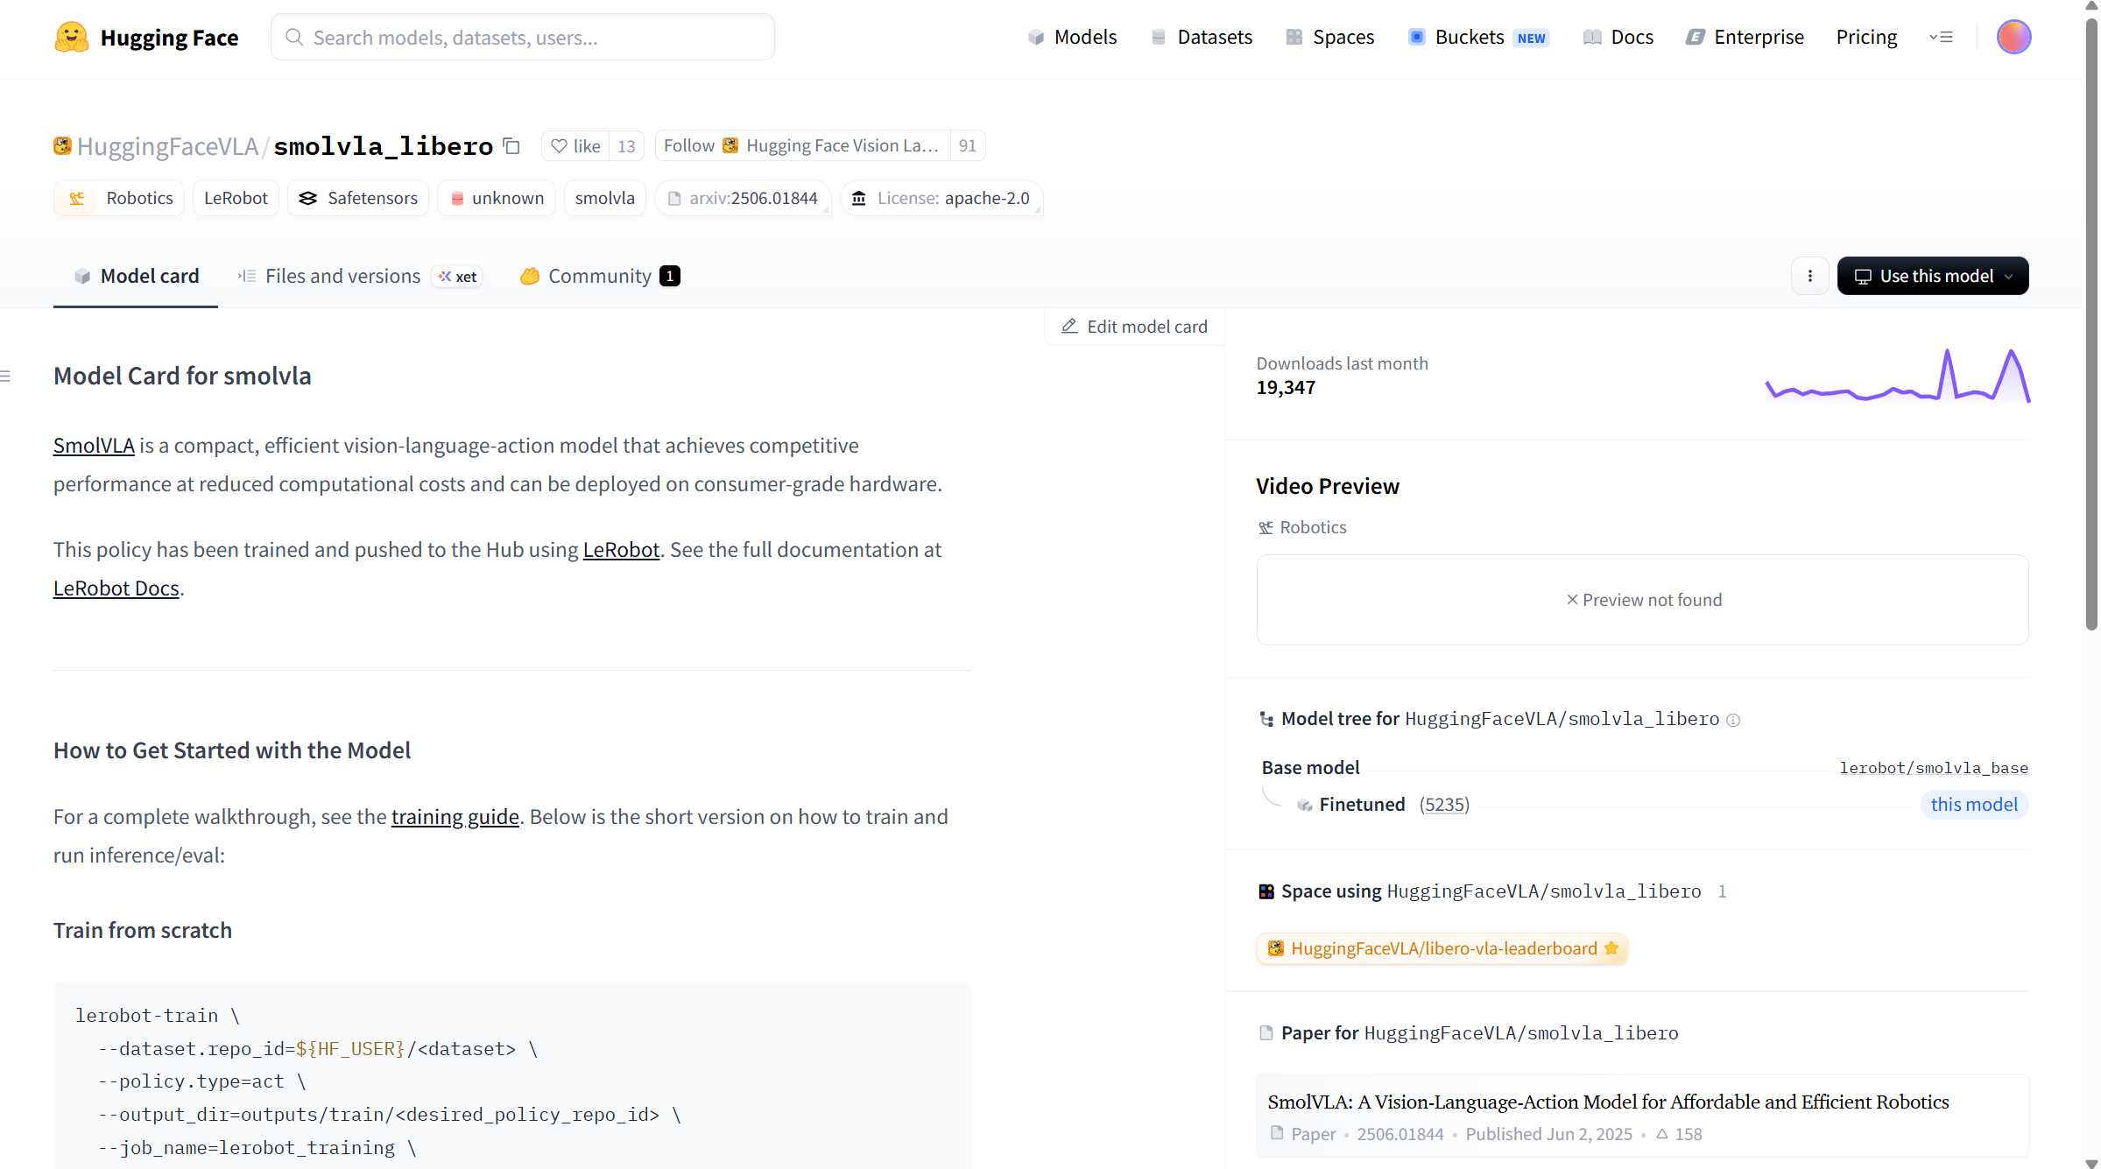
MODEL (VLA) for Robot policy Inference
https://huggingface.co/HuggingFaceVLA/smolvla_libero
https://huggingface.co/spaces/lerobot/robot-learning-tutorial

Slide 15
Challenges addressed
Rendering and viewer instability - MuJoCo native viewer worked better than Matplotlib and Robosuite
Simulation speed was too slow - increased action chunking from 1 to 10 using chunk_size=50 and n_action_steps=10, which gave roughly a 10× speed improvement over the default setup.
Large dataset uploads to Hugging Face were failing - switched from upload_folder to HfApi.upload_large_folder
Task 0 failed during inference: Training on a larger LIBERO-scale dataset improved the behavior, and the strongest results came from using Hugging Face’s already trained LIBERO policy: HuggingFaceVLA/smolvla_libero
Kaggle hardware was underutilized: enabled distributed multi-GPU training so both GPUs could be used

Slide 16
Lesson Learned
Small-to-mid scale data is not enough for robust policy success:
Training SmolVLA policy with 53K records not sufficient. Need larger training dataset
Teleoperation data collection does not scale well on desktop simulation:
Each episode took about 12 minutes total. Hence difficult to scale with teleoperation
Memory-optimized VLA tooling still feels limited
Unable to find Unsloth-style memory-optimized workflow for VLA training
Central limitation:
Without enough data, policy performance stalls.
Solving that requires either large-scale data collection or access to high-quality existing datasets.
Manual Teleoperation of virtual/physical is NOT a scalable solution to collect large training dataset
Automated Large robot data generation and collection is key to scalable Training dataset

Slide 17
Thank you

Slide 18
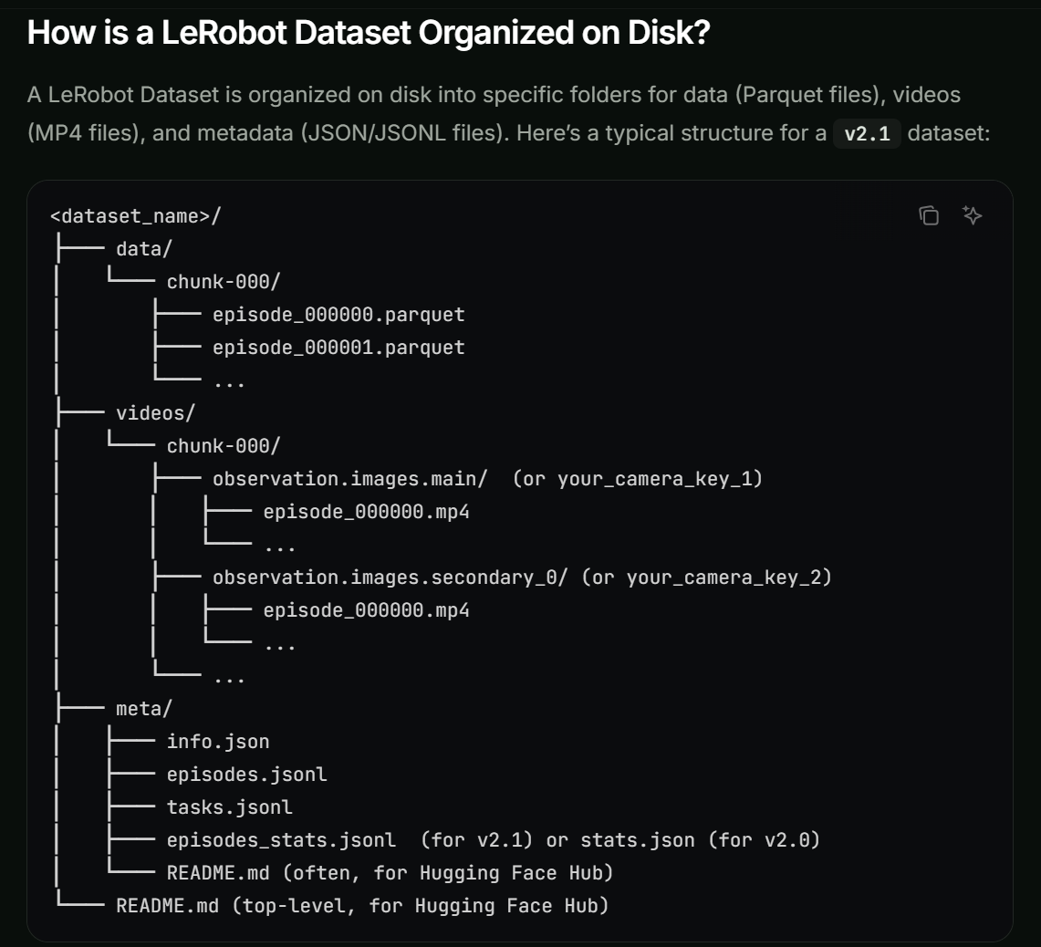
https://docs.phospho.ai/learn/lerobot-dataset

Slide 19
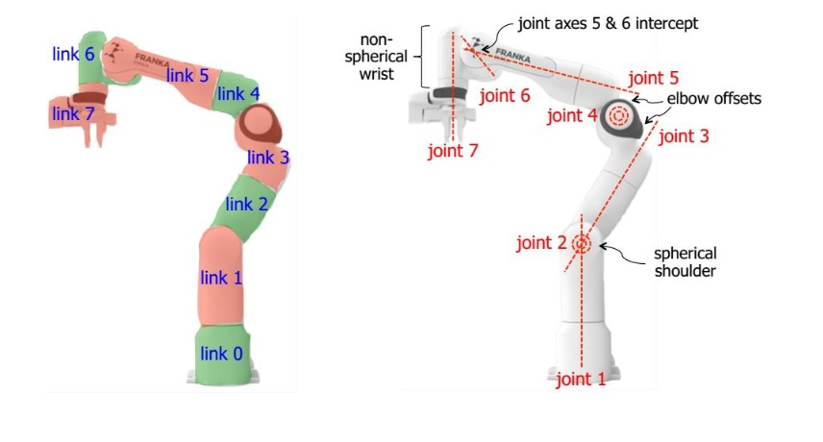
https://wiki.happylab.at/images/5/5e/Panda_Robot_Manual_English.pdf

Slide 20
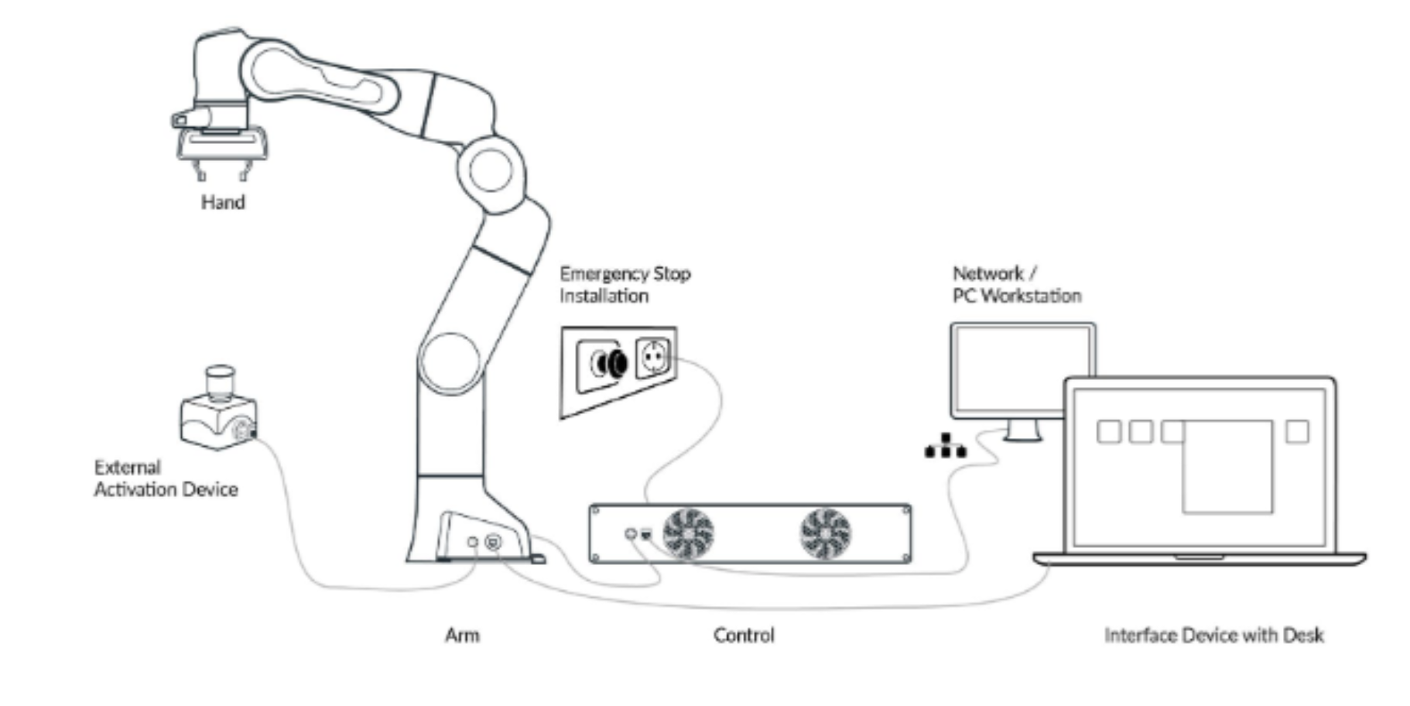
https://wiki.happylab.at/images/5/5e/Panda_Robot_Manual_English.pdf

Slide 21
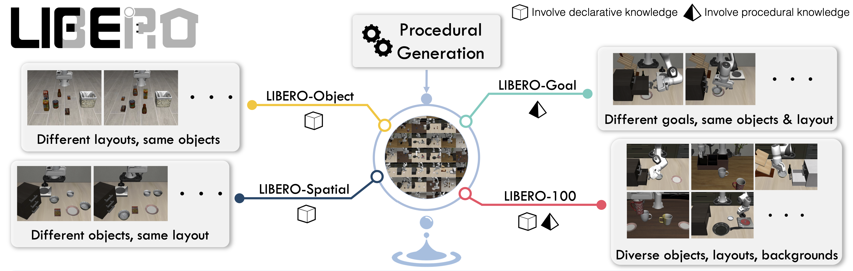
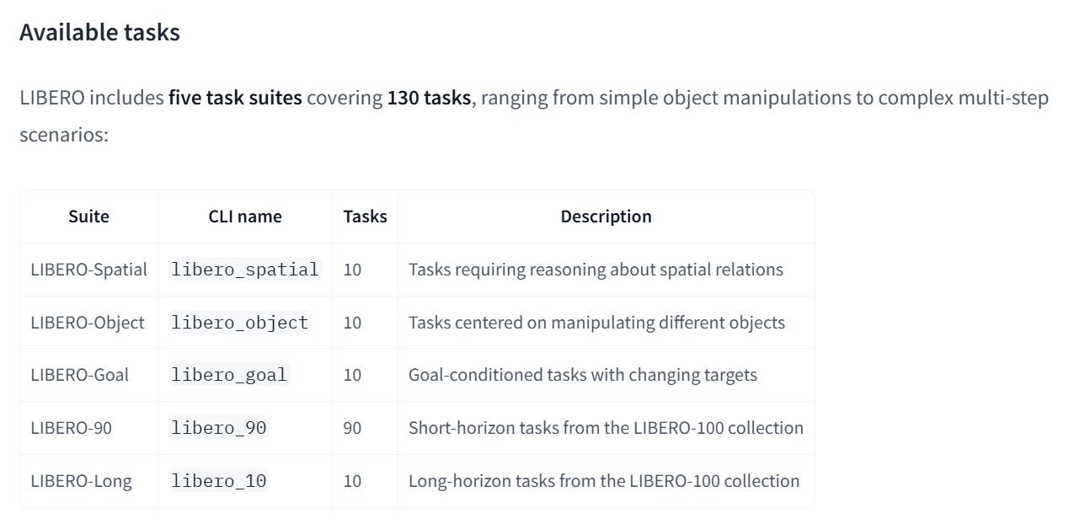
https://huggingface.co/docs/lerobot/libero

Slide 22
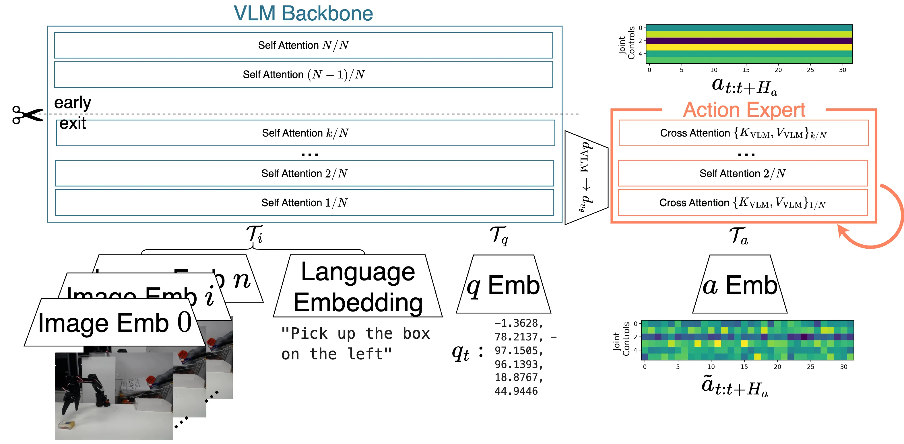
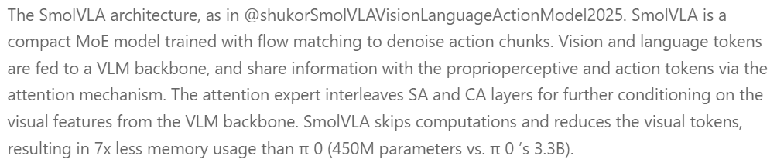
https://huggingface.co/spaces/lerobot/robot-learning-tutorial
https://doi.org/10.48550/arXiv.2506.01844

