Slide 1
Robot policy training Pipeline
Kunal Ghosh
Notes:
Hello Everyone,
- This talk is about training a robot policy without starting with a physical robot.
- The goal is to understand the full workflow first, using free and accessible tools.
- I will walk through simulation, teleoperation, dataset creation, training, and inference.
- The main message is simple: simulation can teach the pipeline before robot hardware becomes necessary.

Slide 2
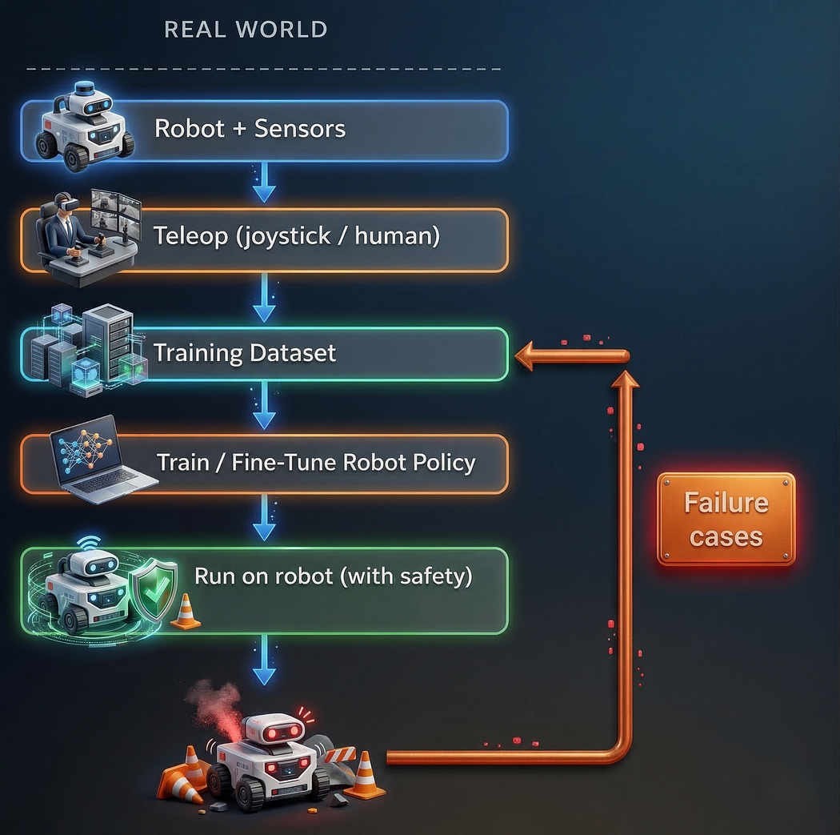
Physical - Robot Policy Training Pipeline
Provision Physical Robot First
Setup Robot with sensors
Teleoperate to gather data
Create Training Data for this specific Robot
Fine Tune Robot Policy
Deploy on Trained Policy on Real Robot
Gather failure dataset and retrain iteratively
Notes:
- This is the usual robotics learning workflow.
- You first buy or provision a robot, add sensors, and set up controllers.
- Then a person teleoperates the robot to collect demonstrations.
- Those demonstrations become training data for a policy model.
- After deployment, failure cases are collected and used for more fine-tuning.
- The problem is that every step assumes robot hardware is available from day one.

Slide 3
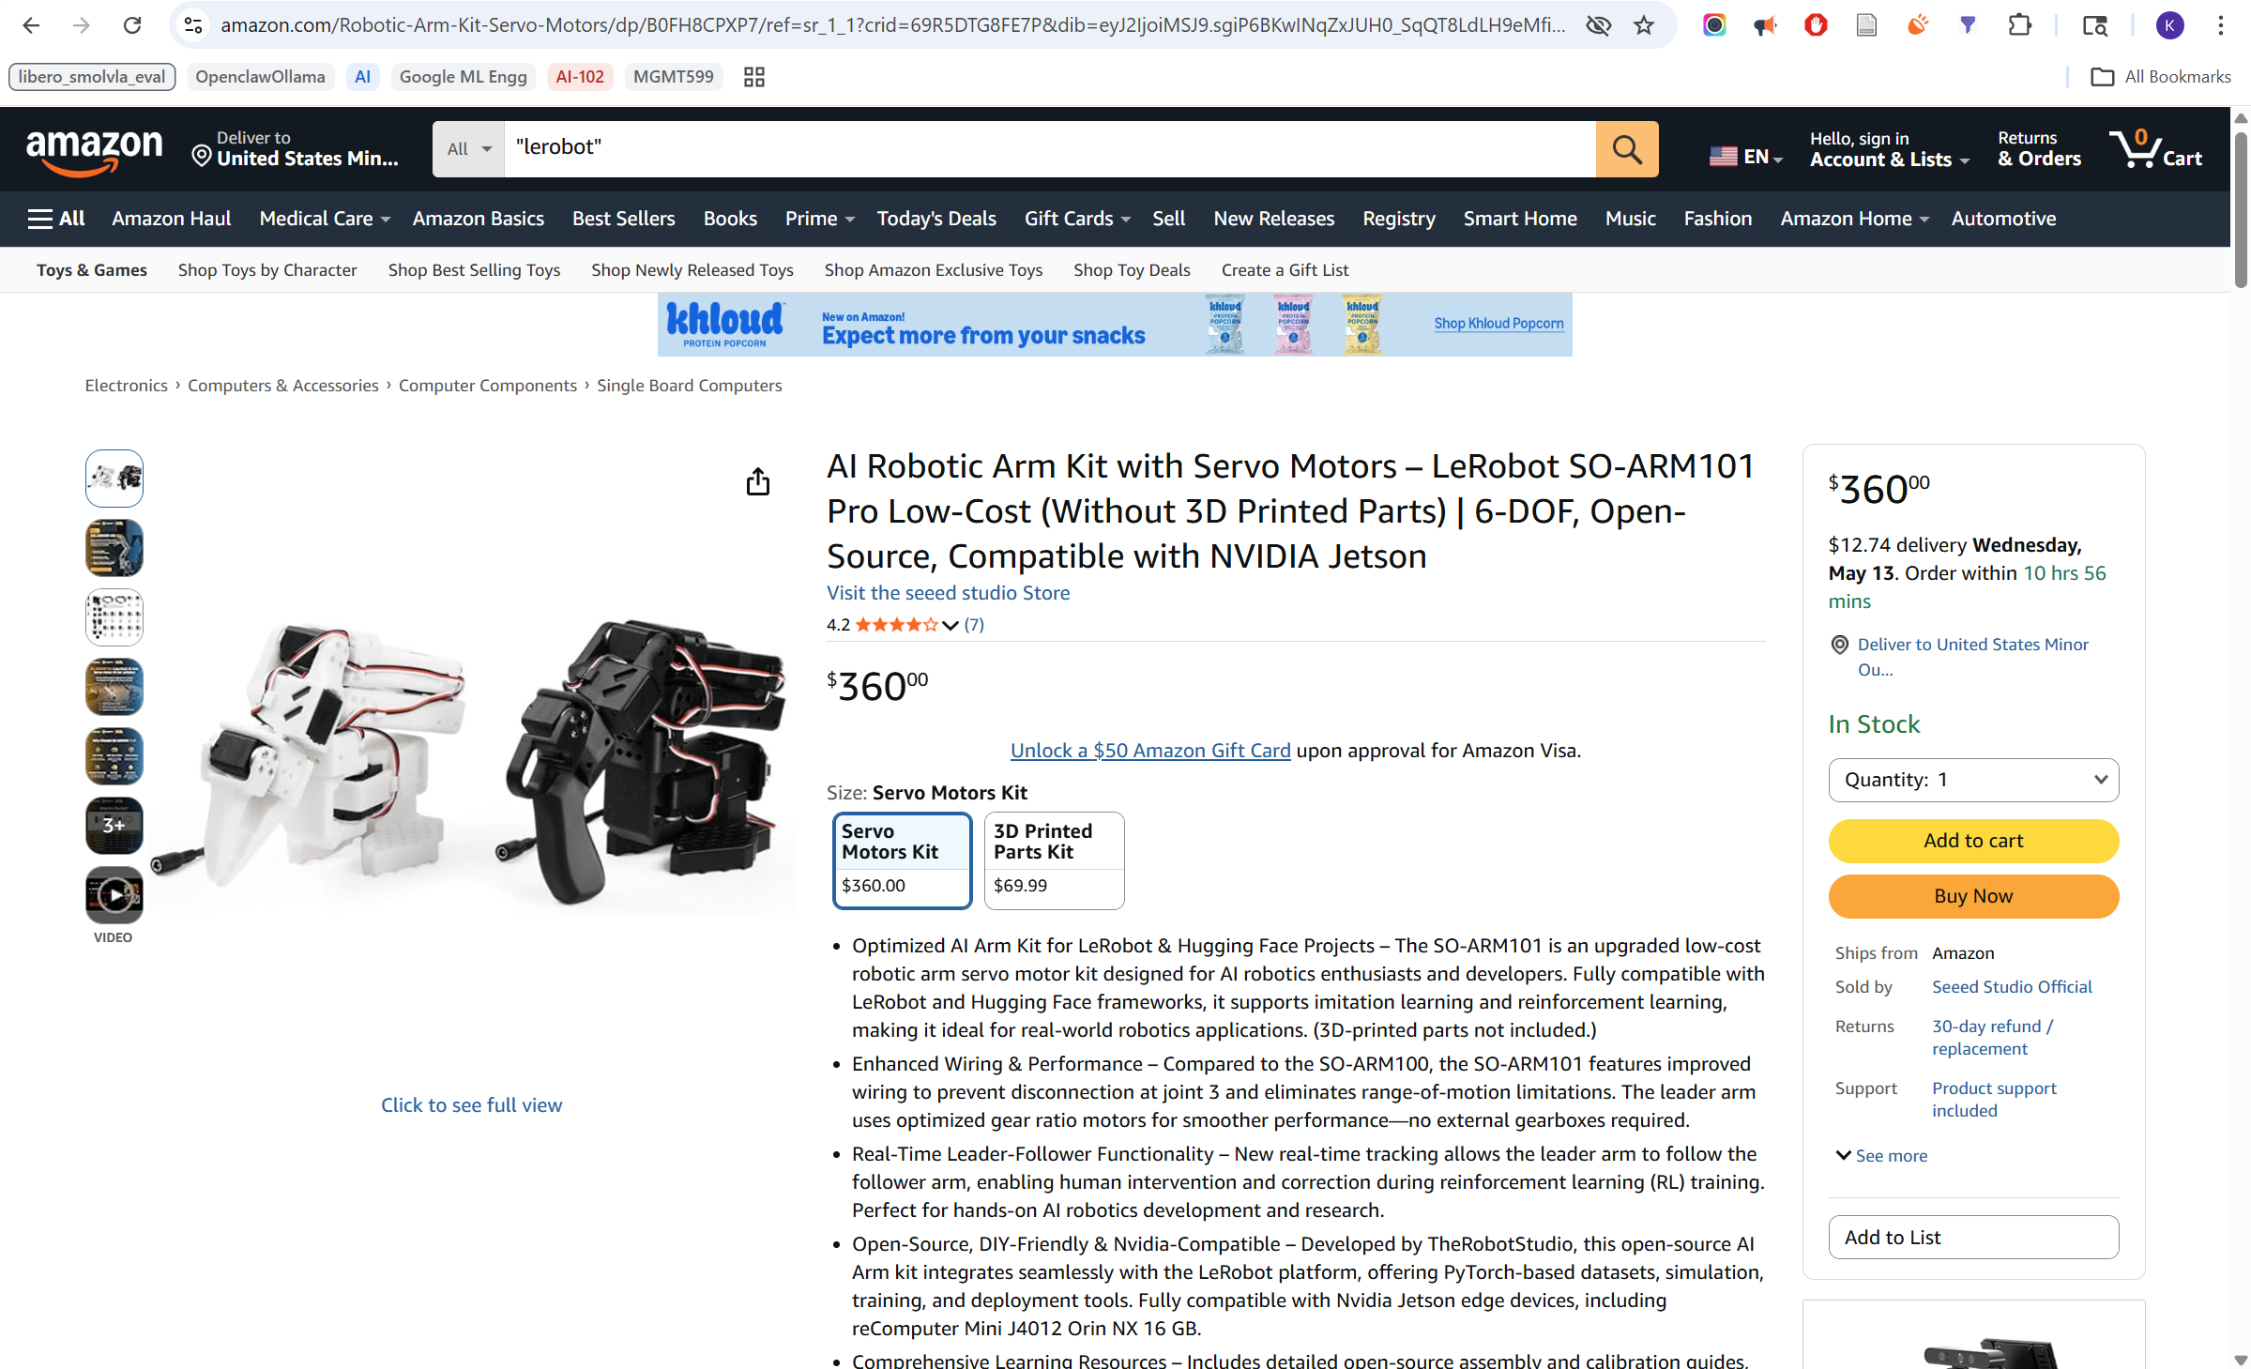
Physical Robot - Price
https://www.amazon.com/Robotic-Arm-Kit-Servo-Motors/dp/B0FH8CPXP7
Notes:
- The hardware-first approach creates a real cost barrier.
- Even a simple robotic arm can feel like a big first investment for a beginner.
- That cost comes before the learner even understands data, training, inference or tradeoffs.
- So, the question becomes: can we learn the workflow before buying the first robot?

Slide 4
Physical Robot – Substitution for Cost Control
From | To
Physical robot | Virtual robot
Joystick | Keyboard teleoperation
Physical environment | MuJoCo simulator
Physical Task | LIBERO (A Lifelong Robot Learning Benchmark to Study Knowledge Transfer in Decision-Making and Robotics at Scale)
https://huggingface.co/docs/lerobot/libero
Notes:
- The approach here is to replace only the expensive physical parts.
- The physical robot becomes a virtual robot.
- The joystick becomes keyboard teleoperation.
- The physical environment becomes a MuJoCo simulation.
- The task is provided by LIBERO, so the objective is still structured and repeatable.
- Everything after that remains close to a real robot learning pipeline.

Slide 5
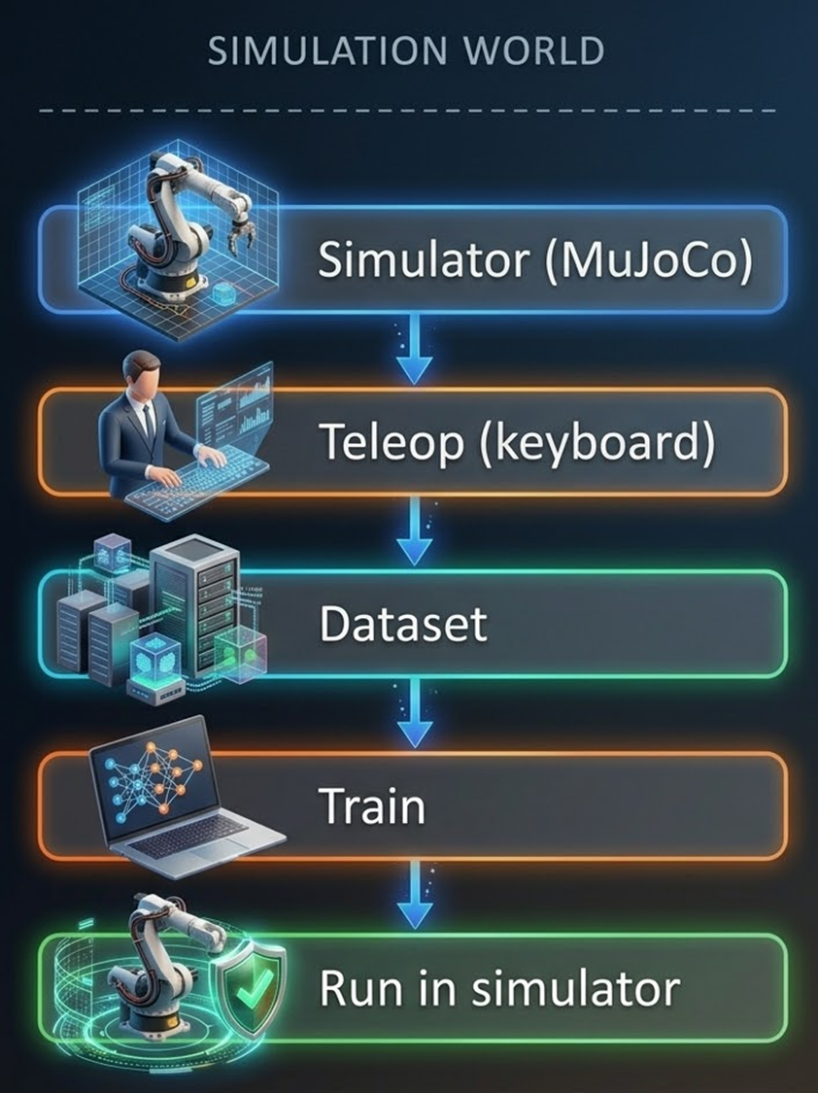
Virtual - Robot Policy Training Pipeline
Set up the simulation environment using MuJoCo + LIBERO
➔ AVOID INITIAL COST OF ROBOT
Collect demonstrations using keyboard teleoperation
Store and structure data locally as HDF5
Convert datasets into the LeRobot format
Upload datasets to a Hugging Face dataset repository
Use the SmolVLA policy model from Hugging Face
Fine-tune SmolVLA on Kaggle using a private or public dataset from Hugging Face
Upload the trained policy back to a Hugging Face model repository
Download the trained policy on the local desktop and run inference in simulation
Notes:
- This is the end-to-end virtual pipeline I implemented.
- First, MuJoCo and LIBERO create the simulated robot task.
- Then keyboard teleoperation records demonstrations into HDF5 files.
- Those demos are converted into the LeRobot dataset format.
- The dataset is uploaded to Hugging Face for training reuse.
- SmolVLA is fine-tuned on Kaggle and pushed back as a model repository.
- Finally, the trained policy is downloaded locally and tested again in simulation.

Slide 6
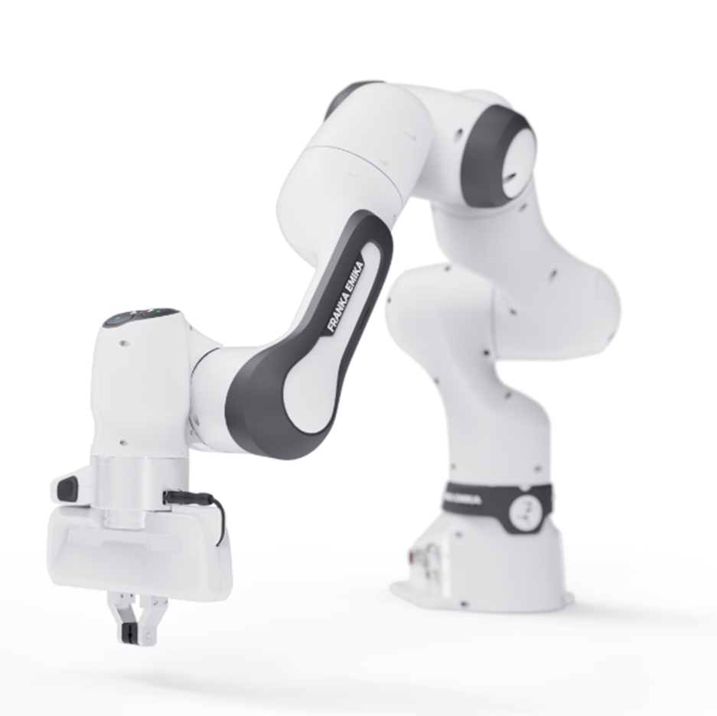
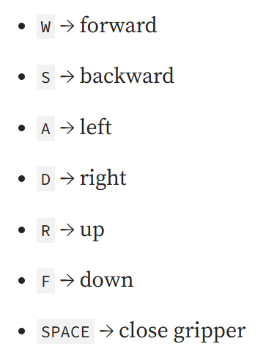
Virtual Robot - Franka Panda Arm
7-DoF robotic arm
two-finger gripper
suited for manipulation Task
desktop keyboard teleoperation:
https://www.wiredworkers.io/cobot/brands/franka-emika/research-3/
Notes:
- The virtual robot is the Franka Panda arm.
- It is a seven degree-of-freedom arm with a two-finger gripper.
- That makes it suitable for tabletop manipulation tasks like pick and place.
- In the code, the teleoperation script defaults to the Panda robot and OSC pose control.
- Keyboard controls move the end effector and toggle the gripper during data collection.

Slide 7
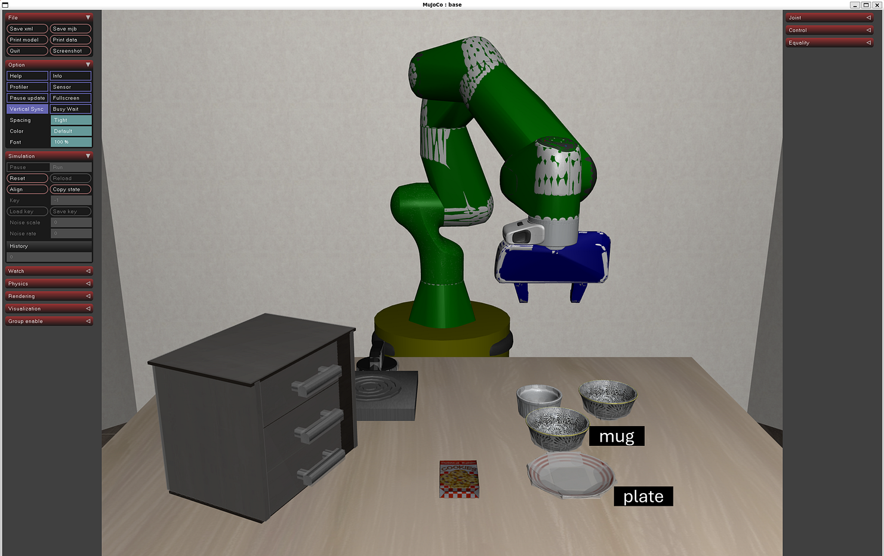
Robot in Simulation
MuJoCo
robot dynamics
contacts
joint motion
Real time interaction
with environment
MuJoCo Native Viewer
rendered the robot and scene state while teleoperation was running
MuJoCo + LIBERO view for Spatial Task 0: pick and place the mug on the plate
wsl -d Ubuntu -- bash -lc "/home/kgaer/robotics/run_teleop_libero_task0.sh"
Notes:
- This slide shows the simulated task environment.
- MuJoCo handles dynamics, contacts, joint motion, and real-time interaction.
- LIBERO defines the task, initial states, object layout, and success condition.
- For Task 0, the goal is to pick up a mug and place it on a plate.
- The implementation uses the native MuJoCo viewer because it was more reliable for live inspection.
Open PowerShell, then paste below
wsl -d Ubuntu -- bash -lc "/home/kgaer/robotics/run_teleop_libero_task0.sh"

Slide 8
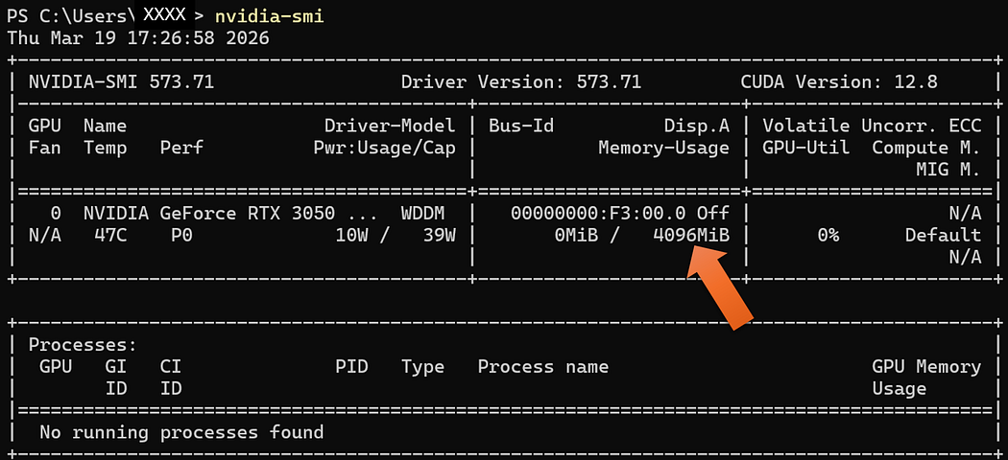
VRAM – Local Desktop
Windows 11 desktop hardware reference from nvidia-smi: NVIDIA GeForce RTX 3050 with 4096 MiB memory
Notes:
- The local inference setup ran on a normal Windows desktop with WSL2.
- The machine had an RTX 3050 with 4 GB of VRAM.
- That was enough for simulation, data collection, and early inference checks.
- The local scripts use CUDA for the policy and MuJoCo GL settings for rendering.
- This matters because the entry point does not require specialized robotics hardware.

Slide 9
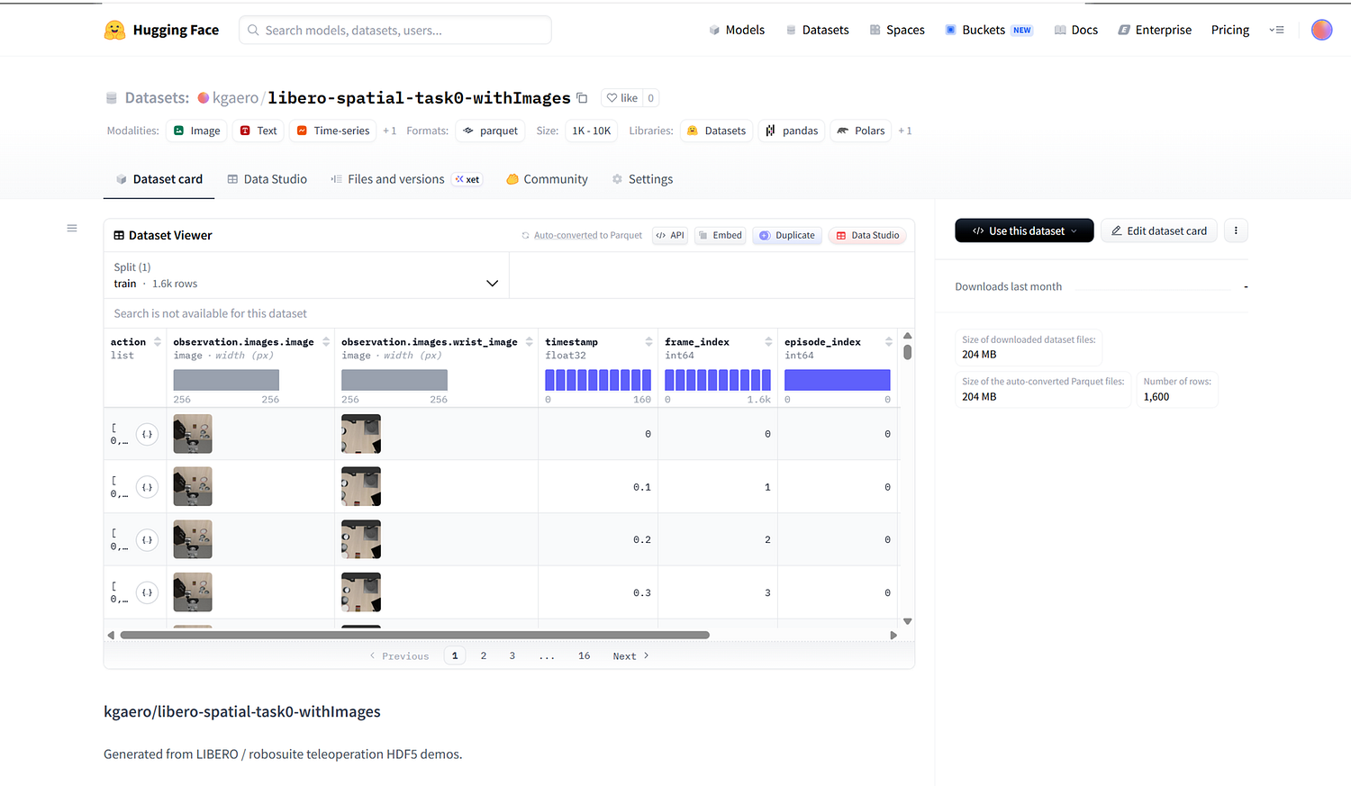
DATASET created by Teleoperation
For LIBERO Task 0, a single teleoperation episode produced around 1,000 records and roughly 235 MB of data due to image and video observations.
Each episode took about 12 minutes total:
around 2 minutes for teleoperation
around 10 minutes for conversion and Hugging Face upload. That makes large-scale manual dataset generation painfully slow.
Hugging Face dataset repository view for teleoperation data exported in LeRobot-style structure
https://huggingface.co/datasets/kgaero/libero-spatial-task0-withImages
Notes:
- This is the teleoperation dataset created from LIBERO Task 0 demos.
- The teleop script saves successful episodes into HDF5.
- A second script adds image observations and converts the data into LeRobot format.
- One episode produced about one thousand records and roughly 235 MB of data.
- The practical issue is speed: about two minutes for teleop and about ten minutes for conversion and upload.
- So manual teleoperation is useful for validating the pipeline, but it does not scale well for training data generation.

Slide 10
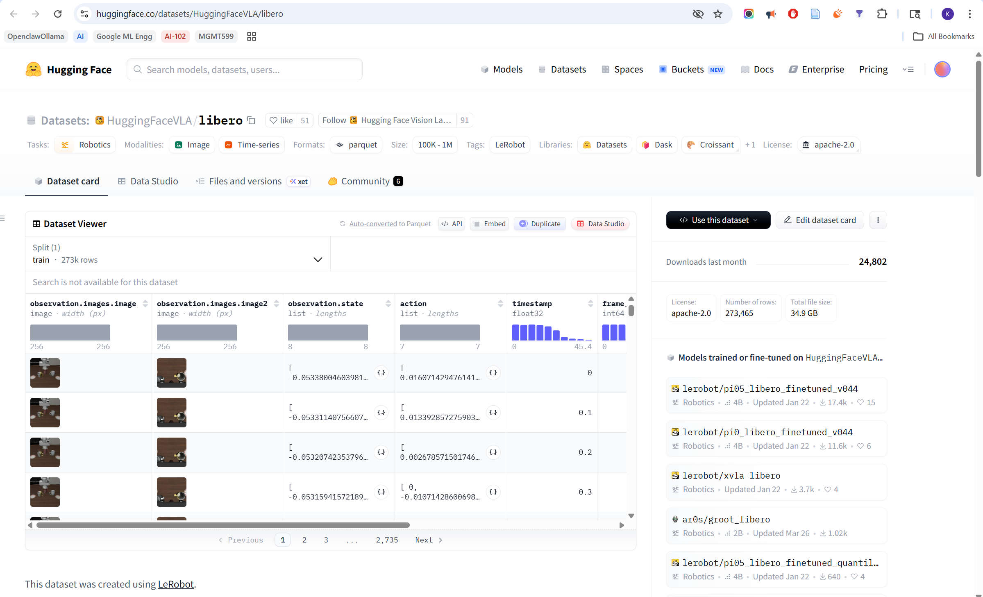
DATASET for Training
Hugging Face model repository view for lerobot/smolvla_base, used as the starting checkpoint for fine-tuning
https://huggingface.co/datasets/HuggingFaceVLA/libero
Notes:
- For actual fine-tuning, a larger dataset became necessary.
- The manually collected dataset was too small to train a reliable policy.
- The experiment used HuggingFaceVLA slash libero as the larger public training source.
- The Kaggle notebook for training uses a LeRobot LIBERO image dataset for the quick multi-GPU run.
- The key point is that public datasets with large size become important very quickly once training begins as data generation with teleoperation is difficult to scale.

Slide 11
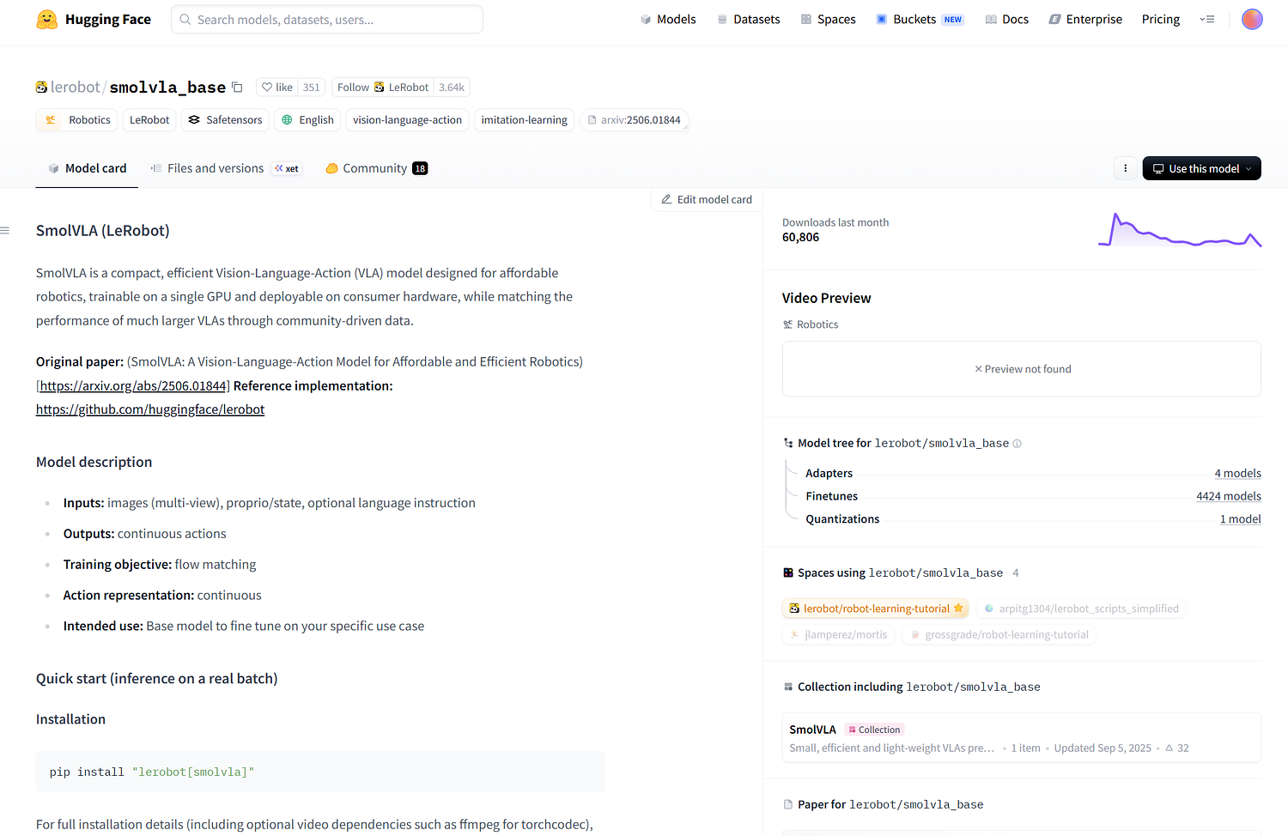
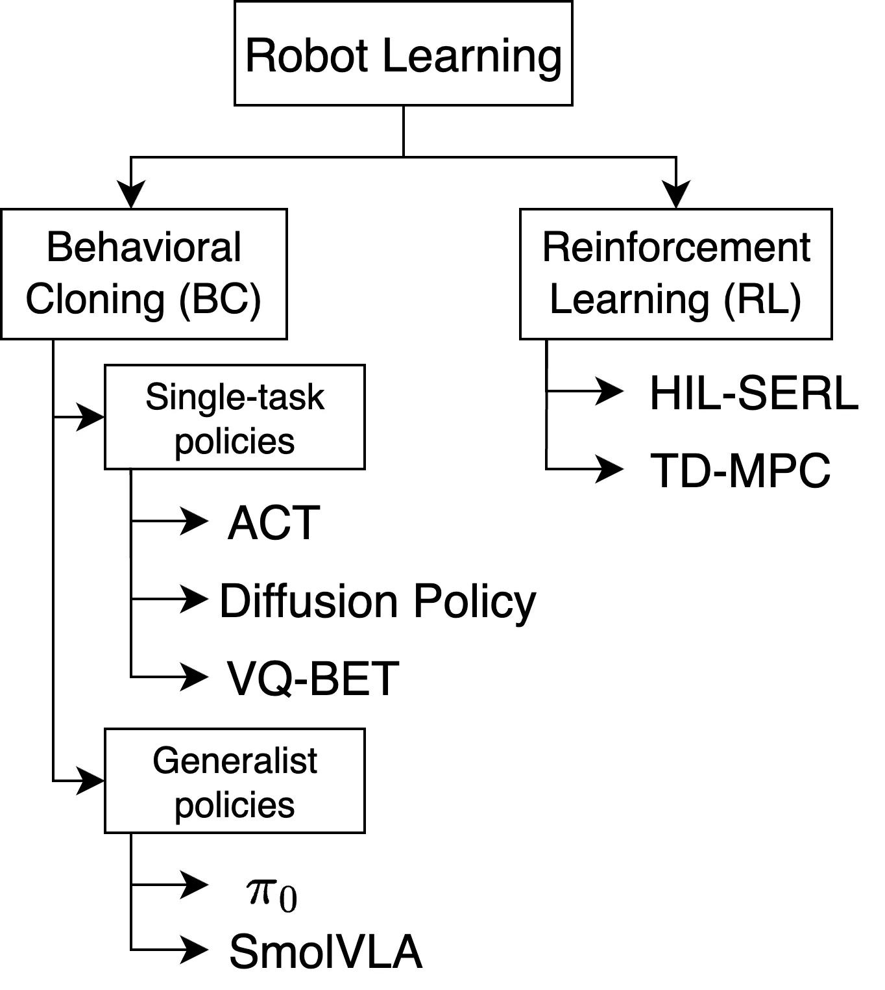
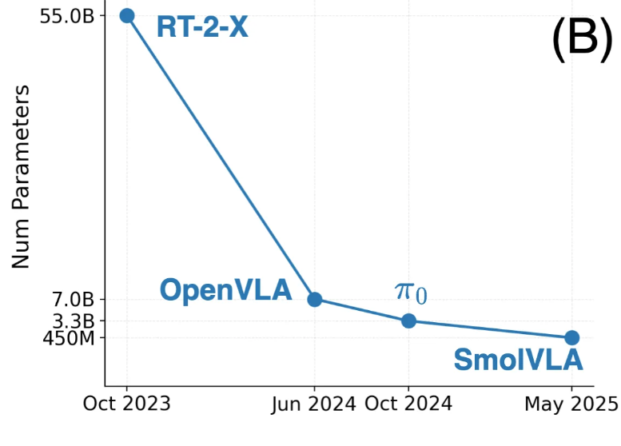
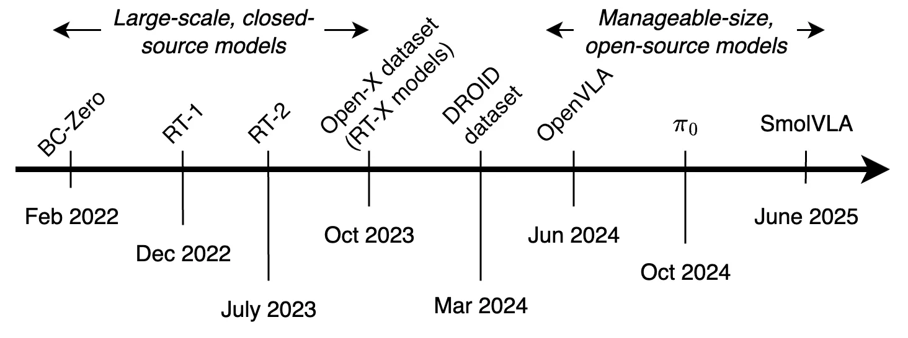
MODEL (VLA) for Robot policy
https://huggingface.co/lerobot/smolvla_base
https://huggingface.co/spaces/lerobot/robot-learning-tutorial
Notes:
- The policy model used here is SmolVLA of 450M parameters.
- SmolVLA is a compact vision-language-action model for robot policies.
- It takes observations and task context, then predicts the next robot action.
- That makes it a good fit for behavior cloning from demonstrations.
- The base checkpoint is lerobot slash smolvla_base on Hugging Face.

Slide 12
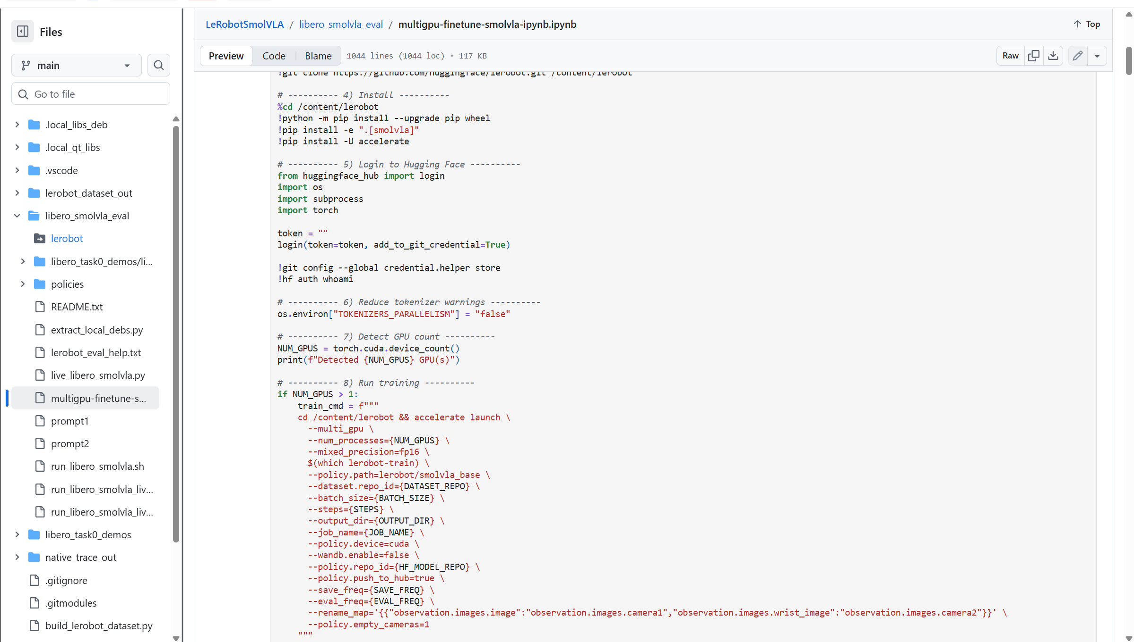
TRAINER
--multi_gpu and --num_processes={NUM_GPUS} allowed training to use both Kaggle T4 GPUs instead of only one.
--policy.path=lerobot/smolvla_base started from a pretrained checkpoint, which is far more data-efficient than training from scratch.
--rename_map fixed image key mismatches between the dataset schema and the model’s expected camera inputs.
--policy.empty_cameras=1 allowed training to continue even when some camera streams were missing.
--mixed_precision=fp16 reduced memory usage and improved throughput on limited hardware.
--policy.push_to_hub=true automatically versioned and uploaded trained checkpoints to Hugging Face.
https://github.com/kgaero/LeRobotSmolVLA/blob/main/libero_smolvla_eval/multigpu-finetune-smolvla-ipynb.ipynb
Notes:
- Training was done in a Kaggle notebook using the LeRobot training command.
- The notebook detects the number of GPUs and uses accelerate for multi-GPU training.
- It starts from lerobot slash smolvla_base instead of training from scratch.
- Mixed precision fp16 helps reduce memory pressure on T4 GPUs.
- The rename map fixes camera key mismatches between the dataset and the model.
- The push-to-hub flag publishes checkpoints directly to Hugging Face.

Slide 13
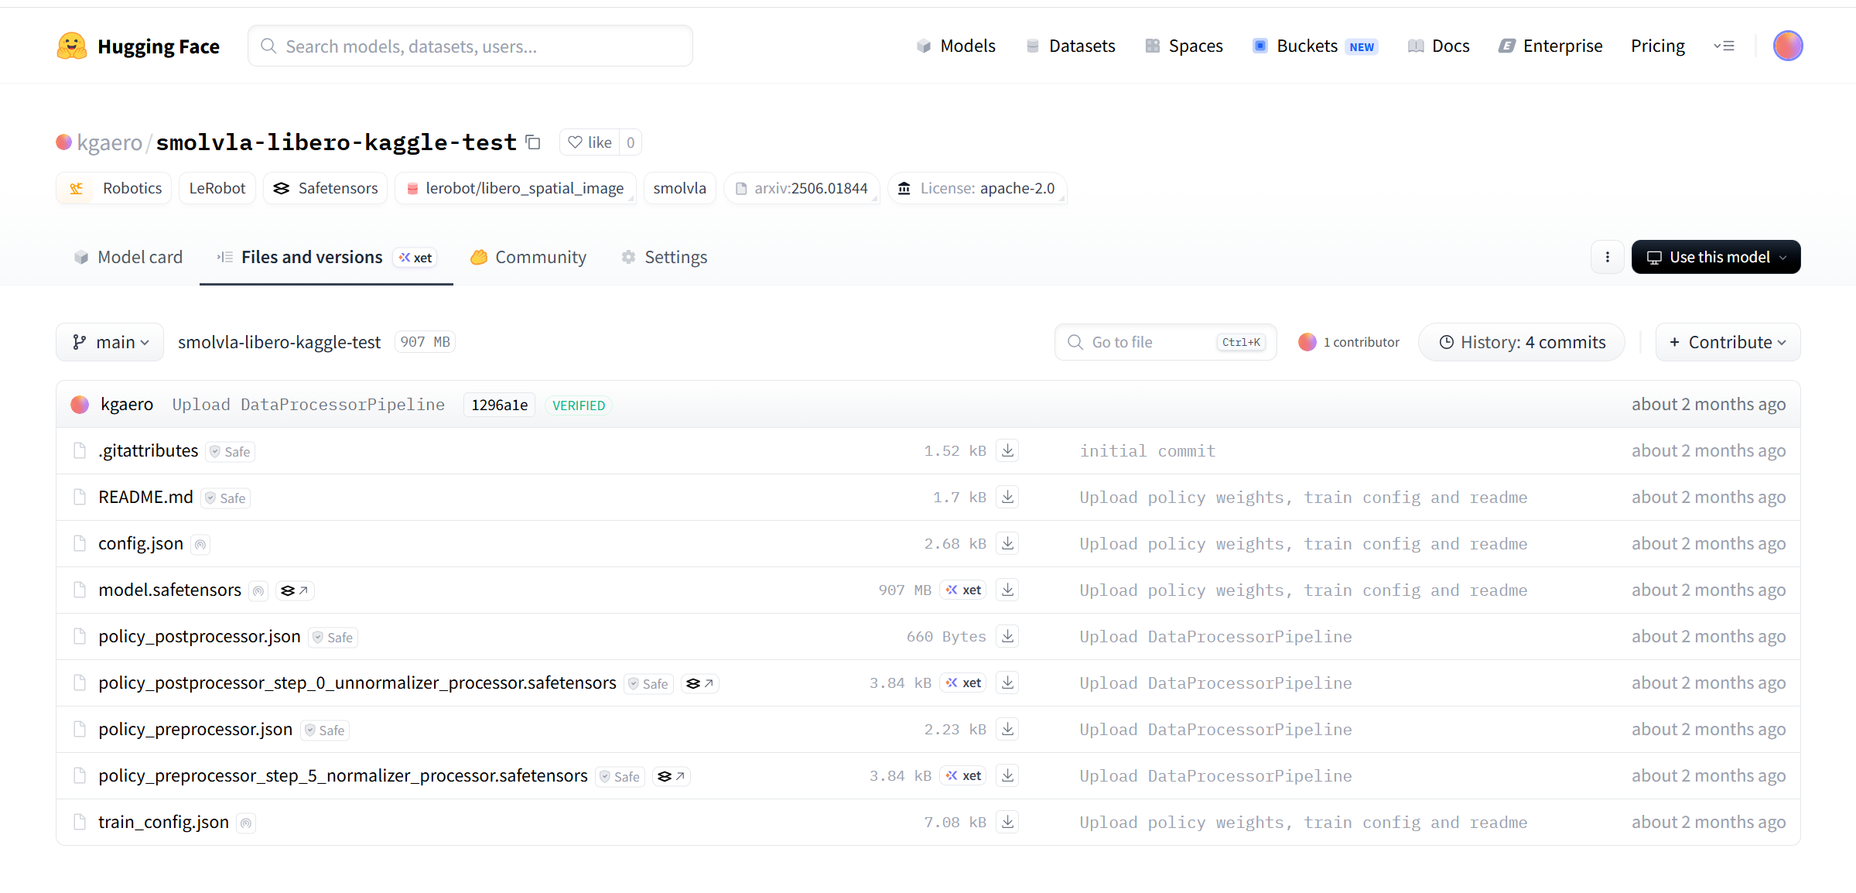
TRAINED MODEL
https://huggingface.co/kgaero/smolvla-libero-kaggle-test/tree/main
Notes:
- This is the trained model repository produced by the Kaggle run.
- Publishing the model confirms that the training stage completed and produced reusable artifacts.
- The local test script can download this model and run it in the LIBERO simulation.
- In practice, this model validated the workflow, but its task performance was still limited.
- That distinction is important: a working pipeline is not the same as a strong policy.

Slide 14
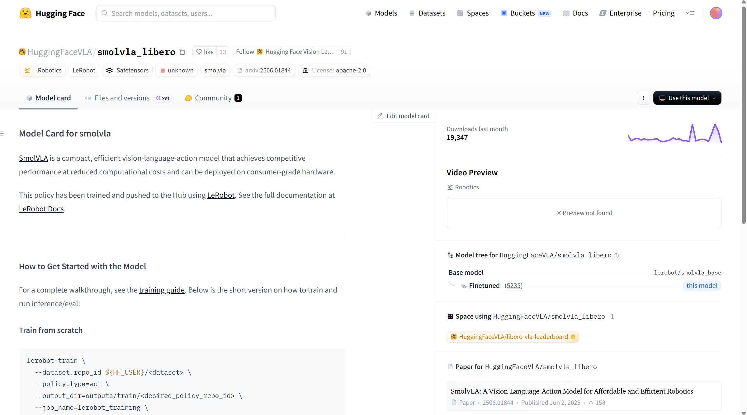
MODEL (VLA) for Robot policy Inference
https://huggingface.co/HuggingFaceVLA/smolvla_libero
https://huggingface.co/spaces/lerobot/robot-learning-tutorial
Notes:
- For the strongest local inference result, I used the Hugging Face LIBERO-trained SmolVLA policy.
- The local run script downloads the policy into the policies folder.
- The live inference script loads the policy, creates a LIBERO task 0 environment, and predicts actions step by step.
- It also applies observation renaming from the policy config when needed.
- The run writes both an MP4 rollout and a JSON summary for verification.
Open PowerShell, then paste below
wsl -d Ubuntu -- bash -lc "/home/kgaer/robotics/libero_smolvla_eval/run_libero_smolvla_live.sh"

Slide 15
Challenges addressed
Rendering and viewer instability - MuJoCo native viewer worked better than Matplotlib and Robosuite
Simulation speed was too slow - increased action chunking from 1 to 10 using chunk_size=50 (predicted actions) and n_action_steps=10 (executed actions), This reduced policy inference calls by roughly 10×, giving a large simulation speedup while preserving reasonable reactivity.
Large dataset uploads to Hugging Face were failing - switched from upload_folder to HfApi.upload_large_folder
Task 0 failed during inference: Training on a larger LIBERO-scale dataset improved the behavior, and the strongest results came from using Hugging Face’s already trained LIBERO policy: HuggingFaceVLA/smolvla_libero
Kaggle hardware was underutilized: enabled distributed multi-GPU training so both GPUs could be used
Notes:
- A few practical problems came up during implementation.
- Rendering was unstable with some viewer paths, so the workflow moved toward the native MuJoCo viewer.
- Inference was too slow until action chunking was increased with n_action_steps set to 10.
- Large dataset uploads were more reliable with upload_large_folder than the standard upload call.
- Small-task training did not solve inference, so a larger LIBERO-trained policy worked better.
- Kaggle also needed explicit multi-GPU settings to use both available GPUs.

Slide 16
Lesson Learned
Small-to-mid scale data is not enough for robust policy success:
Training SmolVLA policy with 53K records not sufficient. Need larger training dataset
Teleoperation data collection does not scale well on desktop simulation:
Each episode took about 12 minutes total. Hence difficult to scale with teleoperation
Memory-optimized VLA tooling still feels limited
Unable to find Unsloth-style memory-optimized workflow for VLA training
Central limitation:
Without enough data, policy performance stalls.
Solving that requires either large-scale data collection or access to high-quality existing datasets.
Manual Teleoperation of virtual/physical is NOT a scalable solution to collect large training dataset
Automated Large robot data generation and collection is key to scalable Training dataset
Notes:
- The biggest lesson is that data scale controls policy quality.
- Small and medium datasets can validate the pipeline, but they may not produce robust success.
- Manual teleoperation is especially hard to scale because each episode takes time and creates large files.
- Public datasets become necessary much earlier than expected.
- There is also limited low-memory tooling for VLA training compared with some LLM workflows.
- So, simulation lowers the entry barrier, but it does not remove the data problem.

Slide 17
Thank you
Notes:
- Thank you for listening.
- The takeaway is that beginners can learn the full robot policy pipeline before buying hardware.
- Simulation is a practical starting point for data collection, training, publishing, and inference.
- But for reliable robot behavior, the next challenge is collecting or accessing much larger datasets.

Slide 18
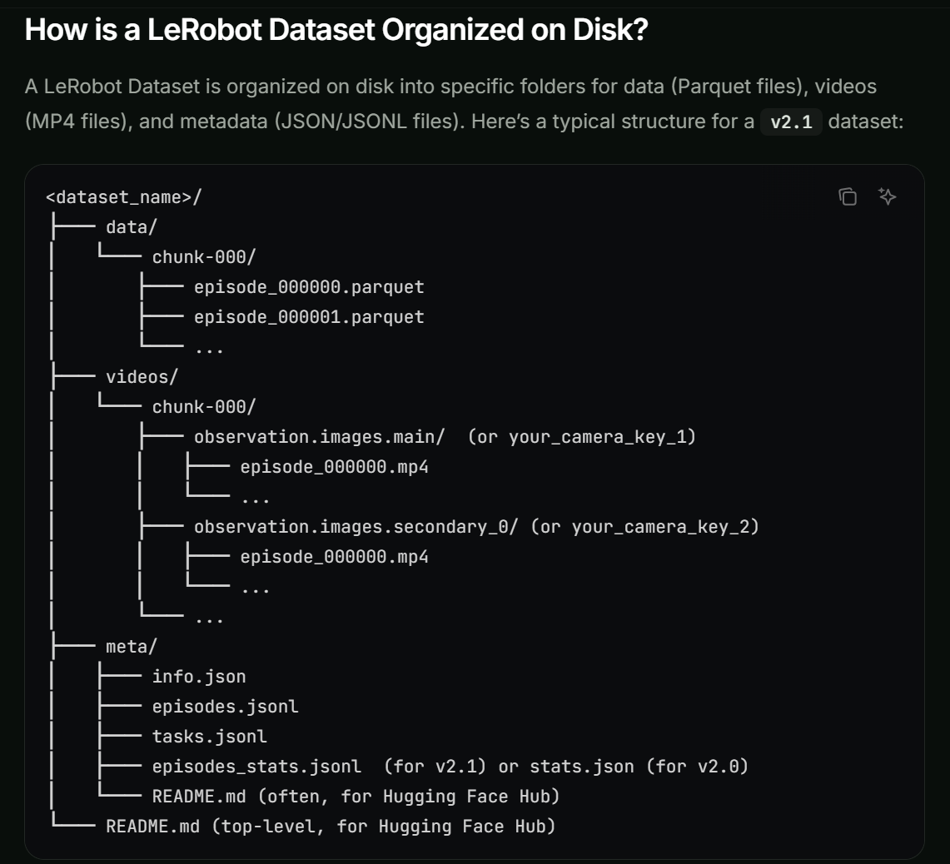
https://docs.phospho.ai/learn/lerobot-dataset
Notes:
- This is a reference for the LeRobot dataset structure.
- It is useful for understanding how episodes, observations, actions, and metadata are organized.
- In this project, the conversion script writes a LeRobot-compatible dataset from HDF5 demos.
- The goal is to avoid inventing a custom robotics dataset format from scratch.

Slide 19
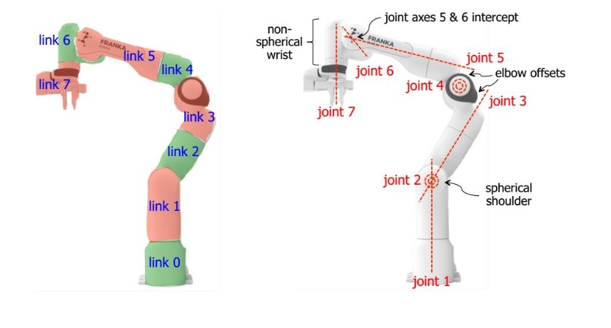
https://wiki.happylab.at/images/5/5e/Panda_Robot_Manual_English.pdf
Notes:
- This reference gives additional context for the Franka Panda robot.
- The Panda arm is widely used for research-style tabletop manipulation tasks.
- In this project, the physical robot is not used directly.
- Its simulated version provides the robot platform for LIBERO Task 0.

Slide 20
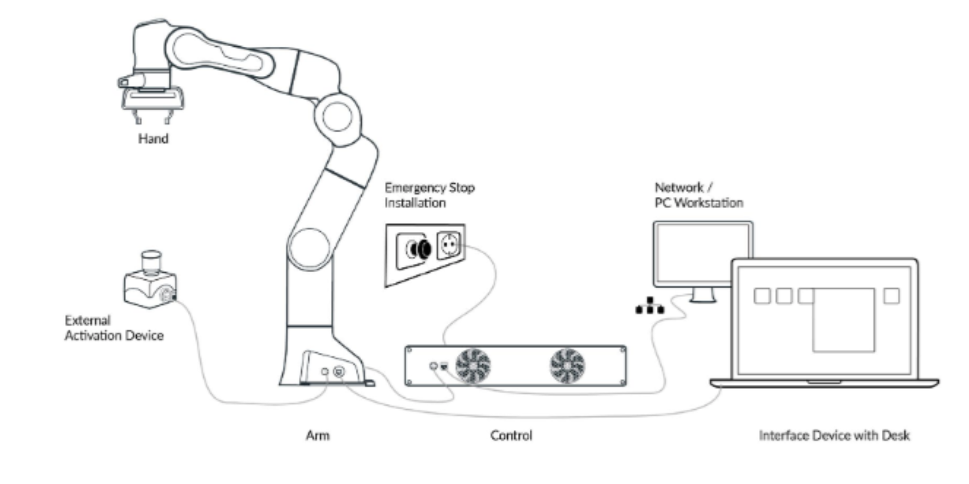
https://wiki.happylab.at/images/5/5e/Panda_Robot_Manual_English.pdf
Notes:
- This second Panda reference slide supports the robot hardware background.
- It helps connect the virtual setup to a real robotic arm design.
- That connection is useful because the simulated workflow still mirrors a real robot policy workflow.
- The important point is that the learning pipeline can begin before the physical robot is purchased.

Slide 21
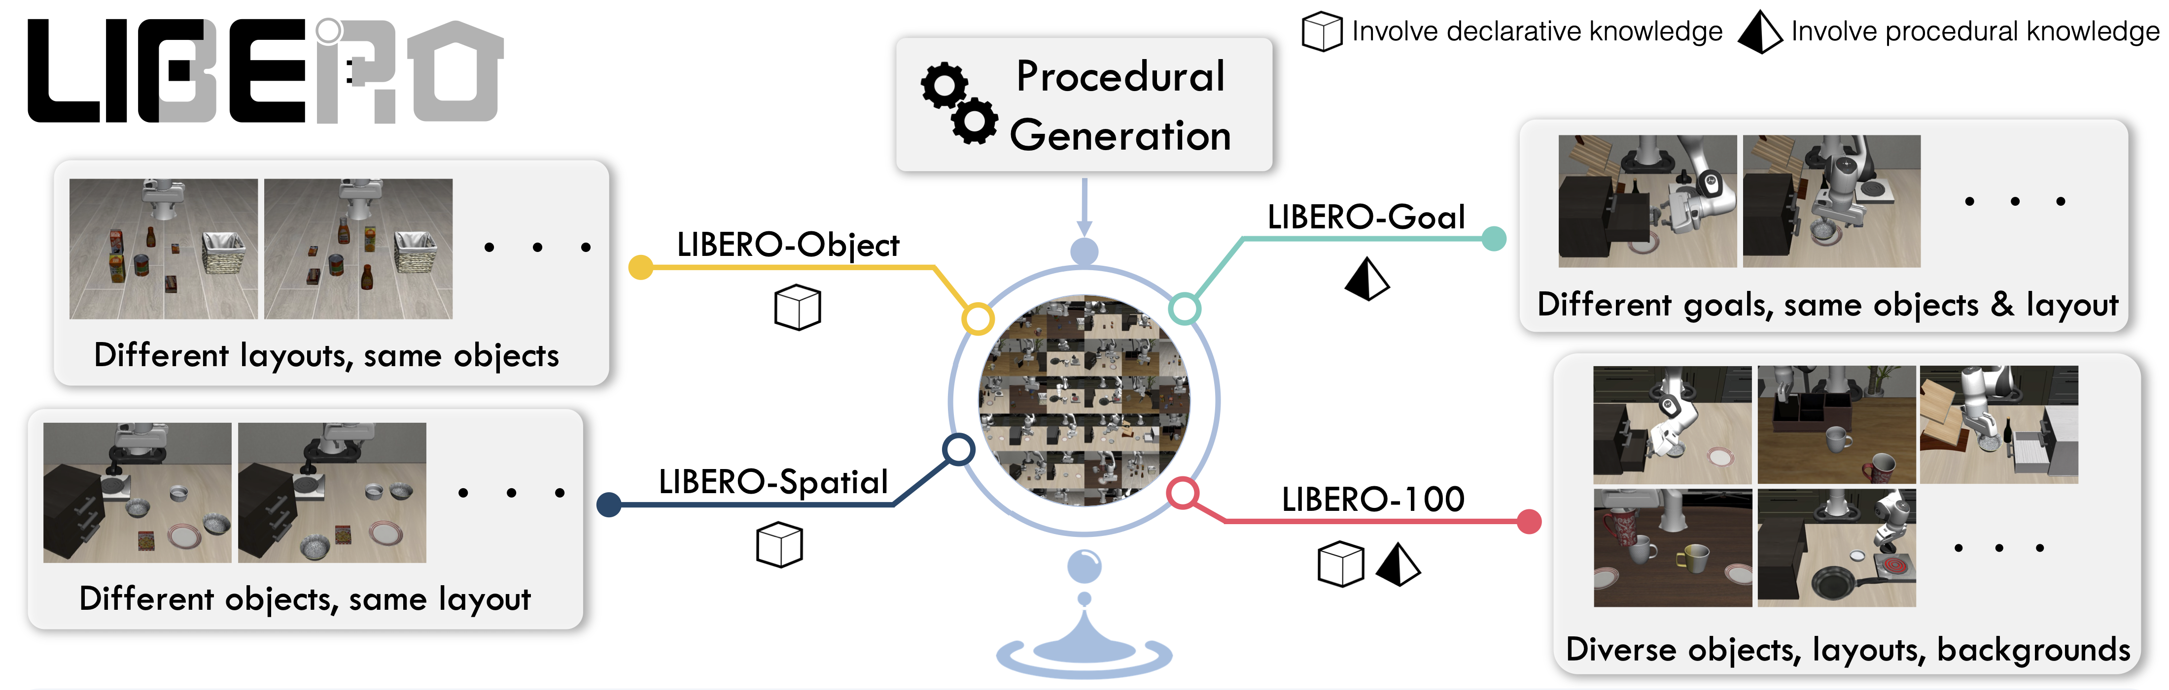
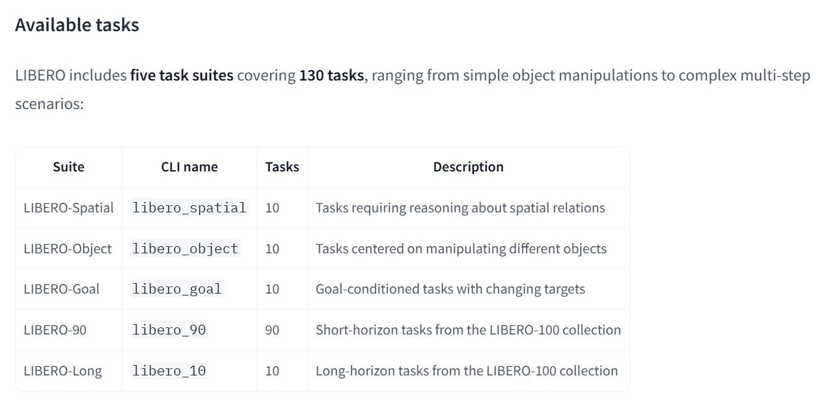
https://huggingface.co/docs/lerobot/libero
Notes:
- This is the LIBERO reference used for the simulation environment.
- LIBERO provides benchmark tasks, object layouts, initial states, and language goals.
- The code uses libero_spatial and task id zero for the mug-to-plate task.
- That keeps data collection and inference focused on a repeatable objective.

Slide 22
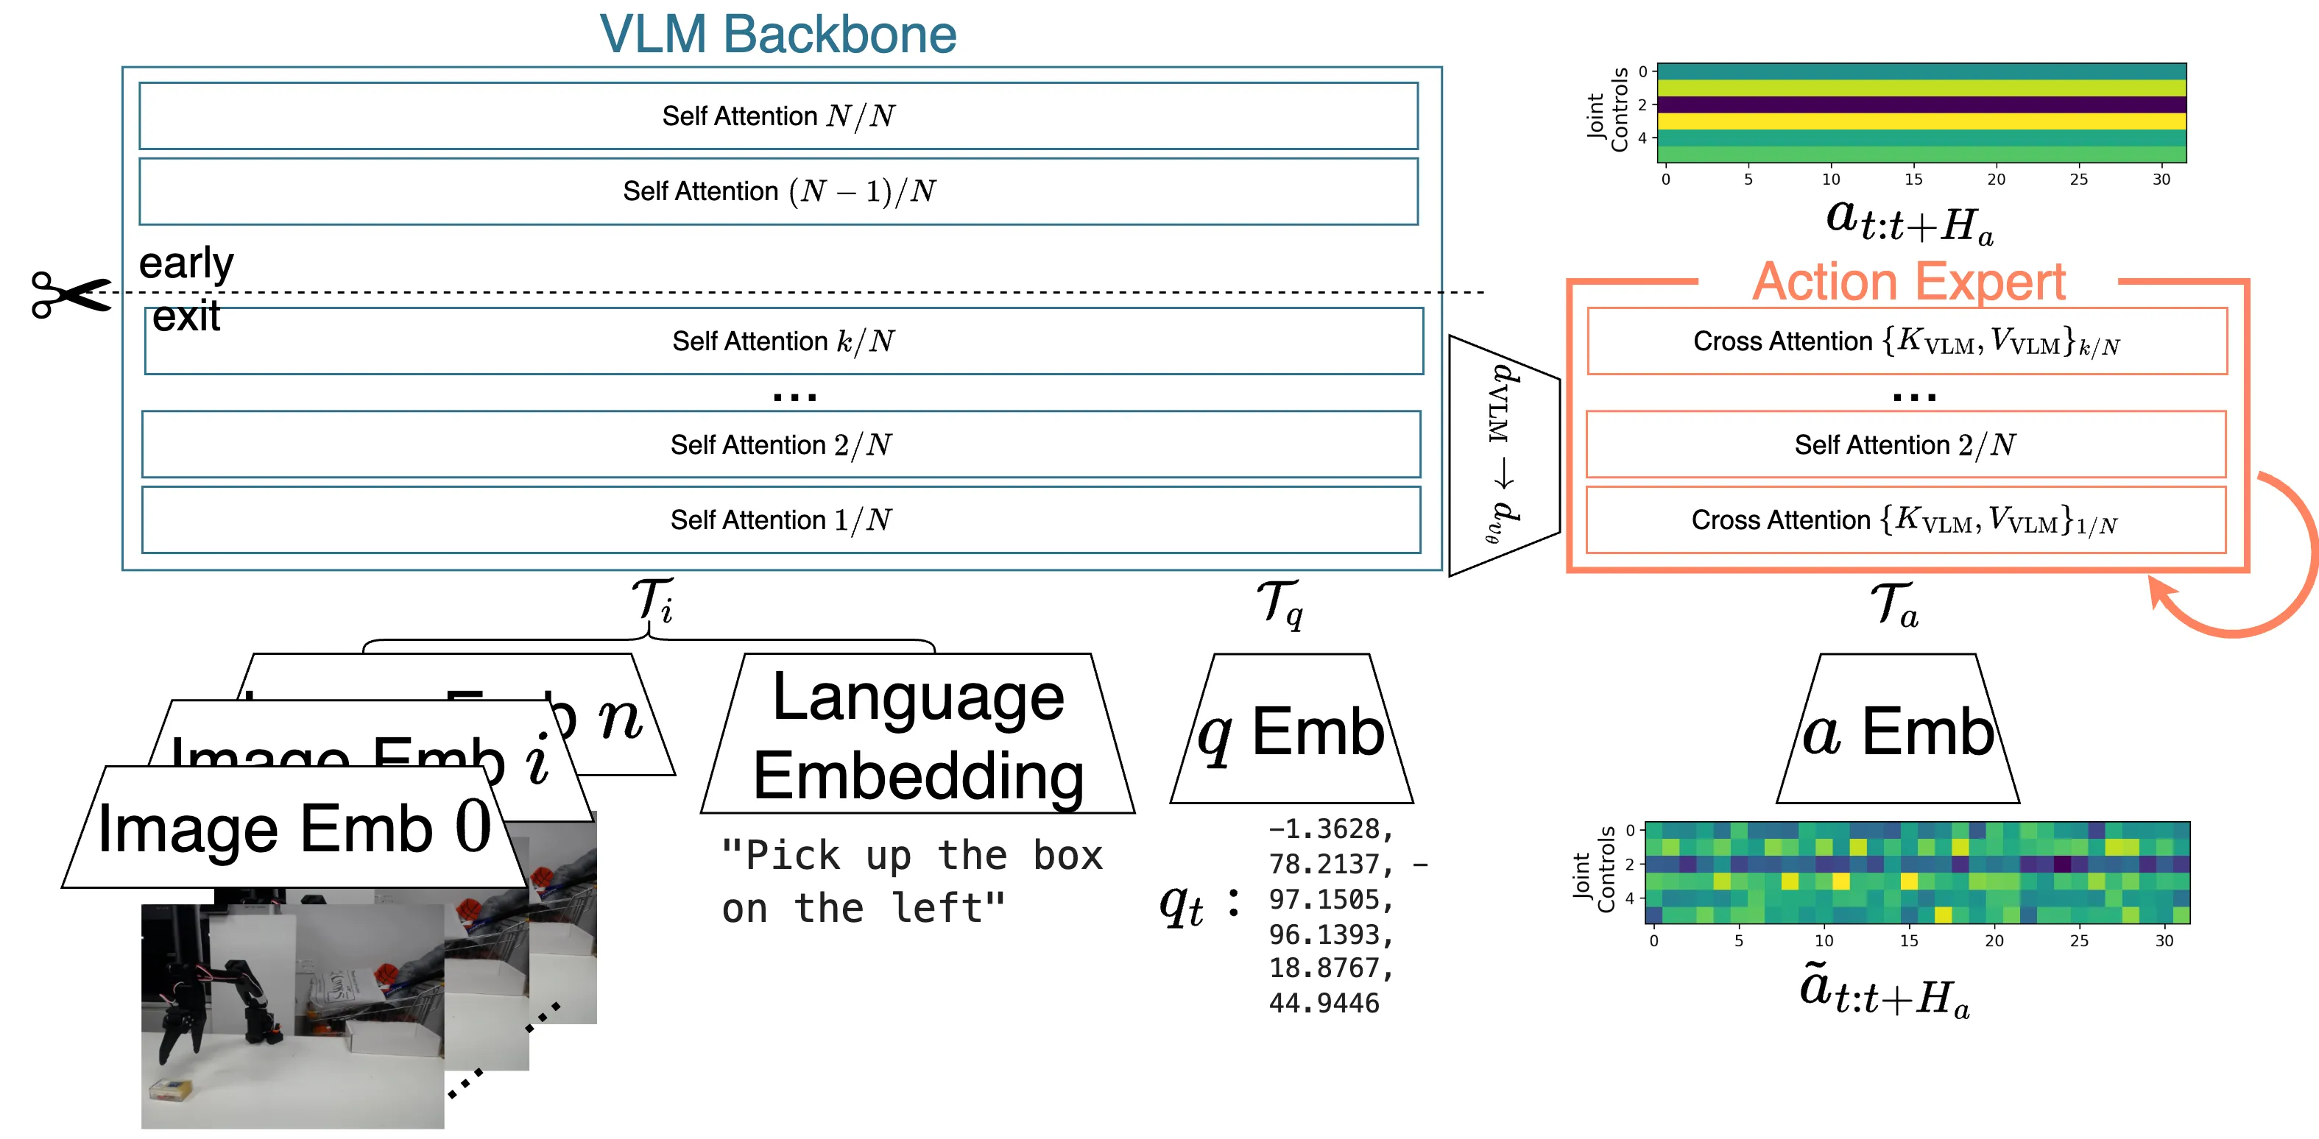
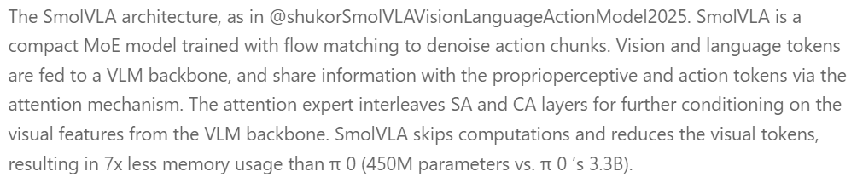
https://huggingface.co/spaces/lerobot/robot-learning-tutorial
https://doi.org/10.48550/arXiv.2506.01844
Notes:
- These are references for SmolVLA and the Hugging Face robot learning tutorial.
- They explain the model family and the broader LeRobot training workflow.
- In this project, SmolVLA is the policy model used for fine-tuning and inference.
- The tutorial is the best starting point for reproducing the training command and model setup.

Slide 23
Project Q&A - Code and Results (1/3)
What problem were you solving?
I built a robot policy training pipeline without first investing in hardware. The pipeline uses LIBERO/MuJoCo simulation to collect teleoperation data, convert it into LeRobot format, and run robot policy inference/evaluation. The tested robot setup was a simulated Franka Panda arm on LIBERO spatial task 0. The successful task-0 evaluation used the downloaded Hugging Face SmolVLA LIBERO with about 450M parameters
Explain the project in simple terms.
Instead of starting with hardware, the project uses a simulated Franka Panda arm. A human can teleoperate the task, the scripts save actions, rewards, states, and camera images, the converter packages those episodes as a LeRobot dataset, and SmolVLA turns images, robot state, and the language task into actions. Outputs are videos and JSON metrics.
Why this model?
SmolVLA was chosen because it is integrated with LeRobot, has a LIBERO-ready checkpoint, supports fine-tuning, and takes robot images, state, and language as inputs. Its 450M-parameter size made it more practical than larger VLA models for the available GPU constraints.
Strictly based on local code/results: run scripts, policy configs, eval_info.json, output_live JSON, and notebook logs.

Slide 24
Project Q&A - Code and Results (2/3)
How did you evaluate it? What metric did you use?
The primary metric was task-completion success rate: whether the inferred robot policy completed LIBERO task 0. For one episode this is binary, then reported as pc_success percentage.
Latest HF live JSON succeeded on task 0 with reward 1.0 in 69 steps; batch eval_info reports 1/1 episode, 100% pc_success, 244.9 s.
What was technically hard about it?
Inference was slow because the policy config had n_action_steps=1, causing frequent policy calls. I improved live viewing by overriding n_action_steps to 10 while chunk_size remained 50.
Rendering was also unstable, so I tested robosuite, Matplotlib, and MuJoCo viewers; the MuJoCo viewer gave the best result.
What was the biggest trade-off?
The biggest trade-off was speed versus reactivity. Increasing n_action_steps to 10 made live inference faster because the model was called less often, but the policy reused a longer action sequence before observing again, so it reacted more slowly to environment changes.
Strictly based on local code/results: run scripts, policy configs, eval_info.json, output_live JSON, and notebook logs.

Slide 25
Project Q&A - Code and Results (3/3)
What failed?
The fine-tuned smolvla-libero-colab-test policy failed during inference evaluation on LIBERO task 0: success was false, reward was 0.0, and it reached 280 steps. The larger multi-GPU fine-tuning attempt also failed at training step 0 with a BF16 AMP error. For successful inference, I used the downloaded HuggingFaceVLA_smolvla_libero checkpoint.
What would you improve?
I would fix the fine-tuning setup first, especially precision, mixed-precision, and hyperparameter choices. Then I would run evaluation sweeps across more task IDs, seeds, and episodes. I would also compare the Hugging Face checkpoint against fine-tuned checkpoints using the same pc_success metric, and use larger GPU memory if available.
Strictly based on local code/results: run scripts, policy configs, eval_info.json, output_live JSON, and notebook logs.

