Slide 1
Save Costs and Personalize OpenClaw with a Fine-Tuned Open-Source LLM
Kunal Ghosh
Notes:
- Hello everyone.
- Today I will talk about reducing the cost of running OpenClaw.
- I will also show how we can make OpenClaw more personalized.
- The main idea is simple.
- We fine-tune a small open-source model and run it locally.
- Then OpenClaw can use that model for agentic tasks.

Slide 2
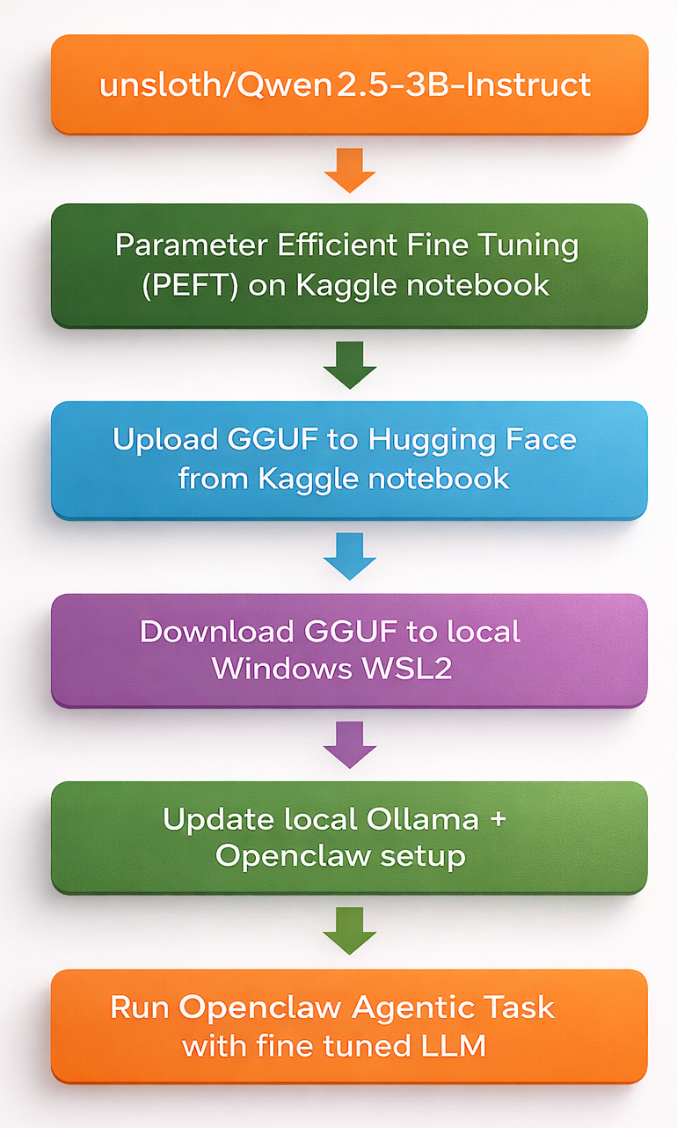
The Pipeline fine-tuning to OpenClaw execution with finetuned model
OpenClaw enables local agentic AI workflows for personal automation, but agentic loops can consume tokens quickly and increase API costs.
Using an open-source small LLM such as Qwen2.5-3B helps reduce the cost of running OpenClaw-based agentic workflows.
Fine-tuning improves personalization, including response style, task behavior, and alignment with user-specific workflows.
Local fine-tuning is memory-intensive and often impractical on consumer GPUs. Unsloth enables efficient PEFT fine-tuning on free Kaggle GPUs.
The fine-tuned model is converted to GGUF for versioning, storage, distribution, and deployment through Hugging Face.
Ollama serves the fine-tuned GGUF model locally, making it easy to run inference on Windows WSL2.
OpenClaw connects to Ollama and executes agentic tasks using the fine-tuned local LLM.
Notes:
- This slide shows the complete pipeline.
- We start with OpenClaw.
- OpenClaw can run local agentic AI workflows for automation.
- But agentic workflows often call the model many times.
- If every call goes to a paid API, the cost can grow quickly.
- To reduce that cost, we use a small open-source model.
- In this case, the model is Qwen2.5 3B Instruct.
- The model is small enough to run locally, but still useful for instruction-following tasks.
- Next, we fine-tune the model.
- Fine-tuning helps us adjust the model to a user’s reasoning requirement, style and workflow.
- It can improve how the model responds, how it follows tasks, and how it behaves inside OpenClaw.
- Training locally can be difficult because fine-tuning needs GPU memory.
- That is why we use Unsloth.
- Unsloth makes PEFT fine-tuning much more efficient.
- It also allows us to train on free Kaggle GPUs.
- After training, we convert the model to GGUF format.
- GGUF is useful for local deployment and model sharing.
- We store the trained model on Hugging Face.
- That gives us a clean place to version and download the model.
- Then Ollama serves the GGUF model locally.
- Ollama makes it easy to run the model from Windows with WSL2.
- Finally, OpenClaw connects to Ollama.
- At that point, OpenClaw can run tasks using the fine-tuned local model.
- So the pipeline gives us three benefits.
- Lower cost, more local control, and better personalization.

Slide 3
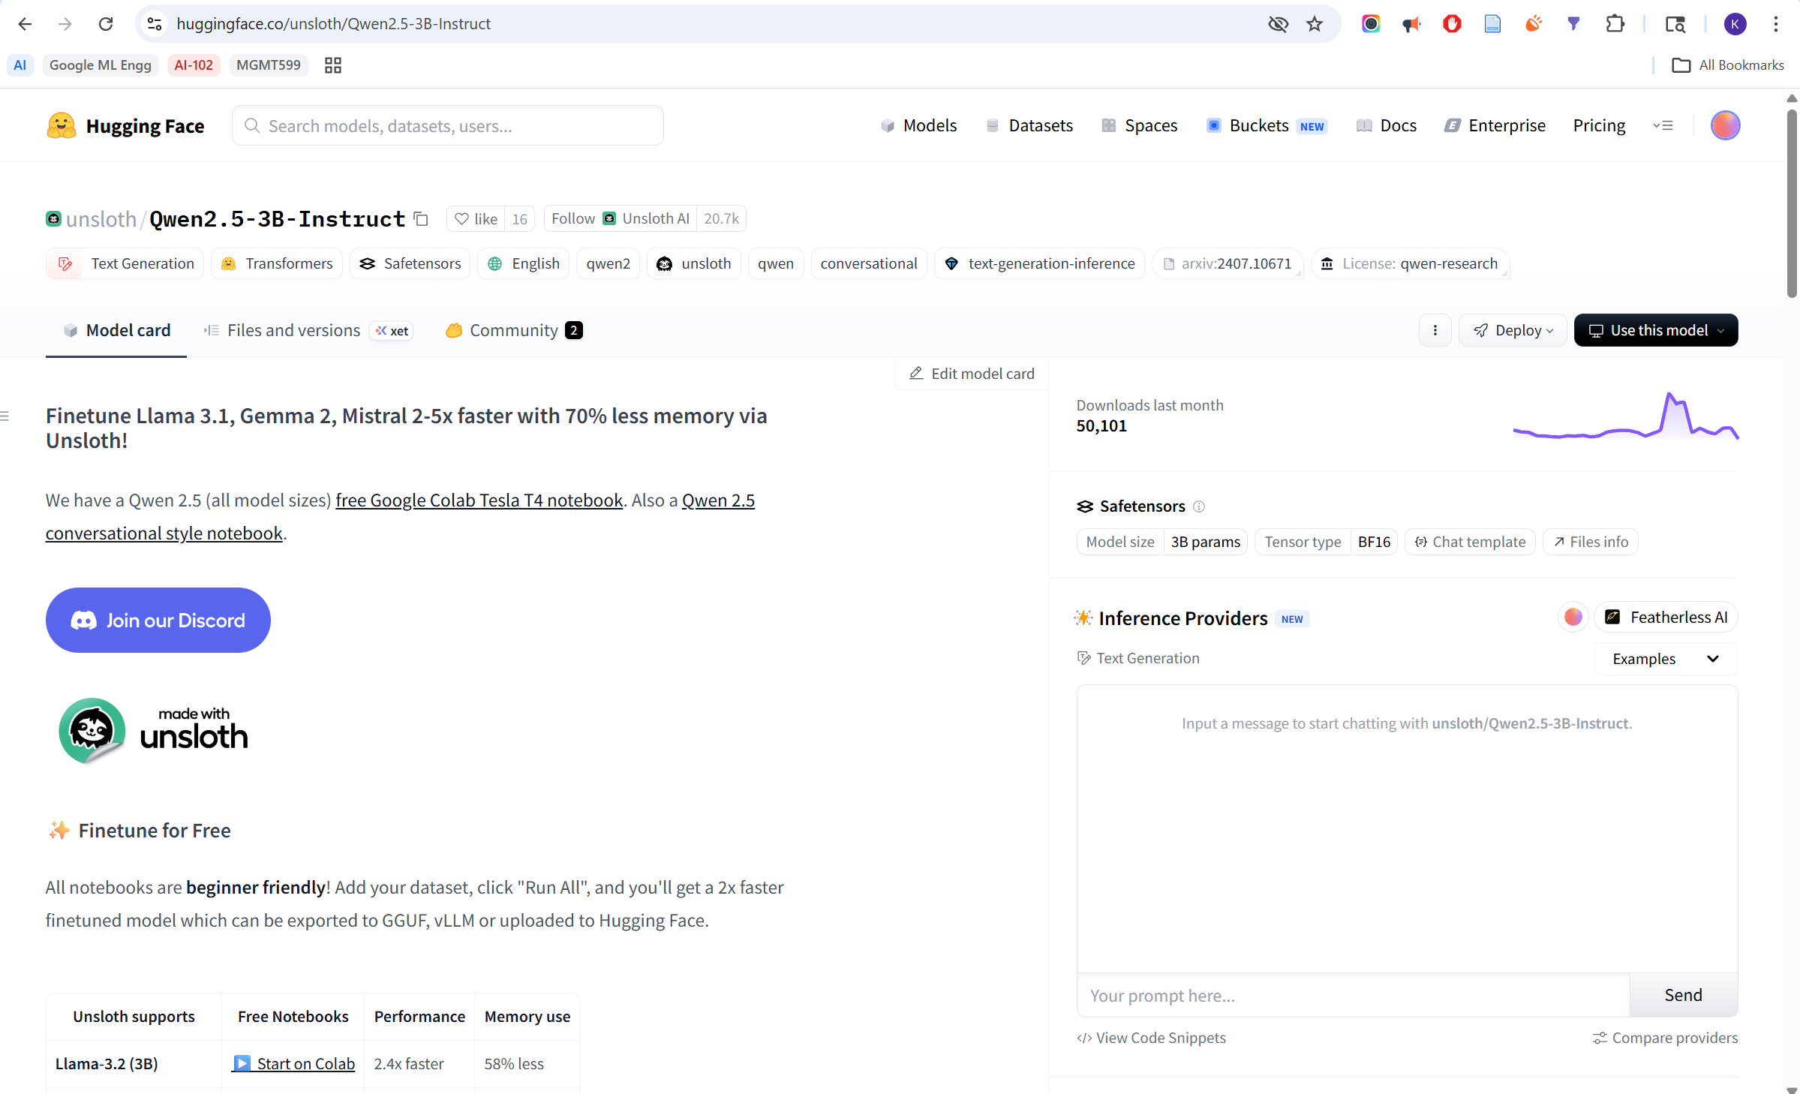
MODEL
https://huggingface.co/unsloth/Qwen2.5-3B-Instruct
Notes:
- This is the base model used in the pipeline.
- It is Qwen2.5 3B Instruct from Unsloth.
- I chose a 3B model because it is practical for local use in my computer with 4GB VRAM.
- It is also already instruction-tuned.
- That gives us a good starting point for fine-tuning.

Slide 4
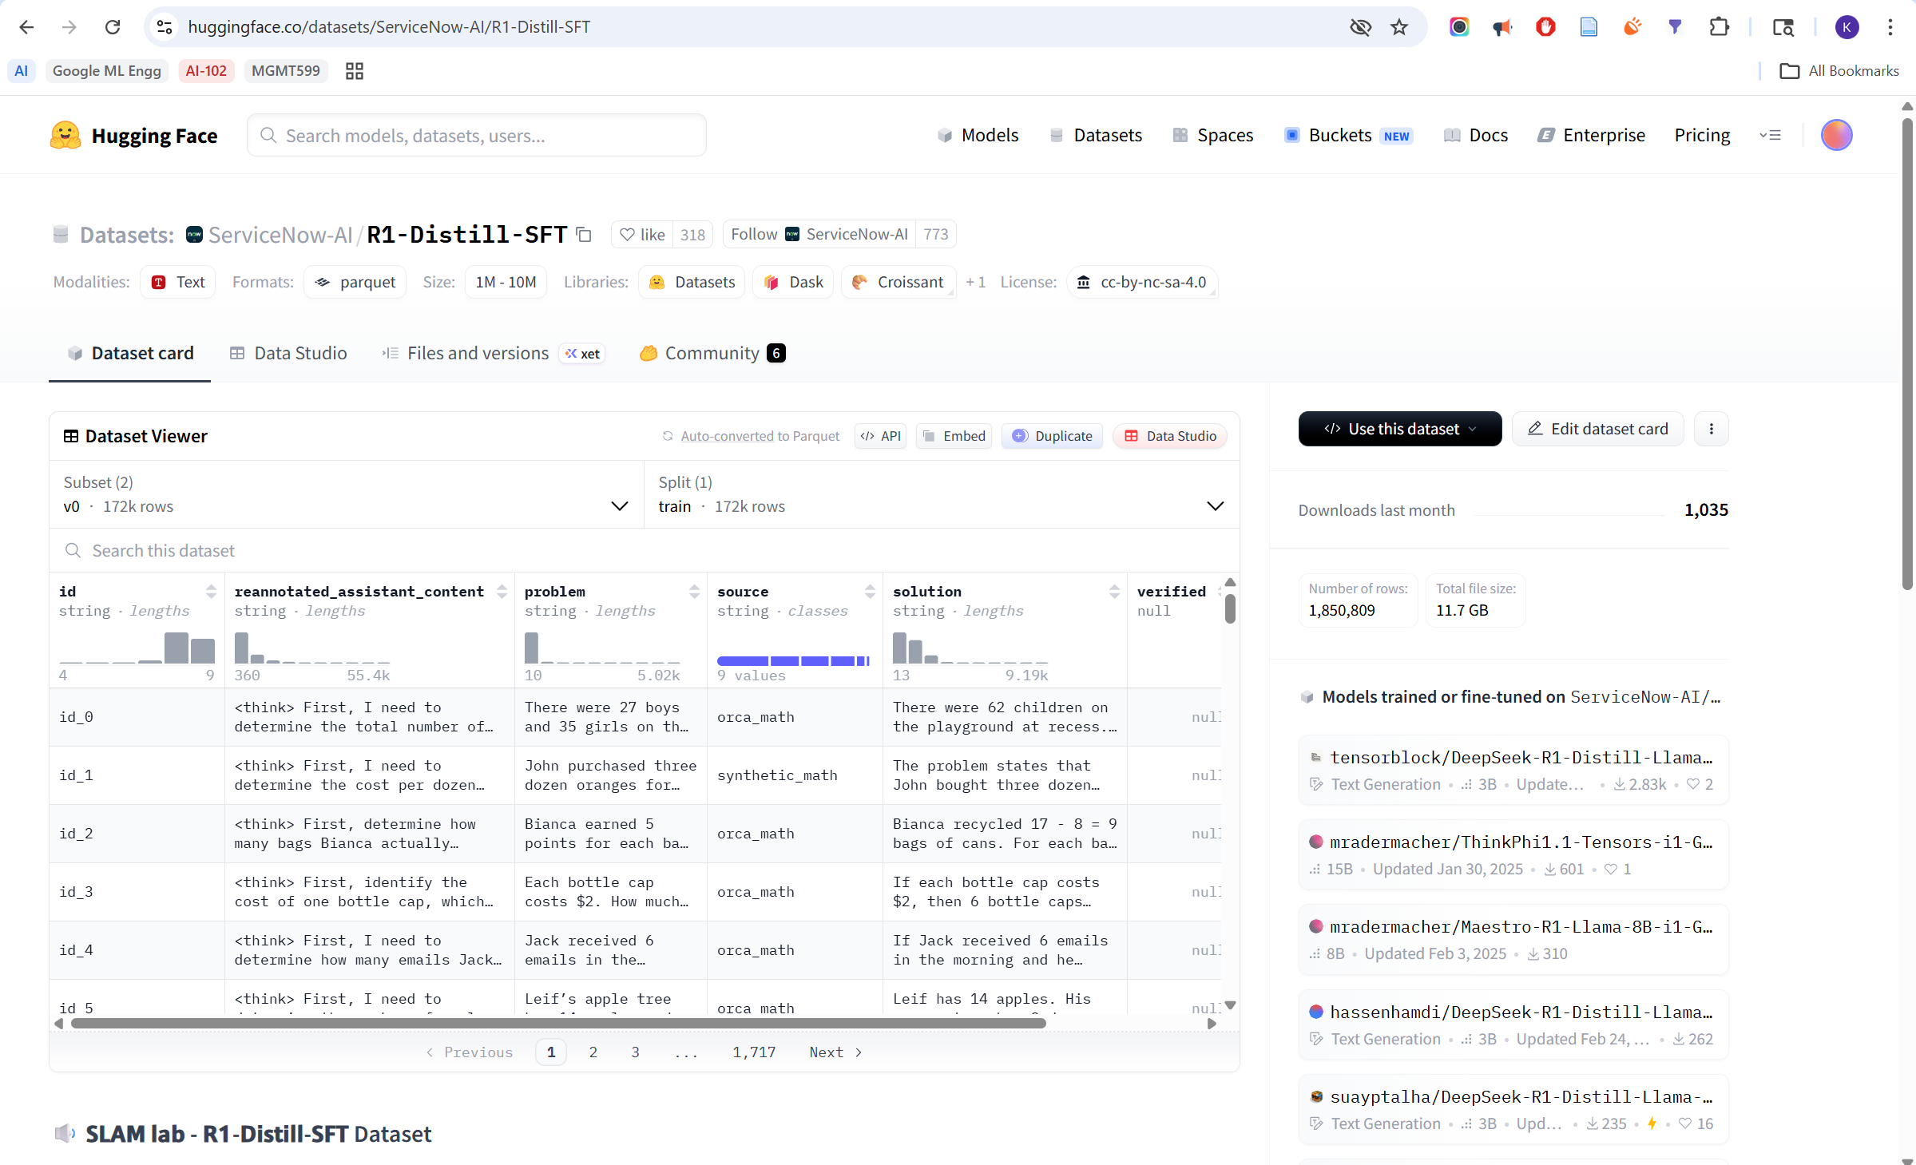
DATASET
https://huggingface.co/datasets/ServiceNow-AI/R1-Distill-SFT
Notes:
- This slide shows the training dataset.
- The dataset is used for supervised fine-tuning.
- It contains examples of instructions and responses.
- These examples help the model learn task-following behavior.
- We are not training a model from scratch.
- We are adapting an existing model for our use case.

Slide 5
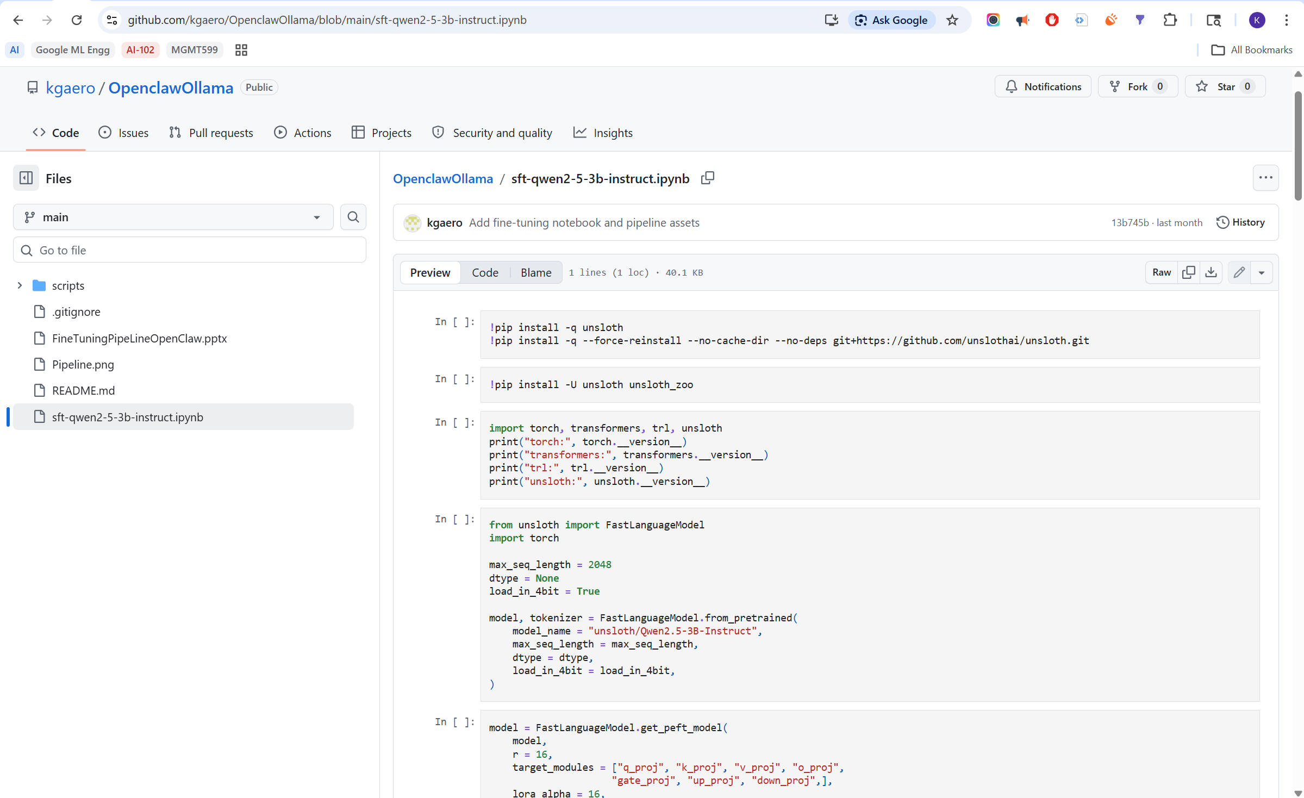
TRAINER
https://github.com/kgaero/OpenclawOllama/blob/main/sft-qwen2-5-3b-instruct.ipynb
Notes:
- This is the training notebook.
- The notebook loads the base model and the dataset.
- It then configures fine-tuning with Unsloth.
- The notebook also runs the training process.
- Using a notebook makes the experiment easy to review and repeat.
- After training, the output can be prepared for local deployment.

Slide 6
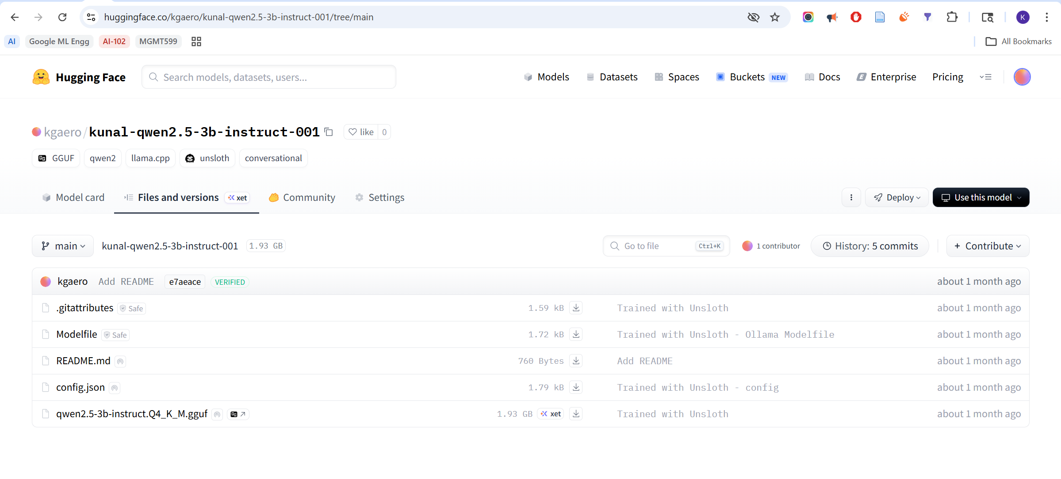
TRAINED MODEL
https://huggingface.co/kgaero/kunal-qwen2.5-3b-instruct-001/tree/main
Notes:
- This is the trained model on Hugging Face.
- Hugging Face is used as the model registry.
- It helps us store and version the trained model.
- It also makes the model easier to download later.
- This separates the training step from the deployment step.

Slide 7
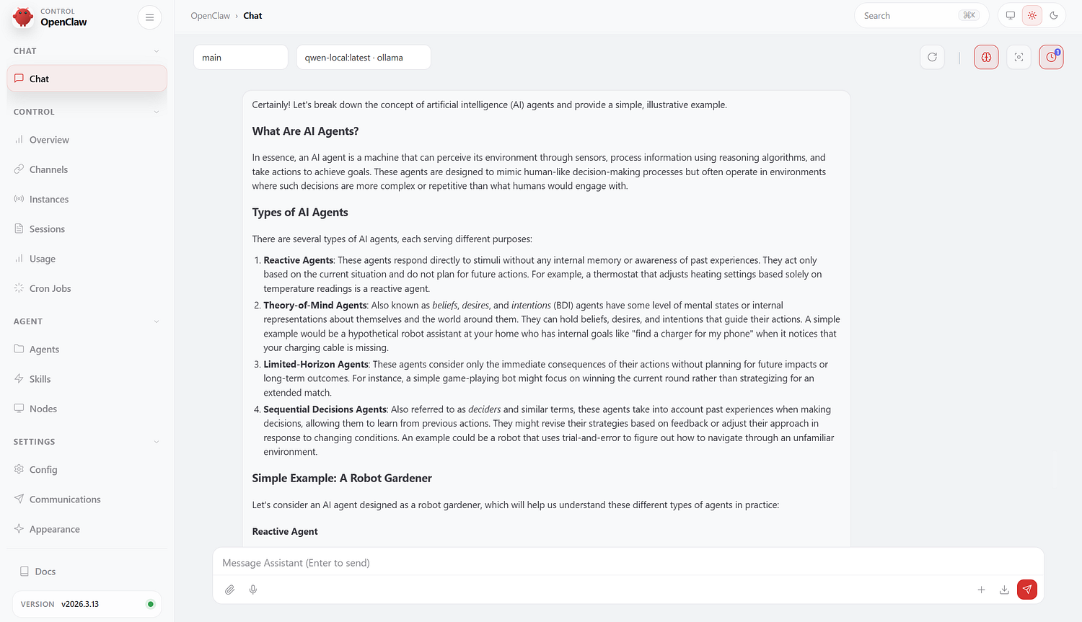
OpenClaw with fine tuned Qwen model
DEPLOYED MODEL
powershell.exe -ExecutionPolicy Bypass -File "\\wsl.localhost\Ubuntu\home\kgaer\code\OpenclawOllama\Start-OpenClaw.ps1" -Session clean
Notes:
- This slide shows the deployed model running with OpenClaw.
- The command starts OpenClaw through the WSL project path.
- Ollama serves the fine-tuned model locally.
- OpenClaw sends model requests to Ollama.
- This confirms that the full pipeline works end to end.
- The trained model is now being used inside OpenClaw.

Slide 8
Thank you
Notes:
- Thank you.
- The key takeaway is that OpenClaw can run with a personalized local LLM.
- This can reduce API cost.
- It can also give more control over model behavior.
- The same pipeline can be repeated with better data or newer models.
I am happy to take questions.
https://medium.com/@kg.aero/save-costs-and-personalize-openclaw-with-a-fine-tuned-open-source-llm-d33335640367

