Slide 1

Final Project
Kanan Gafarov

Slide 2
Python vs Assembly language
This project will compare the performance of Python and assembly language (MIPS) by implementing the Sieve of Eratosthenes which:
was chosen for the prime number generation task due to its efficiency and simplicity in identifying all prime numbers within a given range
works by iteratively marking the multiples of each prime starting from 2, gradually eliminating composite numbers and leaving only the primes

Slide 3
Performance Measurement
Time performance in Python was measured using the time module. The time.time() function was employed to record the start and end times of the execution. The time difference provided an accurate measure of the execution time. In Assembly, time performance measurement depends on the capabilities of the specific environment. A suitable approach is to use the .data segment to store timestamps before and after the execution, and then calculate the time difference. The exact instructions may vary based on the specifics of the Assembly environment.
In Python, memory performance was measured using the sys.getsizeof function from the sys module. This function returns the size of an object in bytes. Memory performance measurement in Assembly, particularly for MIPS architecture on Linux, involved utilizing the getrusage system call. The resulting resource usage information, specifically the integral shared, unshared, and stack memory sizes, was extracted from the structure returned by the system call.

Slide 4
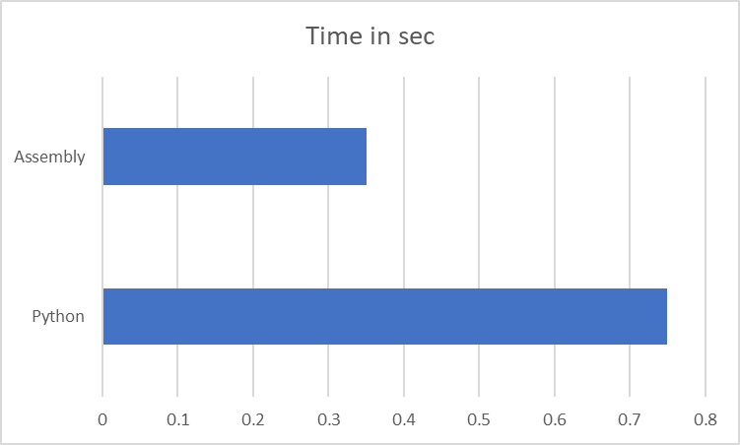
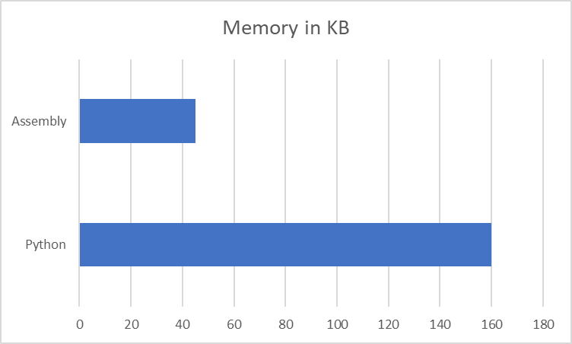
Results
When it comes to performance Assembly language is both faster and uses less memory. However, Python can make up for it with its flexibility due to its dynamic nature. Moreover, Python is much more readable.

Slide 5
Thanks for attention

