Slide 1

SocioFlo in solving Social Anxiety
Team Name: Natural Intelligence
Done by: Md Ahnaf Monwar, Syed Muhtasim Hamid, Kenzie MacIntyre, Can Sozuer, and Michaela Vietinghoff

Slide 2
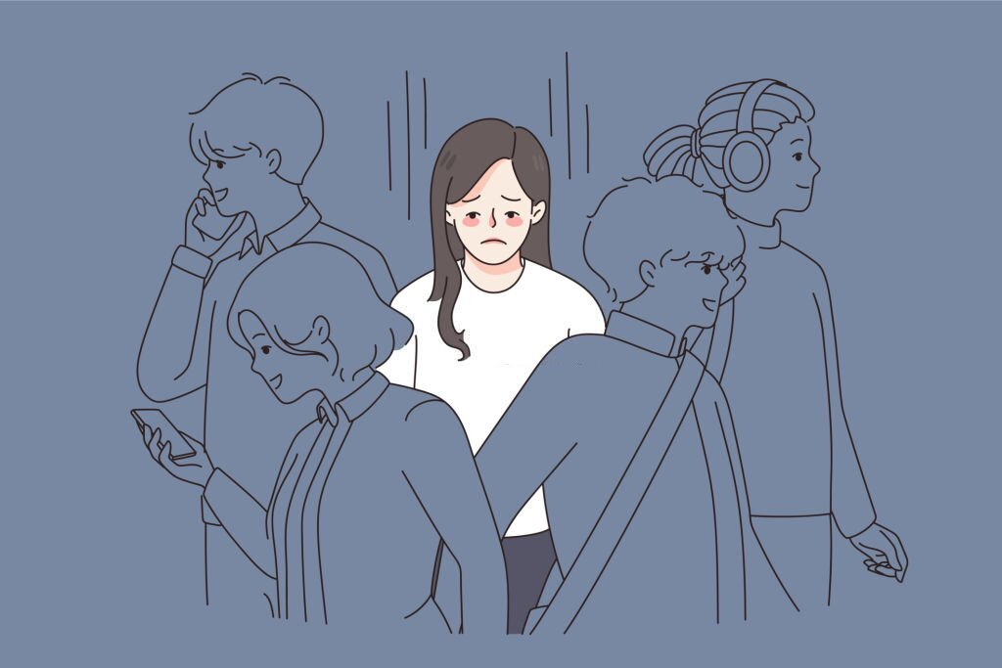
What is social anxiety?
Social anxiety is the fear of being judged or embarrassed in social situations, making it hard to interact with others.

Slide 3
Team Name: Natural Intelligence SocioFlo in solving Social Anxiety
Our bot helps avoid awkward silences by suggesting conversation topics based on what's being discussed.
It’s designed for in-person meetups to keep conversations flowing naturally without taking over.

Slide 4
Operation of “SocioFlo”
It’s getting quiet. Let’s use this bot for conversation topics!
Alex’s message
Here’s a topic: What’s your favorite childhood memory?
Chatbot’s message
Probably family road trips! What about you?
Learning to ride a bike—it was such a big moment!
Jack’s message
Alex’s message

