Slide 1
In Solving Social Anxiety
SocioFlo
Team Name: Natural Intelligence
Done by: Md Ahnaf Monwar, Syed Muhtasim Hamid, Kenzie MacIntyre, Can Sozuer, and Michaela Vietinghoff

Slide 2
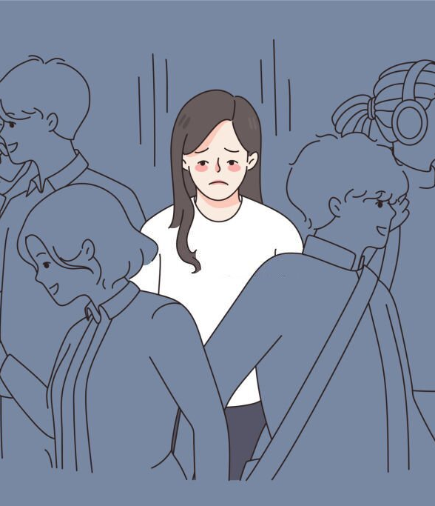
What is social anxiety?
Social anxiety is the fear of being judged or embarrassed in social situations, making it hard to interact with others.

Slide 3
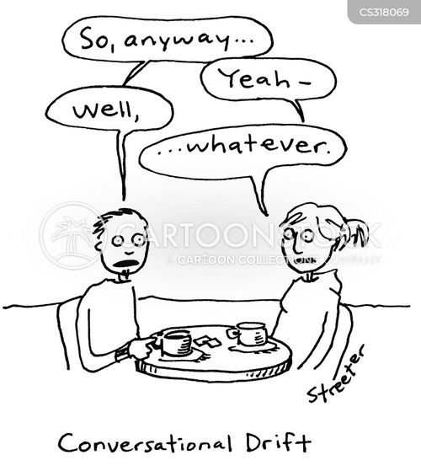
Purpose
Our bot helps avoid awkward silences by suggesting conversation topics based on what's being discussed.
It’s designed for in-person meetups to keep conversations flowing naturally without taking over.

Slide 4
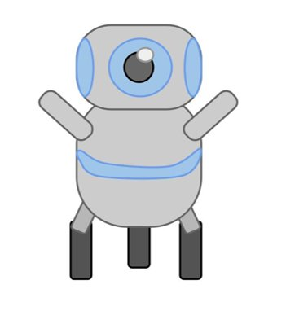
How it operates:
Alex: Learning to ride a bike—it was such a big moment!
A
B
…
…
SocioFlo: What’s your favorite childhood memory?

Slide 5
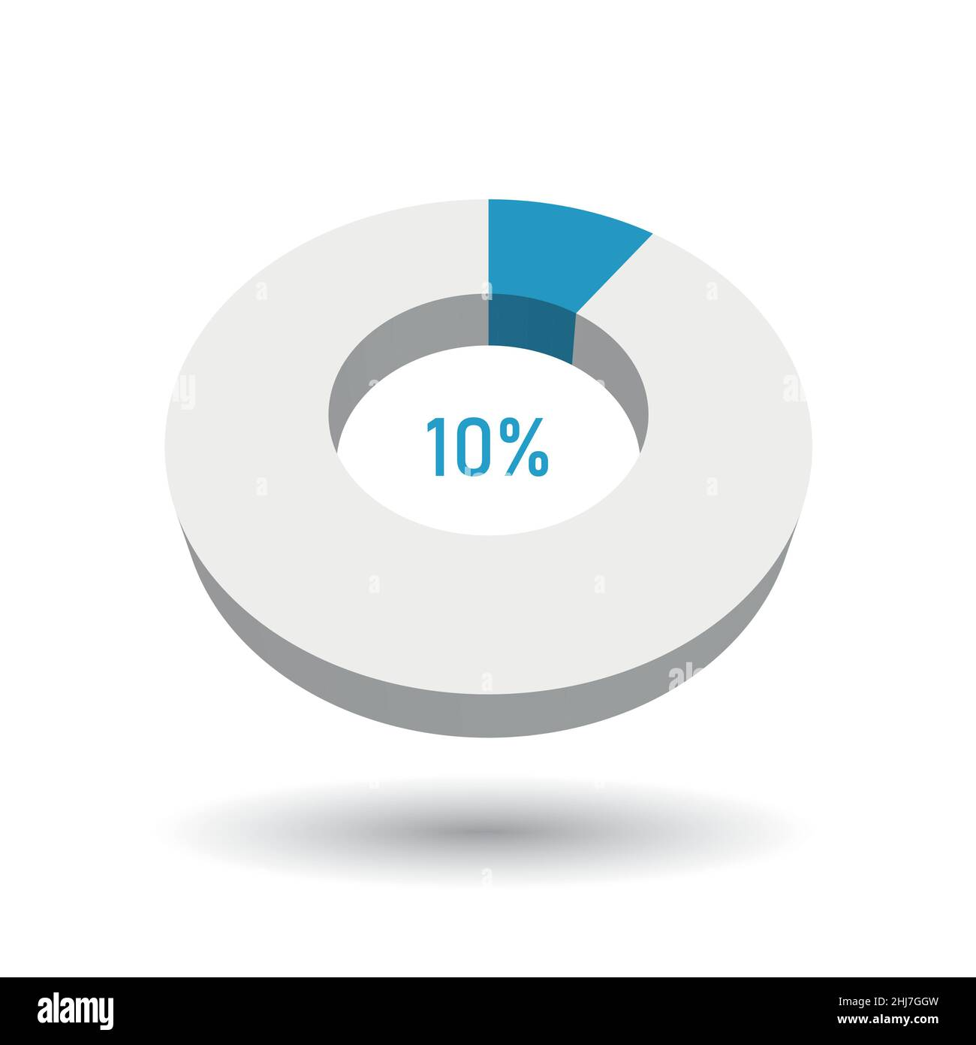

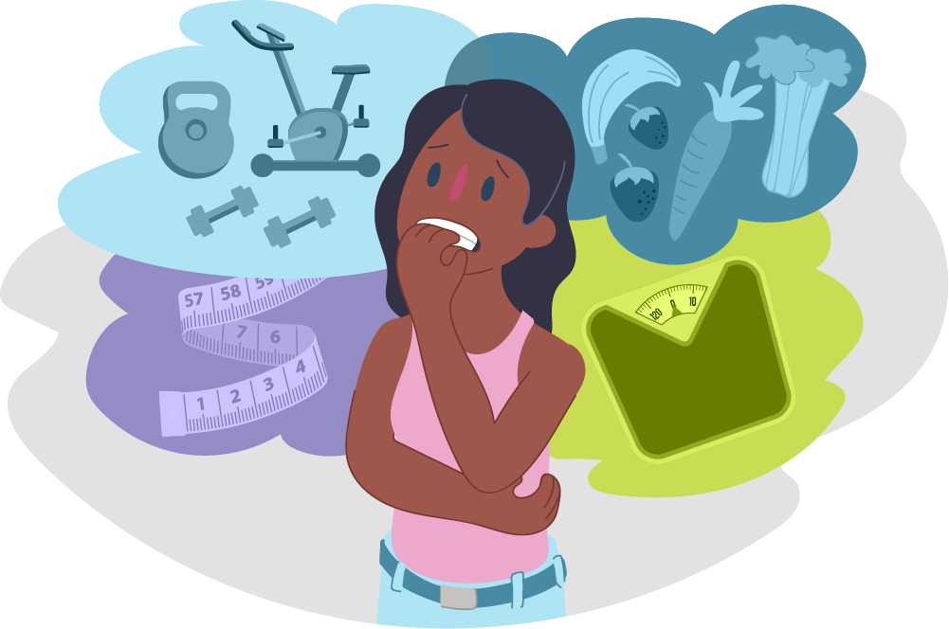
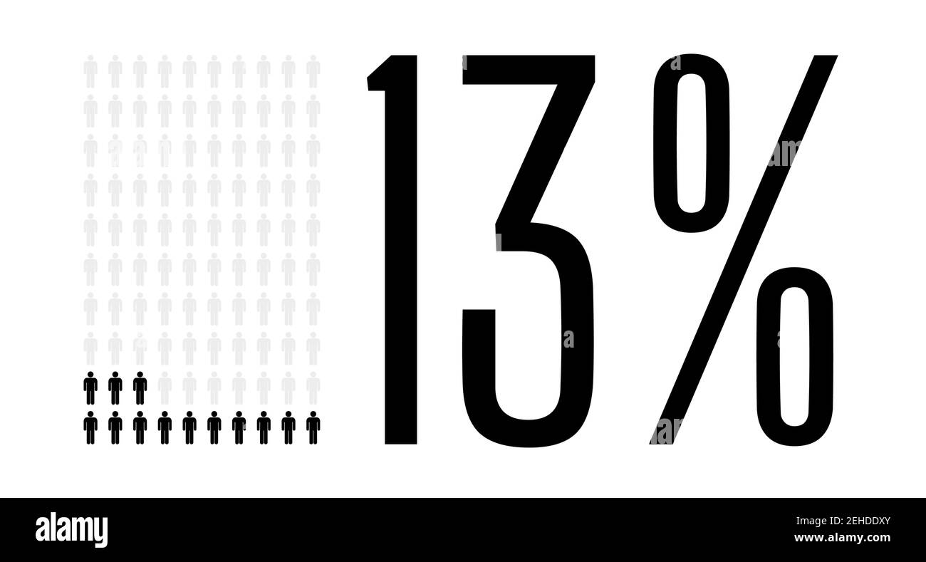
Demographics
7-13% of the population in Canada
5%-10% globally; 3rd most common mental health condition
Social anxiety is highly comorbid with eating disorders
Correlation of binge eating disorders with depression
Higher use of substances in adolescents

Slide 6
References
Lemyre, A., Gauthier-Légaré, A., & Bélanger, R. E. (2019). Shyness, social anxiety, social anxiety disorder, and substance use among normative adolescent populations: A systematic review. The American Journal of Drug and Alcohol Abuse, 45(3), 230–247. https://doi.org/10.1080/00952990.2018.1536882
Araujo, D. M. R., Santos, G. F. da S., & Nardi, A. E. (2010). Binge eating disorder and depression: A systematic review. The World Journal of Biological Psychiatry, 11(2_2), 199–207. https://doi.org/10.3109/15622970802563171
Levinson, C. A., & Rodebaugh, T. L. (2012). Social anxiety and eating disorder comorbidity: The role of negative social evaluation fears. Eating Behaviors : An International Journal, 13(1), 27–35. https://doi.org/10.1016/j.eatbeh.2011.11.006

Slide 7
Demo

Slide 8
Thank you!
Any questions?

Slide 9


Summary
Supports socialization
Allows for better conversation flow
AI generating ideas
Contributing to conversation but not controlling
We made a bot that gets conversations flowing after it stalls. The bot suggests topics that will give the participants something to talk about

