Slide 1
Overview
Part 1 - Deployment of ML Algorithms (ANN)
Part 2 - Deployment and Performance of ML Algorithms
ResNet
Binarized Neural Network
Part 3 - Training and Development of a Sine-Wave Model
Summary of Results
Case 1
Case 2
Case 3
Part 4 - Face Classification using CNNs
Task 1 Task 2 Task 3
Notes:
This presentation covers the following topics…

Slide 2
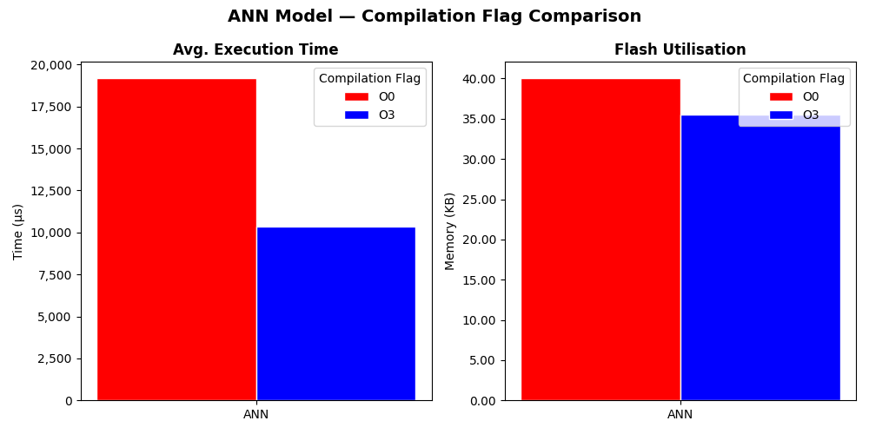
Part 1 - Deployment of ML Algorithms
Model | Compilation Flag | Av. Inference Time (μs) | Memory Utilisation (KB)
 |  |  | RAM | Flash
ANN | O0 | 19196 | 3.80 | 40.06
 | O3 | 10362 | 3.80 | 35.54
Execution time is measured using ticks which are found in the low-level hardware abstraction layer.
The number of runs used to obtain average is determined by max_run.
Double to static const double so that the variable is stored in flash rather than RAM.
Notes:
For Task 1: I implemented the getcurrentmicros() function as it uses ticks that are very low level and accurate, this also prevents overflow errors that I was getting with the method found in Lab 2.
The average inference time should be taken as each run can have slight differences due to changes to how the processer pipelines.
One optimisation I did was converting the test data from double to a static, so that this read only data can be held in flash. I did notice that changing some data types for variables did change the
Memory level optimisations are important as they techniques such as pruning does not take place, this could affect the output result and result in a less accurate model.

Slide 3
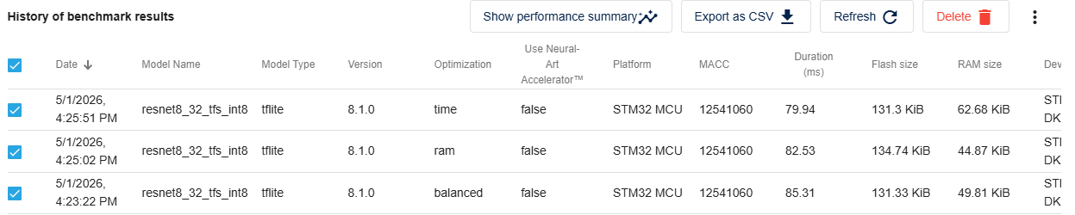
Part 2 - Deployment and Performance of ML Algorithms
ResNet
Model | Processor | Optimisation | Inference Time (μs) | Memory Utilisation (KB) |  | Accuracy (%)
 |  |  |  | RAM | Flash
ST Edge AI Model Zoo | M33 (STM32H573i-DK @ 250 MHz) | N/A | 85310 | 51.01 | 134.48 | 87.01
 |  | Time | 79940 | 64.18 | 134.45 | 87.01
 | M7 | N/A | 52884 | 67.88 | 242.28 | N/A
 |  | Time | 52884 | 67.88 | 242.28 | N/A
RAM usage was increased so that the inference time could decrease.

Slide 4
Part 2 - Deployment and Performance of ML Algorithms
Binarized Neural Network
Model | Processor | Optimisation | Inference Time (μs) | Memory Utilisation (KB) |  | Accuracy (%)
 |  |  |  | RAM | Flash
BNN on Cifar-10 | M33 (STM32H573i-DK @ 250 MHz) | N/A | 314900 | 149.97 | 556.89 | 100
 |  | Time | 314900 | 149.97 | 556.89 | 100
 | M7 | N/A | 255818 | 151.77 | 725.84 | N/A
 |  | Time | 255895 | 151.77 | 722.23 | N/A

Slide 5
Part 3 - Training and Development of a Sine-Wave Model
Summary of Results
Deployment | Processor | Optimisation | Av. Inference Time (μs) | Memory Utilisation (KB) |  | Evaluation Metrics
 |  |  |  | RAM | Flash
 |  |  |  |  |  | MAE | MSE | RMSE
Case 1: CubeIDE | M7 | N/A | 234 | 20.48 | 107.59 | 0.0562 | 0.0043 | 0.0659
Case 2: CubeAI | M7 | N/A | 89 | 8.14 | 48.16 | 0.0266 | 0.0012 | 0.0347
Case 3: ST Edge AI | M7 | Time | 85 | 12.04 | 55.08 | 0.0562 | 0.0043 | 0.0659
CubeAI was 62.00% faster then the baseline
ST Edge AI was 63.70% faster then the baseline.
4.60% reduction in inference time between ST Edge AI and CubeAI
Notes:
This slide just summarises all the results obtained in part 3, as you can see both CubeAI and ST Edge AI far outperformed the

Slide 6
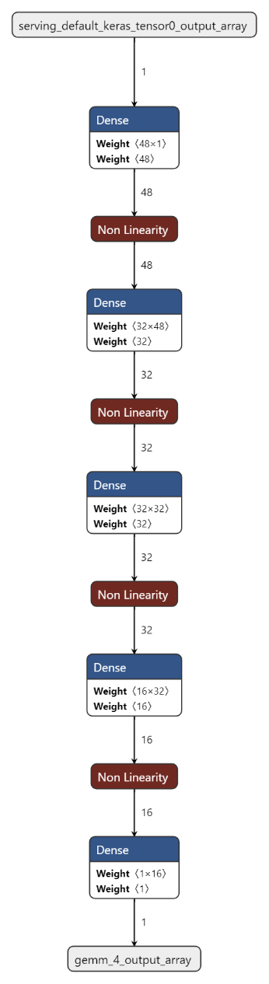
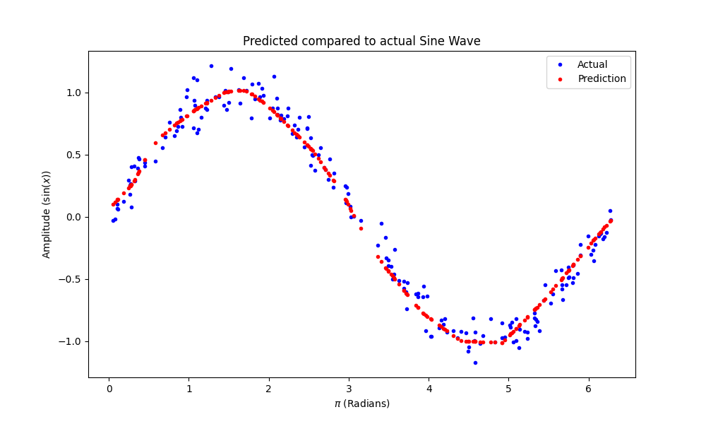
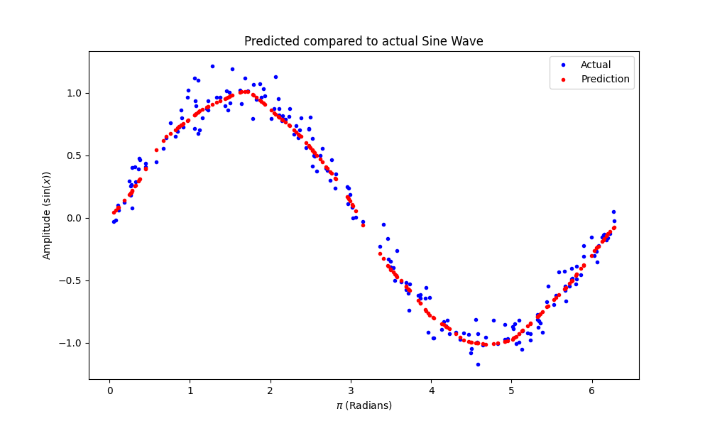
Part 3 - Training and Development of a Sine-Wave Model
Case 1
Total trainable parameters: 1393
Total trainable parameters: 3265
Deployment | Processor | Optimisation | Av. Inference Time (μs) | Memory Utilisation (KB) |  | Evaluation Metrics
 |  |  |  | RAM | Flash
 |  |  |  |  |  | MAE | MSE | RMSE
Case 1: CubeIDE | M7 | N/A | 234 | 20.48 | 107.59 | 0.0562 | 0.0043 | 0.0659
Notes:
For case 1 the model was developed on pycharm using python 3.12.
With guidence from the website provided in the coursework brief, I was able to train a model with about 850 trainable parameters
I noticed that the model could have been improved even further by increasing the number of neurons in each layer.
The two graphs show how increasing the trainable parameters impacted the output graph of the trained model.
The model architecture is shown here.
The table indicated the inference time and memory utilsation was the highest of all three cases, this is understanable as the C code is not optimised by the runtime libraries like in case 2 and 3, these tools are added onto runtime

Slide 7
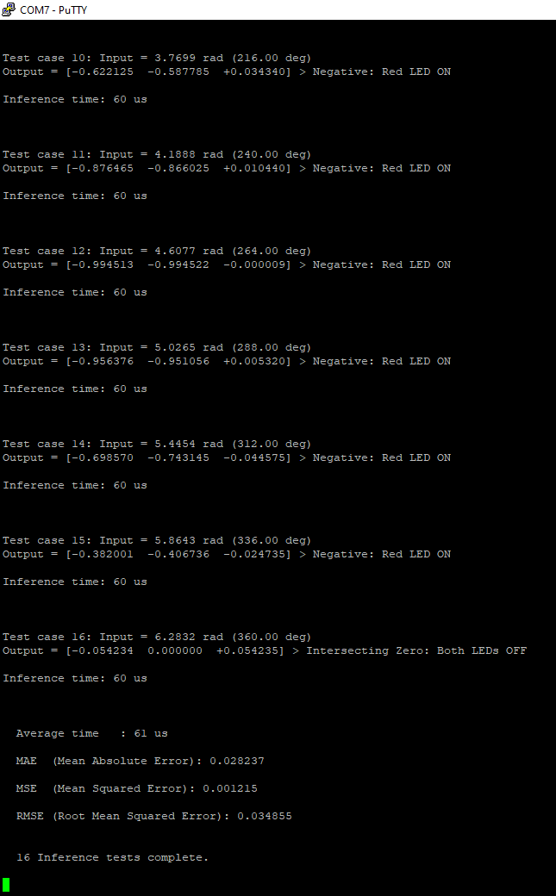
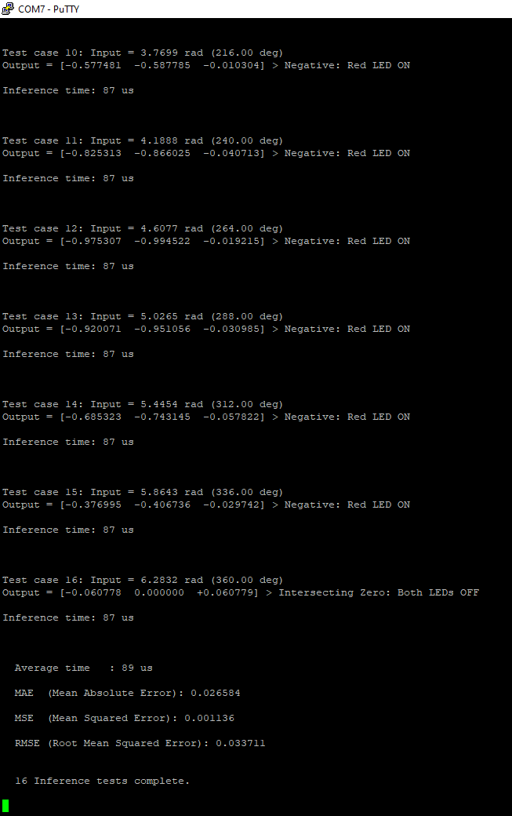
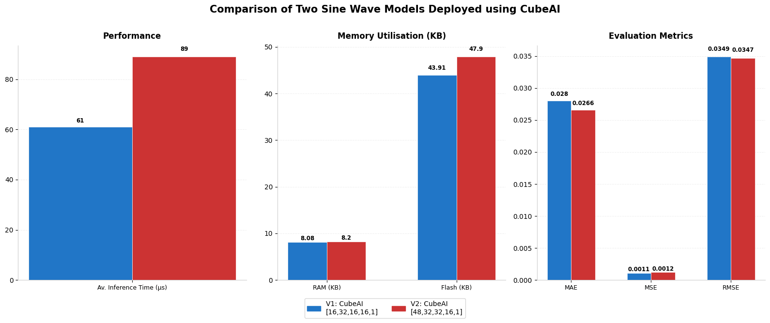
Part 3 - Training and Development of a Sine-Wave Model
Case 2
Deployment | Processor | Compiler Flag | Av. Inference Time (μs) | Memory Utilisation (KB) |  | Evaluation Metrics
 |  |  |  | RAM | Flash
 |  |  |  |  |  | MAE | MSE | RMSE
V1: CubeAI [16,32,16,16,1] | M7 | O3 | 61 | 8.08 | 43.91 | 0.028 | 0.0011 | 0.0349
V2: CubeAI [48,32,32,16,1] | M7 | O3 | 89 | 8.2 | 47.90 | 0.0266 | 0.0012 | 0.0347
V1
V2

Slide 8
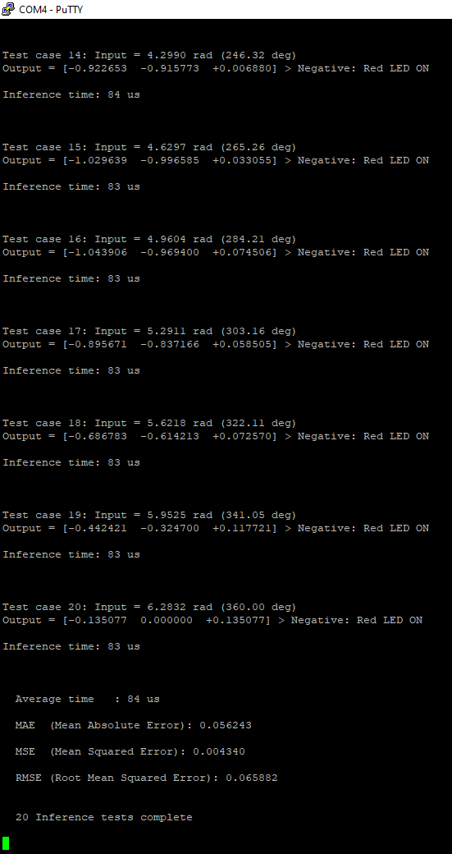
Part 3 - Training and Development of a Sine-Wave Model
Case 3
Deployment | Processor | Optimisation | Av. Inference Time (μs) | Memory Utilisation (KB) |  | Evaluation Metrics
 |  |  |  | RAM | Flash
 |  |  |  |  |  | MAE | MSE | RMSE
Case 3: ST Edge AI | M7 | Time | 84 | 12.04 | 55.08 | 0.0562 | 0.0043 | 0.0659
63.70% faster then the CubeIDE baseline.
More optimised C code.
Reduction in memory size suggested better memory layout.

Slide 9
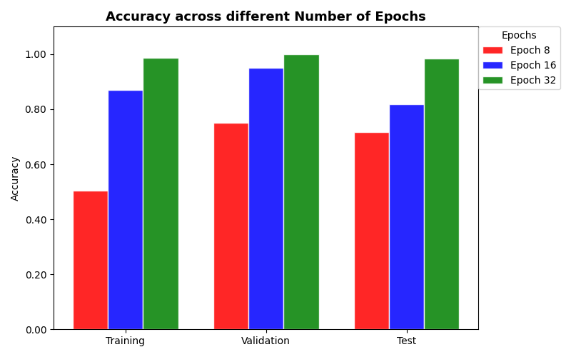
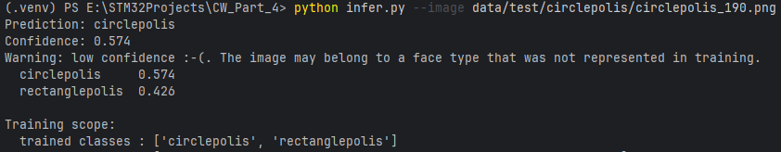
Part 4 - Face Classification using CNNs
Task 1
At 8 epochs low confidence predictions were still being made.
Low confidence predictions suggested a lack of training.
More epochs means more complete passes through the training dataset
Notes:
Task 1: - At the default epoch of 8, I noticed that the accuracy was low, leading to less confident inference model predictions. This meant the model was potentially underfitting.
- To combat this, I increased the number of epochs, the trade-off of doing this is the time it takes to train, however it means a more confident prediction on unseen data.
- I found the best results for two classes was between 16 and 32 epochs, any more would add unnecessary training time for a model that was already making reasonably accurate predictions.

Slide 10
Part 4 - Face Classification using CNNs
Test Image | Predicted Class | Accuracy | Was the correct prediction made?
circlepolis_190 | Circlepolis | 0.999 | Y
ovalopolis_185 | Ovalopolis | 0.986 | N
rectanglepolis_176 | Rectanglepolis | 0.997 | Y
trianglepolis_170 | Trianglepolis | 0.870 | N
Task 2
Model Type | Classes | Accuracy
 |  | Number of Epochs
 |  | 32 | 64
Two Class | Circlepolis | 0.900 | 0.933
 | Rectanglepolis | 0.986 | 0.900
Four Class | Circlepolis | 1.000 | 0.933
 | Ovalopolis | N/A | N/A
 | Rectanglepolis | 0.967 | 0.900
 | Trianglepolis | N/A | N/A
Unseen classes are misclassified.
Model uncertainty shows it has not just memorised the training data (overfitting).
Notes:
Task 2:
When testing images from the two classes that had not been implemented the accuracy of predictions remained high, however the test images of ovals and triangles were being mis-classified.
I ran a single image inference test on four classes to help with improving performance.
It showed that the model was still
I tested the new best.pt file with all four images and found that the circle, rectangle and triangle were correctly classified using 32 epochs. However, the oval was still being misclassified as a circle.
Therefore, I increased the epochs to 64 and found that all classes were being correctly classified.

Slide 11


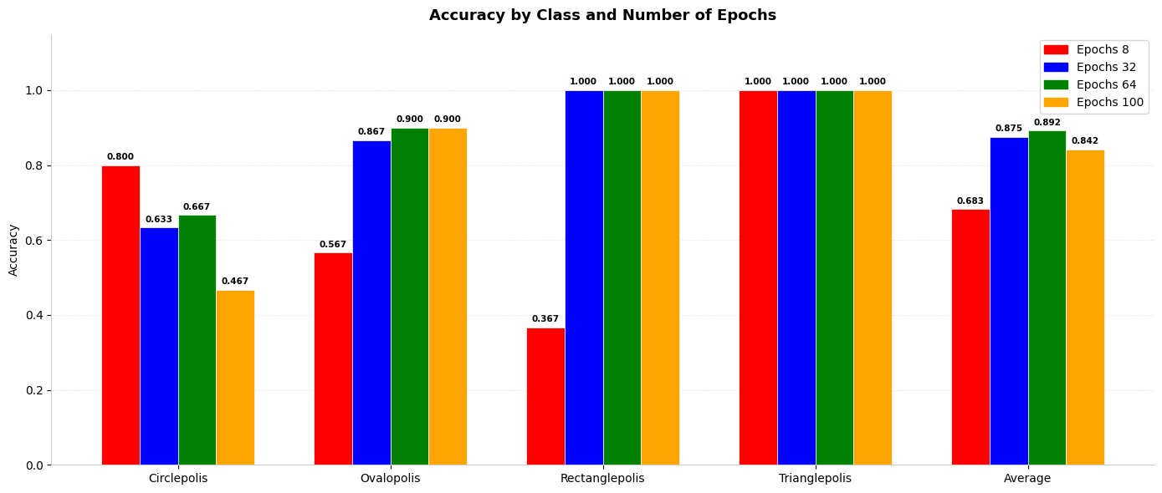
Part 4 - Face Classification using CNNs
Oval
Circle
Task 3
Class | Accuracy based on epochs |  | Was the correct prediction made on 32 epochs?
 | 32 | 64
Circlepolis | 0.991 | 0.973 | Y
Ovalopolis | 0.613 | 0.870 | N
Rectanglepolis | 0.997 | 1.000 | Y
Trianglepolis | 1.000 | 1.000 | Y
Notes:
I then retrained the model using all four classes as part of the training dataset.
For the sake of comparision I tested this four class model on 8, 32, 64 and 100 epochs.
The bar graph shows the confidence of predictions for each class for each epoch and shows the average confidence at each number of runs.

Slide 12
Thanks for listening!
F330590 | Karthekeyan Ganesh | 25WSC334
Notes:
This presentation covers the following topics…

