Slide 1
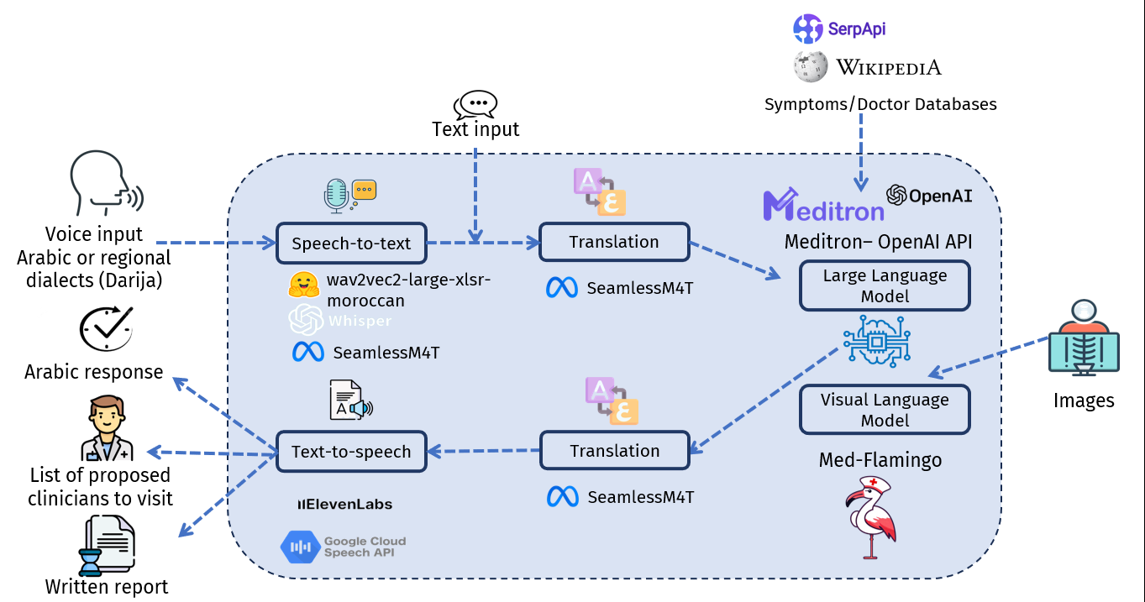
SehhaTech Solution Overview

Slide 2
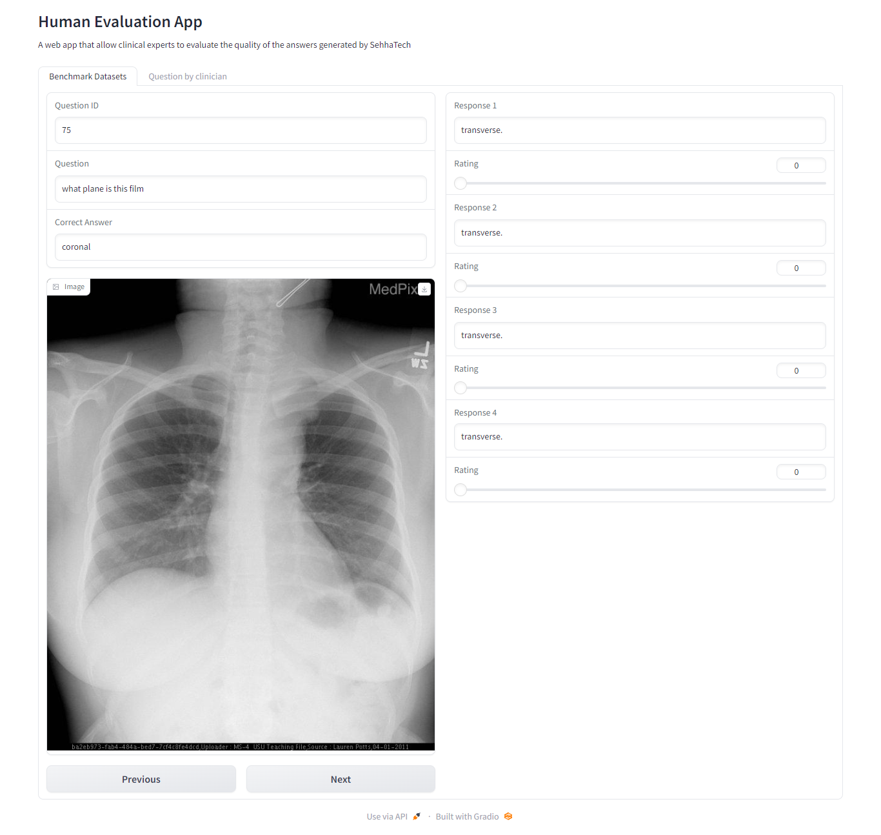
Human Evaluation App - Benchmark Dataset

Slide 3
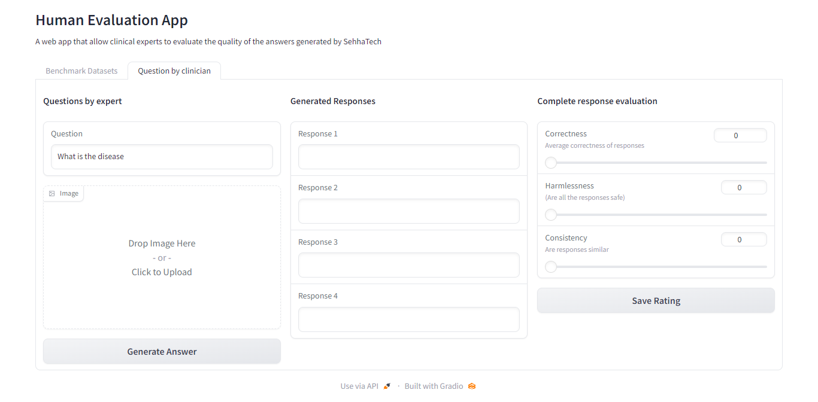
Human Evaluation App - Clinician Questions

