Slide 1
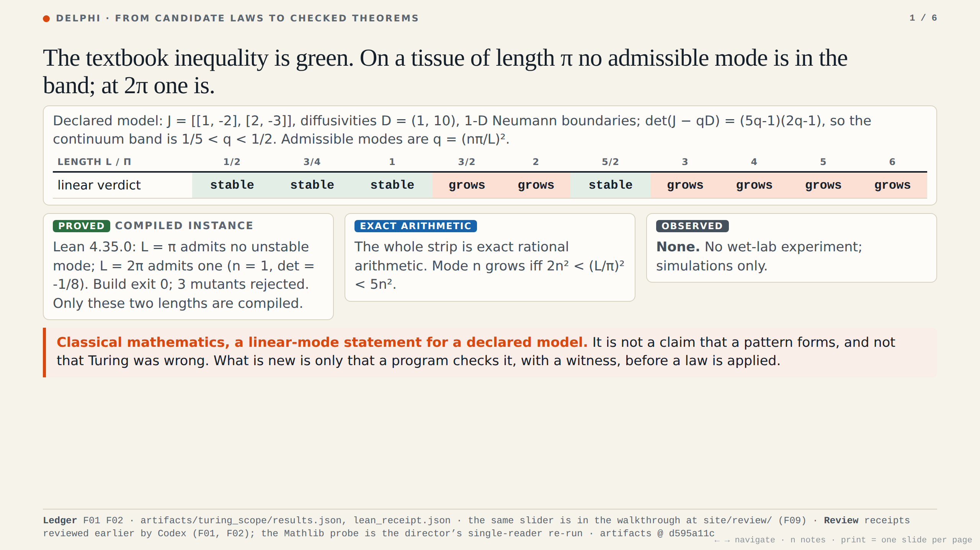
Notes:
The textbook inequality is green. On a tissue of length pi, no admissible mode is in the band; at two pi, one is. This is a linear statement for a declared model, classical mathematics. What is new is only that a program checks it, with a witness, before a law is applied. No wet-lab experiment; simulations only.

Slide 2
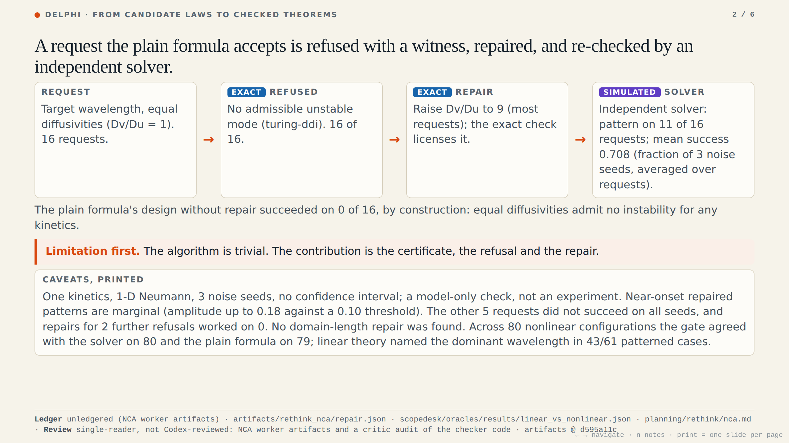
Notes:
Limitation first: the algorithm is trivial. The contribution is the certificate, the refusal and the repair. Sixteen requests with equal diffusivities, which the plain formula accepts, are refused with a witness. The exact check licenses a repair, raising the ratio to nine. An independent solver then finds a pattern on eleven of sixteen, mean 0.708. One kinetics, three seeds, near-onset and marginal. A model check, not an experiment.

Slide 3
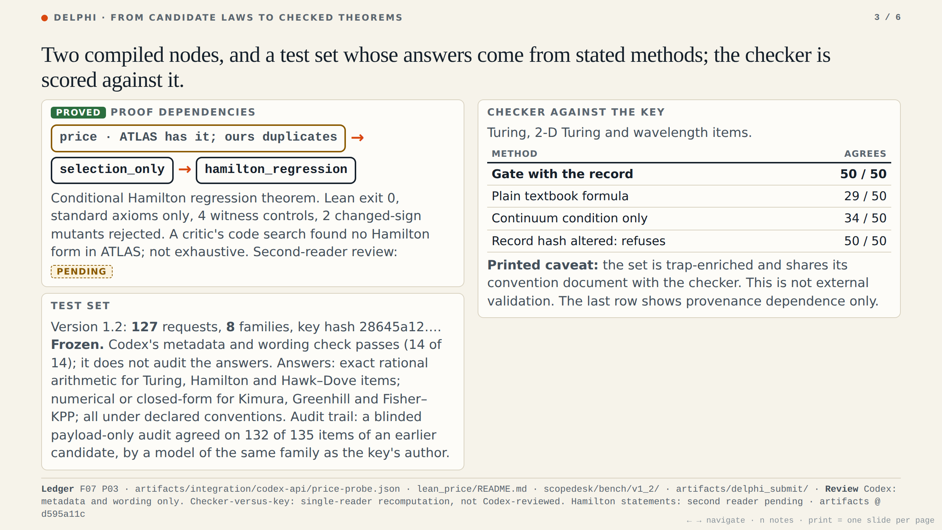
Notes:
The Price identity is already in ATLAS, so ours is a duplicate. We add a compiled conditional Hamilton regression theorem with witnesses. The test set is frozen: one hundred twenty-seven requests, answers from stated methods under declared conventions. On the fifty Turing and wavelength items the gate agrees with the key on all fifty, the plain formula on twenty-nine. Our own conventions: not external validation.

Slide 4
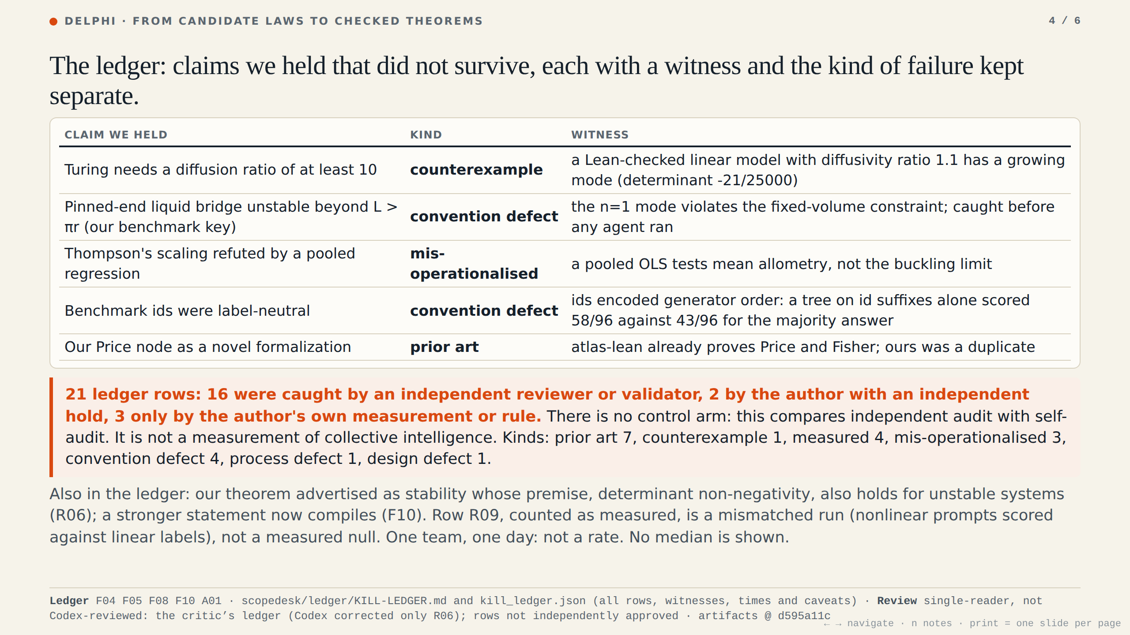
Notes:
The ledger. Five claims we held that did not survive, each with a witness: a diffusion threshold of ten, false at ratio one point one; our liquid bridge key; a regression that tested a different question; ids that leaked labels; our Price node, already in ATLAS. Sixteen of twenty-one rows were caught by an independent reviewer or validator, two with a hold, three only by the author. No control arm: not collective intelligence.

Slide 5
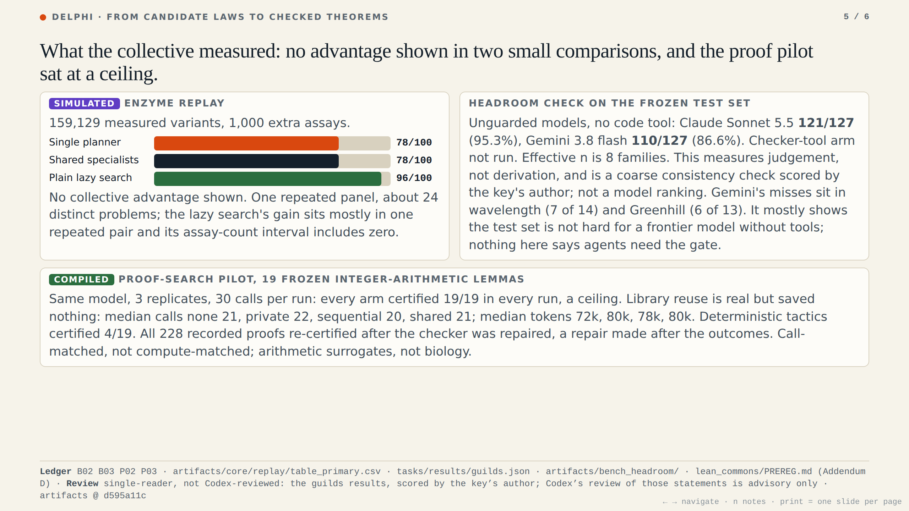
Notes:
What the collective measured. Shared specialists equal a single planner, seventy-eight of a hundred each; a lazy search reaches ninety-six, mostly one pair. No advantage shown in two small comparisons. Unguarded models without a code tool score one hundred twenty-one and one hundred ten of one hundred twenty-seven; the checker arm was not run. The proof pilot sat at a ceiling.

Slide 6
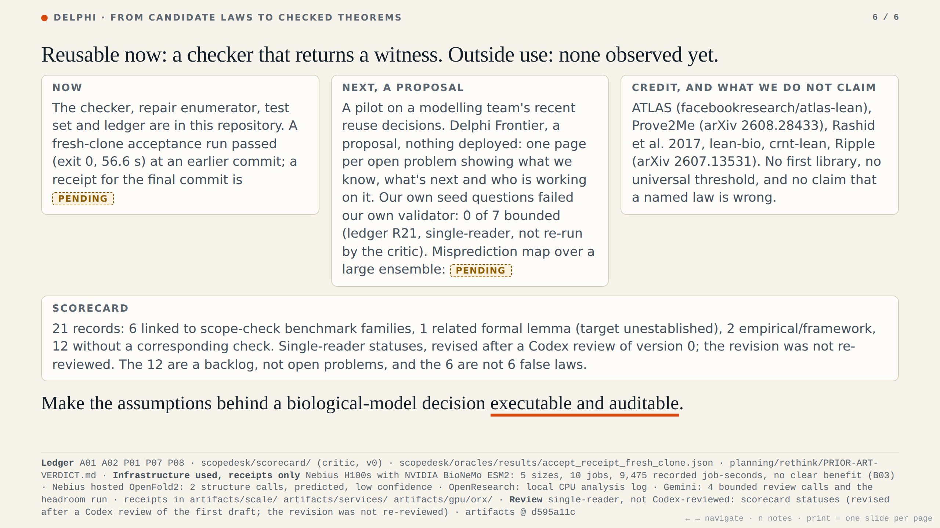
Notes:
Reusable now: a checker that returns a witness. Outside use: none observed yet. Next, a proposal: a pilot on a modelling team's reuse decisions, and Delphi Frontier; our own seed questions failed our own validator, zero of seven bounded. Scorecard: twenty-one records, six linked to benchmark families, one related lemma, two empirical, twelve without a check; single reader. Credit ATLAS and Prove2Me. Make the assumptions executable and auditable.

