Slide 1

Simulating an evolving population using a clonal version of the Wright-Fisher model
M2 BIM - GPOP
Presented by:
Ekaterina Gaydukova
Supervised by:
Prof. Martin Weigt
6 December 2023

Slide 2
Genetic drift
Genetic drift is the change in the frequency of an existing gene variant (allele) in a population due to random chance.
For the simulation, we will use:
Finite population of N haploid individual
Allele A (frequency p)
Allele B (frequency q)
No selection
No mutation

Slide 3
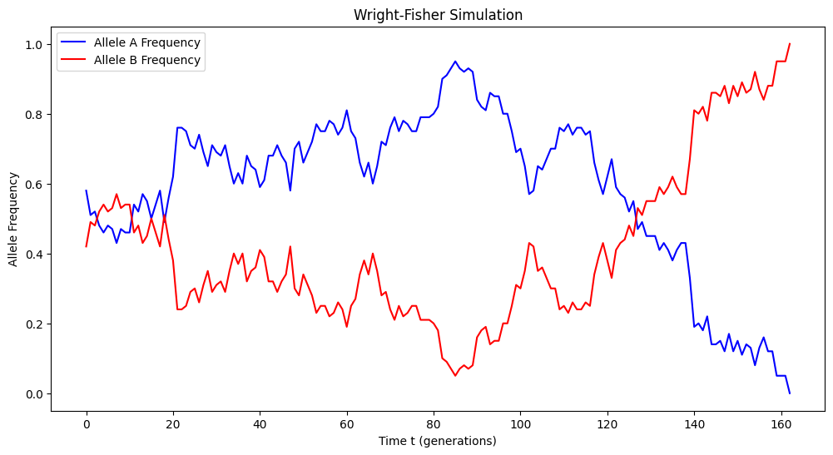
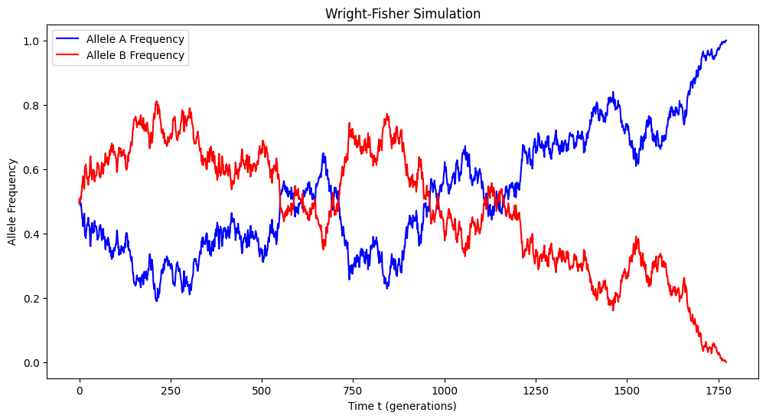
Genetic drift
Allele frequencies over time for the population of 100 individuals
Allele frequencies over time for the population of 1000 individuals

Slide 4
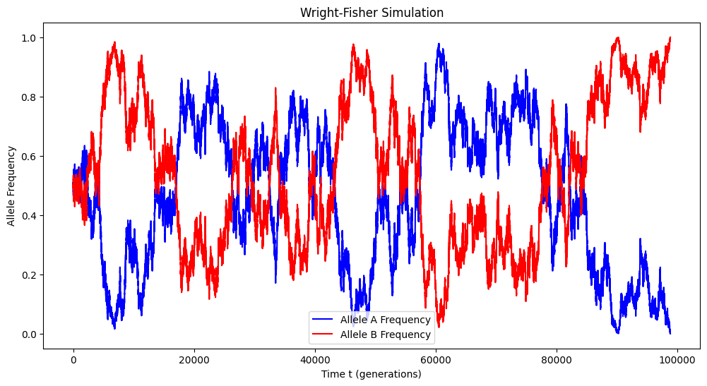
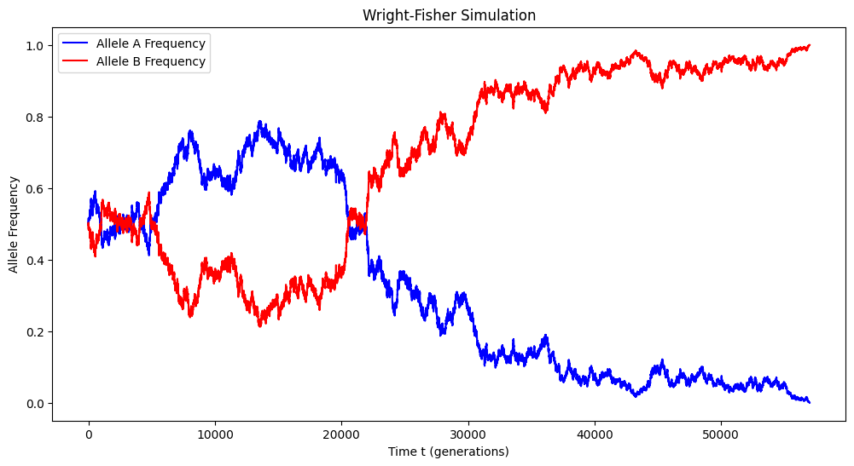
Genetic drift
Allele frequencies over time for the population of 10000 individuals
Allele frequencies over time for the population of 50000 individuals

Slide 5
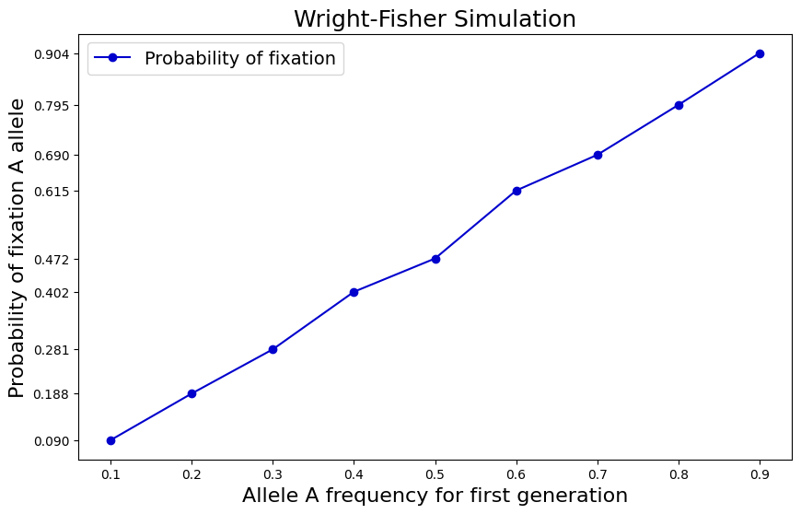
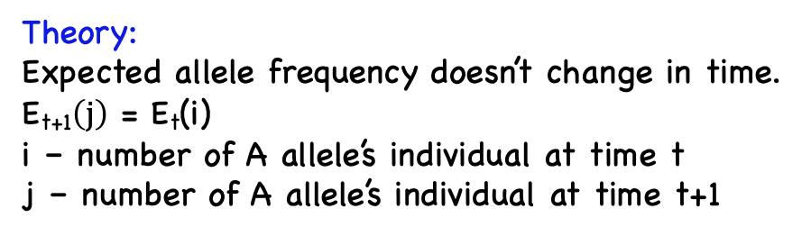
Genetic drift
Theory:
Expected allele frequency doesn’t change in time.
E_{t+1}$\left(j\right)$ = E_{t}(i)
i – number of A allele’s individual at time t
j – number of A allele’s individual at time t+1
Simulations:
One of the alleles (A or B) will be fixed in time.
Probability (population fixes allele A) ≈
frequency of allele A at time t = 0
Fixation probability of allele A in dependence of p
1000 simulations for each value of p
Population size = 1000 individuals

Slide 6
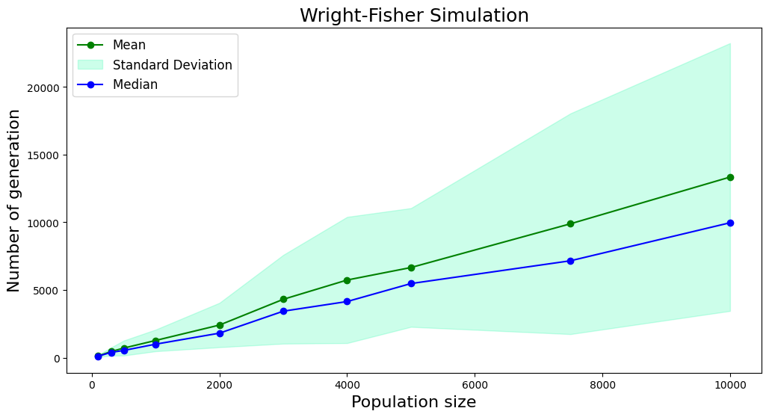
Genetic drift
Number of generation before fixation ≈
Size of population
Number of generations before fixation in dependency of population size
1000 simulations for each value of N
Initial frequency for each allele = 0.5

Slide 7
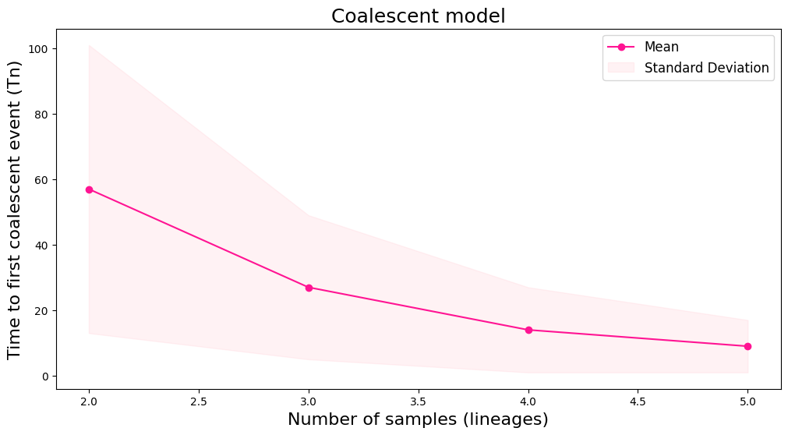
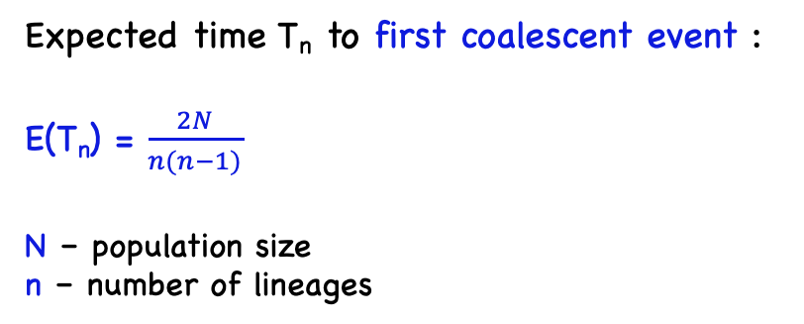
Coalescent model
Expected time T_{n} to first coalescent event :
E(T_{n}) = $\frac{2N}{n(n−1)}$
N – population size
n – number of lineages
 | Expected Tn, generations | Simulated Tn, generations
n=2 | 100 | 57
n=3 | 33 | 25
n=4 | 17 | 14
n=5 | 10 | 9
1000 simulations for 100 haploid individuals for each number of samples
n = [2, 3, 4, 5]

Slide 8
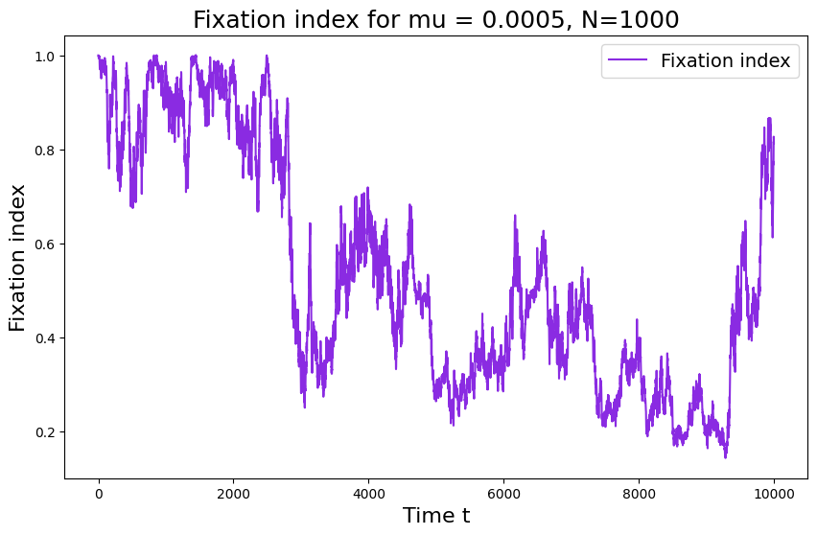
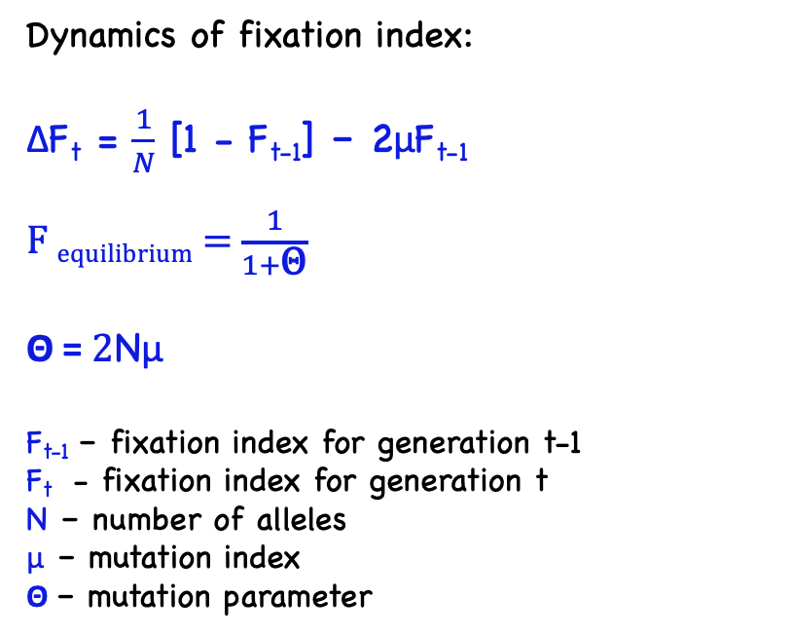
Mutations in the infinite-allele model
Dynamics of fixation index:
ΔF_{t} = $\frac{1}{N}$ [1 - F_{t-1}] – 2μF_{t-1}
F _{equilibrium} = $\frac{1}{1+\text{Θ}}$
Θ = $2\text{N}\text{μ}$
F_{t-1} – fixation index for generation t-1
F_{t} - fixation index for generation t
N – number of alleles
μ – mutation index
Θ – mutation parameter
Θ = 1
F _{equilibrium} = 0.5 (but not static)
Expected number of de novo mutations/generation = $\text{N}\text{μ}$

Slide 9
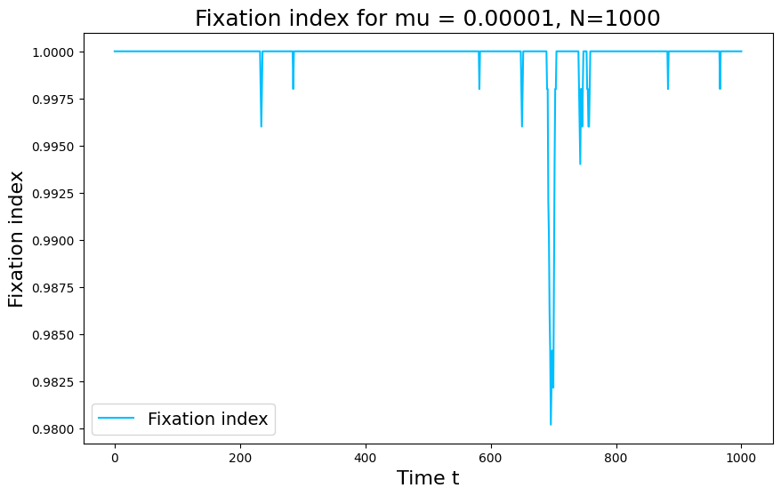
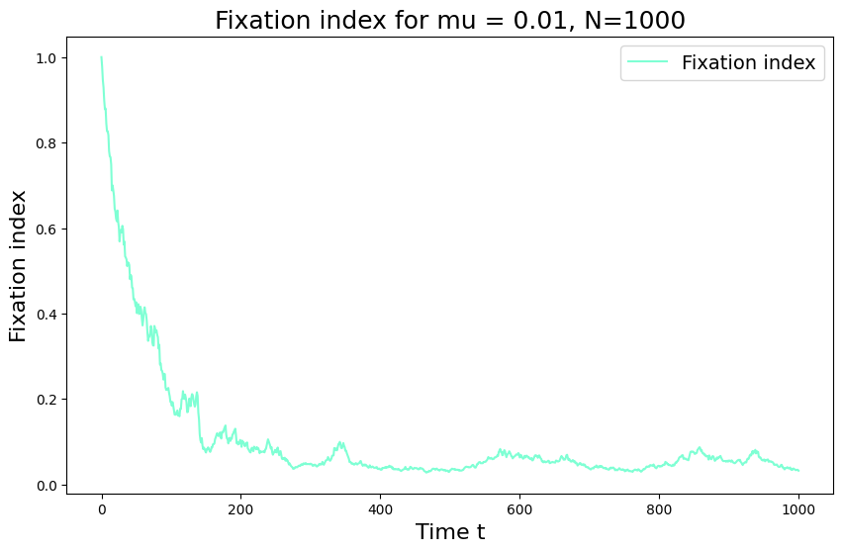
Mutations in the infinite-allele model
Θ = 0.02 << 1
Low mutation rate
F _{equilibrium} ≈ 1
Θ = 200 >> 1
High mutation rate
F _{equilibrium} ≈ 0.004

Slide 10
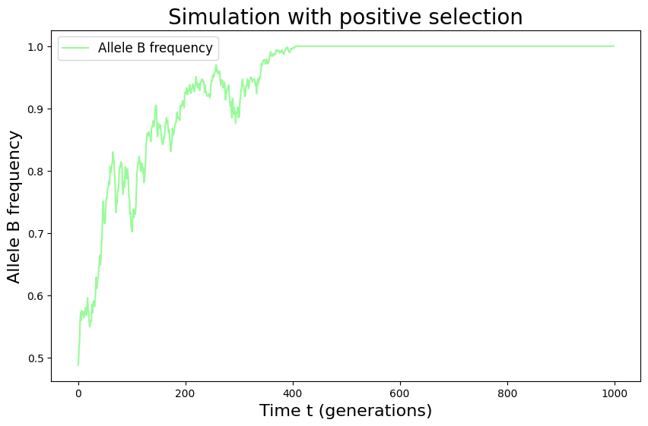
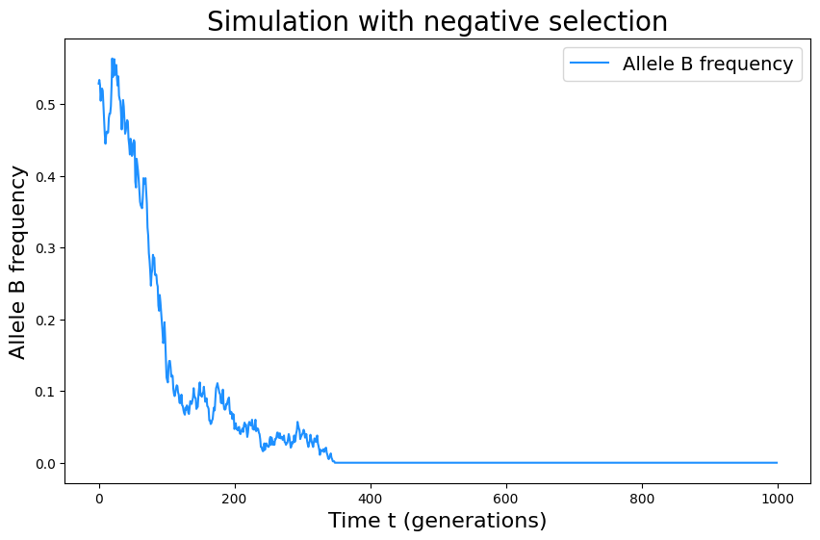
Selection
S = +0.01 (positive)
Allele A fitness = 1
Allele B fitness = 1 + S
S = -0.01 (negative)
Allele A fitness = 1
Allele B fitness = 1 + S

Slide 11
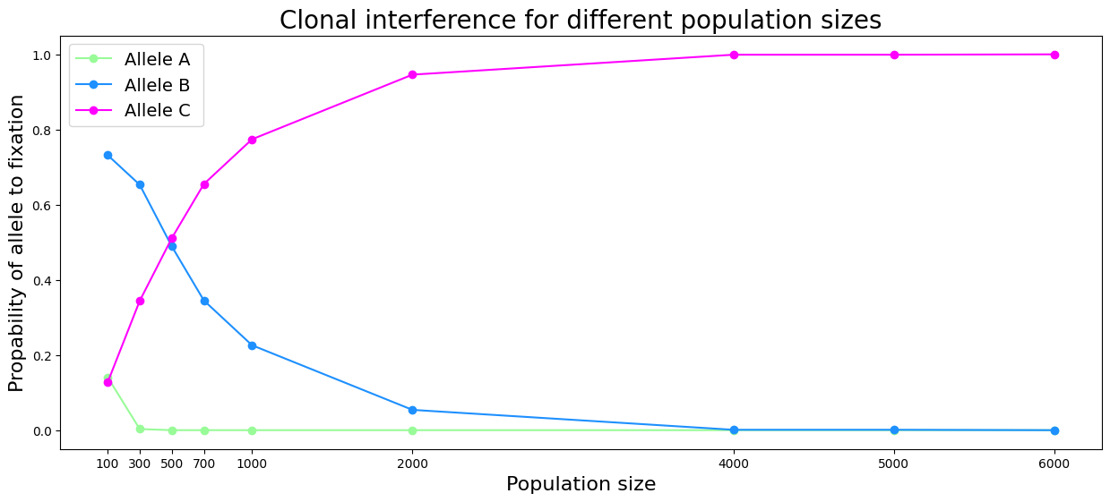
Clonal Interference
Allele A :
p(A) = 0.79,
fitness = 1
Allele B :
p(B) = 0.2, fitness = 1.05
Allele C :
p(C) = 0.01,
fitness = 1.1

Slide 12
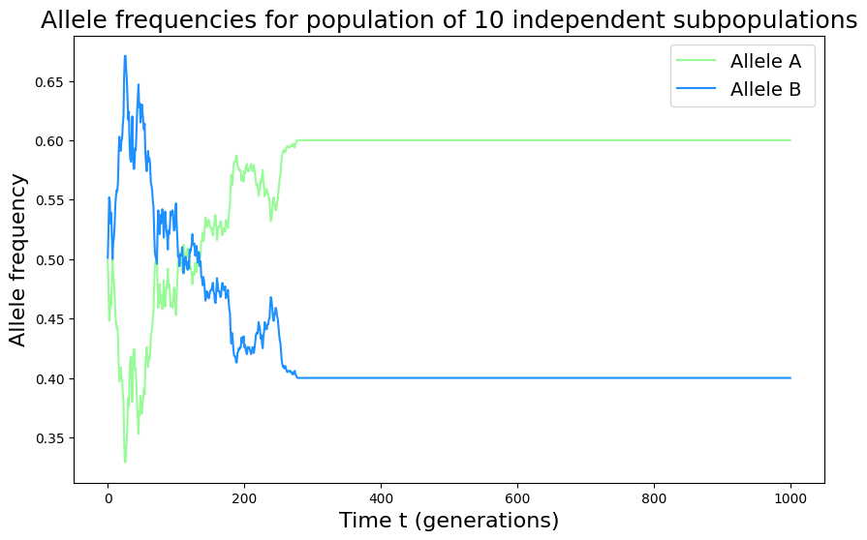
Population structure
1 population ->
10 independent sub-populations
with the same number of individuals
No selection
No mutation
No migration
T = 1000 generations
Population size = 1000 individuals
Sub-population size = 100 individuals
Initial frequency = 0.5 for both alleles A and B

Slide 13
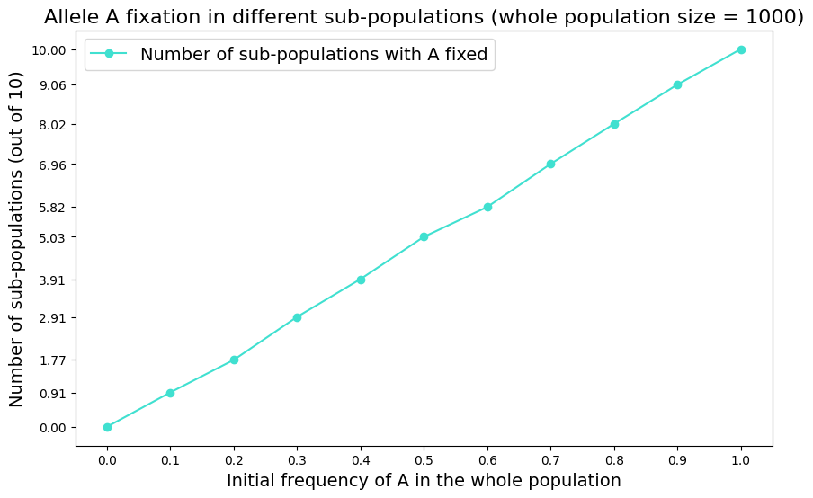
Population structure
1 population ->
10 independent sub-populations
with the same number of individuals
No selection
No mutation
No migration
Number of sub-populations with fixed A allele ≈
10 * frequency of allele A at time t = 0
Population size = 1000 individuals
Sub-population size = 100 individuals

Slide 14
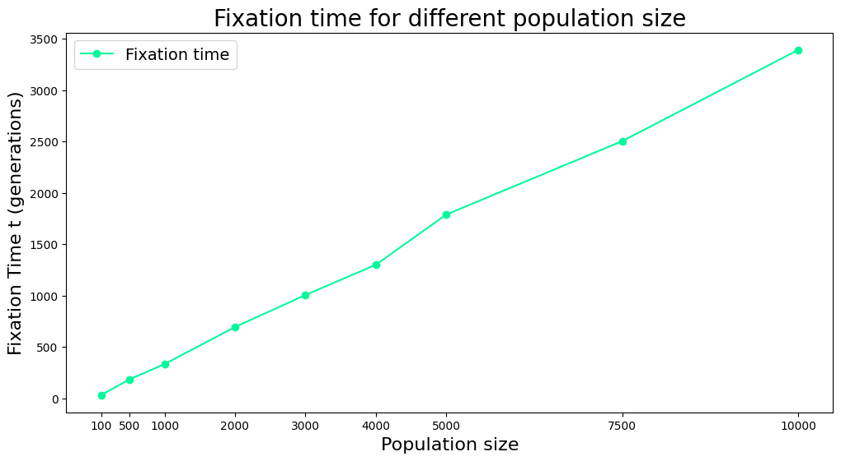
Population structure
Example:
Population = 10000 individuals
Sub-population = 1000 individuals
Time to fixation = 3392 ± 1327 generations
Comparing to Task 1 without splits:
Time to fixation = 13344 ± 9898 generations
for population of 10000 individuals
Number of generations to fixation in each subpopulation in relation to the size of the whole population

Slide 15
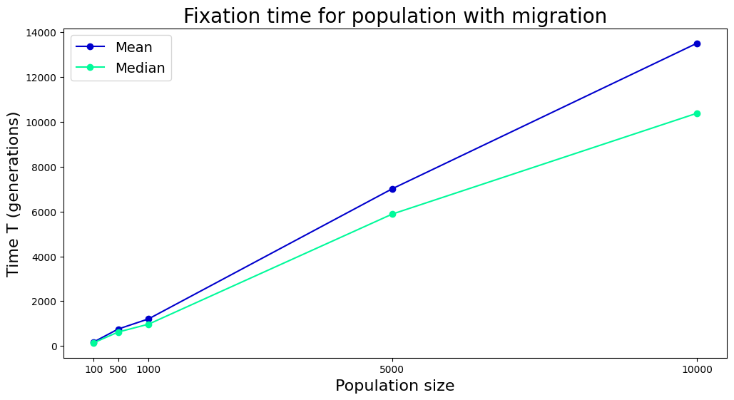
Migration
1 population ->
10 independent sub-populations
with the same number of individuals
Migration rate m = 0.1
Population sizes = [100, 500, 1000, 5000, 10000]
Initial frequency = 0.5 for both alleles A and B

Slide 16
Thank you for your attention!

