Slide 1


From paper registers to one smart pool system
Digital registration, pass, invoice, attendance and accounts — built for swimming pools.
One login · One record · Better control
Presentation for swimming pool owners and operators

Slide 2
The current paper-based reality
02
The same information is written repeatedly, but visibility remains low.
F
Registration form
R
Physical register
B
Bill book
Details stay in files; searching takes time.
Manual gate entry and attendance marking.
Duplicate writing, carbon copies and month-end totals.
P
Printed pass
₹
Expense register
!
Scattered records
Can be lost, forgotten, copied or used after expiry.
Profit is known only after manual calculation.
Owner depends on staff and multiple notebooks.
The result: more writing, slower service, payment disputes and no real-time view of the pool.
SwimIT · Swimming Pool Management System
2

Slide 3
Paper process → SwimIT
03
A direct replacement for the registers pools already use.
Paper registration form
→
Digital registration form with photo, contact and batch
Swimmer register
→
Searchable Active / Inactive swimmer list
Bill book
→
Payment record and tax-inclusive invoice
Printed pass
→
Digital QR pass sent on WhatsApp
Gate attendance register
→
Pass scanner and automatic attendance
Expense notebook
→
Pool Expenses and Balance Sheet
SwimIT · Swimming Pool Management System
3

Slide 4
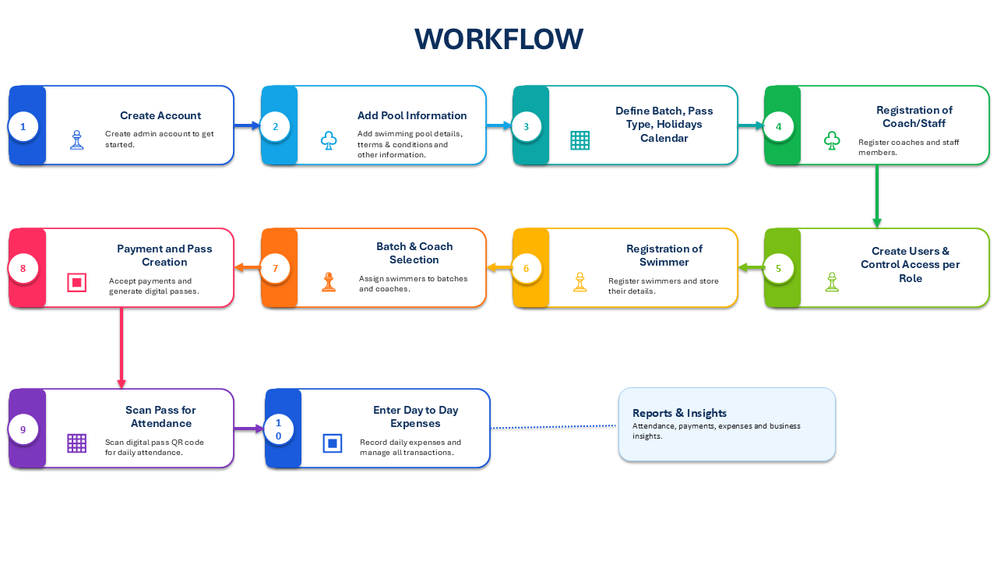
One connected workflow
04
Information is entered once and reused across every operation.
Register → Take payment → Send pass & invoice → Scan at gate → Review attendance and accounts
SwimIT · Swimming Pool Management System
4

Slide 5
What the pool owner gains
05
Control the operation without waiting for registers to be totalled.
1
Daily visibility
2
Less revenue leakage
Active swimmers, attendance, expiring passes and payment totals.
Expired or unpaid passes are visible before entry.
3
Financial control
4
Accountability
Pass income, expenses and coach payouts in one view.
Separate staff logins, page access and activity history.
5
Professional image
6
Scalable operation
Pool branding on digital pass and invoice.
Growth adds records — not more books and manual totals.
SwimIT · Swimming Pool Management System
5

Slide 6
Faster work for desk, gate and coaches
06
Every role gets the information needed for the task.
FRONT DESK
GATE STAFF
COACH / MANAGER
• Register once
• Cash or UPI payment
• Issue / resend pass and invoice
• Search by name or mobile
• Scan QR / ID
• Confirm pass validity
• Optional photo check
• Attendance updates automatically
• Batch and swimmer lists
• Monthly attendance
• Coach payment summary
• Operational reports
Less writing · Fewer errors · Shorter queues · Clear responsibility
SwimIT · Swimming Pool Management System
6

Slide 7
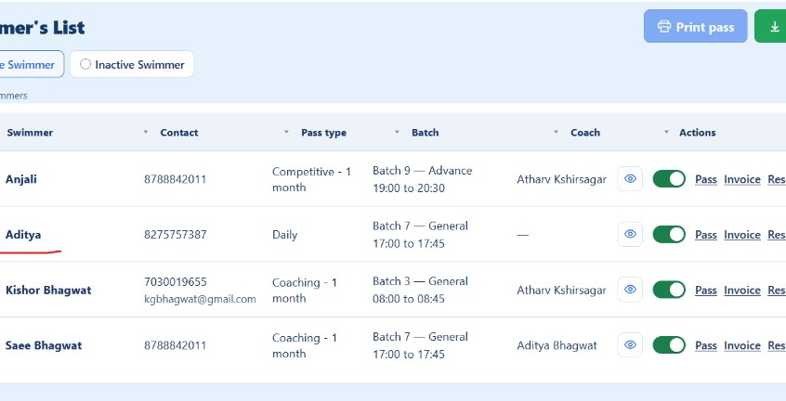
A better experience for swimmers and parents
07
From payment to active pass without repeated visits to the desk.
Swimmer journey
• Fill the registration form on a phone
• Pay by cash or UPI
• Receive pass and invoice on WhatsApp
• Show the QR pass at the gate
• Receive reminders before expiry
Actual SwimIT Active Swimmer view
No paper to carry
Clear validity
Easy support
Digital pass stays on the swimmer’s phone
Expiry date visible to swimmer and gate
Pass and invoice can be resent
SwimIT · Swimming Pool Management System
7

Slide 8
Everything needed to run the pool
08
Modules are organised around setup, daily operations, information and finance.
SETUP
DAILY OPERATIONS
INFORMATION
FINANCE
Core Info Batches & timings Pass types Holidays User access
Registration Pass Payment Pass Scanner WhatsApp Water Quality
Dashboard Swimmer’s List Attendance Sheet Staff List Payment Details
Pool Expenses Coach Payment Invoices Balance Sheet Downloads
SwimIT · Swimming Pool Management System
8

Slide 9
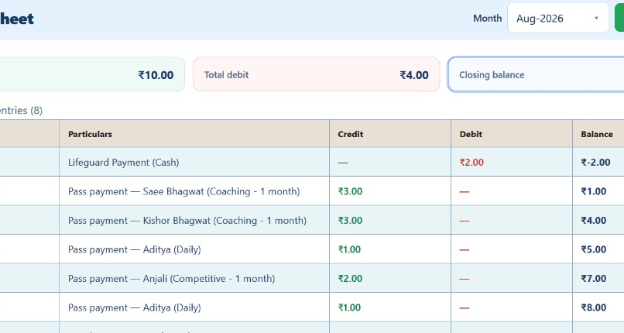
Money visibility without manual totals
09
Every pass payment becomes a credit; expenses and payouts become debits.
Owner can answer instantly:
• How much was collected?
• What was spent?
• Which swimmer paid?
• Cash or online?
• What is the closing balance?
Download when needed
Actual SwimIT Balance Sheet
SwimIT · Swimming Pool Management System
9

Slide 10
Control, trust and continuity
10
Digital records improve both day-to-day discipline and long-term reliability.
A
Role-based access
L
Activity log
D
Pool data isolation
Desk, gate, coach and manager see only the pages assigned to them.
Important changes can be traced to a user instead of relying on memory.
Each pool account has separate swimmers, payments and settings.
1
Consistent records
C
Cloud access
↓
Downloadable reports
Pass, invoice, payment and attendance use the same swimmer record.
Authorised staff can work through a browser without one physical register.
Lists and records can be exported for follow-up or offline review.
SwimIT · Swimming Pool Management System
10

Slide 11
A practical 30-day transition
11
Move gradually — old paper can remain an archive while new activity starts digitally.
WEEK 1
WEEK 2
WEEK 3
WEEK 4
1
2
3
4
→
→
→
Set up
Start registration
Scan at gate
Review money
Pool details, batches, pass types and staff access
Use SwimIT for new swimmers and renewals
Use QR pass and attendance for daily entry
Enter expenses and review the first balance sheet
No need to type ten years of old registers. Begin with today’s new joins and renewals.
SwimIT · Swimming Pool Management System
11

Slide 12
The 5-minute live demonstration
12
Show the complete value chain instead of explaining every menu.
1
2
3
4
5
Register
Collect
Deliver
Scan
Review
→
→
→
→
Create a swimmer record
Take cash / UPI payment
WhatsApp pass + invoice
Mark gate attendance
See credit in Balance Sheet
One swimmer. One payment. One scan. One financial record.
SwimIT · Swimming Pool Management System
12

Slide 13
Paper keeps you busy. SwimIT keeps you in control.
Registration · Pass · Invoice · Gate · Attendance · Expenses · Balance Sheet
Move your pool forward with SwimIT
Thank you

