Slide 1

Airbnb:
A Potential Personal Solution to the Unmanageable Rent Conditions of Toronto
July 2024

Slide 2
Disclaimer
This casual presentation was made for my own interest after learning new techniques on Tableau with practice data from Airbnb
I am not sure if the prices listed are before or after the 30% cut that Airbnb takes and I do not know if the values are USD or CAD (but looking on Airbnb suggests median host revenue is 75 CAD/night for a room and 180 CAD/night for an entire apartment which is a little lower but consistent with values from datasource)

Slide 3
Aims
Evaluate 2 potential strategies to use Airbnb to assist with rental payments
Rent a 2 bedroom apartment with the second room occupied occasionally
Rent a 1 bedroom apartment and rent the whole apartment out part time (10-15 days per month) while travelling anyway or staying with family

Slide 4
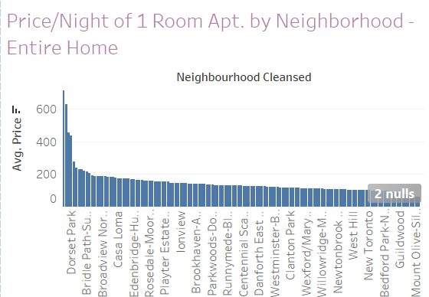
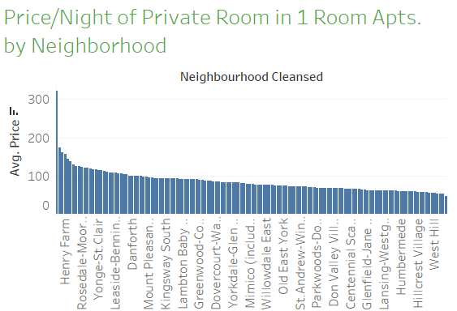
Range of Average Price/Night by Neighborhood
Highest Reasonable Neighborhood: Annex $278/night
Lowest Reasonable Neighborhood: Danforth $107/night
Highest Reasonable Neighborhood: Annex $144/night
Lowest Reasonable Neighborhood: Forest Hill North $61/night

Slide 5
Range of Average Price/Night by Neighborhood
Rent Entire Home
$107 to $278 / night
10 nights / month : $1,070 to $2,780
15 nights / month : $1,605 to $4,170
(note, fewer nights per month can be achieved by asking for higher nightly prices)
Rent 1 of your 2 rooms
$61 to $144 / night
15 nights / month : $915 to $2,160
20 nights / month : $1,220 to $2,880

Slide 6
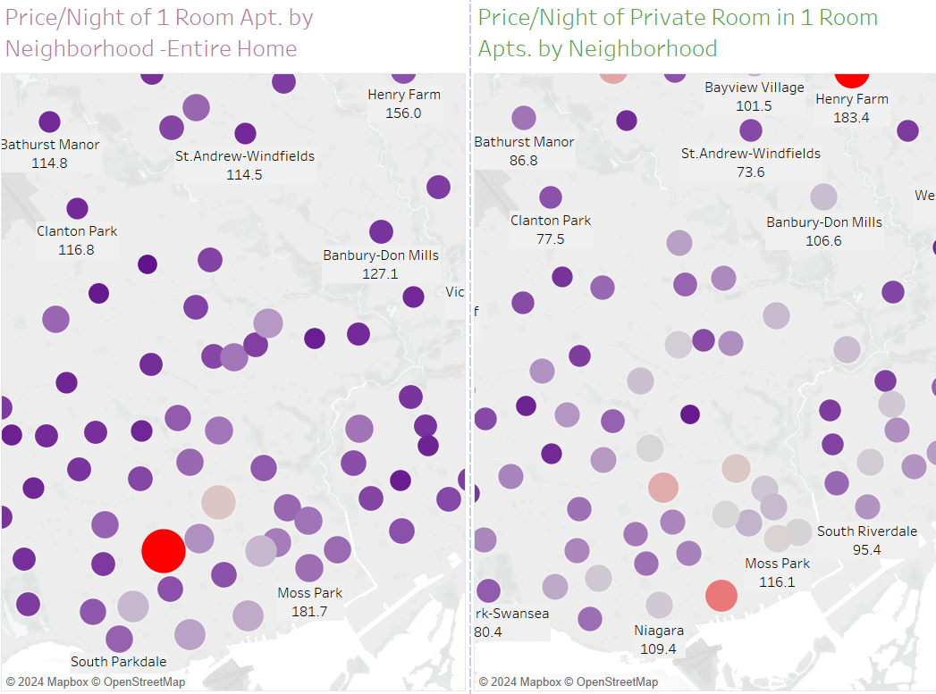
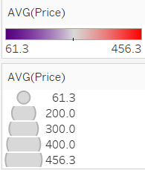
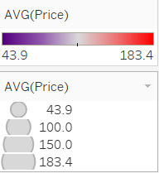
Where to Live Match Airbnb value with proximity to your friends, family, work, and the things you love

Slide 7
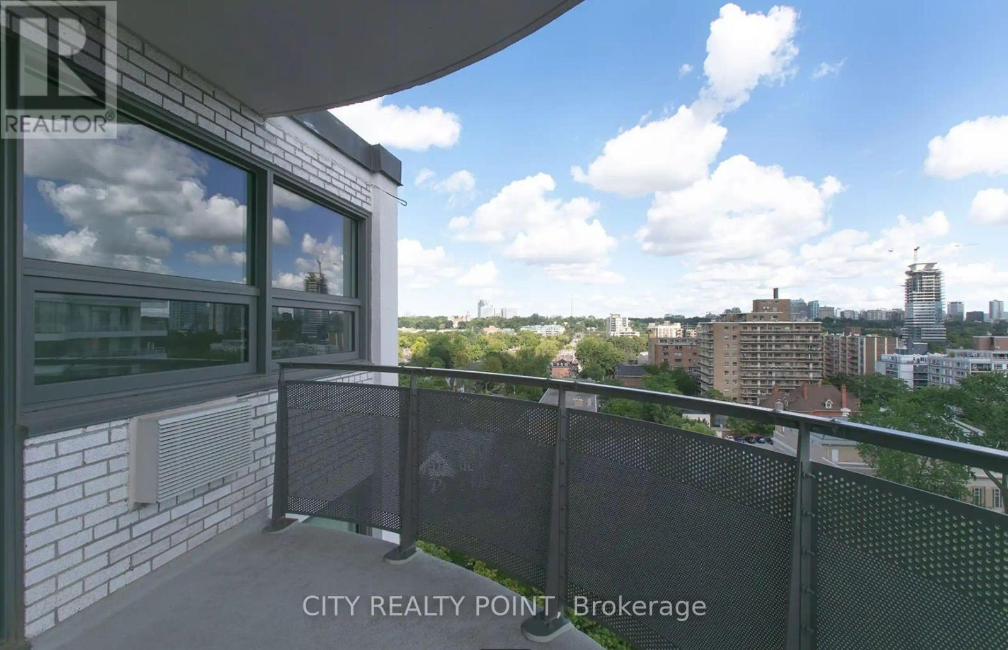
Rental Costs: Annex
1 bedroom
Total Rent in Annex: $2,384
Rent cost after Airbnb earnings:
1o nights / month : $2,384 - $2,160 = $224
15 nights / month : $2,384 - $2,880 = -$496
2 bedroom
Total Rent in Annex: $3,462
Rent cost after Airbnb earnings:
15 nights / month : $3,462 - $2,160 = $1,302
20 nights / month : $3,462 - $2,880 = $582

Slide 8
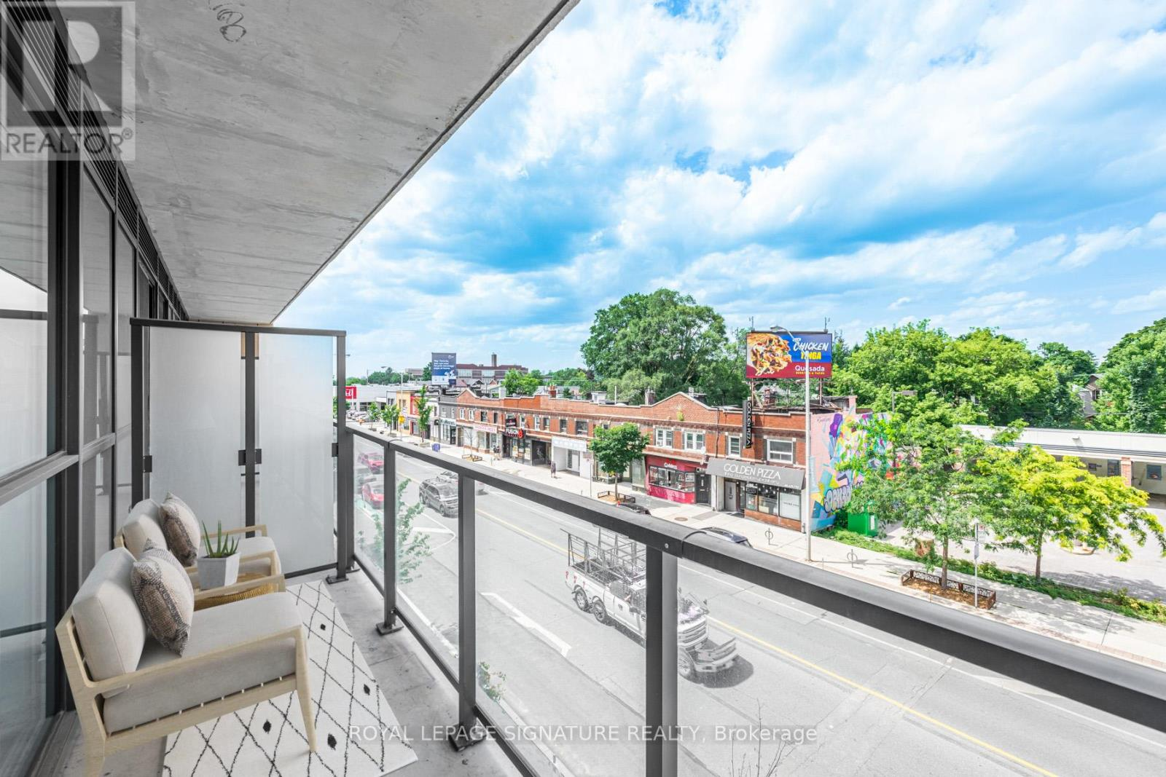
Rental Costs: Danforth
* Rental estimates for Danforth are from imprecise source
1 bedroom
Total Rent in Danforth: $2,000
Rent cost after Airbnb earnings:
10 nights / month : $2,000 - $1,070 $ = $930
15 nights / month : $2,000 – $1,605 = $395
2 bedroom
Total Rent in Danforth: $2,200
Rent cost after Airbnb earnings:
15 nights / month : $2,200 - $915 = $1285
20 nights / month : $2,200 - $1,220 = $980

Slide 9
Conclusion
Airbnb can subsidize rent to a manageable level
Neighborhood is important. It is preferable to live in a more expensive apartment but more central with a higher Airbnb revenue potential
While it is up to personal preference whether it is better to share your space (hosting in 1 room of your 2-bedroom apartment) or moving out for a portion of the month (renting entire 1-bedroom apartment), the finances are preferable for a 1-bedroom

Slide 10
Discussion
It should be noted that a 2-bedroom apartment could also be rented out as the entire apartment when travelling. Or a mixed strategy could be implemented
Other factors such as decoration, host rating, and more can increase income from Airbnb
There is also a 4% municipal accommodation tax on Airbnb revenue (for stays less than 28 days)
Next steps are to choose a specific apartment rental of interest and then verify that similar apartments on Airbnb make sufficient and reliable revenue

