Slide 1
C2T1
Keegan Gelvoria

Slide 2
Goals
Analysis of Credit One client data to determine credit limits for customers

Slide 3
Data Science Framework
BADIR
Business Question
Analysis Plan
Data Collection
Insights
Recommendation

Slide 4
Business question
What is the stated business question?
Credit One has seen an increase in number of customers who have defaulted on loans and needs to solve quickly or risk losing business
What is the intent underlying the question (e.g., what is the context, what is the impacted segment, and what are stakeholders’ current thoughts about the underlying reasons?
Credit One needs a way to understand how much credit to allow someone
Or if someone should be approved or not
What business considerations (e.g., stakeholders, timeline, and cost) are likely to impact the analysis?
Any tools can be utilized - not a data analytics problem
Data Science team has been enlisted
Need to understand difference between what data analytics has been doing and what we are going to do with data science project

Slide 5
Analysis Plan
What is the analysis goal?
Credit One needs a way to understand how much credit to allow someone
Or if someone should be approved or not
What hypotheses are to be tested?
Repayment status history can provide credit limits for clients
What data is required/available to test the hypotheses?
Limit Balance
Sex
Education
Marriage
Age
Repayment Status Scale
Bill Amount
Payment Amount
Default
What methodology(-ies) will you employ?
Regression analysis based on selected attributes for credit limits
What is the project plan (timeline and milestones, risks, phasing, prioritization, …)?
Week 1 - Project Framework
Week 2-4 - Prepare and Explore Data
Week 4-6 - Build and Evaluate Models
Week 6 - Recommendations

Slide 6
Data Collection
From where can the data be obtained?
The CreditOne data can be accessed via SQL query to their MySQL database
How must the data be cleansed and validated?
Data cleaning
Data transformation
Missing values
Data reduction
Data discretization
Text cleaning

Slide 7
Insights - WIP
What patterns do you see in the data?
All data are object format
Are each of the hypotheses proven or disproven?
None from initial review
How much confidence should stakeholders place in the results?
How do you rank your findings in terms of quantified impact on the business?

Slide 8
Recommendation - WIP
How can you most effectively present the results of your analysis to your stakeholders (in terms they can understand and in alignment with information they’ll value)?
Note: A generic template for a recommendation presentation or report might include:
Objective
Background (optional)
Scope (optional)
Approach (optional)
Recommendations
Key insights with impact
Next steps

Slide 9
Data
Data will be accessed via CreditOne’s MySQL database
Downloaded locally
Pre-processed/cleaned
Immediately the data shows that the values are in object format instead of integers and will need to be converted to perform analyses

Slide 10
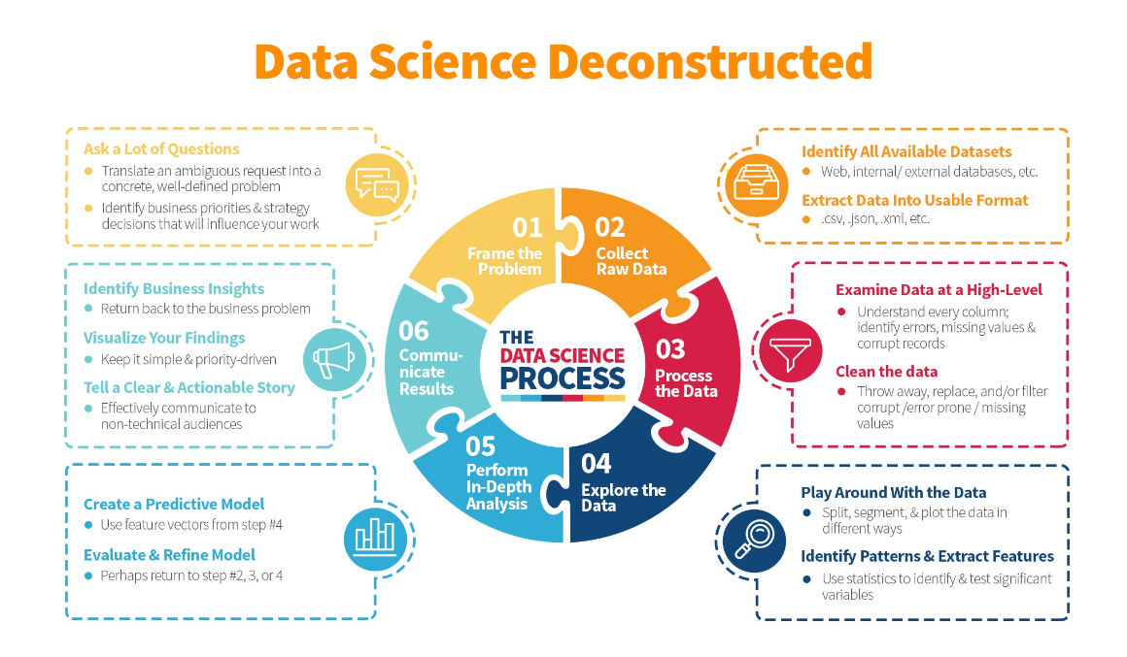

Slide 11
Initial Insights and Recommendations
Initial Insights
Data needs conversion into integers for analysis
Credit limit recommendations will require regression analysis rather than classification analysis for “will a customer default?”
Repayment status history should provide insights into credit limit recommendations
Initial Recommendations
Provide current process for approving a customer for line of credit and how that credit limit is determined
Provide current process for non-payment or delayed payment for a customer
Provide current process for defaulted customer

