Slide 1
Intro to SAS STAT 7500 - Statistical Programming Villanova University Fall 2025 Dr. Katie Fitzgerald Materials adapted from Drs. Michael Posner and Paul Bernhardt

Slide 2


About SAS, Inc.
Started in 1970s
Used in academia, business, and federal government (FDA)
Many analyses and publications use SAS
SAS invests extensive resources to R & D
SAS rated as a Top 5 company to work for over many years
User-groups (SUGs)
http://philasug.org/

Slide 3

Video Introduction to SAS On DEMAND

Slide 4
Accessing SAS: OnDemand
Go to https://welcome.oda.sas.com/login
Sign up for an account with your Villanova email
Select the “Access Now” button
Select the SAS Studio
You should now be in SAS (cloud version)
To open SAS files saved on your machine, open them in a folder and drag the file into the SAS window or, under files in the left window, create a new folder, right click, and upload
You can then save files and data sets onto the cloud
To upload SAS data (you need to upload data to be able to access it), click on the far left icon under the “Server Files and Folders” in the top left and select “import data”, or, you can upload it directly to your folder in the left window

Slide 5
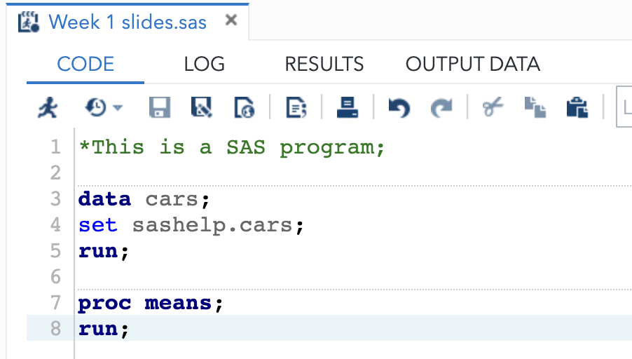
Basics of SAS
SAS Windows
Code (Editor), Log, Output / Results
With very few exceptions, SAS is NOT case sensitive
Elements of a SAS program
“Steps” - DATA, PROCs, (Options)
“Statements” within the steps
Each statement must end with a semicolon!
Begin with identifying keyword (e.g. set)
Execute a step with a run statement

Slide 6
Basic SAS ExAmPLE CODE
data club;
input id name $ team $ startwt endwt;
cards;
1023 David red 189 165
1049 Amelia yellow 145 124
1219 Alan red 210 192
1246 Ravi yellow 194 .
1078 Ashley red 127 118
1221 Jim yellow 220 204
;
run;
proc print data=club;
title 'Data Set of the Club Weight Loss Program';
run;
The data entered in this code is for six
individuals from a weight loss club.
We’ll talk about the data entry shortly.

Slide 7
Basic SAS ExAmPLE CODE
data club;
input id name $ team $ startwt endwt;
cards;
1023 David red 189 165
1049 Amelia yellow 145 124
1219 Alan red 210 192
1246 Ravi yellow 194 .
1078 Ashley red 127 118
1221 Jim yellow 220 204
;
run;
proc print data=club;
title 'Data Set of the Club Weight Loss Program';
run;
These are the data and proc statements (indicating either data input or a procedure to be run on the data, respectively)

Slide 8
Basic SAS ExAmPLE CODE
data club;
input id name $ team $ startwt endwt;
cards;
1023 David red 189 165
1049 Amelia yellow 145 124
1219 Alan red 210 192
1246 Ravi yellow 194 .
1078 Ashley red 127 118
1221 Jim yellow 220 204
;
run;
proc print data=club;
title 'Data Set of the Club Weight Loss Program';
run;
Each and every line of SAS code has a semicolon at the end. Note that the data lines are considered part of a single line of code and hence should/can only have a semicolon at the end, occurring on its own line.

Slide 9
Basic SAS ExAmPLE CODE
data club;
input id name $ team $ startwt endwt;
cards;
1023 David red 189 165
1049 Amelia yellow 145 124
1219 Alan red 210 192
1246 Ravi yellow 194 .
1078 Ashley red 127 118
1221 Jim yellow 220 204
;
run;
proc print data=club;
title 'Data Set of the Club Weight Loss Program';
run;
In the SAS program window, these will show up in blue font because they are SAS commands/statements

Slide 10
Basic SAS ExAmPLE CODE
data club;
input id name $ team $ startwt endwt;
cards;
1023 David red 189 165
1049 Amelia yellow 145 124
1219 Alan red 210 192
1246 Ravi yellow 194 .
1078 Ashley red 127 118
1221 Jim yellow 220 204
;
run;
proc print data=club;
title 'Data Set of the Club Weight Loss Program';
run;
PROC PRINT is a very basic procedure that prints out the data (or subsets of the data)
Whenever we run a proc, we should reference which data set we are running the proc on (if there is more than one data set, it defaults to most recently defined data set)

Slide 11
Basic SAS ExAmPLE CODE
data club;
input id name $ team $ startwt endwt;
cards;
1023 David red 189 165
1049 Amelia yellow 145 124
1219 Alan red 210 192
1246 Ravi yellow 194 .
1078 Ashley red 127 118
1221 Jim yellow 220 204
;
run;
proc print data=club;
title 'Data Set of the Club Weight Loss Program';
run;
In SAS, every proc has a whole bunch of options to modify what is done (sometimes in the proc line, sometimes in new statement/command lines).
The title command adds a title to the data set.

Slide 12
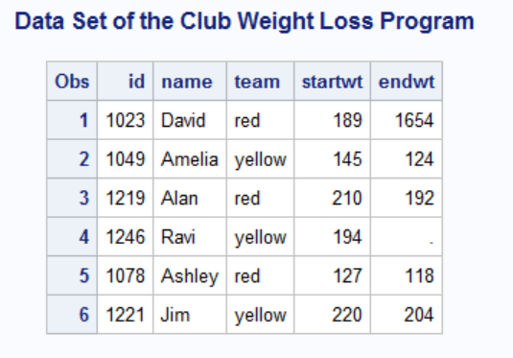
SAS OUTPUT (in RESULTS WINDOW)

Slide 13
Your Turn
Type out the following program and make sure everything runs:
data welcome;
input prof $ bestever $;
cards;
Bernhardt yes
Plum no
Everyoneelse alsono
;
run;
proc print data=welcome;
title “Who is the best Professor ever?”;
run;
2. Check the log, the output data that is included, and the results

Slide 14
Basics of SAS II
Character strings denoted by $
Missing values
“.” for numeric, “” or “ “ for character
Some output control options
ps, ls, pageno=1, nodate
Executing code
Each step must end with run; (or another step)
Submit using F3 or running person
Highlight code to submit subset

Slide 15
Basics of SAS III
Read through the LOG file!
Errors – fatal in that program will abort
Warnings – messages that are usually important
Notes – messages that may or may not be important
Getting help with SAS
Google “proc”
SAS Support – overview, syntax, and examples
Google PROC MEANS

Slide 16
My First SAS Program F25.sas
Download the .SAS file from the course website
Login to SAS ON DEMAND
Upload .SAS file to your workspace (create folder for this class if you want)

Slide 17
Your turn: Exercise 1
Type out the following in your program and make sure everything runs:
data welcome;
input prof $ bestever $;
cards;
Fitzgerald yes
Plum no
Everyoneelse alsono
;
run;
proc print data=welcome;
title “Who is the best Professor ever?”;
run;
2. Check the log, the output data that is included, and the results

Slide 18

2
SAS Programming 1 Quizzes/Questions
Portions were reproduced with permission of SAS Institutes, Inc, Cary, NC, USA. SAS Institute, Inc. makes no warranties with respect to these materials and disclaims all liability therefor.
SAS and all other SAS Institute Inc. product or service names are registered trademarks or trademarks of SAS Institute Inc. in the USA and other countries. ® indicates USA registration. Other brand and product names are trademarks of their respective companies. Copyright © 2009 SAS Institute Inc. Cary, NC, USA. All rights reserved.
Notes:
In this chapter, we want to learn the basics of a SAS program plus find out how to use SAS to submit the program.

Slide 19
How many steps are in this program?
data work.NewSalesEmps;
length First_Name $ 12
Last_Name $ 18 Job_Title $ 25;
infile 'newemps.csv' dlm=',';
input First_Name $ Last_Name $
Job_Title $ Salary;
run;
proc print data=work.NewSalesEmps;
run;
proc means data=work.NewSalesEmps;
class Job_Title;
var Salary;
run;
p102d01
Notes:
3 steps
Based on what you just learned about steps, how many steps do you think are in this program?
LW: Send a text response to the moderator. (This is the first time to officially send a response to moderator, explain in detail if necessary).
IBT: Give me your answer by holding up the correct number of fingers.

Slide 20
Correct Answer
data work.NewSalesEmps;
length First_Name $ 12
Last_Name $ 18 Job_Title $ 25;
infile 'newemps.csv' dlm=',';
input First_Name $ Last_Name $
Job_Title $ Salary;
run;
proc print data=work.NewSalesEmps;
run;
proc means data=work.NewSalesEmps;
class Job_Title;
var Salary;
run;
DATA Step
PROCStep
PROCStep
p102d01
Notes:
3 steps

Slide 21
How does SAS detect the end of the PROC MEANS step?
data work.NewSalesEmps;
length First_Name $ 12
Last_Name $ 18 Job_Title $ 25;
infile 'newemps.csv' dlm=',';
input First_Name $ Last_Name $
Job_Title $ Salary;
run;
proc print data=work.NewSalesEmps;
proc means data=work.NewSalesEmps;
class Job_Title;
var Salary;
Notes:
SAS does not detect the end of the PROC MEANS step. SAS needs a RUN statement to detect the end.
If the DATA step is over because of the RUN and the PROC PRINT is over because of the PROC MEANS, how does SAS detect the end of the PROC MEANS step?
LW: Send a text response to the moderator.
IBT: Ask for verbal responses.

Slide 22

SAS detect the end of the PROC MEANS step?
SAS does not detect the end of the PROC MEANS step. SAS needs a RUN statement to detect the end.
data work.NewSalesEmps;
length First_Name $ 12
Last_Name $ 18 Job_Title $ 25;
infile 'newemps.csv' dlm=',';
input First_Name $ Last_Name $
Job_Title $ Salary;
run;
proc print data=work.NewSalesEmps;
proc means data=work.NewSalesEmps;
class Job_Title;
var Salary;
Notes:
SAS does not detect the end of the PROC MEANS step. SAS needs a RUN statement to detect the end.

Slide 23
How many statements are in the DATA step?
1
3
5
7
data work.NewSalesEmps;
length First_Name $ 12
Last_Name $ 18 Job_Title $ 25;
infile 'newemps.csv' dlm=',';
input First_Name $ Last_Name $
Job_Title $ Salary;
run;
Notes:
c. 5
LW: Send a text response to the moderator.
IBT: Give me your answer by holding up the correct number of fingers.

Slide 24
How many statements are in the DATA step?
1
3
5
7
data work.NewSalesEmps;
length First_Name $ 12
Last_Name $ 18 Job_Title $ 25;
infile 'newemps.csv' dlm=',';
input First_Name $ Last_Name $
Job_Title $ Salary;
run;
Notes:
c. 5

Slide 25
This program has three syntax errors. What are the errors?
daat work.NewSalesEmps;
length First_Name $ 12
Last_Name $ 18 Job_Title $ 25;
infile 'newemps.csv' dlm=',';
input First_Name $ Last_Name $
Job_Title $ Salary;
run;
proc print data=work.NewSalesEmps
run;
proc means data=work.NewSalesEmps average max;
class Job_Title;
var Salary;
run;
p103d03
Notes:
daat instead of data
missing semi-colon
average instead of max
Based on your knowledge so far, do you see any errors?
The first two errors should be apparent to the student. The error in PROC MEANS is really beyond the knowledge that they have so far.
LW: If you see an error in the DATA step, send in the error as a text response. If you see an error in the PROC PRINT step, send in a text response. Anyone see an error in the PROC MEANS step; if so send in a text response? As students send in text responses for a question, give the answer before moving to the next question. Don’t wait for everyone to respond.
IBT: Verbally ask for the errors step by step.

Slide 26
This program has three syntax errors. What are the errors?
daat work.NewSalesEmps;
length First_Name $ 12
Last_Name $ 18 Job_Title $ 25;
infile 'newemps.csv' dlm=',';
input First_Name $ Last_Name $
Job_Title $ Salary;
run;
proc print data=work.NewSalesEmps
run;
proc means data=work.NewSalesEmps average max;
class Job_Title;
var Salary;
run;
p103d03
Notes:
daat instead of data
missing semi-colon
average instead of max
Based on your knowledge so far, do you see any errors?
The first two errors should be apparent to the student. The error in PROC MEANS is really beyond the knowledge that they have so far.
LW: If you see an error in the DATA step, send in the error as a text response. If you see an error in the PROC PRINT step, send in a text response. Anyone see an error in the PROC MEANS step; if so send in a text response? As students send in text responses for a question, give the answer before moving to the next question. Don’t wait for everyone to respond.
IBT: Verbally ask for the errors step by step.

Slide 27
/*************************************************/
/* Example of various commenting options */
/*************************************************/
*The following inputs the dataset;
data ex5_57;
input oxygen @@;
cards;
5.1 4.9 5.6 4.2 4.8 4.5 5.3 5.2
;
run;
*The following prints the data set;
proc print data=ex5_57;
title 'Listing of the Data Set';
run;
*The following creates a normal probability plot to check
the normality assumption;
proc univariate data=ex5_57 noprint;
probplot oxygen / normal;
run;
*The following performs the one sample t-test;
proc ttest data=ex5_57 h0=5 alpha=0.05;
var oxygen;
run;

Slide 28
/*************************************************/
/* Example of the various options */
/*************************************************/
*The following inputs the dataset;
data ex5_57;
input oxygen @@;
cards;
5.1
4.9
5.6
4.2
4.8
4.5
5.3
5.2
;
run;
*The following prints the data set;
proc print data=ex5_57;
title 'Listing of the Data Set';
run;
*The following creates a normal probability plot to check
the normality assumption;
proc univariate data=ex5_57 noprint;
probplot oxygen / normal;
run;
*The following performs the one sample t-test;
proc ttest data=ex5_57 h0=5 alpha=0.05;
var oxygen;
run;
All of these are comments, not commands that are executed

Slide 29
Entering Data Strategy 1: “By Hand”
While data sets can be loaded in, they can also be typed in (either way, it’s a data step)
Components of data step:
Start data step and name the data set to be entered.
Input the variables (columns of the data, make sure to specify $ for categorical)
Enter the data (a CARDS or DATALINES statement must come first)
A RUN statement to execute the entire data step
Outline code:
data dataname;
input variable names;
cards;
data
;
run;

Slide 30
“By Hand” Data Entry Example
data club;
input id name $ team $ startwt endwt;
cards;
1023 David red 189 165
1049 Amelia yellow 145 124
1219 Alan red 210 192
1246 Ravi yellow 194 .
1078 Ashley red 127 118
1221 Jim yellow 220 204
;
run;
proc print data=club;
title 'Data Set of the Club Weight Loss Program';
run;
You can name your data set whatever you like here (usually we want shorter but also informative names)

Slide 31
“By Hand” Data Entry Example
data club;
input id name $ team $ startwt endwt;
cards;
1023 David red 189 165
1049 Amelia yellow 145 124
1219 Alan red 210 192
1246 Ravi yellow 194 .
1078 Ashley red 127 118
1221 Jim yellow 220 204
;
run;
proc print data=club;
title 'Data Set of the Club Weight Loss Program';
run;
Everything following the input statement are variable names and details about the data in the columns for these variables

Slide 32
“By Hand” Data Entry Example
data club;
input id name $ team $ startwt endwt;
cards;
1023 David red 189 165
1049 Amelia yellow 145 124
1219 Alan red 210 192
1246 Ravi yellow 194 .
1078 Ashley red 127 118
1221 Jim yellow 220 204
;
run;
proc print data=club;
title 'Data Set of the Club Weight Loss Program';
run;
These variables are quantitative/numeric (no $ sign after the variable)

Slide 33
“By Hand” Data Entry Example
data club;
input id name $ team $ startwt endwt;
cards;
1023 David red 189 165
1049 Amelia yellow 145 124
1219 Alan red 210 192
1246 Ravi yellow 194 .
1078 Ashley red 127 118
1221 Jim yellow 220 204
;
run;
proc print data=club;
title 'Data Set of the Club Weight Loss Program';
run;
These variables are character/categorical/qualitative since there is a dollar sign after it (having a space between the name and $ is important)

Slide 34
“By Hand” Data Entry Example
data club;
input id name $ team $ startwt endwt;
cards;
1023 David red 189 165
1049 Amelia yellow 145 124
1219 Alan red 210 192
1246 Ravi yellow 194 .
1078 Ashley red 127 118
1221 Jim yellow 220 204
;
run;
proc print data=club;
title 'Data Set of the Club Weight Loss Program';
run;
This statement says we are about to enter data; a more modern but completely equivalent command is DATALINES;

Slide 35
“By Hand” Data Entry Example
Data entry – note that
Data is entered for each row/observational unit (person) in order by variables/columns
The type of value matches the variable type (numbers for the quantitative variables)
The default length of character values is 8 (anything longer is truncated unless we specify otherwise)
There is a space (or at least one) between each data value
Unless we tell SAS otherwise, character values cannot have blanks (SAS will think the value after the blank corresponds to the next variable)
data club;
input id name $ team $ startwt endwt;
cards;
1023 David red 189 165
1049 Amelia yellow 145 124
1219 Alan red 210 192
1246 Ravi yellow 194 .
1078 Ashley red 127 118
1221 Jim yellow 220 204
;
run;
proc print data=club;
title 'Data Set of the Club Weight Loss Program';
run;

Slide 36
“By Hand” Data Entry Example
data club;
input id name $ team $ startwt endwt;
cards;
1023 David red 189 165
1049 Amelia yellow 145 124
1219 Alan red 210 192
1246 Ravi yellow 194 .
1078 Ashley red 127 118
1221 Jim yellow 220 204
;
run;
proc print data=club;
title 'Data Set of the Club Weight Loss Program';
run;
In practice, there is often “missing” data, or data values that are unknown. In SAS, such values are entered using a “period”.

Slide 37
“By Hand” Data Entry Example
data club;
input id name $ team $ startwt endwt;
cards;
1023 David red 189 165
1049 Amelia yellow 145 124
1219 Alan red 210 192
1246 Ravi yellow 194 .
1078 Ashley red 127 118
1221 Jim yellow 220 204
;
run;
proc print data=club;
title 'Data Set of the Club Weight Loss Program';
run;
There is a single semicolon on its own line (since it’s not part of the data) after we have entered ALL of the data.
Then, we have a run statement to actually compile the data. Note that we wouldn’t need a run statement until the end of the program, but it is good practice (and makes the log easier to read).

Slide 38
Your Turn: EXERCISE 2 (raw data entry)
Run the lines of code for “Exercise 2”
Check out the results to confirm everything ran correctly. Also check the log window to make sure there were no errors or warnings.
Copy-paste the Exercise 2 code (to make a second of code that is exactly the same) and then make the following changes:
Add a comment above the pasted code to note that it is Code Exercise #2b.
Change the name of the data set to “club1”
Delete the missing value (don’t put anything in it’s place)
Run this updated code. What printed? Why did this print? Check out the log.
Go the library folder on the left, and then the “work” folder. Verify that there are two different data sets in the folder: club and club1.

Slide 39
Entering Data by Hand: More Options
Suppose we wanted to add last names, but we wanted the whole name to be read as a single variable
This requires read a “space” as part of the variable value
We will now definitely need to specify the following:
That the name variable contains a space and SAS should not consider the last name as a new variable
That there are more than 8 character values that should be saved in the name variable

Slide 40
Entering the Club Data With Last Names
The “&” tells SAS to continue reading the
name variable even after the space; that is,
the variable values contains a space
data club;
input id name & $15. team $ startwt endwt;
cards;
1023 David Shaw red 189 165
1049 Amelia Serrano yellow 145 124
1219 Alan Nance red 210 192
1246 Ravi Sinha yellow 194 .
1078 Ashley McKnight red 127 118
1221 Jim Brown yellow 220 204
;
run;
The “$15.” tells SAS that the variable is
a character variable and that up to 15 characters
should be stored before truncating
Ashley McKnight’s name is the name corresponding to 15 characters. Any value above 15 would also work, but for any value below 15 her name would be truncated.
IMPORTANT: When using “&”, SAS will keep reading the name variable until it encounters a double space or tab

Slide 41
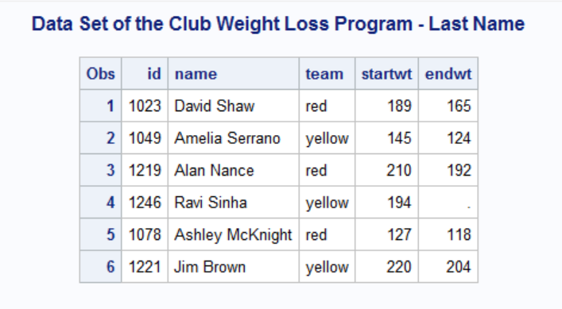
Updated Output: proc print data = club; title 'Data Set of the Club Weight Loss Program - Last Name'; run;

Slide 42
Your Turn: EXERCISE 3
Recall the following program that we entered earlier
data welcome;
input prof $ bestever $;
cards;
Fitzgerald yes;
Plum no
Everyoneelse alsono
;
run;
proc print data=welcome;
title “Who is the best Professor ever?”;
run;
Change the code and data above so that
The prof values are Dr. Fitzgerald, Dr. Plum, and Everyone Else (with spaces)
The best ever values are Yes, No, and Also No (with spaces)

Slide 43
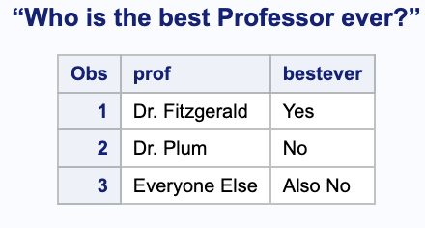
data welcome;
input prof $ & 14. bestever $ & 7.;
cards;
Dr. Fitzgerald Yes
Dr. Plum No
Everyone Else Also No
;
run;
proc print data=welcome;
title “Who is the best Professor ever?”;
run;

Slide 44
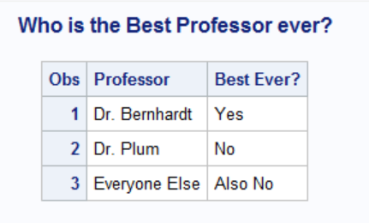
Labeling When Printing
Suppose we wanted to have the variable names be more clearly labeled and include spaces.
proc print data=welcome label;
title 'Who is the Best Professor ever?';
label prof='Professor' bestever='Best Ever?';
run;
Needed to include a label
Creates temporary labels for whatever columns you like

Slide 45
A Note On Entering Data: Equivalent Code:
data club;
input id name & $15. team $ startwt endwt;
cards;
1023 David Shaw red 189 165
1049 Amelia Serrano yellow 145 124
1219 Alan Nance red 210 192
1246 Ravi Sinha yellow 194 .
1078 Ashley McKnight red 127 118
1221 Jim Brown yellow 220 204
;
run;
data club;
input id name & $ 15. team $ startwt endwt;
cards;
1023 David Shaw
red 189 165
1049 Amelia Serrano
yellow 145 124
1219 Alan Nance
red 210 192
1246 Ravi Sinha
yellow 194 .
1078 Ashley McKnight
red 127 118
1221 Jim Brown
yellow 220 204
;
run;

Slide 46

Entering Data by Hand: Multiple Entries per line
Another common data entry technique is to type multiple observations on one line of code. A double @, ‘@@’, at the end of the input line tells SAS that there are multiple observations on one line.
data club;
input id name & $ 15. team $ startwt endwt @@;
cards;
1023 David Shaw red 189 165 1049 Amelia Serrano yellow 145 124
1219 Alan Nance red 210 192 1246 Ravi Sinha yellow 194 .
1078 Ashley McKnight red 127 118 1221 Jim Brown yellow 220 204
;
run;

Slide 47
Your Turn: EXERCISE 4
Run the code on the previous slide found in the SAS file. The printed data set should look the same before.
Now try having the first 3 observations on the first line, the fourth observation on the second line, and the final two observations on the third line. Use the @@ again. Does everything read correctly now?
Try running the code without the @@. What happens?

Slide 48
Another Example
data scores;
input Name : $9. Score1-Score3 Team $&25. Div $;
datalines;
Smith 12 22 46 "Green Hornets, Atlanta" AAA
Mitchel 23 19 25 "High Volts, Portland" AAA
Jones 09 17 54 "Vulcans, Las Vegas" AA
;
proc print data=scores noobs;
run;

Slide 49
Another Example
An alternative way of entering Score1 Score2 Score3
data scores;
input Name : $9. Score1-Score3 Team $&25. Div $;
datalines;
Smith 12 22 46 "Green Hornets, Atlanta" AAA
Mitchel 23 19 25 "High Volts, Portland" AAA
Jones 09 17 54 "Vulcans, Las Vegas" AA
;
proc print data=scores noobs;
run;
Will keep up to 9 characters in Name (not needed here) and the : says to stop keeping variables as soon as a “space” is encountered

Slide 50
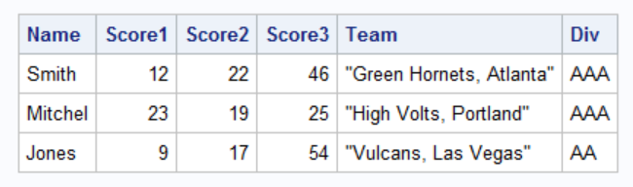
Another Example
data scores;
input Name : $9. Score1-Score3 Team $&25. Div $;
datalines;
Smith 12 22 46 "Green Hornets, Atlanta" AAA
Mitchel 23 19 25 "High Volts, Portland" AAA
Jones 09 17 54 "Vulcans, Las Vegas" AA
;
proc print data=scores noobs;
run;
Keeping up to 25 characters and blanks, only stopping at 25 characters or a double blank/tab
If you want to print the data without the observation column

Slide 51
Much, much more about the Input Statement
https://support.sas.com/resources/papers/proceedings/proceedings/sugi29/253-29.pdf

Slide 52
Entering Data Option 2: libname Creating, Importing, and viewing a Data set
SAS calls the directories that store data sets “libraries”. These can be temporary (in SAS when using) or permanent (on your personal machine/cloud).
To save or recall data sets that were previously saved, we can use a “libname” statement
When saving a SAS data set, we simply use
libname name_of_choice ‘file_location’;
together with a “set” command inside of a data step.
When loading a SAS data set, we use the same libname code pointing to the data set location, potentially including a file type if not defined

Slide 53
Saving A SAS Data SET
libname datahome '/home/u64289425/sasuser.v94/STAT 7500 F25/data’;
data club;
input id name $ team $ startwt endwt;
cards;
1023 David red 189 165
1049 Amelia yellow 145 124
1219 Alan red 210 192
1246 Ravi yellow 194 .
1078 Ashley red 127 118
1221 Jim yellow 220 204
;
run;
data datahome.permclub;
set club;
run;
Statement used to tell SAS that we are going to be saving or loading from a library

Slide 54
Saving A SAS Data SEt….
libname datahome '/home/u64289425/sasuser.v94/STAT 7500 F25/data’;
data club;
input id name $ team $ startwt endwt;
cards;
1023 David red 189 165
1049 Amelia yellow 145 124
1219 Alan red 210 192
1246 Ravi yellow 194 .
1078 Ashley red 127 118
1221 Jim yellow 220 204
;
run;
data datahome.permclub;
set club;
run;
You can make up any name you want for the SAS library (this part is only for temporary storage in SAS itself while the program is open)

Slide 55
Saving A SAS Data SEt….
Location to save file; on your own personal machine or on SAS ON DEMAND, find the file location by right clicking on the folder of interest and right clicking “properties”.
libname datahome '/home/u64289425/sasuser.v94/STAT 7500 F25/data’;
data club;
input id name $ team $ startwt endwt;
cards;
1023 David red 189 165
1049 Amelia yellow 145 124
1219 Alan red 210 192
1246 Ravi yellow 194 .
1078 Ashley red 127 118
1221 Jim yellow 220 204
;
run;
data datahome.permclub;
set club;
run;

Slide 56
Saving A SAS Data SEt….
libname datahome '/home/u64289425/sasuser.v94/STAT 7500 F25/data’;
data club;
input id name $ team $ startwt endwt;
cards;
1023 David red 189 165
1049 Amelia yellow 145 124
1219 Alan red 210 192
1246 Ravi yellow 194 .
1078 Ashley red 127 118
1221 Jim yellow 220 204
;
run;
data datahome.permclub;
set club;
run;
You can have many data steps in the same program. Here the code is saying to “create” a data set called “permclub” within the “datahome” library and set it to be equal to the “club” data set that was created.
Note that the name given to the library in the libname statement needs to match the part before permclub in this data statement.

Slide 57
Loading A SAS Data Set (intro)….
libname datahome '/home/u64289425/sasuser.v94/STAT 7500 F25/data’;
data club;
set datahome.permclub;
run;
Same start as saving a data set…note that if there is already a library created with the same location, call it the same thing
Going the opposite way now…creating a data set called “club” and assigning it to the data set of choice that already exists in this datahome library (there could be several data sets in the library to choose from)

Slide 58
Your Turn: EXERCISE 5
Create a “weather” data set with two variables: month and temperature
Enter the 12 months and the following average high temperatures in Philly for those months: 41, 44, 53, 66, 76, 84, 89, 86, 80, 68, 55, 47
Save the data set in a library of your choice based on a particular folder location on your computer/ON DEMAND
Now try loading the data set that you just created and printing it out (you can close and open SAS if you want or just check your log to make sure it worked)

Slide 59
libname datahome '/home/u64289425/sasuser.v94/STAT 7500 F25/data’;
data weather;
input month $ 9. temp;
cards;
January 41
February 44
March 53
April 66
May 76
June 84
July 89
August 86
September 80
October 68
November 55
December 47
;
run;
data datahome.weather;
set weather;
run;

Slide 60
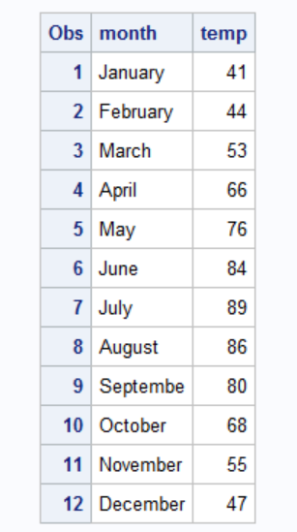
And now loading and printing this data…
libname datahome '/home/u64289425/sasuser.v94/STAT 7500 F25/data’;
data weather2;
set datahome.weather;
run;
proc print data=weather2;
run;

