Slide 1
SAS Week 2
Reading data, attributes of data

Slide 2
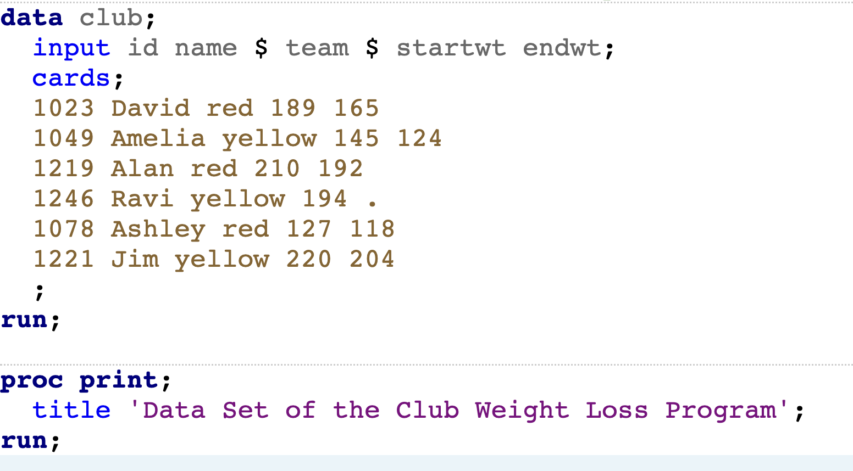
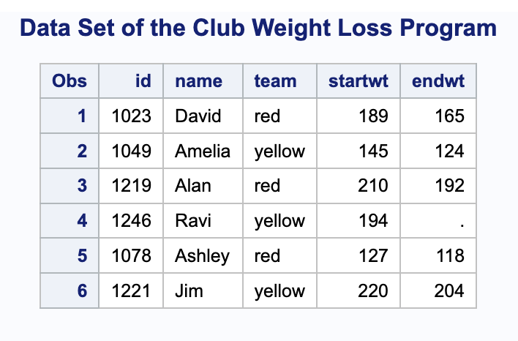
Recap – entering data (manually)
Data statement to specify name of dataset
Input statement to specify variables names & types (and sometimes lengths)
categorical variables must have $ after them
datalines or cards statement
Print/inspect data immediately after entering/importing it to make sure it appears as expected
Use Google/SAS documentation/AI to help with the details!

Slide 3
Coding in the age of AI – let’s have a convo!
Disclaimer: your professors are all figuring this out as we go – your input is really valuable!
What’s not important anymore?
What’s still important?
How do you use it currently? What have you found it to be good at / not so good at?
Course AI policy

Slide 4
Getting started with data

Slide 5
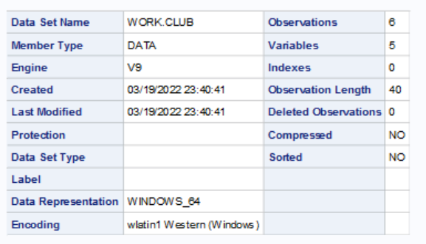
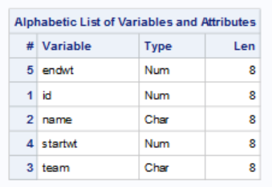
PROC CONTENTS
PROC CONTENTS gives a lot of helpful information about a data sets, including the type and format of a variable, along with any labels
proc contents data=club;
run;

Slide 6
PROC CONTENTS
PROC CONTENTS varnum; orders by position (as compared to alphabetical by default)
PROC CONTENTS position; shows both orderings
Which one you need depends on context

Slide 7
Formatting and Lengths
In SAS data sets, there is a format and length associated with all variables (both character types and numeric types)
The length is by default 8 for all types, meaning that up to 8 values are stored in the string or up to 8 bytes are stored in the number (16 digits)
The format can be set to only show a certain number of values and to round to a certain value; the format will also be different for dates (which are stored as numeric)
Both length and format can be defined in the data statement
Format must be given in its own command line whereas length can also be given in the input statement in the case of character variables

Slide 8
Revisiting The Club Data
data club;
length startwt 4 endwt 4;
format startwt 5.1 endwt 5.1 name $ 15.;
input id name team $ startwt endwt;
cards;
1023 David red 189 165
1049 Amelia yellow 145 124
1219 Alan red 210 192
1246 Ravi yellow 194 .
1078 Ashley red 127 118
1221 Jim yellow 220 204
;
run;
This length statement says to keep up to only keep 4 bytes of info (saves memory)
This format statement says that for startwt and endwt, we should keep up to 5 digits of info (including decimal), and 1 digit to the right of the decimal (leaving 3 digits to the left).
It also says to let name be a character value with length 15.

Slide 9
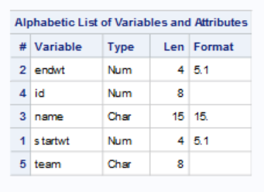
Another Look at Proc Contents
Before
Updated

Slide 10
Attributes of Data/Variables
Variable name requirements
Up to 32 characters
Starts with letter or _ (underscore)
No other special characters allowed
Some words (proc, data, work) are reserved
Valid names
dbp12, DiastolicBloodPressure, dbp_12
Invalid names
12dbp, dbp 12, dbp*12

Slide 11
QUIZ
Which is the FIRST variable name that is valid?
data5mon
5monthsdata
data#5
five months data
five_months_data
FiveMonthsData
This class rocks!
Notes:
Poll Title: Which variable names are valid? five_months_data FiveMonthsData https://www.polleverywhere.com/multiple_choice_polls/yDxFupAYVPq3E8t1Ja3Oh?flow=Default&onscreen=persist

Slide 12
QUIZ
Which is the FIRST variable name that is valid?
data5mon
5monthsdata
data#5
five months data
five_months_data
FiveMonthsData
This class rocks!
Notes:
Poll Title: Which variable names are valid? five_months_data FiveMonthsData https://www.polleverywhere.com/multiple_choice_polls/yDxFupAYVPq3E8t1Ja3Oh?flow=Default&onscreen=persist

Slide 13
QUIZ
Which is the SECOND variable name that is valid?
data5mon
5monthsdata
data#5
five months data
five_months_data
FiveMonthsData
This class rocks!
Notes:
Poll Title: Which variable names are valid? five_months_data FiveMonthsData https://www.polleverywhere.com/multiple_choice_polls/yDxFupAYVPq3E8t1Ja3Oh?flow=Default&onscreen=persist

Slide 14
QUIZ
Which is the SECOND variable name that is valid?
data5mon
5monthsdata
data#5
five months data
five_months_data
FiveMonthsData
This class rocks!
Notes:
Poll Title: Which variable names are valid? five_months_data FiveMonthsData https://www.polleverywhere.com/multiple_choice_polls/yDxFupAYVPq3E8t1Ja3Oh?flow=Default&onscreen=persist

Slide 15
QUIZ
Which is the THIRD variable name that is valid?
data5mon
5monthsdata
data#5
five months data
five_months_data
FiveMonthsData
This class rocks!
Notes:
Poll Title: Which variable names are valid? five_months_data FiveMonthsData https://www.polleverywhere.com/multiple_choice_polls/yDxFupAYVPq3E8t1Ja3Oh?flow=Default&onscreen=persist

Slide 16
QUIZ
Which is the THIRD variable name that is valid?
data5mon
5monthsdata
data#5
five months data
five_months_data
FiveMonthsData
This class rocks!
Notes:
Poll Title: Which variable names are valid? five_months_data FiveMonthsData https://www.polleverywhere.com/multiple_choice_polls/yDxFupAYVPq3E8t1Ja3Oh?flow=Default&onscreen=persist

Slide 17
QUIZ
Which is the FOURTH variable name that is valid?
data5mon
5monthsdata
data#5
five months data
five_months_data
FiveMonthsData
This class rocks!
Notes:
Poll Title: Which variable names are valid? five_months_data FiveMonthsData https://www.polleverywhere.com/multiple_choice_polls/yDxFupAYVPq3E8t1Ja3Oh?flow=Default&onscreen=persist

Slide 18
QUIZ
Which is the FOURTH variable name that is valid?
data5mon
5monthsdata
data#5
five months data
five_months_data
FiveMonthsData
This class rocks!
NA – only 3 valid variable names!
Notes:
Poll Title: Which variable names are valid? five_months_data FiveMonthsData https://www.polleverywhere.com/multiple_choice_polls/yDxFupAYVPq3E8t1Ja3Oh?flow=Default&onscreen=persist

Slide 19
Labels
As per most regulatory guidance documents (e.g. government, pharma), variable names should not be more than 8 characters in length.
Since this leaves few characters to identify the variable, we can add a label to each variable which will more fully describe the function of the variable.
We can also add a dataset label to help identify the contents of the dataset. Labels should typically not be longer than 40 characters.
Labels can also be defined locally within a PROC statement, in which case they are not associated with the data set outside of that run of that PROC

Slide 20
Labels
data club(label="Club Weight Loss Dataset");
set club;
label id = 'Club Member Identifier'
team = 'Weight Loss Team'
name = 'First Name'
startwt = 'Starting Weight (lbs)'
endwt = 'Ending Weight (lbs)';
run;
proc contents data=club;
title 'After Labels';
run;

Slide 21
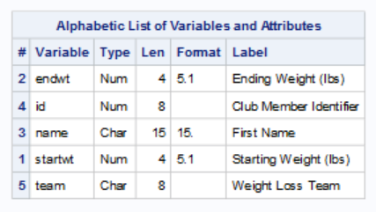
Another Look at Proc Contents
Before
Updated

Slide 22
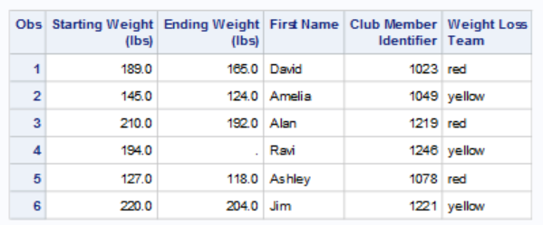
Printing Data Set with Labels
proc print data=club label;
run;
If labels not created in data step, can add temporary labels within a print statement (saw this last week)

Slide 23
Copying / subsetting data

Slide 24
Copying & Subsetting Data
Use the set statement – reads in a dataset
I think about it as placing the data there
The where statement subsets the data – can check row-level conditions
data onlyred; set club; where team='red'; *works with if as well; run;
Notes:
Start here on 9/5, but we already did permanent datasets…

Slide 25
Missing Data revisited
For character variables, “” or “ “
Can be included as a group in frequencies
For numeric variables, “.”
Excluded from calculations (mean)
Is the smallest possible value for comparisons
. < 10 is TRUE

Slide 26
Coding Error with Missing Data
data badsalary;
set salarydata;
where salary < 10000;
To EXCLUDE missing values, here are some options:
where salary <> . and salary < 10000;
where salary > . and salary < 10000;
where salary ne . and salary < 10000;
<> and ne are two ways of saying “not equal to” in SAS

Slide 27
QUIZ
Which data requirements cannot be achieved with the PRINT procedure using a WHERE statement?
Employee_ID must be unique and not missing
Gender must have a value of F or M
Salary must be in the numeric range of 24000 – 500000
Job_Title must not be missing
Country must have a value of AU or US
Birth_Date must occur before Hire_Date value
Hire_Date must have a value of 01/01/1974 or later
Notes:
Poll Title: Which data requirement cannot be achieved with the PRINT procedure using a WHERE statement? https://www.polleverywhere.com/multiple_choice_polls/3xmAlfmL4zvUKznIiziGh?flow=Default&onscreen=persist

Slide 28
QUIZ
Which data requirements cannot be achieved with the PRINT procedure using a WHERE statement?
Employee_ID must be unique and not missing
Gender must have a value of F or M
Salary must be in the numeric range of 24000 – 500000
Job_Title must not be missing
Country must have a value of AU or US
Birth_Date must occur before Hire_Date value
Hire_Date must have a value of 01/01/1974 or later
Notes:
Poll Title: Which data requirement cannot be achieved with the PRINT procedure using a WHERE statement? https://www.polleverywhere.com/multiple_choice_polls/3xmAlfmL4zvUKznIiziGh?flow=Default&onscreen=persist

Slide 29
Quiz
What problems will SAS have reading the numeric data Salary (first highlighted variable) and Hire_Date (second highlighted variable)?
Partial nonsales.csv
120101,Patrick,Lu,M,163040,Director,AU,18AUG1976,01JUL2003 120104,Kareen,Billington,F,46230,Administration Manager,au,11MAY1954,01JAN1981 120105,Liz,Povey,F,27110,Secretary I,AU,21DEC1974,01MAY1999 120106,John,Hornsey,M,unknown,Office Assistant II,AU,23DEC1944,01JAN1974 120107,Sherie,Sheedy,F,30475,Office Assistant III,AU,01FEB1978,21JAN1953 120108,Gladys,Gromek,F,27660,Warehouse Assistant II,AU,23FEB1984,01AUG2006 120108,Gabriele,Baker,F,26495,Warehouse Assistant I,AU,15DEC1986,01OCT2006 120110,Dennis,Entwisle,M,28615,Warehouse Assistant III,AU,20NOV1949,01NOV1979 120111,Ubaldo,Spillane,M,26895,Security Guard II,AU,23JUL1949,99NOV1978 120112,Ellis,Glattback,F,26550, ,AU,17FEB1969,01JUL1990 120113,Riu,Horsey,F,26870,Security Guard II,AU,10MAY1944,01JAN1974 120114,Jeannette,Buddery,G,31285,Security Manager,AU,08FEB1944,01JAN1974 120115,Hugh,Nichollas,M,2650,Service Assistant I,AU,08MAY1984,01AUG2005 .,Austen,Ralston,M,29250,Service Assistant II,AU,13JUN1959,01FEB1980 120117,Bill,Mccleary,M,31670,Cabinet Maker III,AU,11SEP1964,01APR1986
Notes:
Observation 4: Salary = unknown
Observation 9: Hire_Date = 99NOV1978
On this slide, I am showing some of the records for NONSALES.CSV. See we have Office and Warehouse Assistants, Security Guards, … Look at the salary values for each record, the salaries is the first blue highlight on each record. Are we going to have any problems reading in any of those salaries as numeric?
LW: If you see a problem, send in a text response of the problem.
IBT: Shout the problem if you see a problem.
Yes, unknown is not a numeric value. This will create a problem. Are we going to have any problems reading in any of those hire dates as a SAS date value?
LW: If you see a problem, send in a text response of the problem.
IBT: Shout the problem if you see a problem.
Yes, 99NOV1978 is not a valid date.

Slide 30
Quiz
What problems will SAS have reading the numeric data Salary (first highlighted variable) and Hire_Date (second highlighted variable)?
Partial nonsales.csv
120101,Patrick,Lu,M,163040,Director,AU,18AUG1976,01JUL2003 120104,Kareen,Billington,F,46230,Administration Manager,au,11MAY1954,01JAN1981 120105,Liz,Povey,F,27110,Secretary I,AU,21DEC1974,01MAY1999 120106,John,Hornsey,M,unknown,Office Assistant II,AU,23DEC1944,01JAN1974 120107,Sherie,Sheedy,F,30475,Office Assistant III,AU,01FEB1978,21JAN1953 120108,Gladys,Gromek,F,27660,Warehouse Assistant II,AU,23FEB1984,01AUG2006 120108,Gabriele,Baker,F,26495,Warehouse Assistant I,AU,15DEC1986,01OCT2006 120110,Dennis,Entwisle,M,28615,Warehouse Assistant III,AU,20NOV1949,01NOV1979 120111,Ubaldo,Spillane,M,26895,Security Guard II,AU,23JUL1949,99NOV1978 120112,Ellis,Glattback,F,26550, ,AU,17FEB1969,01JUL1990 120113,Riu,Horsey,F,26870,Security Guard II,AU,10MAY1944,01JAN1974 120114,Jeannette,Buddery,G,31285,Security Manager,AU,08FEB1944,01JAN1974 120115,Hugh,Nichollas,M,2650,Service Assistant I,AU,08MAY1984,01AUG2005 .,Austen,Ralston,M,29250,Service Assistant II,AU,13JUN1959,01FEB1980 120117,Bill,Mccleary,M,31670,Cabinet Maker III,AU,11SEP1964,01APR1986
Notes:
Observation 4: Salary = unknown
Observation 9: Hire_Date = 99NOV1978
On this slide, I am showing some of the records for NONSALES.CSV. See we have Office and Warehouse Assistants, Security Guards, … Look at the salary values for each record, the salaries is the first blue highlight on each record. Are we going to have any problems reading in any of those salaries as numeric?
LW: If you see a problem, send in a text response of the problem.
IBT: Shout the problem if you see a problem.
Yes, unknown is not a numeric value. This will create a problem. Are we going to have any problems reading in any of those hire dates as a SAS date value?
LW: If you see a problem, send in a text response of the problem.
IBT: Shout the problem if you see a problem.
Yes, 99NOV1978 is not a valid date.

Slide 31
Formats for Data Values
Formats and Informats define the formatting for values of a variable
Informat: when being read in (tells SAS how to interpret incoming data)
data mydata;
input charvar $3.; (character, length 3)
Format: when being displayed (tells SAS how to show stored data)
proc print data=mydata;
format birthday mmddyy8.;
data demo;
input birthday mmddyy10.; /* Informat: read "09/03/2025" */
format birthday date9.; /* Format: display as 03SEP2025 */
datalines;
09/03/2025
;
run;
proc print data=demo;
run;

Slide 32
User-defined Formats for Data Values
Allow you to map raw codes to human readable labels
User-defined formats require two steps:
Step 1: Define the format (with PROC FORMAT)
proc format;
value malefemf
1='Male’
2='Female';
value likef
1 = 'strongly dislike’
2 = 'dislike’
3 = 'neutral’
4 = 'like’
5 = 'strongly like’;
Step 2: Assign the format to a variable (in DATA or PROC)
DATA assignments are permanent
data mydata;
input gender like;
format gender malefemf. like likef.; * permanent assignment;
datalines;
1 5
2 3
1 2;
run;
PROC assignments are temporary (for that PROC)
proc print data=mydata;
format gender malefemf. like likef.; /* only affects this PROC PRINT */
run;
Stored values: gender=1, like=5
Displayed values: Male, Strongly Like
Every time you use this dataset, SAS remembers the format.
Always add a . when assigning formats:
gender malefemf. ✅
Without the dot, SAS thinks it’s a variable name.

Slide 33
Formats for Data Values (cont’d)
Multiple formats can be assigned at once
format birthdate deathdate mmddyy10.
like1 like2 like3 verymuchlike likef.;
Can use “:” as a wildcard operator (to locate any variables that start with that prefix)
format thedate1 thedate2 mmddyy10.;
format thedate: mmddyy10.;
Length is technically a format
length longname $30.;
See Labels and Formats.sas

Slide 34
Date Formats
Dates are recorded as the number of days since Jan 1, 1960
Date formats include the following (and more):
mmddyy10. 01/14/2019
mmddyy8. 01/14/19
monyy7. Jan2019
date9. 14Jan2019

Slide 35
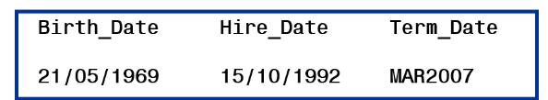
QUIZ
Which FORMAT statement creates the output?
Option A: format Birth_Date Hire_Date ddmmyy9.
Term_Date mmyy7.;
Option B: format Birth_Date Hire_Date ddmmyyyy.
Term_Date mmmyyyy.;
Option C: format Birth_Date Hire_Date ddmmyy10.
Term_Date monyy7.;
Option D: Any PROC FORMAT will do that for me!
Notes:
Poll Title: Which FORMAT statement creates the output? https://www.polleverywhere.com/multiple_choice_polls/LzJCKNDeXNPGSHi1GMwti?flow=Default&onscreen=persist

Slide 36
QUIZ
Which FORMAT statement creates the output?
Option A: format Birth_Date Hire_Date ddmmyy9.
Term_Date mmyy7.;
Option B: format Birth_Date Hire_Date ddmmyyyy.
Term_Date mmmyyyy.;
Option C: format Birth_Date Hire_Date ddmmyy10.
Term_Date monyy7.;
Option D: Any PROC FORMAT will do that for me!
Notes:
Poll Title: Which FORMAT statement creates the output? https://www.polleverywhere.com/multiple_choice_polls/LzJCKNDeXNPGSHi1GMwti?flow=Default&onscreen=persist

Slide 37
attrib Statement
Can be used instead of labels and formats
data formatdata2;
attrib gender format=malefemf. label="Patient Gender"
like format=likef.;
input gender like;
datalines;
…same as before after this…;
This command does not create the variables until they are read in, so order isn’t affected
See more here

Slide 38
Practice Problems 1 & 2

Slide 39
Saving/Reading Data

Slide 40
Recap – libname (READING/LOADING Data option 1)
libname anyname ’filepath’;
Points SAS to the location (library) where you will be saving/loading your data to/from
Data in workspaces are TEMPORARY. Data in libraries are PERMANENT.
To SAVE a dataset TO a library:
data nameoflibrary.nameofpermanentdata;
set nameoftemporarydata;
run;
To READ/LOAD a dataset FROM your library:
data nameoflibrary.nameoftemporarydata;
set nameofpermanentdata;
run;
Data line: data you are ”creating” (in your workspace or library)
Set line: data that SAS already knows/has access to (from your workspace or library)

Slide 41
Saving permanent datasets
Permanent data:
Stored using the .sas7bdat extension
Keeps variable and dataset attributes
Libname statement stays in effect until cancelled, changed, or your SAS session ends
Notes:
Note – Fall 2021 - Change to explain each element like I do in R code

Slide 42
READING/Loading Data Option 2: Proc import
SAS Proc Import can import Excel data as well as other types of files such as .txt files
Importing the data will still create a temporary data set in a SAS library
General Code:
PROC IMPORT DATAFILE = "file_location"
OUT = dataset_name
DBMS = file_type REPLACE;
/*SHEET="XXXX"; <-- include this code if loading in multiple sheets */
GETNAMES=YES;
RUN;

Slide 43
PROC IMPORT
SAS Proc Import can import Excel data as well as other types of files such as .txt files
Importing the data will still create a temporary data set in a SAS library
General Code:
PROC IMPORT DATAFILE = "file_location"
OUT = dataset_name
DBMS = file_type
REPLACE;
/*SHEET="XXXX"; <-- include this code if loading in multiple sheets */
GETNAMES=YES;
RUN;
The out statement creates the dataset with the name you give.

Slide 44
PROC IMPORT
SAS Proc Import can import Excel data as well as other types of files such as .txt files
Importing the data will still create a temporary data set in a SAS library
General Code:
PROC IMPORT DATAFILE = "file_location"
OUT= dataset_name
DBMS= file_type
REPLACE;
/*SHEET="XXXX"; <-- include this code if loading in multiple sheets */
GETNAMES=YES;
RUN;
Common file extensions include txt (though SAS requires “dlm”), xls, xlsx, csv
Only need if replacing a data set with same name
(a good idea to include if you may reload several
times after making changes)

Slide 45
PROC IMPORT
SAS Proc Import can import Excel data as well as other types of files such as .txt files
Importing the data will still create a temporary data set in a SAS library
General Code:
PROC IMPORT DATAFILE = "file_location"
OUT= dataset_name
DBMS= file_type
REPLACE;
/*SHEET="XXXX"; <-- include this code if loading in multiple sheets */
GETNAMES=YES;
RUN;
Only needs for xlsx formats when you are choosing a particular sheet.

Slide 46
PROC IMPORT
SAS Proc Import can import Excel data as well as other types of files such as .txt files
Importing the data will still create a temporary data set in a SAS library
General Code:
PROC IMPORT DATAFILE = "file_location"
OUT= dataset_name
DBMS= file_type
REPLACE;
/*SHEET="XXXX"; <-- include this code if loading in multiple sheets */
GETNAMES=YES;
RUN;
Tells SAS that the first line of the data are variable names; the default is yes

Slide 47
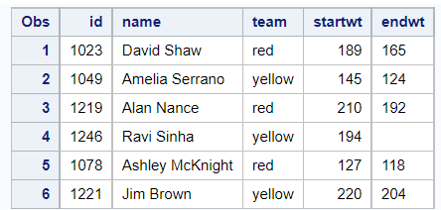
Proc import Example (XLSX)
PROC IMPORT DATAFILE = "/home/u64289425/sasuser.v94/STAT 7500 F25/data/club.xlsx"
OUT = club
DBMS= xlsx
REPLACE;
SHEET="SHEET1"; *not needed since only one sheet;
GETNAMES=YES;
RUN;
proc print data=club;
run;

Slide 48
.txt files & Delimiters
When loading a “text” file, you need to specify dmbs=dlm and delimiter=<delimiter> (many options for delimiter; for tab and space delimited files – the most common – use ‘09’x and ’20’x respectively)
OR
for tab delimited files, simply dmbs=tab
Here are some examples in SAS Documentation

Slide 49
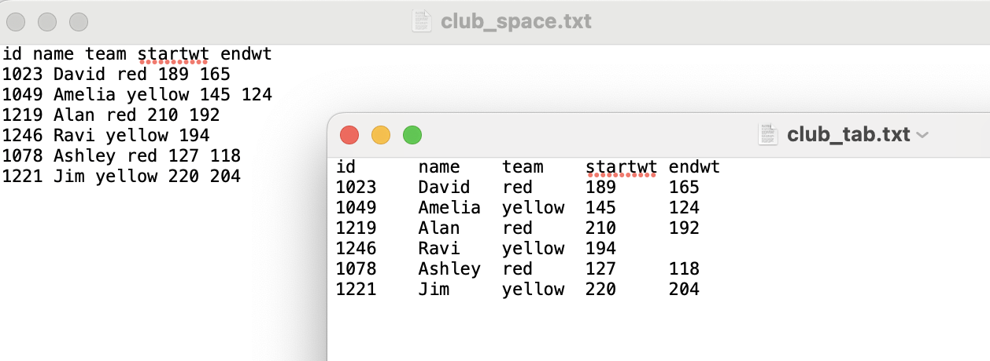
With tab delimited files, two options:
/* Option 1 – space delimited file*/ PROC IMPORT DATAFILE = "/home/u64289425/sasuser.v94/STAT 7500 F25/data/club_space.txt" OUT = club DBMS= dlm REPLACE; DELIMITER = '20'x; RUN; /* Option 2 – tab delimited file*/ PROC IMPORT DATAFILE = "/home/u64289425/sasuser.v94/STAT 7500 F25/data/club_tab.txt" OUT = club DBMS= tab REPLACE; RUN;

Slide 50
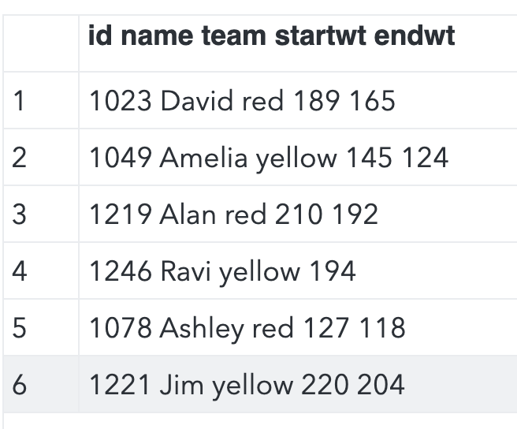
What can go Wrong…
With the wrong delimiter or without one given…
PROC IMPORT DATAFILE = "/home/u64289425/sasuser.v94/STAT 7500 F25/data/club_space.txt" OUT = club DBMS= dlm REPLACE; DELIMITER = ‘09'x; RUN;
proc print data=club;
run;

Slide 51
Other Options for Importing Data
In PROC IMPORT, can specify the statement DATAROW=<number>, where for any integer number, the data will not be read in above this row
INFILE can be used in the data step (and manipulations to the data done manually directly when importing)
There is also an import wizard (helpful the first time around, as it also generates SAS code) – only works for Excel files in SAS On Demand.
Note: If a variable name is read in as “First Name”, you can reference it in SAS using “First Name”n.

Slide 52
Quiz
The DATALINES statement is used when reading data located:
A) In an external file on your computer or network drive. B) Directly in the SAS program itself, embedded in the DATA step. C) Only in Excel or CSV files. D) In a permanent SAS dataset in a library.

Slide 53
Quiz
The DATALINES statement is used when reading data located:
A) In an external file on your computer or network drive. B) Directly in the SAS program itself, embedded in the DATA step. C) Only in Excel or CSV files. D) In a permanent SAS dataset in a library.

Slide 54
QUIZ
During an interactive SAS session, every time that you submit a program you must also resubmit the LIBNAME statement
TRUE
FALSE

Slide 55
QUIZ
During an interactive SAS session, every time that you submit a program you must also resubmit the LIBNAME statement
TRUE
FALSE

Slide 56
QUIZ
True or False? The DATA step below reads a temporary SAS data set to create a permanent SAS data set.
libname mylib "/home/u12345/sasuser.v94/STAT7500";
data mylib.dataABC;
set work.dataXYZ;
run;

Slide 57
QUIZ
True or False? The DATA step below reads a temporary SAS data set to create a permanent SAS data set.
libname mylib "/home/u12345/sasuser.v94/STAT7500";
data mylib.dataABC;
set work.dataXYZ;
run;

Slide 58
Exporting Data to Excel Sheet
PROC EXPORT data=club dbms=xlsx outfile="/home/u64289425/sasuser.v94/STAT 7500 F25/data/clubexport.xlsx" replace; run;

