Slide 1
Combining Datasets in SAS STAT 7500 - Statistical Programming Dr. Fitzgerald Fall 2025

Slide 2
Combining Datasets - Overview
Sorting data (proc sort)
Program Data Vector (PDV)
Set (DATA Step)
“Appending” and “Concatenating”
Merge (DATA Step)
Nonmatching data in set and merge
Issues with merging data

Slide 3
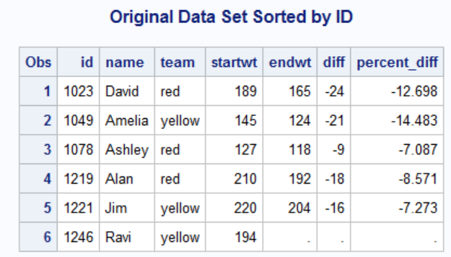
PROC SORT
proc sort data=club;
by id;
run;
proc print data=club;
title 'Original Data Set Sorted by ID';
run;

Slide 4
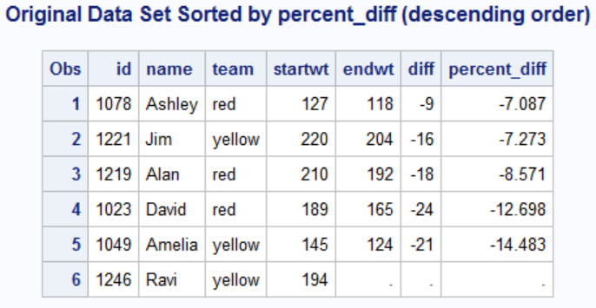
PROC SORT
proc sort data=club;
by descending percent_diff;
run;
proc print data=club;
title 'Original Data Set Sorted by percent_diff (descending order)';
run;

Slide 5
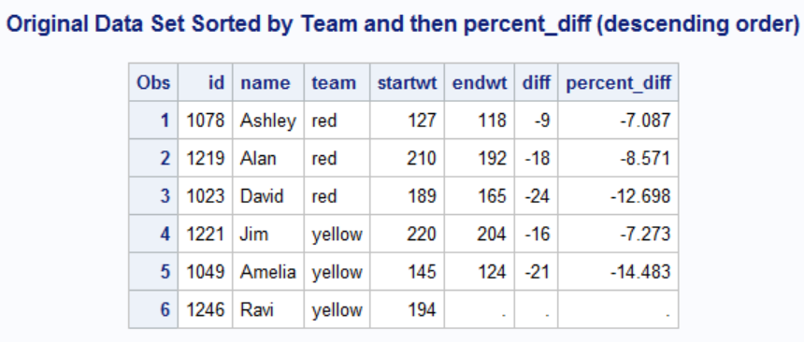
PROC SORT
proc sort data=club;
by team descending percent_diff;
run;
proc print data=club;
title 'Original Data Set Sorted by Team and then percent_diff (descending order)';
run;
Now sorted by team first (alphabetically) and then by percent difference within team second

Slide 6
PROC SORT
Sort the data by one or more variables
proc sort data=mydata; by ID;
Can sort in descending order
by descending ID;
Can sort sequentially by more than one variable
proc sort data=mydata; by id age; (sorts by id and age within id)
Necessary for some statements (like merge)
Can remove duplicates
Use out=newdsname so you don’t overwrite the data!
proc sort data=mydata out=newdata nodup; by ID;
removes cases that are identical in all variables
proc sort data=mydata out=newdata nodupkey; by ID;
removes cases with identical variable(s) in by statement

Slide 7
nodup vs. nodupkey Example
nodup & nodupkey (in proc sort) restrict duplicates
Consider the following data:
ID Var1
001 100
001 100
001 200
002 100
002 200
nodup (with by ID) removes the 2nd obs
Keeps only the 1st instance of the fully matched row
nodupkey with by ID removes the 2nd, 3rd, and 5th obs
Keeps only the first row per BY group

Slide 8
Appending and Concatenating (SET Statement)
Appending and concatenating involves combining SAS data sets (vertically), one after the other, into a single SAS data set.
SAS Data Set
Appending adds the observations in the second data set directly to the end of the original data set
Modifies, doesn’t create new dataset
Requires matching structures
PROC APPEND
Concatenating copies all observations from the first data set and then copies all observations from one or more successive data sets into a new data set.
More flexible, but slower
DATA step
+
SAS Data Set
Notes:
Appending and concatenating are very similar; it is bringing the data together vertically. Appending … Concatenating …

Slide 9
Merging
Merging involves combining observations from two or more SAS data sets into a single observation in a new SAS data set.
Observations can be merged based on their positions in the original data sets or merged by one or more common variables.
SAS Data Set
SAS Data Set
+
Notes:
Merging involves bringing the data together side by side…

Slide 10
Example: Appending a Data Set
One data set is appended to a master data set.
Emps
First | Gender | HireYear
Stacey | F | 2006
Gloria | F | 2007
James | M | 2007
Emps
First | Gender | HireYear
Stacey | F | 2006
Gloria | F | 2007
James | M | 2007
Brett | M | 2008
Renee | F | 2008
Emps2008
First | Gender | HireYear
Brett | M | 2008
Renee | F | 2008
Notes:
Here is a specific example of appending … Note that the first data set is growing, we aren’t actually creating a new data set.

Slide 11
Example: Concatenating Data Sets
Two data sets are concatenated to create a new data set.
EmpsDK
First | Gender | Country
Lars | M | Denmark
Kari | F | Denmark
Jonas | M | Denmark
EmpsAll1
First | Gender | Country
Lars | M | Denmark
Kari | F | Denmark
Jonas | M | Denmark
Pierre | M | France
Sophie | F | France
EmpsFR
First | Gender | Country
Pierre | M | France
Sophie | F | France
Notes:
With concatenating, we actually create a new data set …

Slide 12
Compiling/Executing a SET statement in SAS
Concatenate EmpsDK and EmpsFR to create a new data set named EmpsAll1.
The data sets contain the same variables.
EmpsDK
First | Gender | Country
Lars | M | Denmark
Kari | F | Denmark
Jonas | M | Denmark
EmpsFR
First | Gender | Country
Pierre | M | France
Sophie | F | France
data EmpsAll1;
set EmpsDK EmpsFR;
run;
p110d02

Slide 13
Compilation
EmpsDK
First | Gender | Country
Lars | M | Denmark
Kari | F | Denmark
Jonas | M | Denmark
EmpsFR
First | Gender | Country
Pierre | M | France
Sophie | F | France
data EmpsAll1;
set EmpsDK EmpsFR;
run;
PDV
First | Gender | Country
EmpsAll1
First | Gender | Country
Program Data Vector (PDV) is a logical area of memory
that is created during the data step processing. Behind the scenes, SAS processes one row at a time in memory.
...

Slide 14
Example: Merging Data Sets
Two data sets are merged to create a new data set.
EmpsAU
First | Gender | EmpID
Togar | M | 121150
Kylie | F | 121151
Birin | M | 121152
PhoneH
EmpID | Phone
121150 | +61(2)5555-1793
121151 | +61(2)5555-1849
121152 | +61(2)5555-1665
EmpsAUH
First | Gender | EmpID | Phone
Togar | M | 121150 | +61(2)5555-1793
Kylie | F | 121151 | +61(2)5555-1849
Birin | M | 121152 | +61(2)5555-1665
Notes:
In this example of merging, we are matching observations by EmpID and bringing the observations together …

Slide 15
Match-Merging
Match-merging combines observations from two or more SAS data sets into a single observation in a new data set based on the values of one or more common variables.
A | B | C
 |  | 1
 |  | 2
 |  | 3
C | D | E
1
2
3
A | B | C
 |  | 1
 |  | 2
 |  | 2
C | D | E
1
1
2
A | B | C
 |  | 1
 |  | 2
 |  | 4
C | D | E
2
3
4
Notes:
In these merging sections, we will look at match-merging …

Slide 16
Match-Merging
A | B | C
 |  | 1
 |  | 2
 |  | 3
C | D | E
1
2
3
One-to-One
A single observation in one data set is related to one and only one observation from another data set based on the values of one or more selected variables.
One-to-Many or Many-to-One
A single observation in one data set is related to more than one observation from another data set based on the values of one or more selected variables and vice versa.
Nonmatches
At least one single observation in one data set is unrelated to any observation from another data set based on the values of one or more selected variables.
A | B | C
 |  | 1
 |  | 2
 |  | 2
C | D | E
1
1
2
A | B | C
 |  | 1
 |  | 2
 |  | 4
C | D | E
2
3
4
Notes:
There are different types of match-merging, here are three different types …
In this section, we are looking at one-to-one.

Slide 17
One-to-One Merge
Merge EmpsAU and PhoneH by EmpID to create a new data set named EmpsAUH.
The data sets must be sorted by EmpID.
EmpsAU
First | Gender | EmpID
Togar | M | 121150
Kylie | F | 121151
Birin | M | 121152
PhoneH
EmpID | Phone
121150 | +61(2)5555-1793
121151 | +61(2)5555-1849
121152 | +61(2)5555-1665
data EmpsAUH;
merge EmpsAU PhoneH;
by EmpID;
run;
This is new code for us
p110d05
Notes:
Instructors, this one-to-one is so basic we opted not to show compile and execute phases. We will show this in the one-to-may example.

Slide 18
One-to-Many Merge
Merge EmpsAU and PhoneHW by EmpID to create a new data set named EmpsAUHW.
The data sets are sorted by EmpID.
PhoneHW
EmpID | Type | Phone
121150 | Home | +61(2)5555-1793
121150 | Work | +61(2)5555-1794
121151 | Home | +61(2)5555-1849
121151 | Work | +61(2)5555-1850
121152 | Home | +61(2)5555-1665
121152 | Work | +61(2)5555-1666
EmpsAU
First | Gender | EmpID
Togar | M | 121150
Kylie | F | 121151
Birin | M | 121152
data EmpsAUHW;
merge EmpsAU PhoneHW;
by EmpID;
run;
p110d06

Slide 19
Final Results
EmpsAUHW
First | Gender | EmpID | Type | Phone
Togar | M | 121150 | Home | +61(2)5555-1793
Togar | M | 121150 | Work | +61(2)5555-1794
Kylie | F | 121151 | Home | +61(2)5555-1849
Kylie | F | 121151 | Work | +61(2)5555-1850
Birin | M | 121152 | Home | +61(2)5555-1665
Birin | M | 121152 | Work | +61(2)5555-1666

Slide 20
Nonmatches Merge
Merge EmpsAU and PhoneC by EmpID to create a new data set named EmpsAUC.
The data sets are sorted by EmpID.
EmpsAU
First | Gender | EmpID
Togar | M | 121150
Kylie | F | 121151
Birin | M | 121152
PhoneC
EmpID | Phone
121150 | +61(2)5555-1795
121152 | +61(2)5555-1667
121153 | +61(2)5555-1348
data EmpsAUC;
merge EmpsAU PhoneC;
by EmpID;
run;
p110d07

Slide 21
Final Results
The final results include matches and nonmatches.
Matches are observations that contain data from both input data sets.
Nonmatches are observations that contain data from only one input data set.
EmpsAUC
First | Gender | EmpID | Phone
Togar | M | 121150 | +61(2)5555-1795
Kylie | F | 121151
Birin | M | 121152 | +61(2)5555-1667
 |  | 121153 | +61(2)5555-1348
Notes:
By default in SAS, you get matches and non-matches …

Slide 22
Differing Data in Set/Merge
Missing values
Variables missing in some datasets being set
Observations missing for some datasets being merged
The rename= statement can be used to combine datafiles with different names
Ex: data1 has “sex” but data2 has “gender”
data combined;
set data1 (rename=(sex=gender)) data2;
Alternate version – rename as a statement
data data1b; set data1;
rename sex = gender;
* then set data1b with data2

Slide 23
Issues with Merging Data
Be careful with merges!
Overwriting datasets
Incorrect merges (without by statement)
We will learn a trick with merges later (in=a)
Formats
SAS will complain about combining data with different formats (more on this later)

Slide 24
Quiz
Which method should be used for the given business scenario?
The JanSales, FebSales, and MarSales data sets need to be combined to create the Qtr1Sales data set
Appending
Concatenating
Merging
Surfing

Slide 25
Quiz
Which method should be used for the given business scenario?
The Sales data set needs to be combined with the Target data set by month to compare the sales data to the target data
Appending
Concatenating
Merging
Surfing

Slide 26
Quiz
Which method should be used for the given business scenario?
The OctSales data set needs to be added to the YTD data set.
Appending
Concatenating
Merging
Surfing

Slide 27
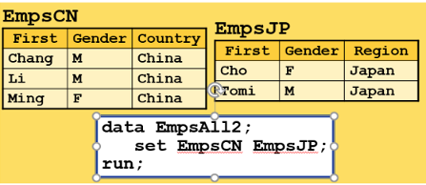
Quiz
How many variables will be in EmpsAll2 after concatenating EmpsCN and EmpsJP?
0
1
2
3
4
5
6

Slide 28
Quiz
Which step is sorting the observations in a SAS data set and overwriting the same SAS data set?
1. proc sort data = work.EmpsAU
out = work.sorted; by First; run;
2. proc sort data = work.EmpsAU
out = orion.EmpsAU; by First; run;
3. proc sort data = work.EmpsAU; by First; run;

Slide 29
Creating new variables

Slide 30
Creating new variables
New variables can be created rather easily from existing variables
New variables can be created in the same or new data step in which the data is entered (if done by hand or “infile”). This can be done with a new data step using a SET statement.
Calculations in SAS:
+ addition x=y+z
- subtraction x=y-z
* multiplication x=y*z
/ division x=y/z
** raises to a power x=y**z
log( ) calculates the natural log x=log(y)
log10( ) calculates the log base 10 x=log10(y)
exp( ) calculates the e to the power of ( ) x=exp(y)

Slide 31
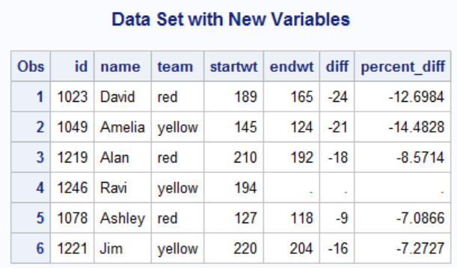
Creating new variables
Creating new data set and setting it equal to the club data to start
data club2;
set club;
diff = endwt - startwt;
percent_diff = ((endwt - startwt)/startwt)*100;
run;
proc print data=club2;
title 'Data Set with New Variables';
run;

Slide 32
Changing formats of variables
/* The following formats the percent_diff variable to have two decimal places*/
data club2;
set club;
diff = endwt - startwt;
format percent_diff 8.2;
percent_diff = ((endwt - startwt)/startwt)*100;
run;
proc print data=club2;
title 'Data Set with New Variables';
run;

Slide 33
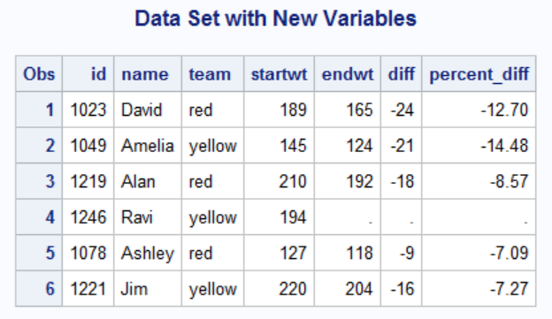
Changing formats of variables
If the percent_diff values were exactly an integer or a value with only a “tenths” place, then a trailing 0 would be added (assuming the number of columns saved is large enough)

Slide 34
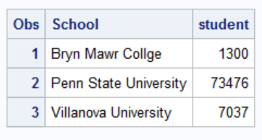
Another example of changing format
data enrollment;
input School &$30. student comma6.;
cards;
Bryn Mawr College 1,300
Penn State University 73,476
Villanova University 7,037
;
proc print data=enrollment;
run;

Slide 35
Another example of changing format
Read six positions (including commas) and make numeric (removes comma)
data enrollment;
input School &$30. student comma6.;
cards;
Bryn Mawr College 1,300
Penn State University 73,476
Villanova University 7,037
;
proc print data=enrollment;
run;

Slide 36
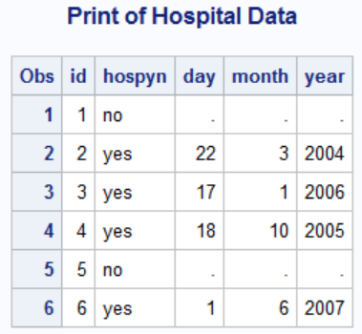
Date formats
Recall: SAS saves dates as the number of days since January 1, 1960
When displaying dates, it is necessary to format the SAS date in a recognizable format to the reader.
data hospital;
input id hospyn $ day month year;
cards;
1 no . . .
2 yes 22 3 2004
3 yes 17 1 2006
4 yes 18 10 2005
5 no . . .
6 yes 1 6 2007
;
run;
proc print data=hospital;
title 'Print of Hospital Data';
run;
Month, day, and year stored separately but we want to combine into a single piece of information

Slide 37
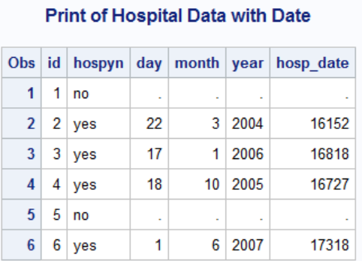
Date formats
Converts month, day, and year into a single number of days since January 1st, 1960
data hospital2;
set hospital;
hosp_date = mdy(month, day, year);
run;
proc print data=hospital2;
title 'Print of Hospital Data with Date';
run;

Slide 38
Date formats
data hospital3;
set hospital2;
format hosp1 date9. hosp2 date8. hosp3 ddmmyy8. hosp4 ddmmyy9.
hosp5 ddmmyy10. hosp6 ddmmyyd10. hosp7 ddmmyyp10.
hosp8 worddate.;
hosp1 = hosp_date;
hosp2 = hosp_date;
hosp3 = hosp_date;
hosp4 = hosp_date;
hosp5 = hosp_date;
hosp6 = hosp_date;
hosp7 = hosp_date;
hosp8 = hosp_date;
run;
proc print data=hospital3;
title 'Print of Hospital Data with Date Formats';
run;
Various data format options

Slide 39
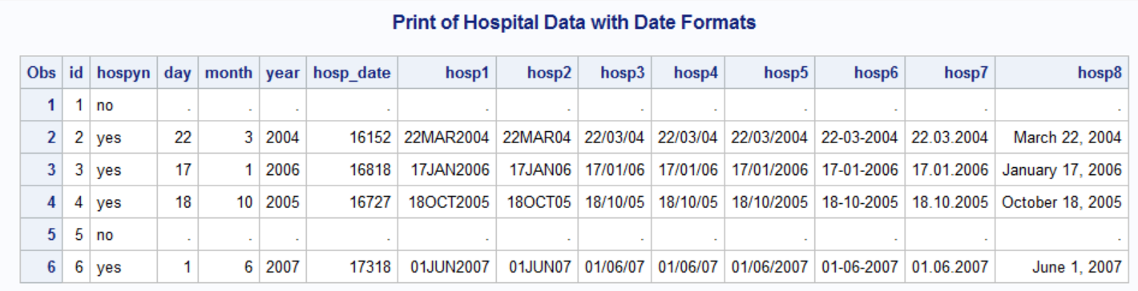
Date Formats

Slide 40
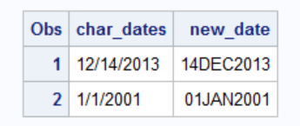
Date formats
data dates;
input char_dates $10.;
cards;
12/14/2013
1/1/2001;
run;
data dates;
set dates;
format new_date date9.;
new_date = input( char_dates, MMDDYY10.);
run;
proc print data=dates;
run;
What if you had character date data and needed to convert it?
Creating a new variable new_date and giving it date9. format (stored as numeric, but tells it how to display)
Informat telling it how to interpret/convert the character string into a date

Slide 41
Date formats
When the date comes in as a timestamp (for example, 1/1/2013 5:00), you can use the datepart and timepart statement to pull out just the date or just the time).
proc import datafile='/home/u64289425/sasuser.v94/STAT 7500 F25/data/NYCflights2013.csv'
out=NYCflights
dbms=csv
replace;
run;
data NYC_datetime; set NYCflights;
dates = datepart(time_hour);
times = timepart(time_hour);
format dates2 worddate. times2 time8.;
dates2 = dates;
times2 = times;
keep time_hour dates times dates2 times2;
run;
We will talk about the keep statement shortly, but note that it will only keep these five variables in the NYC2 data set.

Slide 42
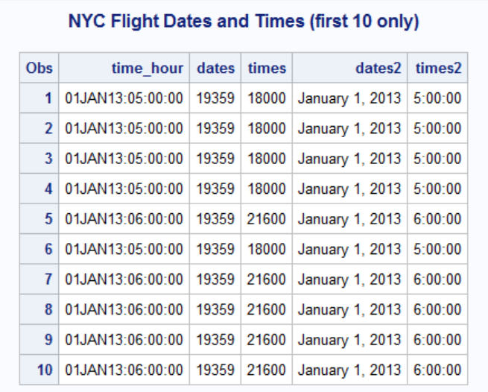
Date formats
proc print data=NYC_datetime(obs=10);
run;
Note that times values are number
of seconds since midnight

Slide 43
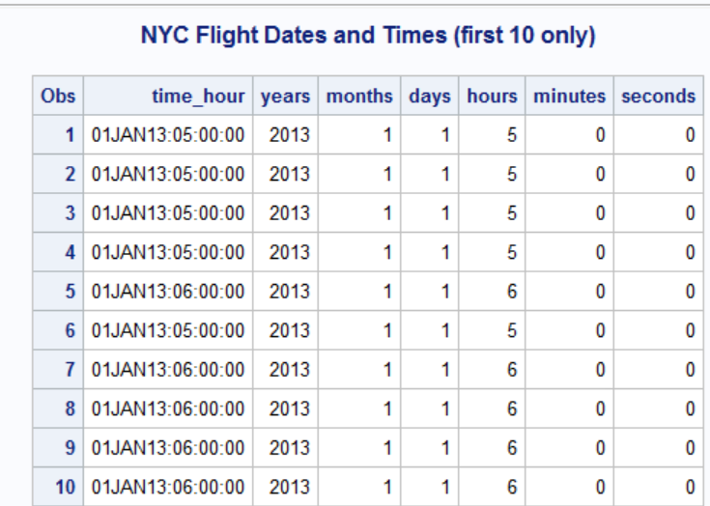
Date formats
data NYC_datetime2; set NYC_datetime;
years = year(dates);
months = month(dates);
days = day(dates);
hours = hour(times);
minutes = minute(times);
seconds = second(times);
keep time_hour years months days hours minutes seconds;
run;
proc print data=NYC_datetime2(obs=10);
title 'NYC Flight Dates and Times (first 10 only)';
run;
Pulling out year/month/day and hours/minute/second from date information
Print out first 10 observations only

