Slide 1
Working with Data in SAS STAT 7500 - Statistical Programming Dr. Fitzgerald Fall 2025
Notes:
Start here on 9/17

Slide 2
Creating Variables
Must be done within a DATA step
Numeric or Character
filenumber = 1; file = ‘file 1’;
Arithmetic operators (+, -, *, /, **)
increase = posttest – pretest;
missing data outputs missing result
SUM(Var1, Var2, etc.), among others
Adds variables, but excludes missing

Slide 3
Quiz
What is the value of num in the statement:
4 + 10 / 2;
Missing
0
7
9

Slide 4
Quiz
If var1 = . and var2 = 10, then what is num in the statement num = var1 + var2/2;
.
0
5
10
SAS will break

Slide 5
Rounding
ROUND, CEIL, FLOOR
Default # of decimal places is 0
2nd Argument represents place, not # digits
Call | Result
Round(15.15) | 15
Ceil(14.01) | 15
Floor(0.55) | 0
Round(12.345,10) | 10
Round(12.345,0.1) | 12.3
Round(12.345,100) | 0
Call | Result
Round(15.15) | 15
Ceil(14.01) | 15
Floor(0.55) | 0
Round(12.345,10)
Round(12.345,0.1)
Round(12.345,100)
Call | Result
Round(15.15)
Ceil(14.01)
Floor(0.55)
Round(12.345,10)
Round(12.345,0.1)
Round(12.345,100)

Slide 6
Working with Strings
UPCASE (also LOWCASE, PROPCASE)
upcase(firstname);
SUBSTR(variable, firstchar, length)
Extracts a substring of a character variable
Input | Output
Joe | JOE
joe | JOE
JOE | JOE
Purpose | Input | Output
Extract ID# only | substr(‘ID525’,3,3) | “525”
First Three Letters of Name | substr(‘Daniel’,1,3) | ?
data ids;
id = ‘ID525’;
id_num_char = substr(id, 3, 3); *’525’ will still be character string;
id_num = input(id_num_char, best.); *use input() to convert to numeric;
run;

Slide 7
Working with Strings II
SCAN(variable, word#, <delimiter>)
Extracts a word within a string
The default delimiter is a space
Example
Scan(‘Sir David Spiegelhalter’, 2)
results in “David”
Scan(‘Sir David Spiegelhalter’, -1)
results in “Spiegelhalter”

Slide 8
Concatenation and Trimming
Concatenation: ||
Combines text variables into one
fullname = firstname || ‘ ‘ || lastname;
firstname = ‘Wendy’ and lastname = ‘Smith’
becomes fullname = ‘Wendy Smith’
LEFT, RIGHT, TRIM, COMPRESS
Removes blanks from variables
LEFT and RIGHT align the string
TRIM removes trailing blanks
COMPRESS removes all blanks (or other)
compress(variable, <exact characters to remove>, <modifiers>)
compress(variable) will remove spaces by default
compress(variable, , ‘kd’) will keep numeric digits
compress(variable, , ‘d’) will remove numeric digits

Slide 9
Character ⬄ Numeric
PUT – changes variable format
Makes variable character
idchar = put(idnum,$8.);
INPUT – makes variable numeric
idnum = input(idchar,8.);
Alternative trick for converting to numeric: multiply by 1
idnum = idchar * 1;
Notes:
Start here (review 2-1) on 9/17

Slide 10
Subsetting (DROP/KEEP)
Syntax
In a DATA Step
data newdata; set olddata; drop var7 var12;
As part of a data argument
proc sort data=olddata out=newdata (keep=id var1) ; by id;
proc sort data=olddata (keep=id var1) out=newdata; by id;
(which one is more efficient?)

Slide 11
If…then
Creating variables
if bp>200 then highbp=1;
(there are some issues here – see “else” later)
Changing variables to correct errors
if name=‘Suzane’ then name=‘Suzanne’;
if firstname=‘Suzane’ and lastname=‘Jones’ then
firstname=‘Suzanne’;
if ID=5067 then pretest=56;
Deleting observations
if age<0 then delete; or if age>=0;

Slide 12
If…then…else
Using else is a more efficient, as it continues from its own step.
if age>65 then agecat=‘old’;
if age<=65 then agecat=‘young’;
vs. if age>65 then agecat=‘old’;
else if age>. then agecat=‘young’;
In SAS, an else is its own statement
If height > 72 then heightcat=‘tall’;
else if height < 60 then heightcat=‘short’;
else heightcat=‘medium’;

Slide 13
Comparing to Multiple Values
If religion in (‘Catholic’ ‘Protestant’);
will remove all other religions
(be careful of capitalizations)
If substr(religion,1,2) in (‘Ca’ ‘ca’ ‘CA’ ‘PR’ ‘pr’ ‘Pr’);
If (substr(upcase(religion),1,2)) in (‘CA’ ‘PR’);

Slide 14
Split Datasets in DATA Step
Splitting men and women from a dataset
data males females;
set alldata;
if gender=‘M’ then output males;
if gender=‘F’ then output females;
(how can this code be made more efficient?)

Slide 15
Checking Merged Data
in= creates a temporary (local) variable that can be referenced in the datastep. It’s particularly useful when checking merges:
data mergeddata;
merge dstime1 (in=a) dstime2 (in=b); by id;
length source $11.;
if a and b then source=‘both’;
else if a then source=‘time 1 only’;
else if b then source=‘time 2 only’;
else if not a and not b then source=‘neither’;
(can you make this more efficient?)

Slide 16
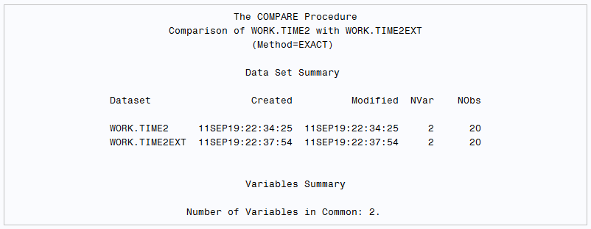
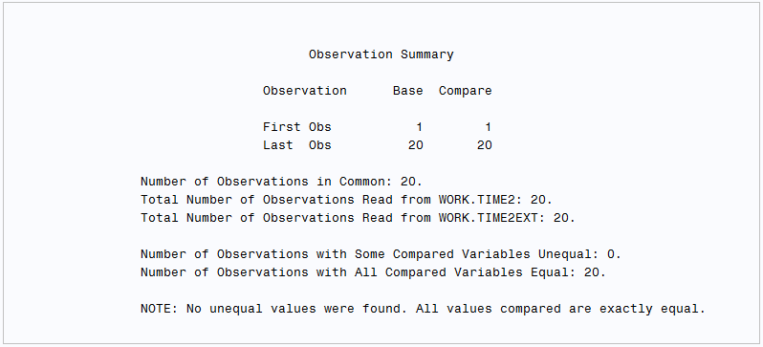
PROC COMPARE
Compares files to determine similarity
Proc compare base=dsname1 compare=dsname2; run;
Notes:
Moved to COMMON PROCs instead for next time

Slide 17
first. and last.
You can use these to identify the first or last record from sorted data
Ex - When was each Philadelphia Dragon’s first game with one homerun

Slide 18
Philadelphia Dragons (Original) Data
Player | Day | HR
Mo’Ne Davis | 1 | 0
Mo’Ne Davis | 2 | 1
Mo’Ne Davis | 3 | 1
Mo’Ne Davis | 4 | 0
Mo’Ne Davis | 5 | 2
Scott Banduras | 1 | 0
Scott Banduras | 2 | 0
Scott Banduras | 3 | 1
Scott Banduras | 4 | 0
Think about code to determine…
When was each Dragon’s
first game with one homerun?

Slide 19
Philadelphia Dragons Data - Sorted
Player | Day | HR
Mo’Ne Davis | 1 | 0
Mo’Ne Davis | 4 | 0
Mo’Ne Davis | 2 | 1
Mo’Ne Davis | 3 | 1
Mo’Ne Davis | 5 | 2
Scott Banduras | 1 | 0
Scott Banduras | 2 | 0
Scott Banduras | 4 | 0
Scott Banduras | 3 | 1
proc sort data=dragons;
by name HR day;
proc print;
run;

Slide 20
Philadelphia Dragons Data – First HR
Player | Day | HR
Mo’Ne Davis | 1 | 0
Mo’Ne Davis | 4 | 0
Mo’Ne Davis | 2 | 1
Mo’Ne Davis | 3 | 1
Mo’Ne Davis | 5 | 2
Scott Banduras | 1 | 0
Scott Banduras | 2 | 0
Scott Banduras | 4 | 0
Scott Banduras | 3 | 1
First.HR
1
0
1
0
1
1
0
0
1
proc sort data=dragons;
by name HR day;
data dragonsfirstHR;
set dragons;
by name HR;
if HR = 1 and first.HR;
run;
Player | Day | HR
Mo’Ne Davis | 2 | 1
Scott Banduras | 3 | 1
First.HR
1
1
Notes:
Stopped here on 2/17/21

Slide 21
Optional topics
Do Loops & Random Number Generation

Slide 22
Do Loops (Optional)
Do loops are useful for repeating statements (generating data)
The output statement creates an observation each time it’s executed
Assumed with the end of a step
To repeat steps, you’ll need to use the macro command %do and %end

Slide 23
Do/Output Example (Optional)
To generate data….
data mydata;
do k=1 to 10;
x=k;
y=500 + 10*x;
output;
end;
run;
(what happens without the output statement?)

Slide 24
Random Number Generation (Optional)
RAND(Distribution,<Parameters>)
Common distributions - Uniform, Normal, Binomial, Weibull, etc.
rand(‘Uniform’) is from a (Continuous) Unif(0,1)
rand(‘Normal’) is from a N(0,1)
rand(‘Normal’,100,15) is from a N(100,15)
Note: functions used to be separate
RANUNI, RANNOR, etc.
Seed numbers
Starting point on an internal table of random digits
Allows for reproducibility

Slide 25
Practice Problem (Optional)
Generate simulated data on weight vs. height for men.
Generate 100 observations for height in inches for men from a N(70,2.5) distribution
For each one, make weight = -202 + 5.26 * height (on average)
Add a random term to each weight value that comes from a N(0,27) distribution
Create plot of the data (proc gplot; plot weight*height;)
Optional: Make each person have a 52% chance of being male. Females follow a N(65,2.5) distribution, but have the same weight function from height (I don’t think that is true, but let’s go with it for our data). You can use var2*var1=var3 with sgplot to produce a plot of var1 and var2 with a separate plotting character for each unique value of var3.

