Slide 1
Common PROCs and Output STAT 7500 - Statistical Programming Dr. Fitzgerald

Slide 2
Concept map
What are the SAS commands we’ve seen so far?
What do they do?
How do they connect with one another?

Slide 3
PROC FREQ
Summarize one or multiple categorical variables
proc freq; table religion religion*gender;
Performs Chi-squared tests
proc freq; table religion*gender / chisq;
Output options (in tables statement)
nocol, norow, nocum, nopercent (suppress output)
/ list crosslist (changes from tabular format)
/ format (formatting options for table)
/ missing (includes missing data in table)

Slide 4
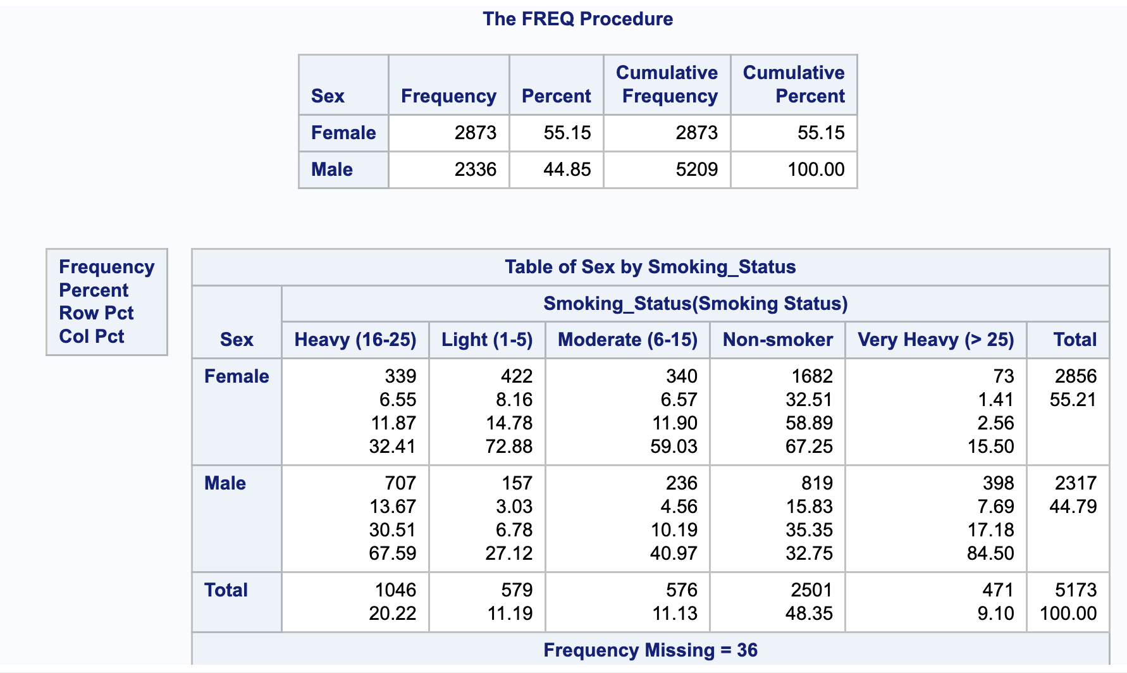
sashelp.heart
proc freq data = heart;
table Sex Sex*Smoking_Status;
run;
What’s
non-optimal about the output?

Slide 5
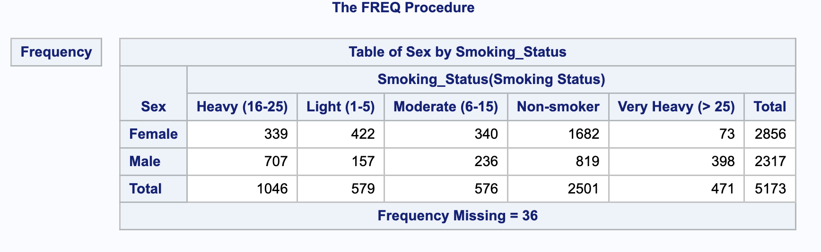
Suppress Output
proc freq data = heart;
table Sex Sex*Smoking_Status;
run;

Slide 6
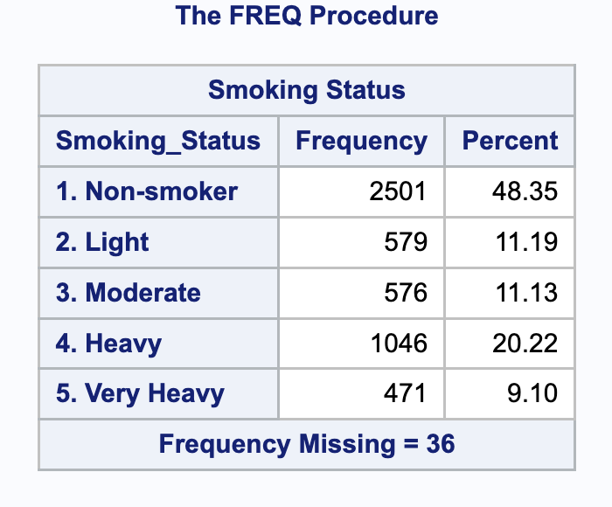
Change/re-order levels
proc format; value $smkorder 'Non-smoker' = '1. Non-smoker' 'Light (1-5)' = '2. Light' 'Moderate (6-15)' = '3. Moderate' 'Heavy (16-25)' = '4. Heavy' 'Very Heavy (> 25)' = '5. Very Heavy'; run; proc freq data= heart order = formatted; tables Smoking_Status / nocum; format Smoking_Status $smkorder.; run;

Slide 7
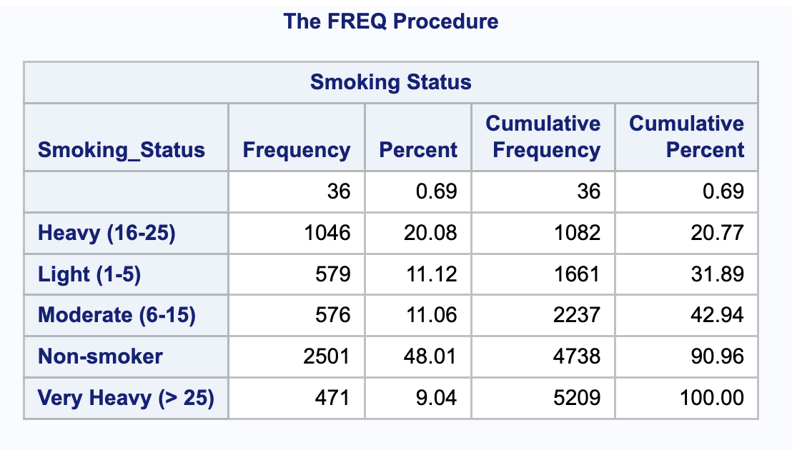
Show Missing Data in Tables
If you add / missing to a PROC FREQ, all missing values will be printed as their own category.
proc freq data = heart order = formatted;
table smoking_status / missing;
run;

Slide 8
Quiz
Cumulative percents are used with…
All Data Types
Numeric Data
Categorical data
No one uses cumulative percents…
Ordinal data
I don’t know

Slide 9
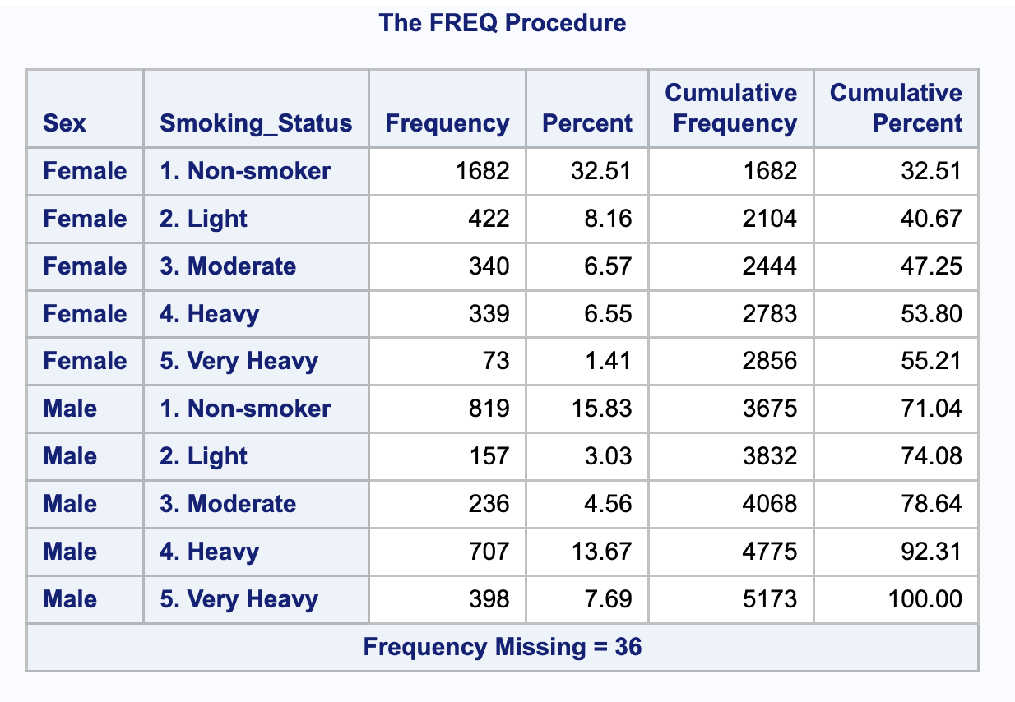
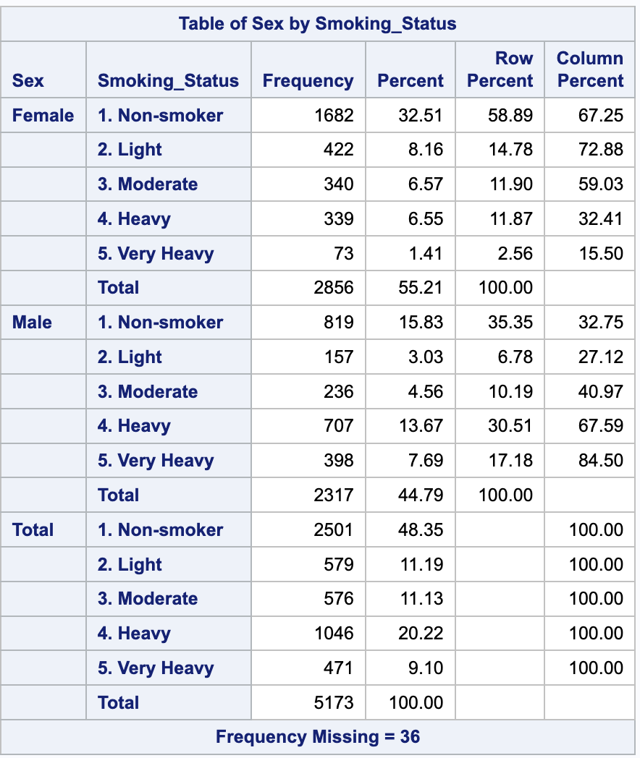
LIST and CROSSLIST options
tables Sex*Smoking_Status/ list;
tables Sex*Smoking_Status/ crosslist;

Slide 10
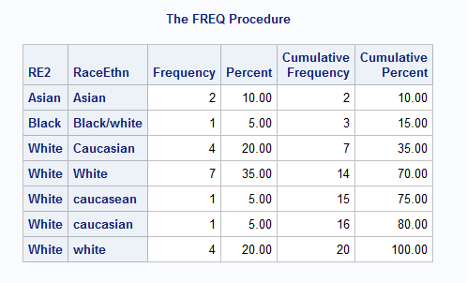
Another Use of / list
Check data manipulations…
proc freq data=merged;
tables RE2 * raceethn / list;

Slide 11
PROC MEANS
Shortest method of printing summary stats for numeric variables
Class statement partitions data

Slide 12
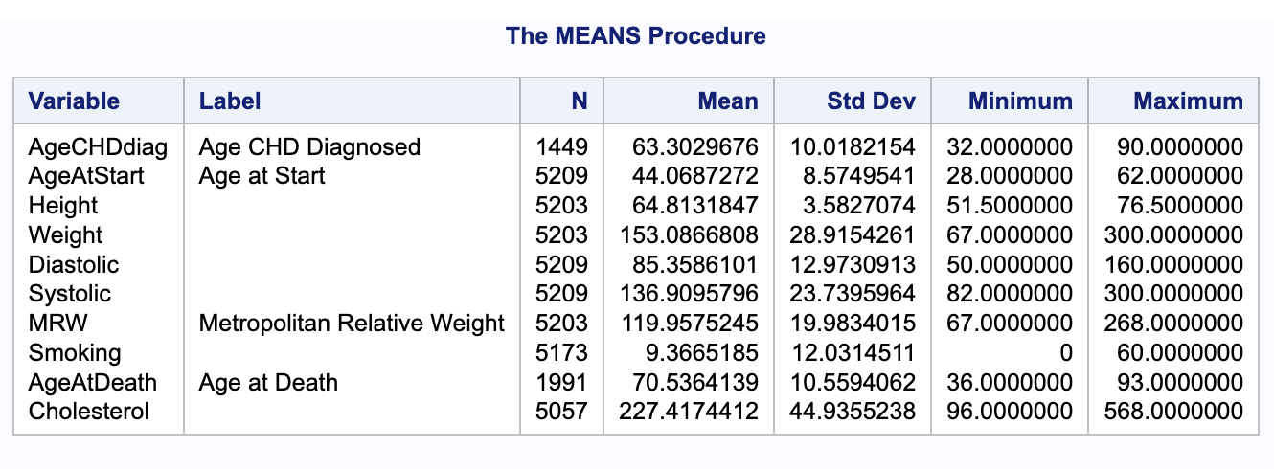
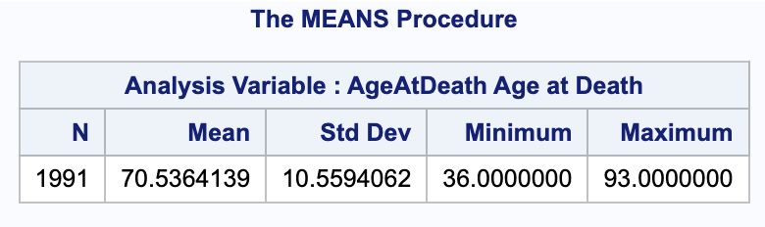
PROC MEANS Example I
proc means data=heart;
By default does all numeric variables
proc means data = heart; var AgeAtDeath; run;
Note the change in layout
What’s non-optimal about the output?

Slide 13
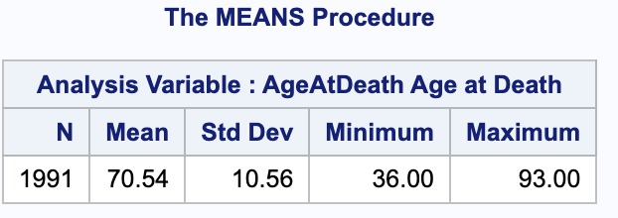
PROC MEANS Statement Options
Option | Description
MAXDEC= | specifies the number of decimal places to use in printing the statistics.
FW= | specifies the field width to use in displaying the statistics.
NONOBS | suppresses reporting the total number of observations for each unique combination of the class variables.
proc means data = heart maxdec = 2; var AgeAtDeath; run;

Slide 14
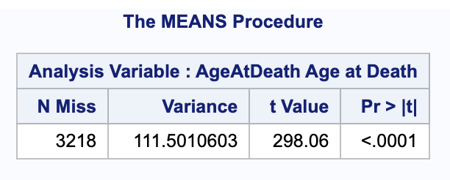
PROC MEANS Example II
Select statistics to calculate…
proc means data=heart nmiss var t probt; var AgeAtDeath;
Notice that these supersede the defaults

Slide 15
PROC MEANS Statistics
Descriptive Statistic Keywords
CLM | CSS | CV | LCLM | MAX
MEAN | MIN | MODE | N | NMISS
KURTOSIS | RANGE | SKEWNESS | STDDEV | STDERR
SUM | SUMWGT | UCLM | USS | VAR
Quantile Statistic Keywords
MEDIAN | P50 | P1 | P5 | P10 | Q1 | P25
Q3 | P75 | P90 | P95 | P99 | QRANGE
Hypothesis Testing Keywords
PROBT | T

Slide 16
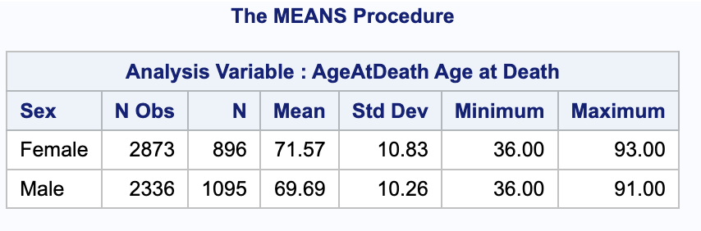
PROC MEANS Example III
Split by other variables…
proc means data = heart maxdec = 2; var AgeAtDeath; class Sex; run;

Slide 17
PROC UNIVARIATE
Provides more details than PROC MEANS
Extreme observations
Plots – histogram, boxplot, etc.
Test for normality

Slide 18
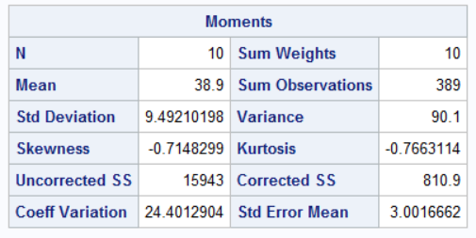
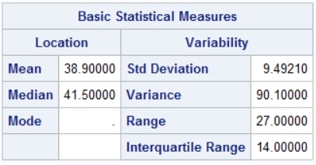
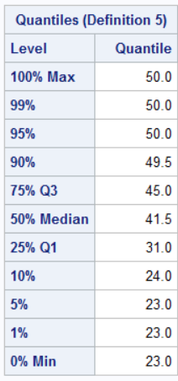
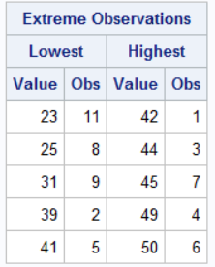
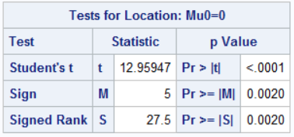
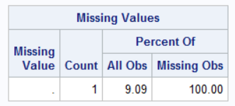
UNIVARIATE - Output
From the philatemps data (readdata.sas)
proc univariate data=philatemps; var high;

Slide 19
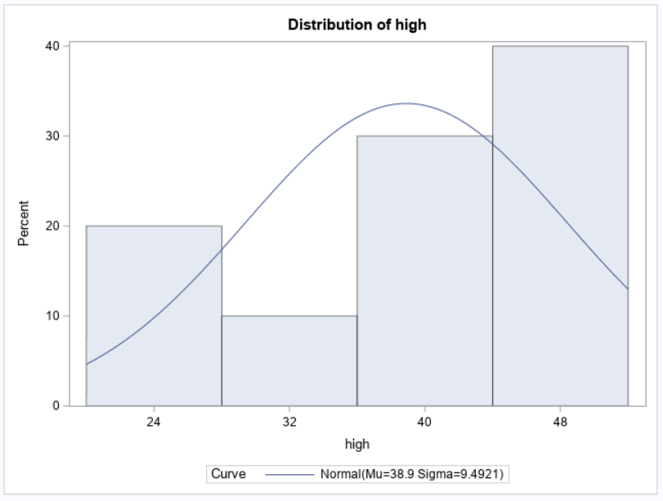
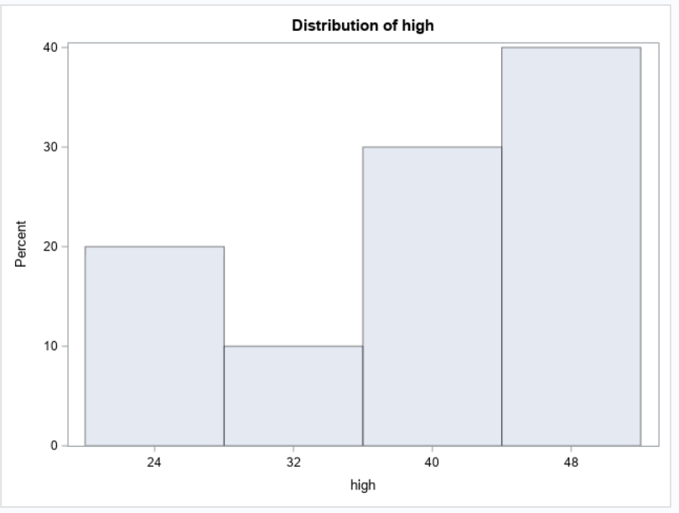
Univariate - Histogram
proc univariate data=philatemps;
var high;
histogram ;
/ normal;

Slide 20
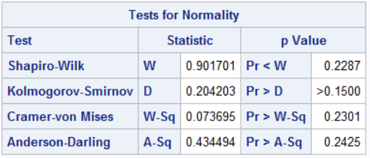
Univarate - Test for Normality
proc univariate data=philatemps normal;
var high;
Null hypothesis is “normal”

Slide 21
Quiz
Which PROCs should I use to create a data dictionary with frequency distributions and summary statistics?
PROC DATA and PROC DICTIONARY
PROC FREQ and PROC MEANS
PROC FREQ and PROC UNIVARIATE
PROC MEANS and PROC UNIVARIATE
PROC FREQ, PROC MEANS, and PROC UNIVARIATE
I have no PROCing clue

Slide 22
OUT= vs. OUTPUT OUT=
OUT= (option in PROC/TABLES)
Saves the procedure’s output table
Captures counts, percents, or other printed results
OUTPUT OUT= (separate statement)
Creates a dataset of summary statistics
Lets you specify which stats (mean, std, etc.)
Key Difference:
OUT= → stores what SAS already produces
OUTPUT OUT= → calculates new statistics

Slide 23
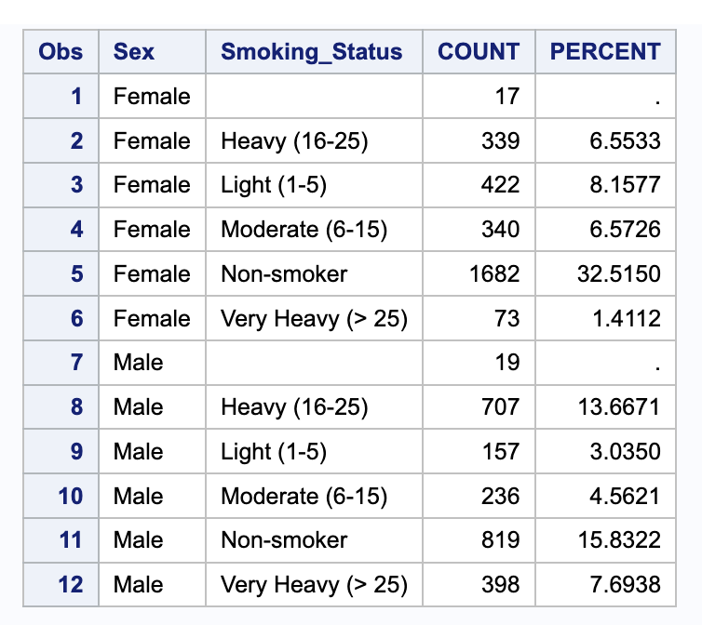
OUT= (option in PROC/TABLES) Saves the procedure’s output table
proc freq data = heart noprint;
tables sex*smoking_status / out=freq_out; run;
proc print data=freq_out;
run;

Slide 24
TABLES Statement OUT= Option - Specific Output
Options can be added to the TABLES statement after the forward slash to control the additional statistics added to the output data set.
Option | Description
OUTCUM | includes the cumulative frequency and cumulative percentage in the output data set for one-way frequency tables.
OUTPCT | includes the percentage of column frequency and row frequency in the output data set for n-way frequency tables.

Slide 25
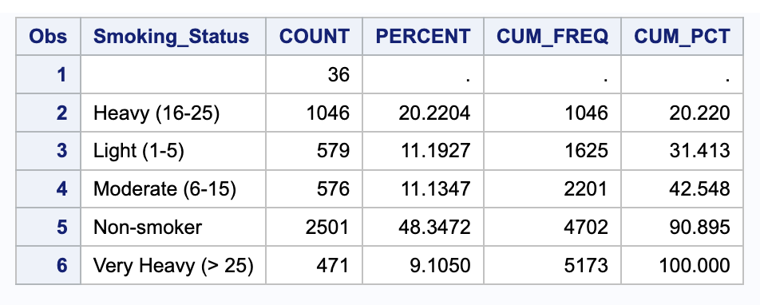
Outcum option
proc freq data = heart noprint; tables smoking_status / out=freq_out outcum; run; proc print data=freq_out; run;

Slide 26
Outpct option
proc freq data = heart noprint; tables smoking_status / out=freq_out outpct; run; proc print data=freq_out; run;

Slide 27
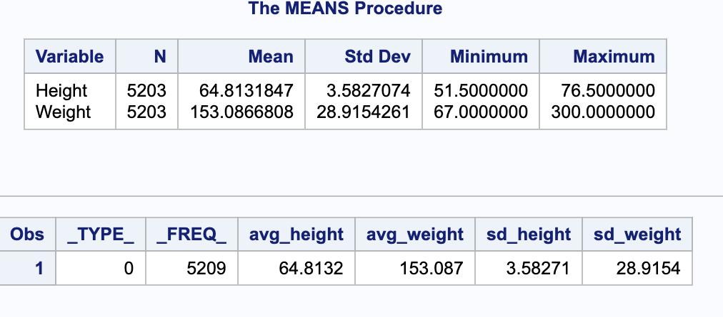
OUTPUT OUT= (separate statement)
Creates a dataset of summary statistics
Lets you specify which stats (mean, std, etc.)
Can use BY variables for subgroups
proc means data= heart; var height weight; output out=means_out mean=avg_height avg_weight std=sd_height sd_weight; run; proc print data=means_out; run;

Slide 28
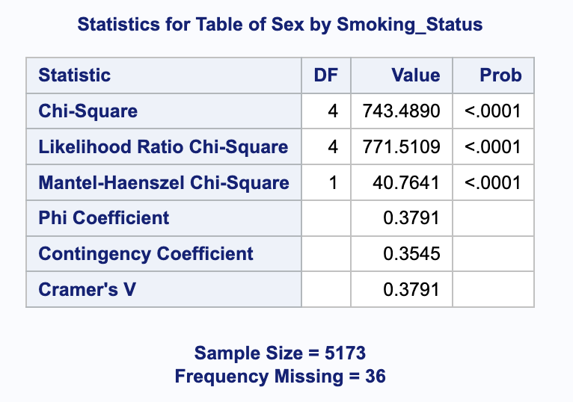
Chi-squared Analysis w/PROC FREQ
proc freq data = heart; tables sex*smoking_status / chisq; run;

Slide 29
Quiz
What type of chi-squared test was this?
Chi-squared test of Homogeneity
Chi-squared test of Convenience
Chi-squared test of Independence
Chi-squared Goodness of Fit
It’s not, it’s a z-test for two proportions
I have no idea
proc freq data = heart; tables sex*smoking_status / chisq; run;

Slide 30
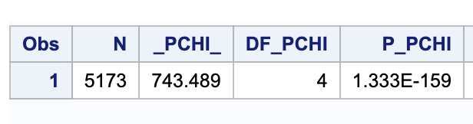
OUTPUT Statement OUT= Option
proc freq data = heart noprint; tables sex*smoking_status / chisq; output out = chisq_sex_smoking chisq; run; proc print data = chisq_sex_smoking; run;
chi-square
p-value
degrees of freedom

Slide 31
Output Data Sets
When you use CLASS in PROC MEANS, SAS generates summary rows:
One for each group.
One for the overall total.
SAS uses two automatic variables to keep track of this:
_TYPE_ → describes which combination of class variables the row represents.
0 = overall total (all data combined)
1, 2, ... = specific class levels
_FREQ_ → number of observations summarized for that row.
Important: A blank class value with _TYPE_ = 0 is not missing data — it’s just the overall total row.

Slide 32
OUTPUT Statement OUT= Option
_TYPE_ is a numeric variable that shows which combination of class variables produced the summary statistics in that observation.
PROC PRINT Output
min max sum ave
Obs Gender Country _TYPE_ _FREQ_ Salary Salary Salary Salary
1 0 165 22710 243190 5141420 31160.12
2 AU 1 63 25185 108255 1900015 30158.97
3 US 1 102 22710 243190 3241405 31778.48
4 F 2 68 25185 83505 1955865 28762.72
5 M 2 97 22710 243190 3185555 32840.77
6 F AU 3 27 25185 30890 747965 27702.41
7 F US 3 41 25390 83505 1207900 29460.98
8 M AU 3 36 25745 108255 1152050 32001.39
9 M US 3 61 22710 243190 2033505 33336.15
overall summary
summary by Country only
summary by Gender only
summary by Country and Gender

Slide 33
OUTPUT Statement OUT= Option
For this example,
_TYPE_ = 0 is an overall summary
PROC PRINT Output:
min max sum ave
Obs Gender Country _TYPE_ _FREQ_ Salary Salary Salary Salary
1 0 165 22710 243190 5141420 31160.12
2 AU 1 63 25185 108255 1900015 30158.97
3 US 1 102 22710 243190 3241405 31778.48
4 F 2 68 25185 83505 1955865 28762.72
5 M 2 97 22710 243190 3185555 32840.77
6 F AU 3 27 25185 30890 747965 27702.41
7 F US 3 41 25390 83505 1207900 29460.98
8 M AU 3 36 25745 108255 1152050 32001.39
9 M US 3 61 22710 243190 2033505 33336.15
_TYPE_ | Type of Summary | _FREQ_
0 | overall summary | 165
1 | summary by Country only | 63 AU + 102 AU = 165
2 | summary by Gender only | 68 F + 97 M = 165
3 | summary by Country and Gender | 27 F AU + 41 F US + 36 M AU + 61 M US = 165

Slide 34
OUTPUT Statement OUT= Option
Options can be added to the PROC MEANS statement to control the output data set.
Option | Description
NWAY | specifies that the output data set contain only statistics for the observations with the highest _TYPE_ value.
DESCENDTYPES | orders the output data set by descending _TYPE_ value.
CHARTYPE | specifies that the _TYPE_ variable in the output data set is a character representation of the binary value of _TYPE_.

Slide 35
OUTPUT Statement OUT= Option
without options
min max sum ave
Obs Gender Country _TYPE_ _FREQ_ Salary Salary Salary Salary
1 0 165 22710 243190 5141420 31160.12
2 AU 1 63 25185 108255 1900015 30158.97
3 US 1 102 22710 243190 3241405 31778.48
4 F 2 68 25185 83505 1955865 28762.72
5 M 2 97 22710 243190 3185555 32840.77
6 F AU 3 27 25185 30890 747965 27702.41
7 F US 3 41 25390 83505 1207900 29460.98
8 M AU 3 36 25745 108255 1152050 32001.39
9 M US 3 61 22710 243190 2033505 33336.15
with NWAY
min max sum ave
Obs Gender Country _TYPE_ _FREQ_ Salary Salary Salary Salary
1 F AU 3 27 25185 30890 747965 27702.41
2 F US 3 41 25390 83505 1207900 29460.98
3 M AU 3 36 25745 108255 1152050 32001.39
4 M US 3 61 22710 243190 2033505 33336.15
p112d06

Slide 36
OUTPUT Statement OUT= Option
with DESCENDTYPES
min max sum ave
Obs Gender Country _TYPE_ _FREQ_ Salary Salary Salary Salary
1 F AU 3 27 25185 30890 747965 27702.41
2 F US 3 41 25390 83505 1207900 29460.98
3 M AU 3 36 25745 108255 1152050 32001.39
4 M US 3 61 22710 243190 2033505 33336.15
5 F 2 68 25185 83505 1955865 28762.72
6 M 2 97 22710 243190 3185555 32840.77
7 AU 1 63 25185 108255 1900015 30158.97
8 US 1 102 22710 243190 3241405 31778.48
9 0 165 22710 243190 5141420 31160.12
p112d06

Slide 37
OUTPUT Statement OUT= Option
with CHARTYPE
min max sum ave
Obs Gender Country _TYPE_ _FREQ_ Salary Salary Salary Salary
1 00 165 22710 243190 5141420 31160.12
2 AU 01 63 25185 108255 1900015 30158.97
3 US 01 102 22710 243190 3241405 31778.48
4 F 10 68 25185 83505 1955865 28762.72
5 M 10 97 22710 243190 3185555 32840.77
6 F AU 11 27 25185 30890 747965 27702.41
7 F US 11 41 25390 83505 1207900 29460.98
8 M AU 11 36 25745 108255 1152050 32001.39
9 M US 11 61 22710 243190 2033505 33336.15
p112d06

Slide 38
PROC TABULATE
A quick way of getting summary statistics for specific values of by variables
Useful for output produced for reports for frequently updated data

Slide 39
The TABULATE Procedure
The TABULATE procedure displays descriptive statistics in tabular format.
General form of the TABULATE procedure:
PROC TABULATE DATA=SAS­data­set <options>;
CLASS classification­variable(s);
VAR analysis-variable(s);
TABLE page­expression,
row­expression,
column­expression </ option(s)>;
RUN;

Slide 40
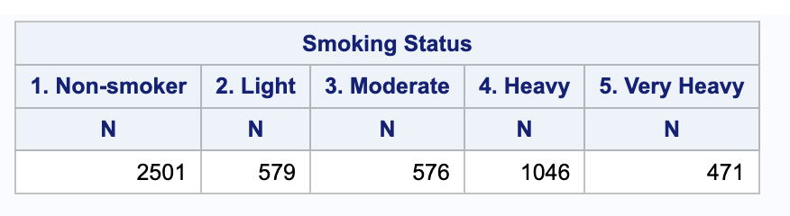
One-dimensional table
proc tabulate data = heart order = formatted;
class smoking_status;
table smoking_status;
run;

Slide 41
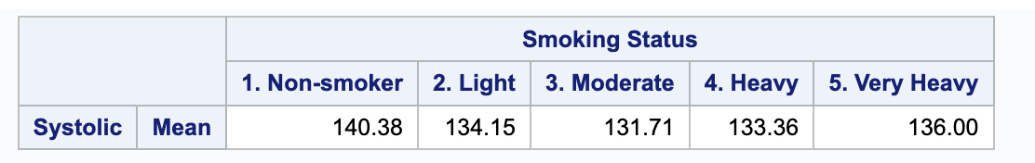
Add analysis variable + statistic
proc tabulate data = heart order = formatted; class smoking_status; var systolic; table systolic*mean, smoking_status; run;
Left of comma = row,
right of comma = column
If you don’t specify a statistic, it will default to sum

Slide 42
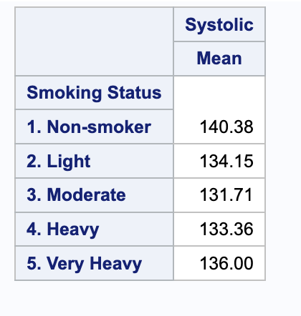
Switch row/column
proc tabulate data = heart order = formatted; class smoking_status; var systolic; table smoking_status, systolic*mean; run;
Left of comma = row,
right of comma = column

Slide 43
The TABLE Statement
The TABLE statement describes the structure of the table.
Commas separate the dimension expressions.
Every variable that is part of a dimension expression must be specified as a classification variable (CLASS statement) or an analysis variable (VAR statement).
table , , ;
page expression
row expression
column expression
dimension expressions

Slide 44
The TABLE Statement
Examples:
table , , ;
page expression
row expression
column expression
table smoking_status;
table systolic*mean, smoking_status;
table Sex, systolic*mean, smoking_status;

Slide 45
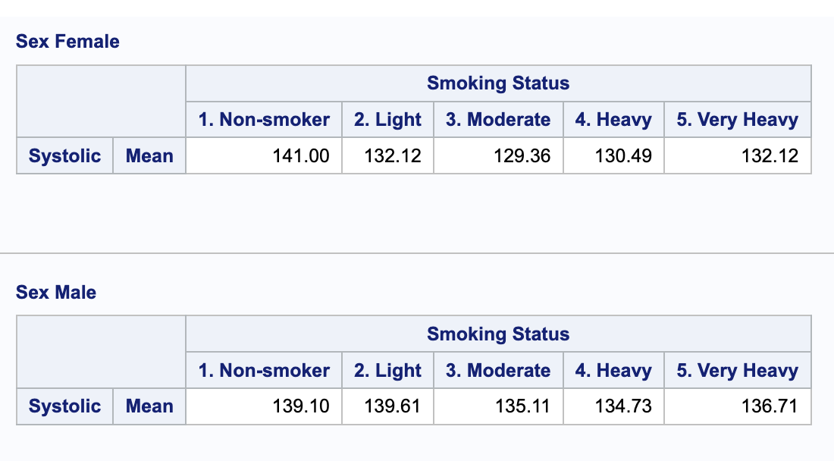
Add page (3rd dimension)
proc tabulate data = heart order = formatted; class smoking_status sex; var systolic; table sex, systolic*mean, smoking_status; run;

Slide 46
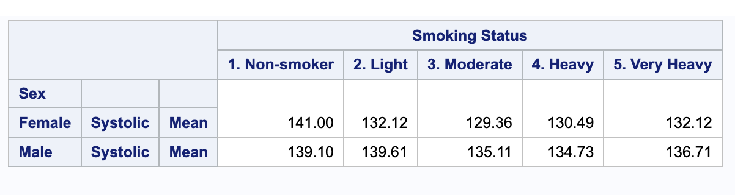
Two-dimensional table (+ statistic)
proc tabulate data = heart order = formatted; class smoking_status sex; var systolic; table sex*systolic*mean, smoking_status; run;

Slide 47
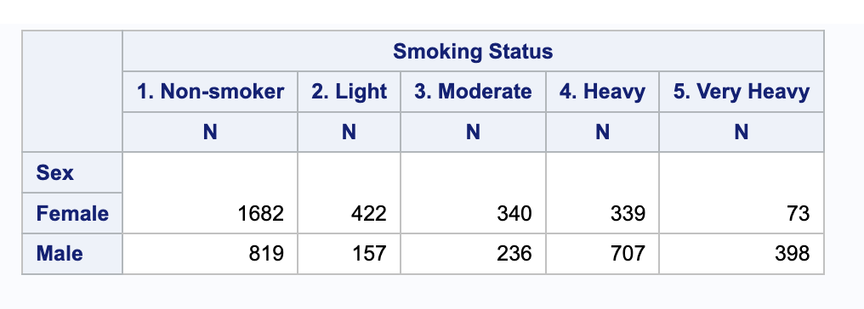
Two-dimensional table (freq only)
proc tabulate data = heart order = formatted; class smoking_status sex; table sex, smoking_status; run;

Slide 48
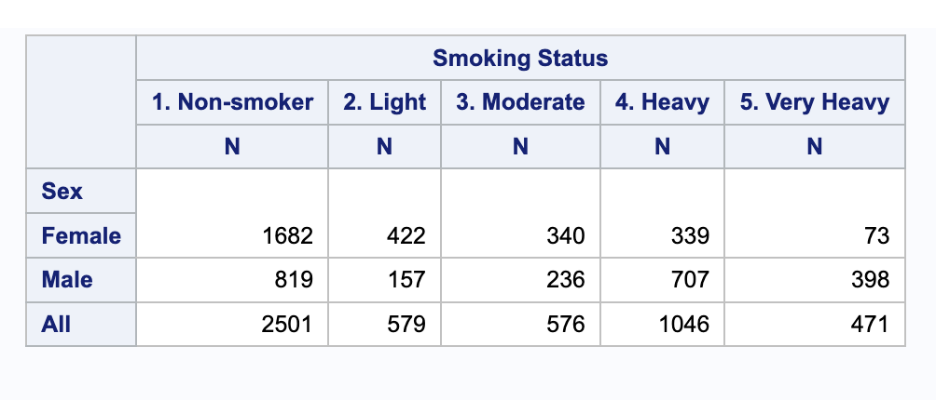
Add “all” row/column
proc tabulate data = heart order = formatted; class smoking_status sex; table sex all, smoking_status; run;

Slide 49
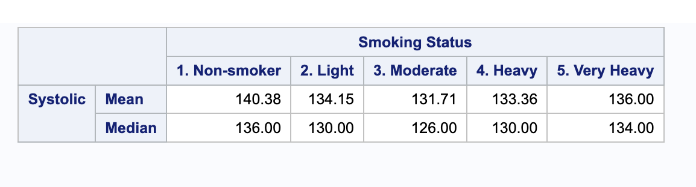
Add more than one statistic
proc tabulate data = heart order = formatted; class smoking_status; var systolic; table systolic*(mean median), smoking_status; run;

Slide 50
Dimension Expression
Elements that can be used in a dimension expression:
classification variables
analysis variables
the universal class variable ALL
keywords for statistics
Operators that can be used in a dimension expression:
blank, which concatenates table information
asterisk *, which crosses table information
parentheses (), which group elements

Slide 51
PROC TABULATE Statistics
Descriptive Statistic Keywords
 | CSS | CV | LCLM | MAX
MEAN | MIN | MODE | N | NMISS
KURTOSIS | RANGE | SKEWNESS | STDDEV | STDERR
SUM | SUMWGT | UCLM | USS | VAR
PCTN | REPPCTN | PAGEPCTN | ROWPCTN | COLPCTN
PCTSUM | REPPCTSUM | PAGEPCTSUM | ROWPCTSUM | COLPCTSUM
Quantile Statistic Keywords
MEDIAN | P50 | P1 | P5 | P10 | Q1 | P25
Q3 | P75 | P90 | P95 | P99 | QRANGE
Hypothesis Testing Keywords
PROBT | T

Slide 52
SAS Graphics

Slide 53
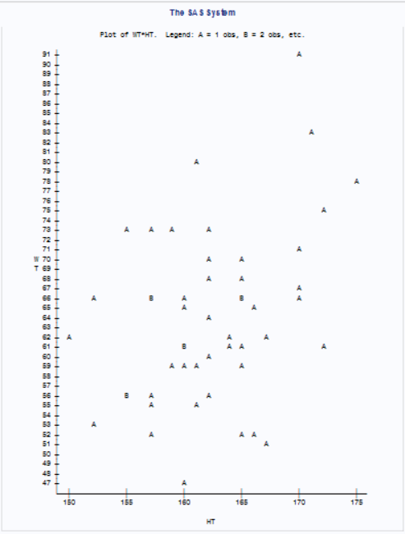
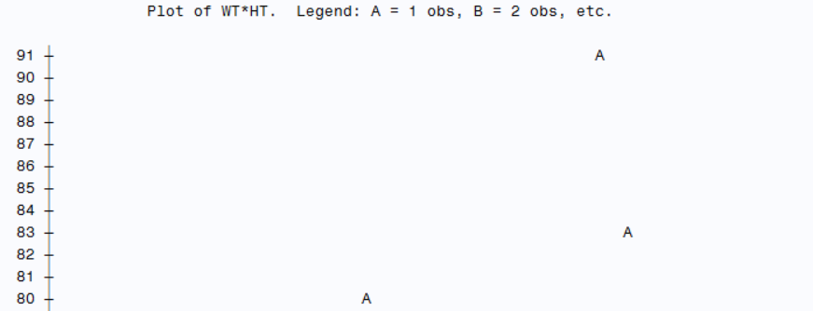
PROC PLOT (OLD)
proc plot data=hhs;
plot wt * ht;
run;

Slide 54
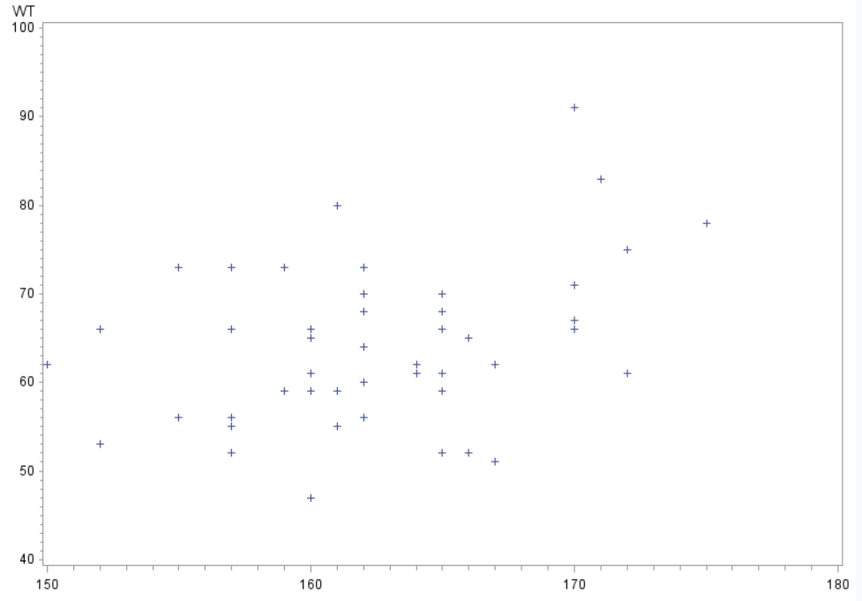
PROC GPLOT (OLD)
proc gplot data=hhs;
plot wt * ht;
run;
Describe the Relationship
Direction, Linearity, Strength, Outliers, (Interesting), (Takehome)

Slide 55
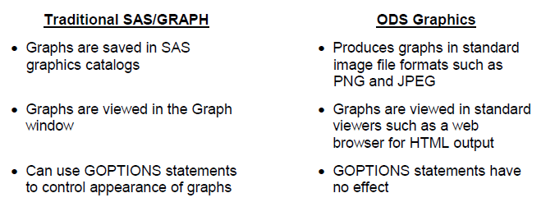
PROC SGPLOT
Replaces PROC G* commands
Ref: https://support.sas.com/resources/papers/proceedings10/154-2010.pdf

Slide 56
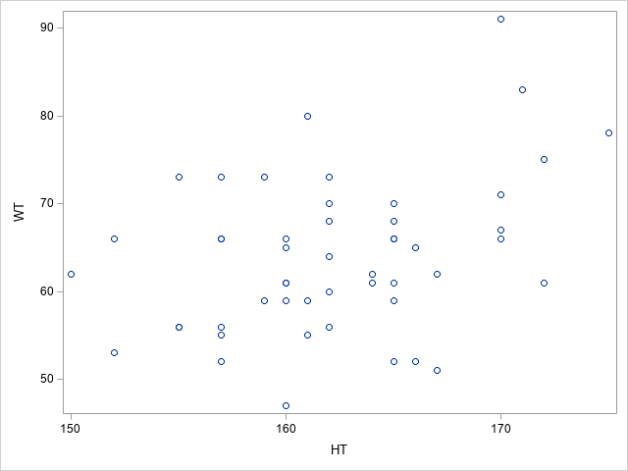
PROC SGPLOT - Scatterplot
proc sgplot data=hhs;
scatter x=ht y=wt;
run;

Slide 57
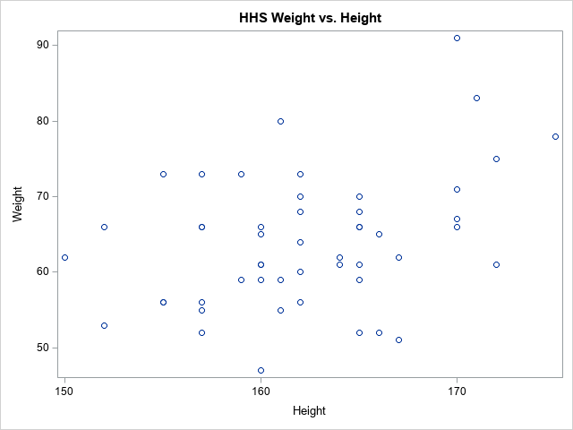
Adding Labels
proc sgplot data=hhs;
scatter x=ht y=wt;
title "HHS Weight vs. Height";
yaxis label="Weight";
xaxis label="Height";
run;

Slide 58
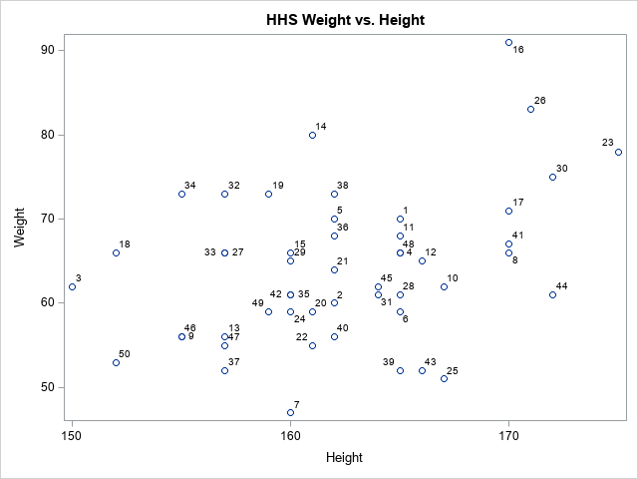
Adding Data Labels
proc sgplot data=hhs;
scatter x=ht y=wt / datalabel=id;
title "HHS Weight vs. Height";
yaxis label="Weight";
xaxis label="Height";
run;

Slide 59
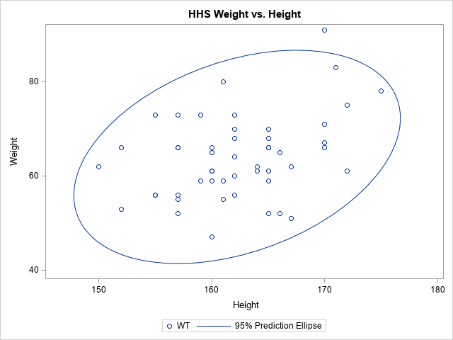
Overlaying an Ellipse
proc sgplot data=hhs;
scatter x=ht y=wt;
ellipse x=ht y=wt;
title "HHS Weight vs. Height";
yaxis label="Weight";
xaxis label="Height";
run;

Slide 60
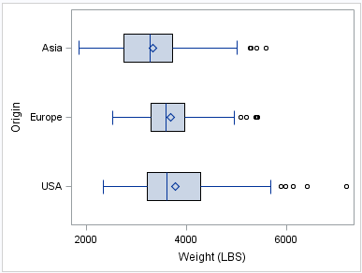
PROC SGPLOT - Boxplots
proc sgplot data=cars;
hbox weight / category=origin;
run;
Describe the Distribution
Shape, Outliers, Center, Spread,
(Interesting), (Takehome)

Slide 61
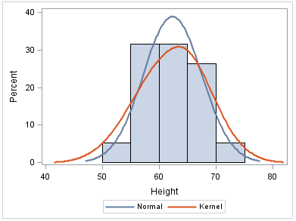
PROC SGPLOT - Histogram
proc sgplot data=class;
histogram height;
density height;
density height /
type=kernel;
run;

Slide 62
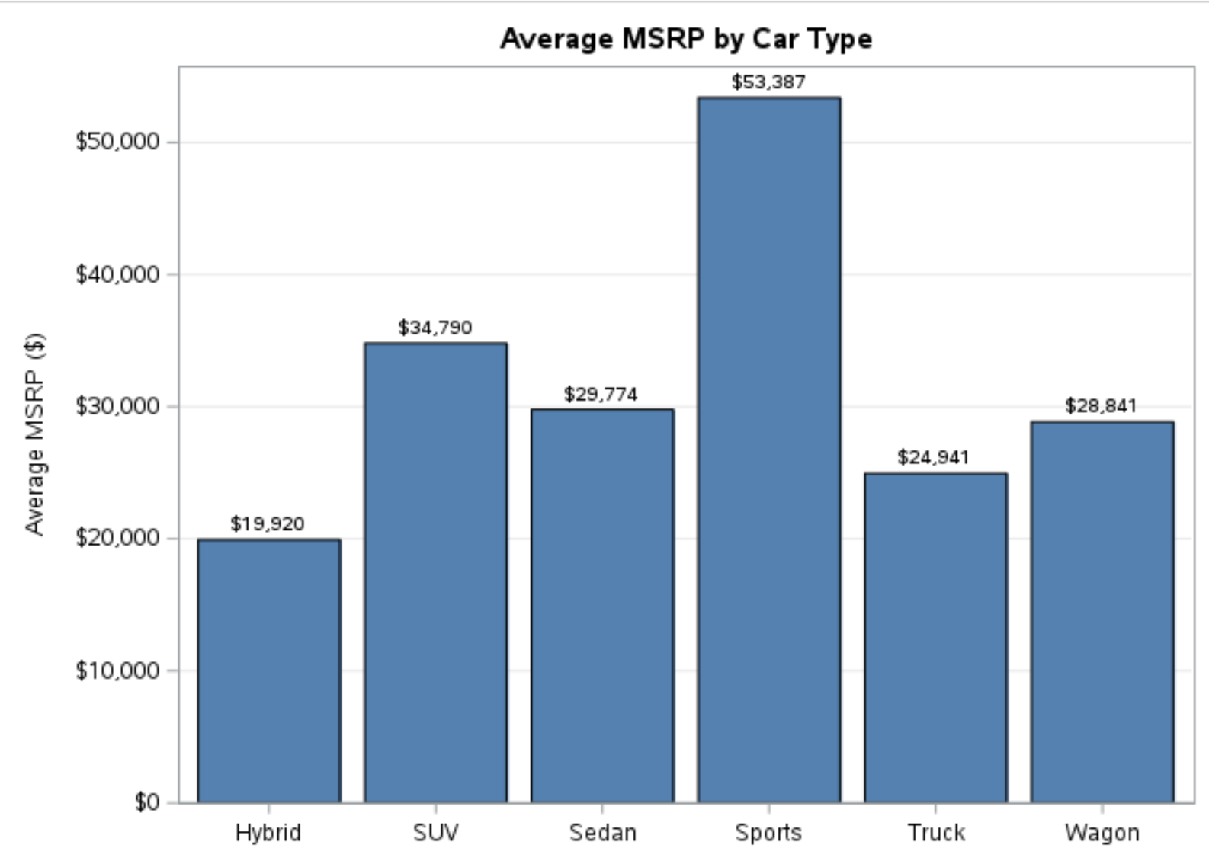
SGPLOT Barcharts
proc sgplot data=sashelp.cars;
vbar type / response=msrp stat=mean
datalabel
fillattrs=(color=steelblue);
yaxis label="Average MSRP ($)" grid;
xaxis label="Car Type";
title "Average MSRP by Car Type";
run;

