Slide 1
🎓 StudentPulse
Data-Driven Event Management Platform
ISTE 240 – Web and Mobile II | Spring 2026 | Group 6
Aditya Avinash – 761005899
Khaleel Hassan – 412002594
Harsh Bhatia – 400003132
Rochester Institute of Technology – Dubai | April 26, 2026

Slide 2
PRESENTATION OUTLINE
What We'll Cover
01
Problem & Solution
05
Comment Module
Why StudentPulse and what it solves
Khaleel Hassan Entity, API, Frontend
02
Tech Stack & Architecture
06
Database & API Docs
Spring Boot, MariaDB, Bootstrap 5, jQuery
Schema, REST endpoints, Git workflow
03
Student Module
07
Live Demo
Aditya Avinash Entity, API, Frontend
Full walkthrough of the working application
04
Event Module
Harsh Bhatia Entity, API, Frontend

Slide 3
CONTEXT
Problem & Solution
The Problem
StudentPulse Solution
Event proposals sent via WhatsApp & email no visibility
Dedicated portal for student-driven event proposals
No tracking of peer interest or support counts
Threshold model: proposal auto-advances on sufficient support
No structured admin review decisions are informal
Structured CRUD for Students, Events, and Comments
Students have no feedback loop on their proposals
Transparent workflow with full audit trail via REST API
Replacing informal channels with a transparent, threshold-based digital workflow

Slide 4
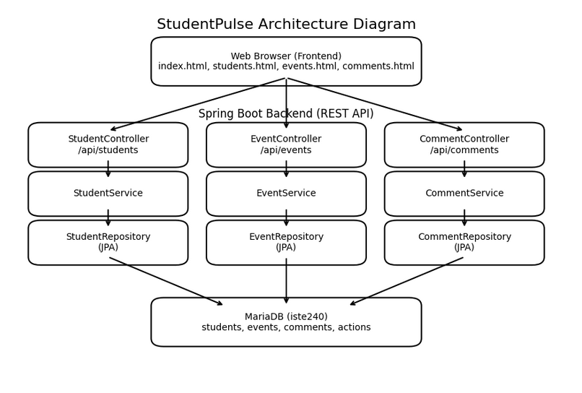
TECHNICAL OVERVIEW
Tech Stack & Architecture
🖥️
Frontend
HTML5 • Bootstrap 5.3 • jQuery 3.7.1
⚙️
Backend
Java 21 • Spring Boot 3.2.5 • REST APIs
🗄️
Persistence
Spring Data JPA • Hibernate 6.4 • MariaDB 12.1
🛠️
Dev Tools
Apache Maven • IntelliJ IDEA • Git / GitHub
MVC Flow:
Browser
→
HTML / jQuery
→
REST API
→
Service
→
Repository
→
MariaDB

Slide 5
ADITYA AVINASH – 761005899
Student Module
Aditya Avinash
Student.java
students.html
JPA entity mapped to students table; fields: id, ritId, name, email, active
Real-time name search table updates as you type (JPQL LIKE, no page reload)
StudentRepository
Extends JpaRepository; includes findByEmail, existsByEmail, searchByName (JPQL LIKE), updateActiveById (@Modifying)
Add / Edit modal Bootstrap 5 with pre-filled fields & active toggle
StudentService
Delete with confirmation dialog
Transactional service; validates name/email/ritId, prevents duplicate emails, delegates to repository
StudentController
Toast notifications on every action
@RestController on /api/students; all 6 HTTP endpoints with ResponseEntity returns
Active / Inactive badge per row
StudentDataSeeder
@PostConstruct seeds 5 students on first startup when table is empty
Table hover highlighting
Also: Redesigned index.html landing page with beige theme, Browse & Quick Add nav cards, and consistent dark-brown navbar

Slide 6
HARSH BHATIA – 400003132
Event Module
Harsh Bhatia
Event.java
events.html
JPA entity mapped to events table; fields: id (BIGINT PK), title (VARCHAR 150), description (TEXT), category (VARCHAR 50), status (VARCHAR 30), supportCount (INT default 0)
Real-time title search JPQL LIKE, table refreshes on input
EventRepository
Extends JpaRepository<Event, Long>; methods: findByCategory, findByStatus, searchByTitle (JPQL LIKE), updateStatusById (@Modifying @Query), deleteById
Status badges: PENDING (grey), IN_PROGRESS (brown), APPROVED (green)
EventService
Add / Edit modal with category dropdown and status selector
@Transactional service; validates title/category/status not empty, delegates to repository, throws IllegalArgumentException on bad input
EventController
Support count displayed per event row
@RestController on /api/events; all 6 HTTP methods returning ResponseEntity — GET all, GET/{id}, GET /search?title=, POST, PUT/{id}, DELETE/{id}
Delete confirmation dialog + toast feedback
events.html
Bootstrap 5 + jQuery; table with title, category, status badge, support count; Add/Edit modal; real-time title search; delete confirmation; toast notifications
Category filter integrated into search bar
Threshold model: events auto-advance from PENDING -> IN_PROGRESS once support count reaches the configured threshold

Slide 7
KHALEEL HASSAN – 412002594
Comment Module
Khaleel Hassan
Comment.java
comments.html
JPA entity mapped to comments table; fields: id (BIGINT PK), eventId (VARCHAR 20), studentId (VARCHAR 20), content (TEXT NOT NULL)
Real-time content search JPQL LIKE, no page reload
CommentRepository
Extends JpaRepository<Comment, Long>; methods: findByEventId, findByStudentId, searchByContent (JPQL LIKE), updateContentById (@Modifying @Query), deleteById
Table shows event ID, student ID, and comment preview
CommentService
Add / Edit modal with event & student ID inputs
@Transactional service; validates content/eventId/studentId not empty; throws IllegalArgumentException on missing fields; delegates to repository
CommentController
Filter comments by event dropdown linked to events API
@RestController on /api/comments; all 6 HTTP methods GET all, GET/{id}, GET /search?content=, POST, PUT/{id}, DELETE/{id} with ResponseEntity
Delete with confirmation dialog
comments.html
Bootstrap 5 + jQuery; table showing event ID, student ID, content snippet; Add/Edit modal; real-time content search; delete confirmation; toast notifications
Toast notifications on every CRUD action
Also: Merge Manager reviewed & merged all feature branches into main via GitHub pull requests

Slide 8
DATABASE DESIGN
Database Schema
students (Aditya Avinash)
events (Harsh Bhatia)
Column | Type | Notes
id | BIGINT PK | Auto-increment
rit_id | VARCHAR(20) | Unique, NOT NULL
name | VARCHAR(100) | NOT NULL
email | VARCHAR(100) | Unique, NOT NULL
active | BIT(1) | Default true
Column | Type | Notes
id | BIGINT PK | Auto-increment
title | VARCHAR(150) | NOT NULL
description | TEXT | Nullable
category | VARCHAR(50) | NOT NULL
status | VARCHAR(30) | Default PENDING
support_count | INT | Default 0
comments (Khaleel Hassan)
Database: iste240 • Engine: MariaDB 12.1 • Schema managed by Hibernate ddl-auto=update
Column | Type | Notes
id | BIGINT PK | Auto-increment
event_id | VARCHAR(20) | NOT NULL
student_id | VARCHAR(20) | NOT NULL
content | TEXT | NOT NULL

Slide 9
API DOCUMENTATION
REST API Endpoints
/api/students (Aditya)
Method | Endpoint | Status | Description
GET | /api/students | 200 OK | Returns all students as JSON array
GET | /api/students/{id} | 200 / 404 | Returns single student by ID
GET | /api/students/search?name= | 200 OK | Partial-match search via JPQL LIKE
POST | /api/students | 201 / 400 | Creates new student; validates fields
PUT | /api/students/{id} | 200 / 404 | Full update of existing student
DELETE | /api/students/{id} | 204 / 404 | Deletes student; 404 if not found
/api/events (Harsh Bhatia)
/api/comments (Khaleel Hassan)
Method | Endpoint | Status | Description
GET | /api/comments | 200 OK | Returns all comments
GET | /api/comments/{id} | 200/404 | Get one comment by ID
GET | /api/comments/search?content= | 200 OK | Search by content (LIKE)
POST | /api/comments | 201/400 | Create new comment
PUT | /api/comments/{id} | 200/404 | Update existing comment
DELETE | /api/comments/{id} | 204/404 | Delete comment by ID
Method | Endpoint | Status | Description
GET | /api/events | 200 OK | Returns all events
GET | /api/events/{id} | 200/404 | Get one event by ID
GET | /api/events/search?title= | 200 OK | Search by title (LIKE)
POST | /api/events | 201/400 | Create new event
PUT | /api/events/{id} | 200/404 | Update existing event
DELETE | /api/events/{id} | 204/404 | Delete event by ID

Slide 10
TEAM & GIT
Team Contributions & Git
Aditya Avinash
Harsh Bhatia
Khaleel Hassan
761005899
400003132
412002594
Student.java entity + StudentRepository (5+ methods)
Event.java entity + EventRepository (5+ methods incl. JPQL)
Comment.java entity + CommentRepository (5+ methods)
StudentService (@Transactional) + StudentController (6 endpoints)
EventService (@Transactional) + EventController (6 endpoints)
CommentService (@Transactional) + CommentController (6 endpoints)
StudentDataSeeder – @PostConstruct seeds 5 students
events.html – search, status badges, support count, modal
comments.html – filter by event, search, CRUD modal
students.html – real-time search, modal, toasts
EventDataSeeder – seeds initial events on startup
Merge Manager – reviewed & merged all PRs into main
index.html – landing page with Browse & Quick Add cards
Threshold logic: status auto-updates on support count
README setup, branch strategy coordination
application.properties, pom.xml, MainService fix
Branch Strategy: each student → own feature branch • Merge Manager: Khaleel Hassan • Min. 6 commits per member • PRs used for all merges • Repo URL: https://github.com/kgh6265/iste240-team6.git

Slide 11
🎬
Live Demo
Landing page navigation cards and Quick Add shortcuts
Students page full CRUD: Add, Edit, Delete, Search (Aditya)
Events page full CRUD, status badges, support count (Harsh)
Comments page filter by event, search, CRUD (Khaleel)
API responses network tab showing JSON

Slide 12
Thank You
Questions & Answers
🎓
StudentPulse
Full-stack event management platform for RIT Dubai
⚙️
Spring Boot 3 + MariaDB
JPA/Hibernate backend with REST APIs
🖥️
Bootstrap 5 + jQuery
Responsive, no-reload frontend
👥
3 Independent Modules
Student · Event · Comment each per-student
Group 6 • ISTE 240 • Spring 2026 • RIT Dubai

