Slide 1
Hydration Free Energy Calculations using the Drude Force Field with CHARMM
Christopher Rowley
Department of Biochemistry and
Molecular Biology
University of Chicago

Slide 2
A New Model for NMA
The new NMA model was developed using a revised charge fitting scheme developed by Lei Huang
charges, polarizabilities, Thole parameters, and anisotrophies are optimized simultaneously
polarizabilities are restrained near Miller polarizabilities
Old | Lei’s Code
ATOM CL CD33C -0.300 ALPHA -2.511 THOLE 0.254 ATOM HL1 HDA3A 0.058 ATOM HL2 HDA3A 0.058 ATOM HL3 HDA3A 0.058 ATOM C CD2O1A 0.682 ALPHA -1.576 THOLE 0.886 ATOM O OD2C1A -0.009 ALPHA -1.167 THOLE 1.310 ATOM N ND2A2 -0.465 ALPHA -1.810 THOLE 1.149 ATOM H HDP1A 0.325 ATOM CC CD33C -0.065 ALPHA -2.020 THOLE 0.254 ATOM HC1 HDA3A 0.094 ATOM HC2 HDA3A 0.094 ATOM HC3 HDA3A 0.094 ATOM LPA LP -0.3425 ATOM LPB LP -0.2815 ANISOTROPY O C LPA LPB A11 0.88 A22 1.32 | ATOM CL CD33C -0.249 ALPHA -1.584 THOLE 0.330 ATOM HL1 HDA3A 0.050 ATOM HL2 HDA3A 0.050 ATOM HL3 HDA3A 0.050 ATOM C CD2O1A 0.784 ALPHA -1.748 THOLE 1.517 ATOM O OD2C1A 0.035 ALPHA -1.032 THOLE 0.915 ATOM N ND2A2 -0.585 ALPHA -1.544 THOLE 0.438 ATOM H HDP1A 0.297 ATOM CC CD33C 0.119 ALPHA -1.229 THOLE 0.738 ATOM HC1 HDA3A 0.041 ATOM HC2 HDA3A 0.041 ATOM HC3 HDA3A 0.041 ATOM LPA LP -0.418 ATOM LPB LP -0.256 ANISOTROPY O C LPA LPB A11 0.82322 A22 1.14332

Slide 3
Lennard-Jones Terms
Pedro found new Lennard-Jones parameters for these electrostatics
Physical properties must be reevaluated with new model
hydration free energy
Atom Type |  | Emin (kcal/mol) | Rmin (Å)
N | Old | -0.260 | 1.925
 | New | -0.200 | 1.800
O | Old | -0.180 | 1.900
 | New | -0.200 | 1.750
C (sp²) | Old | -0.100 | 1.600
 | New | -0.050 | 1.775
C (methyl) | Old | -0.070 | 1.740
 | New | -0.078 | 1.940
NBFIX |  | Emin (kcal/mol) | Rmin (Å)
N – ODW | Old | -0.2250 | 3.6569
 | New | -0.2054 | 3.6569
 | Comb. | -0.2341 | 3.712
O – ODW | Old | -0.2054 | 3.7369
 | New | -0.2054 | 3.6269
 | Comb. | -0.2202 | 3.5369

Slide 4
The Problem
Procedures by the MacKerell and Roux groups gave hydration free energies that differed by ~1.5 kcal/mol for the hydration energy of NMA
Ethanol | ΔG_{rep} | ΔG_{att} | ΔG_{chg} | ΔG_{solv}
Lopez | 14.23 | -13.00 | -10.35 | -9.11
Rowley | 14.74 | -13.11 | -10.22 | -8.59
Exptl |  |  |  | -10.1
*LRC estimated at -0.45 kcal/mol

Slide 5
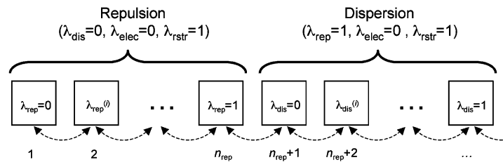
Hamiltonian Exchange Replica Exchange MD
18 Repulsive Energy Windows
scaling intervals:
[0.0, 0.2, 0.3, 0.4, 0.5, 0.6, 0.7, 0.8, 0.9, 1.0]
λ=[0,1]
11 Attractive Energy Windows
Charging component of Drude systems cannot be included in exchange
Exchanges attempted every 100 fs
~50% acceptance rate

Slide 6
Thermostats Used in Gas Phase Component
Monomer FEP was calculated using leap-frog Langevin integrator (NOT Dual thermostat)
Results in ~0.1 kcal/mol errors
There is now a functional dual-Langevin thermostat in CHARMM that works with VV2
TPCONTROL NTHER 2 NHGAM 5.0 NHGAMD 10.0 - THER 1 TREF 298.15 LANG SELECT .NOT. TYPE D* END - THER 2 TREF 1.0 LANG SELECT TYPE D* END DYNAMICS vv2 start nstep @nstep timestp @timestep - ntrfrq @nstep iprfrq -1 - nprint 1000 iseed @useed - iasvel 1 firstt @temp finalt @temp - inbfrq -1 imgfrq -1 ihbfrq 0 ilbfrq 0 - iunread -1 - iunwrite -1 - iuncrd -1 nsavcrd 100 - punit 52 wham 54

Slide 7
Integration of Charging Free Energy Component
The charging free energies component
The non-polar components can be integrated using WHAM
Integrating the charging component with WHAM introduces an error ~0.6 kcal/mol
Run | Integration | ΔG (kcal/mol)
1 | WHAM | -62.39
1 | TI | -63.11
2 | WHAM | -62.48
2 | TI | -63.18

Slide 8
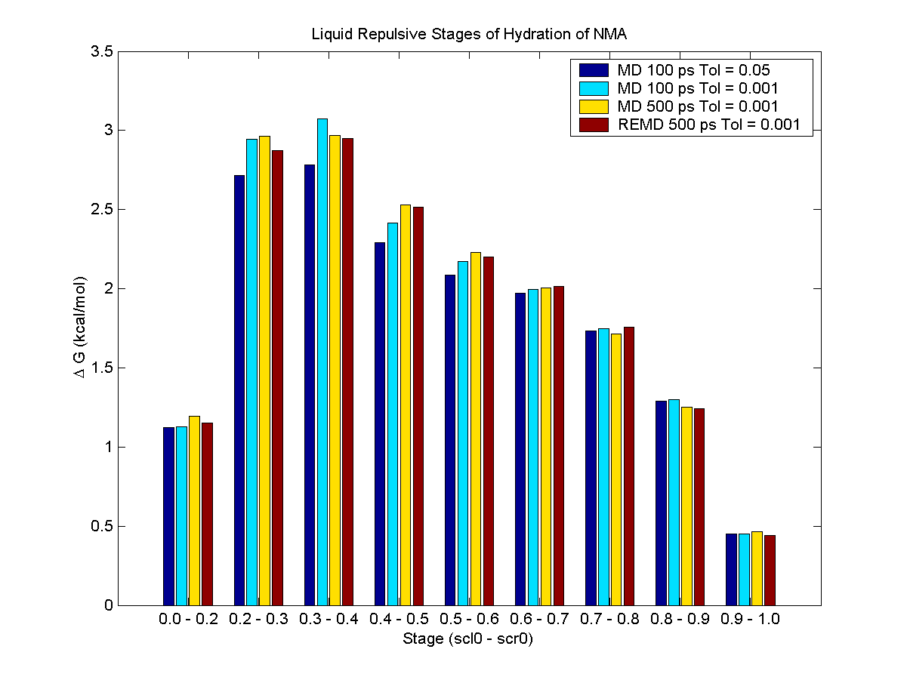
Difference in Repulsive Component is Due to WHAM SCF Tolerance
Simulation | WHAM Tolerance | ΔG^{rep} (kcal/mol)
MD 100 ps | 0.050 | 16.45
MD 100 ps | 0.001 | 17.22
MD 500 ps | 0.001 | 17.32
REMD 500 ps | 0.001 | 17.15
open read card unit 54 name @job.wham WHAM MAXWindow 50 MAXTime @MTIME WSIZe @wsize - unit 54 tol 0.05 nstep 200 close unit 54 write title unit 55 * job @job * Wham free energy: ?WHAMFE * RETURN | open read card unit 54 name @job.wham WHAM MAXWindow 50 MAXTime @MTIME WSIZe @wsize - unit 54 tol 0.001 nstep 200 close unit 54 write title unit 55 * job @job * Wham free energy: ?WHAMFE

Slide 9
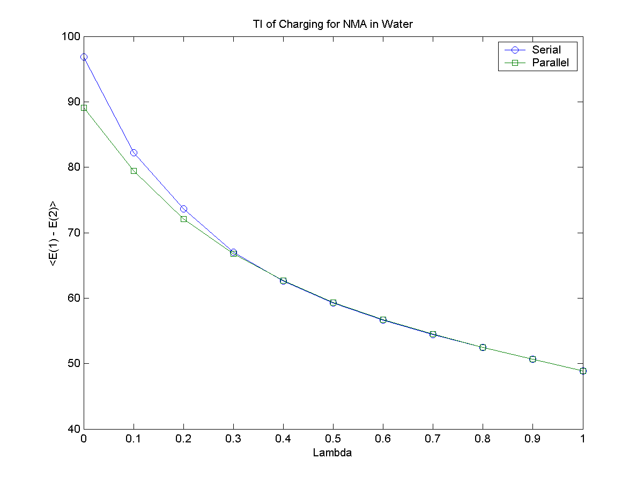
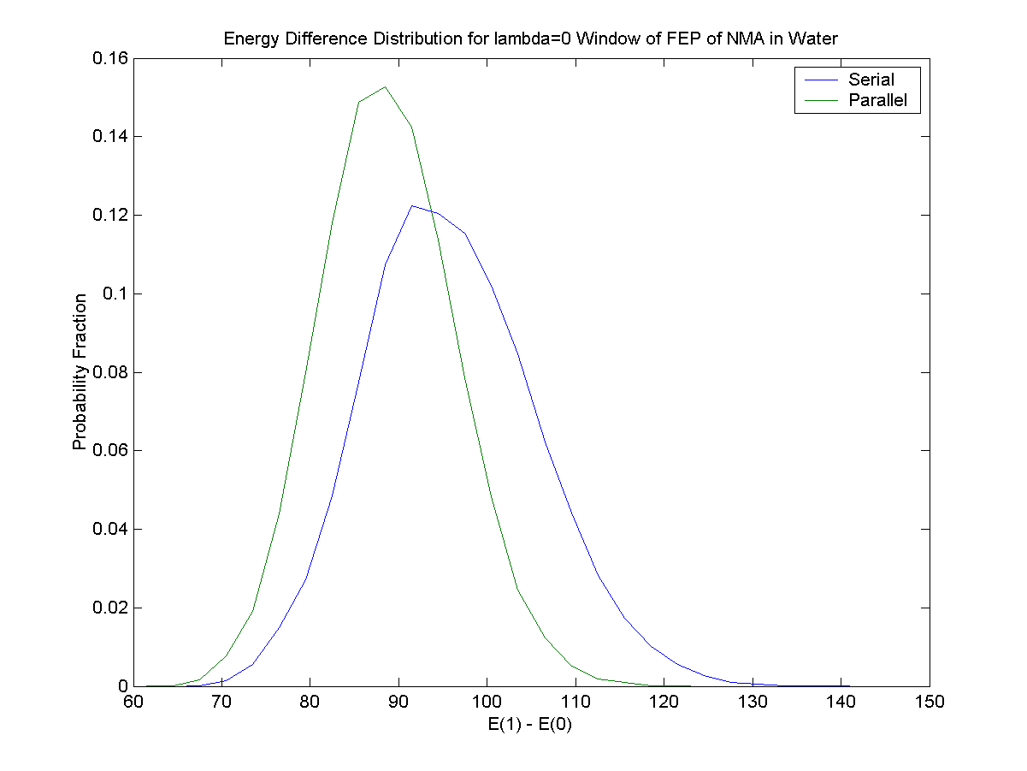
Serial vs Parallel CHARMM
A small but significant difference between the parallel and serial versions of CHARMM was found in the charging free energy of NMA.

Slide 10
Serial vs Parallel Resolution
A bug was present in epert.src that called the THOLE_NBX subroutine only once rather than once per process
Serial and parallel CHARMM now give statistically equivalent results
IF (MYNOD == 0) THEN !##PARALLELx IF (QDRUDE .AND. QETPRT(ELEC)) THEN CALL THOLE_NBX(ISDRUDE,ALPHADP,THOLEI, & PPCG, & ETPRTM(ELEC),BNBNDR%INB14,BNBNDR%IBLO14, & X,Y,Z,DX,DY,DZ,DD1,IUPT,QSECDL,NATOMP)

Slide 11
Results
With the revised procedure the calculated hydration free energy of NMA is:
NMA (with NBFIX) | ΔG_{rep} | ΔG_{att} | ΔG_{chg} | ΔG_{solv}
Revised | 14.92 | -13.03 | -10.98 | -9.09
REMD | 14.76 | -13.07 | -10.98 | -9.30
Exptl |  |  |  | -10.1
NMA (without NBFIX) | ΔG_{rep} | ΔG_{att} | ΔG_{chg} | ΔG_{solv}
Revised | 14.62 | -12.69 | -13.47 | -11.54
REMD | 14.65 | -12.78 | -13.47 | -11.60
Exptl |  |  |  | -10.1

Slide 12
Part II: Revisiting Old Molecules
I have used this procedure to recalculate the hydration free energies for some existing molecules in the Drude force field
Test cases:
Benzene
Ethanol
Butane

Slide 13
Hydration Free Energy of Benzene
Benzene | ΔG_{rep} | ΔG_{att} | ΔG_{chg} | ΔG_{solv}
Published¹ | 14.61 | -14.24 | -1.43 | -1.06
Revised | 15.47 | -12.34 | -2.53 | 0.60
REMD | 15.18 | -12.43 | -2.53 | 0.22
Exptl |  |  |  | -0.86
¹Lopez et al. J. Phys. Chem. B 2007, 111, 2873-2885

Slide 14
Hydration Free Energy of Ethanol
Ethanol | ΔG_{rep} | ΔG_{att} | ΔG_{chg} | ΔG_{solv}
Published¹ |  |  |  | -5.66
Published (PS LJ)² |  |  |  | -5.38
Revised | 11.61 | -8.44 | -7.11 | -3.93
REMD | 11.30 | -8.46 | -7.11 | -4.26
Exptl |  |  |  | -5.01
¹Anisimov et al, J. Chem. Theory Comput. 2007, 3, 1927–1946
²Baker et al. J. Chem. Theory Comput. 2010, 6, 1181–1198

Slide 15
Hydration Free Energy of Butane
Ethanol | ΔG_{rep} | ΔG_{att} | ΔG_{chg} | ΔG_{solv}
Published¹ | 14.12 | -12.34 | -0.31 | 1.46
Published (PS LJ)² |  |  |  | 2.54
Revised | 14.99 | -11.16 | -0.41 | 3.42
REMD | 15.03 | -11.21 | -0.41 | 3.42
Exptl |  |  |  | 2.15
¹Vorobyov et al. J. Phys. Chem. B 2005, 109, 18988–18999
²Baker et al. J. Chem. Theory Comput. 2010, 6, 1181–1198

Slide 16
Charge Fitting of Benzene
Old | Lei’s Code
ATOM CG CD2R6A -0.1106 ALPHA -1.615 THOLE 1.195 ATOM HG HDR6A 0.1106 ATOM CD1 CD2R6A -0.1106 ALPHA -1.615 THOLE 1.195 ATOM HD1 HDR6A 0.1106 ATOM CD2 CD2R6A -0.1106 ALPHA -1.615 THOLE 1.195 ATOM HD2 HDR6A 0.1106 ATOM CE1 CD2R6A -0.1106 ALPHA -1.615 THOLE 1.195 ATOM HE1 HDR6A 0.1106 ATOM CE2 CD2R6A -0.1106 ALPHA -1.615 THOLE 1.195 ATOM HE2 HDR6A 0.1106 ATOM CZ CD2R6A -0.1106 ALPHA -1.615 THOLE 1.195 ATOM HZ HDR6A 0.1106 | ATOM CG CA -0.085 ALPHA -1.820 THOLE 1.279 ATOM HG HA 0.085 ATOM CD1 CA -0.085 ALPHA -1.820 THOLE 1.279 ATOM HD1 HA 0.085 ATOM CD2 CA -0.085 ALPHA -1.820 THOLE 1.279 ATOM HD2 HA 0.085 ATOM CE1 CA -0.085 ALPHA -1.820 THOLE 1.279 ATOM HE1 HA 0.085 ATOM CE2 CA -0.085 ALPHA -1.820 THOLE 1.279 ATOM HE2 HA 0.085 ATOM CZ CA -0.085 ALPHA -1.820 THOLE 1.279 ATOM HZ HA 0.085

Slide 17
Charge Fitting of Ethanol
Old | Lei’s Code
ATOM C1 CD32A -0.060 ALPHA -1.000 THOLE 1.3 ATOM O1 OD31A 0.000 ALPHA -1.028 THOLE 1.3 ATOM HO1 HDP1A 0.360 ATOM H1A HDA2A 0.080 ATOM H1B HDA2A 0.080 ATOM C2 CD33A -0.180 ALPHA -1.400 THOLE 1.3 ATOM H2A HDA3A 0.060 ATOM H2B HDA3A 0.060 ATOM H2C HDA3A 0.060 ATOM LP1A LP -0.230 ATOM LP1B LP -0.230 ANISOTROPY O1 C1 LP1A LP1B A11 0.8108 A22 1.2162 | ATOM C1 C3 0.138 ALPHA -1.902 THOLE 1.134 ATOM O1 OH 0.140 ALPHA -0.969 THOLE 1.140 ATOM HO1 HO 0.351 ATOM H1A H1 0.010 ATOM H1B H1 0.010 ATOM C2 C3 -0.047 ALPHA -2.049 THOLE 1.142 ATOM H2A HC 0.010 ATOM H2B HC 0.010 ATOM H2C HC 0.010 ATOM LPAO1 LP -0.316 ATOM LPBO1 LP -0.316 ANISOTROPY O1 C1 LPAO1 LPBO1 A11 0.70099 A22 1.119

Slide 18
Charge Fitting of Butane
Old | Lei’s Code
Atom H11 HDA3A 0.059 Atom H12 HDA3A 0.059 Atom H13 HDA3A 0.059 Atom C1 CD33A -0.177 ALPHA -2.051 THOLE 1.3 Atom H21 HDA2A 0.078 Atom H22 HDA2A 0.078 Atom C2 CD32A -0.156 ALPHA -1.660 THOLE 1.3 Atom H31 HDA2A 0.078 Atom H32 HDA2A 0.078 atom C3 CD32A -0.156 ALPHA -1.660 THOLE 1.3 atom H41 HDA3A 0.059 atom H42 HDA3A 0.059 atom H43 HDA3A 0.059 atom C4 CD33A -0.177 ALPHA -2.051 THOLE 1.3 | ATOM H11 HC 0.049 ATOM H12 HC 0.047 ATOM H13 HC 0.047 ATOM C1 C3 -0.215 ALPHA -2.070 THOLE 1.028 ATOM H21 HC 0.010 ATOM H22 HC 0.010 ATOM C2 C3 0.053 ALPHA -1.943 THOLE 1.017 ATOM H31 HC 0.010 ATOM H32 HC 0.010 ATOM C3 C3 0.053 ALPHA -1.943 THOLE 1.017 ATOM H41 HC 0.047 ATOM H42 HC 0.047 ATOM H43 HC 0.047 ATOM C4 C3 -0.215 ALPHA -2.070 THOLE 1.028

