Slide 1
THE SPENDING BEHAVIOR OF TOP 10 COUNTRIES
SUBMITTED BY: KANCHAN GHIMIRE
DATE: MARCH 7, 2019

Slide 2
RAW DATA
Source of Data: The World Bank (“https://data.worldbank.org/indicator”)
Raw data file: “Raw Data” sheet and “Definition and Source” sheet on “SpendingData_4.xlsx”
19 G20 countries’ data on Population, GDP (current US$), Education Expenditure (current US$), Healthcare Per Capita Expenditure (current US$),and Military Expenditure (current US$)
Data with years 2010 to 2017

Slide 3
DATA PRE-PROCESSING
Tools used for data cleaning: Excel (formulas in excel)
Tasks (Calculations): GDP Per Capita from GDP and Population, Education Expenditure Per Capita from Education Expenditure and Population, Healthcare Expenditure from Healthcare Expenditure Per Capita and Population, Military Expenditure Per Capita from Military Expenditure, Education Expenditure Growth from Education Expenditure, Healthcare Expenditure Growth from Healthcare Expenditure, Average Expenditures across each sector (2011-2015)

Slide 4
CLEANED DATA
Cleaned data: “SpendingData_4.xlsx”
Link to the data: https://docs.google.com/spreadsheets/d/1ORN7toUfgOtJlH8FAwuVn88PmSkO2_NmCwD6WMSw0Hs/edit?usp=sharing
10 Countries used: Brazil, China, Germany, India, Japan, South Korea, Russia, Saudi Arabia, United Kingdom, United States
5 Years used: 2011, 2012, 2013, 2014, 2015
Data used: Population, GDP, GDP Per Capita, Education Expenditure, Education Expenditure Per Capita, Healthcare Expenditure, Healthcare Expenditure Per Capita, Military Expenditure, Military Expenditure Per Capita, Education Expenditure Growth, Healthcare Expenditure Growth, Average Expenditure for countries (2011 to 2015)

Slide 5
PROCESSES AND TOOLS USED
Tools Used: HTML, CSS, JavaScript, Google API
HTML used for basic webpage layout for each page (”index.html”, “education.html”, “healthcare.html”, ”military.html”)
Css file used for design/ layout of the webpages (“css.css”)
JavaScript (.js) files used to make Google API calls to graph charts for each web pages (“index.js”, “education.js”, “healthcare.js”, “military.js”)
Types of charts used: Column chart, Stacked bar chart, Bubble chart and Geo chart, Line chart, Pie chart
Expenditure for Sectors: Education, Healthcare and Military

Slide 6
PROJECT OVERVIEW
Understanding the spending behavior (on education, healthcare and military) of the top 10 countries
Comparison of expenditure on different sectors compared to the country’s GDP (expenditure on a certain sector as a % of their GDP)
Comparison of military expenditure to the countries’ education and healthcare expenditure
Comparison (to see if there is a correlation) between per capita expenditure on each of the sectors and per capita GDP
Identify the fastest growing countries in education and healthcare spending

Slide 7
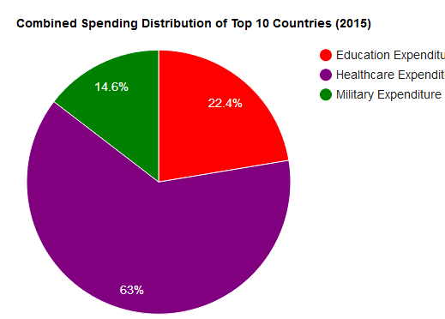
KEY FINDINGS AND ANALYSIS
Of the combined Expenditure of all 10 countries for 2015, 63% was spent on healthcare, 22.4% on education and 14.6% on military

Slide 8
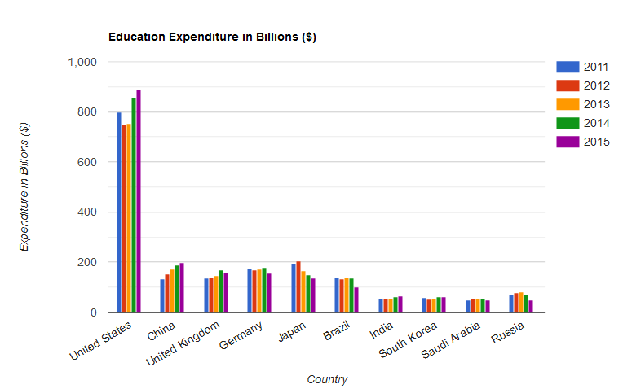
KEY FINDINGS AND ANALYSIS

Slide 9
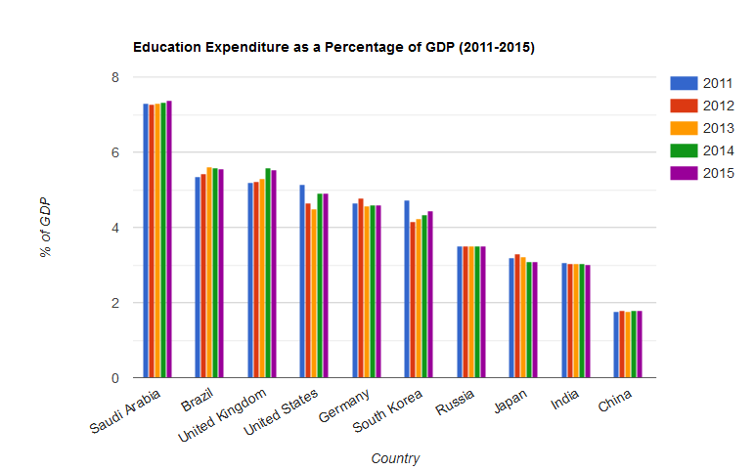
KEY FINDINGS AND ANALYSIS

Slide 10
KEY FINDINGS AND ANALYSIS
For the education sector, United States spends the most compared to other 9 countries.
For education sector, Saudi Arabia spends almost the least amount compared to other 9 countries. However, Saudi Arabia spends the most as a percentage of the country’s GDP (about 7% of their GDP)

Slide 11
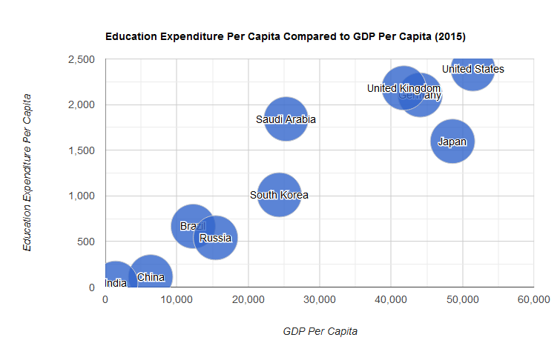
KEY FINDINGS AND ANALYSIS
There seems to be a positive linear correlation between Education Expenditure per capita and GDP Per Capita

Slide 12
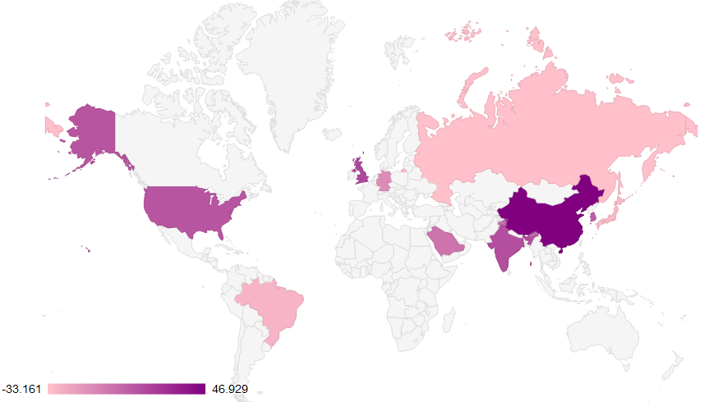
KEY FINDINGS AND ANALYSIS
Fig: Percentage Growth in Education Expenditure from 2011 to 2015

Slide 13
KEY FINDINGS AND ANALYSIS
Education expenditure growth from 2011 to 2015 were highest for china with a growth of about 46%. Other positive growth countries were United Kingdom (17%), India(14%), United States (11%) and South Korea (8%)
However, Russia (-33%), Brazil (-28%) and Japan (-30%) had highest negative growths or expenditure cuts. Other negative growth countries were Germany (-11%) and Saudi Arabia (-1%)
The range in differences between countries was 79%

Slide 14
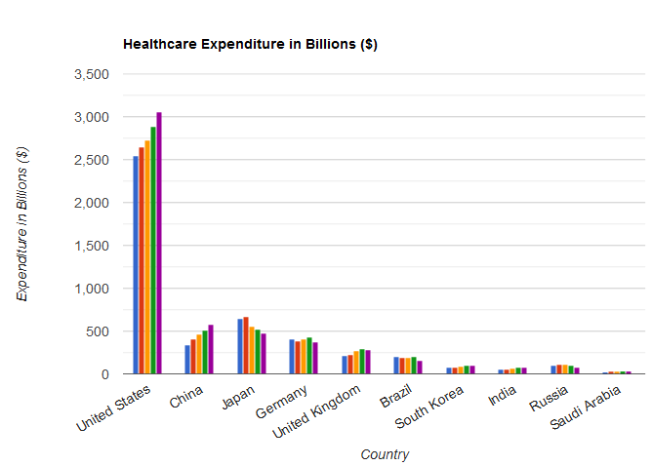
KEY FINDINGS AND ANALYSIS
United States spends the most, whereas Saudi Arabia spends the least amount

Slide 15
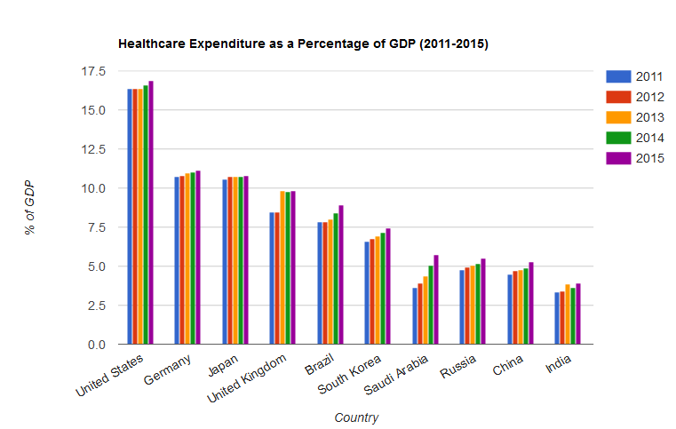
KEY FINDINGS AND ANALYSIS
United States spends the most in healthcare (as a % of GDP), as compared to other countries, whereas India spends the least

Slide 16
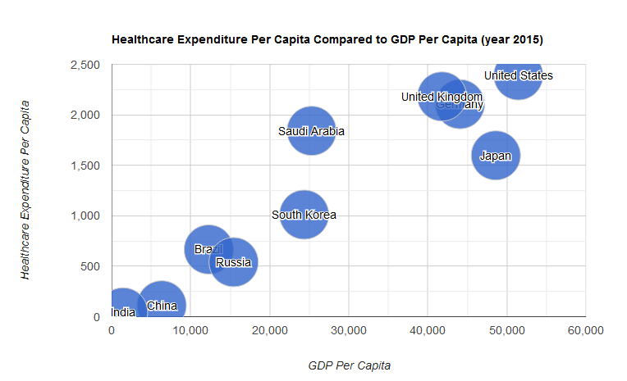
KEY FINDINGS AND ANALYSIS
There seems to be a positive linear correlation between Healthcare Expenditure per capita and GDP Per Capita

Slide 17
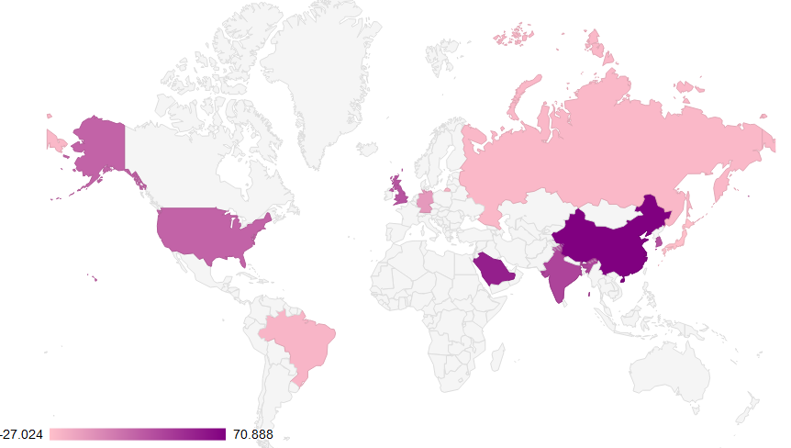
KEY FINDINGS AND ANALYSIS
Fig: Percentage Growth in Healthcare Expenditure from 2011 to 2015

Slide 18
KEY FINDINGS AND ANALYSIS
Healthcare expenditure growth from 2011 to 2015 were highest for china with a growth of about 70%. Other positive growth countries were Saudi Arabia (55%), India (36%), South Korea (29%), United Kingdom (28%) and United States (20%)
However, Japan (-27%) had highest negative growths or expenditure cuts. Other negative growth countries were Russia (-22%), Brazil (-21%) and Germany (-7%)
The range in differences between countries was about 98%
As compared to Education, countries are spending more on Healthcare over the years

Slide 19
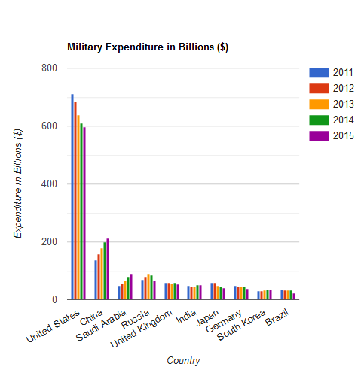
KEY FINDINGS AND ANALYSIS
United states spends the most in Military, whereas South Korea and Brazil spend around the lowest

Slide 20
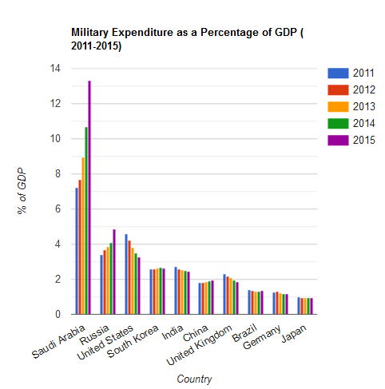
KEY FINDINGS AND ANALYSIS
Saudi Arabia spends the most in military (as a % of GDP), as compared to other countries, whereas Japan spends the least

Slide 21
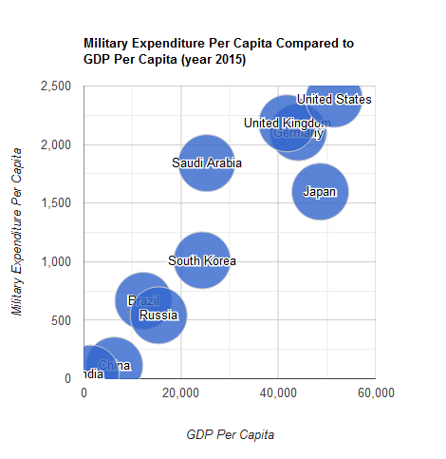
KEY FINDINGS AND ANALYSIS
There seems to be a somewhat positive linear correlation between Military Expenditure per capita and GDP Per Capita

Slide 22
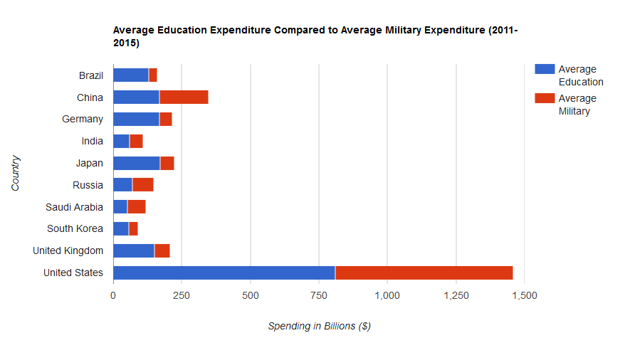
KEY FINDINGS AND ANALYSIS

Slide 23
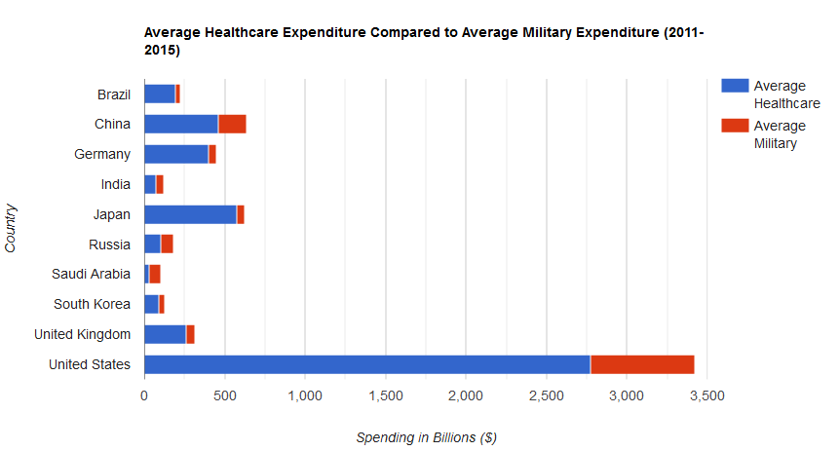
KEY FINDINGS AND ANALYSIS

Slide 24
CONCLUSION
As a combined Expenditure of top 10 countries, the expenditure on healthcare (63%) were more than education (22.4%) and military (14.6%) together in 2015
There seems to somewhat linear positive correlation between GDP Per Capita and Per Capita Expenditures on either of the three sectors (Education, Healthcare and Military)
There seems to be a higher positive increase in spending in healthcare than education
Top 10 countries spend less in military than in education or healthcare

Slide 25
LEARNING PROCESSES
Learning processes for the project was mostly revision of in-class labs and learning
“w3schools.com” on HTML/ CSS
https://developers.google.com/chart/interactive/docs/gallery on using Google API and chart/ graph selections
Prior knowledge of Data Pre-Processing, Excel, and Statistics

Slide 26
PUBLISHED PROJECT LINKS

