Slide 1
Emergent Word Senses in Online Media
Katherine Howitt
May 2016
Methods in Computational Linguistics II
CUNY Graduate Center

Slide 2
Agenda
Agenda and Introduction
Theoretical Motivation
Examples
Task and Implementation Outline
Implementation:
Data Acquisition
Feature Extraction
Training and Results
Challenges and Methodological Issues
Conclusions

Slide 3
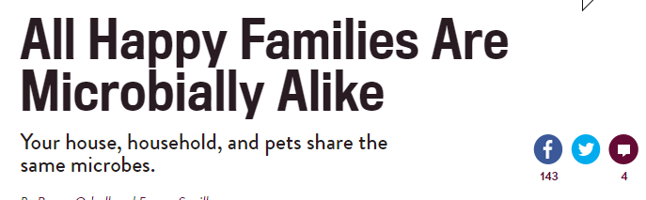



Theoretical Motivation
Emergent meanings of words In sociopolitical news articles
Social media has played an integral role in socially conscious movements
Occupy Wall Street
http://www.slate.com/blogs/behold/2015/05/14/jan_wandrag_our_streets_repurposes_photos_from_the_occupy_wall_street_movement.html
http://www.slate.com/articles/health_and_science/medical_examiner/2014/09/microbes_in_homes_and_on_pets_humans_inoculate_surfaces_with_own_microbiomes.html
Notes:
Emergent meanings of words In sociopolitical news articles take on novel connotations and implications in distinct contexts.
Social media has played an integral role in socially conscious movements of the past decade. With the advent of movements like the Arab Spring and Occupy Wall Street, language is readily adopted to facilitate those communities.

Slide 4
Theoretical Motivation
“understanding” context-sensitive environments.
Target Form | Standard Sense | Emergent Sense
OCCUPY | Do people pay more for houses once occupied by famous writers? | “On paper, it isn't easy to reproduce the oddity of the Occupy the London Stock Exchange rally that took place on the steps of St. Paul's Cathedral last weekend.”
PRIVILEGE | “He has made such an indelible impact on New York, and I had the great privilege of working with him as First Lady and then, of course, as a new senator.” | “One of the powers of privilege is that when you speak out, people are more likely to listen.”
PHOBIC | Perhaps these jet injections of the future will solve needle phobias, patient compliance and accidental sticking. | In independent statements released yesterday, boxing great Muhammad Ali and basketball legend Kareem Abdul-Jabbar denounced Donald Trump after his Islamophobic, xenophobic, everything-o-phobic campaign reached its most offensive low yet.
Notes:
Machines are then faced with the task of “understanding” the language of the movement in predominantly context-sensitive environments.
By extracting features that generally lend themselves to language used in these contexts, one can teach a machine to rapidly learn and utilize emergent definitions – potentially as they are emerging.
This analysis seeks to use three target forms to create and refine features that can be generalized across contexts.
PRIVILEGE Appears as a synonym for honor or right with generally positive connotation, or as a synonym for societal advantage, often referenced negatively.
PHOBIC Used to reference fears, both clinically and casually, but in other instances can modify groups or ideologies with the intent to mean x-hating. Both sense serve as productive suffixes
OCCUPY Traditionally meant to inhabit or fill space, has been extended through its use in the Occupy Wall Street movement to mean to gather in a place for the purpose of protesting x.
Like x phobic constructions, Occupy x constructions are highly productive.

Slide 5
Agenda
Agenda and Introduction
Theoretical Motivation
Example Cases
Task and Implementation Outline
Implementation:
Data Acquisition
Feature Extraction
Training and Results
Challenges and Methodological Issues
Conclusions

Slide 6
Experimental Design
Task: Teach a classifier to recognize emergent contexts and correctly classify senses based on distinctive features.
30 training articles per TF
BOW
POS
Training Data
Gold Standard
Feature Extraction
75%
Data Acquisition
counts
Capitalization
Test Data
Feature Extraction
Train Model
25%
10 test articles per TF
Naïve Bayes
Logistic Regression
SVM
Classify

Slide 7
Implementation Map
Clean data of unknown characters and html
Challenges included UTF/ASCII issues
Defining features as categorical, counts or binary
Challenges included controlling for article size
Model included one target form at a time
Plans for expansion
Data Acquisition
Urllib
glob
Feature Extraction
Regex
Classification and Scoring
Sklearn SVM
beautifulsoup
Sklearn count vectorizer
Python functions
NLTK
Sklearn Naïve Bayes
Sklearn Linear Regression
Stanford POS

Slide 8
Agenda
Agenda and Introduction
Theoretical Motivation
Example Cases
Task and Implementation Outline
Implementation:
Data Acquisition
Feature Extraction
Training
Results
Challenges and Methodological Issues
Conclusions

Slide 9
Data Acquisition
Data set contains 120 articles from www.slate.com
Urls stored in a csv and accessed with urllib and glob
Training data is manually annotated for gold-standard
Contains 30 articles per target sense(15 emergent, 15 standard)
Test set contains 10 articles per target form

Slide 10
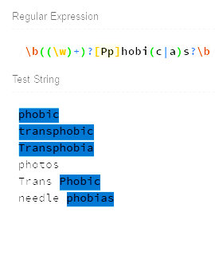
Features: Capitalization and Frequency
Regex allowed me to capture and count
frequency of occurrence
Also counted frequency of capital occurrences
Capitalization was extremely predictive for
“Occupy” but not for other forms

Slide 11
Features: Token Counts in Training Data
 | Occupy |  | Privilege |  | Phobic
 | Occurrences | Capitalized Occurrences | Occurrences | Capitalized Occurrences | Occurrences | Capitalized Occurrences
Emergent | 72 | 69 | 37 | 1 | 40 | 0
Standard | 19 | 0 | 88 | 0 | 51 | 8
Emergent | 37 | 34 | 41 | 6 | 31 | 1
Standard | 5 | 0 | 39 | 0 | 22 | 1
Training
Test

Slide 12

Features: Bag of Words
Sklearn Count Vectorizer was used to create Bag of Words representation
Bag of Words motivated by the context-sensitive quality of target articles
BOW greatly improved Logistic Regression classifier but had a negative effect on SVM
List of groups comes from Chris Bowers on DailyKos. The descriptions were retrieved from Facebook on October 12 using their API.

Slide 13
Features: Part of Speech
Stanford POS tagger presented many immediate issues to process
JAVA problems
Memory issues
Solution: chunking
Solution: bidist to left3word
Part of Speech informative for standard vs. emergent uses of Occupy.
Noun vs verb
Stored as BOW representation for each target form

Slide 14
Features: Implementation and Storage
Each feature represented by a function that stored a list
Pandas data frame: issues with arrays
Vector conversion and addition

Slide 15
Agenda
Agenda and Introduction
Theoretical Motivation
Example Cases
Task and Implementation Outline
Implementation:
Data Acquisition
Feature Extraction
Training
Results
Challenges and Methodological Issues
Conclusions

Slide 16
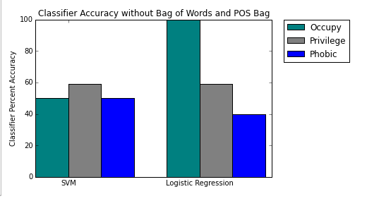
Results
Without Bag of Words and Part of Speech, Classifiers behave at or below chance, with the exception of Occupy in the LR.
This is likely due to Capitalization and Occurrence frequencies which were >1 in all train and test data for emergent forms and =1 for standard.

Slide 17
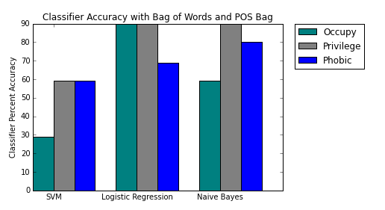
Results
With the addition of Bag of Words and Part of Speech, SVM scores below chance for Occupy, with the exception of Occupy but improves for phobic.
Both Logistic Regression and Naïve Bayes perform above chance.

Slide 18
Agenda
Agenda and Introduction
Theoretical Motivation
Example Cases
Task and Implementation Outline
Implementation:
Data Acquisition
Feature Extraction
Training and Results
Challenges and Methodological Issues
Conclusions

Slide 19
Data Acquisition Challenges
Source material
Data set size too small for reliable results
ASCII / Unicode Issues
Memory problems

Slide 20
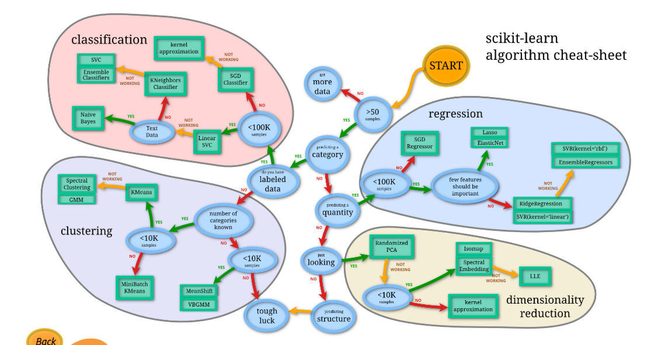
Data Challenges
http://scikit-learn.org/stable/tutorial/machine_learning_map/

Slide 21
Agenda
Agenda and Introduction
Theoretical Motivation
Example Cases
Task and Implementation Outline
Implementation:
Data Acquisition
Feature Extraction
Training and Results
Challenges and Methodological Issues
Conclusions

Slide 22
Conclusions
Larger data set with more robust instances
Focus on word classification rather than article classification
Expand context-sensitive features

Slide 23
References
Hwee Tou Ng, Bin Wang, and Yee Seng Chan. 2003. Exploiting parallel texts for word sense disambiguation: an empirical study. In Proceedings of the 41st Annual Meeting on Association for Computational Linguistics - Volume 1 (ACL '03), Vol. 1. Association for Computational Linguistics, Stroudsburg, PA, USA, 455-462. DOI=http://dx.doi.org/10.3115/1075096.1075154
Jurafsky, Daniel and James H. Martin. 2009. Speech and Language Processing: An Introduction to Natural Language Processing, Computational Linguistics, and Speech Recognition. (2nd Edition.) Prentice-Hall.
Kobus Barnard, Matthew Johnson, and David Forsyth. 2003. Word sense disambiguation with pictures. In Proceedings of the HLT-NAACL 2003 workshop on Learning word meaning from non-linguistic data - Volume 6 (HLT-NAACL-LWM '04), Vol. 6. Association for Computational Linguistics, Stroudsburg, PA, USA, 1-5. DOI=http://dx.doi.org/10.3115/1119212.1119213
Martelli, Alex, Anna Martelli. Ravenscroft, and David Ascher. 2005. Python Cookbook. Beijing: O'Reilly.
Michael Sussna. 1993. Word sense disambiguation for free-text indexing using a massive semantic network. In Proceedings of the second international conference on Information and knowledge management (CIKM '93), Bharat Bhargava, Tim Finin, and Yelena Yesha (Eds.). ACM, New York, NY, USA, 67-74. DOI=http://dx.doi.org/10.1145/170088.170106

