Slide 1
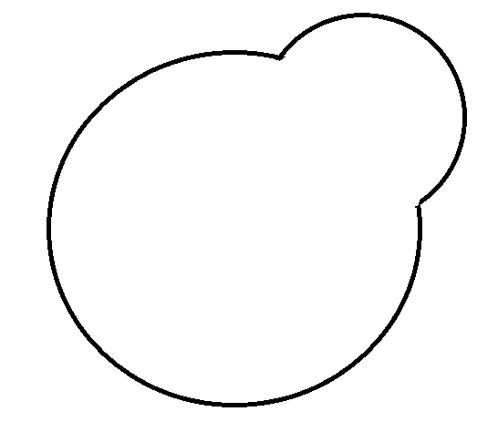
Gene 1
Gene 2
Environment 1
Environment 2
Environment 3
Dudley et al. (2005)

Slide 2
Gene 1
Gene 2
Environment 1
Environment 2
Environment 3
Gene 1 deletion: Normal growth
Gene 2 deletion: Normal growth
Gene 1 deletion: No growth
Gene 2 deletion: Intermediate growth
Gene 1 deletion: No growth
Gene 2 deletion: No growth
Dudley et al. (2005)

Slide 3
Gene 1
Gene 2
Environment 1
Environment 2
Environment 3
Gene 1 deletion: Normal growth
Gene 2 deletion: Normal growth
Gene 1 deletion: No growth
Gene 2 deletion: Intermediate growth
Gene 1 deletion: No growth
Gene 2 deletion: No growth
Gene Name | Environment 1 | Environment 2 | Environment 3 | …
Gene 1 | 2 | 0 | 0 | …
Gene 2 | 2 | 1 | 0 | …
… | … | … | … | …
Dudley et al. (2005)

Slide 4
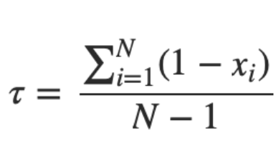

Slide 5
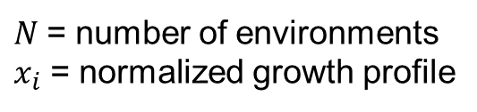
$N$= number of environments
$x_{i}$ = normalized growth profile

Slide 6
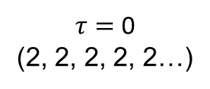
$N$= number of environments
$x_{i}$ = normalized growth profile
$τ=$ 0
(2, 2, 2, 2, 2…)

Slide 7
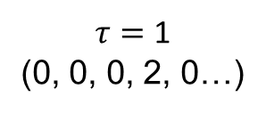
$N$= number of environments
$x_{i}$ = normalized growth profile
$τ=$ 0
(2, 2, 2, 2, 2…)
$τ=$ 1
(0, 0, 0, 2, 0…)

Slide 8
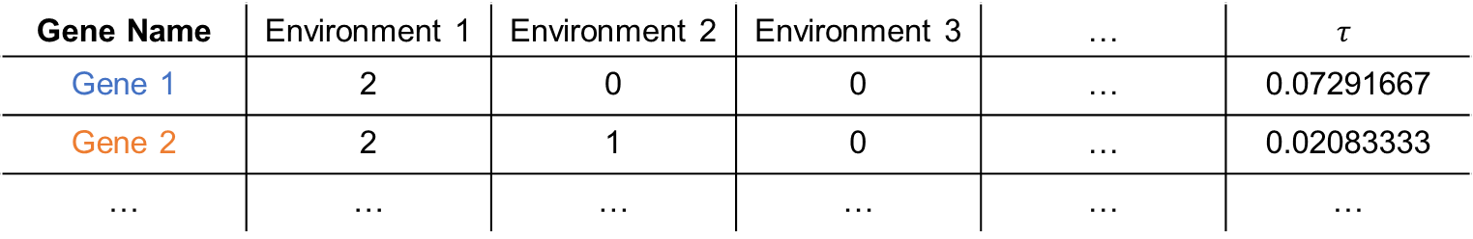
$N$= number of environments
$x_{i}$ = normalized growth profile
$τ=$ 0
(2, 2, 2, 2, 2…)
$τ=$ 1
(0, 0, 0, 2, 0…)
Gene Name | Environment 1 | Environment 2 | Environment 3 | … | $$τ$$
Gene 1 | 2 | 0 | 0 | … | 0.07291667
Gene 2 | 2 | 1 | 0 | … | 0.02083333
… | … | … | … | … | …

Slide 9
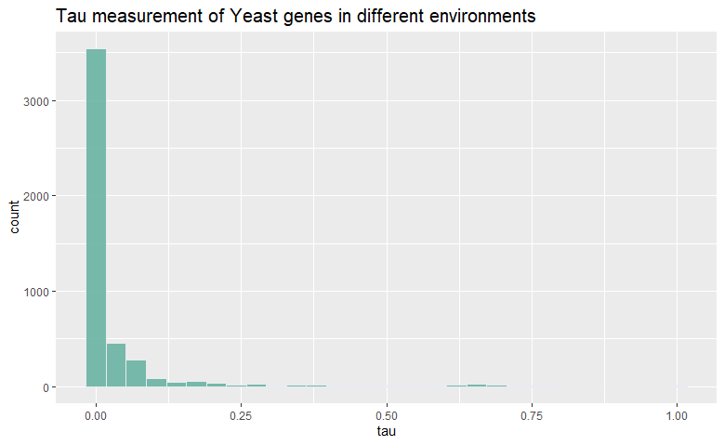

Slide 10
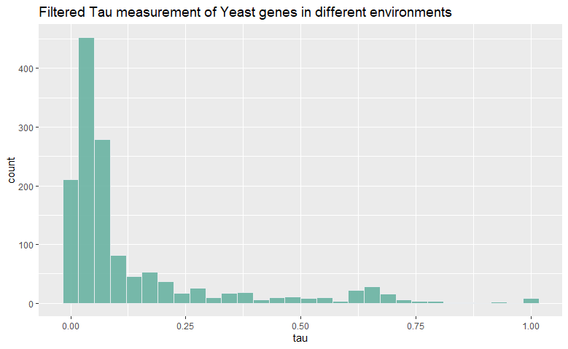

Slide 11
Next steps…
Calculating Tau for different (…better) datasets
Barkai data
Writing functions for other statistical metrics
Gini coefficient, EE score, etc.

