Slide 1
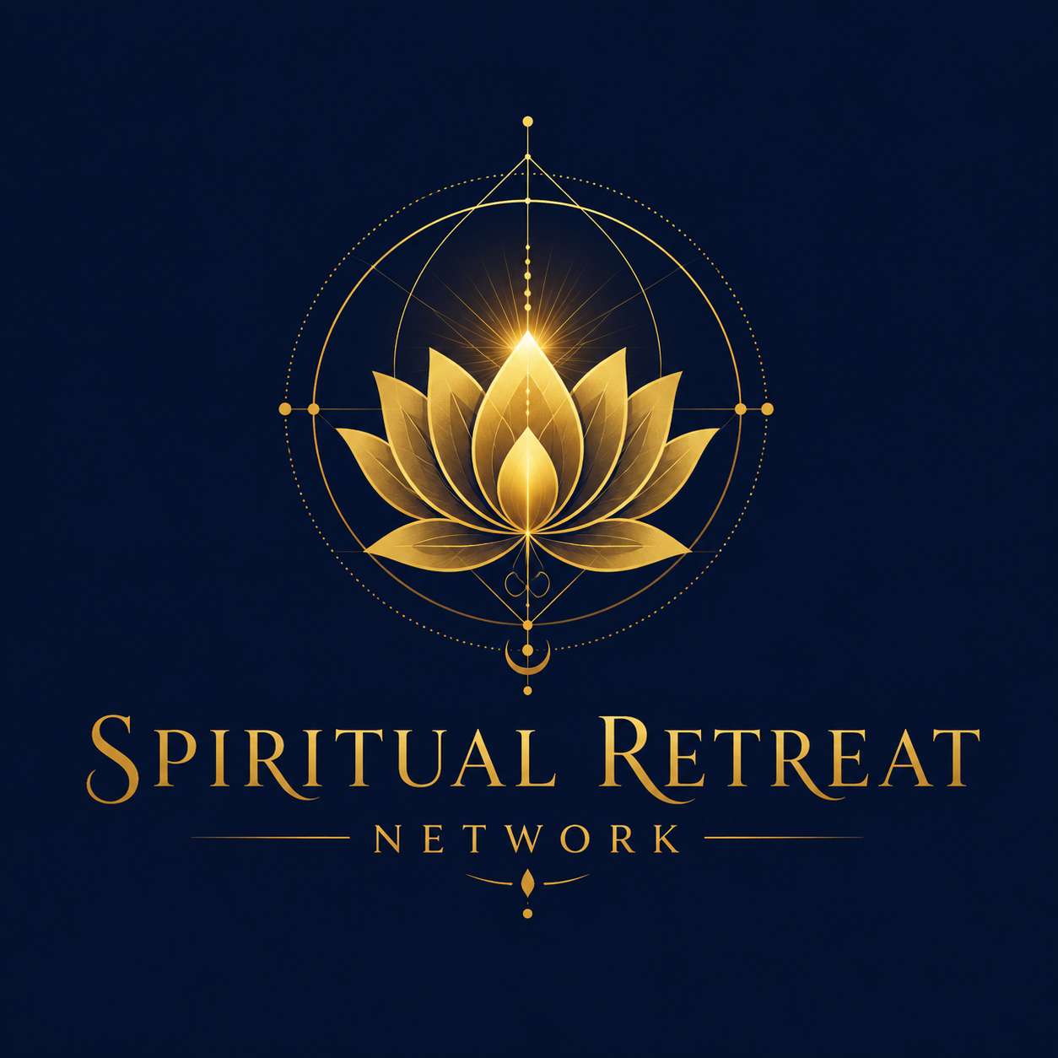
BRANDING PORTFOLIO
SpiritualRetreats.network

Slide 2

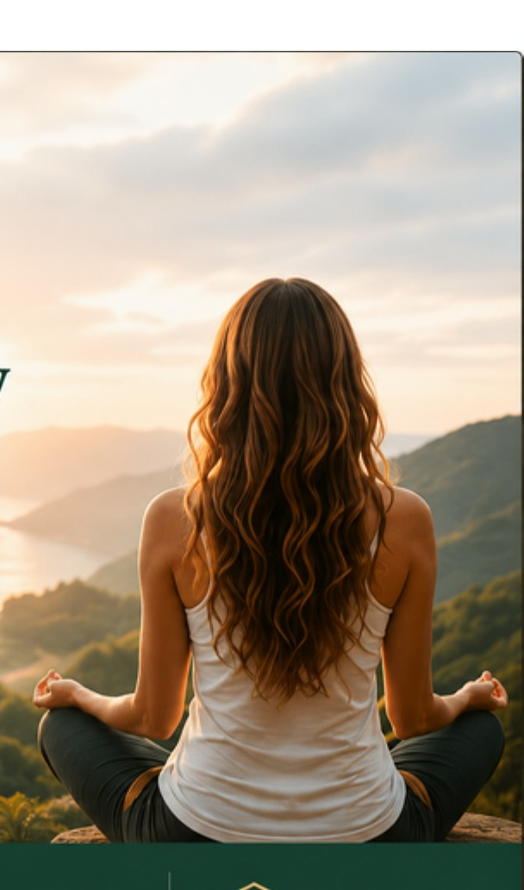
01
The New Brand Direction
Earth meets Heaven: a grounded retreat platform with a sacred, premium soul.
Brand idea
A bridge between nature and spirit: the deep celestial blue holds the sacred lotus, the forest greens keep the platform rooted in real retreats, and gold carries the feeling of transformation, trust, and light.
Naming note
Use SpiritualRetreats.network for the domain and platform. The elegant logo lockup can hold the display name Spiritual Retreat Network as the public-facing master mark.
SpiritualRetreats.network | Brand Portfolio

Slide 3
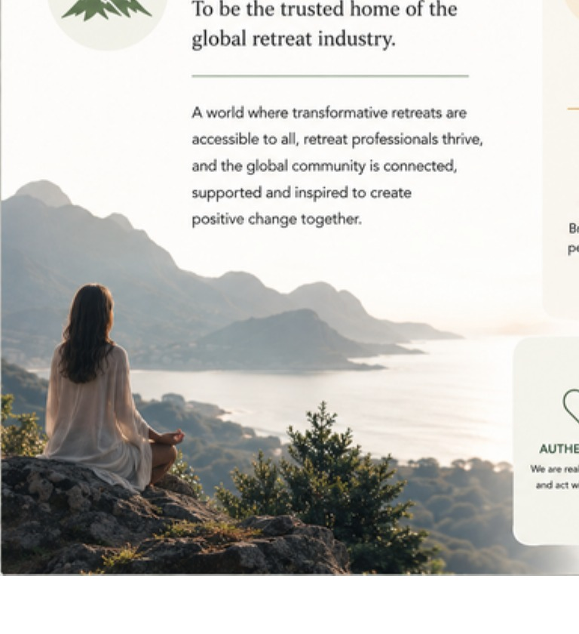
02
Brand Essence
A clear emotional core for every page, deck, profile, message, and retreat experience.
Purpose
Promise
To become the trusted home where seekers, retreat leaders, facilitators, and venues can find each other, grow together, and create genuinely transformational retreat experiences.
SpiritualRetreats.network brings beauty, clarity, support, and connection to an industry that is often fragmented, manual, and difficult to navigate.
Positioning line
Brand mantra
The global connection hub for spiritual retreats - where seekers find the right retreat and retreat professionals find the right people, tools, visibility, and support.
Grounded in nature. Guided by spirit. Built for trust.
Core feeling: calm, premium, human, spiritual, professional, and quietly powerful.
SpiritualRetreats.network | Brand Portfolio

Slide 4
03
Logo System
The lotus is the sacred master symbol. The geometry gives it structure, mystery, and authority.
SPIRITUAL RETREAT
NETWORK
Master lockup
Sacred mark
Wordmark
Use on navy or deep image backgrounds.
Use for favicon, social avatar, stamps, seals.
Use when the full lotus mark is already present nearby.
SpiritualRetreats.network | Brand Portfolio

Slide 5
04
Colour System
A blended palette: celestial blue, living green, transformation gold, and soft natural light.
Primary colours
How to balance it
Use cream and mist as the spacious base. Use forest green for trust and structure. Use navy for sacred moments, hero areas, and premium depth. Use gold sparingly as the blessing, highlight, rule line, or call to action.
Celestial Navy
Forest Retreat
Sacred Gold
Warm Cream
#061A33
#0B4A36
#D9A233
#F8F2E7
Supporting colours
Sage Mist
Mountain Moss
River Teal
Earth Clay
Wisdom Violet
#DDE9D8
#6C875A
#1E7A78
#B77938
#5B3B7A
SpiritualRetreats.network | Brand Portfolio

Slide 6
05
Typography
Elegant, readable, and premium - spiritual without becoming decorative or hard to read.
Display Serif
Body Sans
Cormorant Garamond / Georgia
Inter / Aptos
Use for the brand name, large headings, sacred statements, and premium editorial moments.
Use for body copy, explanations, navigation, forms, profile content, and practical platform instructions.
Hierarchy example
The Home of the Global Spiritual Retreat Industry
One platform. Four pillars. Unlimited possibilities.
Connecting seekers, leaders, facilitators and venues to grow the retreat community together.
SpiritualRetreats.network | Brand Portfolio

Slide 7
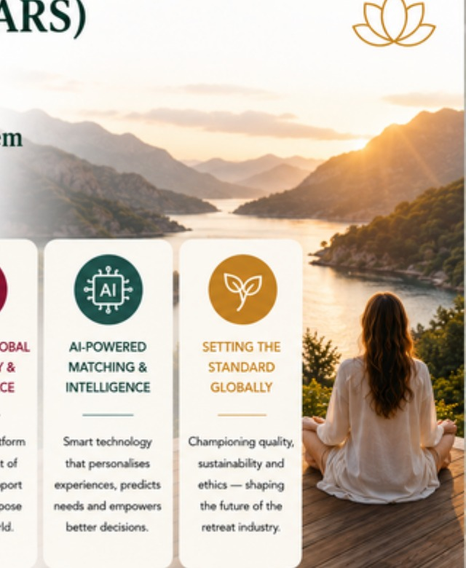
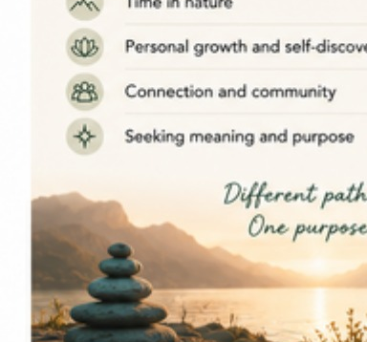
06
Photography & Mood
The imagery should feel real, spacious, grounded, human, and gently mystical.
Use imagery that says
Avoid imagery that feels
nature, mountain air, water, forests, sunrise, ceremony, stillness
people in retreat settings - often from behind or at respectful distance
light entering the scene, but never fake or over-saturated
organic textures: stone, wood, linen, earth, sky, leaves, paths
overly corporate, glossy wellness stock, plastic, sterile or cold
too religious, dogmatic or tied to one spiritual tradition
too dark, occult, fantasy-heavy, or disconnected from real retreats
crowded, noisy, or visually busy
SpiritualRetreats.network | Brand Portfolio

Slide 8
07
Graphic Language
Sacred geometry above, nature beneath, clean platform structure in the middle.
Sacred geometry
Nature base
The geometry should be treated as a premium signal, not a pattern everywhere. Use it as a seal, a very subtle watermark, a hero detail, or a special section divider.
Use soft earth forms, mountain silhouettes, river curves, leaf motifs and warm textures to keep the brand grounded in the actual retreat experience.
The four-pillar colour rhythm
1
DISCOVER - seekers
2
GROW - leaders
3
CONNECT - facilitators & venues
4
LEARN - community
SpiritualRetreats.network | Brand Portfolio

Slide 9
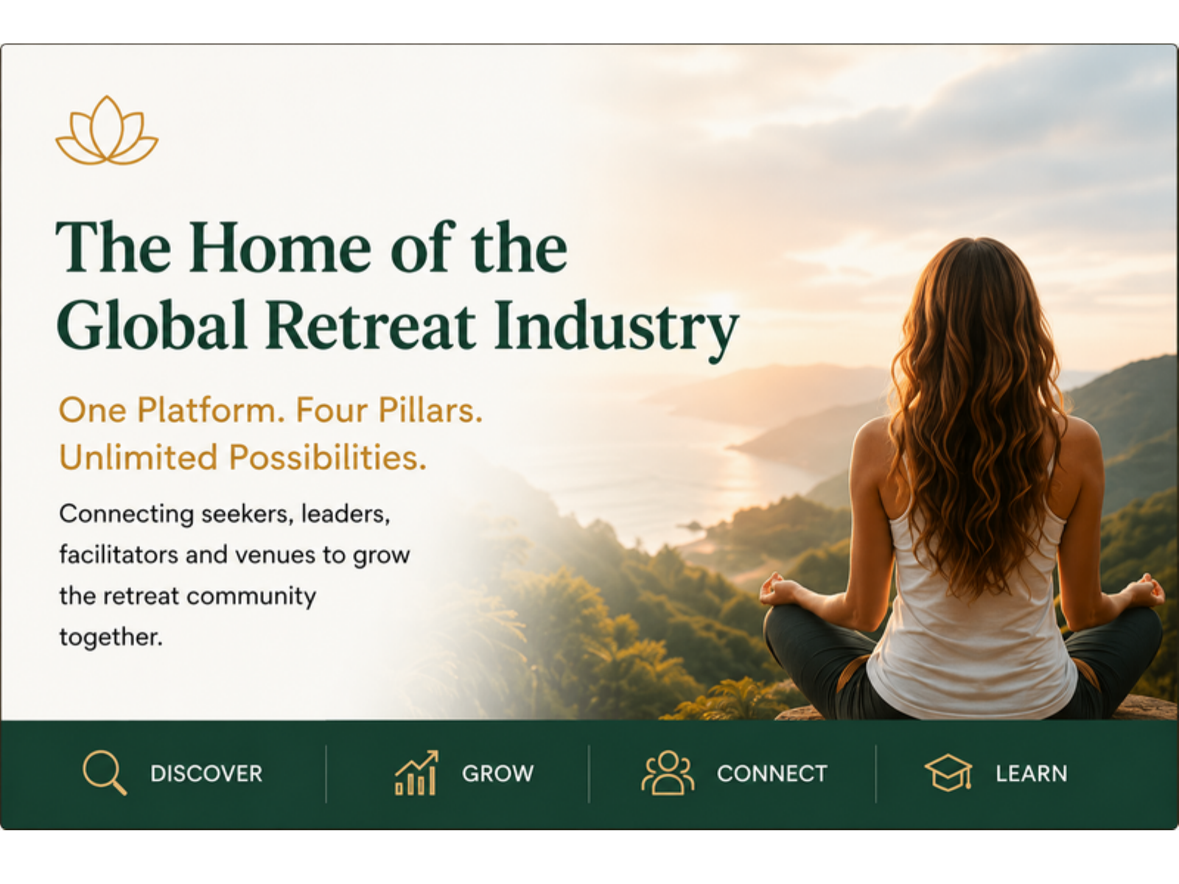
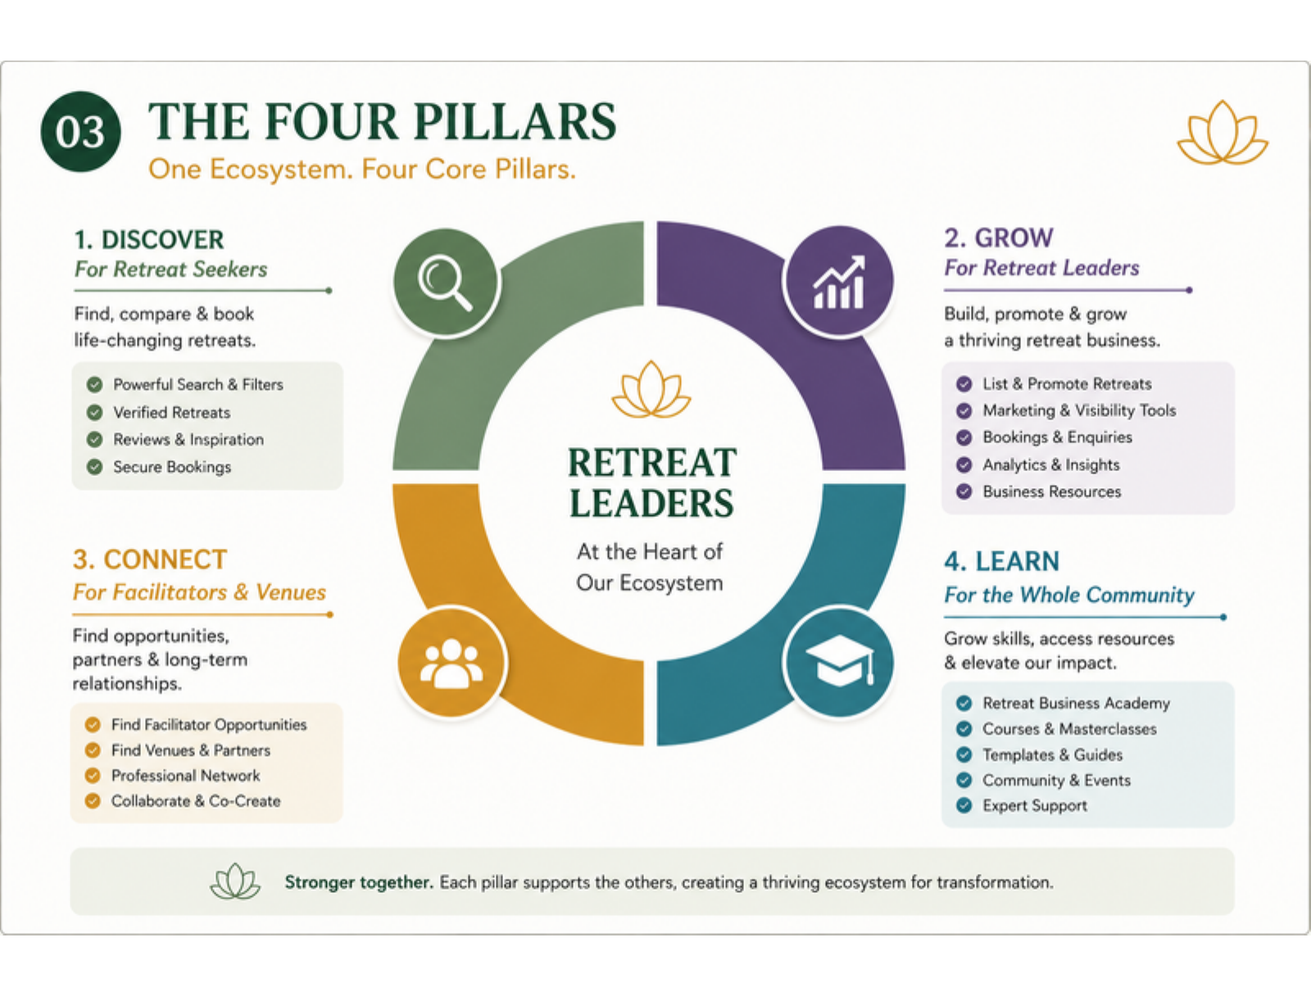
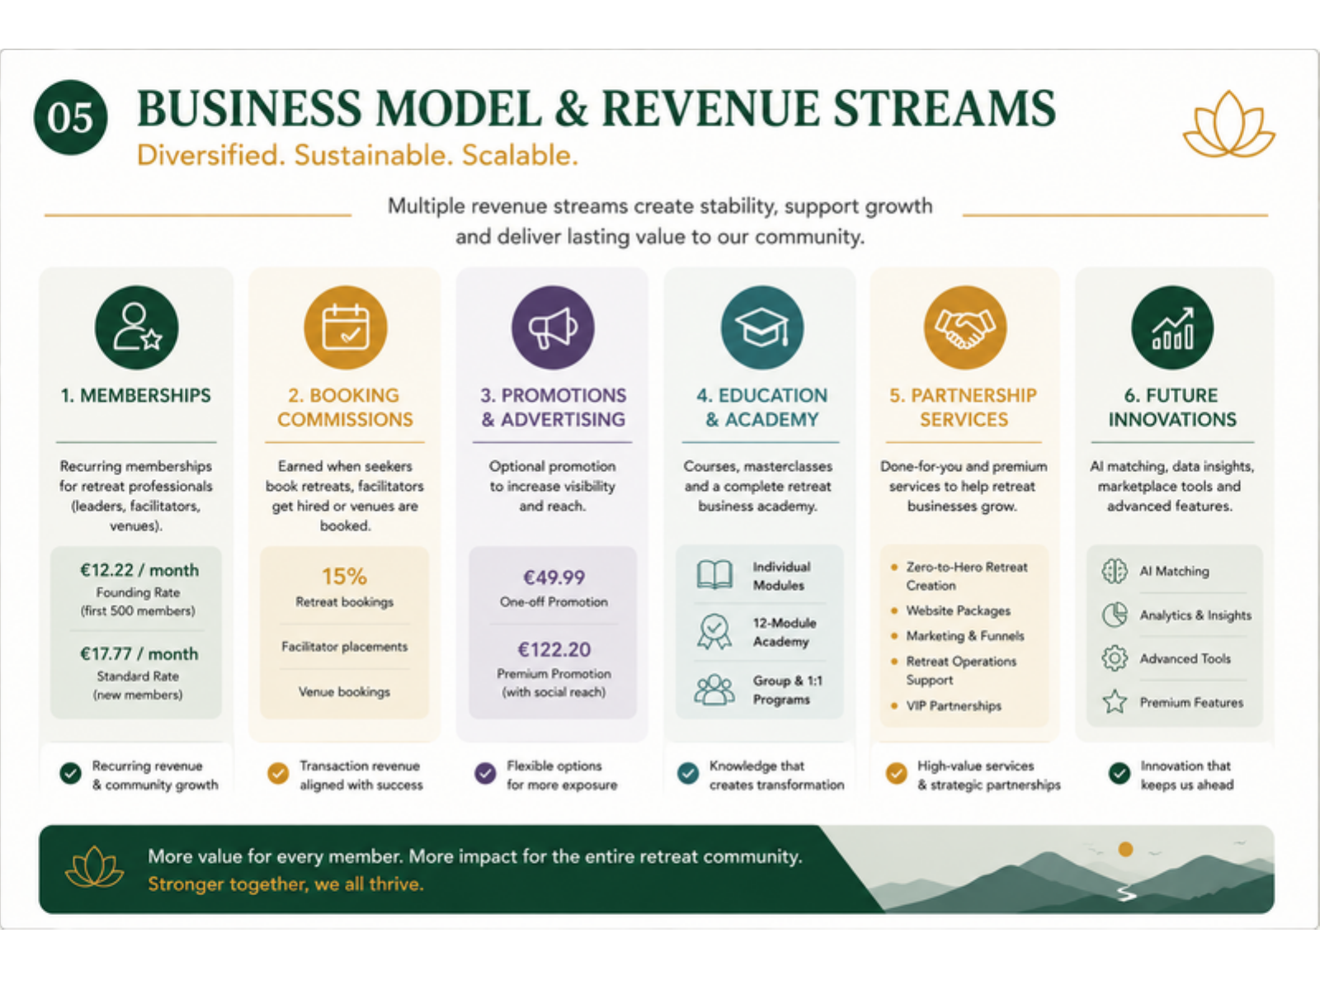
08
Layout System
Spacious, editorial, human, and easy to understand in five seconds.
Keep from the current deck
Upgrade with the new logo
The cream base, forest green headlines, gold details, and clear four-pillar structure already work beautifully.
Use the deep blue and gold lotus for covers, signature pages, ceremonial transitions, and premium moments.
SpiritualRetreats.network | Brand Portfolio

Slide 10
09
Brand Voice
Warm, wise, simple, human, and welcoming across many spiritual paths.
Voice principles
Example headline
Professional without becoming cold or transactional.
Spiritual without becoming vague, dogmatic, or exaggerated.
Supportive and human, always making the next step clear.
Trust-building: clear terms, transparent process, respectful language.
Global and inclusive: many paths, one purpose.
Find the retreat that is truly right for you.
Example support line
Tell us what you are seeking, where you feel called to go, and what kind of transformation you are ready for. We will help you discover retreat options that fit your path.
Preferred words: connection, trust, retreat, nature, transformation, clarity, support, community, alignment.
Use carefully: healing, awakening, sacred, alchemy, spiritual - powerful words, but only where they feel genuine.
SpiritualRetreats.network | Brand Portfolio

Slide 11
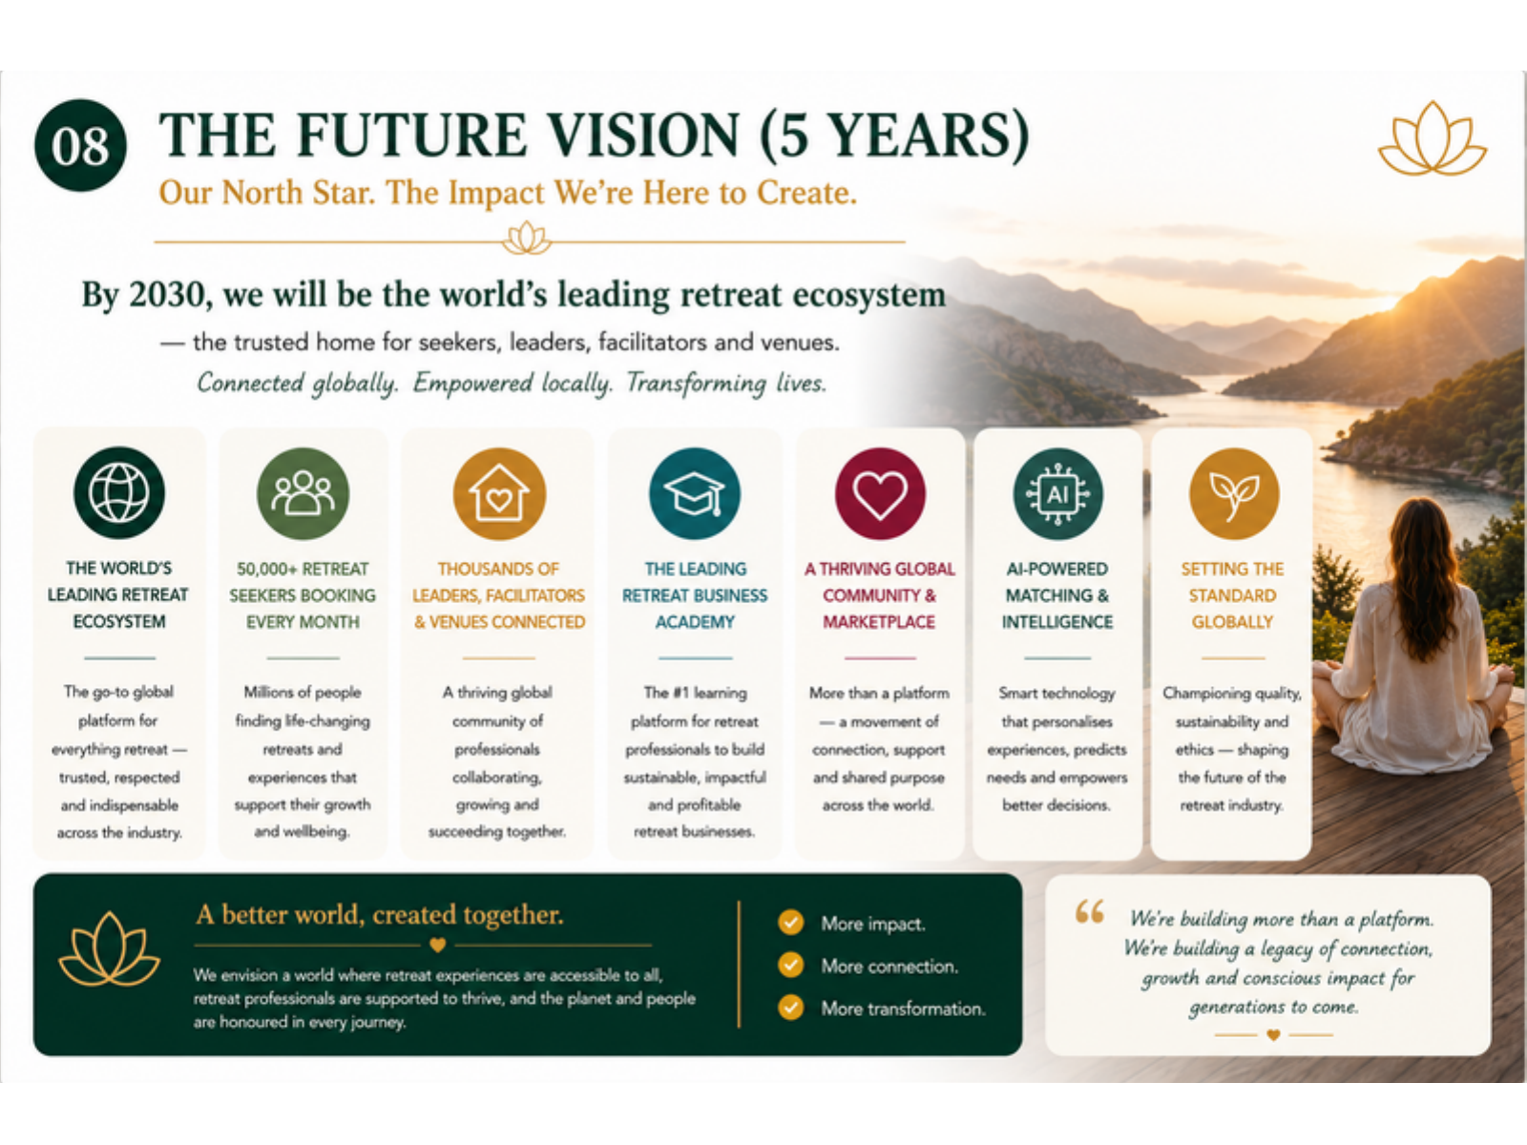
10
Application Direction
How the identity begins to look in real platform moments.
Website hero
Social & campaigns
Investor / partner decks
Navy + lotus for the sacred first impression. Cream + green for the practical pathways: seekers, leaders, facilitators, venues.
Use nature photographs with a small lotus seal, gold headline, and very clear call-to-action.
Use the current green-and-cream presentation system, elevated with navy cover slides and gold ceremonial transitions.
SpiritualRetreats.network | Brand Portfolio

Slide 12
11
Final Brand Formula
A simple guide for every designer, page builder, deck maker, and content creator.
The formula
Begin with a calm, spacious layout.
Bring in cream, sage and forest green for nature and trust.
Use navy for sacred depth and premium authority.
Use gold as light: highlights, rules, buttons, seals and moments of transformation.
Keep human photographs real, warm, and connected to nature.
Make every next step clear and kind.
One-line identity
The global home where spiritual retreats, seekers, facilitators, leaders and venues meet in trust, beauty, and transformation.
Grounded in nature. Guided by spirit. Built for trust.
SpiritualRetreats.network | Brand Portfolio

Slide 13
12
Implementation Checklist
What to update next so the new identity becomes consistent everywhere.
Brand assets
Platform rollout
Confirm the final domain spelling: SpiritualRetreats.network.
Create final transparent PNG/SVG logo files from the chosen master logo.
Prepare favicon, social avatar, horizontal logo, dark logo, and light-background version.
Lock the colour palette and font choices before web build.
Update the existing retreat platform deck with the new name and logo.
Apply the blue/green/gold system to website hero, forms, and emails.
Create templates for retreat profiles, facilitator profiles, social posts, and partner proposals.
Use the brand voice guide for seeker, leader, facilitator, and venue copy.
SPIRITUAL RETREAT NETWORK
Ready for the next step: logo export pack + refreshed website/deck templates.
SpiritualRetreats.network | Brand Portfolio

