Slide 1
Paranormal Distribution
Andy Chung
Kevin Gilbert
Jason Sun

Slide 2
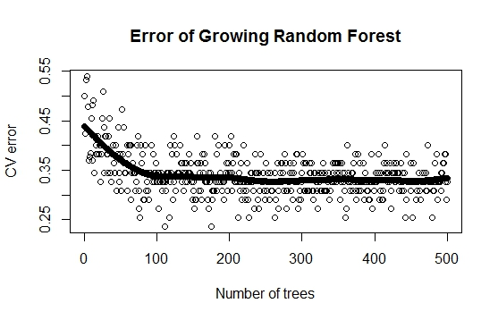
First Step: Random Forest
One decision tree: One classification
500 decision trees: One classification
We bag these trees into a “random forest”

Slide 3
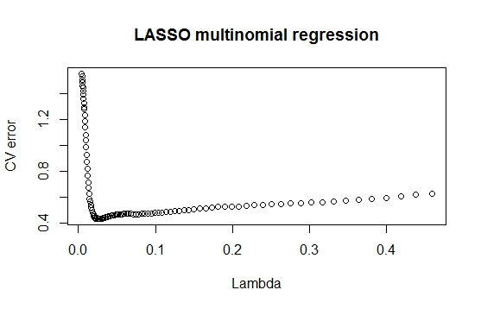
Second Step: LASSO (glmnet)
What if Random Forest isn't sure?
Recalculate unsure nodes with LASSO, ridge
Replacing decisions reduced our CV error

Slide 4
Results on training data
Random Forest prone to overfit
Individual forests vary between 25% and 40% error
Two-stage algorithm has only 30% error
Tested on 4-folds cross-validation
We're pretty sure map of neighborhoods is... Pittsburgh!

Slide 5
