Slide 1
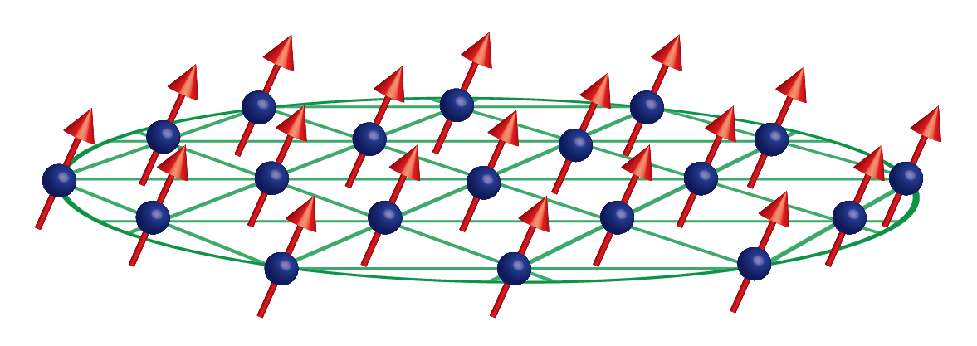

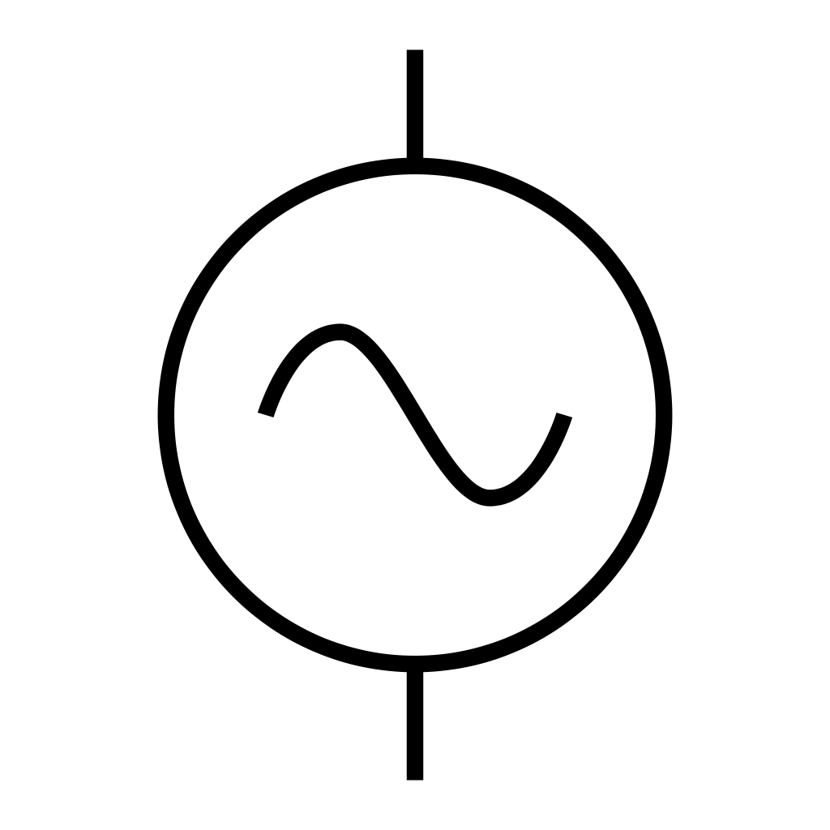


Sensing with a trapped-ion mechanical oscillator
$$ω_{odf}$$
$$ω_{odf}+μ$$
Notes:
Drumhead modes of 2D crystal in Penning trap analogous to cavity optomechanics experiments. With cavity – oscillator pairing, motion of mechanical oscillator shifts frequency of cavity, which is read out.

Slide 2
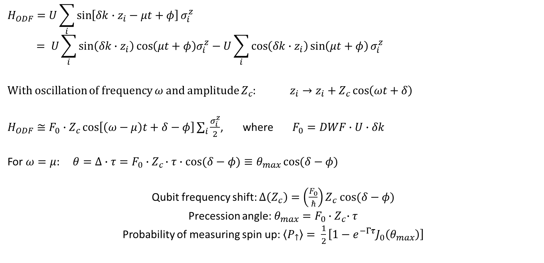
Precession due to axial oscillation
$$H_{ODF}=U\sum_{i}{\sin\left[δk∙z_{i}−μt+φ\right]σ_{i}^{z}}$$
$$= U\sum_{i}{\sin\left(δk∙z_{i}\right)\cos\left(μt+φ\right)σ_{i}^{z}−U\sum_{i}{\cos\left(δk∙z_{i}\right)\sin\left(μt+φ\right)}}σ_{i}^{z}$$
With oscillation of frequency $ω$ and amplitude $Z_{c}$: $z_{i}→z_{i}+Z_{c}\cos\left(ωt+δ\right)$
$H_{ODF}≅F_{0}∙Z_{c}\cos\left[\left(ω−μ\right)t+δ−φ\right]\sum_{i}{\frac{σ_{i}^{z}}{2}}$, where $F_{0}=DWF∙U∙δk$
For $ω=μ:$ $θ=Δ∙τ=F_{0}∙Z_{c}∙τ∙cos{(δ−φ)}≡θ_{max}\cos{(δ−φ)}$
Qubit frequency shift: $Δ\left(Z_{c}\right)=\left(\frac{F_{0}}{ℏ}\right)Z_{c} cos⁡(δ−φ)$
Precession angle: $θ_{max}=F_{0}{∙Z}_{c}∙τ$
Probability of measuring spin up: $\left\langle P_{↑}\right\rangle = \frac{1}{2}\left[1−e^{−Γτ}J_{0}\left(θ_{max}\right)\right]$
Notes:
Like the cavity-mechanical oscillator, due to the spin-motion coupling induced by the ODF, qubit frequency sees a shift – hence precession. The qubit frequency shift evaluated at Z_c = 2 nm (zero point fluc of COM mode for 100 ions) is the equivalent of the vacuum optomechanical coupling strength/

Slide 3

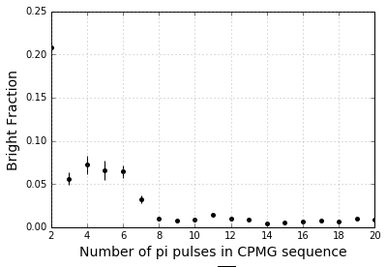



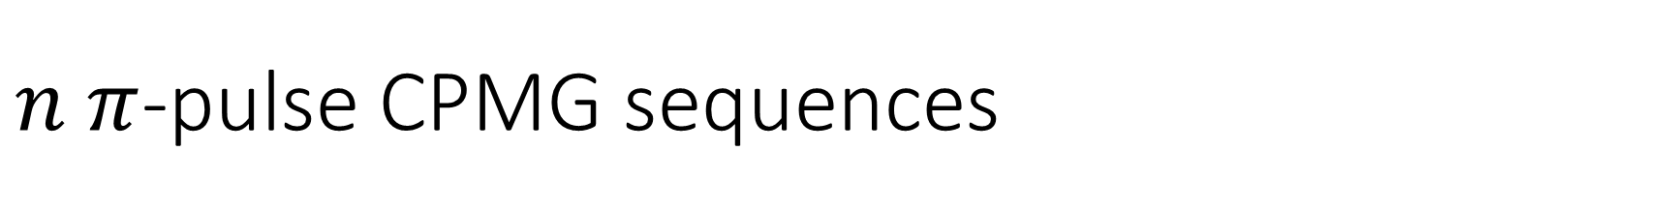
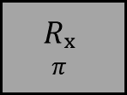

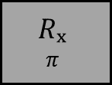




$n π$-pulse CPMG sequences
ODF Phase jumps:
$$Δφ=μ(T+t_{π})$$
$$Δφ=μ(T+t_{π})$$
$$T$$
$$T$$
$$T$$
$$T$$
Cool
R_{y}
ODF
$$Rₓ$$
$$π$$
$$Rₓ$$
$$π$$
R_{y}𝜽
Detect
ODF
ODF
$$t_{π}$$
$$t_{π}$$
CPMG sequences (no ODF) with 20 ms total interaction time
Using more pi pulses for same total ODF interaction time decreases dephasing due to magnetic field fluctuations without accumulating errors from microwave pulses – for up to 20 pi pulses

Slide 4


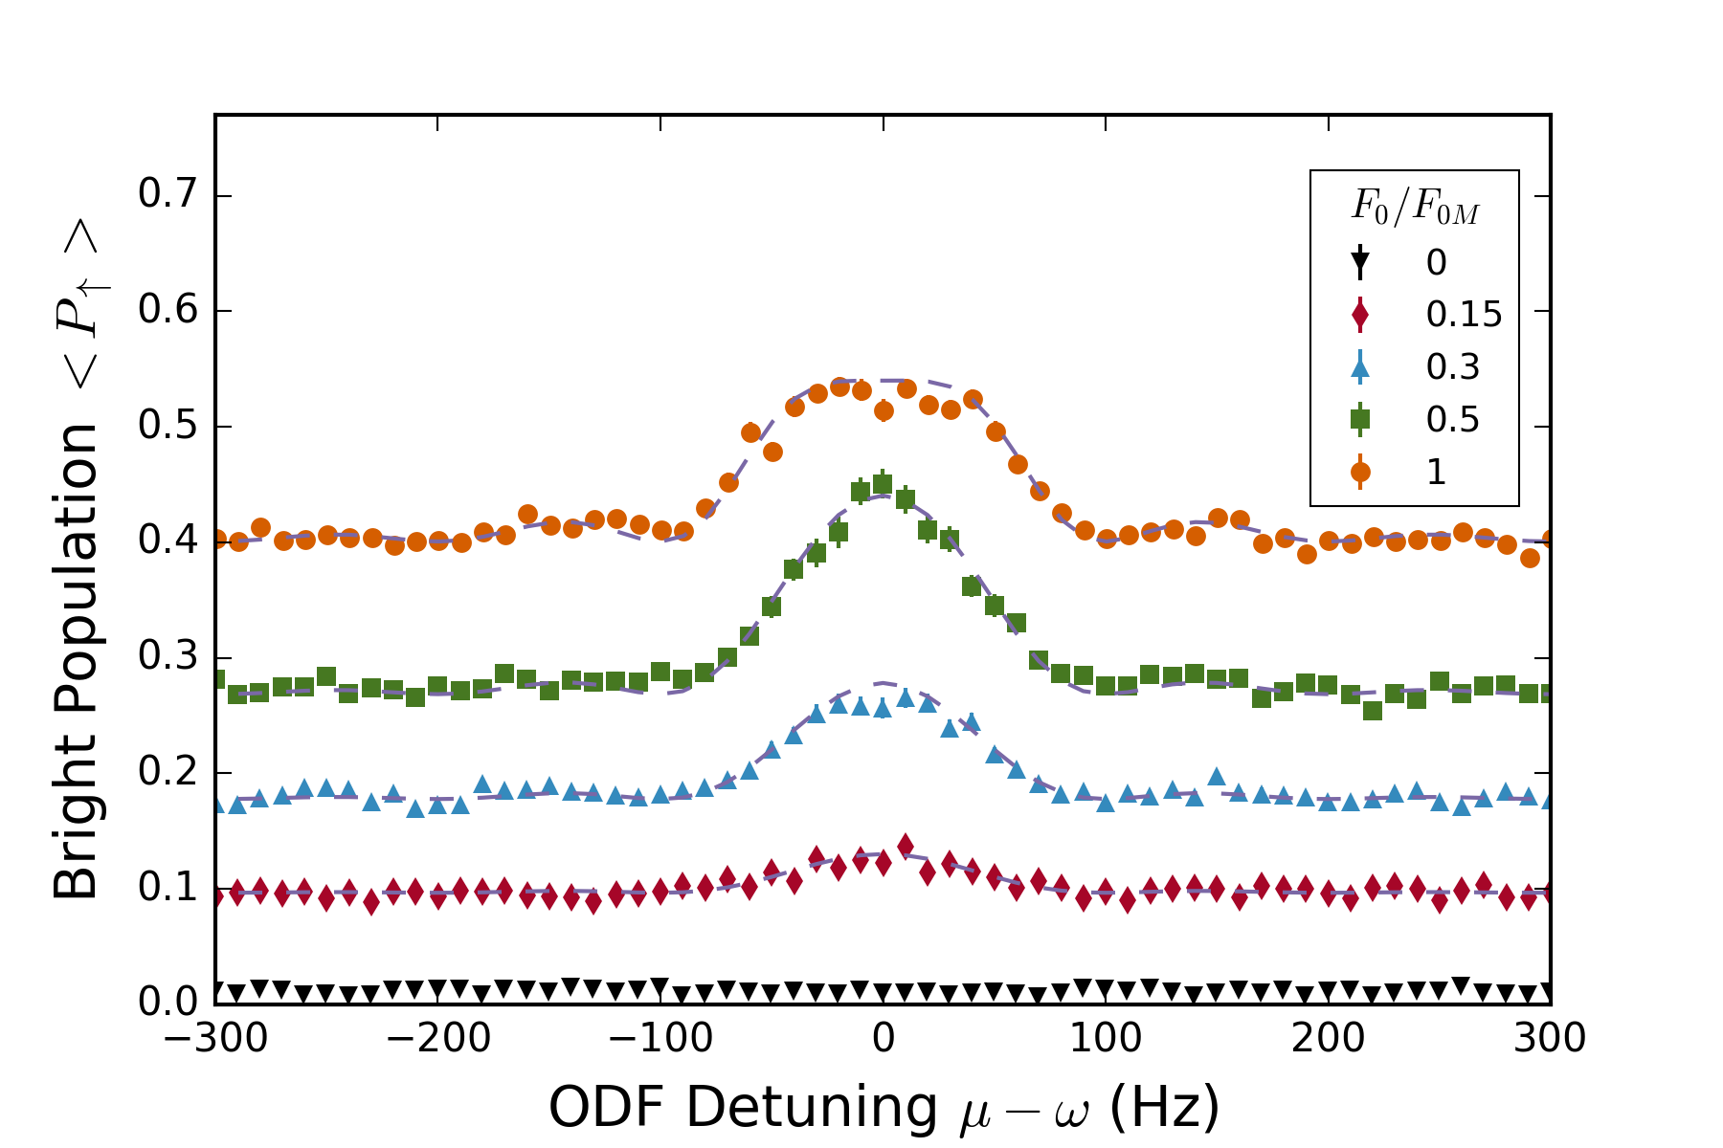
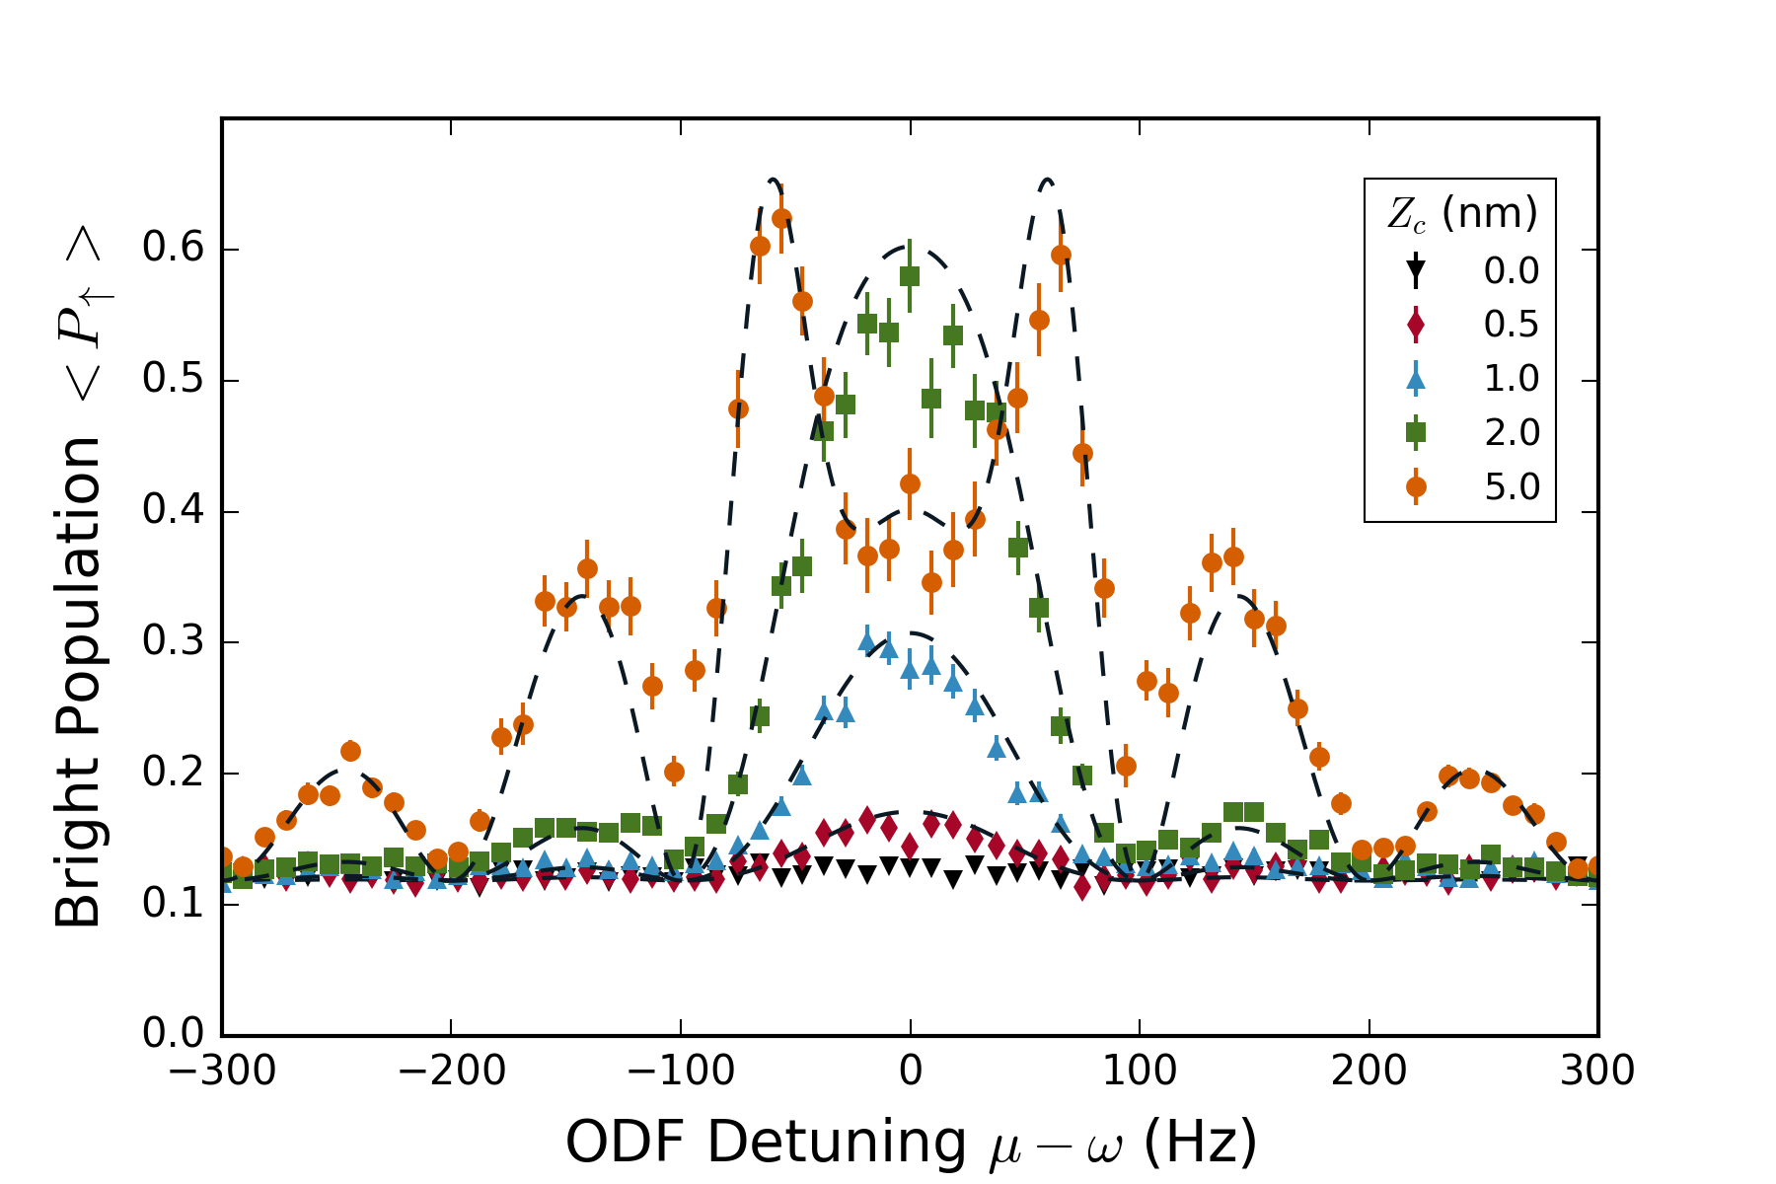
Lineshape – theory agrees well

Slide 5
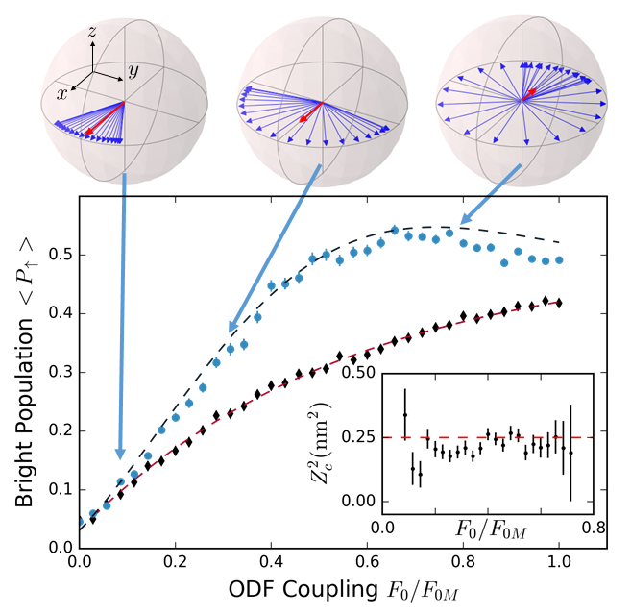
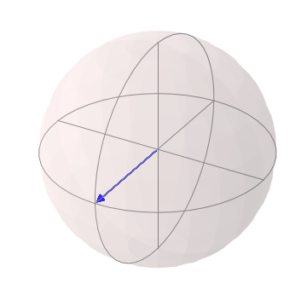
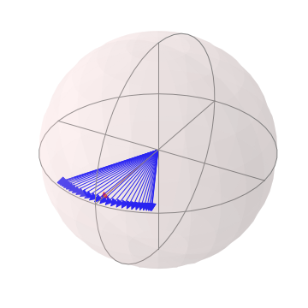
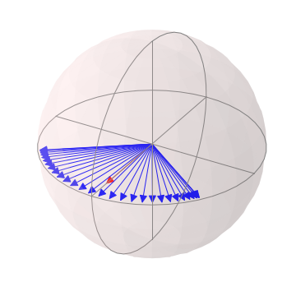
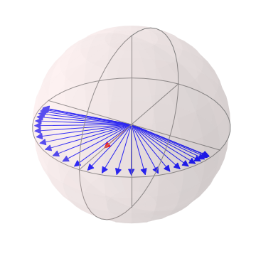
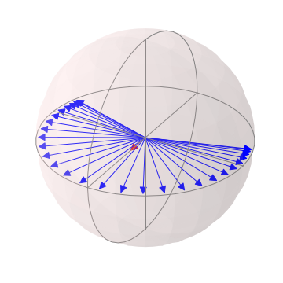
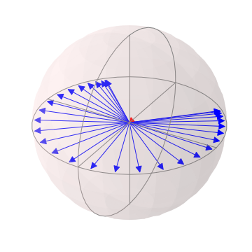
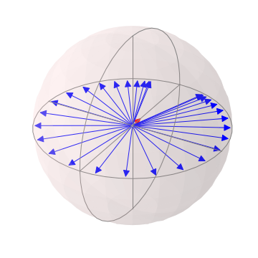
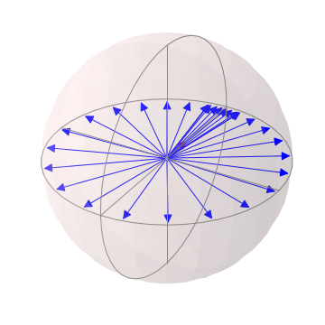
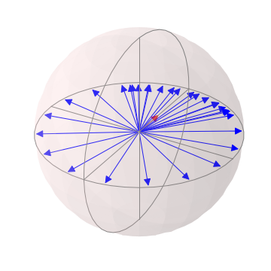
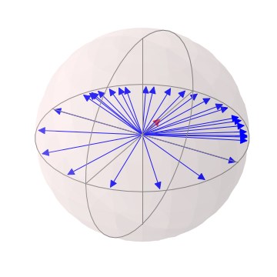
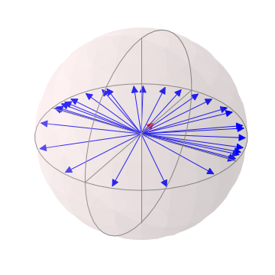
Spin dephasing vs measurement strength

Slide 6
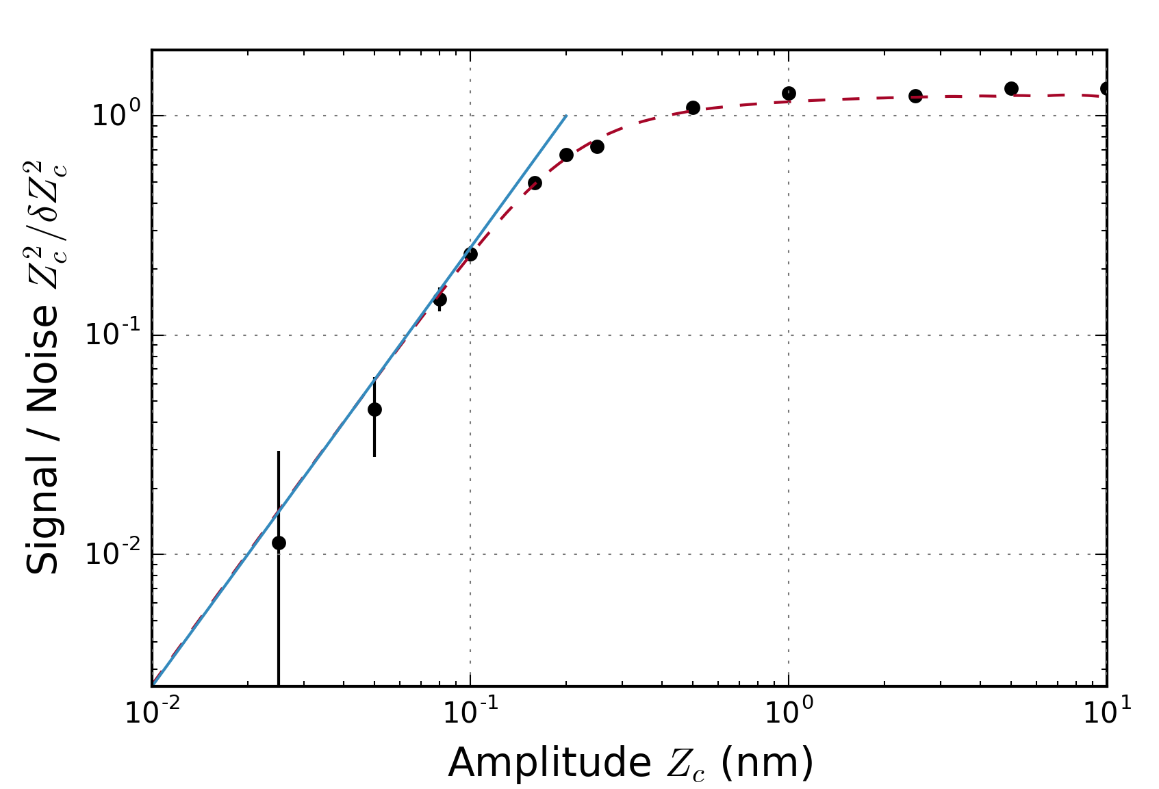
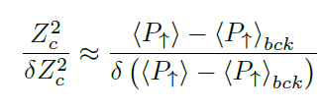
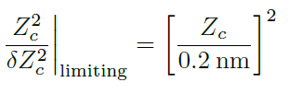
Limits to sensitivity / signal-to-noise
Projection noise limit
50 pm – smallest detected amplitude

Slide 7
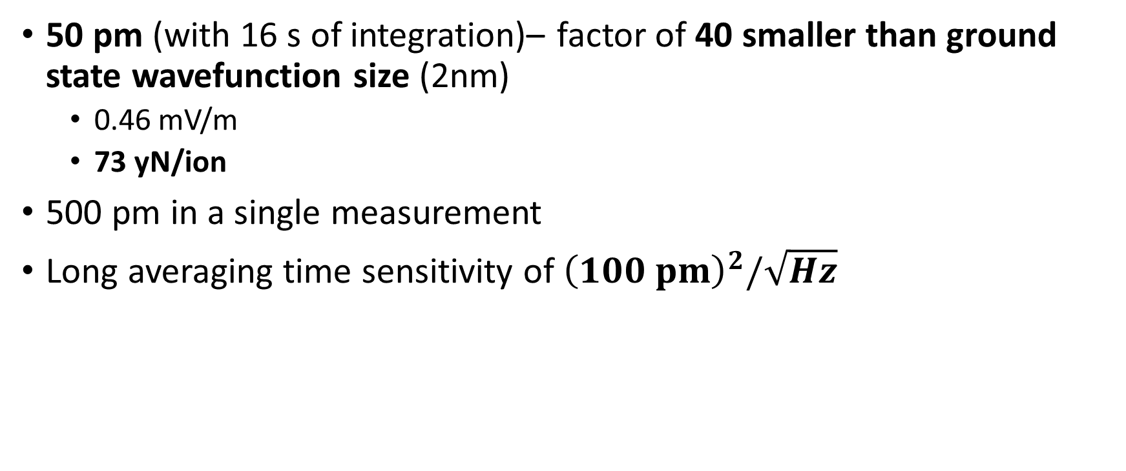
Off-resonant, incoherent amplitude sensing
50 pm (with 16 s of integration)– factor of 40 smaller than ground state wavefunction size (2nm)
0.46 mV/m
73 yN/ion
500 pm in a single measurement
Long averaging time sensitivity of ${\left(100 pm\right)}^{2}/\sqrt{Hz}$

Slide 8
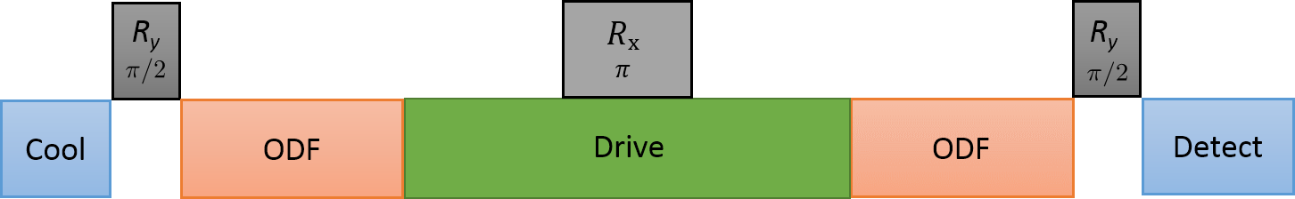


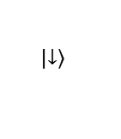
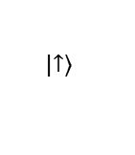
On resonance sensing scheme
$$p_{z}$$
$$z$$
$$\left|\left.↓\right\rangle \right.$$
$$\left|\left.↑\right\rangle \right.$$

Slide 9
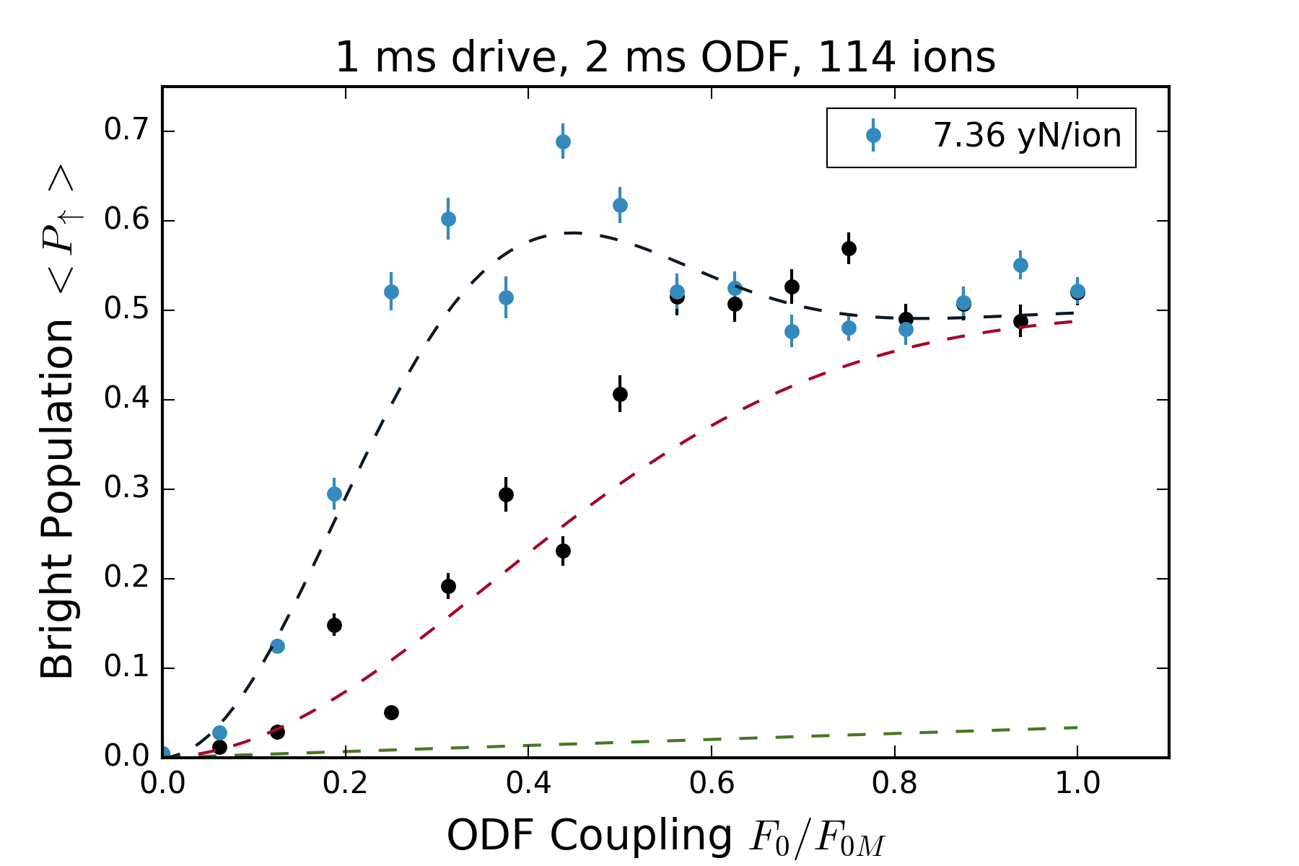
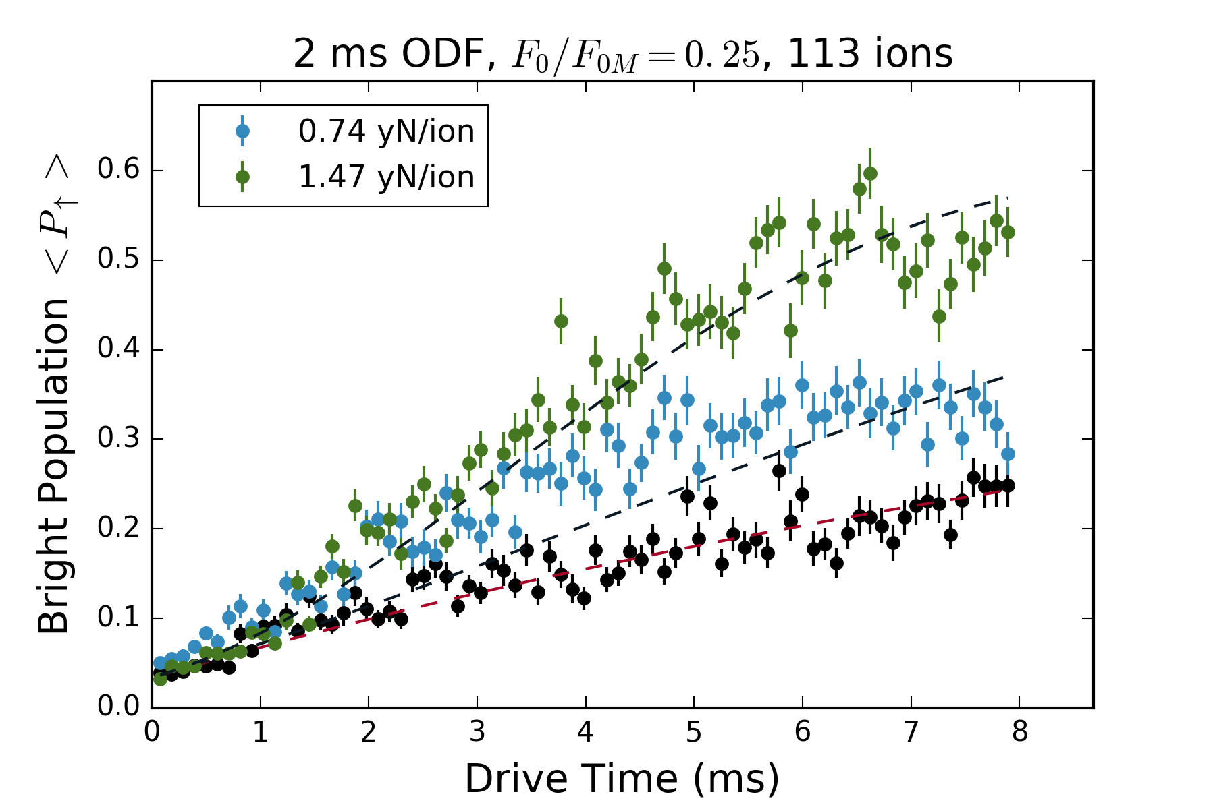
On-resonance, background not understood – sensitivity limited
7.4 yN/ion, 45.5 uV/m
0.74 yN/ion, 4.5 uV/m

Slide 10

Predictions for on-resonance, phase coherent sensing
74 pm in a single measurement
$18 pm/\sqrt{Hz}$
20 pm in 5 ms
7 nV/m
10^-3 yN / ion

