Slide 1
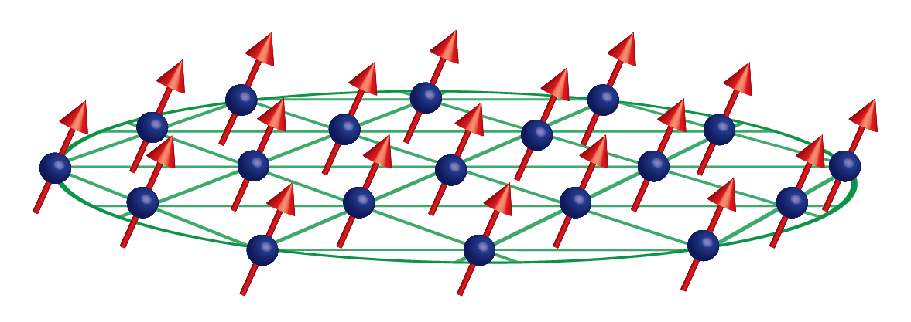




Sensing with a trapped-ion mechanical oscillator
$$ω_{odf}$$
$$ω_{odf}+μ$$
Notes:
Drumhead modes of 2D crystal in Penning trap analogous to cavity optomechanics experiments. With cavity – oscillator pairing, motion of mechanical oscillator shifts frequency of cavity, which is read out.

Slide 2
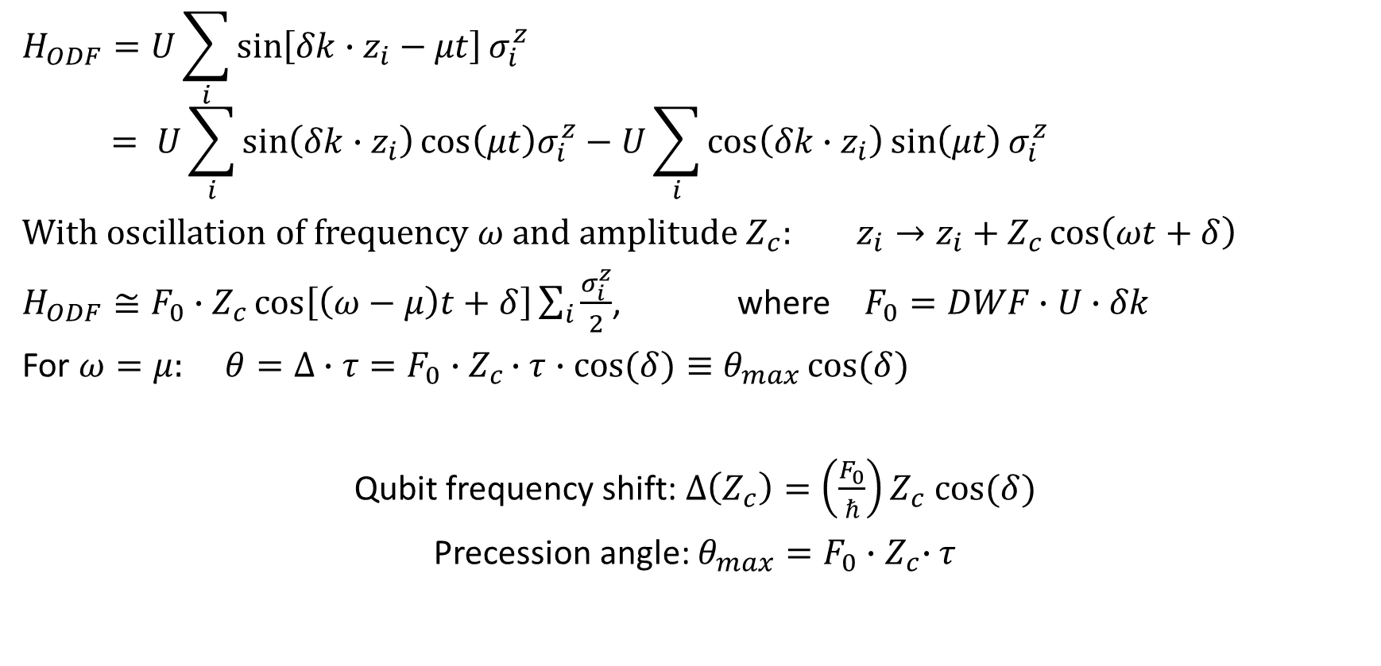
Precession due to axial oscillation
$$H_{ODF}=U\sum_{i}{\sin\left[δk∙z_{i}−μt\right]σ_{i}^{z}}$$
$$= U\sum_{i}{\sin\left(δk∙z_{i}\right)\cos\left(μt\right)σ_{i}^{z}−U\sum_{i}{\cos\left(δk∙z_{i}\right)\sin\left(μt\right)}}σ_{i}^{z}$$
With oscillation of frequency $ω$ and amplitude $Z_{c}$: $z_{i}→z_{i}+Z_{c}\cos\left(ωt+δ\right)$
$H_{ODF}≅F_{0}∙Z_{c}\cos\left[\left(ω−μ\right)t+δ\right]\sum_{i}{\frac{σ_{i}^{z}}{2}}$, where $F_{0}=DWF∙U∙δk$
For $ω=μ:$ $θ=Δ∙τ=F_{0}∙Z_{c}∙τ∙cos{(δ)}≡θ_{max}\cos{(δ)}$
Qubit frequency shift: $Δ\left(Z_{c}\right)=\left(\frac{F_{0}}{ℏ}\right)Z_{c} cos⁡(δ)$
Precession angle: $θ_{max}=F_{0}{∙Z}_{c}∙τ$
Notes:
Like the cavity-mechanical oscillator, due to the spin-motion coupling induced by the ODF, qubit frequency sees a shift – hence precession. The qubit frequency shift evaluated at Z_c = 2 nm (zero point fluc of COM mode for 100 ions) is the equivalent of the vacuum optomechanical coupling strength

Slide 3
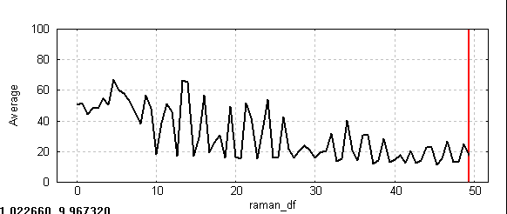
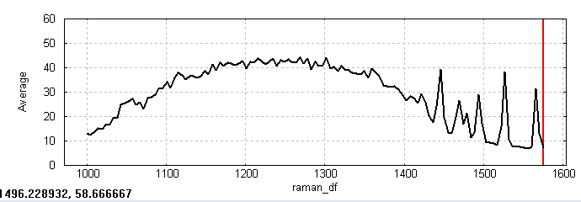
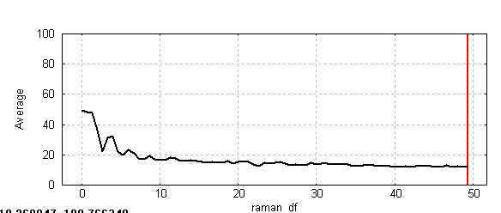
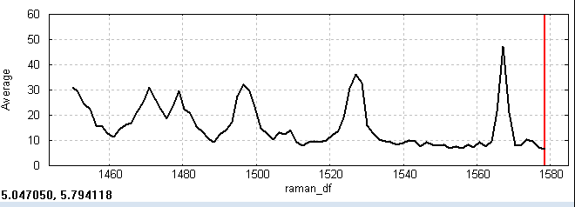
Modes and low frequency signal

Slide 4

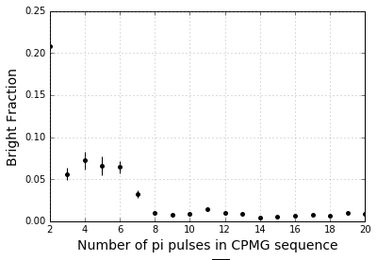








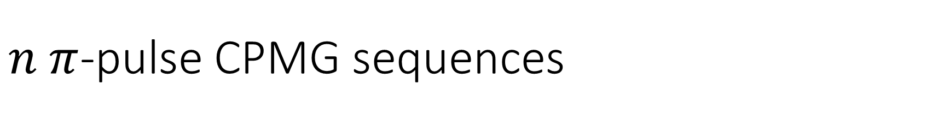














$n π$-pulse CPMG sequences
ODF Phase jumps:
$$Δφ=μ(T+t_{π})$$
$$Δφ=μ(T+t_{π})$$
$$Δφ$$
$$Δφ$$
$$T$$
$$t_{π}$$
$$T$$
$$T$$
$$t_{π}$$
$$T$$
$$T$$
$$T$$
$$T$$
$$T$$
Cool
R_{y}
ODF
$$Rₓ$$
$$π$$
$$Rₓ$$
$$π$$
R_{y}𝜽
Detect
ODF
ODF
ODF
ODF
ODF
ODF
$$t_{π}$$
$$t_{π}$$
$$\frac{π}{2}{\left.​\right|}_{y}$$
$$π{\left.​\right|}_{x}$$
$$π{\left.​\right|}_{x}$$
$$\frac{π}{2}{\left.​\right|}_{y}$$
CPMG sequences (no ODF) with 20 ms total interaction time
Probability of measuring spin up: $\left\langle P_{↑}\right\rangle = \frac{1}{2}\left[1−e^{−Γτ}J_{0}\left(θ_{max}\right)\right]$
Using more pi pulses for same total ODF interaction time decreases dephasing due to magnetic field fluctuations without accumulating errors from microwave pulses – for up to 20 pi pulses

Slide 5


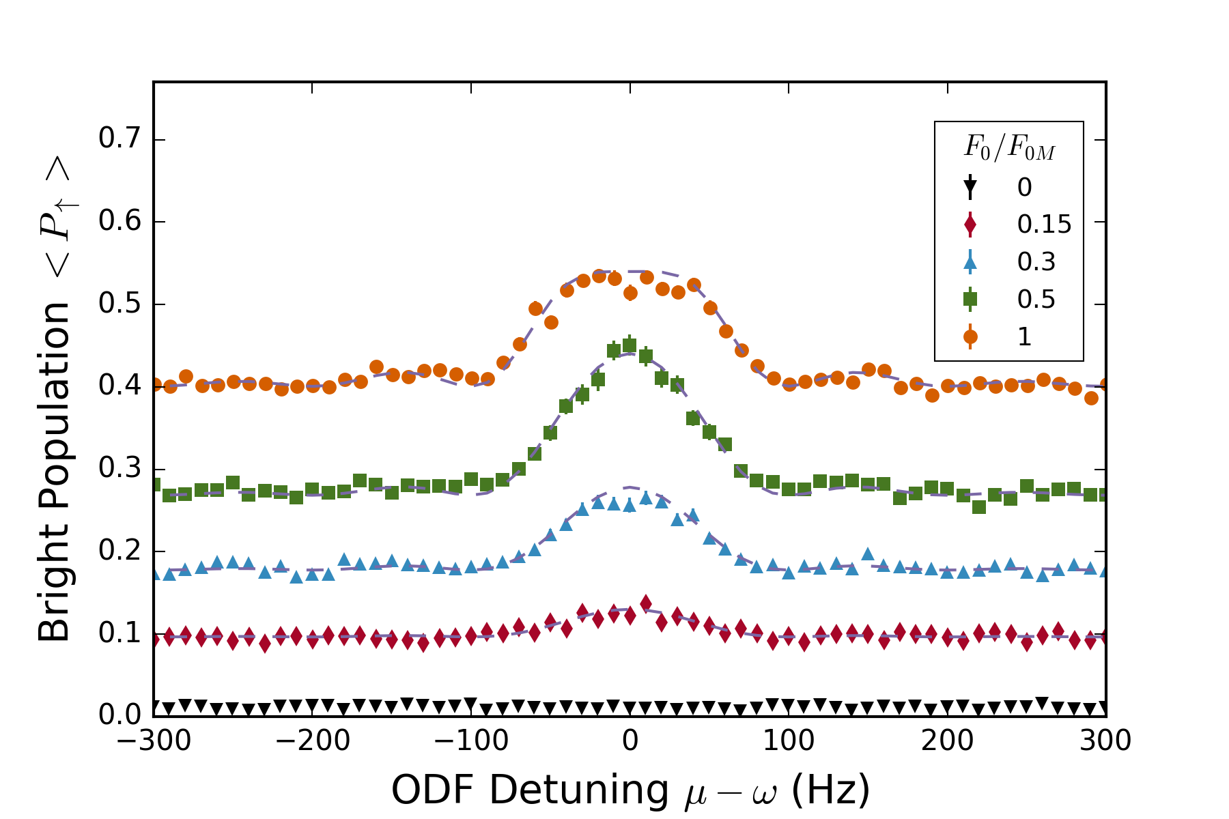
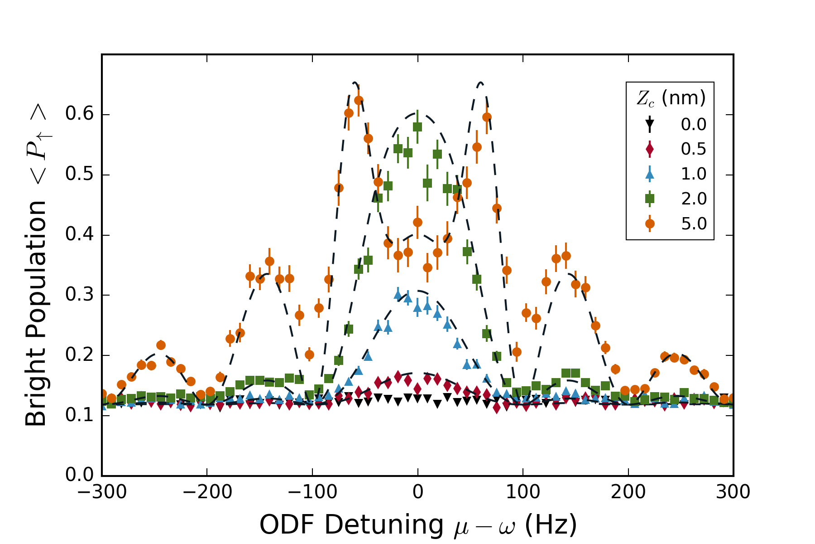
Lineshape is well understood
Z_c = 500 pm
F/F_0M = 0.2

Slide 6
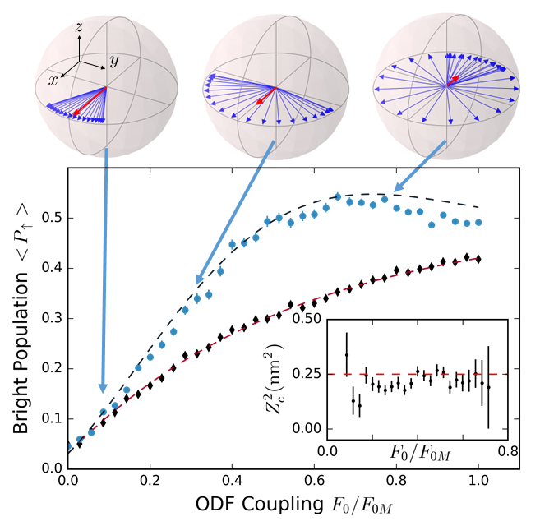
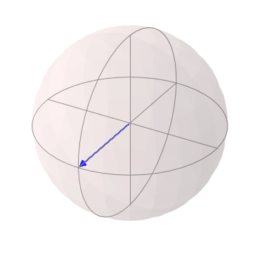
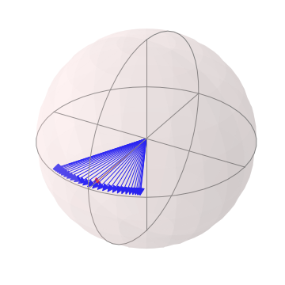
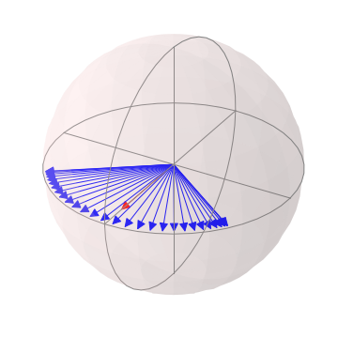
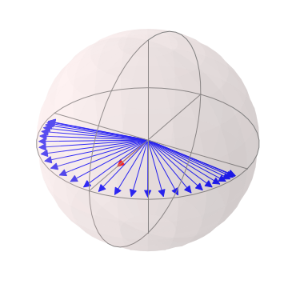
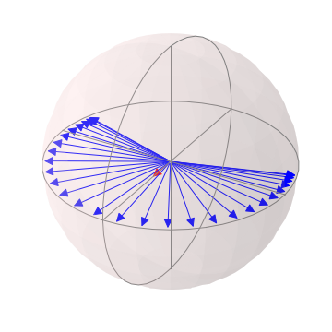
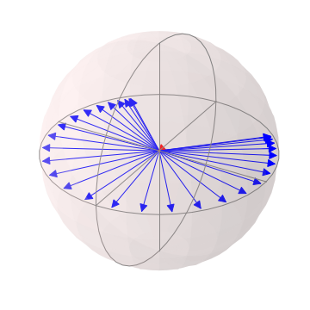
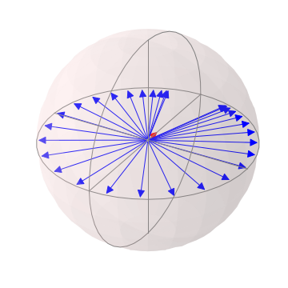
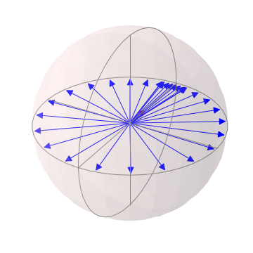
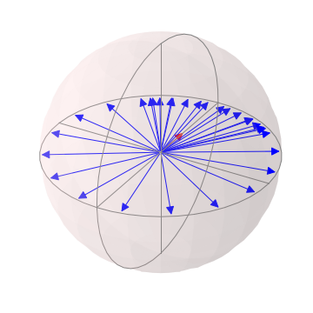
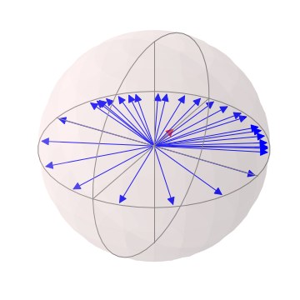
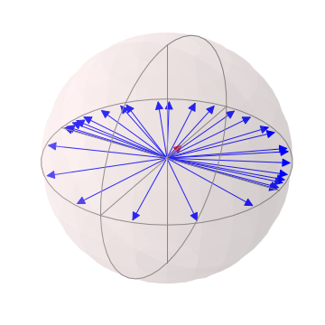
Spin dephasing vs measurement strength
Our scheme is second order sensitive to Z_c ie we measure Z_c^2

Slide 7
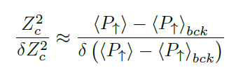
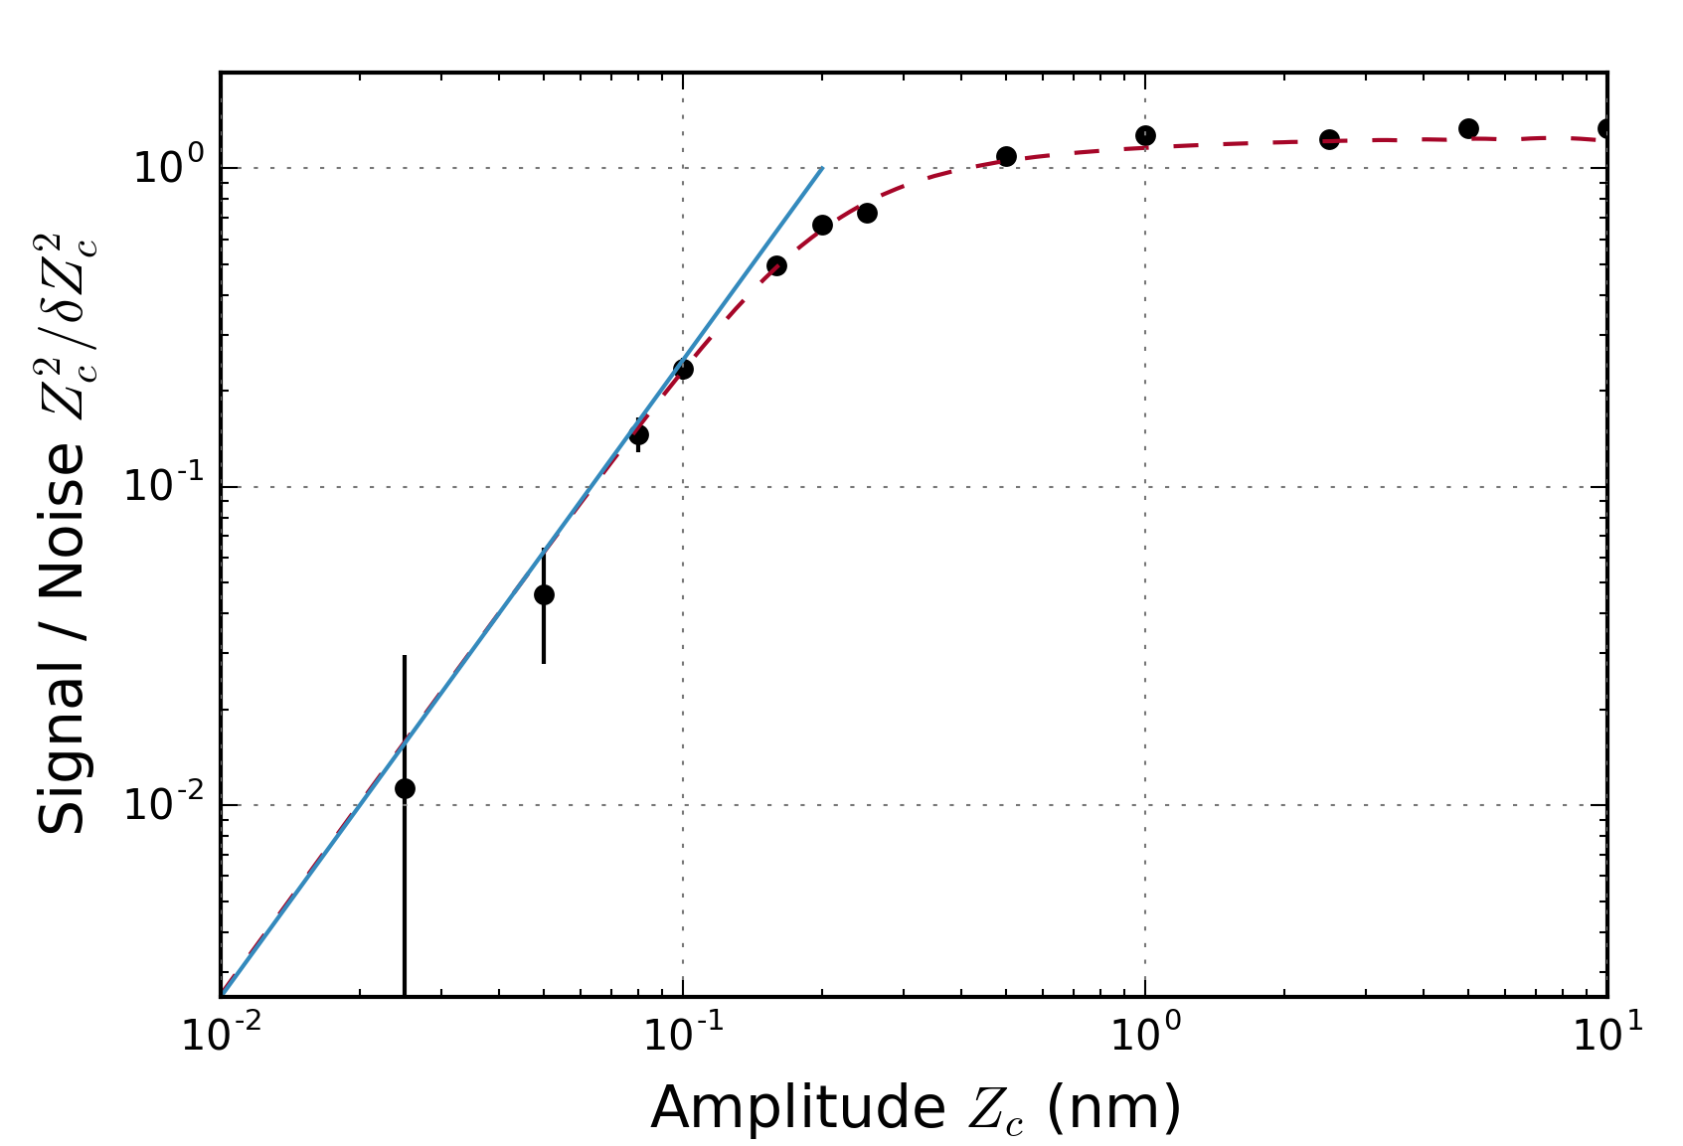

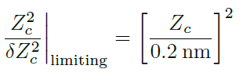



Limits to sensitivity / signal-to-noise
Projection noise limit
50 pm – smallest detected amplitude
$$\sim$$
Notes:
Projection noise dominates at small Z_c. Fundamental limit due to spontaneous emission (xi)

Slide 8
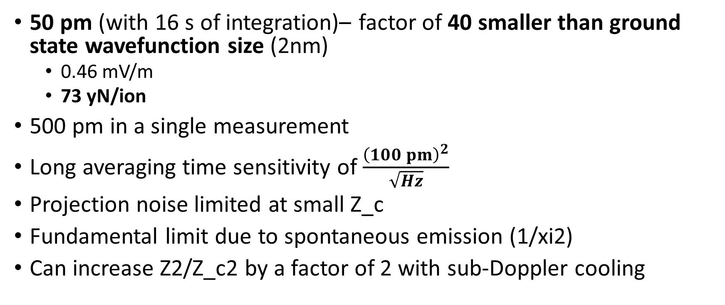
Off-resonant, incoherent amplitude sensing
50 pm (with 16 s of integration)– factor of 40 smaller than ground state wavefunction size (2nm)
0.46 mV/m
73 yN/ion
500 pm in a single measurement
Long averaging time sensitivity of $\frac{{\left(100 pm\right)}^{2}}{\sqrt{Hz}}$
Projection noise limited at small Z_c
Fundamental limit due to spontaneous emission (1/xi2)
Can increase Z2/Z_c2 by a factor of 2 with sub-Doppler cooling

Slide 9
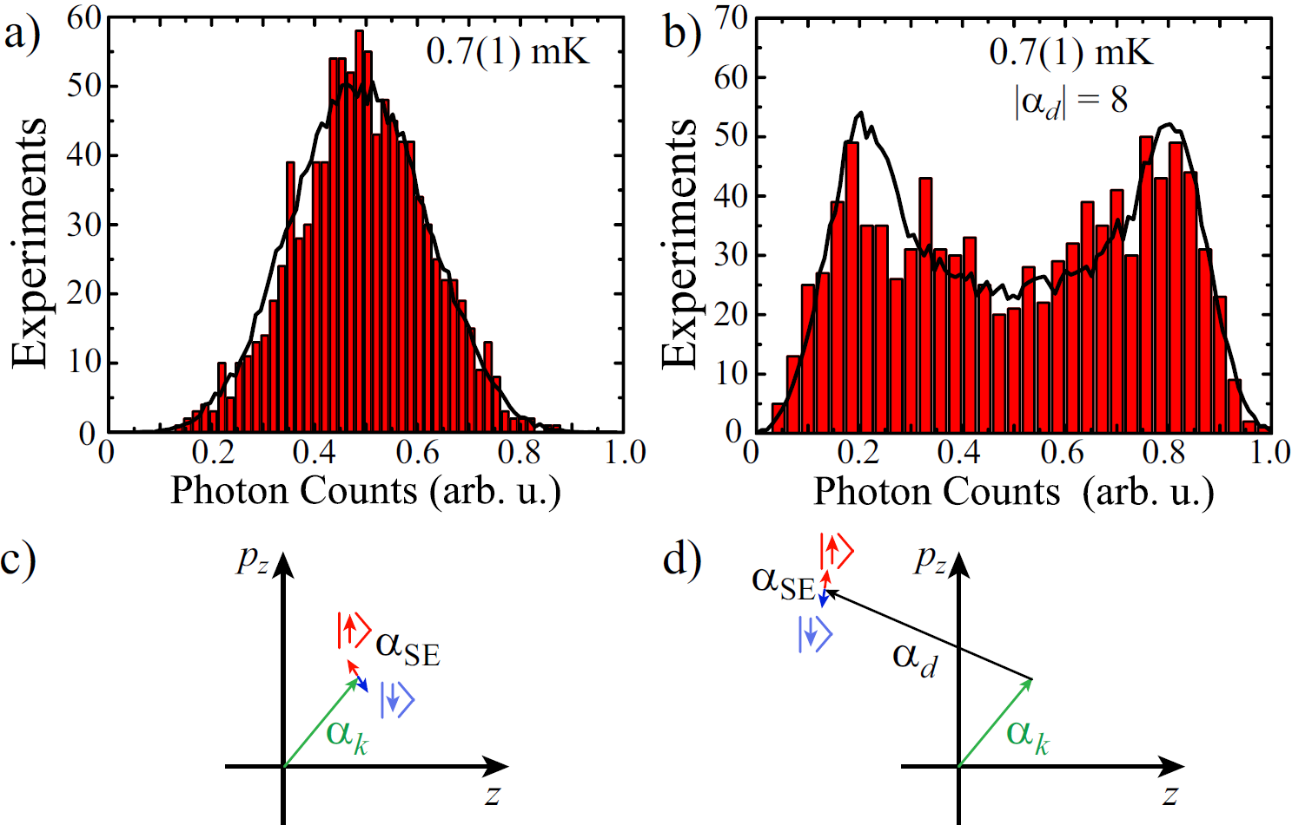



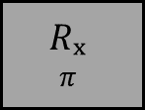


On resonance with thermal fluctuations
$$T$$
$$T$$
Drive
ODF
ODF
$$\frac{π}{2}{\left.​\right|}_{y}$$
$$π{\left.​\right|}_{x}$$
$$\frac{π}{2}{\left.​\right|}_{y}$$
Split histogram is result of phase incoherence between drive and ODF. If the phase relation was set, this would look like a coherent rotation. Use spins to read out coherent displacement.
Cool
R_{y}
ODF
$$Rₓ$$
$$π$$
R_{y}𝜽
Detect
ODF
Notes:
can measure displacement with this straight forward extension of the off-resonant sensing that you demonstrated, but one will be looking for a signal that sits on top of thermal fluctuations.

Slide 10
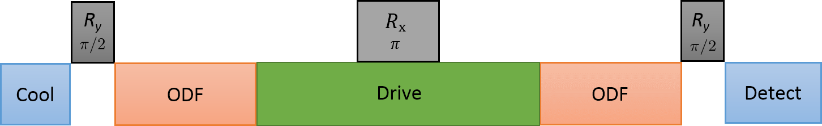

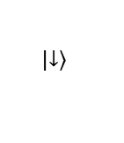
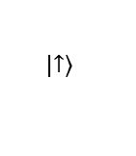

On resonance sensing scheme
$$p_{z}$$
If thermal fluctuations are coherent through the sequence, this scheme cancels them
$$z$$
$$\left|\left.↓\right\rangle \right.$$
$$\left|\left.↑\right\rangle \right.$$
Notes:
possible to cancel out thermal fluctuations with separated ODF's, but thermal fluctuations need to be coherent throughout the sequence.

Slide 11
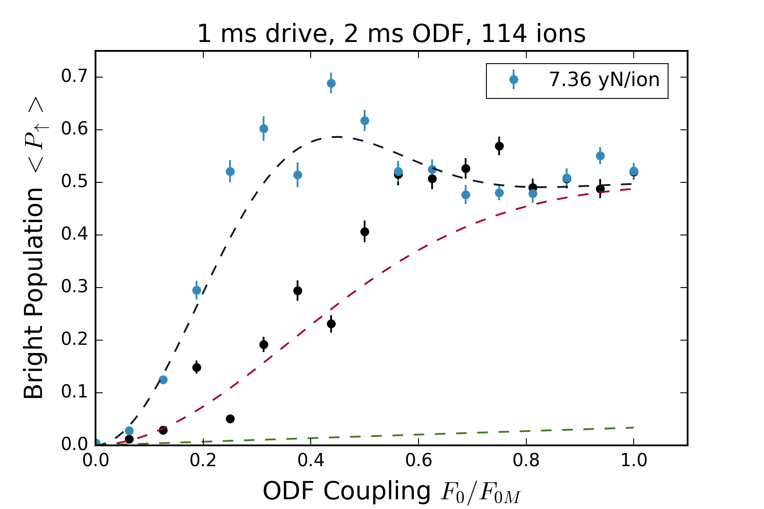
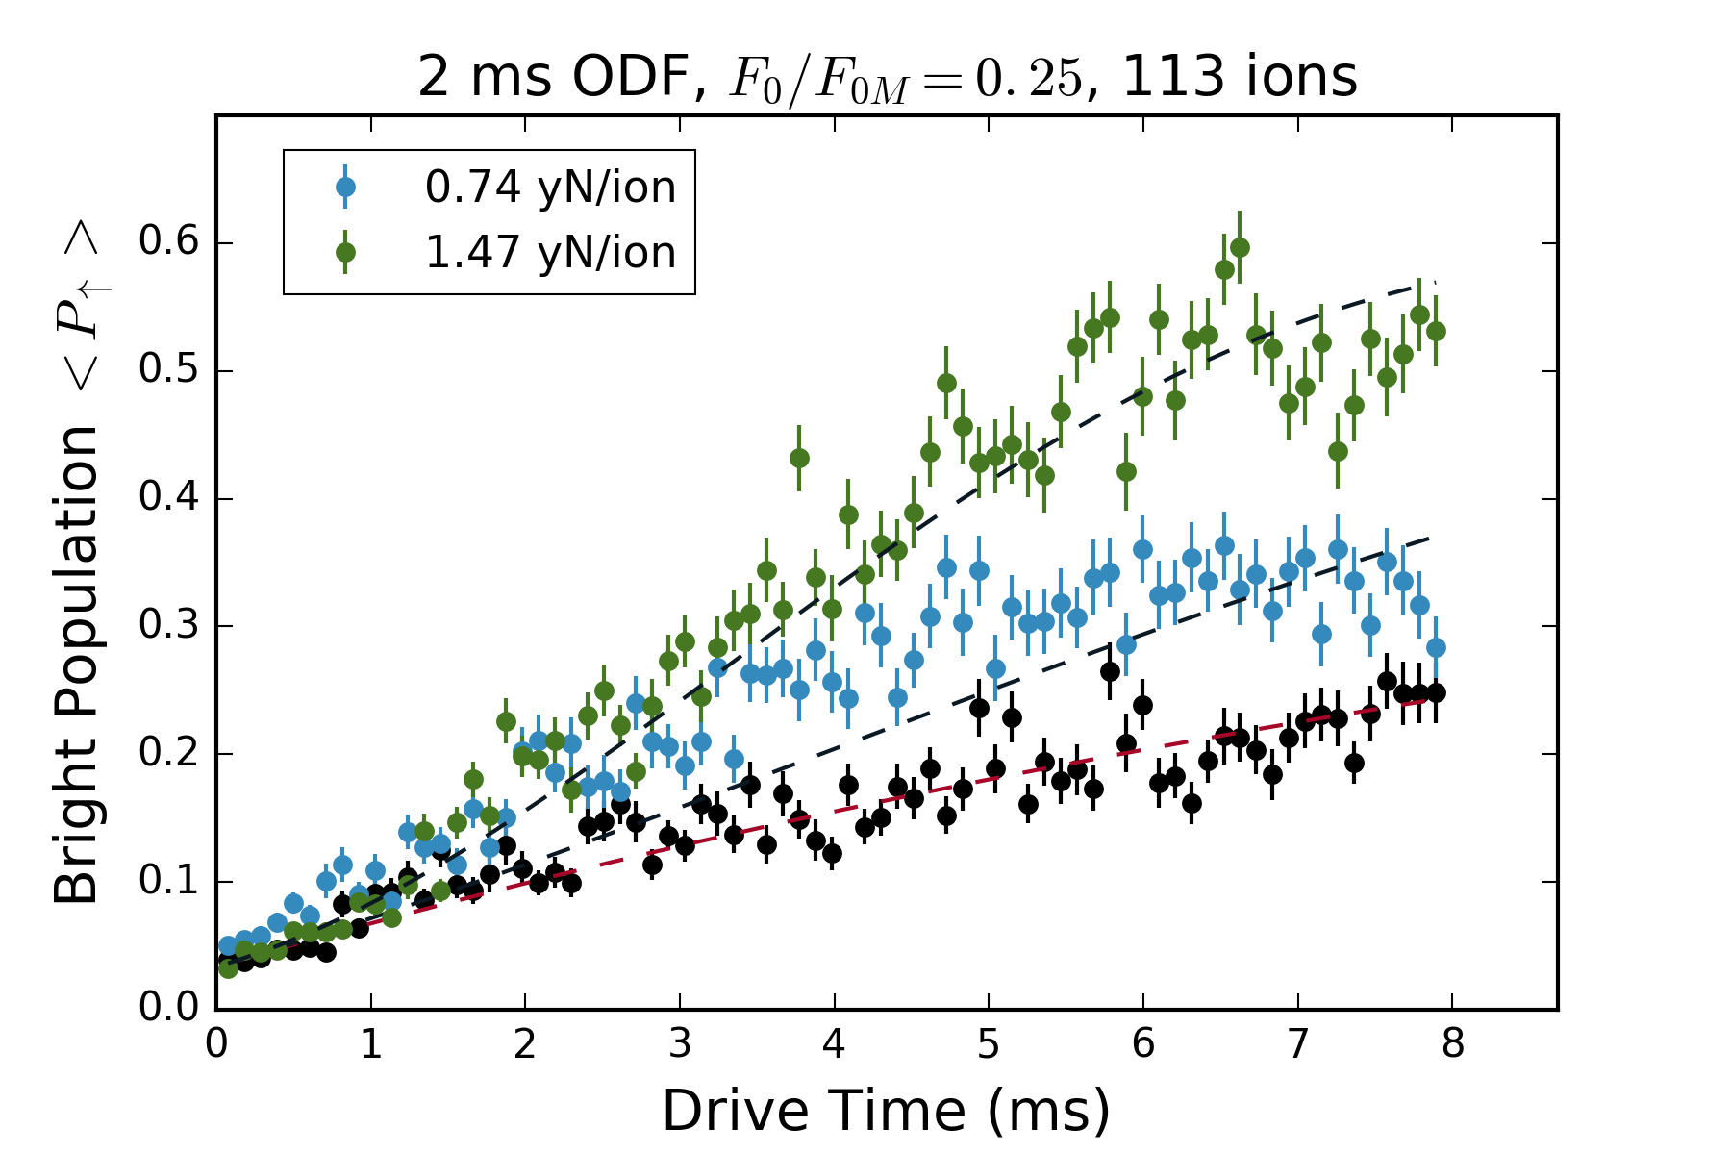
On-resonance, background not understood – sensitivity limited
7.4 yN/ion, 45.5 uV/m
0.74 yN/ion, 4.5 uV/m

Slide 12
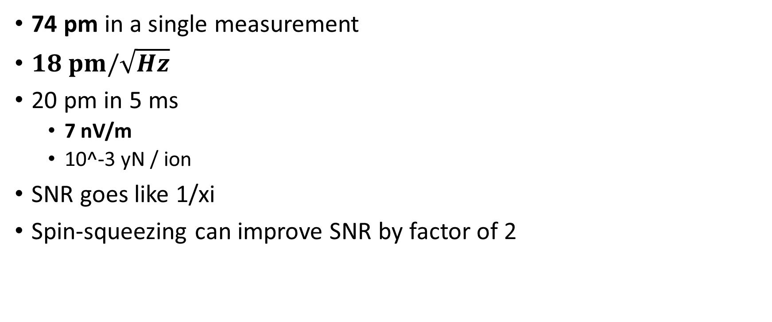
Predictions for on-resonance, phase coherent sensing
74 pm in a single measurement
$18 pm/\sqrt{Hz}$
20 pm in 5 ms
7 nV/m
10^-3 yN / ion
SNR goes like 1/xi
Spin-squeezing can improve SNR by factor of 2

Slide 13
WISPS and electric field sensing

