Slide 1

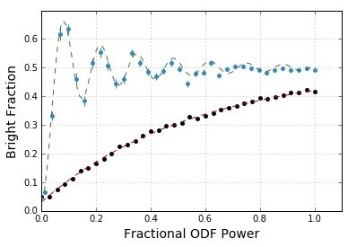
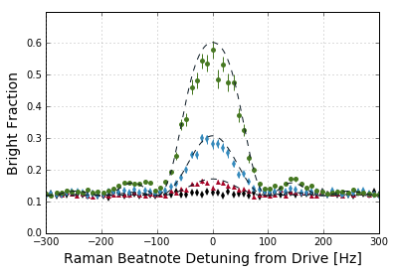


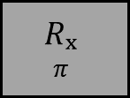

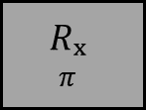





(a)
ODF Phase jumps:
$$Δφ=μ(T+t_{π})$$
$$Δφ=μ(T+t_{π})$$
$$T$$
$$T$$
$$T$$
$$T$$
Cool
R_{y}
ODF
$$Rₓ$$
$$π$$
$$Rₓ$$
$$π$$
R_{y}𝜽
Detect
ODF
ODF
(b)
$$t_{π}$$
$$t_{π}$$
(c)
(d)

Slide 2
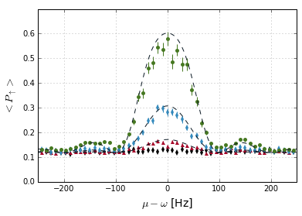
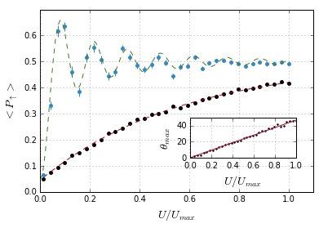

(a)
ODF Phase jumps:
$$Δφ=μ(T+t_{π})$$
$$Δφ=μ(T+t_{π})$$
$$T$$
$$T$$
$$T$$
$$T$$
Cool
R_{y}
ODF
$$Rₓ$$
$$π$$
ODF
$$Rₓ$$
$$π$$
R_{y}𝜽
Detect
ODF
ODF
$$t_{π}$$
$$t_{π}$$
(b)
(c)

Slide 3
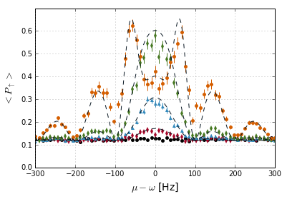
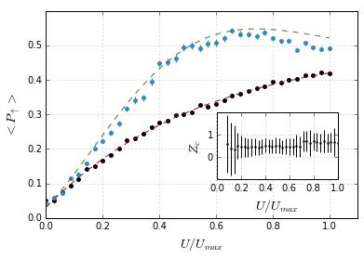
(a)
ODF Phase jumps:
$$Δφ=μ(T+t_{π})$$
$$Δφ=μ(T+t_{π})$$
$$T$$
$$T$$
$$T$$
$$T$$
Cool
R_{y}
ODF
$$Rₓ$$
$$π$$
ODF
$$Rₓ$$
$$π$$
R_{y}𝜽
Detect
ODF
ODF
$$t_{π}$$
$$t_{π}$$
(b)
(c)

Slide 4
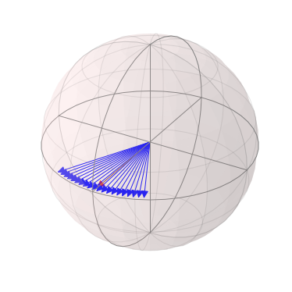
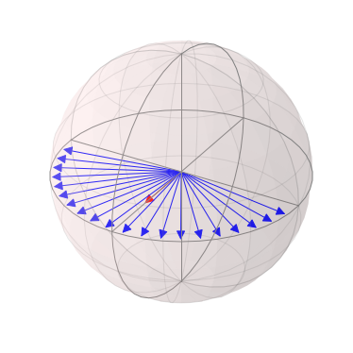
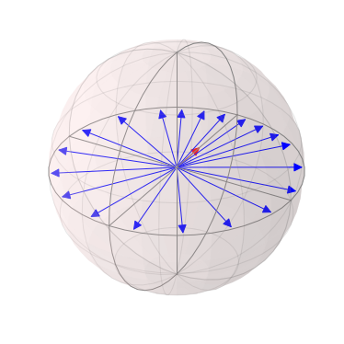
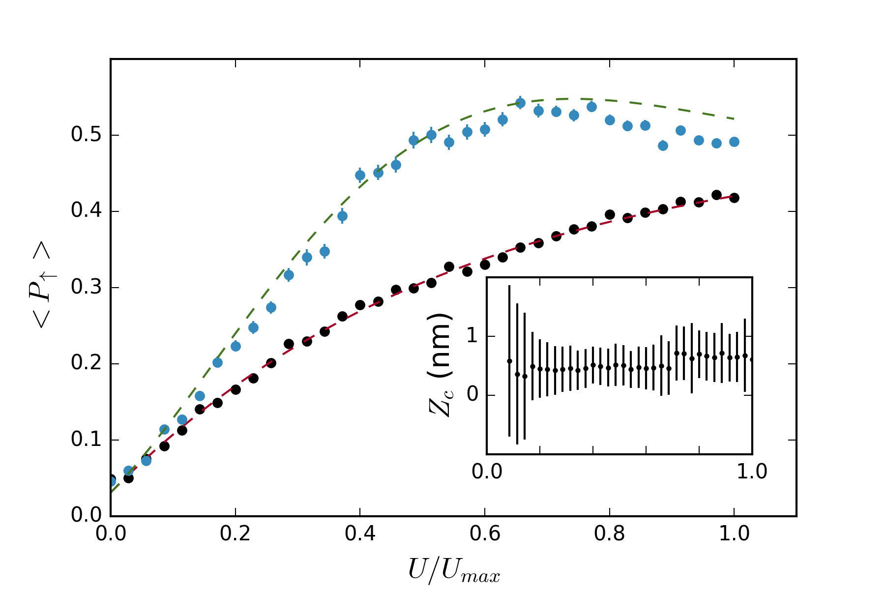


Slide 5
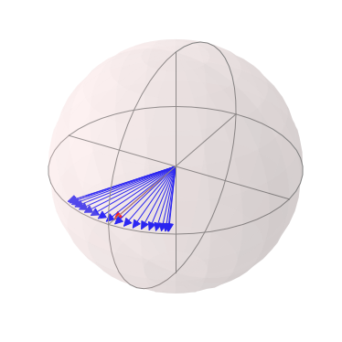
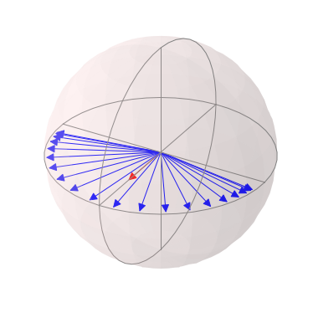
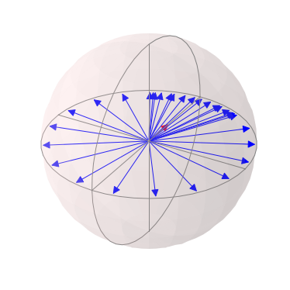
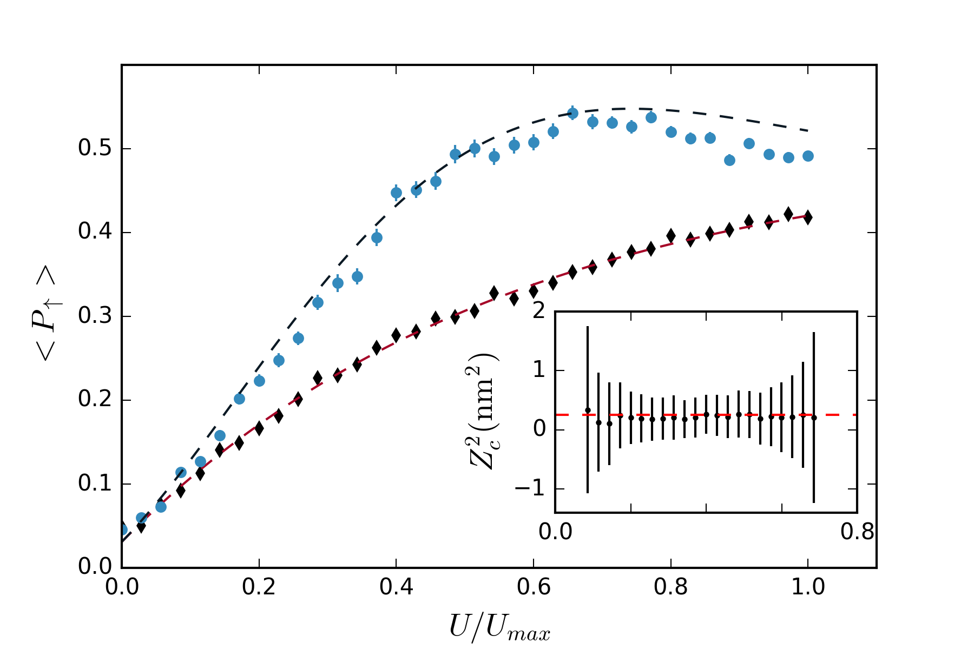

Slide 6
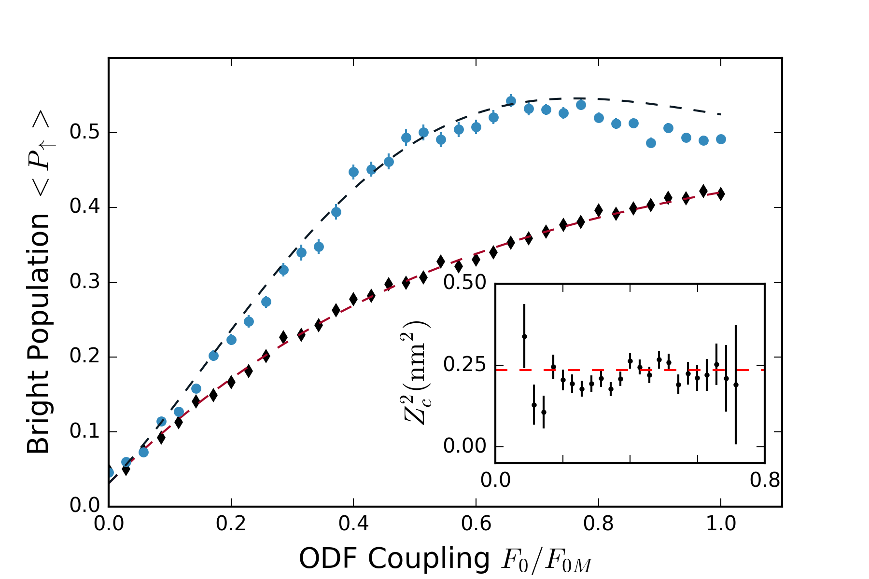

Slide 7
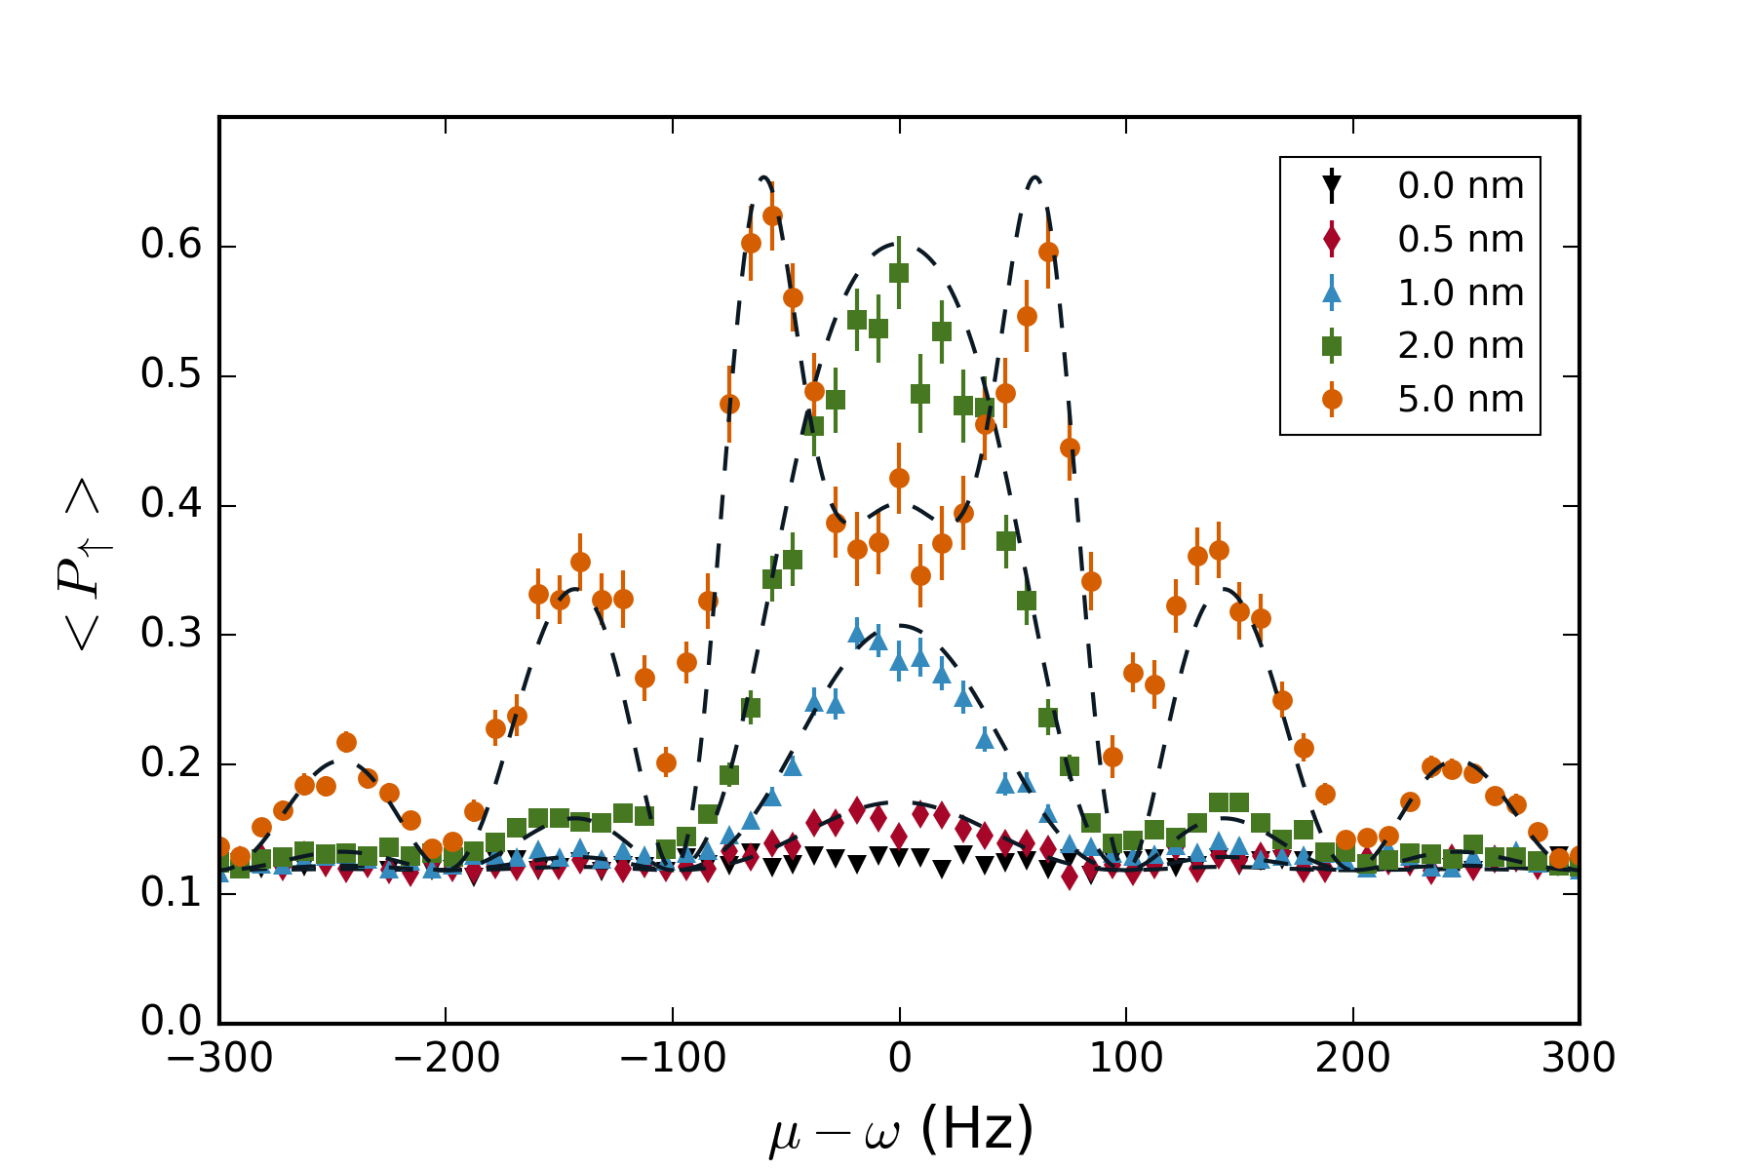
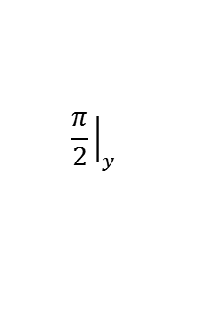



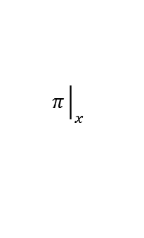

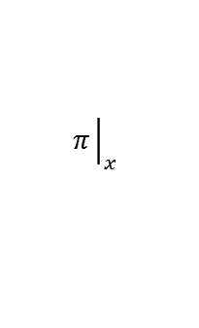

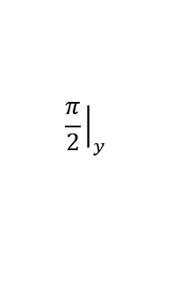
(a)
$$Δφ$$
$$Δφ$$
$$T$$
$$t_{π}$$
$$T$$
$$T$$
$$t_{π}$$
$$T$$
ODF
ODF
ODF
ODF
$$\frac{π}{2}{\left.​\right|}_{y}$$
$$π{\left.​\right|}_{x}$$
$$π{\left.​\right|}_{x}$$
$$\frac{π}{2}{\left.​\right|}_{y}$$
(b)

Slide 9







$$χ_{1}$$
$$χ_{2}$$
$$χ_{3}$$
$$χ_{4}$$
$$T$$
$$T$$
$$T$$
$$T$$
ODF
$$Rₓ$$
$$π$$
$$Rₓ$$
$$π$$
ODF
ODF
$$t_{π}$$
$$t_{π}$$
$$φ=φ$$
$$φ=φ+μ(T+t_{π})$$
$$φ=φ+2μ(T+t_{π})$$

Slide 10
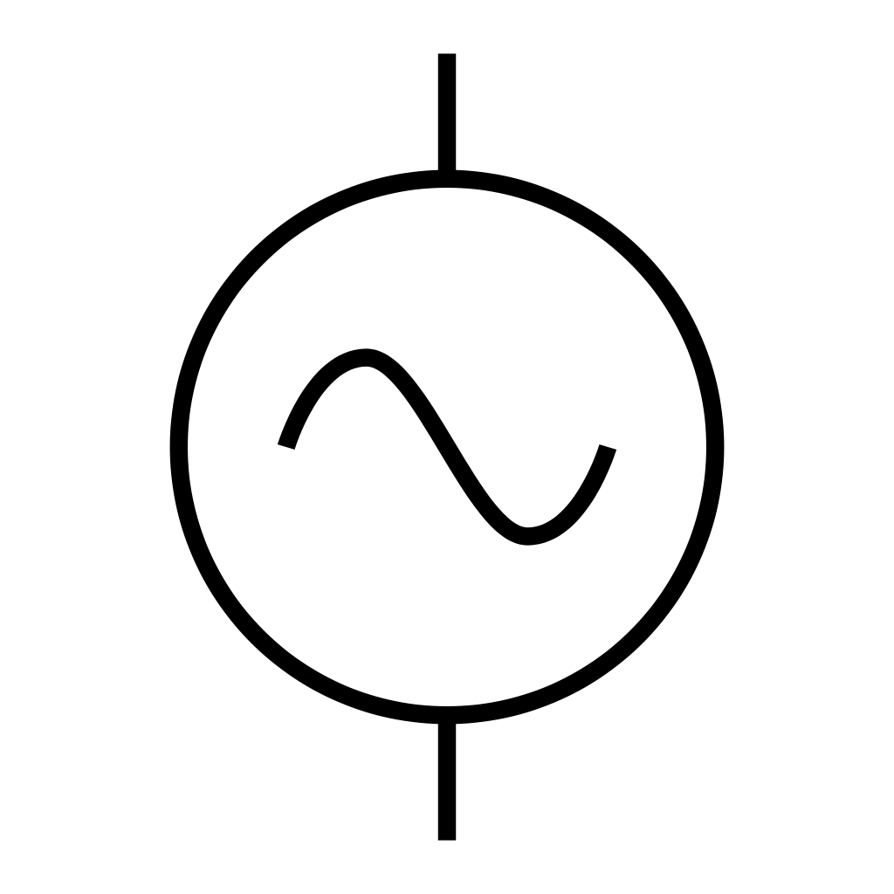
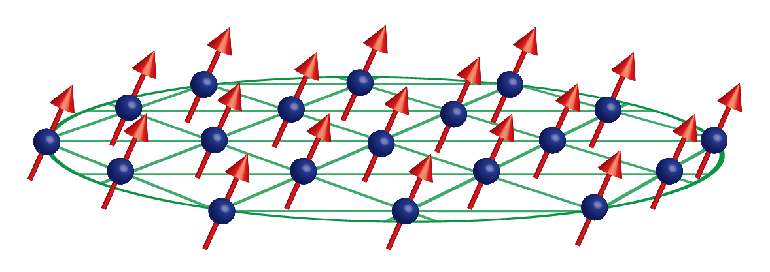


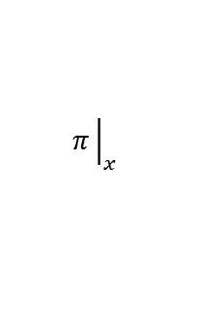

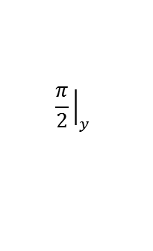
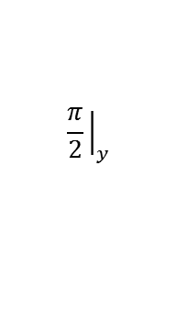

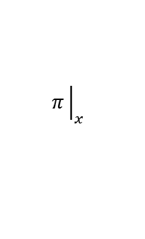


(a)
$$ω_{odf}$$
$$ω_{odf}+μ$$
(b)
(c)
$$Δφ$$
$$Δφ$$
$$T$$
$$t_{π}$$
$$T$$
$$T$$
$$t_{π}$$
$$T$$
ODF
ODF
ODF
ODF
$$\frac{π}{2}{\left.​\right|}_{y}$$
$$π{\left.​\right|}_{x}$$
$$π{\left.​\right|}_{x}$$
$$\frac{π}{2}{\left.​\right|}_{y}$$

Slide 11














(a)
$$ω_{odf}$$
$$ω_{odf}+μ$$
(b)
$$t_{π}$$
$$Δφ$$
$$t_{π}$$
$$Δφ$$
$$T$$
$$T$$
$$T$$
$$T$$
ODF
ODF
ODF
ODF
$$\frac{π}{2}{\left.​\right|}_{y}$$
$$π{\left.​\right|}_{x}$$
$$π{\left.​\right|}_{x}$$
$$\frac{π}{2}{\left.​\right|}_{y}$$

Slide 12















(a)
$$ω_{odf}$$
$$ω_{odf}+μ$$
$$\hat{z}$$
$$\hat{x}$$
$$\hat{y}$$
(b)
$$Δφ$$
$$Δφ$$
$$T$$
$$t_{π}$$
$$T$$
$$T$$
$$t_{π}$$
$$T$$
ODF
ODF
ODF
ODF
$$\frac{π}{2}{\left.​\right|}_{y}$$
$$π{\left.​\right|}_{x}$$
$$π{\left.​\right|}_{x}$$
$$\frac{π}{2}{\left.​\right|}_{y}$$

