Slide 1

Amplitude sensing below the zero-point fluctuations with a two-dimensional trapped-ion mechanical oscillator
Kevin Gilmore
NIST-Boulder
Ion storage group
Justin Bohnet, Brian Sawyer (GTRI),
Joseph Britton (ARL), John Bollinger

Slide 2
Outline
Introduction & motivations
Overview
The Penning trap
Spin-motion coupling
Spin precession and experimental sequence
Amplitude sensing off-resonance
Limits of sensitivity
Measuring both quadratures of motion
Ring down
On-resonance sensing
Backaction
Force sensing limits

Slide 3


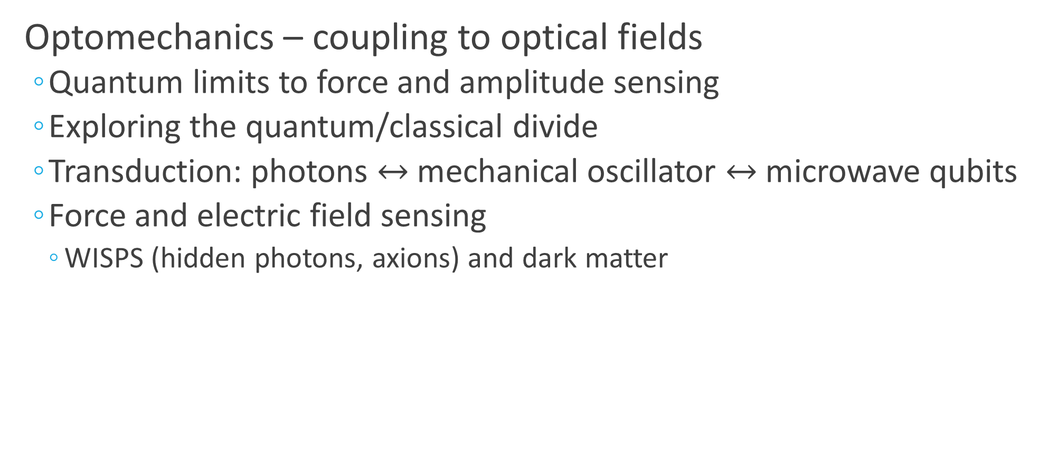
Quantum couplings to mechanical oscillators
Optomechanics – coupling to optical fields
Quantum limits to force and amplitude sensing
Exploring the quantum/classical divide
Transduction: photons $↔$ mechanical oscillator $↔$ microwave qubits
Force and electric field sensing
WISPS (hidden photons, axions) and dark matter
Notes:
Already projection noise limited with off-resonance experiment
Our crystal of ions looks and behaves much like the nanomechanical membranes used in some optomechanics experiments. Such objects offer chance to study quantum mechanics at the meso/macroscopic level. We can probe the zero-point fluctuations of our mechanical oscillator. Perhaps this affords study of transition from quantum microscopic regime to classical macroscopic world.
Related, much work in the optomechanics community concerns transducing signals and linking disparate quantum info systems through mechanical oscillators.
Finally, we’re very sensitive to electric fields and forces – so maybe that’s interesting in it’s own right. Potential for joining search for dark matter by detecting weak oscillating electric fields etc.

Slide 4
Motivations

Slide 5
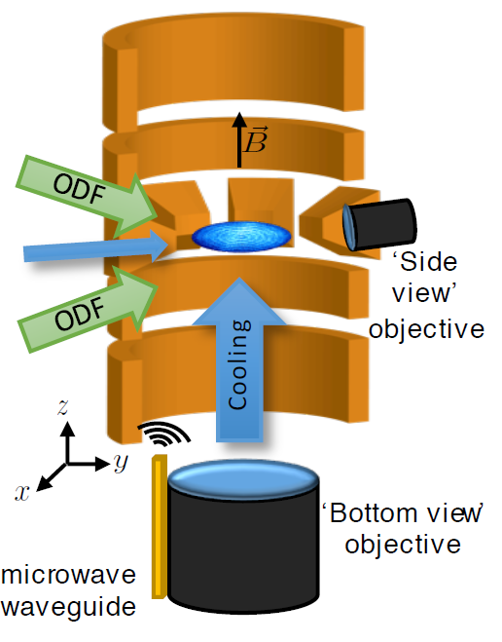
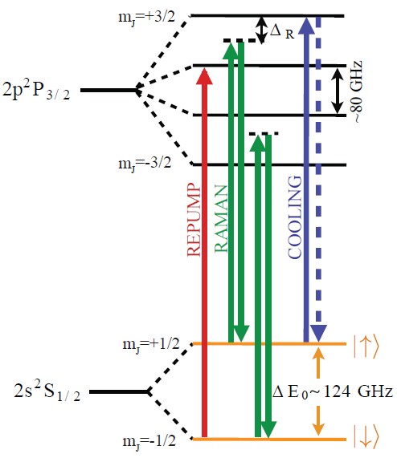
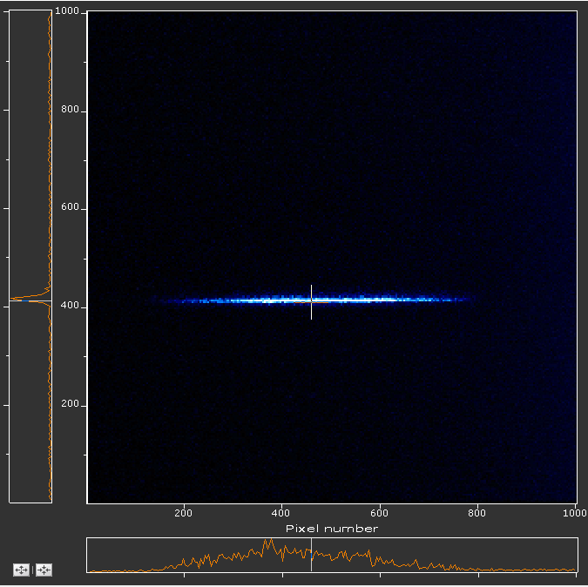
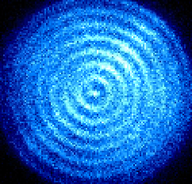
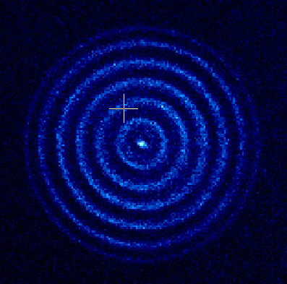
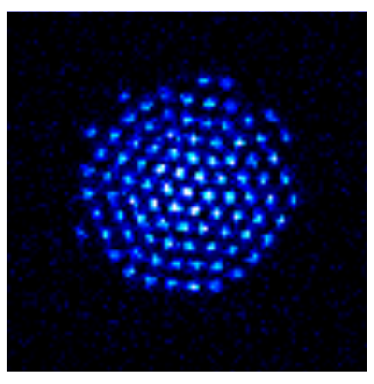


Penning trap
Lab frame CCD images
Side view
Cooling
$$100 μm$$
$$100 μm$$
Bottom view
Rotating frame from timed single photon counts

Slide 6
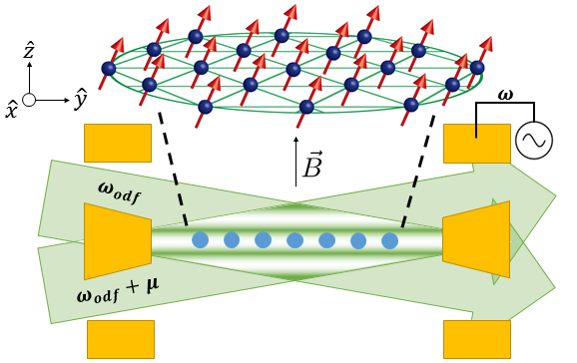
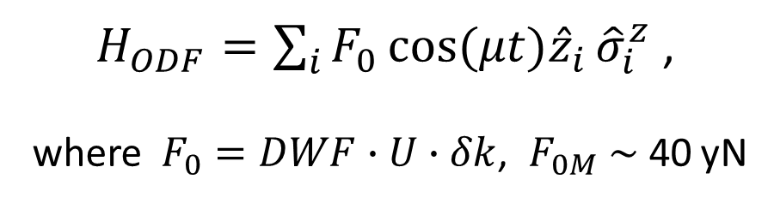

Spin-motion coupling
ODF couples the spin and motional degrees of freedom :
$H_{ODF}=\sum_{i}{F_{0}\cos{(μt){\hat{z}}_{i}}{\hat{σ}}_{i}^{z}}$ ,
where$F_{0}=DWF∙U∙δk$, ${ F}_{0M} \sim \text{40}$ yN
$$δk$$

Slide 7
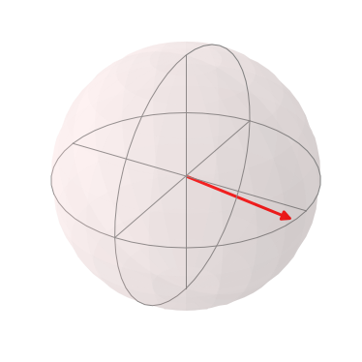
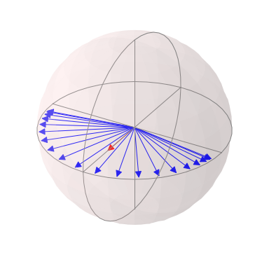



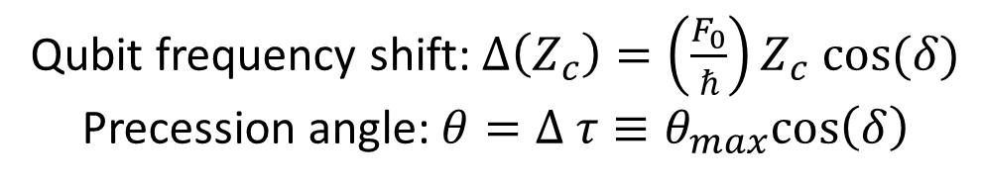

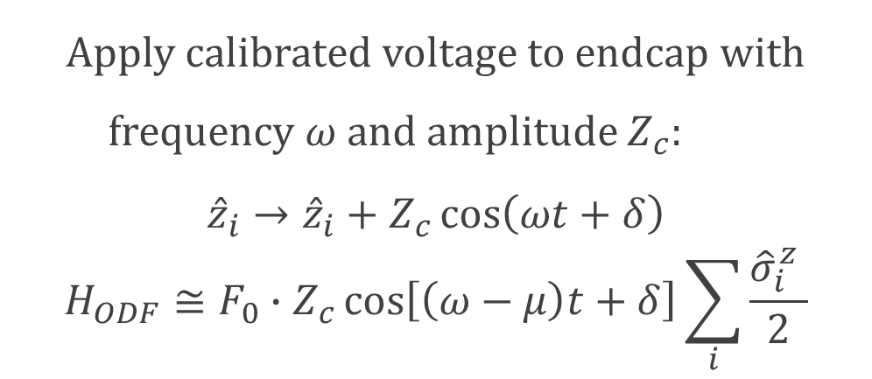
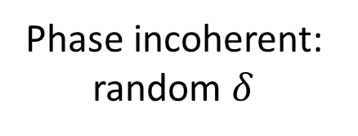
Spin precession due to axial oscillation
Apply calibrated voltage to endcap with frequency $ω$ and amplitude $Z_{c}$:
$${\hat{z}}_{i}→{\hat{z}}_{i}+Z_{c}\cos\left(ωt+δ\right)$$
$$H_{ODF}≅F_{0}∙Z_{c}\cos\left[\left(ω−μ\right)t+δ\right]\sum_{i}{\frac{{\hat{σ}}_{i}^{z} }{2}}$$
Phase coherent:
$$δ=0$$
Phase incoherent: random $δ$
$$θ_{max}$$
$$θ$$
Qubit frequency shift: $Δ\left(Z_{c}\right)=\left(\frac{F_{0}}{ℏ}\right)Z_{c} cos⁡(δ)$
Precession angle:$θ=Δ τ≡θ_{max}cos\left(δ\right)$
$θ_{max}=F_{0}∙Z_{c}∙τ$

Slide 8
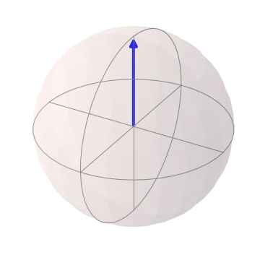
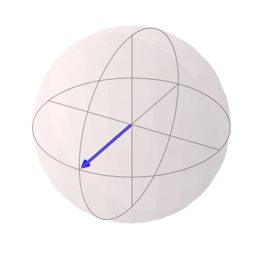
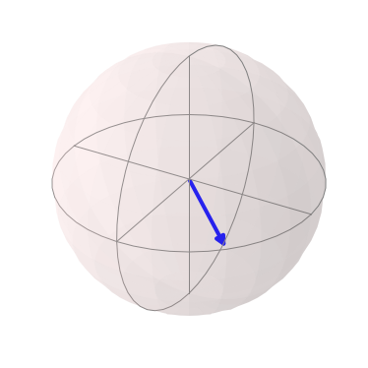
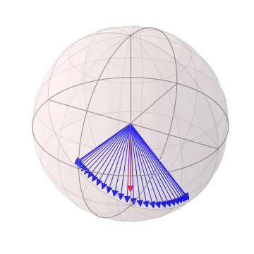
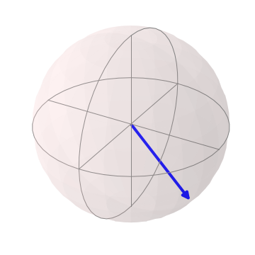
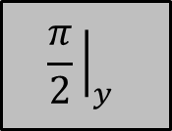




Measuring spin precession
Cool & Prepare
$$\frac{π}{2}{\left.​\right|}_{y}$$
ODF
$$\frac{π}{2}{\left.​\right|}_{y}$$
Detect
$$θ$$
$$θ$$
Probability of measuring spin up:
$$\left\langle P_{↑}\right\rangle = \frac{1}{2}\left(1−e^{−Γτ}\left\langle \cos{θ}\right\rangle \right)$$
$${\left\langle \cos{θ}\right\rangle =J}_{0}\left(θ_{max}\right)$$

Slide 9
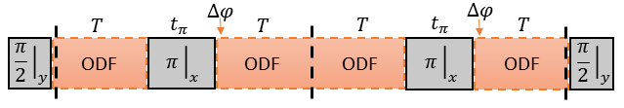
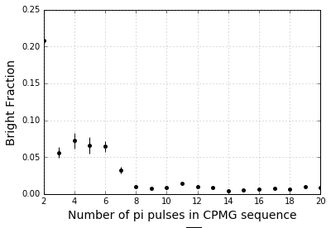
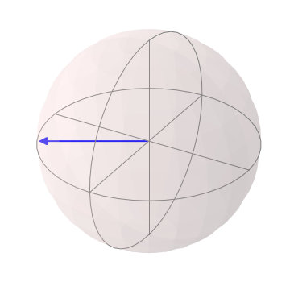
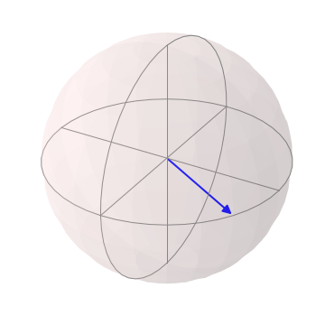

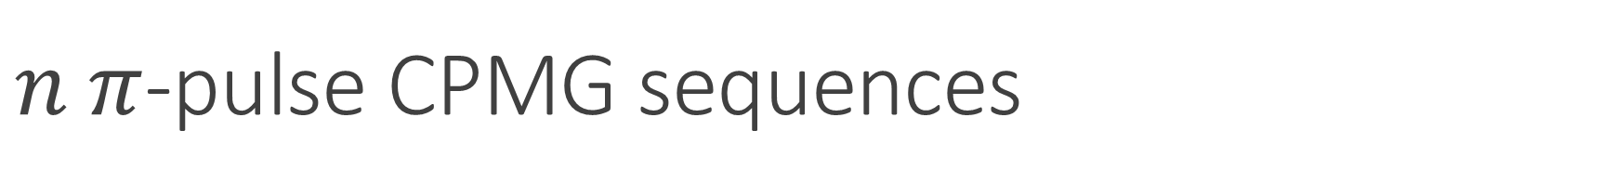


$n π$-pulse CPMG sequences
CPMG sequences (no ODF) with 20 ms total interaction time
$$Δφ=π$$
$$θ$$
$$θ$$
Notes:
The phase jumps are chosen to cancel the cos term in the H. For µ/2π = (2n + 1)/(2(T + t_π)), the phase jump is pi and the spin precession is added coherently through the sequence . Can spin-echo away homogenous magnetic field flucs

Slide 10
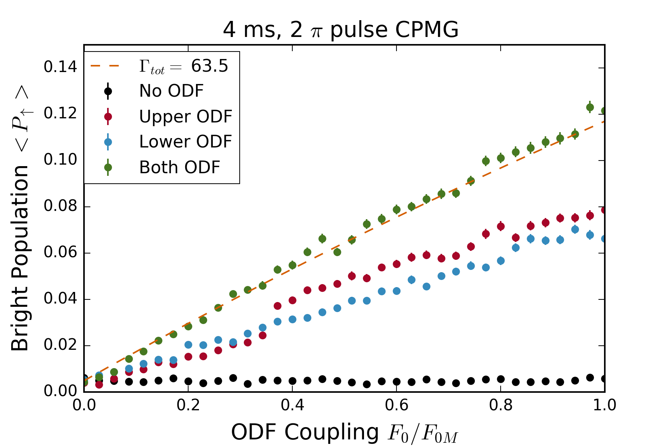
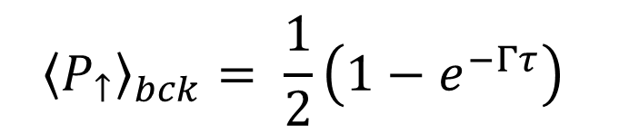
Background characterization
$${\left\langle P_{↑}\right\rangle }_{bck}= \frac{1}{2}\left(1−e^{−Γτ}\right)$$

Slide 11
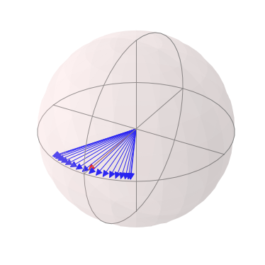
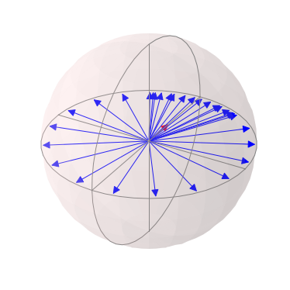
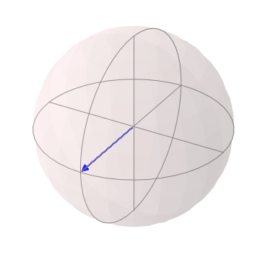
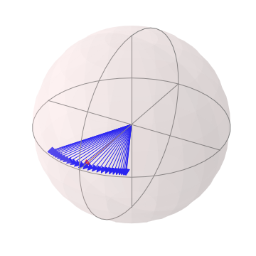
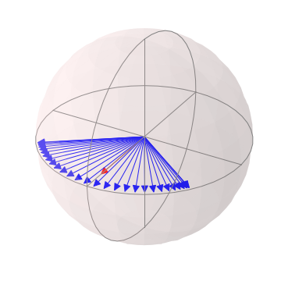
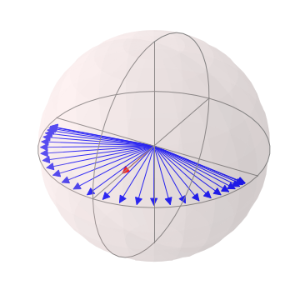
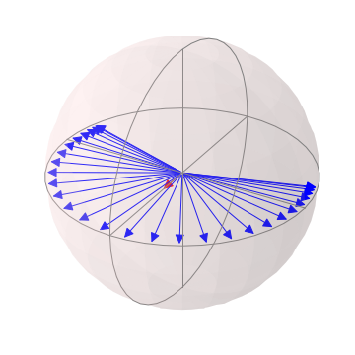
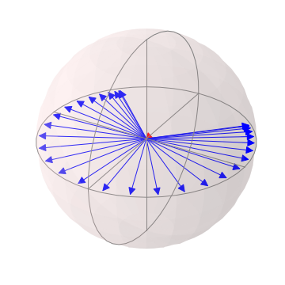
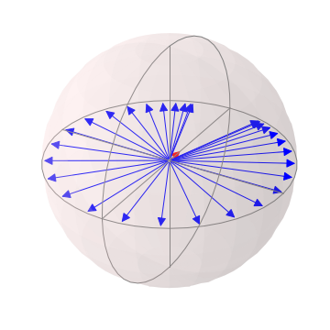
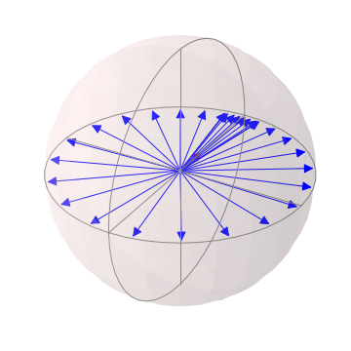
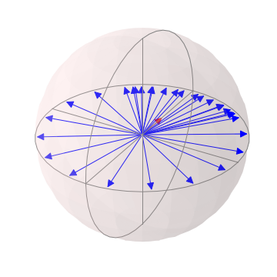
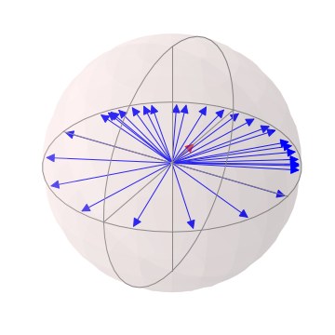
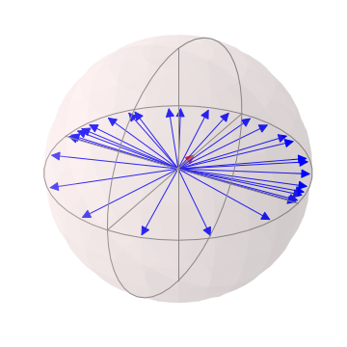
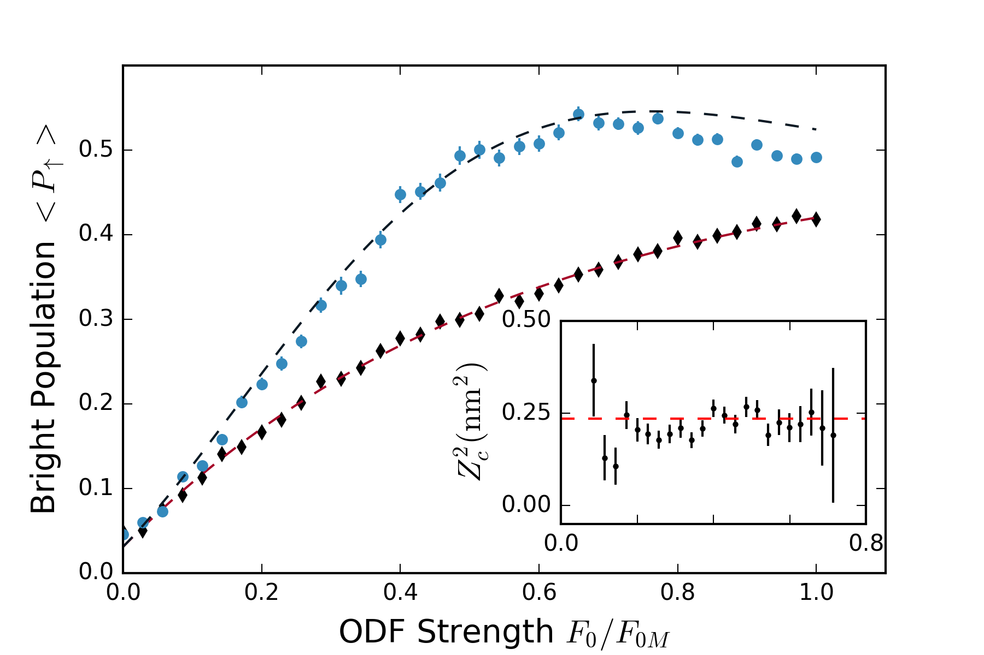
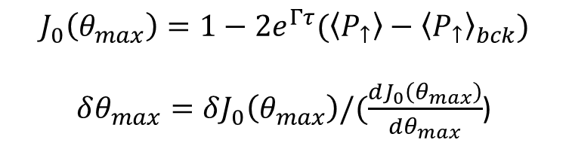


Spin dephasing vs measurement strength
$Z_{c}=500$ pm
`
Our scheme is second order sensitive to $Z_{c}$, i.e. we measure $Z_{c}^{2}$
$$J_{0}\left(θ_{max}\right)=1−2e^{Γτ}(\left\langle P_{↑}\right\rangle −{\left\langle P_{↑}\right\rangle }_{bck})$$
$δθ_{max}=δJ_{0}\left(θ_{max}\right)/(\frac{dJ_{0}\left(θ_{max}\right)}{dθ_{max}}$)

Slide 12
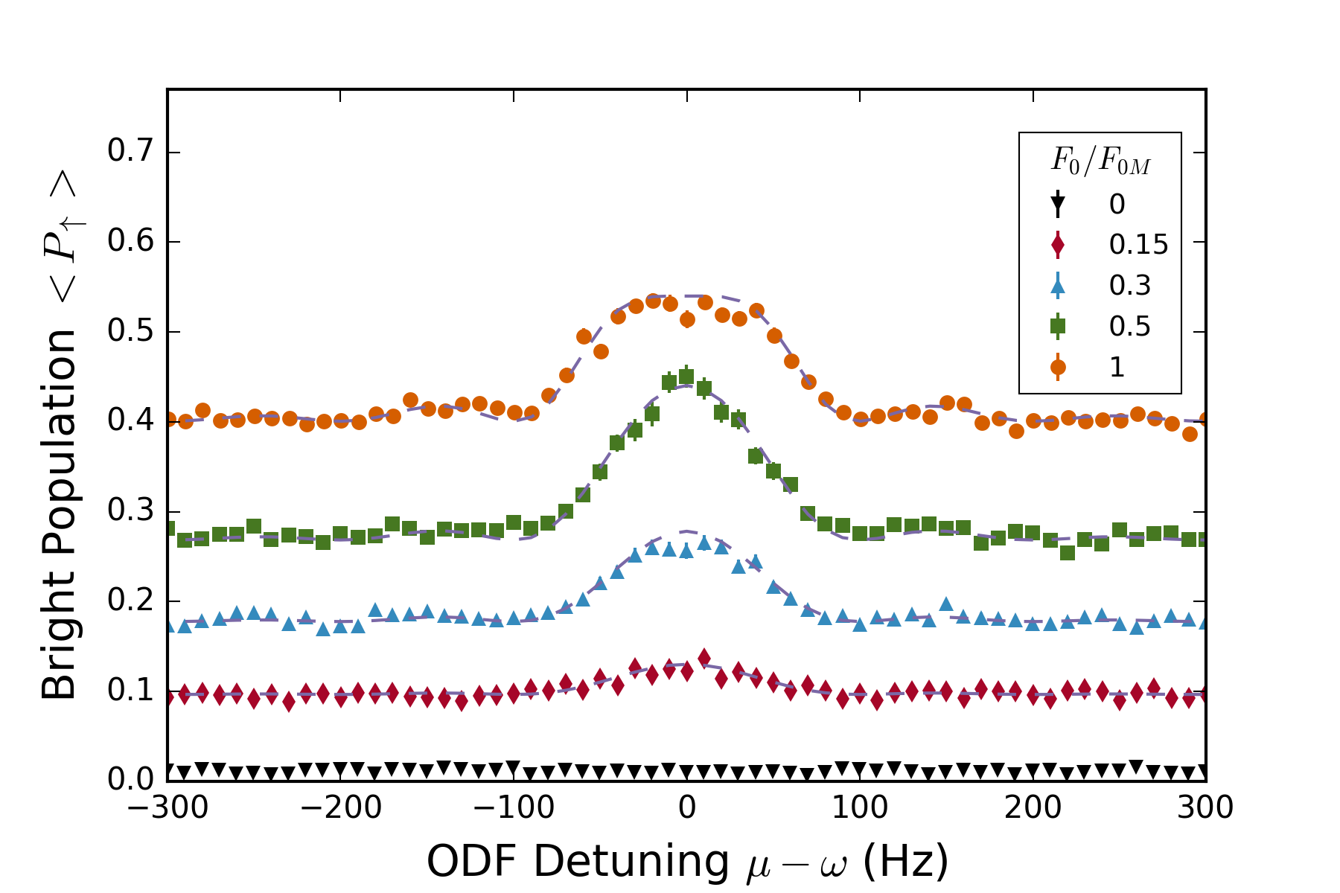
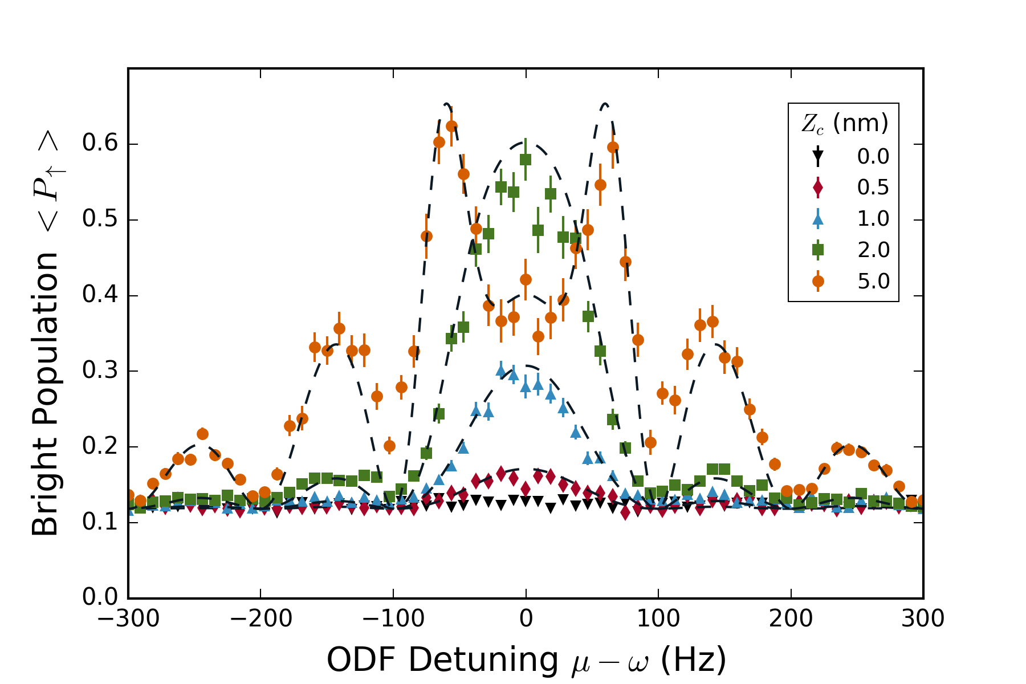





Lineshape is well understood
$${F_{0}/F}_{0M}=0.2$$
$Z_{c}=500$ pm
$θ_{max}=F_{0}∙Z_{c}∙τ$

Slide 13
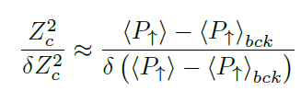
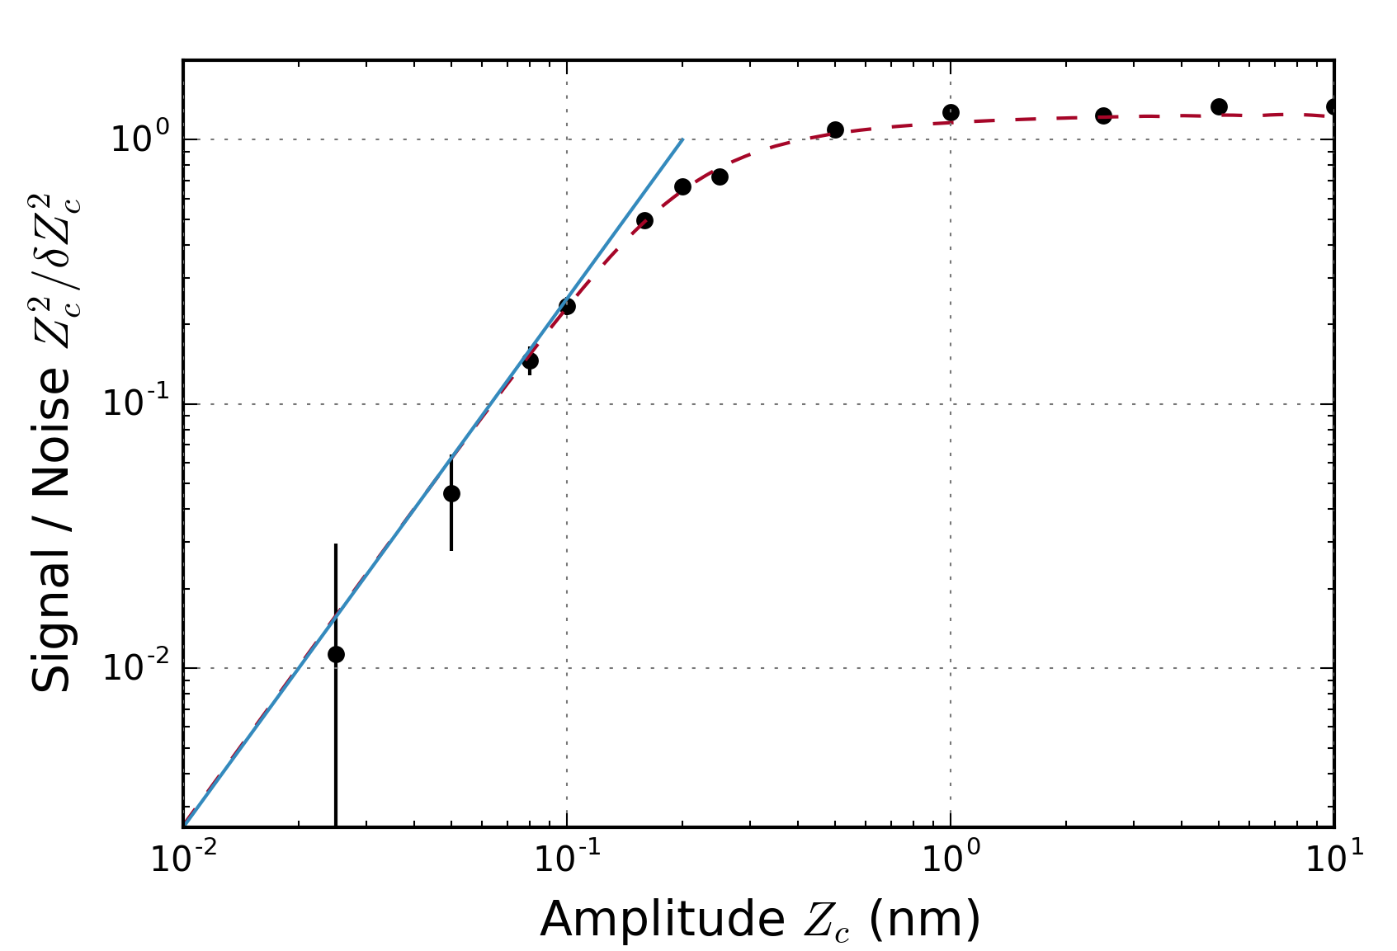

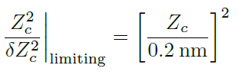



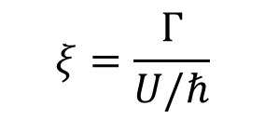

Limits to sensitivity / signal-to-noise
SNR limited due to noise from fluctuations in $δ$
Projection noise limit
Projection noise limit
50 pm – smallest detected amplitude
$$ξ=\frac{Γ}{U/ℏ}$$
$$\sim$$
Notes:
Projection noise dominates at small Z_c. Fundamental limit due to spontaneous emission (xi – ratio of gamma to U)

Slide 14














Mapping both quadratures to amplitude
$$T$$
$$T$$
$$\frac{π}{2}{\left.​\right|}_{y}$$
ODF
$$\frac{π}{2}{\left.​\right|}_{x}$$
$$\frac{π}{2}{\left.​\right|}_{y}$$
ODF
$$θ_{1}$$
$$θ_{1}$$
$$θ_{1}$$
$$θ_{2}$$
$$θ_{1}=θ_{max}cos\left(δ\right)$$
$$θ_{2}=θ_{max}sin\left(δ\right)$$
Notes:
With phase incoherent experiment, measure random quadrature of motion from one experimental trial to the next. With above sequence, can map both quadratures in a single experimental trial onto spin state.

Slide 15


Ring down
Notes:
Q~10^6 based on ring down time of >100 ms
Pretty good agreement with theory for lineshape

Slide 16

Off-resonant, incoherent amplitude sensing
50 pm (with 16 s of integration)– factor of 40 smaller than ground state wavefunction size (2nm)
0.46 mV/m
73 yN/ion
500 pm in a single measurement
Long averaging time sensitivity of $\frac{{\left(100 pm\right)}^{2}}{\sqrt{Hz}}$
Projection noise limited at small $Z_{c}$
Fundamental limit due to spontaneous emission $\frac{1}{ξ^{2}}$
Can increase $\frac{Z_{c}^{2}}{δZ_{c}^{2}}(\sim δk^{2})$ by a factor of 2 with sub-Doppler cooling

Slide 17

On resonance
Enhance force and electric field sensitivities by Q of the COM mode
$Q\sim {10}^{6}$
Exploit spins
Spin-squeezed states
Thermal fluctuations
Understand system off-resonance, away from drumhead modes
Possible to cancel

Slide 18












On resonance with thermal fluctuations
$$T$$
$$T$$
$$T$$
$$T$$
$$\frac{π}{2}{\left.​\right|}_{y}$$
ODF
$$π{\left.​\right|}_{x}$$
$$\frac{π}{2}{\left.​\right|}_{x}$$
Drive
$$\frac{π}{2}{\left.​\right|}_{y}$$
ODF
$$π{\left.​\right|}_{x}$$
$$\frac{π}{2}{\left.​\right|}_{x}$$
ODF
ODF
Thermal fluctuations
Displacement on top of thermal fluctuations
Phase incoherent
B. C. Sawyer, J. W. Britton, and J. J. Bollinger, Physical Review A 89, 033408 (2014)
Notes:
can measure displacement with this straight forward extension of the demonstrated off-resonant sensing, but looking for signal that sits on top of thermal fluctuations.

Slide 19





On resonance sensing scheme
$$p_{z}$$
If thermal fluctuations are coherent through the sequence, this scheme cancels them
$$\left|\left.↓\right\rangle \right.$$
$$\left|\left.↑\right\rangle \right.$$
$$z$$
Notes:
possible to cancel out thermal fluctuations with separated ODF's, but thermal fluctuations need to be coherent throughout the sequence.

Slide 20


On-resonance, background not understood – sensitivity limited
7.4 yN/ion, 45.5 uV/m, 25 nm
0.74 yN/ion, 4.5 uV/m

Slide 21

Predictions for on-resonance, phase coherent sensing
74 pm in a single measurement
$18 pm/\sqrt{Hz}$
20 pm
7 nV/m
${10}^{−3}$ yN / ion
SNR goes like $1/ξ$
Spin-squeezing can improve SNR by factor of 2
1 nV/m is the electric field of an electron at 1 m

Slide 22



Search for hidden photons as dark matter
$$ε=\frac{E}{3.3\frac{nV}{m}}∗{10}^{−12}$$
Hidden photons are theorized to interact with ‘regular’ photons through a kinetic mixing term $ε$, producing an electric field of amplitude E
Unfortunately, it seems shielding effects may severely reduce our sensitivity to these electric fields

Slide 23












Modes and low frequency signal
4 ms ODF interaction time
$\left\langle P_{↑}\right\rangle$ (%)
ODF Difference Frequency $μ$ (kHz)
800 us ODF interaction time
$\left\langle P_{↑}\right\rangle$ (%)
$\left\langle P_{↑}\right\rangle$ (%)
ODF Difference Frequency $μ$ (kHz)
ODF Difference Frequency $μ$ (kHz)
800 us ODF interaction time w/ phase jump
$\left\langle P_{↑}\right\rangle$ (%)
ODF Difference Frequency $μ$ (kHz)
Notes:
measuring spin precession induced by thermal fluctuations with a single pi-pulse sequence (top) and 1 pi-pulse comg (left and lower center)

Slide 24






Canceling low frequency oscillations
No phase jump
$$H_{ODF}=U\sum_{i}{\sin\left[δk∙{\hat{z}}_{i}−μt\right]{\hat{σ}}_{i}^{z}}$$
$$= U\sum_{i}{\sin\left(δk∙{\hat{z}}_{i}\right)\cos\left(μt\right){\hat{σ}}_{i}^{z}−U\sum_{i}{\cos\left(δk∙{\hat{z}}_{i}\right)\sin\left(μt\right)}}{\hat{σ}}_{i}^{z}$$
$$H_{ODF}=\sum_{i}{F_{0}\cos{(μt)}{{\hat{z}}_{i}\hat{σ}}_{i}^{z}}$$
$\left\langle P_{↑}\right\rangle$ (%)
ODF Difference Frequency $μ$ (kHz)
w/ phase jump
$\left\langle P_{↑}\right\rangle$ (%)
ODF Difference Frequency $μ$ (kHz)
Can ignore second term when $\frac{U}{μ}≪1$.
At low frequencies $μ$, can cancel by setting: $Δφ=μ(T+t_{π})$
For $\frac{ω}{2π}=\frac{2n+1}{2\left(T+t_{π}\right)}$, $Δφ=π$ and spin precession is coherently accumulated
Notes:
The ODF couples the spin and motional degrees of freedom through… If U/mu is small, can make simplification. However, as will be discussed, it is also possible to choose the phases of the ODF to cancel the cos term. Like the cavity-mechanical oscillator, due to the spin-motion coupling induced by the ODF, qubit frequency sees a shift – hence precession. The qubit frequency shift evaluated at Z_c = 2 nm (zero point fluc of COM mode for 100 ions) is the equivalent of the vacuum optomechanical coupling strength. To get the prob of spin up, have to average over cos of random phase – result is J0

