Slide 1
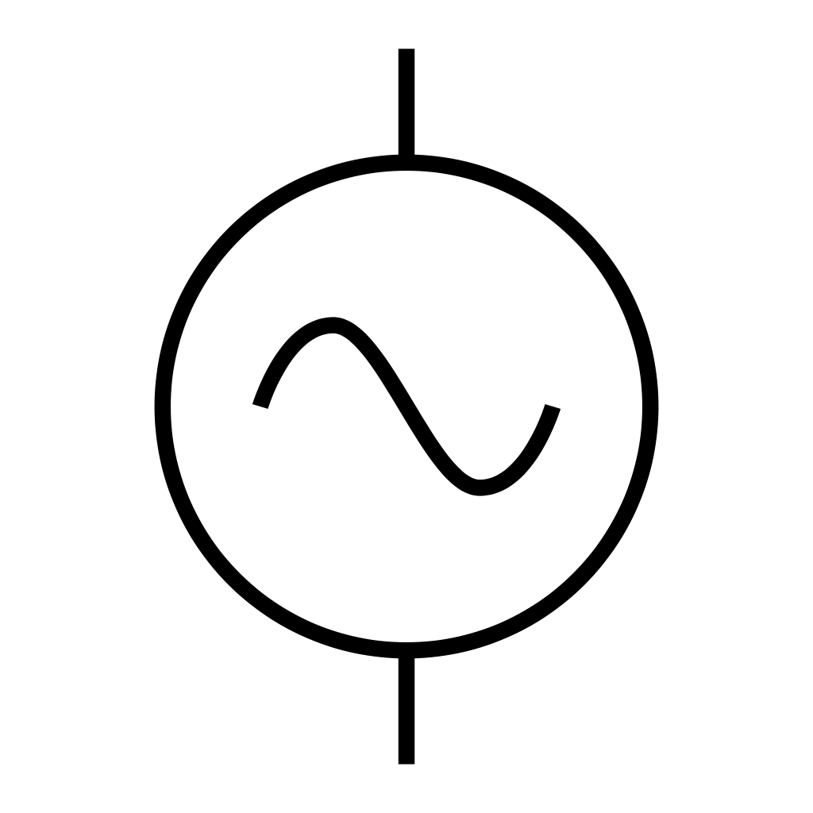
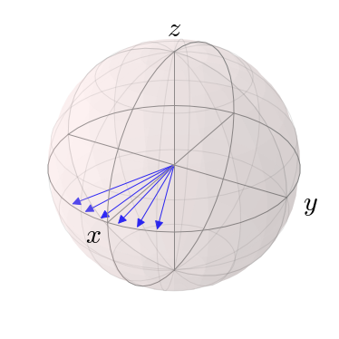
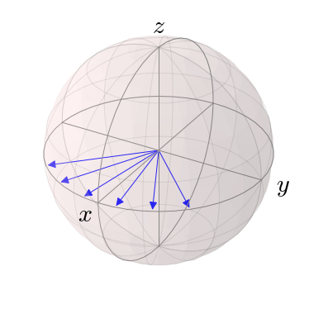
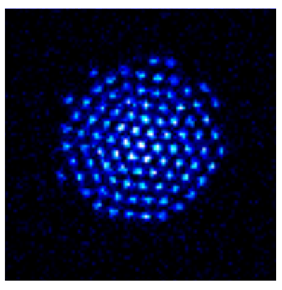
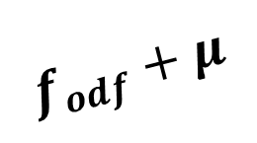




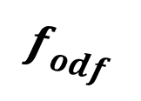
Spin dephasing as a sensitive measure of an off-resonance perturbation
Side view
(a)
(c)
$$f_{odf}$$
$$f_{odf}+μ$$
(b)
Bottom view
$$\vec{B}$$
$$y$$
$$z$$
$$x$$
50 μm

Slide 2
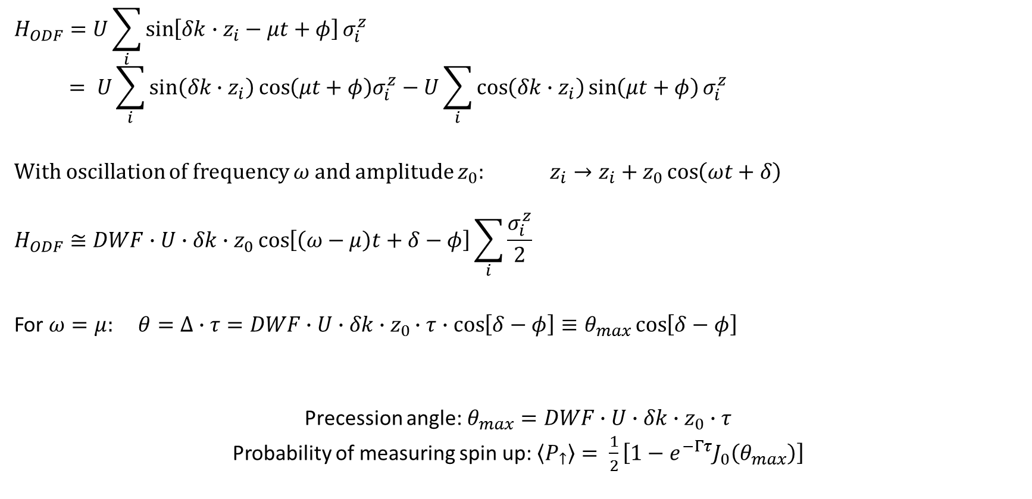
Precession due to axial oscillation
$$H_{ODF}=U\sum_{i}{\sin\left[δk∙z_{i}−μt+φ\right]σ_{i}^{z}}$$
$$= U\sum_{i}{\sin\left(δk∙z_{i}\right)\cos\left(μt+φ\right)σ_{i}^{z}−U\sum_{i}{\cos\left(δk∙z_{i}\right)\sin\left(μt+φ\right)}}σ_{i}^{z}$$
With oscillation of frequency $ω$ and amplitude $z_{0}$: $z_{i}→z_{i}+z_{0}\cos\left(ωt+δ\right)$
$$H_{ODF}≅DWF∙U∙δk∙z_{0}\cos\left[\left(ω−μ\right)t+δ−φ\right]\sum_{i}{\frac{σ_{i}^{z}}{2}}$$
For $ω=μ:$ $θ=Δ∙τ=DWF∙U∙δk∙z_{0}∙τ∙cos\left[δ−φ\right]≡θ_{max}\cos\left[δ−φ\right]$
Precession angle: $θ_{max}=DWF∙U∙δk∙z_{0}∙τ$
Probability of measuring spin up: $\left\langle P_{↑}\right\rangle = \frac{1}{2}\left[1−e^{−Γτ}J_{0}\left(θ_{max}\right)\right]$

Slide 3

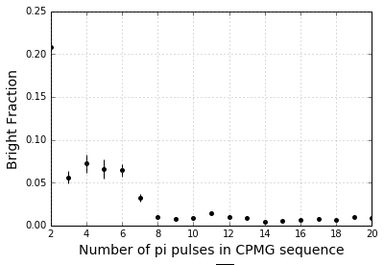



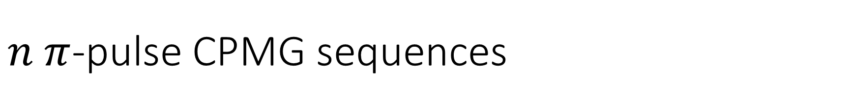
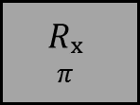

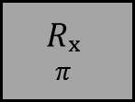




$n π$-pulse CPMG sequences
ODF Phase jumps:
$$Δφ=μ(T+t_{π})$$
$$Δφ=μ(T+t_{π})$$
$$T$$
$$T$$
$$T$$
$$T$$
Cool
R_{y}
ODF
$$Rₓ$$
$$π$$
$$Rₓ$$
$$π$$
R_{y}𝜽
Detect
ODF
ODF
$$t_{π}$$
$$t_{π}$$
CPMG sequences (no ODF) with 20 ms total interaction time
Using more pi pulses for same total ODF interaction time decreases dephasing due to magnetic field fluctuations without accumulating errors from microwave pulses – for up to 20 pi pulses

Slide 4
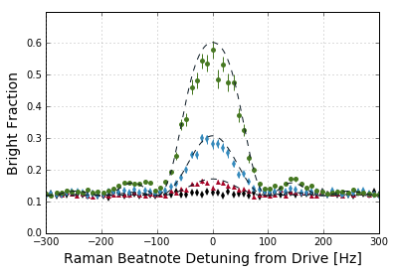
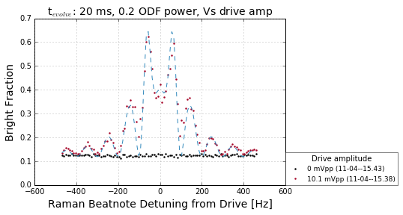

Slide 5
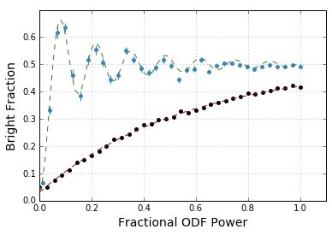
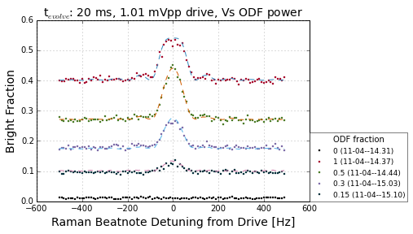

Slide 6
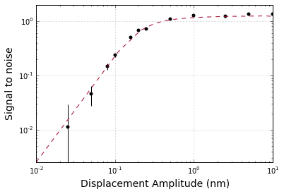

Slide 7
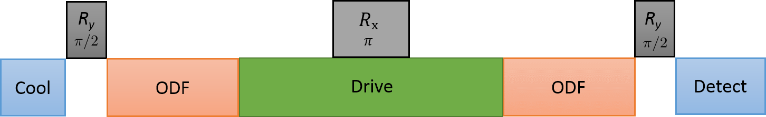


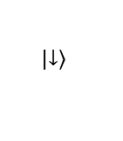
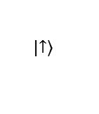
$$p_{z}$$
$$z$$
$$\left|\left.↓\right\rangle \right.$$
$$\left|\left.↑\right\rangle \right.$$

Slide 8
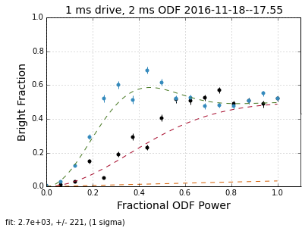
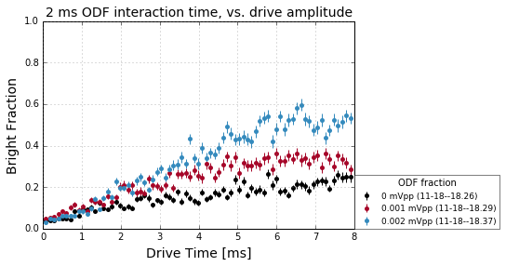
1 uV -> 0.73 yN/ion

