Slide 1
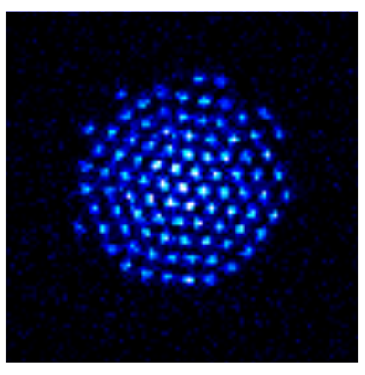


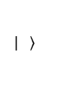
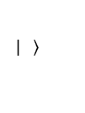



a
Side view
Axial phonon mode
$$f_{odf}$$
$$\left.| \right\rangle$$
$$f_{odf}+μ_{r}$$
$$\left.| \right\rangle$$
$$V_{z}$$
c
b
Bottom view
$$\vec{B}$$
$$y$$
$$z$$
$$x$$
50 μm

Slide 2
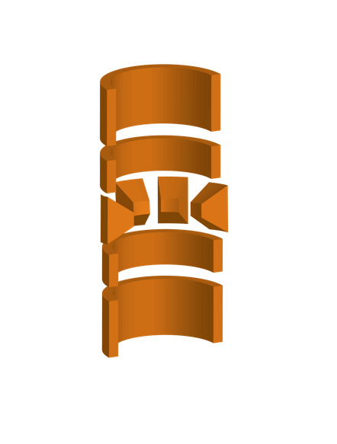
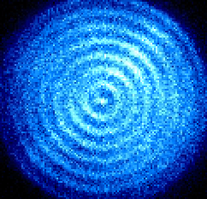
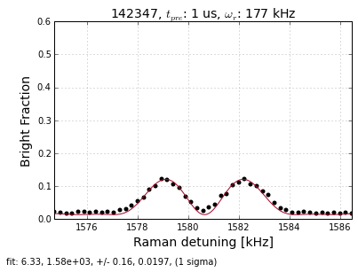
a
c
ODF
ODF
ODF
Repump
Cooling
Cooling
b
d
Population
50 μm
Drive frequency (kHz)

Slide 3
a
b
Population
Drive frequency (kHz)

Slide 4


a
b
Population
Cooling
Drive frequency (kHz)
Cooling
b
$$f_{odf}$$
$$λ$$
$$f_{odf}+μ$$

Slide 5




a
b
$$V_{z}$$
$$f_{odf}$$
$$λ$$
$$f_{odf}+μ$$
50 μm
c
$$\frac{ω_{c}}{2π}$$
Population
Drive frequency (kHz)

Slide 6
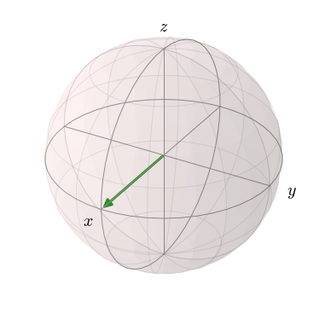




Side view
a
$$f_{odf}$$
$$f_{odf}+μ$$
b
Bottom view
$$\vec{B}$$
c
$$y$$
$$z$$
$$x$$
50 μm

Slide 7
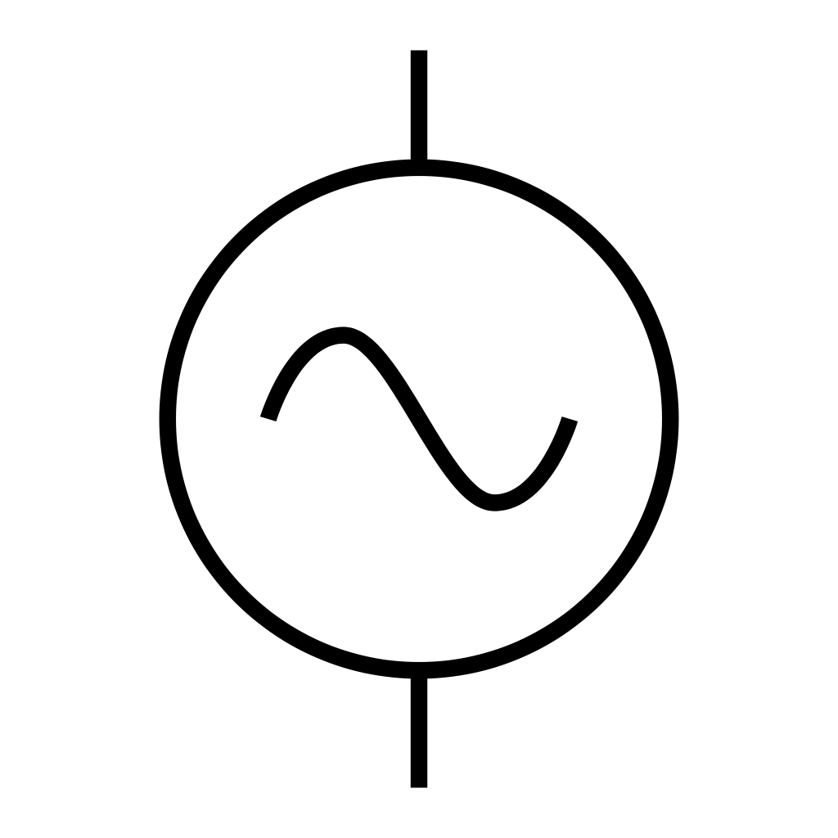
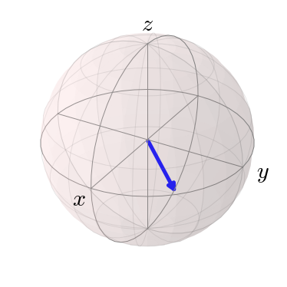
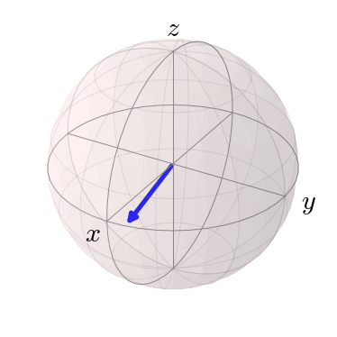
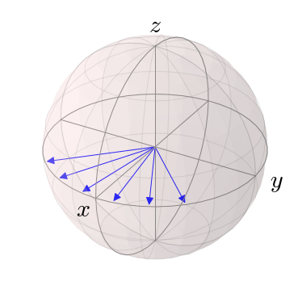







Side view
(a)
$$Z_{c 2}$$
$$f_{odf}$$
$$Z_{c 1}$$
$$f_{odf}+μ$$
$$V_{z}$$
(b)
Bottom view
(c)
$$\vec{B}$$
$$y$$
$$z$$
$$x$$
50 μm

Slide 8
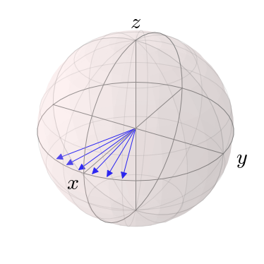



Side view
(a)
(c)
$$f_{odf}$$
$$f_{odf}+μ$$
(b)
Bottom view
$$\vec{B}$$
$$y$$
$$z$$
$$x$$
50 μm

Slide 9


Side view
(a)
(c)
$$f_{odf}$$
$$f_{odf}+μ$$
(b)
Bottom view
$$\vec{B}$$
$$y$$
$$z$$
$$x$$
50 μm

Slide 10
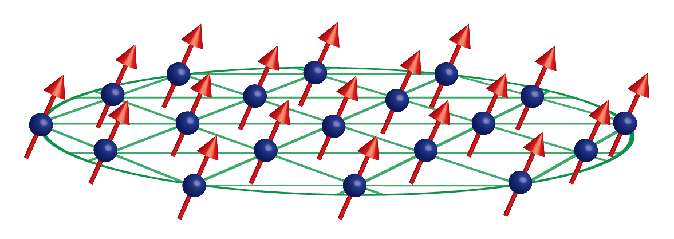
(a)
(c)
$$f_{odf}$$
$$f_{odf}+μ$$
(b)
50 μm

Slide 11


(a)
$$f_{odf}$$
$$f_{odf}+μ$$
(b)

Slide 12




Side view
$$f_{odf}$$
$$f_{odf}+μ$$
Bottom view
$$\vec{B}$$
$$y$$
$$z$$
$$x$$
50 μm

