Slide 1
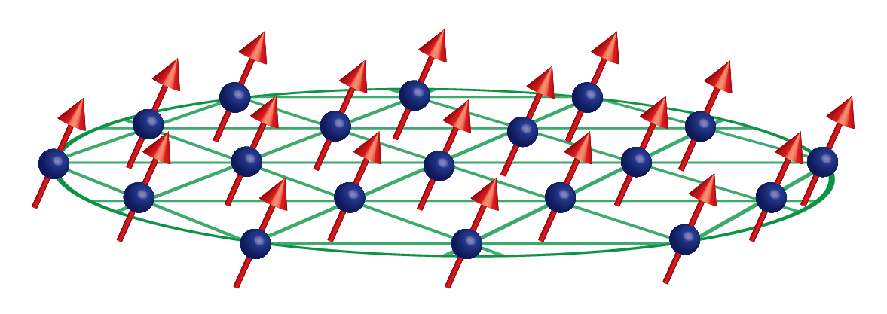

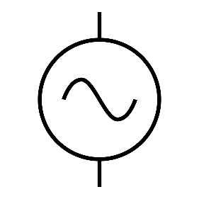




Sensing with a trapped-ion mechanical oscillator
$$ω,Z_{c}$$
$$ω_{odf}$$
$$δk$$
$$ω_{odf}+μ$$
Notes:
Drumhead modes of 2D crystal in Penning trap analogous to cavity optomechanics experiments. With cavity – oscillator pairing, motion of mechanical oscillator shifts frequency of cavity, which is read out. For us, ion motion is read out via spin state. Spins are coupled to mechanical motion of crystal with a spin-dependent optical dipole force. The motion effectively shifts the qubit frequency, which in the bloch sphere rep looks like a rotation. The majority of this work is done off-resonance – away from the COM mode – and with a random relative phase between the ODF beatnote and the applied drive – phase incoherently. With near term improvements, we plan to revisit this work on-resonance and phase coherently.

Slide 2
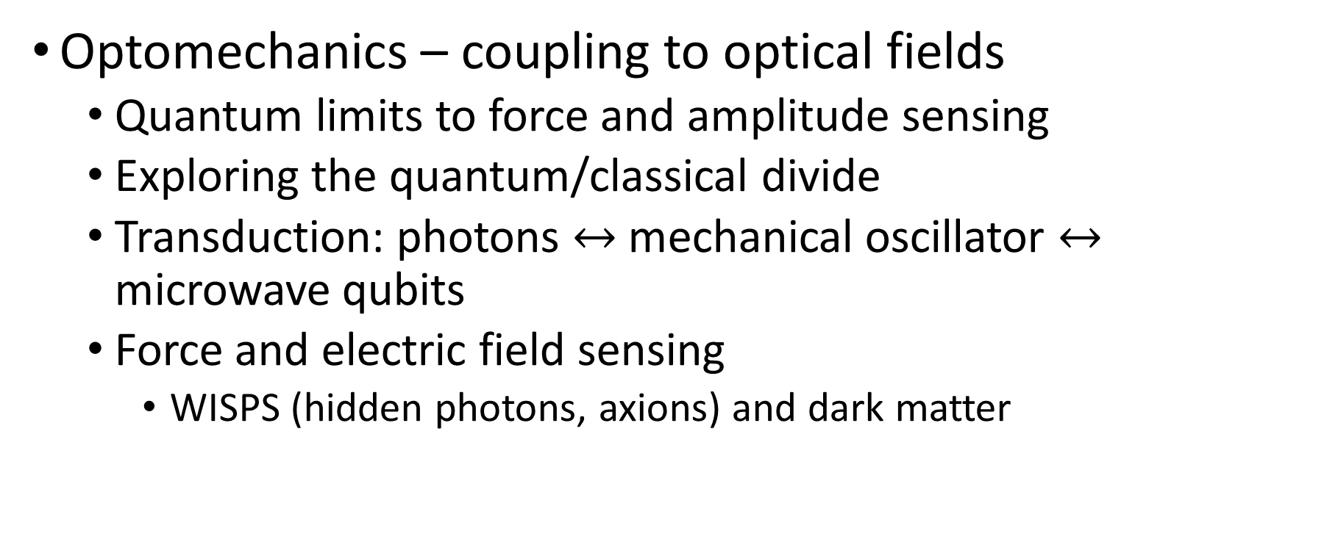
Quantum couplings to mechanical oscillators
Optomechanics – coupling to optical fields
Quantum limits to force and amplitude sensing
Exploring the quantum/classical divide
Transduction: photons $↔$ mechanical oscillator $↔$ microwave qubits
Force and electric field sensing
WISPS (hidden photons, axions) and dark matter
Notes:
Already projection noise limited with off-resonance experiment
Our crystal of ions looks and behaves much like the nanomechanical membranes used in some optomechanics experiments. Such objects offer chance to study quantum mechanics at the meso/macroscopic level. We can probe the zero-point fluctuations of our mechanical oscillator. Perhaps this affords study of transition from quantum microscopic regime to classical macroscopic world.
Related, much work in the optomechanics community concerns transducing signals and linking disparate quantum info systems through mechanical oscillators.
Finally, we’re very sensitive to electric fields and forces – so maybe that’s interesting in it’s own right. Potential for joining search for dark matter by detecting weak oscillating electric fields etc.

Slide 3
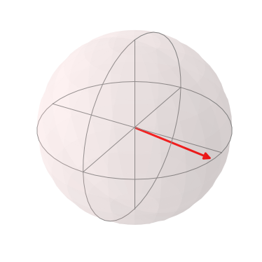
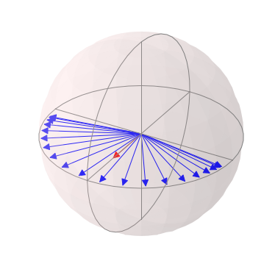



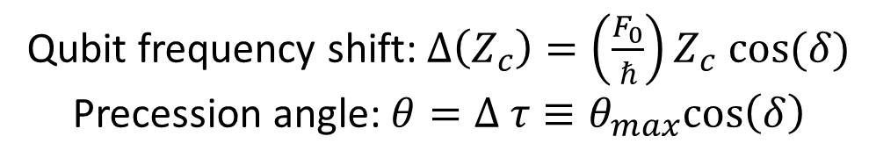
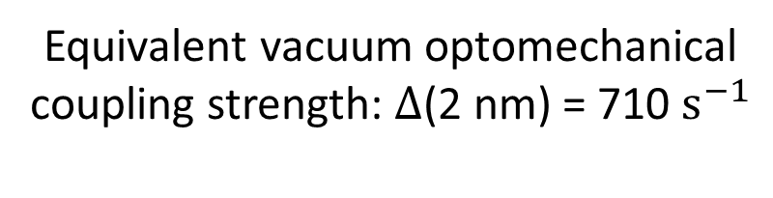

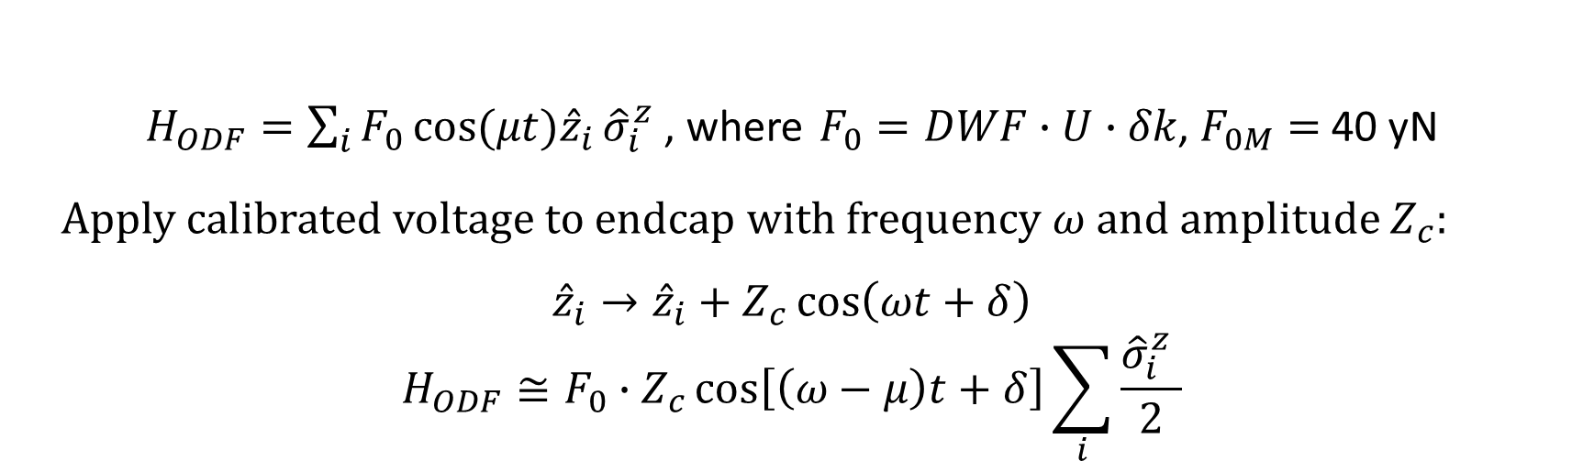
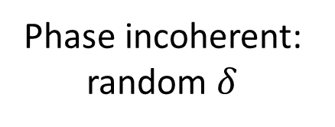
Precession due to axial oscillation
$H_{ODF}=\sum_{i}{F_{0}\cos{(μt){\hat{z}}_{i}}{\hat{σ}}_{i}^{z}}$ , where $F_{0}=DWF∙U∙δk$, $F_{0M}=$ 40 yN
Apply calibrated voltage to endcap with frequency $ω$ and amplitude $Z_{c}$:
$${\hat{z}}_{i}→{\hat{z}}_{i}+Z_{c}\cos\left(ωt+δ\right)$$
$$H_{ODF}≅F_{0}∙Z_{c}\cos\left[\left(ω−μ\right)t+δ\right]\sum_{i}{\frac{{\hat{σ}}_{i}^{z} }{2}}$$
Qubit frequency shift: $Δ\left(Z_{c}\right)=\left(\frac{F_{0}}{ℏ}\right)Z_{c} cos⁡(δ)$
Precession angle:$θ=Δ τ≡θ_{max}cos\left(δ\right)$
Phase coherent:
$$δ=0$$
Phase incoherent: random $δ$
Equivalent vacuum optomechanical coupling strength: $Δ$(2 nm) = 710 $s^{−1}$
$$θ_{max}$$
$$θ$$
$θ_{max}=F_{0}∙Z_{c}∙τ$

Slide 4

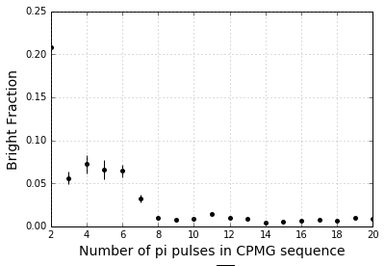

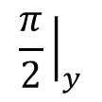
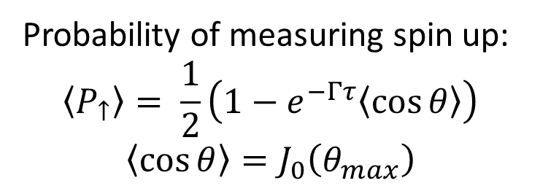
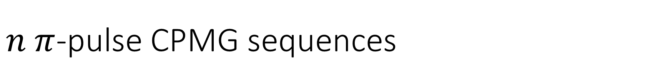

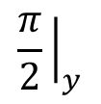








$n π$-pulse CPMG sequences
ODF Phase jumps:
$$Δφ=π$$
$$Δφ=π$$
$$T$$
$$t_{π}$$
$$T$$
$$T$$
$$t_{π}$$
$$T$$
ODF
ODF
ODF
ODF
$$\frac{π}{2}{\left.​\right|}_{y}$$
$$π{\left.​\right|}_{x}$$
$$π{\left.​\right|}_{x}$$
$$\frac{π}{2}{\left.​\right|}_{y}$$
CPMG sequences (no ODF) with 20 ms total interaction time
Probability of measuring spin up:
$$\left\langle P_{↑}\right\rangle = \frac{1}{2}\left(1−e^{−Γτ}\left\langle \cos{θ}\right\rangle \right)$$
$${\left\langle \cos{θ}\right\rangle =J}_{0}\left(θ_{max}\right)$$
Notes:
The phase jumps are chosen to cancel the cos term in the H. For µ/2π = (2n + 1)/(2(T + t_π)), the phase jump is pi and the spin precession is added coherently through the sequence . Can spin-echo away homogenous magnetic field flucs

Slide 5
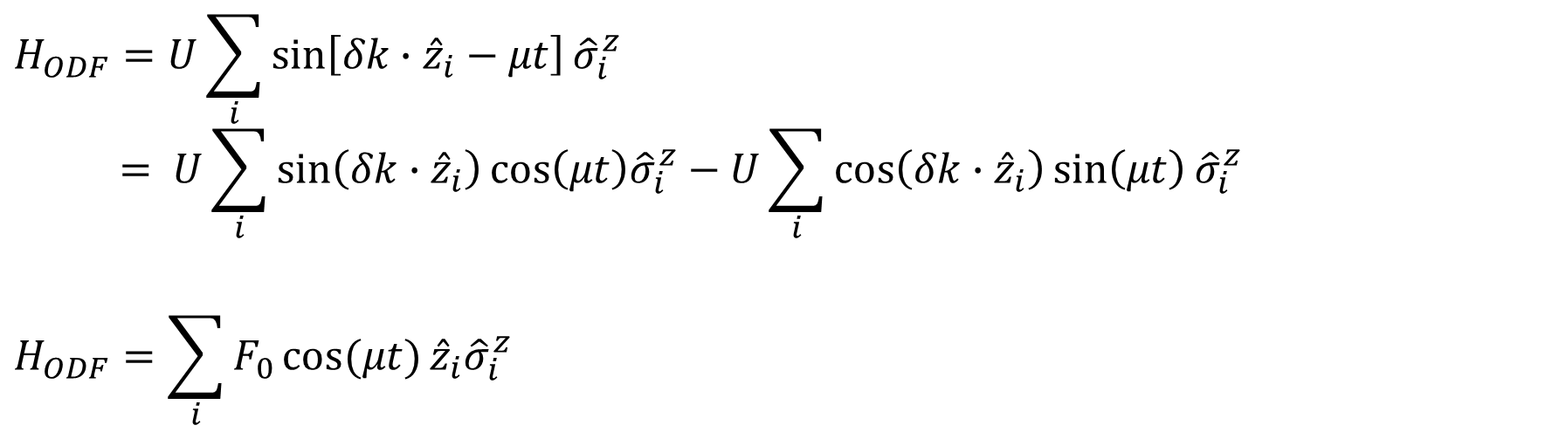
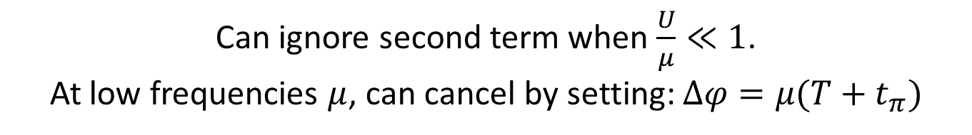
Canceling low frequency oscillations
$$H_{ODF}=U\sum_{i}{\sin\left[δk∙{\hat{z}}_{i}−μt\right]{\hat{σ}}_{i}^{z}}$$
$$= U\sum_{i}{\sin\left(δk∙{\hat{z}}_{i}\right)\cos\left(μt\right){\hat{σ}}_{i}^{z}−U\sum_{i}{\cos\left(δk∙{\hat{z}}_{i}\right)\sin\left(μt\right)}}{\hat{σ}}_{i}^{z}$$
$$H_{ODF}=\sum_{i}{F_{0}\cos{(μt)}{{\hat{z}}_{i}\hat{σ}}_{i}^{z}}$$
Can ignore second term when $\frac{U}{μ}≪1$.
At low frequencies $μ$, can cancel by setting: $Δφ=μ(T+t_{π})$
For $\frac{ω}{2π}=\frac{2n+1}{2\left(T+t_{π}\right)}$, $Δφ=π$ and spin precession is coherently accumulated
Notes:
The ODF couples the spin and motional degrees of freedom through… If U/mu is small, can make simplification. However, as will be discussed, it is also possible to choose the phases of the ODF to cancel the cos term. Like the cavity-mechanical oscillator, due to the spin-motion coupling induced by the ODF, qubit frequency sees a shift – hence precession. The qubit frequency shift evaluated at Z_c = 2 nm (zero point fluc of COM mode for 100 ions) is the equivalent of the vacuum optomechanical coupling strength. To get the prob of spin up, have to average over cos of random phase – result is J0

Slide 6
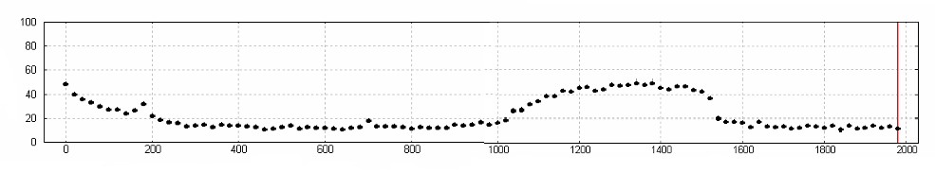
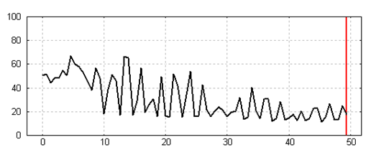
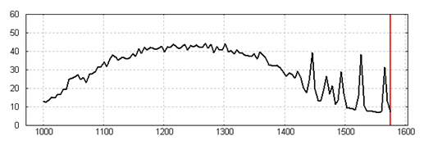
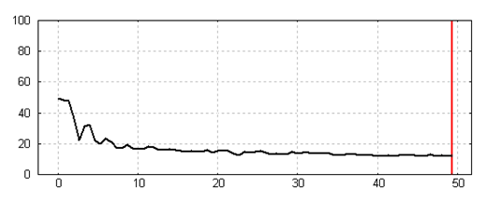








Modes and low frequency signal
4 ms ODF interaction time
$\left\langle P_{↑}\right\rangle$ (%)
ODF Difference Frequency $μ$ (kHz)
800 us ODF interaction time
$\left\langle P_{↑}\right\rangle$ (%)
$\left\langle P_{↑}\right\rangle$ (%)
ODF Difference Frequency $μ$ (kHz)
ODF Difference Frequency $μ$ (kHz)
800 us ODF interaction time w/ phase jump
$\left\langle P_{↑}\right\rangle$ (%)
ODF Difference Frequency $μ$ (kHz)
Notes:
measuring spin precession induced by thermal fluctuations with a single pi-pulse sequence (top) and 1 pi-pulse comg (left and lower center)

Slide 7
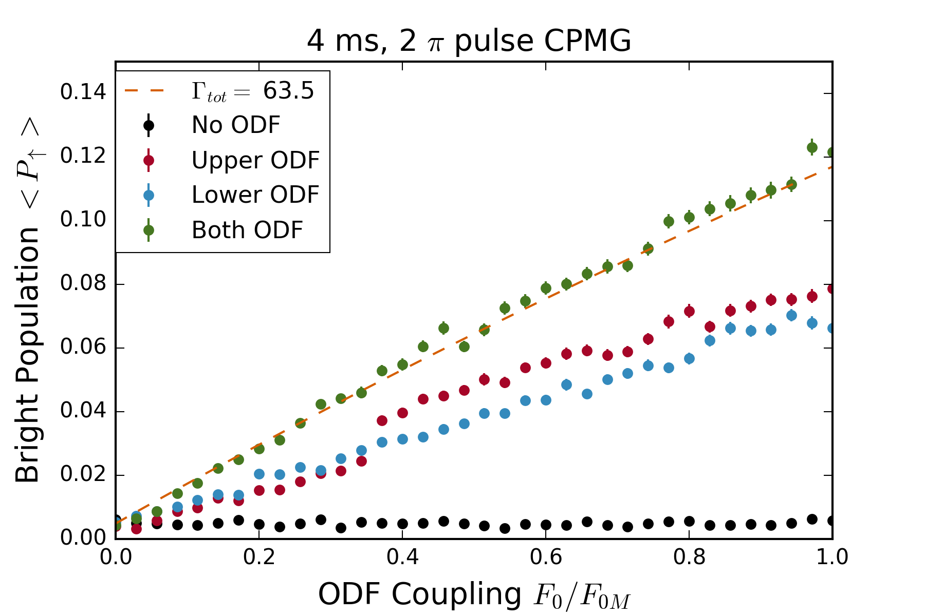
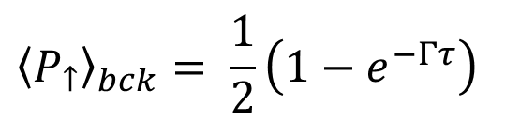
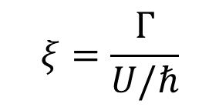
Background characterized by spontaneous emission and magnetic field fluctuations
$${\left\langle P_{↑}\right\rangle }_{bck}= \frac{1}{2}\left(1−e^{−Γτ}\right)$$
$$ξ=\frac{Γ}{U/ℏ}$$

Slide 8
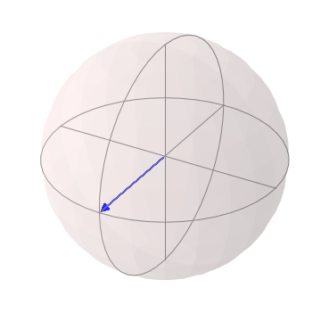
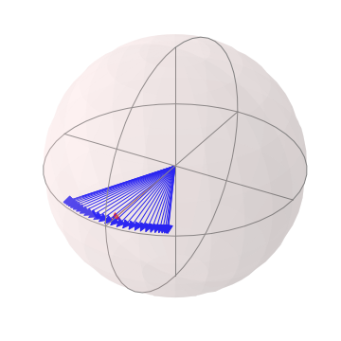
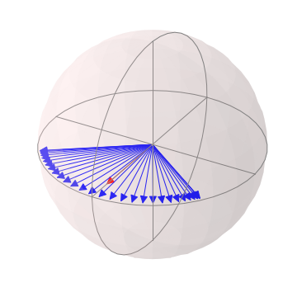
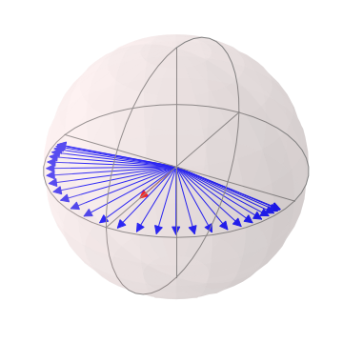
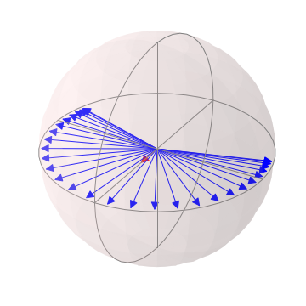
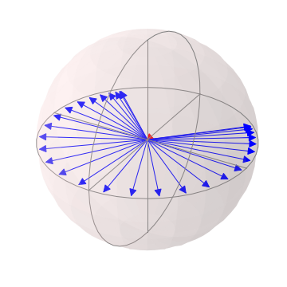
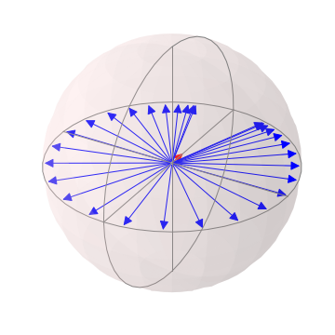
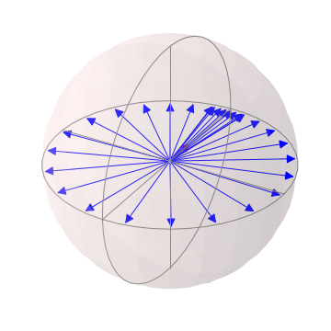
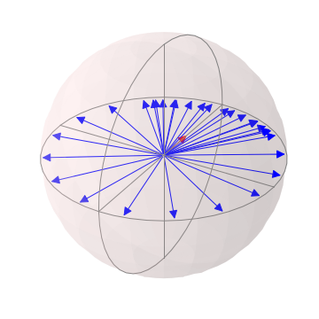
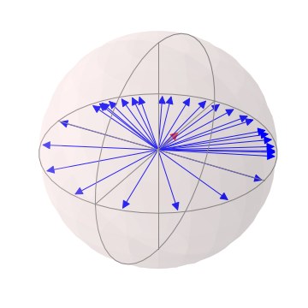
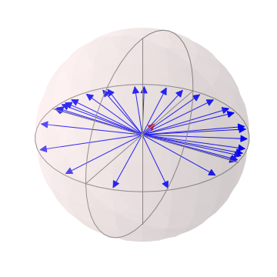
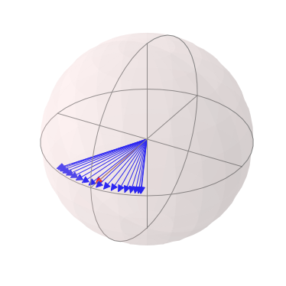
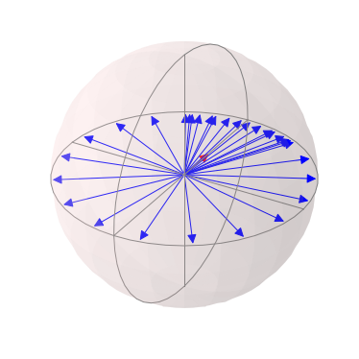
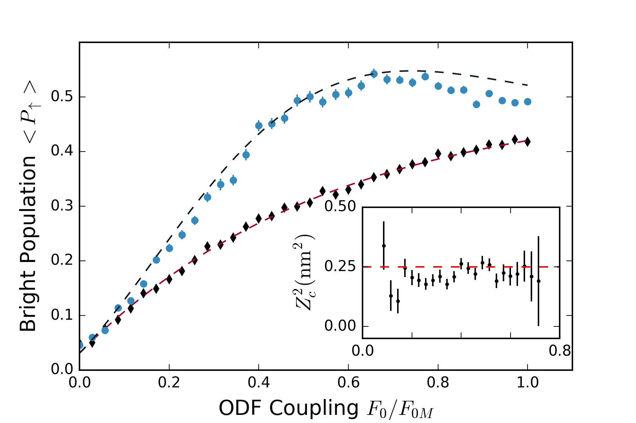
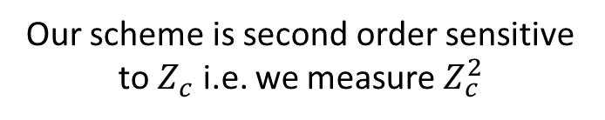
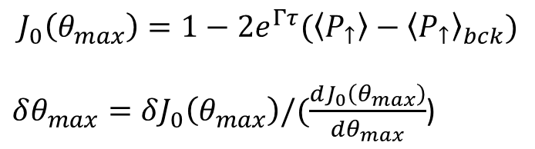

Spin dephasing vs measurement strength
$Z_{c}=500$ pm
`
Our scheme is second order sensitive to $Z_{c}$ i.e. we measure $Z_{c}^{2}$
$$J_{0}\left(θ_{max}\right)=1−2e^{Γτ}(\left\langle P_{↑}\right\rangle −{\left\langle P_{↑}\right\rangle }_{bck})$$
$δθ_{max}=δJ_{0}\left(θ_{max}\right)/(\frac{dJ_{0}\left(θ_{max}\right)}{dθ_{max}}$)

Slide 9


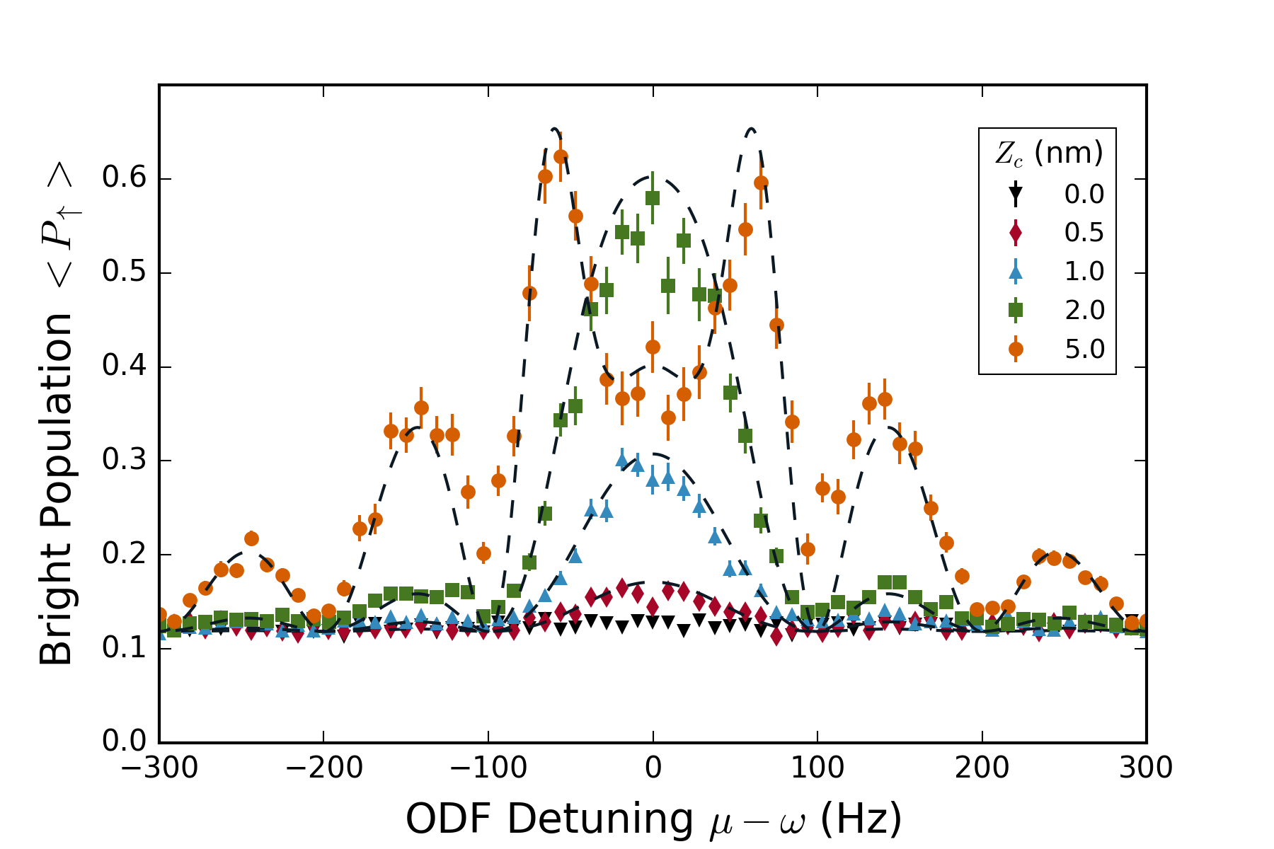
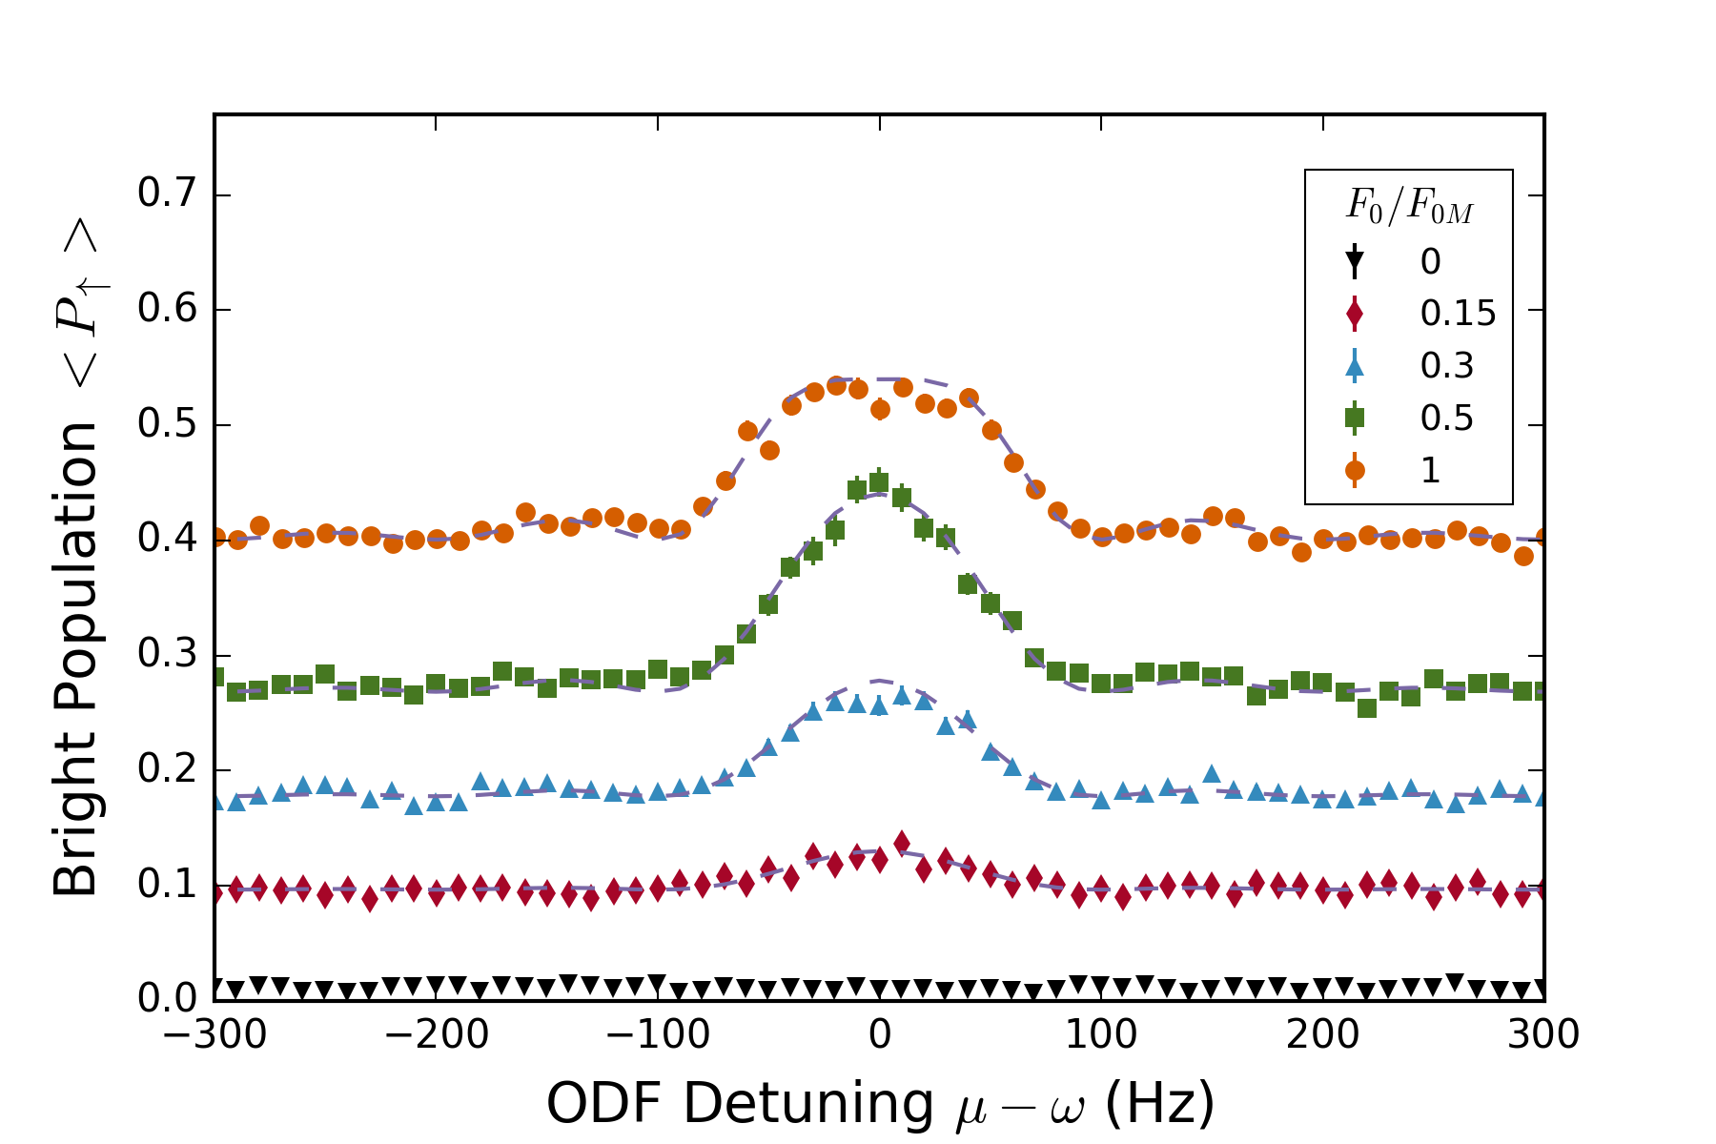



Lineshape is well understood
$θ_{max}=F_{0}∙Z_{c}∙τ$
$${F_{0}/F}_{0M}=0.2$$
$Z_{c}=500$ pm

Slide 10
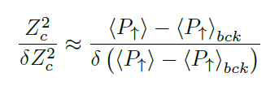
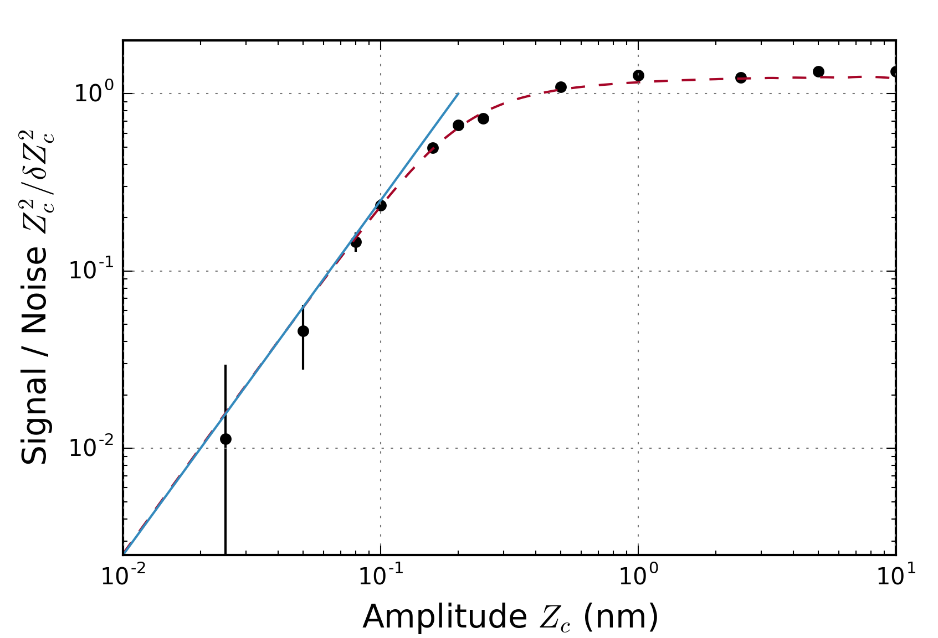

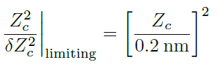



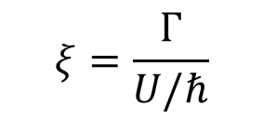
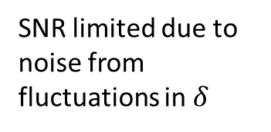
Limits to sensitivity / signal-to-noise
SNR limited due to noise from fluctuations in $δ$
Projection noise limit
Projection noise limit
50 pm – smallest detected amplitude
$$ξ=\frac{Γ}{U/ℏ}$$
$$\sim$$
Notes:
Projection noise dominates at small Z_c. Fundamental limit due to spontaneous emission (xi – ratio of gamma to U)

Slide 11
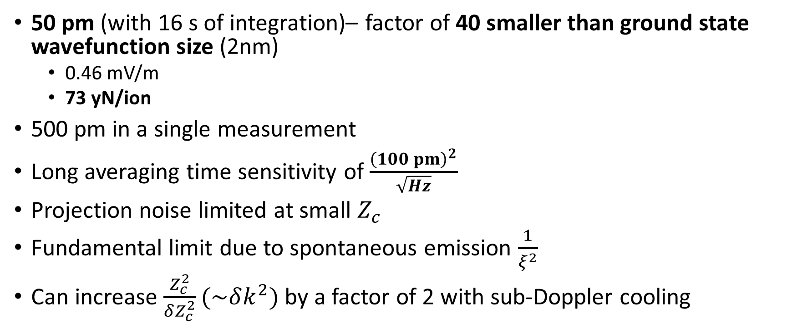
Off-resonant, incoherent amplitude sensing
50 pm (with 16 s of integration)– factor of 40 smaller than ground state wavefunction size (2nm)
0.46 mV/m
73 yN/ion
500 pm in a single measurement
Long averaging time sensitivity of $\frac{{\left(100 pm\right)}^{2}}{\sqrt{Hz}}$
Projection noise limited at small $Z_{c}$
Fundamental limit due to spontaneous emission $\frac{1}{ξ^{2}}$
Can increase $\frac{Z_{c}^{2}}{δZ_{c}^{2}}(\sim δk^{2})$ by a factor of 2 with sub-Doppler cooling

Slide 12
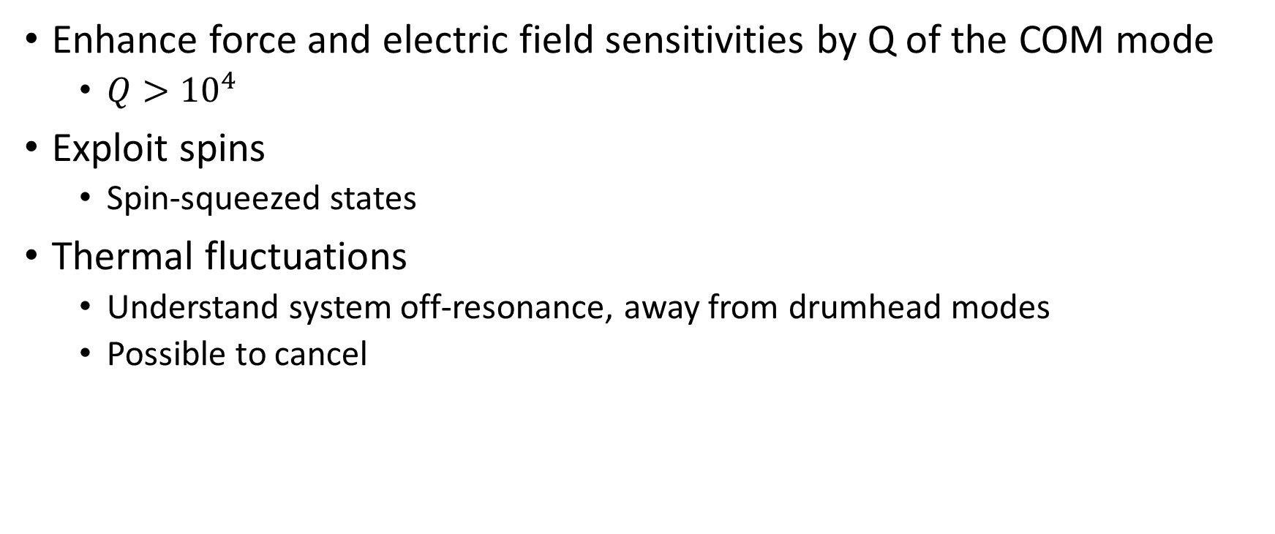
On resonance
Enhance force and electric field sensitivities by Q of the COM mode
$Q>{10}^{4}$
Exploit spins
Spin-squeezed states
Thermal fluctuations
Understand system off-resonance, away from drumhead modes
Possible to cancel

Slide 13
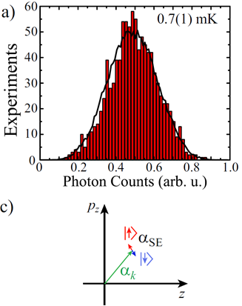











On resonance with thermal fluctuations
$$T$$
$$T$$
$$T$$
$$T$$
ODF
Drive
ODF
ODF
ODF
$$\frac{π}{2}{\left.​\right|}_{y}$$
$$π{\left.​\right|}_{x}$$
$$\frac{π}{2}{\left.​\right|}_{x}$$
$$\frac{π}{2}{\left.​\right|}_{y}$$
$$π{\left.​\right|}_{x}$$
$$\frac{π}{2}{\left.​\right|}_{x}$$
Thermal fluctuations
Displacement on top of thermal fluctuations
Phase incoherent
B. C. Sawyer, J. W. Britton, and J. J. Bollinger, Physical Review A 89, 033408 (2014)
Notes:
can measure displacement with this straight forward extension of the demonstrated off-resonant sensing, but looking for signal that sits on top of thermal fluctuations.

Slide 14





On resonance sensing scheme
$$p_{z}$$
If thermal fluctuations are coherent through the sequence, this scheme cancels them
$$\left|\left.↓\right\rangle \right.$$
$$\left|\left.↑\right\rangle \right.$$
$$z$$
Notes:
possible to cancel out thermal fluctuations with separated ODF's, but thermal fluctuations need to be coherent throughout the sequence.

Slide 15


On-resonance, background not understood – sensitivity limited
7.4 yN/ion, 45.5 uV/m, 25 nm
0.74 yN/ion, 4.5 uV/m

Slide 16

Predictions for on-resonance, phase coherent sensing
74 pm in a single measurement
$18 pm/\sqrt{Hz}$
20 pm
7 nV/m
${10}^{−3}$ yN / ion
SNR goes like $1/ξ$
Spin-squeezing can improve SNR by factor of 2
1 nV/m is the electric field of an electron at 1 m

Slide 17



Search for hidden photons as dark matter
$$ε=\frac{E}{3.3\frac{nV}{m}}∗{10}^{−12}$$
Hidden photons are theorized to interact with ‘regular’ photons through a kinetic mixing term $ε$, producing an electric field of amplitude E
Unfortunately, it seems shielding effects may severely reduce our sensitivity to these electric fields

