Slide 1
TTIC 31190: Natural Language Processing
Kevin Gimpel
Winter 2016
Lecture 1: Introduction

Slide 2
What is natural language processing?

Slide 3
What is natural language processing?
an experimental computer science research area
that includes problems and solutions pertaining to
the understanding of human language

Slide 4
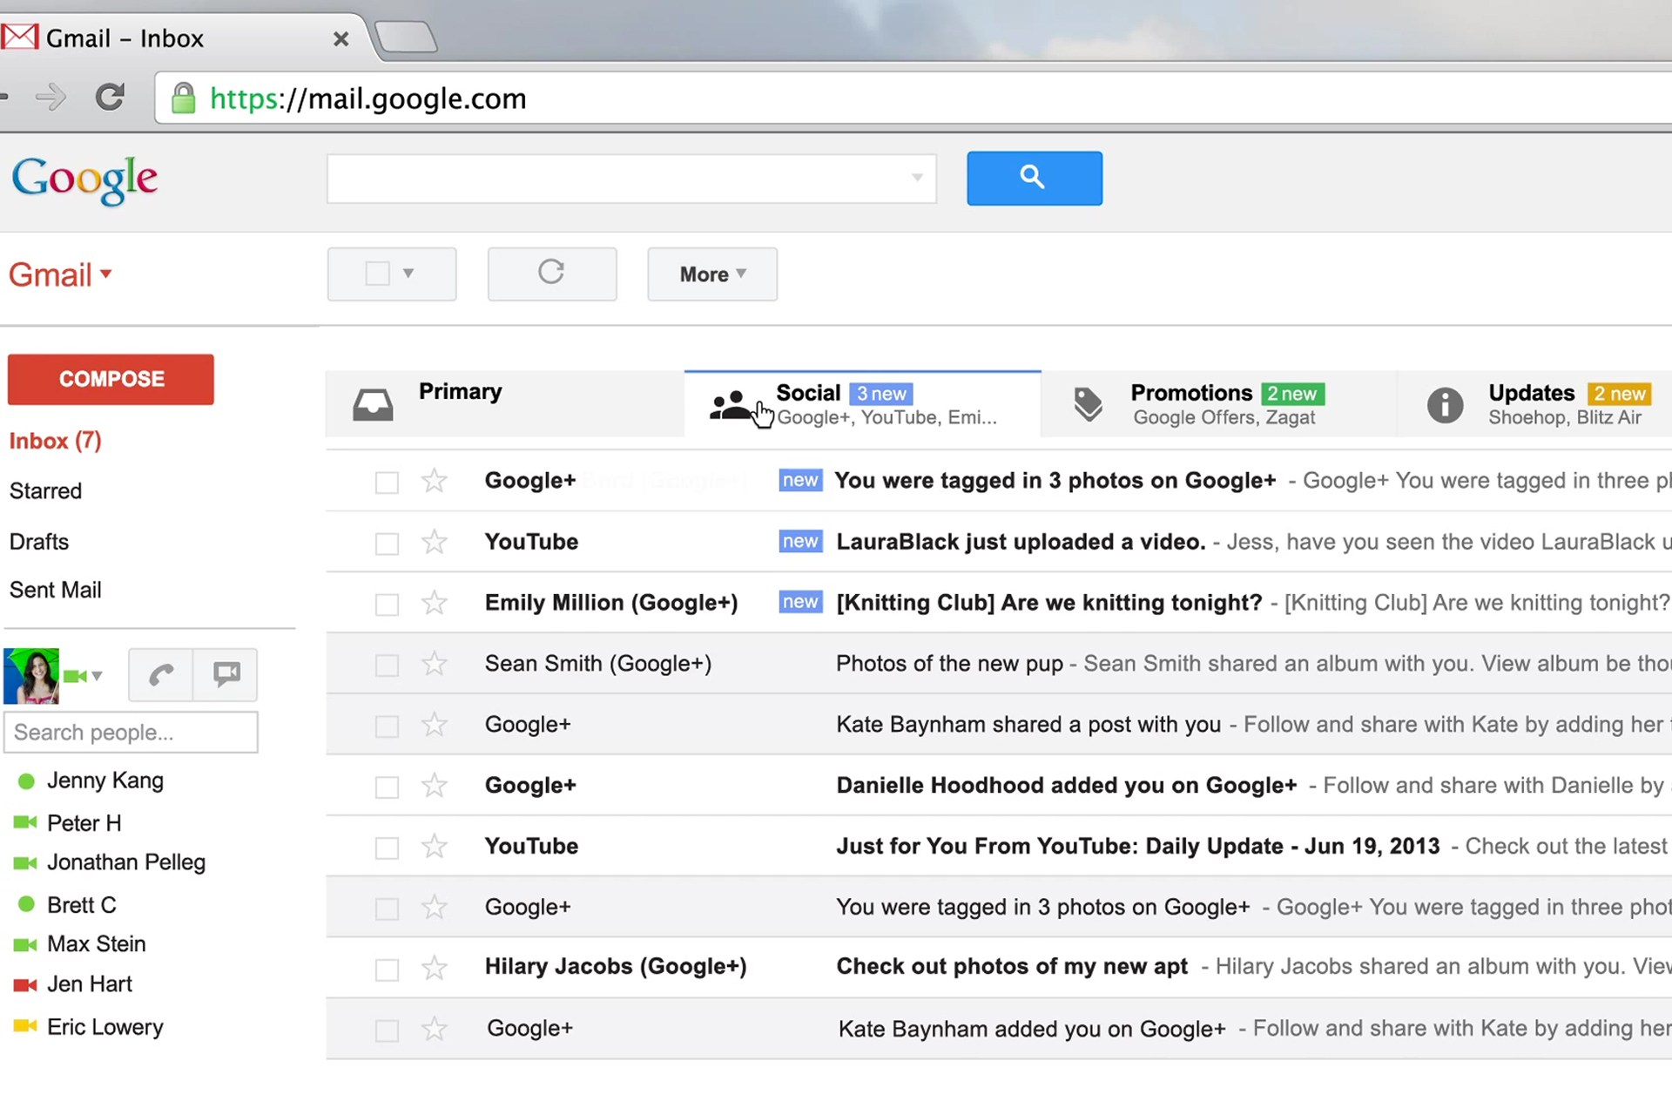
Text Classification
Notes:
sentence -> NER labeling
sentence -> translation
Neue Umfrage: Kaufen Sie eine Apple Watch?
sentence -> parse tree
set of documents -> summary

Slide 5
Text Classification
spam / not spam
priority level
category (primary / social / promotions / updates)
Notes:
sentence -> NER labeling
sentence -> translation
Neue Umfrage: Kaufen Sie eine Apple Watch?
sentence -> parse tree
set of documents -> summary

Slide 6
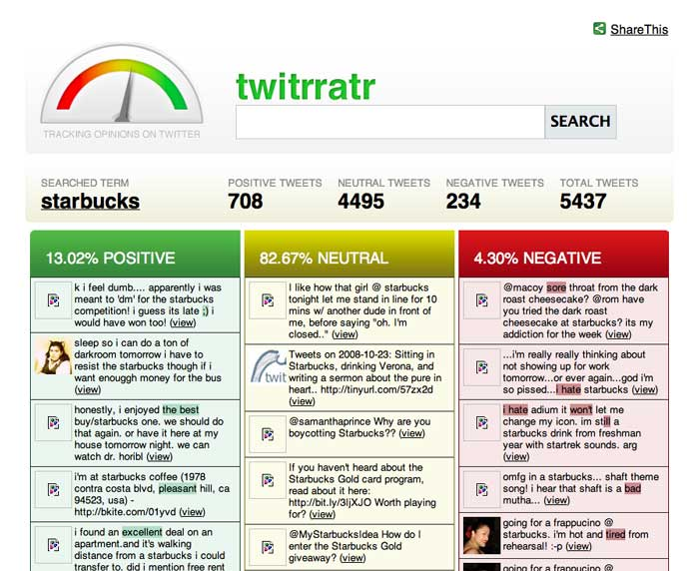
Sentiment Analysis
Notes:
sentence -> NER labeling
sentence -> translation
Neue Umfrage: Kaufen Sie eine Apple Watch?
sentence -> parse tree
set of documents -> summary

Slide 7
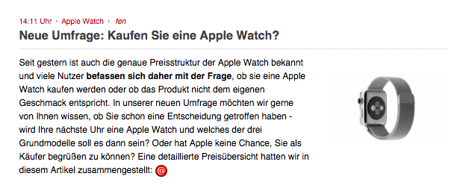
Machine Translation
Notes:
sentence -> NER labeling
sentence -> translation
Neue Umfrage: Kaufen Sie eine Apple Watch?
sentence -> parse tree
set of documents -> summary

Slide 8
Machine Translation
New Poll: Will you buy an Apple Watch?
Notes:
sentence -> NER labeling
sentence -> translation
Neue Umfrage: Kaufen Sie eine Apple Watch?
sentence -> parse tree
set of documents -> summary

Slide 9
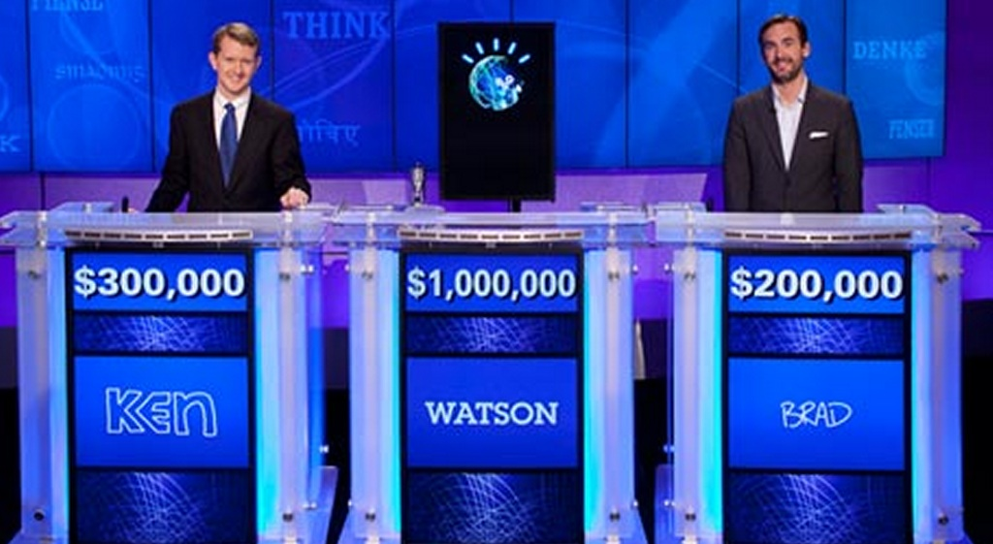
Question Answering
Notes:
sentence -> NER labeling
sentence -> translation
Neue Umfrage: Kaufen Sie eine Apple Watch?
sentence -> parse tree
set of documents -> summary

Slide 10
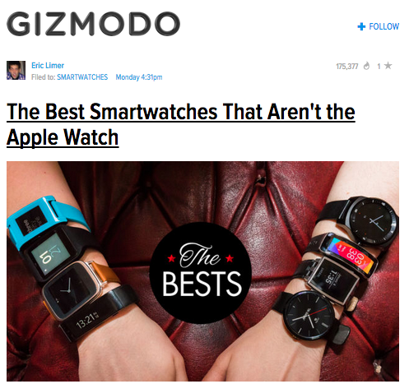
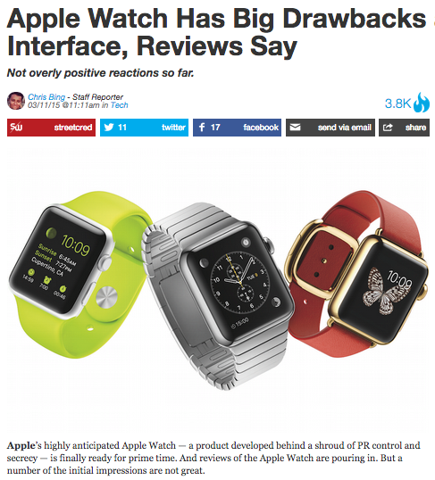
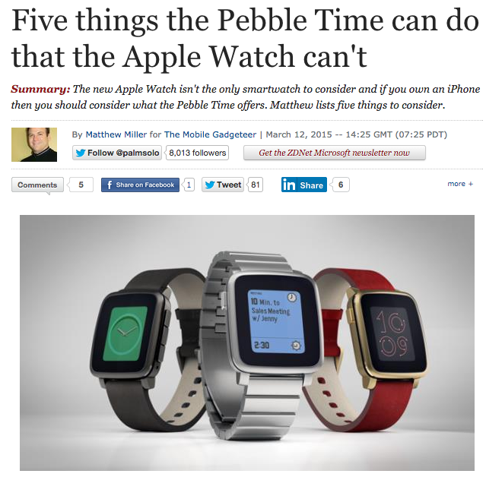
Summarization
Notes:
sentence -> NER labeling
sentence -> translation
Neue Umfrage: Kaufen Sie eine Apple Watch?
sentence -> parse tree
set of documents -> summary

Slide 11
Summarization
The Apple Watch has drawbacks. There are other smartwatches that offer more capabilities.
Notes:
sentence -> NER labeling
sentence -> translation
Neue Umfrage: Kaufen Sie eine Apple Watch?
sentence -> parse tree
set of documents -> summary

Slide 12
Dialog Systems
user: Schedule a meeting with Matt and David on Thursday.
computer: Thursday won’t work for David. How about Friday?
user: I’d prefer Monday then, but Friday would be ok if necessary.

Slide 13
Part-of-Speech Tagging
determiner verb (past) prep. proper proper poss. adj. noun
Some questioned if Tim Cook ’s first product
modal verb det. adjective noun prep. proper punc.
would be a breakaway hit for Apple .
Notes:
sentence -> NER labeling
sentence -> translation
Neue Umfrage: Kaufen Sie eine Apple Watch?
sentence -> parse tree
set of documents -> summary

Slide 14
Part-of-Speech Tagging
determiner verb (past) prep. proper proper poss. adj. noun
modal verb det. adjective noun prep. proper punc.
determiner verb (past) prep. noun noun poss. adj. noun
Some questioned if Tim Cook ’s first product
modal verb det. adjective noun prep. noun punc.
would be a breakaway hit for Apple .
Notes:
sentence -> NER labeling
sentence -> translation
Neue Umfrage: Kaufen Sie eine Apple Watch?
sentence -> parse tree
set of documents -> summary

Slide 15
Part-of-Speech Tagging
determiner verb (past) prep. proper proper poss. adj. noun
modal verb det. adjective noun prep. proper punc.
determiner verb (past) prep. noun noun poss. adj. noun
Some questioned if Tim Cook ’s first product
modal verb det. adjective noun prep. noun punc.
would be a breakaway hit for Apple .
Named Entity Recognition
Some questioned if Tim Cook’s first product would be a breakaway hit for Apple.
PERSON
ORGANIZATION
Notes:
sentence -> NER labeling
sentence -> translation
Neue Umfrage: Kaufen Sie eine Apple Watch?
sentence -> parse tree
set of documents -> summary

Slide 16
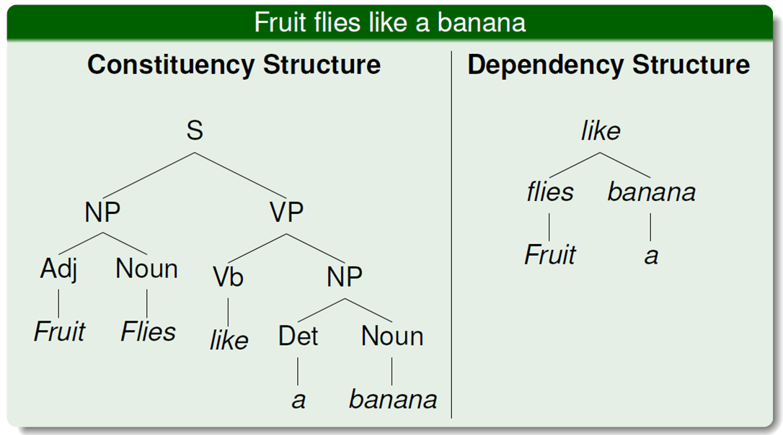
Syntactic Parsing
Notes:
sentence -> NER labeling
sentence -> translation
Neue Umfrage: Kaufen Sie eine Apple Watch?
sentence -> parse tree
set of documents -> summary

Slide 17
Entity Linking
Coreference Resolution
figure credit: Durrett & Klein (2014)

Slide 18
“Winograd Schema” Coreference Resolution
The man couldn't lift his son because he was so weak.
The man couldn't lift his son because he was so heavy.

Slide 19
“Winograd Schema” Coreference Resolution
The man couldn't lift his son because he was so weak.
The man couldn't lift his son because he was so heavy.
man
son

Slide 20
Reading Comprehension
Once there was a boy named Fritz who loved to draw. He drew everything. In the morning, he drew a picture of his cereal with milk. His papa said, “Don’t draw your cereal. Eat it!”
After school, Fritz drew a picture of his bicycle. His uncle said, “Don't draw your bicycle. Ride it!”
…
What did Fritz draw first?
A) the toothpaste
B) his mama
C) cereal and milk
D) his bicycle

Slide 21
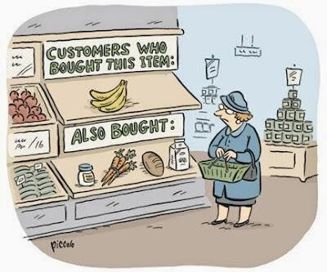
Conspicuous by their absence…
speech recognition (see TTIC 31110)
information retrieval and web search
knowledge representation
recommender systems

Slide 22
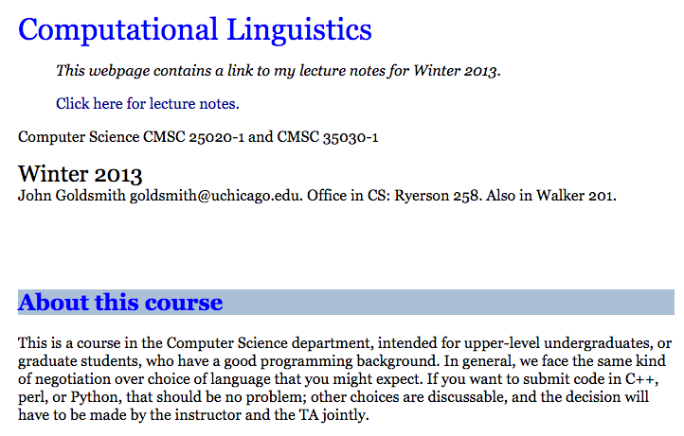
Computational Linguistics vs. Natural Language Processing
how do they differ?

Slide 23
Computational Biology vs. Bioinformatics
“Computational biology = the study of biology using computational techniques. The goal is to learn new biology, knowledge about living systems. It is about science.
Bioinformatics = the creation of tools (algorithms, databases) that solve problems. The goal is to build useful tools that work on biological data. It is about engineering.”
--Russ Altman

Slide 24
Computational Linguistics vs. Natural Language Processing
many people think of the two terms as synonyms
computational linguistics is more inclusive; more likely to include sociolinguistics, cognitive linguistics, and computational social science
NLP is more likely to use machine learning and involve engineering / system-building

Slide 25
Is NLP Science or Engineering?
goal of NLP is to develop technology, which takes the form of engineering
though we try to solve today’s problems, we seek principles that will be useful for the future
if science, it’s not linguistics or cognitive science; it’s the science of computational processing of language
so I like to think that we’re doing the science of engineering

Slide 26
Course Overview
New course, first time being offered
Aimed at first-year PhD students
Instructor office hours: Mondays 3-4 pm, TTIC 531
Teaching assistant: Lifu Tu, TTIC PhD student

Slide 27
Prerequisites
No course prerequisites, but I will assume:
some programming experience (no specific language required)
familiarity with basics of probability, calculus, and linear algebra
Undergraduates with relevant background are welcome to take the course. Please bring an enrollment approval form to me if you can’t enroll online.

Slide 28
Grading
3 assignments (15% each)
midterm exam (15%)
course project (35%):
preliminary report and meeting with instructor (10%)
class presentation (5%)
final report (20%)
class participation (5%)
no final

Slide 29
Assignments
Mixture of formal exercises, implementation, experimentation, analysis
“Choose your own adventure” component based on your interests, e.g.:
exploratory data analysis
machine learning
implementation/scalability
model and error analysis
visualization

Slide 30
Project
Replicate [part of] a published NLP paper, or define your own project.
The project may be done individually or in a group of two. Each group member will receive the same grade.
More details to come.

Slide 31
Collaboration Policy
You are welcome to discuss assignments with others in the course, but solutions and code must be written individually

Slide 32

Textbooks
All are optional
Speech and Language Processing, 2nd Ed.
some chapters of 3rd edition are online
The Analysis of Data, Volume 1: Probability
freely available online
Introduction to Information Retrieval
freely available online

Slide 33
Roadmap
classification
words
lexical semantics
language modeling
sequence labeling
syntax and syntactic parsing
neural network methods in NLP
semantic compositionality
semantic parsing
unsupervised learning
machine translation and other applications

Slide 34
Why is NLP hard?
ambiguity and variability of linguistic expression:
variability: many forms can mean the same thing
ambiguity: one form can mean many things
there are many different kinds of ambiguity
each NLP task has to address a distinct set of kinds

Slide 35
Word Sense Ambiguity
many words have multiple meanings

Slide 36
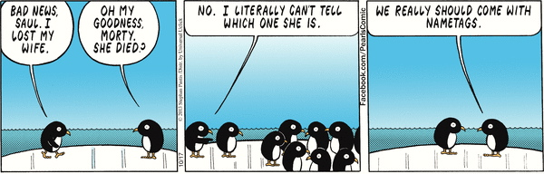
Word Sense Ambiguity
credit: A. Zwicky

Slide 37
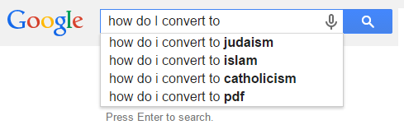
Word Sense Ambiguity
credit: A. Zwicky

Slide 38
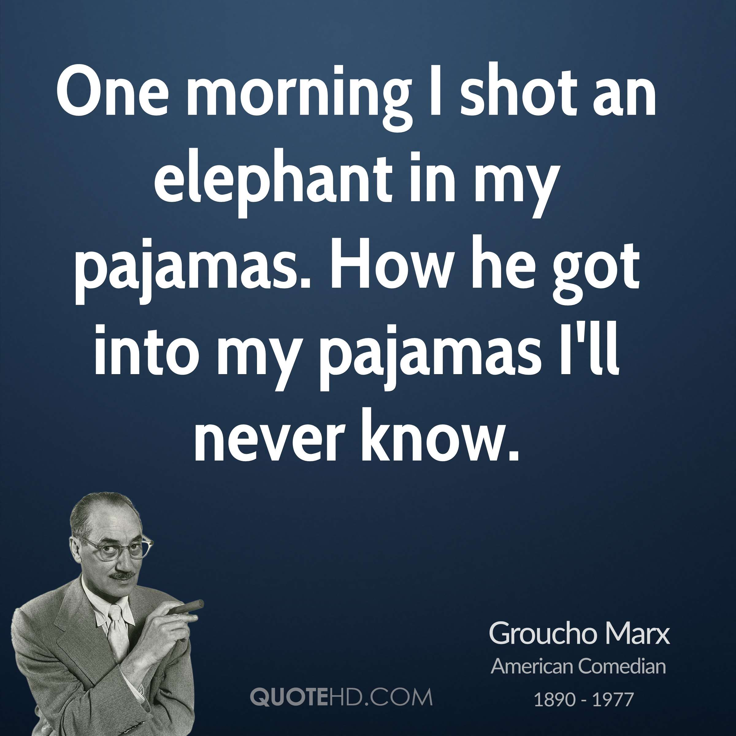
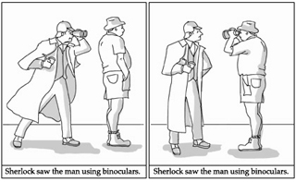
Attachment Ambiguity

Slide 39
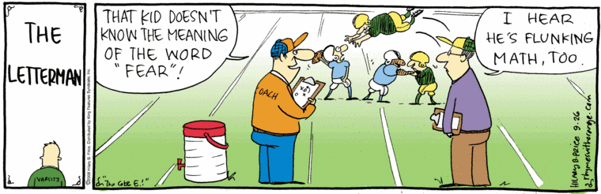
Meaning Ambiguity

Slide 40
Text Classification
simplest user-facing NLP application
email (spam, priority, categories):
sentiment:
topic classification
others?

Slide 41
What is a classifier?

Slide 42
What is a classifier?
a function from inputs x to classification labels y

Slide 43
What is a classifier?
a function from inputs x to classification labels y
one simple type of classifier:
for any input x, assign a score to each label y, parameterized by vector :

Slide 44
What is a classifier?
a function from inputs x to classification labels y
one simple type of classifier:
for any input x, assign a score to each label y, parameterized by vector :
classify by choosing highest-scoring label:

Slide 45
Course Philosophy
From reading papers, one gets the idea that machine learning concepts are monolithic, opaque objects
e.g., naïve Bayes, logistic regression, SVMs, CRFs, neural networks, LSTMs, etc.
Nothing is opaque
Everything can be dissected, which reveals connections
The names above are useful shorthand, but not useful for gaining understanding

Slide 46
Course Philosophy
We will draw from machine learning, linguistics, and algorithms, but technical material will be (mostly) self-contained; we won’t use many black boxes
We will focus on declarative (rather than procedural) specifications, because they highlight connections and differences

Slide 47
Modeling, Inference, Learning

Slide 48
Modeling, Inference, Learning
modeling: define score function
Modeling: How do we assign a score to an (x,y) pair using parameters ?

Slide 49
Modeling, Inference, Learning
inference: solve _
modeling: define score function
Inference: How do we efficiently search over the space of all labels?

Slide 50
Modeling, Inference, Learning
inference: solve _
modeling: define score function
learning: choose _
Learning: How do we choose ?

Slide 51
Modeling, Inference, Learning
inference: solve _
modeling: define score function
learning: choose _
We will use this same paradigm throughout the course, even when the output space size is exponential in the size of the input or is unbounded (e.g., machine translation)

Slide 52
Notation
We’ll use boldface for vectors:
Individual entries will use subscripts and no boldface, e.g., for entry i:

Slide 53
Modeling: Linear Models
Score function is linear in :
f : feature function vector
: weight vector

Slide 54
Modeling: Linear Models
Score function is linear in :
f : feature function vector
: weight vector
How do we define f ?

Slide 55
Defining Features
This is a large part of NLP
Last 20 years: feature engineering
Last 2 years: representation learning
In this course, we will do both
Learning representations doesn’t mean that we don’t have to look at the data or the output!
There’s still plenty of engineering required in representation learning

Slide 56
Defining Features
This is a large part of NLP
Last 20 years: feature engineering
Last 2 years: representation learning
In this course, we’ll do both
Learning representations doesn’t mean that we don’t have to look at the data or the output!
There’s still plenty of engineering required in representation learning

Slide 57
Feature Engineering
Often decried as “costly, hand-crafted, expensive, domain-specific”, etc.
But in practice, simple features typically give the bulk of the performance
Let’s get concrete: how should we define features for text classification?

Slide 58
Feature Engineering for Text Classification

Slide 59
Feature Engineering for Text Classification
is now a vector because it is a sequence of words

Slide 60
Feature Engineering for Text Classification
is now a vector because it is a sequence of words
let’s consider sentiment analysis:

Slide 61
Feature Engineering for Text Classification
is now a vector because it is a sequence of words
let’s consider sentiment analysis:
so, here is our sentiment classifier that uses a linear model:

Slide 62
Feature Engineering for Text Classification
Two features:
where
What should the weights be?

Slide 63
Feature Engineering for Text Classification
Two features:
where
What should the weights be?

Slide 64
Feature Engineering for Text Classification
Two features:
Let’s say we set
On sentences containing “great” in the Stanford Sentiment Treebank training data, this would get us an accuracy of 69%
But “great’’ only appears in 83/6911 examples

Slide 65
Feature Engineering for Text Classification
Two features:
Let’s say we set
On sentences containing “great” in the Stanford Sentiment Treebank training data, this would get us an accuracy of 69%
But “great’’ only appears in 83/6911 examples
ambiguity: “great” can mean different things in different contexts
variability: many other words can indicate positive sentiment

Slide 66
Usually, great indicates positive sentiment:
The most wondrous love story in years, it is a great film.
A great companion piece to other Napoleon films .
Sometimes not. Why?
Negation: It's not a great monster movie .
Different sense: There's a great deal of corny dialogue and preposterous moments .
Multiple sentiments: A great ensemble cast can't lift this heartfelt enterprise out of the familiar.
And there are many other words that indicate positive sentiment

Slide 67
Usually, great indicates positive sentiment:
The most wondrous love story in years, it is a great film.
A great companion piece to other Napoleon films .
Sometimes not. Why?
Negation: It's not a great monster movie .
Different sense: There's a great deal of corny dialogue and preposterous moments .
Multiple sentiments: A great ensemble cast can't lift this heartfelt enterprise out of the familiar.

Slide 68
Feature Engineering for Text Classification
What about a feature like the following?
What should its weight be?

Slide 69
Feature Engineering for Text Classification
What about a feature like the following?
What should its weight be?
Doesn’t matter.
Why?

Slide 70
Text Classification
our linear sentiment classifier:

Slide 71
Inference for Text Classification
inference: solve _

Slide 72
Inference for Text Classification
inference: solve _
trivial (loop over labels)

Slide 73
Text Classification

Slide 74
Learning for Text Classification
learning: choose _

Slide 75
Learning for Text Classification
learning: choose _
There are many ways to choose

Slide 76
Experimental Practice
in the beginning, we just had data
first innovation: split into train and test
motivation: simulate conditions of applying system in practice
but, there’s a problem with this…
we need to explore and evaluate methodological choices
after multiple evaluations on test, it is no longer a simulation of real-world conditions

Slide 77
Experimental Practice
in the beginning, we just had data
first innovation: split into train and test
motivation: simulate conditions of applying system in practice
but, there’s a problem with this…
we need to explore and evaluate methodological choices
after multiple evaluations on test, it is no longer a simulation of real-world conditions

Slide 78
Experimental Practice
in the beginning, we just had data
first innovation: split into train and test
motivation: simulate conditions of applying system in practice
but, there’s a problem with this…
we need to explore and evaluate methodological choices
after multiple evaluations on test, it is no longer a simulation of real-world conditions

Slide 79
Experimental Practice
in the beginning, we just had data
first innovation: split into train and test
motivation: simulate conditions of applying system in practice
but, there’s a problem with this…
we need to explore and evaluate methodological choices
after multiple evaluations on test, it is no longer a simulation of real-world conditions

Slide 80
Experimental Practice
we need to explore/evaluate methodological choices
what should we do?
some use cross validation on train, but this is slow and doesn’t quite simulate real-world settings (why?)
second innovation: divide data into train, test, and a third set called development or validation
use development/validation to evaluate choices
then, when ready to write the paper, evaluate the best model on test
are we done yet? no! there’s still a problem

Slide 81
Experimental Practice
we need to explore/evaluate methodological choices
what should we do?
some use cross validation on train, but this is slow and doesn’t quite simulate real-world settings (why?)
second innovation: divide data into train, test, and a third set called development (dev) or validation (val)
use dev/val to evaluate choices
then, when ready to write the paper, evaluate the best model on test
are we done yet? no! there’s still a problem:
overfitting to dev/val

Slide 82
Experimental Practice
we need to explore/evaluate methodological choices
what should we do?
some use cross validation on train, but this is slow and doesn’t quite simulate real-world settings (why?)
second innovation: divide data into train, test, and a third set called development (dev) or validation (val)
use dev/val to evaluate choices
then, when ready to write the paper, evaluate the best model on test
are we done yet? no! there’s still a problem:
overfitting to dev/val

Slide 83
Experimental Practice
we need to explore/evaluate methodological choices
what should we do?
some use cross validation on train, but this is slow and doesn’t quite simulate real-world settings (why?)
second innovation: divide data into train, test, and a third set called development (dev) or validation (val)
use dev/val to evaluate choices
then, when ready to write the paper, evaluate the best model on test
are we done yet? no! there’s still a problem:
overfitting to dev/val

Slide 84
Experimental Practice
best practice: split data into train, development (dev), development test (devtest), and test
train model on train, tune hyperparameter values on dev, do preliminary testing on devtest, do final testing on test a single time when writing the paper
Even better to have even more test sets! test1, test2, etc.
experimental credibility is a huge component of doing useful research
when you publish a result, it had better be replicable without tuning anything on test

Slide 85
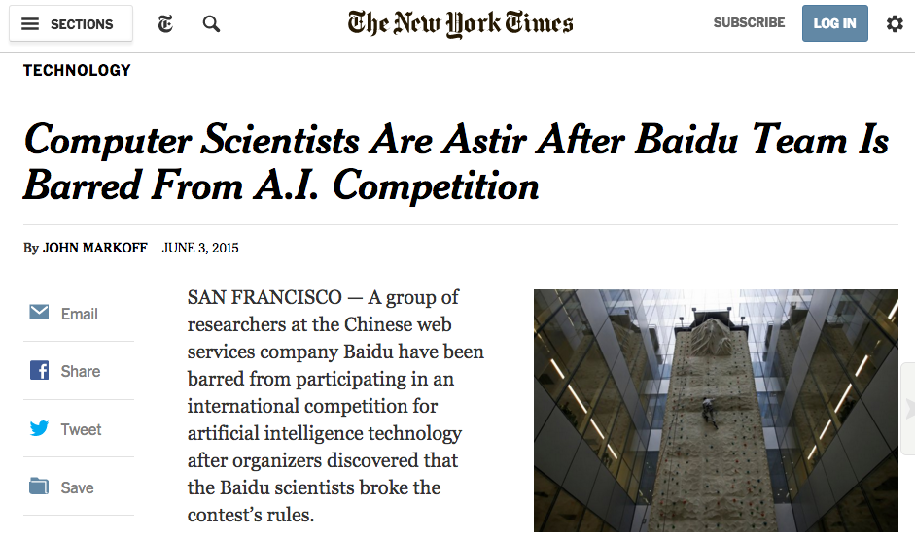
Don’t Cheat!

