Slide 1
TTIC 31190: Natural Language Processing
Kevin Gimpel
Winter 2016
Lecture 10:
Neural Networks for NLP

Slide 2
Announcements
Assignment 2 due Friday
project proposal due Tuesday, Feb. 16
midterm on Thursday, Feb. 18

Slide 3
Roadmap
classification
words
lexical semantics
language modeling
sequence labeling
neural network methods in NLP
syntax and syntactic parsing
semantic compositionality
semantic parsing
unsupervised learning
machine translation and other applications

Slide 4
What is a neural network?
just think of a neural network as a function
it has inputs and outputs
the term “neural” typically means a particular type of functional building block (“neural layers”), but the term has expanded to mean many things

Slide 5
Classifier Framework
linear model score function:
we can also use a neural network for the score function!

Slide 6
neural layer = affine transform + nonlinearity
nonlinearity
affine transform
this is a single “layer” of a neural network
input vector is
vector of “hidden units” is

Slide 7
Nonlinearities
most common: elementwise application of g function to each entry in vector
examples…

Slide 8
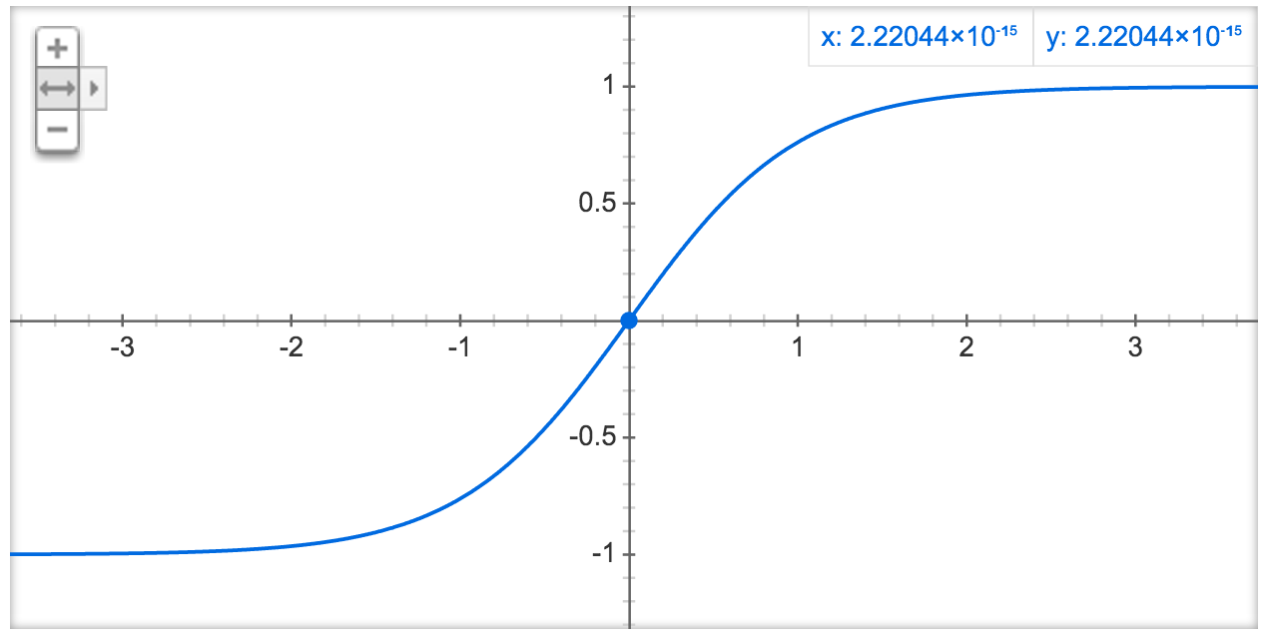
tanh:

Slide 9
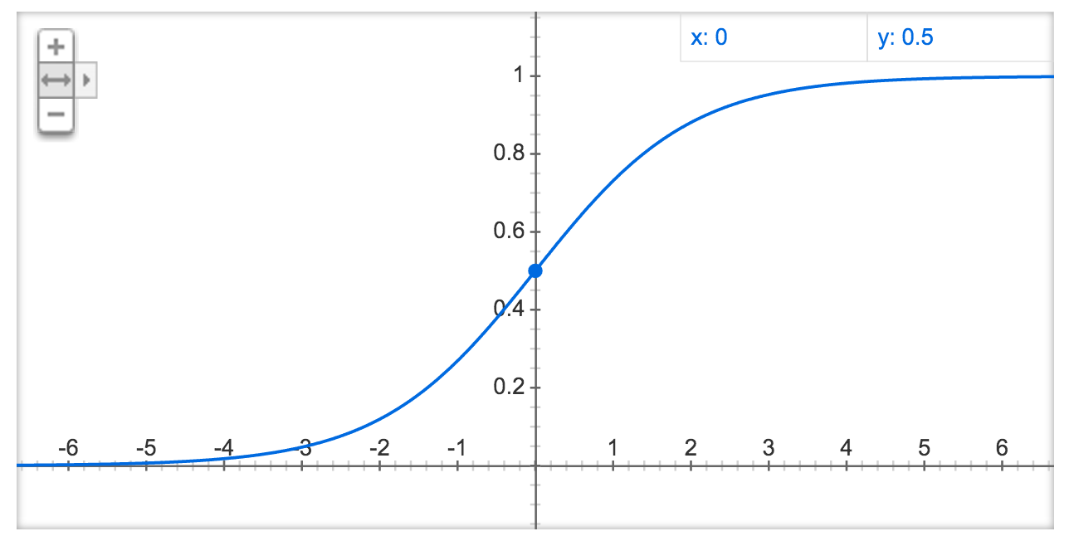
(logistic) sigmoid:

Slide 10
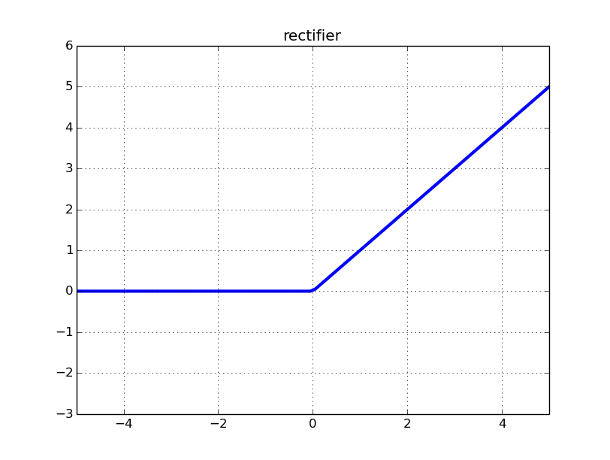
rectified linear unit (ReLU):

Slide 11
2-layer network
vector of label scores
this is a 2-layer neural network
input vector is
output vector is

Slide 12
2-layer neural network for sentiment classification

Slide 13
Use softmax function to convert scores into probabilities

Slide 14
Why nonlinearities?
2-layer network:
written in a single equation:
if g is linear, then we can rewrite the above as a single affine transform
can you prove this? (use distributivity of matrix multiplication)

Slide 15
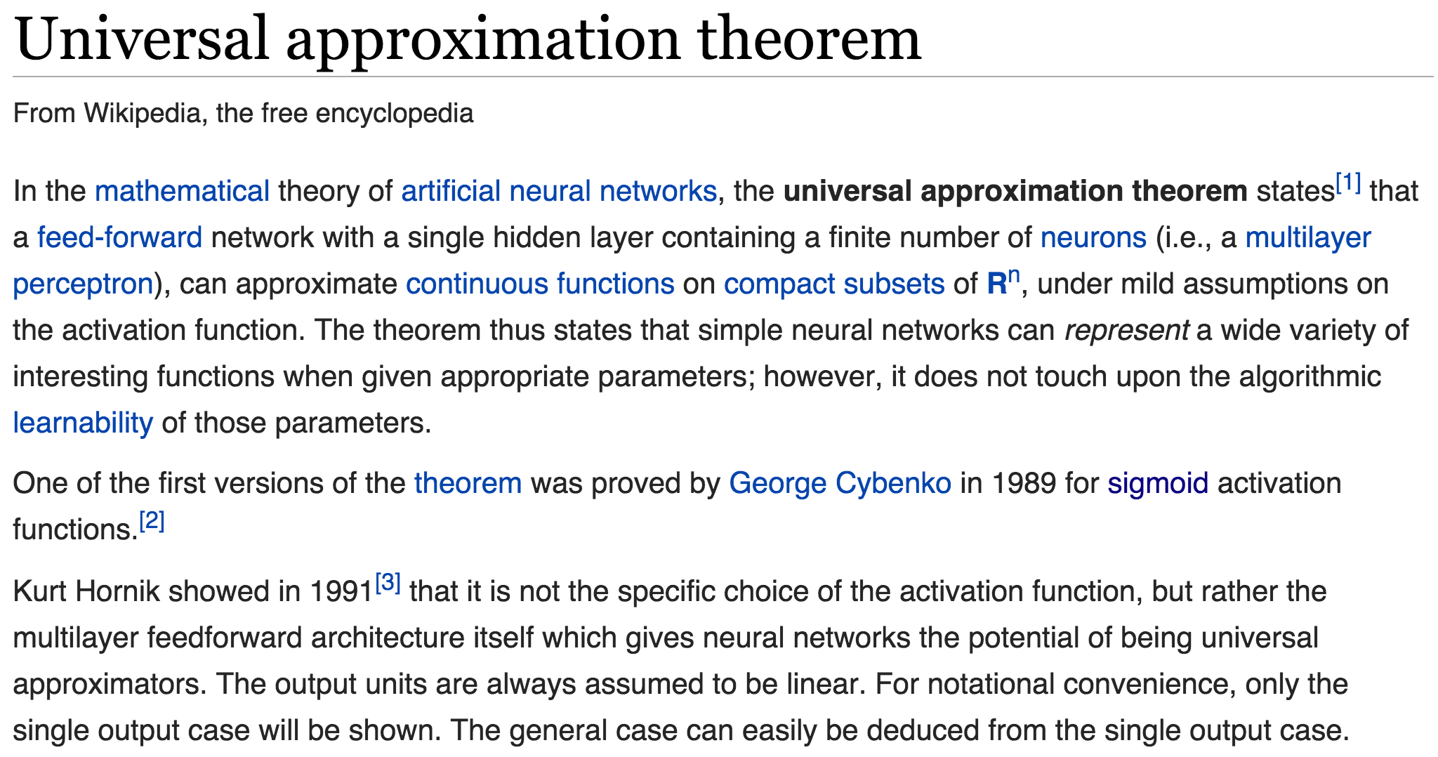

Slide 16
Understanding the score function
entry 2 of bias vector
row vector corresponding to row 2 of

Slide 17
Parameter sharing
parameters NOT shared between labels
parameters shared between labels

Slide 18
Observation
with linear models:
when using linear models for, say, sentiment classification, every feature included a label
no parameters were shared between labels
with neural networks
we now have parameters shared across labels!
we still have some parameters that are devoted to particular labels
to define x, we design features that only look at the input (not at the labels)

Slide 19
Defining input features
say we’re doing sentiment classification and we want to use a neural network
what should x be?
it has to be independent of the label
it has to be a fixed-length vector

Slide 20
Empirical Risk Minimization with Surrogate Loss Functions
given training data:
where each is a label
we want to solve the following:
many possible loss functions to consider optimizing

Slide 21
Loss Functions
name | loss | where used
cost (“0-1”) |  | intractable, but underlies “direct error minimization”
perceptron |  | perceptron algorithm (Rosenblatt, 1958)
hinge |  | support vector machines, other large-margin algorithms
log |  | logistic regression, conditional random fields, maximum entropy models

Slide 22
(Sub)gradients of Losses for Linear Models
name | entry j of (sub)gradient of loss for linear model
cost (“0-1”) | not subdifferentiable in general
perceptron
hinge
log

Slide 23
Learning with Neural Networks
we can use any of our loss functions from before, as long as we can compute (sub)gradients
algorithm for doing this efficiently: backpropagation
it’s basically just the chain rule of derivatives

Slide 24
Computation Graphs
a useful way to represent the computations performed by a neural model (or any model!)
why useful? makes it easy to implement automatic differentiation (backpropagation)
many neural net toolkits let you define your model in terms of computation graphs (Theano, Torch, TensorFlow, CNTK, CNN, PENNE, etc.)

Slide 25
Backpropagation
backpropagation has become associated with neural networks, but it’s much more general
I also use backpropagation to compute gradients in linear models for structured prediction

Slide 26
A simple computation graph:
represents expression “a + 3”

Slide 27
A slightly bigger computation graph:
represents expression “(a + 3)² + 4a²”

Slide 28
Operators can have more than 2 operands:
still represents expression “(a + 3)² + 4a²”

Slide 29
more concise:

Slide 30
Overfitting & Regularization
when we can fit any function, overfitting becomes a big concern
overfitting: learning a model that does well on the training set but doesn’t generalize to new data
there are many strategies to reduce overfitting (we’ll use the general term regularization for any such strategy)
you used early stopping in Assignment 1, which is one kind of regularization

Slide 31
Empirical Risk Minimization
given training data:
where each is a label
we want to solve the following:

Slide 32
Regularized Empirical Risk Minimization
given training data:
where each is a label
we want to solve the following:
regularization strength
regularization term

Slide 33
Regularization Terms
most common: penalize large parameter values
intuition: large parameters might be instances of overfitting
examples:
L₂ regularization:
(also called Tikhonov regularization
or ridge regression)
L₁ regularization:
(also called basis pursuit or LASSO)

Slide 34
Regularization Terms
L₂ regularization:
differentiable, widely-used
L₁ regularization:
not differentiable (but is subdifferentiable)
leads to sparse solutions (many parameters become zero!)

Slide 35
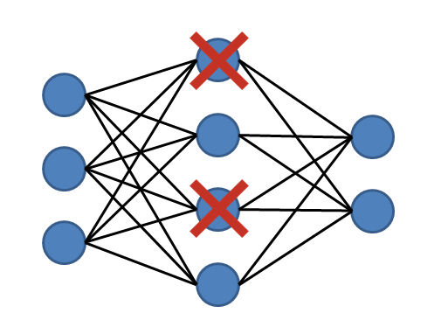
Dropout
popular regularization method for neural networks
randomly “drop out” (set to zero) some of the vector entries in the layers

Slide 36
Optimization Algorithms
you used stochastic gradient descent (SGD) in Assignment 1
but there are many other choices:
AdaGrad
AdaDelta
Adam
SGD with momentum
we don’t have time to go through these in class, but you should try using them! (most toolkits have implementations of these and others)

