Slide 1
TTIC 31190: Natural Language Processing
Kevin Gimpel
Winter 2016
Lecture 11:
Recurrent and Convolutional Neural Networks in NLP

Slide 2
Announcements
Assignment 3 assigned yesterday, due Feb. 29
project proposal due Tuesday, Feb. 16
midterm on Thursday, Feb. 18

Slide 3
Roadmap
classification
words
lexical semantics
language modeling
sequence labeling
neural network methods in NLP
syntax and syntactic parsing
semantic compositionality
semantic parsing
unsupervised learning
machine translation and other applications

Slide 4
2-transformation (1-layer) network
vector of label scores
we’ll call this a “2-transformation” neural network, or a “1-layer” neural network
input vector is
score vector is
one hidden vector (“hidden layer”)

Slide 5
1-layer neural network for sentiment classification

Slide 6
Use softmax function to convert scores into probabilities

Slide 7
Neural Networks for Twitter Part-of-Speech Tagging
other verb det noun pronoun
intj pronoun prep adj prep verb
ikr smh he asked fir yo last name so he can add u on fb lololol
verb prep intj
adj = adjective
prep = preposition
intj = interjection
pronoun proper
noun
in Assignment 3, you’ll build a neural network classifier to predict a word’s POS tag based on its context

Slide 8
Neural Networks for Twitter Part-of-Speech Tagging
other verb det noun pronoun
intj pronoun prep adj prep verb
ikr smh he asked fir yo last name so he can
e.g., predict tag of yo given context
what should the input x be?
it has to be independent of the label
it has to be a fixed-length vector

Slide 9
Neural Networks for Twitter Part-of-Speech Tagging
other verb det noun pronoun
intj pronoun prep adj prep verb
ikr smh he asked fir yo last name so he can
e.g., predict tag of yo given context
what should the input x be?
word vector for yo

Slide 10
Neural Networks for Twitter Part-of-Speech Tagging
other verb det noun pronoun
intj pronoun prep adj prep verb
ikr smh he asked fir yo last name so he can
e.g., predict tag of yo given context
what should the input x be?
word vector for fir
word vector for yo

Slide 11
Neural Networks for Twitter Part-of-Speech Tagging
other verb det noun pronoun
intj pronoun prep adj prep verb
ikr smh he asked fir yo last name so he can
when using word vectors as part of input, we can also treat them as more parameters to be learned!
this is called “updating” or “fine-tuning” the vectors (since they are initialized using something like word2vec)
word vector for fir
word vector for yo

Slide 12
Neural Networks for Twitter Part-of-Speech Tagging
other verb det noun pronoun
intj pronoun prep adj prep verb
ikr smh he asked fir yo last name so he can
let’s use the center word + two words to the right:
vector for yo
vector for last
vector for name
if name is to the right of yo, then yo is probably a form of your
but our x above uses separate dimensions for each position!
i.e., name is two words to the right
what if name is one word to the right?

Slide 13
Features and Filters
we could use a feature that returns 1 if name is to the right of the center word, but that does not use the word’s embedding
how do we include a feature like “a word similar to name appears somewhere to the right of the center word”?
rather than always specify relative position and embedding, we want to add filters that look for words like name anywhere in the window (or sentence!)

Slide 14
Filters
for now, think of a filter as a vector in the word vector space
the filter matches a particular region of the space
“match” = “has high dot product with”

Slide 15
Convolution
convolutional neural networks use a bunch of such filters
each filter is matched against (dot product computed with) each word in the entire context window or sentence
e.g., a single filter is a vector of same length as word vectors

Slide 16
Convolution
vector for yo
vector for last
vector for name

Slide 17
Convolution
vector for yo
vector for last
vector for name

Slide 18
Convolution
vector for yo
vector for last
vector for name

Slide 19
Convolution
= “feature map”, has an entry for each word position in context window / sentence
vector for yo
vector for last
vector for name

Slide 20
Pooling
= “feature map”, has an entry for each word position in context window / sentence
how do we convert this into a fixed-length vector?
use pooling:
max-pooling: returns maximum value in
average pooling: returns average of values in
vector for yo
vector for last
vector for name

Slide 21
Pooling
= “feature map”, has an entry for each word position in context window / sentence
how do we convert this into a fixed-length vector?
use pooling:
max-pooling: returns maximum value in
average pooling: returns average of values in
vector for yo
vector for last
vector for name
then, this single filter produces a single feature
value (the output of some kind of pooling).
in practice, we use many filters of many different
lengths (e.g., n-grams rather than words).

Slide 22
Convolutional Neural Networks
convolutional neural networks (convnets or CNNs) use filters that are “convolved with” (matched against all positions of) the input
informally, think of convolution as “perform the same operation everywhere on the input in some systematic order”
“convolutional layer” = set of filters that are convolved with the input vector (whether x or hidden vector)
could be followed by more convolutional layers, or by a type of pooling
often used in NLP to convert a sentence into a feature vector

Slide 23
Recurrent Neural Networks
Input is a sequence:
not too bad

Slide 24
Recurrent Neural Networks
Input is a sequence:
“hidden vector”

Slide 25
Recurrent Neural Networks
“hidden vector”

Slide 26
Disclaimer
these diagrams are often useful for helping us understand and communicate neural network architectures
but they rarely have any sort of formal semantics (unlike graphical models)
they are more like cartoons

Slide 27
Long Short-Term Memory RNNs (gateless)
“memory cell”

Slide 28
Long Short-Term Memory RNNs (gateless)

Slide 29
Long Short-Term Memory RNNs (gateless)

Slide 30
Long Short-Term Memory RNNs (gateless)
Experiment: text classification
Stanford Sentiment Treebank
binary classification (positive/negative)
25-dim word vectors
50-dim cell/hidden vectors
classification layer on final hidden vector
AdaGrad, 10 epochs, mini-batch size 10
early stopping on dev set
accuracy
80.6

Slide 31
Output Gates

Slide 32
Output Gates

Slide 33
Output Gates

Slide 34
Output Gates
this is pointwise multiplication!
is a vector

Slide 35
Output Gates
this is pointwise multiplication!
is a vector

Slide 36
Output Gates
logistic sigmoid, so output ranges from 0 to 1
diagonal matrix

Slide 37
Output Gates
 |  | acc.
gateless |  | 80.6
output gates |  | 81.9

Slide 38
Output Gates
 |  | acc.
gateless |  | 80.6
output gates |  | 81.9
What’s being learned?
(demo)

Slide 39
Input Gates

Slide 40
Input Gates
again, this is pointwise multiplication

Slide 41
Input Gates

Slide 42
Input Gates
diagonal matrix

Slide 43
Output Gates
Input Gates
difference

Slide 44
Input Gates
 |  | acc.
gateless |  | 80.6
output gates |  | 81.9
input gates |  | 84.4

Slide 45
Input and Output Gates
 |  | acc.
gateless |  | 80.6
output gates |  | 81.9
input gates |  | 84.4
input & output gates |  | 84.6

Slide 46
Forget Gates

Slide 47
Forget Gates

Slide 48
Forget Gates

Slide 49
Forget Gates
 |  | acc.
gateless |  | 80.6
output gates |  | 81.9
input gates |  | 84.4
forget gates |  | 82.1

Slide 50
All Gates

Slide 51
All Gates
 |  | acc.
gateless |  | 80.6
output gates |  | 81.9
input gates |  | 84.4
input & output gates |  | 84.6
forget gates |  | 82.1
input & forget gates |  | 84.1
forget & output gates |  | 82.6
input, forget, output gates |  | 85.3

Slide 52
Backward & Bidirectional LSTMs
bidirectional:
if shallow, just use forward and backward LSTMs in parallel, concatenate
final two hidden vectors, feed to softmax

Slide 53
Backward & Bidirectional LSTMs
bidirectional:
if shallow, just use forward and backward LSTMs in parallel, concatenate
final two hidden vectors, feed to softmax
 |  | forward | backward
gateless |  | 80.6 | 80.3
output gates |  | 81.9 | 83.7
input gates |  | 84.4 | 82.9
forget gates |  | 82.1 | 83.4
input, forget, output gates |  | 85.3 | 85.9

Slide 54
Backward & Bidirectional LSTMs
bidirectional:
if shallow, just use forward and backward LSTMs in parallel, concatenate
final two hidden vectors, feed to softmax
 |  | forward | backward | bidirectional
gateless |  | 80.6 | 80.3 | 81.5
output gates |  | 81.9 | 83.7 | 82.6
input gates |  | 84.4 | 82.9 | 83.9
forget gates |  | 82.1 | 83.4 | 83.1
input, forget, output gates |  | 85.3 | 85.9 | 85.1

Slide 55
LSTM

Slide 56
Deep LSTM (2-layer)
layer 1
layer 2

Slide 57
Deep LSTM (2-layer)
 |  | acc.
gateless | shallow (50) | 80.6
 | deep (30, 30) | 80.8
input, forget, output | shallow (50) | 85.3
 | deep (30, 30) | ~85
layer 1
layer 2

Slide 58
Deep Bidirectional LSTMs
concatenate hidden vectors of forward & backward LSTMs, connect each entry to forward and backward hidden vectors in next layer

Slide 59
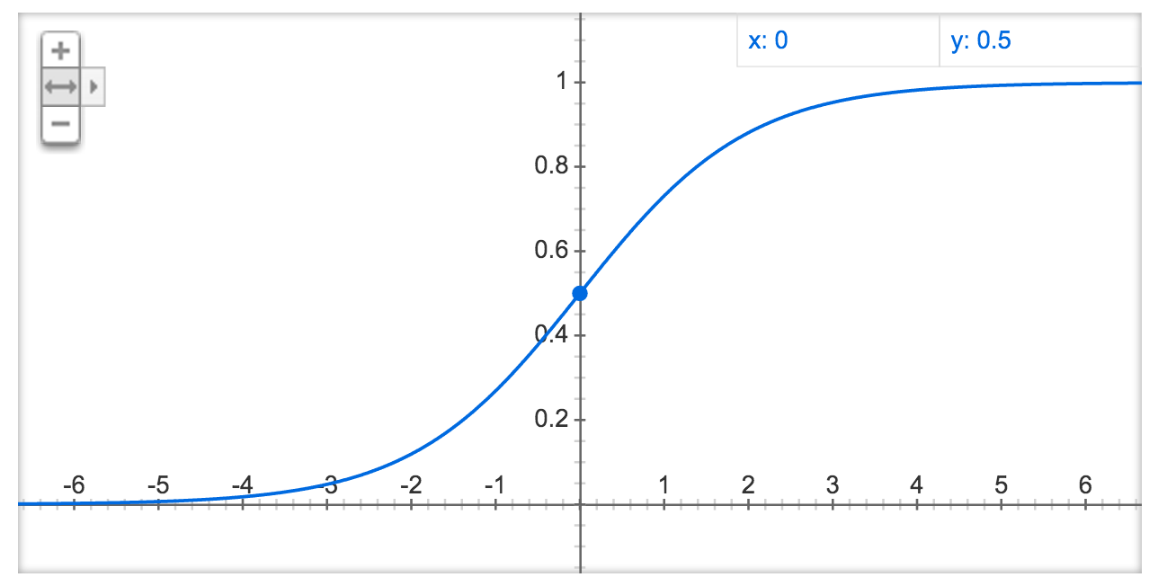
(logistic) sigmoid:

