Slide 1
TTIC 31190: Natural Language Processing
Kevin Gimpel
Winter 2016
Lecture 12:
Syntax and Parsing

Slide 2
Announcement
project proposal due Tuesday

Slide 3
Announcement
midterm is one week from today, room #530
it’ll be closed-book
if you want, you can bring an 8.5x11 sheet, but I don’t think you’ll need to
on Tuesday we will review all the course material and go through some example questions

Slide 4
Office Hours Next Week
unfortunately, my office hour on Monday must be canceled (EAC visit)
I will instead have it on Tuesday 9:30-10:30 am (right before class)
feel free to email me and make an appointment if that time does not work for you

Slide 5
Roadmap
classification
words
lexical semantics
language modeling
sequence labeling
neural network methods in NLP
syntax and syntactic parsing
semantic compositionality
semantic parsing
unsupervised learning
machine translation and other applications

Slide 6
What is Syntax?
rules, principles, processes that govern sentence structure of a language
can differ widely among languages
but every language has systematic structural principles

Slide 7
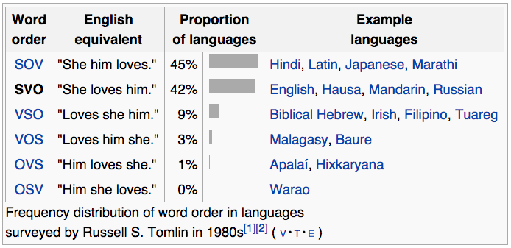
Subject, Verb, Object
syntax determines the ordering of these three objects in a sentence

Slide 8

Yodish
often (though certainly not always) Yoda uses object-subject-verb order
“Powerful you have become. The dark side I sense in you.”

Slide 9
Grammars
we will use grammar to denote a formal object that represents the rules/principles/processes that determine sentence structure

Slide 10
phrase structure / constituent grammar
focuses on the constituent relation
informally: “sentences have hierarchical structure”
a sentence is made up of two pieces:
subject, typically a noun phrase (NP)
predicate, typically a verb phrase (VP)
NPs and VPs are in turn made of up of pieces:
old books = (old + books)
the old books = (the + (old + books))
walked to the park = (walked + (to + (the + park)))
each parenthesized phrase is a constituent in the constituent parse

Slide 11
Bracketing
constituent parse = bracketing (that represents the hierarchical structure)
e.g., sentence:
the man walked to the park
bracketing:
((the man) (walked (to (the park))))

Slide 12
Bracketing → Tree
((the man) (walked (to (the park))))
we often draw the bracketing as a tree:
the man walked to the park

Slide 13
Labeled Bracketings/Trees
(S (NP the man) (VP walked (PP to (NP the park))))
S
VP
Key:
S = sentence
NP = noun phrase
VP = verb phrase
PP = prepositional phrase
NP
PP
NP
the man walked to the park

Slide 14
Labeled Bracketings/Trees
(S (NP the man) (VP walked (PP to (NP the park))))
S
VP
Key:
S = sentence
NP = noun phrase
VP = verb phrase
PP = prepositional phrase
DT = determiner
NN = noun
VBD = verb (past tense)
IN = preposition
NP
PP
NP
DT
NN
VBD IN DT NN
the man walked to the park

Slide 15
Labeled Bracketings/Trees
(S (NP the man) (VP walked (PP to (NP the park))))
S
VP
NP
nonterminals
PP
NP
preterminals
DT
NN
VBD IN DT NN
the man walked to the park
terminals

Slide 16
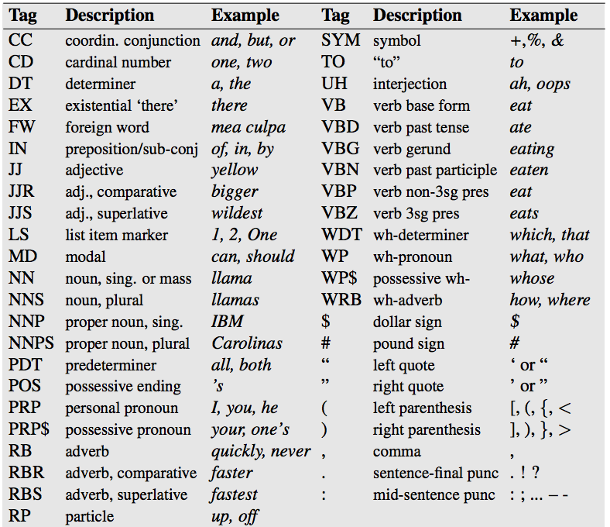
Penn Treebank tag set

Slide 17
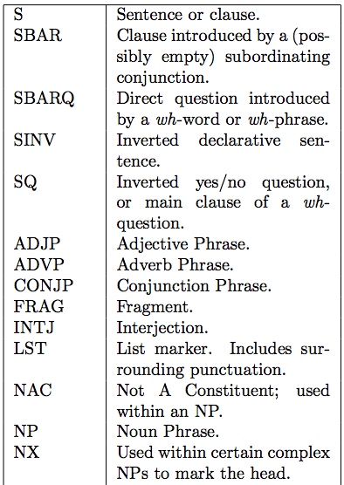
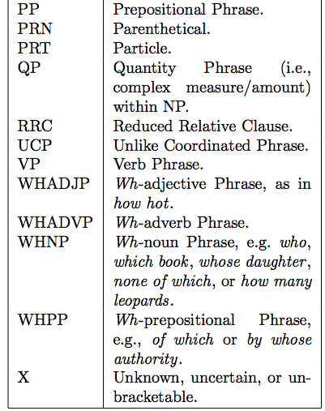
Penn Treebank Nonterminals

Slide 18
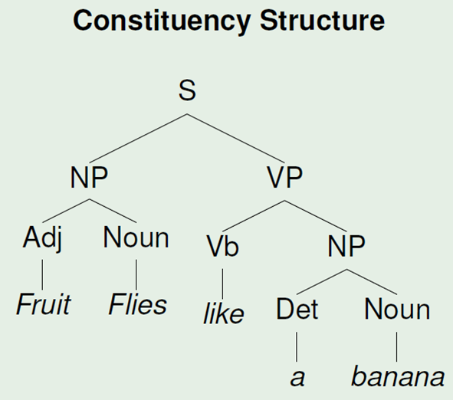
Syntactic Ambiguities
Time flies like an arrow.
Fruit flies like a banana.

Slide 19
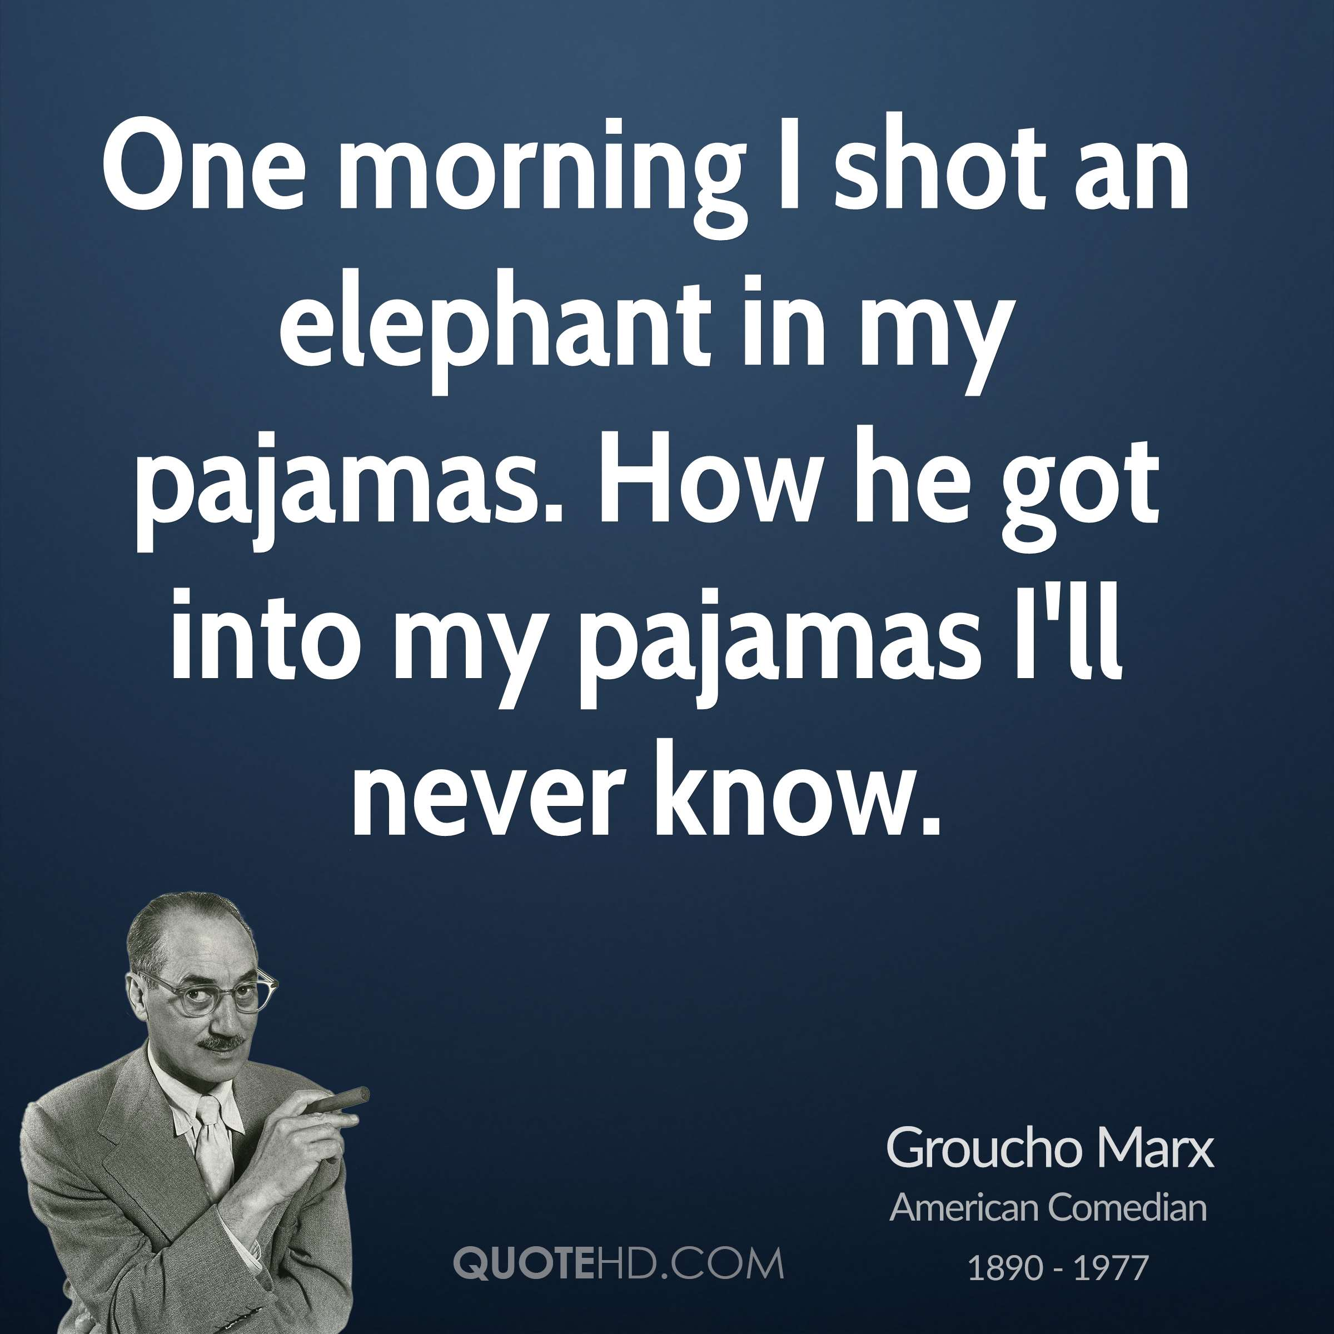
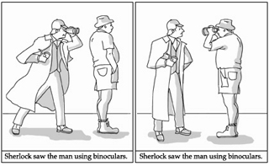
Attachment Ambiguity

Slide 20
Syntactic Ambiguities
PP attachment ambiguity
coordination ambiguity
noun compound ambiguity

Slide 21
Attachment Ambiguity

Slide 22
coordination ambiguities
often found when modifiers are used with conjunctions:
keyboard and monitor with the Apple logo
old men and women

Slide 23
coordination ambiguities
often found when modifiers are used with conjunctions:
(keyboard and monitor) with the Apple logo
keyboard and (monitor with the Apple logo)
old (men and women)
(old men) and women

Slide 24
other attachment ambiguities
Infant pulled from car involved in short police pursuit
Somali tied to militants held on U.S. ship for months

Slide 25
other attachment ambiguities
(Infant pulled from car) involved in short police pursuit
Infant pulled from (car involved in short police pursuit)
(Somali tied to militants) held on U.S. ship for months
Somali tied to (militants held on U.S. ship for months)

Slide 26
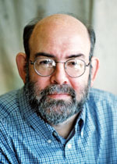
NLP Task: Constituent Parsing
given a sentence, output its constituent parse
widely-studied task with a rich history
most based on the Penn Treebank (Marcus et al.), developed at Penn in early 1990s
Treebank = “corpus of annotated parse trees”

Slide 27
Context-Free Grammar (CFG)
has “rewrite rules” to rewrite nonterminals as terminals or other nonterminals
S → NP VP
“S goes to NP VP”
NP → DT NN
VP → VBD PP
PP → IN NP
NN → man
DT → the

Slide 28
Context-Free Grammar (CFG)
sequence of rewrites corresponds to a bracketing (induces a hierarchical tree structure)
S
S → NP VP
VP
VP → VBD PP
NP
PP
NP → DT NN
NP
DT
NN
VBD IN DT NN
DT → the
the man walked to the park

Slide 29
Why “context-free”?
a rule to rewrite NP does not depend on the context of NP
that is, the left-hand side of a rule is only a single non-terminal (without any other context)

Slide 30
Probabilistic Context-Free Grammar (PCFG)
assign probabilities to rewrite rules:
NP → DT NN 0.5
NP → NNS 0.3
NP → NP PP 0.2
same nonterminal can be on both left and right sides

Slide 31
Probabilistic Context-Free Grammar (PCFG)
assign probabilities to rewrite rules:
NP → DT NN 0.5
NP → NNS 0.3
NP → NP PP 0.2
probabilities must sum to one for each left-hand side nonterminal

Slide 32
Probabilistic Context-Free Grammar (PCFG)
assign probabilities to rewrite rules:
NP → DT NN 0.5
NP → NNS 0.3
NP → NP PP 0.2
NN → man 0.01
NN → park 0.0004
NN → walk 0.002
NN → ….
given a treebank, we can estimate these probabilities using maximum likelihood estimation (“relative frequency estimates”; “count and normalize”),
just like we did with n-gram language models and HMMs for POS tagging

Slide 33
Probabilistic Context-Free Grammar (PCFG)
for each nonterminal, a PCFG has a probability distribution over possible right-hand side sequences
so, a PCFG assigns probabilities to:
bracketings of sentences
sequences of rewrite operations (derivations) that eventually terminate in terminals
hierarchical tree structures that ground out in sequences of terminals
these are different ways of saying the same thing

Slide 34
Constituent Parsing
evaluation: evalb score
first compute precision and recall (at the level of constituents)
then compute F1 (harmonic mean of precision and recall)

Slide 35
How well does a PCFG work?
a PCFG learned from the Penn Treebank with maximum likelihood estimation (count & normalize) gets about 73% F1 score
state-of-the-art parsers are around 92%

Slide 36
How well does a PCFG work?
a PCFG learned from the Penn Treebank with maximum likelihood estimation (count & normalize) gets about 73% F1 score
state-of-the-art parsers are around 92%
but, simple modifications can improve the PCFG a lot!
smoothing
tree transformations (selective flattening)
“parent annotation”

Slide 37
Parent Annotation
VP → V NP PP
VP^{S} → V NP^{VP} PP^{VP}
adds more information, but also fragments counts, making parameter estimates noisier (since we’re just using MLE)

Slide 38
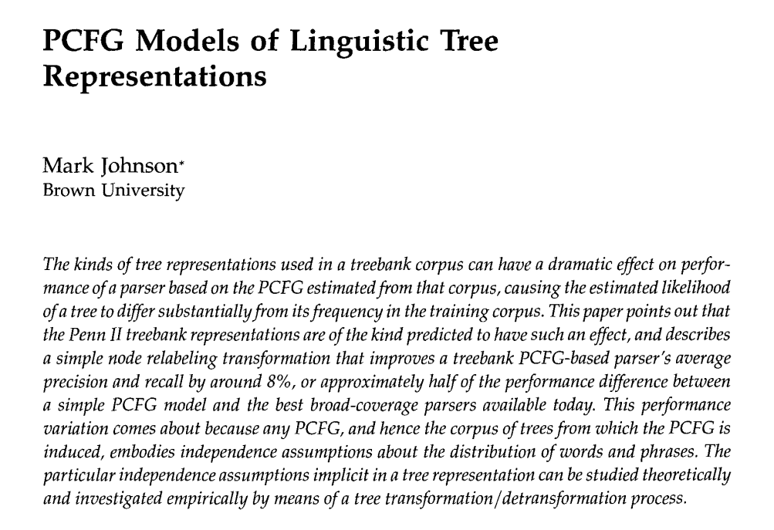
Johnson (1998)

Slide 39
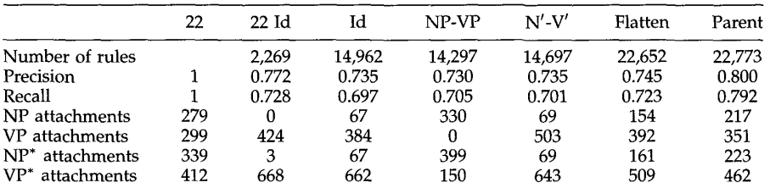
Johnson (1998)

Slide 40
Classification Framework for Constituent Parsing
inference: solve _
modeling: define score function
learning: choose _
x = a sentence
y = a constituent parse
inference requires searching all possible constituent parses!
this is very expensive due to large training sets

Slide 41
How are constituent parses used?
language modeling
predict the next word better by using syntactic structure
machine translation
there are many syntactic translation models that require parsers for one or both languages
text classification
for certain kinds of classification, features on syntactic fragments can help
question answering, coreference resolution, etc.

Slide 42
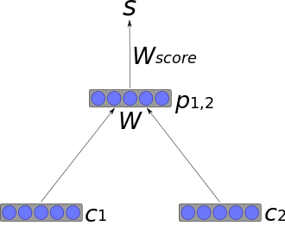
Recursive Neural Networks for NLP
first, run a constituent parser on the sentence
convert the constituent tree to a binary tree (each rewrite has exactly two children)
construct vector for sentence recursively at each rewrite (“split point”):

Slide 43
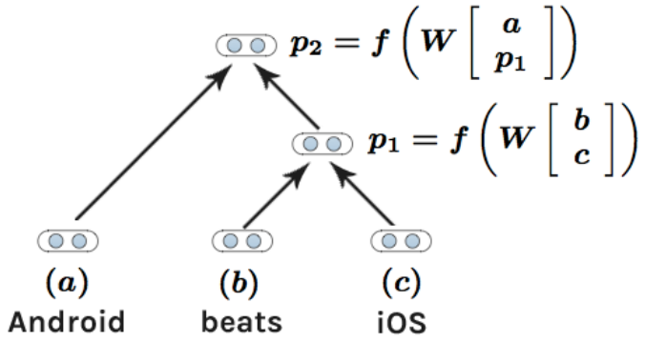
Recursive Neural Networks for NLP

Slide 44
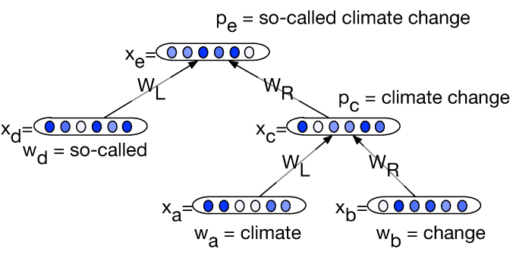
Recursive Neural Networks for NLP

