Slide 1
TTIC 31190: Natural Language Processing
Kevin Gimpel
Winter 2016
Lecture 13:
Dependency Syntax/Parsing
& Review for Midterm

Slide 2
Announcement
project proposal due today
email me to set up a 15-minute meeting next week to discuss your project proposal
times posted on course webpage
let me know if none of those work for you

Slide 3
Announcement
midterm is Thursday, room #530
closed-book, but you can bring an 8.5x11 sheet (though I don’t think you’ll need to)
we will start at 10:35 am, finish at 11:50 am

Slide 4
Roadmap
classification
words
lexical semantics
language modeling
sequence labeling
neural network methods in NLP
syntax and syntactic parsing
semantic compositionality
semantic parsing
unsupervised learning
machine translation and other applications

Slide 5
What is Syntax?
rules, principles, processes that govern sentence structure of a language
can differ widely among languages
but every language has systematic structural principles

Slide 6
Constituent Parse (Bracketing/Tree)
(S (NP the man) (VP walked (PP to (NP the park))))
S
VP
Key:
S = sentence
NP = noun phrase
VP = verb phrase
PP = prepositional phrase
DT = determiner
NN = noun
VBD = verb (past tense)
IN = preposition
NP
PP
NP
DT
NN
VBD IN DT NN
the man walked to the park

Slide 7
Constituent Parse (Bracketing/Tree)
(S (NP the man) (VP walked (PP to (NP the park))))
S
VP
NP
nonterminals
PP
NP
preterminals
DT
NN
VBD IN DT NN
the man walked to the park
terminals

Slide 8
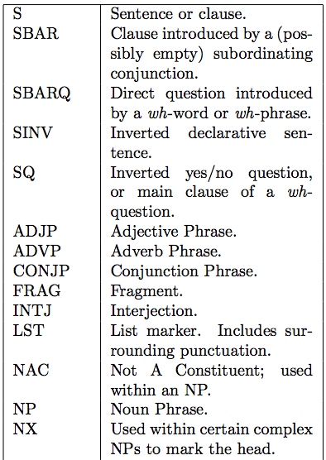
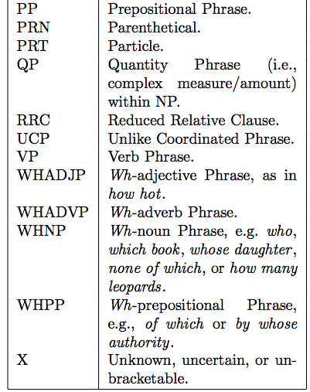
Penn Treebank Nonterminals

Slide 9
Probabilistic Context-Free Grammar (PCFG)
assign probabilities to rewrite rules:
NP → DT NN 0.5
NP → NNS 0.3
NP → NP PP 0.2
NN → man 0.01
NN → park 0.0004
NN → walk 0.002
NN → ….
given a treebank, estimate these probabilities using MLE (“count and normalize”)

Slide 10
How well does a PCFG work?
PCFG learned from the Penn Treebank with MLE gets about 73% F1 score
state-of-the-art parsers are around 92%
simple modifications can improve PCFGs:
smoothing
tree transformations (selective flattening)
parent annotation

Slide 11
Parent Annotation
VP → V NP PP
VP^{S} → V NP^{VP} PP^{VP}
adds more information, but also fragments counts, making parameter estimates noisier (since we’re just using MLE)

Slide 12
How well does a PCFG work?
PCFG learned from the Penn Treebank with MLE gets about 73% F1 score
state-of-the-art parsers are around 92%
simple modifications can improve PCFGs:
smoothing
tree transformations (selective flattening)
parent annotation
lexicalization

Slide 13
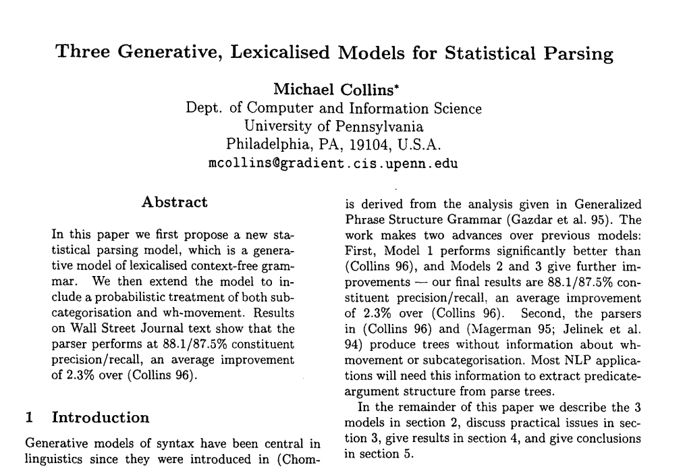
Collins (1997)

Slide 14
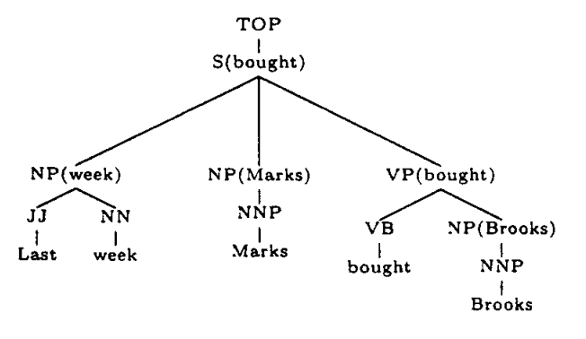
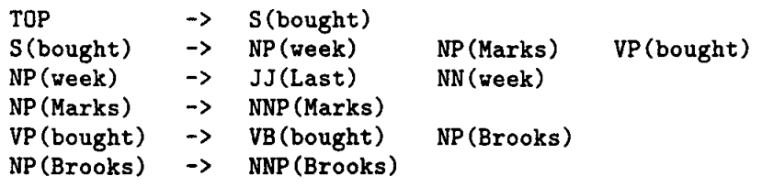
Lexicalized PCFGs
nonterminals are decorated with
the head word of the subtree

Slide 15
Lexicalization
this adds a lot more rules!
many more parameters to estimate → smoothing becomes much more important
e.g., right-hand side of rule might be factored into several steps
but it’s worth it because head words are really useful for constituent parsing

Slide 16
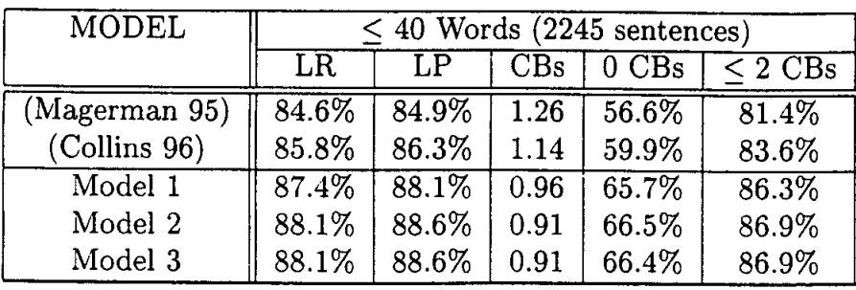
Results (Collins, 1997)

Slide 17
Head Rules
how are heads decided?
most researchers use deterministic head rules (Magerman/Collins)
for a PCFG rule A → B₁ … B_{N}, these head rules say which of B₁ … B_{N} is the head of the rule
examples:
S → NP VP
VP → VBD NP PP
NP → DT JJ NN

Slide 18
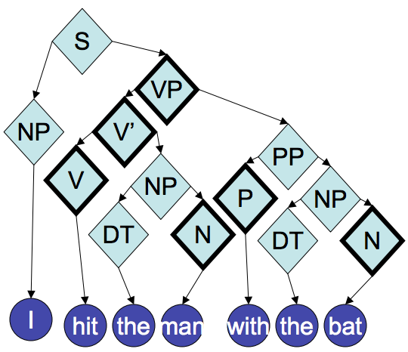
Head Annotation
from Noah Smith

Slide 19
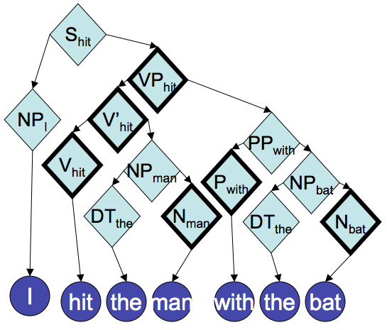
Lexical Head Annotation
from Noah Smith

Slide 20
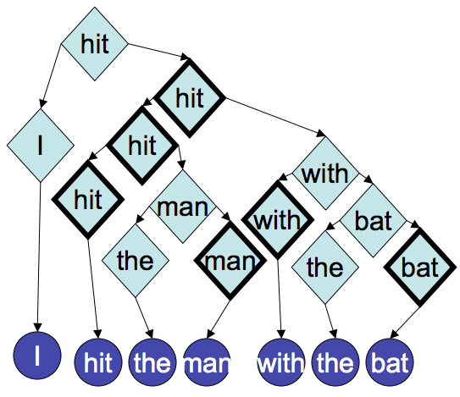
Lexical Head Annotation → Dependencies
remove nonlexical parts:
from Noah Smith

Slide 21
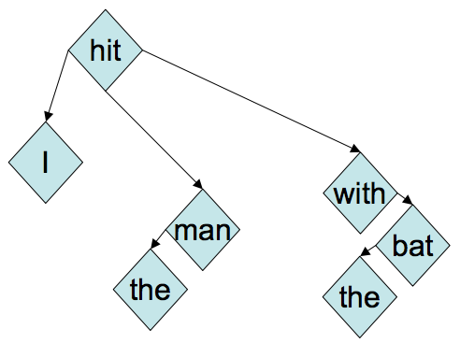
Dependencies
merge redundant nodes:
from Noah Smith

Slide 22
constituent parse:
dependency parse:

Slide 23
constituent parse:
labeled dependency parse:
nsubj
prep
dobj
pobj
det
det
nsubj = “nominal subject”
dobj = “direct object”
prep = “preposition modifier”
pobj = “object of preposition”
det = “determiner”

Slide 24
captures some semantic relationships
constituent parse:
labeled dependency parse:
nsubj
prep
dobj
pobj
det
det
nsubj = “nominal subject”
dobj = “direct object”
prep = “preposition modifier”
pobj = “object of preposition”
det = “determiner”

Slide 25
how (unlabeled) dependency trees are typically drawn:
root of tree is represented by $ (“wall symbol”)
arrows drawn entirely above (or below) sentence
arrows are directed from child to parent (or from parent to child); you will see both in practice—don’t get confused!
“wall” symbol

Slide 26
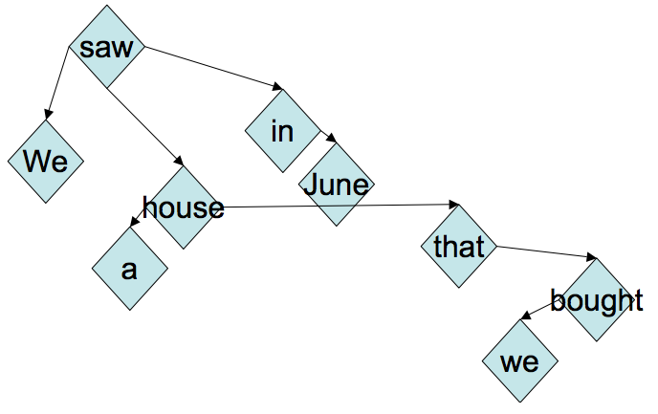
Crossing Dependencies
if dependencies cross (“nonprojective”), no longer corresponds to a PCFG
from Noah Smith

Slide 27
Projective vs. Nonprojective Dependency Parsing
English dependency treebanks are mostly projective
but when focusing more on semantic relationships, often becomes more nonprojective
some (relatively) free word order languages, like Czech, are fairly nonprojective
nonprojective parsing can be formulated as a minimum spanning tree problem
projective parsing cannot

Slide 28
Dependency Parsing
several widely-used algorithms
different guarantees but similar performance in practice
graph-based:
dynamic programming (Eisner, 1997)
minimum spanning tree (McDonald et al., 2005)
transition-based:
shift-reduce (Nivre, inter alia)

Slide 29
Dependency Parsers
Stanford parser
TurboParser
Joakim Nivre’s MALT parser
Ryan McDonald’s MST parser
and many others for many non-English languages

Slide 30
Complexity Comparison
constituent parsing: O(Gn³)
parsing complexity depends on grammar structure (“grammar constant” G)
since it has lots of nonterminal-only rules at the top of the tree, there are many rule probabilities to estimate
dependency parsing: O(n³)
operates directly on words, so parsing complexity has no grammar constant
features designed on possible dependencies (pairs of words) and larger structures
transition-based parsing algorithms are O(n), though not optimal; also, non-projective parsing is faster

Slide 31
Applications of Dependency Parsing
widely used for NLP tasks because:
faster than constituent parsing
captures more semantic information
text classification (features on dependencies)
syntax-based machine translation
relation extraction
e.g., extract relation between Sam Smith and AITech:
Sam Smith was named new CEO of AITech.
use dependency path between Sam Smith and AITech:
Smith → named, named ← CEO, CEO ← of, of ← AITech

Slide 32
Summary: two types of grammars
phrase structure / constituent grammars
inspired mostly by Chomsky and others
only appropriate for certain languages (e.g., English)
dependency grammars
closer to a semantic representation; some have made this more explicit
problematic for certain syntactic structures (e.g., conjunctions, nesting of noun phrases, etc.)
both are widely used in NLP
you can find constituent parsers and dependency parsers for several languages online

Slide 33
Review

Slide 34
Modeling, Inference, Learning
modeling: define score function
Modeling: How do we assign a score to an (x,y) pair using parameters ?

Slide 35
Modeling, Inference, Learning
inference: solve _
modeling: define score function
Inference: How do we efficiently search over the space of all labels?

Slide 36
Modeling, Inference, Learning
inference: solve _
modeling: define score function
learning: choose _
Learning: How do we choose ?

Slide 37
Applications

Slide 38
Applications of our Classification Framework
text classification:
= {objective, subjective}
x | y
the hulk is an anger fueled monster with incredible strength and resistance to damage . | objective
in trying to be daring and original , it comes off as only occasionally satirical and never fresh . | subjective

Slide 39
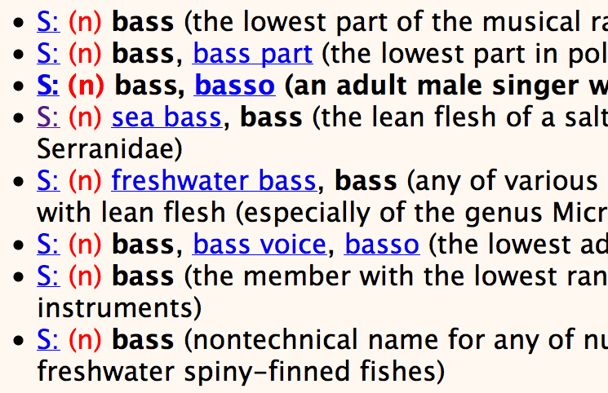
Applications of our Classification Framework
word sense classifier for bass:
= {bass₁, bass₂, …, bass₈}
x | y
he’s a bass in the choir . | bass₃
our bass is line-caught from the Atlantic . | bass₄

Slide 40
Applications of our Classification Framework
skip-gram model as a classifier:
= V (the entire vocabulary)
x | y
agriculture | <s>
agriculture | is
agriculture | the
corpus (English Wikipedia):
agriculture is the traditional mainstay of the cambodian economy .
but benares has been destroyed by an earthquake .
…

Slide 41
Simplest kind of structured prediction: Sequence Labeling
Part-of-Speech Tagging
determiner verb (past) prep. proper proper poss. adj. noun
modal verb det. adjective noun prep. proper punc.
determiner verb (past) prep. noun noun poss. adj. noun
Some questioned if Tim Cook ’s first product
modal verb det. adjective noun prep. noun punc.
would be a breakaway hit for Apple .
Notes:
sentence -> NER labeling
sentence -> translation
Neue Umfrage: Kaufen Sie eine Apple Watch?
sentence -> parse tree
set of documents -> summary

Slide 42
Formulating segmentation tasks as sequence labeling via B-I-O labeling:
Named Entity Recognition
O O O B-PERSON I-PERSON O O O
Some questioned if Tim Cook ’s first product
O O O O O O B-ORGANIZATION O
would be a breakaway hit for Apple .
B = “begin”
I = “inside”
O = “outside”
Notes:
sentence -> NER labeling
sentence -> translation
Neue Umfrage: Kaufen Sie eine Apple Watch?
sentence -> parse tree
set of documents -> summary

Slide 43
Applications of our Classifier Framework so far
task | input (x) | output (y) | output space ( ) | size of
text classification | a sentence | gold standard label for x | pre-defined, small label set (e.g., {positive, negative}) | 2-10
word sense disambiguation | instance of a particular word (e.g., bass) with its context | gold standard word sense of x | pre-defined sense inventory from WordNet for bass | 2-30
learning skip-gram word embeddings | instance of a word in a corpus | a word in the context of x in a corpus | vocabulary | |V|
part-of-speech tagging | a sentence | gold standard part-of-speech tags for x | all possible part-of-speech tag sequences with same length as x | |P|^{|x|}

Slide 44
Applications of Classifier Framework (continued)
task | input (x) | output (y) | output space ( ) | size of
named entity recognition | a sentence | gold standard named entity labels for x (BIO tags) | all possible BIO label sequences with same length as x | |P|^{|x|}
constituent parsing | a sentence | gold standard constituent parse (labeled bracketing) of x | all possible labeled bracketings of x | exponential in length of x (Catalan number)
dependency parsing | a sentence | gold standard dependency parse (labeled directed spanning tree) of x | all possible labeled directed spanning trees of x | exponential in length of x

Slide 45
each application draws from particular linguistic concepts and must address different kinds of linguistic ambiguity/variability:
word sense: sense granularity, relationships among senses, word sense ambiguity
word vectors: distributional properties, sense ambiguity, different kinds of similarity
part-of-speech: tag granularity, tag ambiguity
parsing: constituent/dependency relationships, attachment & coordination ambiguities

Slide 46
Modeling

Slide 47
model families
linear models
lots of freedom in defining features, though feature engineering required for best performance
learning uses optimization of a loss function
one can (try to) interpret learned feature weights
stochastic/generative models
linear models with simple “features” (counts of events)
learning is easy: count & normalize (but smoothing needed)
easy to generate samples
neural networks
can usually get away with less feature engineering
learning uses optimization of a loss function
hard to interpret (though we try!), but often works best

Slide 48
special case of linear models: stochastic/generative models
model | tasks | context expansion
n-gram language models | language modeling (for MT, ASR, etc.) | increase n
hidden Markov models | part-of-speech tagging, named entity recognition, word clustering | increase order of HMM (e.g., bigram HMM → trigram HMM)
probabilistic context-free grammars | constituent parsing | increase size of rules, e.g., flattening, parent annotation, etc.
all use MLE + smoothing (though probably different kinds of smoothing)
all assign probability to sentences (some assign probability jointly to pairs of <sentence, something else>)
all have the same trade-off of increasing “context” (feature size) and needing more data / better smoothing

Slide 49
Feature Engineering for Text Classification
Two features:
where
What should the weights be?

Slide 50
Higher-Order Binary Feature Templates
unigram binary template:
bigram binary template:
trigram binary features
…

Slide 51
Unigram Count Features
a ``count’’ feature returns the count of a particular word in the text
unigram count feature template:

Slide 52
Feature Count Cutoffs
problem: some features are extremely rare
solution: only keep features that appear at least k times in the training data

Slide 53
2-transformation (1-layer) network
vector of label scores
we’ll call this a “2-transformation” neural network, or a “1-layer” neural network
input vector is
score vector is
one hidden vector (“hidden layer”)

Slide 54
1-layer neural network for sentiment classification

Slide 55
Neural Networks for Twitter Part-of-Speech Tagging
other verb det noun pronoun
intj pronoun prep adj prep verb
ikr smh he asked fir yo last name so he can
let’s use the center word + two words to the right:
vector for yo
vector for last
vector for name
if name is to the right of yo, then yo is probably a form of your
but our x above uses separate dimensions for each position!
i.e., name is two words to the right
what if name is one word to the right?

Slide 56
Convolution
= “feature map”, has an entry for each word position in context window / sentence
vector for yo
vector for last
vector for name

Slide 57
Pooling
= “feature map”, has an entry for each word position in context window / sentence
how do we convert this into a fixed-length vector?
use pooling:
max-pooling: returns maximum value in
average pooling: returns average of values in
vector for yo
vector for last
vector for name

Slide 58
Pooling
= “feature map”, has an entry for each word position in context window / sentence
how do we convert this into a fixed-length vector?
use pooling:
max-pooling: returns maximum value in
average pooling: returns average of values in
vector for yo
vector for last
vector for name
then, this single filter produces a single feature
value (the output of some kind of pooling).
in practice, we use many filters of many different
lengths (e.g., n-grams rather than words).

Slide 59
Convolutional Neural Networks
convolutional neural networks (convnets or CNNs) use filters that are “convolved with” (matched against all positions of) the input
think of convolution as “perform the same operation everywhere on the input in some systematic order”
“convolutional layer” = set of filters that are convolved with the input vector (whether x or hidden vector)
could be followed by more convolutional layers, or by a type of pooling
often used in NLP to convert a sentence into a feature vector

Slide 60
Recurrent Neural Networks
“hidden vector”

Slide 61
Long Short-Term Memory (LSTM) Recurrent Neural Networks

Slide 62
Backward & Bidirectional LSTMs
bidirectional:
if shallow, just use forward and backward LSTMs in parallel, concatenate
final two hidden vectors, feed to softmax

Slide 63
Deep LSTM (2-layer)
layer 1
layer 2

Slide 64
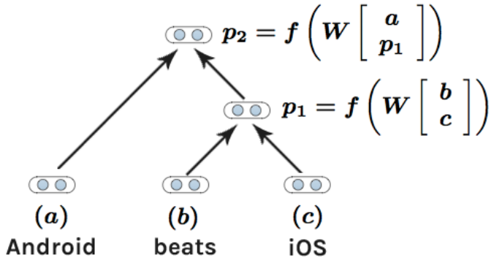
Recursive Neural Networks for NLP
first, run a constituent parser on the sentence
convert the constituent tree to a binary tree (each rewrite has exactly two children)
construct vector for sentence recursively at each rewrite (“split point”):

Slide 65
Learning

Slide 66
Cost Functions
cost function: scores output against a gold standard
should reflect the evaluation metric for your task
usual conventions:
for classification, what cost should we use?
for classification, what cost should we use?

Slide 67
Empirical Risk Minimization (Vapnik et al.)
replace expectation with sum over examples:

Slide 68
Empirical Risk Minimization (Vapnik et al.)
replace expectation with sum over examples:
problem: NP-hard even for binary classification with linear models

Slide 69
Empirical Risk Minimization with Surrogate Loss Functions
given training data:
where each is a label
we want to solve the following:
many possible loss functions to consider optimizing

Slide 70
Loss Functions
name | loss | where used
cost (“0-1”) |  | intractable, but underlies “direct error minimization”
perceptron |  | perceptron algorithm (Rosenblatt, 1958)
hinge |  | support vector machines, other large-margin algorithms
log |  | logistic regression, conditional random fields, maximum entropy models

Slide 71
(Sub)gradients of Losses for Linear Models
name | entry j of (sub)gradient of loss for linear model
cost (“0-1”) | not subdifferentiable in general
perceptron
hinge
log

Slide 72
(Sub)gradients of Losses for Linear Models
name | entry j of (sub)gradient of loss for linear model
cost (“0-1”) | not subdifferentiable in general
perceptron
hinge
log
expectation of feature value with respect to distribution over y (where distribution is defined by theta)
alternative notation:

Slide 73
Visualization
score
five possible outputs

Slide 74
Visualization
cost
five possible outputs

Slide 75

Visualization
cost
gold standard

Slide 76
Visualization
cost
gold standard

Slide 77
Visualization
score + cost
gold standard

Slide 78
perceptron loss:

Slide 79
perceptron loss:
score
gold standard

Slide 80
perceptron loss:
score
gold standard

Slide 81
perceptron loss:
score
effect of learning?
gold standard

Slide 82
perceptron loss:
score
effect of learning:
gold standard will have highest score
gold standard

Slide 83
hinge loss:

Slide 84
hinge loss:
score + cost
gold standard

Slide 85
hinge loss:
score + cost
gold standard

Slide 86
hinge loss:
effect of learning?
score + cost
gold standard

Slide 87
hinge loss:
effect of learning:
score of gold standard will be higher than score+cost of all others
score + cost
gold standard

Slide 88
Regularized Empirical Risk Minimization
given training data:
where each is a label
we want to solve the following:
regularization strength
regularization term

Slide 89
Regularization Terms
most common: penalize large parameter values
intuition: large parameters might be instances of overfitting
examples:
L₂ regularization:
(also called Tikhonov regularization
or ridge regression)
L₁ regularization:
(also called basis pursuit or LASSO)

Slide 90
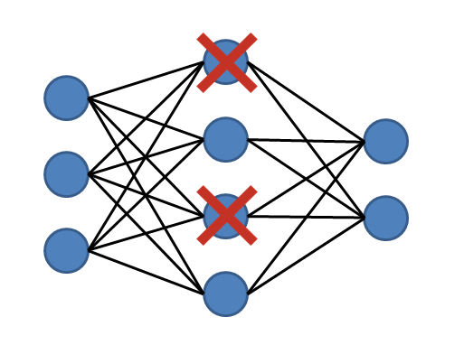
Dropout
popular regularization method for neural networks
randomly “drop out” (set to zero) some of the vector entries in the layers

Slide 91
Inference

Slide 92
Exponentially-Large Search Problems
inference: solve _
when output is a sequence or tree, this argmax requires iterating over an exponentially-large set

Slide 93
Learning requires solving exponentially-hard problems too!
loss | entry j of (sub)gradient of loss for linear model
perceptron
hinge
log
computing each of these terms requires iterating through every possible output

Slide 94
Dynamic Programming (DP)
what is dynamic programming?
a family of algorithms that break problems into smaller pieces and reuse solutions for those pieces
only applicable when the problem has certain properties (optimal substructure and overlapping sub-problems)
in this class, we use DP to iterate over exponentially-large output spaces in polynomial time
we focus on a particular type of DP algorithm: memoization

Slide 95
Implementing DP algorithms
even if your goal is to compute a sum or a max, focus first on counting mode (count the number of unique outputs for an input)
memoization = recursion + saving/reusing solutions
start by defining recursive equations
“memoize” by creating a table to store all intermediate results from recursive equations, use them when requested

Slide 96
Inference in HMMs
since the output is a sequence, this argmax requires iterating over an exponentially-large set
last week we talked about using dynamic programming (DP) to solve these problems
for HMMs (and other sequence models), the for solving this is called the Viterbi algorithm

Slide 97
Viterbi Algorithm
recursive equations + memoization:
base case:
returns probability of sequence starting with label y for first word
recursive case:
computes probability of max-probability label sequence that ends with label y at position m
final value is in:

Slide 98
Viterbi Algorithm
space and time complexity?
can be read off from the recursive equations:
space complexity:
size of memoization table, which is # of unique indices of recursive equations
length of sentence
number of labels
*
so, space complexity is O(|x| |L|)

Slide 99
Viterbi Algorithm
space and time complexity?
can be read off from the recursive equations:
time complexity:
size of memoization table * complexity of computing each entry
length of sentence
number of labels
each entry requires iterating through the labels
*
*
so, time complexity is O(|x| |L| |L|) = O(|x| |L|²)

Slide 100
Feature Locality
feature locality: how “big” are your features?
when designing efficient inference algorithms (whether w/ DP or other methods), we need to be mindful of this
features can be arbitrarily big in terms of the input, but not in terms of the output!
the features in HMMs are small in both the input and output sequences (only two pieces at a time)

