Slide 1
TTIC 31190: Natural Language Processing
Kevin Gimpel
Winter 2016
Lecture 15:
Introduction
to Machine Translation

Slide 2
Announcements
Assignment 3 due Monday
email me to sign up for your (10-minute) class presentation on 3/3 or 3/8

Slide 3
Roadmap
classification
words
lexical semantics
language modeling
sequence labeling
neural network methods in NLP
syntax and syntactic parsing
computational semantics
machine translation
other NLP applications

Slide 4


People rely on machine translation!

Slide 5

People rely on machine translation!

Slide 6
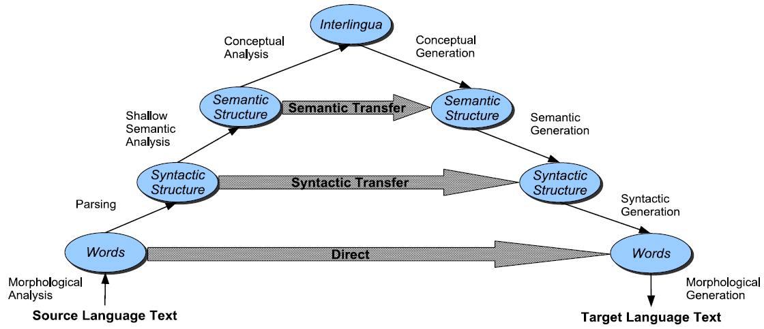
Approaches to Machine Translation: The Vauquois Triangle

Slide 7
Interlingua Example

Slide 8
Classification Framework for Machine Translation
inference: solve _
modeling: define score function
learning: choose _
modern systems are data-driven
first we need data!

Slide 9
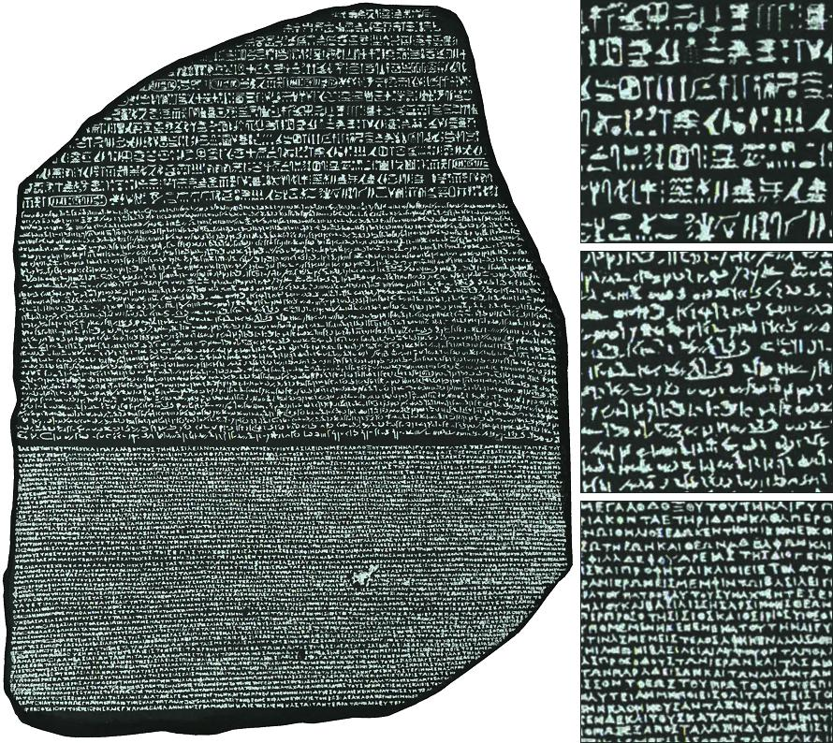
Data?

Slide 10
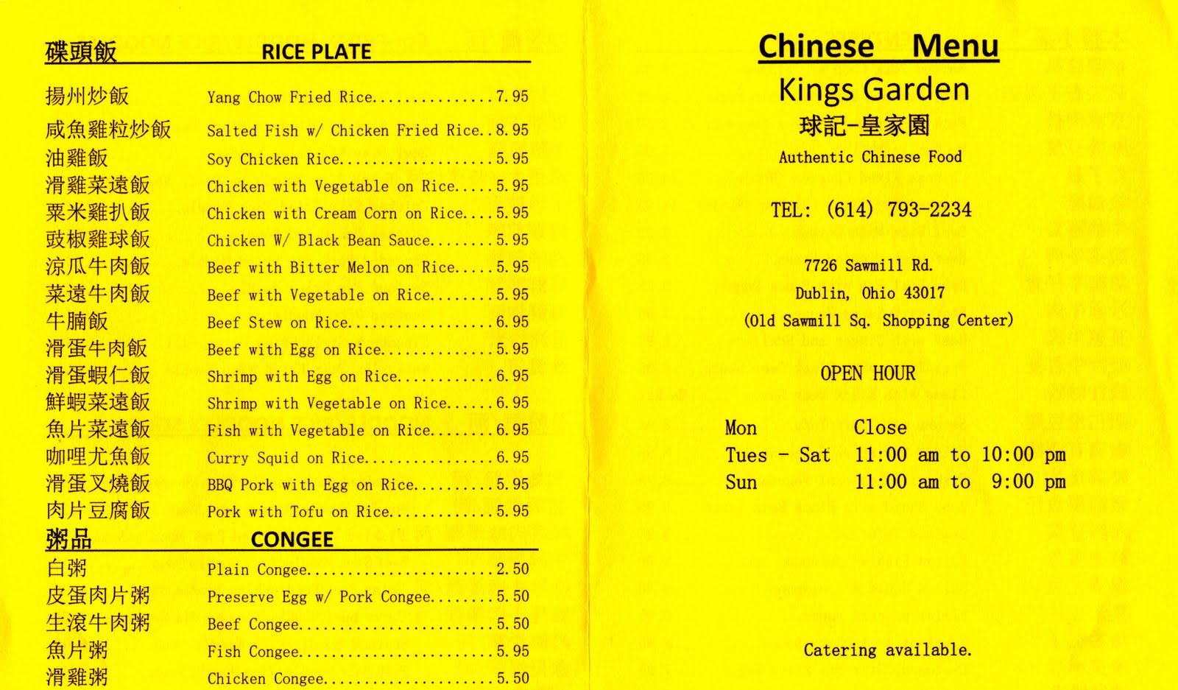
Data?

Slide 11
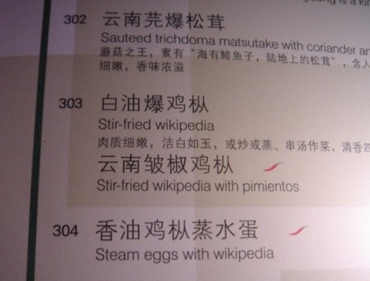
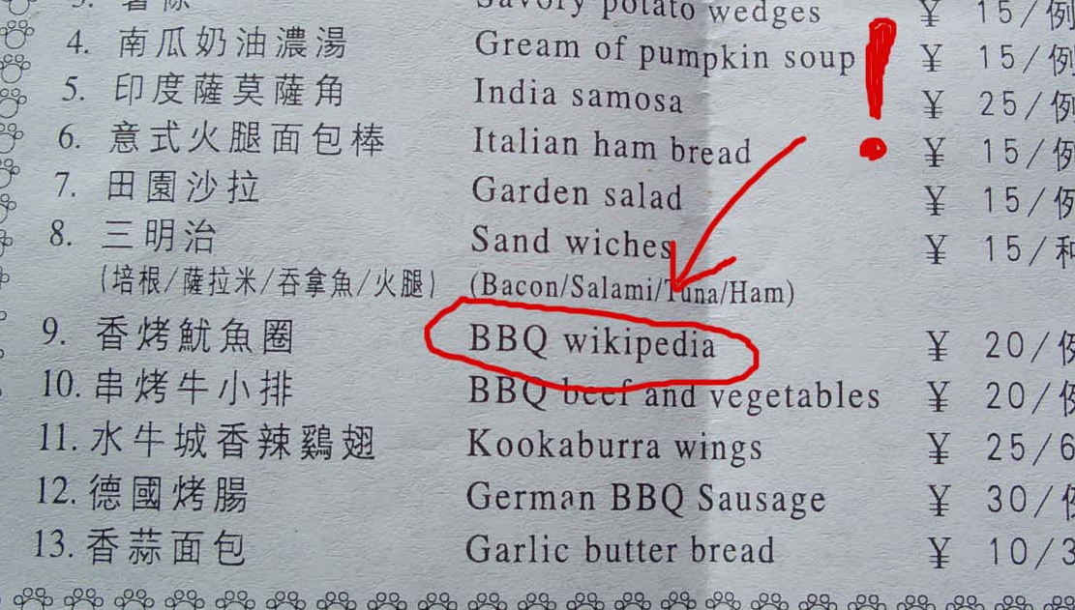
Data?

Slide 12


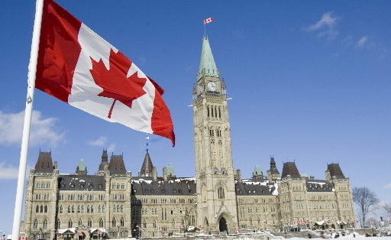


Data?
Also:
news articles
company websites
laws & patents
subtitles

Slide 13
Parallel Data
parallel data: bilingual data that is naturally aligned at some level
usually aligned at the document level
sentence-level alignments are generated automatically
how might you design an algorithm for this?
it can be done well without dictionaries!
can throw out sentences that don’t align with anything

Slide 14
Learning from Parallel Sentences
Chickasaw
English
Ofi 'at kowi 'ã lhiyohli
Kowi 'at ofi 'ã lhiyohli
Ofi 'at shoha
The dog chases the cat
The cat chases the dog
The dog stinks

Slide 15
Learning from Parallel Sentences
Chickasaw
English
Ofi 'at kowi 'ã lhiyohli
Kowi 'at ofi 'ã lhiyohli
Ofi 'at shoha
The dog chases the cat
The cat chases the dog
The dog stinks

Slide 16
Machine Translation Evaluation
human judgments are ideal, but expensive
what other problems are there with human judgments?
we need automatic evaluation metrics
BLEU (BiLingual Evaluation Understudy), Papineni et al. (2002)
compare n-gram overlap between system output and human-produced translation
correlates with human judgments surprisingly well, but only at the document level (not sentence level!)
other metrics do soft matching based on stemming and synonyms from WordNet
this is not a solved problem!

Slide 17
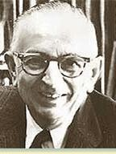
Statistical Machine Translation
One naturally wonders if the problem of translation could conceivably be treated as a problem in cryptography.
When I look at an article in Arabic, I say: “This is really written in English, but it has been coded in some strange symbols. I will now proceed to decode.”
Warren Weaver, 1947

Slide 18
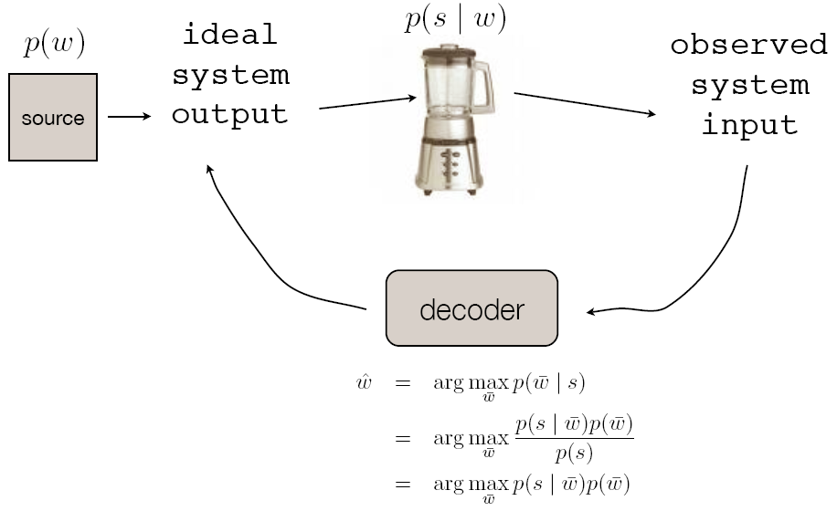
Noisy Channel Model

Slide 19
Noisy Channel Model for Translating French ( f ) to English (e)
e
f

Slide 20
Modeling for the Noisy Channel
We need to model two probability distributions: P(e) and P(f | e)
P(e) should favor fluent translations
P(f | e) should favor accurate/faithful translations

Slide 21
Modeling for the Noisy Channel
We need to model two probability distributions: P(e) and P(f | e)
P(e) should favor fluent translations
P(f | e) should favor accurate/faithful translations
Let’s start with P(e)
How do we compute the probability of an English sentence?
This is an important part of MT (e.g., Google)

Slide 22
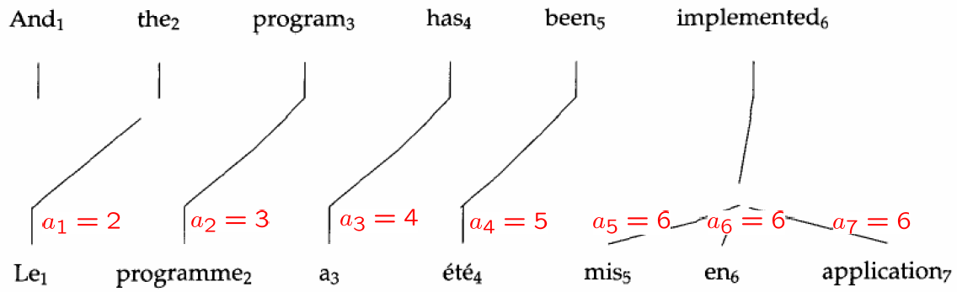
Word Alignments

Slide 23
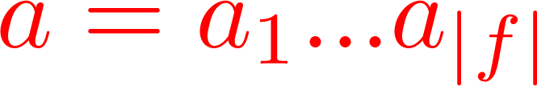

Word Alignments
is a “hidden” variable (not part of training data)
for each French word, it holds the index of the aligned
English word (or NULL)
Notes:
Not symmetric
We can have multiple French words aligned to the same English word
Can we have multiple English words aligned to the same French word?

Slide 24
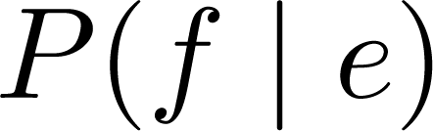
remember: our goal was to model
why would we introduce a hidden variable?
to make it “easier” to define the model
we often want to share certain types of information across multiple instances in our data
latent variables are a natural way to capture this
think of clustering (some of the points come from the same cluster)

Slide 25
Alignments as Hidden Variables
for simplicity, assume that each French word aligns to 1 English word (or to NULL)
analogy to clustering:
each data point has 1 vote which it can distribute among all the clusters
here, each French word has 1 vote which it can distribute among all the English words or NULL

Slide 26
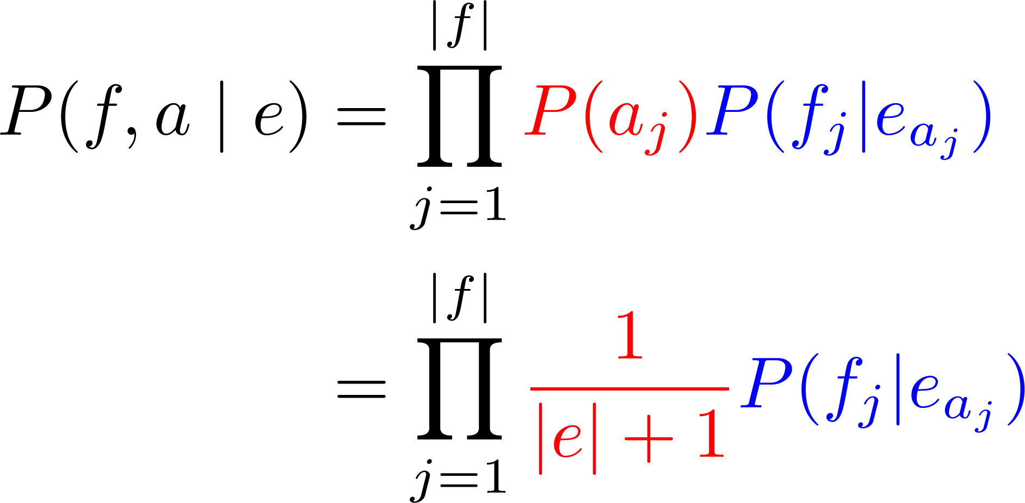
Modeling Alignments: IBM Model 1
Notes:
The score of a word link will only depend on lexical translation parameters, not on the positions of the words

Slide 27
Modeling Alignments: IBM Model 1
How do we obtain ?
Notes:
The score of a word link will only depend on lexical translation parameters, not on the positions of the words

Slide 28
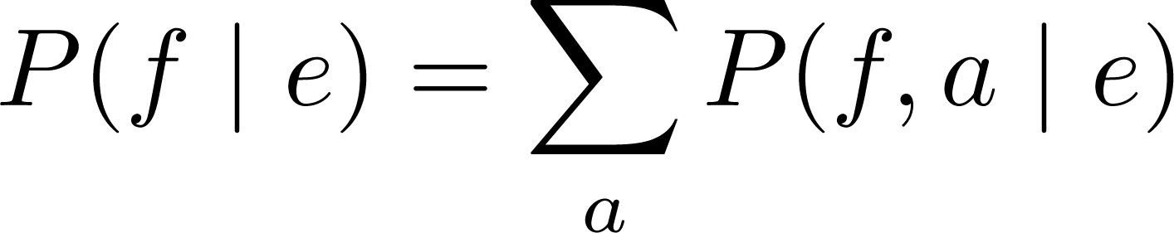
Modeling Alignments: IBM Model 1
How do we obtain ?
Sum over all alignments:
Notes:
The score of a word link will only depend on lexical translation parameters, not on the positions of the words

Slide 29
Modeling Alignments: IBM Model 1
Parameters in the model,
learned using expectation maximization
Notes:
The score of a word link will only depend on lexical translation parameters, not on the positions of the words

Slide 30
Aside: are alignments always hidden?
certain small parallel corpora have been hand-aligned
issues with this?
annotators don’t agree
we have lots of parallel text, very little is hand-aligned
for some language pairs, we will never have manual alignments
word alignment has become a fundamental part of MT, and we need unsupervised learning to solve it!

Slide 31
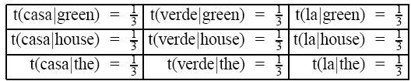

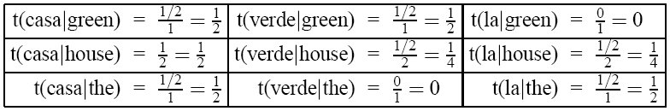
IBM Model 1 Example
Consider a training set of two sentence pairs:
green
house
the
house
casa
verde
la
casa
Initial Parameter Estimates:
= probability of translating e into f
After 1 iteration of EM:

Slide 32
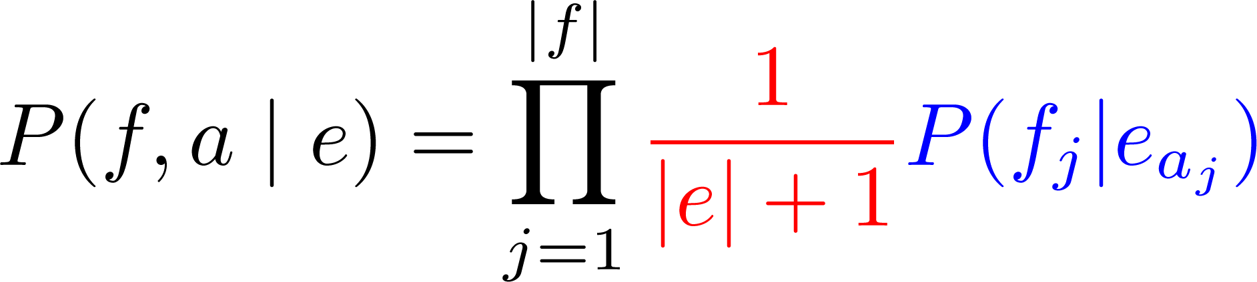
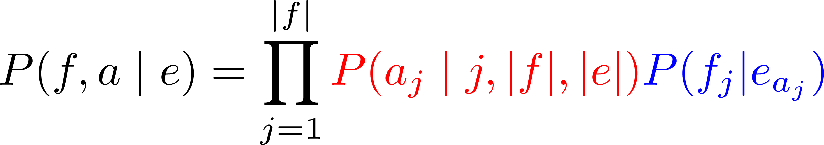
IBM Model 2
IBM Model 1
Notes:
The score of a word link will only depend on lexical translation parameters, not on the positions of the words

Slide 33
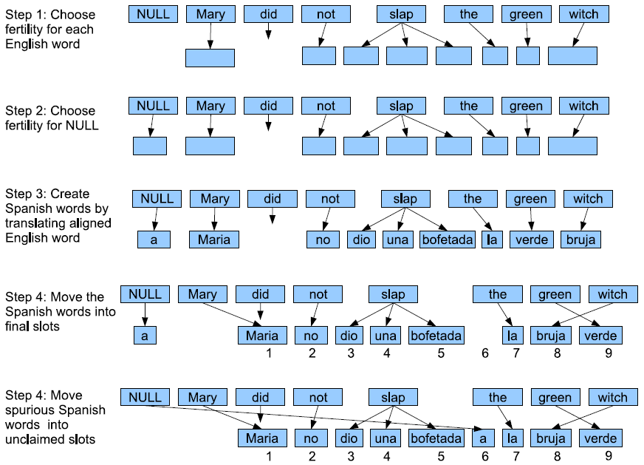
IBM Model 3

Slide 34
Moving to Phrases
NULL
Auf
diese
Frage
habe
ich
leider
keine
Antwort
bekommen
I
did
not
unfortunately
receive
an
answer
to
this
question

Slide 35
Moving to Phrases
Not necessarily syntactic phrases
Auf
diese
Frage
habe
ich
leider
keine
Antwort
bekommen
I
did
not
unfortunately
receive
an
answer
to
this
question

Slide 36
“Phrase-Based” Translation
Relies on a phrase table
massive bilingual phrase dictionary, with probabilities
To build:
Find the best word alignment for each sentence pair
Extract all phrase pairs consistent with the word alignment
Compute probabilities using relative frequency estimation

Slide 37
Phrase-Based Translation
Relies on a phrase table
massive bilingual phrase dictionary, with probabilities
To build:
Find the best word alignment for each sentence pair
Extract all phrase pairs consistent with the word alignment
Compute probabilities using relative frequency estimation
Auf
diese
Frage
habe
ich
leider
keine
Antwort
bekommen
I
did
not
unfortunately
receive
an
answer
to
this
question

Slide 38
Phrase-Based Translation
Relies on a phrase table
massive bilingual phrase dictionary, with probabilities
To build:
Find the best word alignment for each sentence pair
Extract all phrase pairs consistent with the word alignment
Compute probabilities using relative frequency estimation
Auf diese Frage to this question 1.0
Auf
diese
Frage
habe
ich
leider
keine
Antwort
bekommen
I
did
not
unfortunately
receive
an
answer
to
this
question

Slide 39
Phrase-Based Translation
Relies on a phrase table
massive bilingual phrase dictionary, with probabilities
To build:
Find the best word alignment for each sentence pair
Extract all phrase pairs consistent with the word alignment
Compute probabilities using relative frequency estimation
Auf diese Frage to this question 1.0
Antwort an answer 1.0
Antwort answer 1.0
…
Auf
diese
Frage
habe
ich
leider
keine
Antwort
bekommen
I
did
not
unfortunately
receive
an
answer
to
this
question

Slide 40
Phrase-Based Translation
Relies on a phrase table
massive bilingual phrase dictionary, with probabilities
To build:
Find the best word alignment for each sentence pair
Extract all phrase pairs consistent with the word alignment
Compute probabilities using relative frequency estimation:
German | English | Count
Auf diese Frage | to this question | 1.0
Antwort | an answer | 1.0
Antwort | answer | 1.0
…
German | English | P( e | f )
Auf diese Frage | to this question | 1.0
Antwort | an answer | 0.5
Antwort | answer | 0.5
…

Slide 41
Adding Syntax: Synchronous Context-Free Grammars
CFG
SCFG
NN

Slide 42
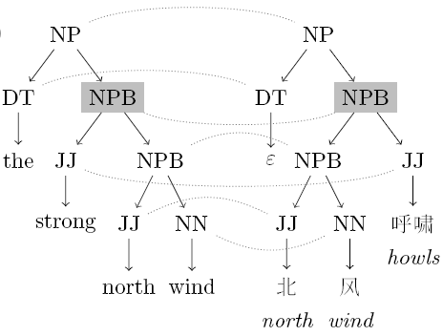
CFG
SCFG
NN

Slide 43
Noisy Channel

Slide 44
Noisy Channel
source
sentence
predicted
translation

Slide 45
Noisy Channel
assumes we have the right model, and that we estimate it perfectly

Slide 46
Noisy Channel
assumes we have the right model, and that we estimate it perfectly

Slide 47
Noisy Channel
assumes we have the right model, and that we estimate it perfectly
extra parameters to tune, can tune to optimize BLEU

Slide 48
Noisy Channel
assumes we have the right model, and that we estimate it perfectly
extra parameters to tune, can tune to optimize BLEU
“tuning”

Slide 49
Noisy Channel → Linear Model?
since we’re not using idealized decoding rule anymore,
why not add more feature functions?
“word count feature”:

Slide 50
Noisy Channel → Linear Model?
since we’re not using idealized decoding rule anymore,
why not add more feature functions?
“word count feature”:

Slide 51
Noisy Channel → Linear Model?
since we’re not using idealized decoding rule anymore,
why not add more feature functions?
“word count feature”:
“reverse translation model feature”:

Slide 52
Notes:
Each circle is one translation, all are for a single input sentence in our training data.
Horizontal bands correspond to different derivations of the same translation; same BLEU score, different model scores.
Our MT system outputs the translation that is farthest to the right. By changing the weights of our model, we move translations left or right. We can’t move them up or down.
The goal of training is to change the parameters so that, on average, our system’s predictions for all input sentences are translations with high BLEU scores.

Slide 53
Gold standard:
African National Congress opposes sanctions against Zimbabwe
Notes:
Each circle is one translation, all are for a single input sentence in our training data.
Horizontal bands correspond to different derivations of the same translation; same BLEU score, different model scores.
Our MT system outputs the translation that is farthest to the right. By changing the weights of our model, we move translations left or right. We can’t move them up or down.
The goal of training is to change the parameters so that, on average, our system’s predictions for all input sentences are translations with high BLEU scores.

Slide 54
Gold standard:
African National Congress opposes sanctions against Zimbabwe
Notes:
Each circle is one translation, all are for a single input sentence in our training data.
Horizontal bands correspond to different derivations of the same translation; same BLEU score, different model scores.
Our MT system outputs the translation that is farthest to the right. By changing the weights of our model, we move translations left or right. We can’t move them up or down.
The goal of training is to change the parameters so that, on average, our system’s predictions for all input sentences are translations with high BLEU scores.

Slide 55
Gold standard:
African National Congress opposes sanctions against Zimbabwe
predicted translation
opposition to sanctions against
Zimbabwe African National Congress
Notes:
Each circle is one translation, all are for a single input sentence in our training data.
Horizontal bands correspond to different derivations of the same translation; same BLEU score, different model scores.
Our MT system outputs the translation that is farthest to the right. By changing the weights of our model, we move translations left or right. We can’t move them up or down.
The goal of training is to change the parameters so that, on average, our system’s predictions for all input sentences are translations with high BLEU scores.

Slide 56
Gold standard:
African National Congress opposes sanctions against Zimbabwe
African National Congress opposition sanctions against Zimbabwe
predicted translation
opposition to sanctions against
Zimbabwe African National Congress
Notes:
Each circle is one translation, all are for a single input sentence in our training data.
Horizontal bands correspond to different derivations of the same translation; same BLEU score, different model scores.
Our MT system outputs the translation that is farthest to the right. By changing the weights of our model, we move translations left or right. We can’t move them up or down.
The goal of training is to change the parameters so that, on average, our system’s predictions for all input sentences are translations with high BLEU scores.

Slide 57
Gold standard:
African National Congress opposes sanctions against Zimbabwe
African National Congress opposition sanctions against Zimbabwe
predicted translation
opposition to sanctions against
Zimbabwe African National Congress
African sanctioning to
Zimbabwe’s opposing
Notes:
Each circle is one translation, all are for a single input sentence in our training data.
Horizontal bands correspond to different derivations of the same translation; same BLEU score, different model scores.
Our MT system outputs the translation that is farthest to the right. By changing the weights of our model, we move translations left or right. We can’t move them up or down.
The goal of training is to change the parameters so that, on average, our system’s predictions for all input sentences are translations with high BLEU scores.

Slide 58
Gold standard:
African National Congress opposes sanctions against Zimbabwe
learning moves translations in this plot
Notes:
Each circle is one translation, all are for a single input sentence in our training data.
Horizontal bands correspond to different derivations of the same translation; same BLEU score, different model scores.
Our MT system outputs the translation that is farthest to the right. By changing the weights of our model, we move translations left or right. We can’t move them up or down.
The goal of training is to change the parameters so that, on average, our system’s predictions for all input sentences are translations with high BLEU scores.

Slide 59
Gold standard:
African National Congress opposes sanctions against Zimbabwe
learning moves translations left or right in this plot
Notes:
Each circle is one translation, all are for a single input sentence in our training data.
Horizontal bands correspond to different derivations of the same translation; same BLEU score, different model scores.
Our MT system outputs the translation that is farthest to the right. By changing the weights of our model, we move translations left or right. We can’t move them up or down.
The goal of training is to change the parameters so that, on average, our system’s predictions for all input sentences are translations with high BLEU scores.

Slide 60
Gold standard:
African National Congress opposes sanctions against Zimbabwe
“ideal” model
Notes:
Each circle is one translation, all are for a single input sentence in our training data.
Horizontal bands correspond to different derivations of the same translation; same BLEU score, different model scores.
Our MT system outputs the translation that is farthest to the right. By changing the weights of our model, we move translations left or right. We can’t move them up or down.
The goal of training is to change the parameters so that, on average, our system’s predictions for all input sentences are translations with high BLEU scores.

Slide 61
Gold standard:
African National Congress opposes sanctions against Zimbabwe
Where’s the gold standard translation?
Notes:
Each circle is one translation, all are for a single input sentence in our training data.
Horizontal bands correspond to different derivations of the same translation; same BLEU score, different model scores.
Our MT system outputs the translation that is farthest to the right. By changing the weights of our model, we move translations left or right. We can’t move them up or down.
The goal of training is to change the parameters so that, on average, our system’s predictions for all input sentences are translations with high BLEU scores.

Slide 62
Issue: gold standard translation is often unreachable by the model
Gold standard:
African National Congress opposes sanctions against Zimbabwe
Why?
limited translation rules,
free translations,
noisy data
Notes:
This causes problems when applying standard learning algorithms to MT.

Slide 63
Free Translations
Machine translation:
Sharon's office said, leader of the main opposition Labor Party has admitted defeat and congratulatory telephone calls to Sharon.
Human-generated translation:
According to a representative of Sharon's office, the leader of the main opposition Labor Party has admitted defeat and made the obligatory congratulating telephone call to Sharon.
Notes:
Sharon's office said that, Mitzna, leader of the main opposition Labor Party, has conceded the election and telephoned Sharon for congratulation.
Sharon's office said, leader of the main opposition Labor Party recognized, and called the failure of Sharon's congratulations.
Sharon's office said, leader of the main opposition Labor Party has admitted defeat and congratulatory call to Sharon.
Sharon's office said, leader of the main opposition Labor Party has admitted defeat and congratulatory telephone calls to Sharon.
According to a representative of Sharon's office, the leader of the main opposition Labor Party has admitted defeat and made the obligatory congratulating telephone call to Sharon.

Slide 64
Free Translations
Even if gold standard translation was reachable by model, we might not want to learn from it directly
Machine translation:
Sharon's office said, leader of the main opposition Labor Party has admitted defeat and congratulatory telephone calls to Sharon.
Human-generated translation:
According to a representative of Sharon's office, the leader of the main opposition Labor Party has admitted defeat and made the obligatory congratulating telephone call to Sharon.
Applicable to other tasks:
summarization
image caption generation
Notes:
Sharon's office said that, Mitzna, leader of the main opposition Labor Party, has conceded the election and telephoned Sharon for congratulation.
Sharon's office said, leader of the main opposition Labor Party recognized, and called the failure of Sharon's congratulations.
Sharon's office said, leader of the main opposition Labor Party has admitted defeat and congratulatory call to Sharon.
Sharon's office said, leader of the main opposition Labor Party has admitted defeat and congratulatory telephone calls to Sharon.
According to a representative of Sharon's office, the leader of the main opposition Labor Party has admitted defeat and made the obligatory congratulating telephone call to Sharon.

Slide 65
Loss Functions
name | loss | where used
cost (“0-1”) |  | intractable, but underlies “direct error minimization”
perceptron |  | perceptron algorithm (Rosenblatt, 1958)
hinge |  | support vector machines, other large-margin algorithms
log |  | logistic regression, conditional random fields, maximum entropy models

Slide 66
Loss Functions
issue: gold standard translation is often unreachable by the model
name | loss | where used
cost (“0-1”) |  | intractable, but underlies “direct error minimization”
perceptron |  | perceptron algorithm (Rosenblatt, 1958)
hinge |  | support vector machines, other large-margin algorithms
log |  | logistic regression, conditional random fields, maximum entropy models

Slide 67
Loss Functions
intractable, but it doesn’t need to compute model score of gold standard!
name | loss | where used
cost (“0-1”) |  | intractable, but underlies “direct error minimization”
perceptron |  | perceptron algorithm (Rosenblatt, 1958)
hinge |  | support vector machines, other large-margin algorithms
log |  | logistic regression, conditional random fields, maximum entropy models

Slide 68
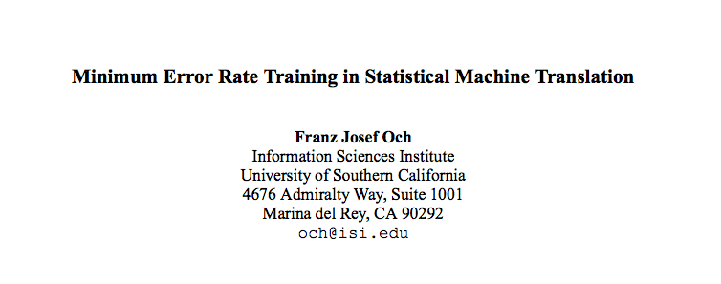
MERT, Och (2003)

Slide 69
Notation
feature
weights
feature
vector
latent
derivation
source
sentence
translation

Slide 70
Minimum Error Rate Training (MERT)
Notes:
What are some issues with this loss function?

Slide 71
Minimum Error Rate Training (MERT)
set of source sentences
references
decoder
outputs
Notes:
What are some issues with this loss function?

Slide 72
Minimum Error Rate Training (MERT)
“how bad are these translations?”
e.g., negative BLEU
set of source sentences
references
decoder
outputs
Notes:
What are some issues with this loss function?

Slide 73
Minimum Error Rate Training (MERT)
minimize the cost of the decoder output
intractable in general – how can we solve it?
“how bad are these translations?”
e.g., negative BLEU
set of source sentences
references
decoder
outputs
Notes:
What are some issues with this loss function?

Slide 74
Minimum Error Rate Training (MERT)
minimize the cost of the decoder output
intractable in general – how can we solve it?
“how bad are these translations?”
e.g., negative BLEU
set of source sentences
generate k-best lists of translations, approximately minimize cost on k-best lists, repeat with new parameters
(pool k-best lists across iterates)
references
decoder
outputs
Notes:
What are some issues with this loss function?

Slide 75
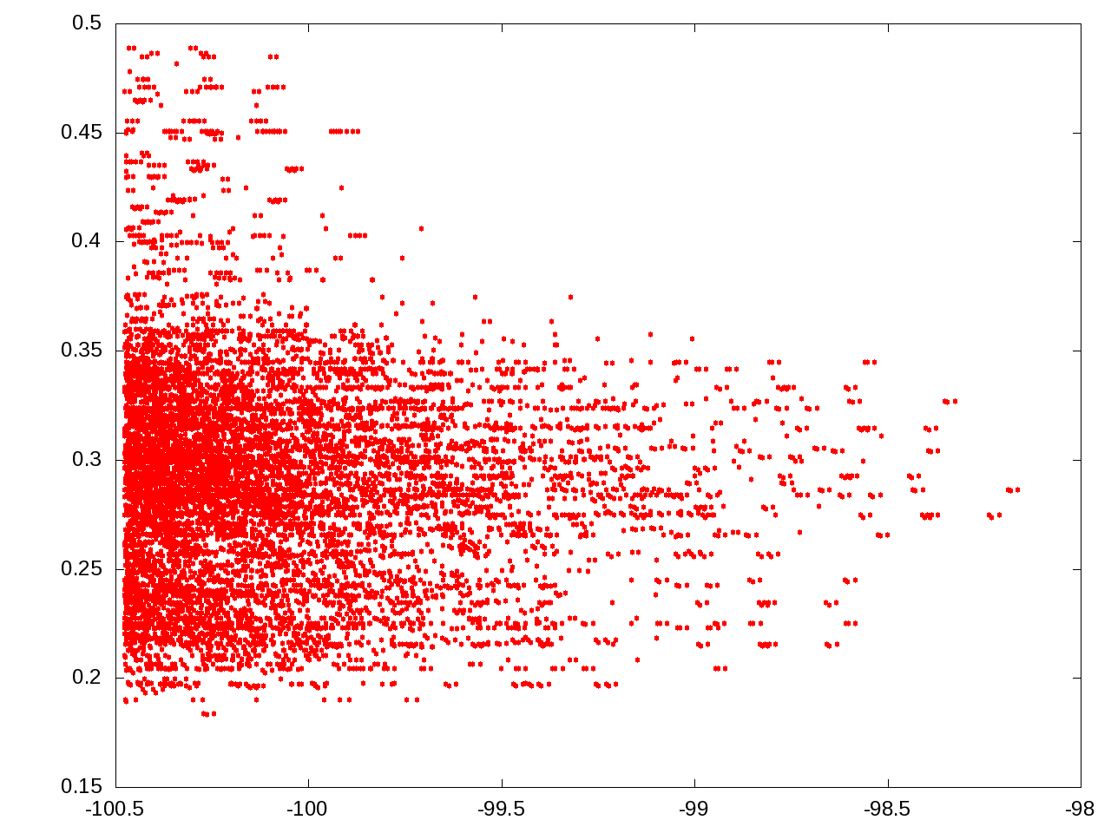
BLEU
model score

Slide 76
each point is a translation for the same sentence
BLEU
Arabic-English,
phrase-based
model score

Slide 77
10,000-best list,
default Moses weights
BLEU
1-best:
28 BLEU
model score

Slide 78
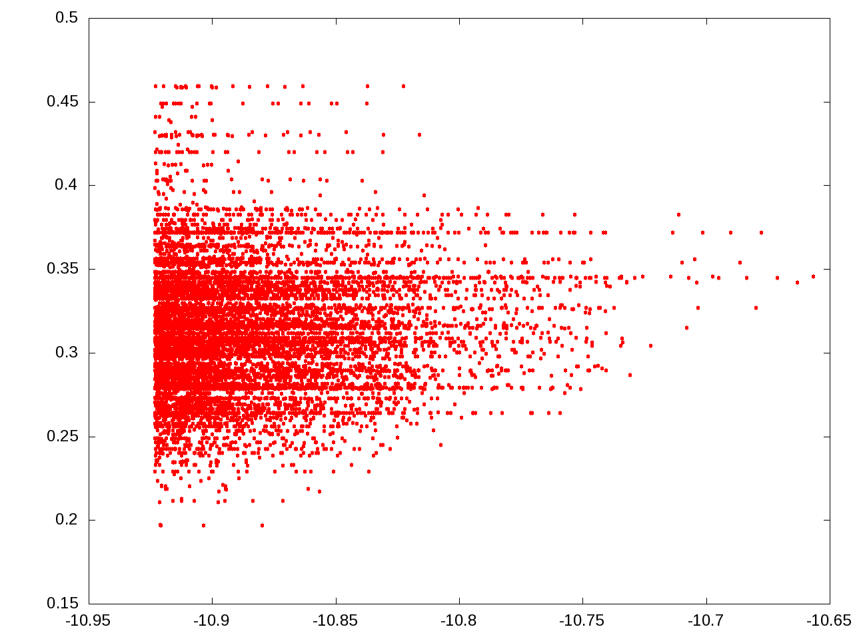
same sentence,
10,000-best list
after MERT
BLEU
1-best:
34 BLEU
model score

Slide 79
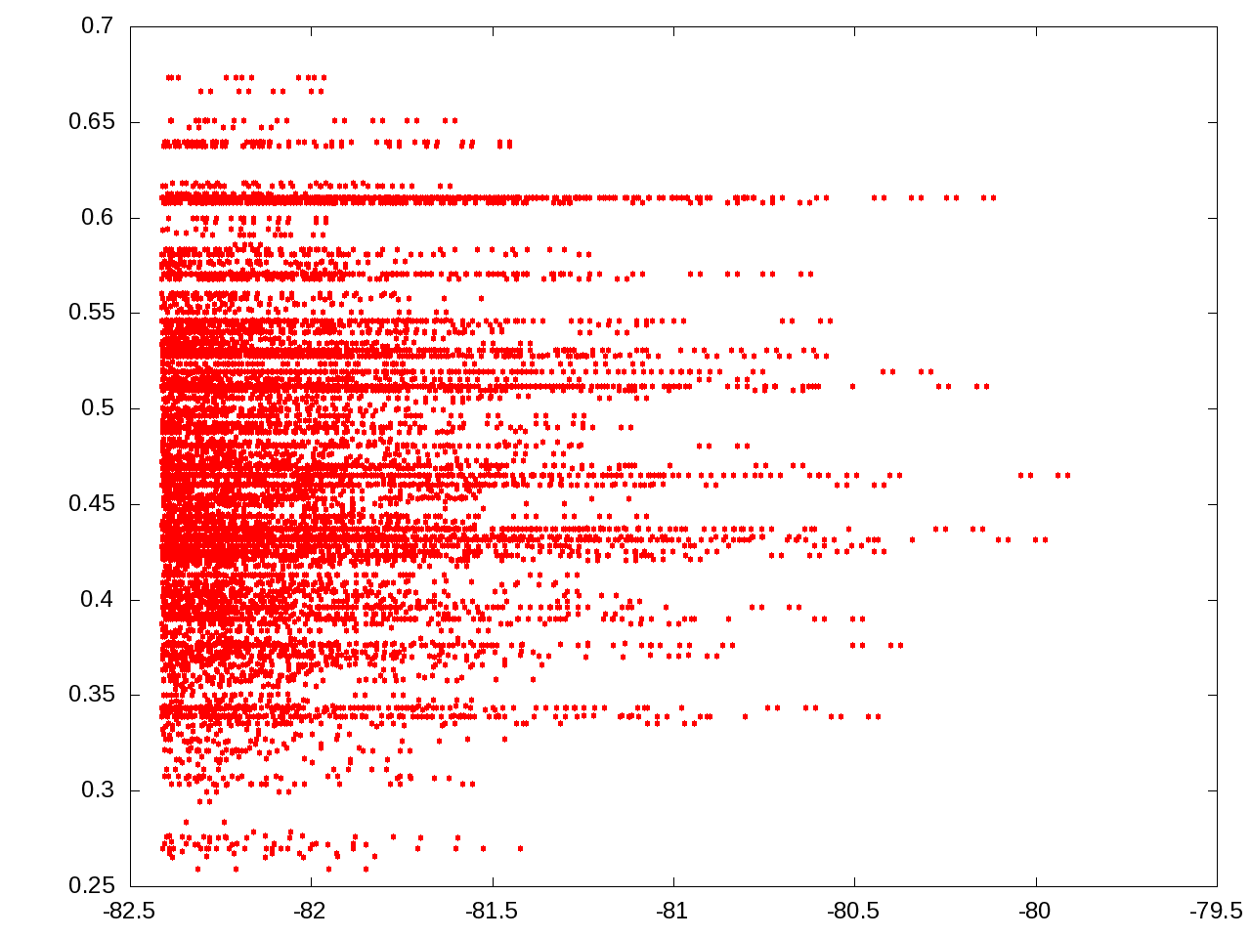
another sentence,
default Moses weights
BLEU
1-best:
46 BLEU
model score

Slide 80
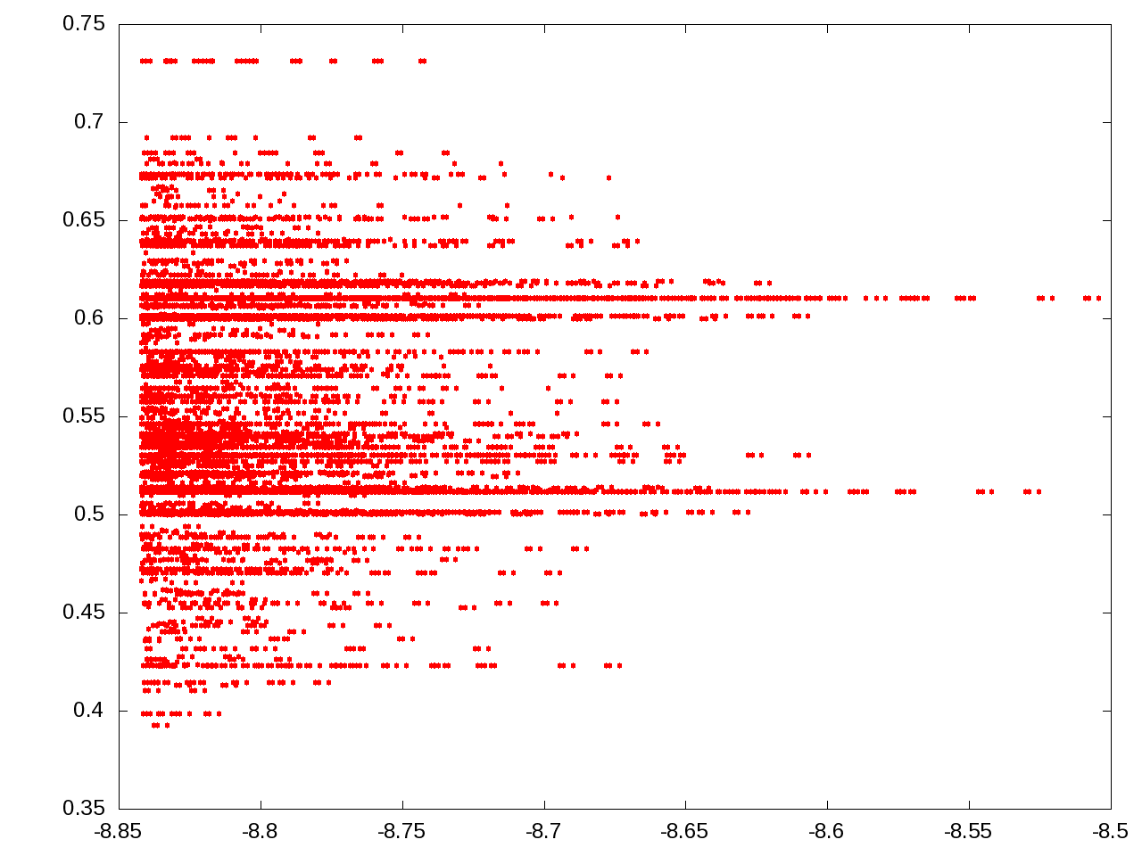
same sentence,
after MERT
BLEU
1-best:
62 BLEU
model score

Slide 81
Why are there horizontal “bands”?
BLEU
model score

Slide 82
Why are there horizontal “bands”?
latent derivations,
different translations
with same BLEU
BLEU
model score

Slide 83
references
decoder
outputs
What are some issues with this loss function?
Discontinuous & non-convex → optimization relies on randomized search
No regularization → leads to overfitting
As a result, MERT is only effective for very small models (<40 parameters)
Notes:
Overfits to training data
Shows high variance across runs
Works well for small feature sets (<40 features), but fails for large feature sets
Despite its shortcomings, minimum error rate training is the predominant approach to training MT models

Slide 84
Many researchers tried to improve MERT:
Regularization and Search for MERT (Cer et al., 2008)
Random Restarts in MERT for MT (Moore & Quirk, 2008)
Stabilizing MERT (Foster & Kuhn, 2009)
Issues remain:
Better Hypothesis Testing for Statistical MT: Controlling for Optimizer Instability (Clark et al., 2011)
They suggest running MERT 3-5 times due to its instability

Slide 85
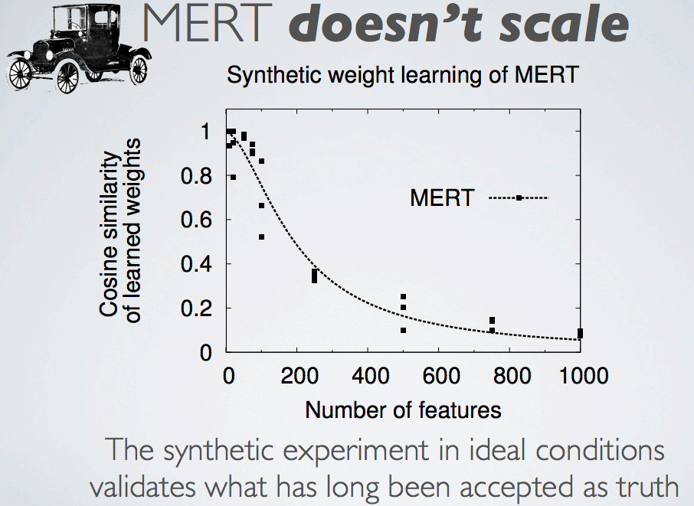

Slide 86
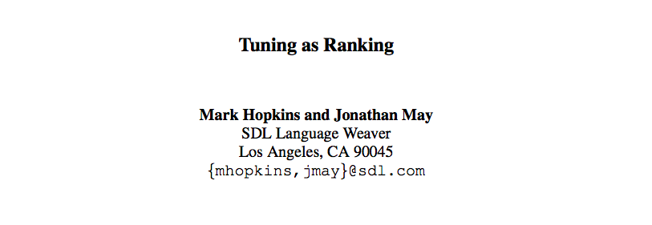

Slide 87
Perceptron Loss
reference
Notes:
This causes problems when applying standard learning algorithms to MT.

Slide 88
Perceptron Loss
reference
model prediction
Notes:
This causes problems when applying standard learning algorithms to MT.

Slide 89
Perceptron Loss for MT? (Collins, 2002)
reference
model prediction
Notes:
This causes problems when applying standard learning algorithms to MT.

Slide 90
k-Best Perceptron for MT (Liang et al., 2006)
model prediction
Notes:
This causes problems when applying standard learning algorithms to MT.

Slide 91
k-Best Perceptron for MT (Liang et al., 2006)
model prediction
Notes:
This causes problems when applying standard learning algorithms to MT.

Slide 92
k-Best Perceptron for MT (Liang et al., 2006)
BLEU oracle on k-best list
model prediction
Notes:
This causes problems when applying standard learning algorithms to MT.

Slide 93
Ramp Loss Minimization
Notes:
This causes problems when applying standard learning algorithms to MT.

Slide 94
Ramp Loss Minimization
model prediction
Notes:
This causes problems when applying standard learning algorithms to MT.

Slide 95
Ramp Loss Minimization
model prediction
“fear” translation
Notes:
This causes problems when applying standard learning algorithms to MT.

Slide 96
“Fear” Ramp Loss (Do et al., 2008)
model prediction
“fear” translation
Notes:
This causes problems when applying standard learning algorithms to MT.

Slide 97
“Fear” Ramp Loss (Do et al., 2008)
model prediction
gold standard
“fear” translation
Notes:
This causes problems when applying standard learning algorithms to MT.

Slide 98
“Hope” Ramp Loss (McAllester & Keshet, 2011; Liang et al., 2006)
model prediction
Notes:
This causes problems when applying standard learning algorithms to MT.

Slide 99
“Hope” Ramp Loss (McAllester & Keshet, 2011; Liang et al., 2006)
“hope” translation
model prediction
Notes:
This causes problems when applying standard learning algorithms to MT.

Slide 100
“Hope-Fear” Ramp Loss (Chiang et al., 2008; 2009; Cherry & Foster, 2012; Chiang, 2012)
“hope” translation
“fear” translation
Notes:
This causes problems when applying standard learning algorithms to MT.

Slide 101
“Hope-Fear” Ramp Loss (Chiang et al., 2008; 2009; Cherry & Foster, 2012; Chiang, 2012)
“hope” translation
“fear” translation
Notes:
This causes problems when applying standard learning algorithms to MT.

Slide 102
Experiments (Gimpel, 2012)
averages over 8 test sets across 3 language pairs
 | Moses | Hiero
 | %BLEU | %BLEU
MERT | 35.9 | 37.0
Fear Ramp (away from bad) | 34.9 | 34.2
Hope Ramp (toward good) | 35.2 | 36.0
Hope-Fear Ramp (toward good + away from bad) | 35.7 | 37.0

Slide 103
Pairwise Ranking Optimization (Hopkins & May, 2011)

