Slide 1
TTIC 31190: Natural Language Processing
Kevin Gimpel
Winter 2016
Lecture 2: Text Classification

Slide 2
Please email me (kgimpel@ttic.edu) with the following:
your name
your email address
whether you taking the class for credit
I will use your address to create a mailing list for course announcements

Slide 3
Roadmap
classification
words
lexical semantics
language modeling
sequence labeling
syntax and syntactic parsing
neural network methods in NLP
semantic compositionality
semantic parsing
unsupervised learning
machine translation and other applications

Slide 4
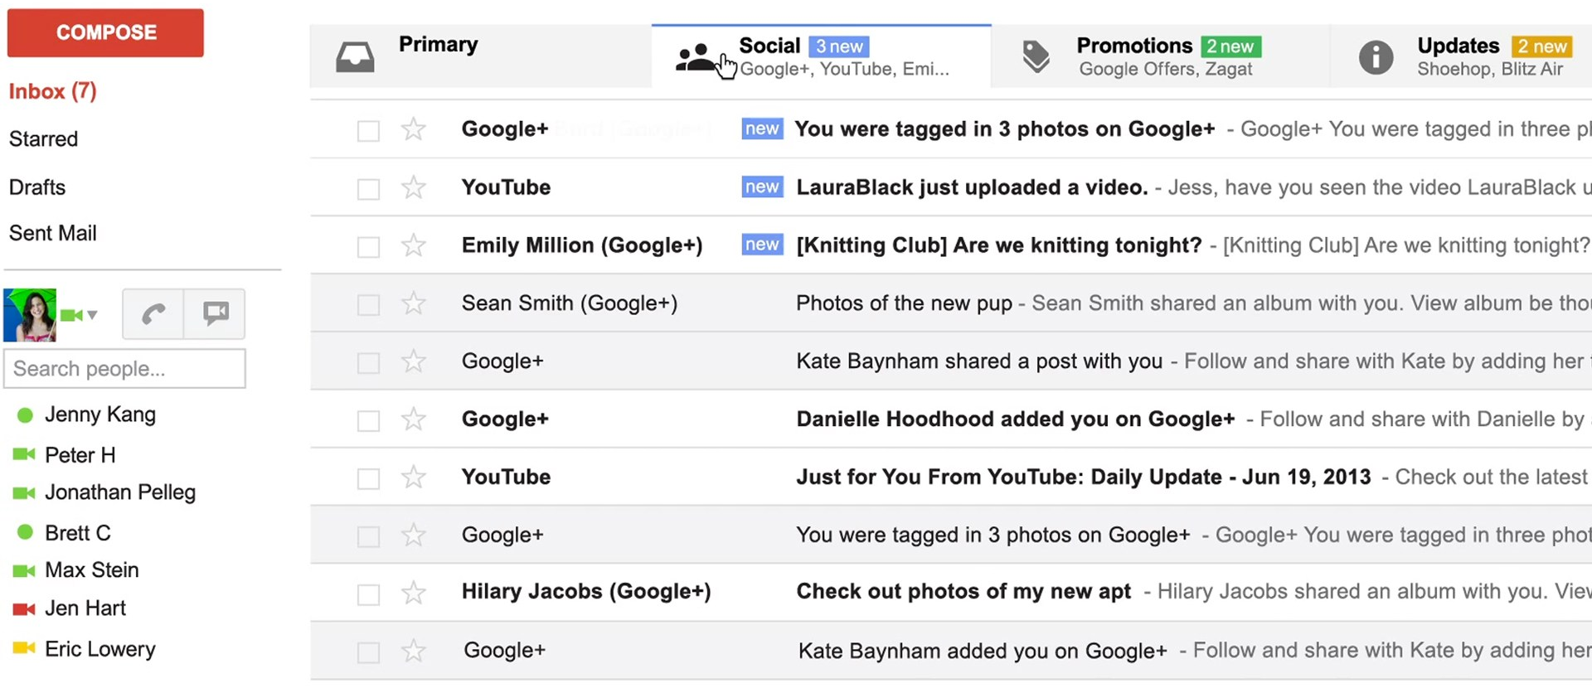
Text Classification
spam / not spam
priority level
category (primary / social / promotions / updates)
Notes:
sentence -> NER labeling
sentence -> translation
Neue Umfrage: Kaufen Sie eine Apple Watch?
sentence -> parse tree
set of documents -> summary

Slide 5
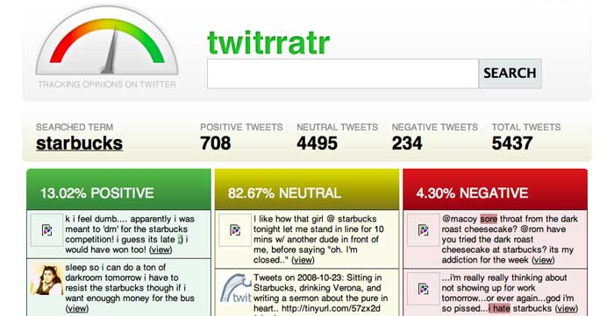
Sentiment Analysis
Notes:
sentence -> NER labeling
sentence -> translation
Neue Umfrage: Kaufen Sie eine Apple Watch?
sentence -> parse tree
set of documents -> summary

Slide 6
Classification
datasets
features
learning

Slide 7
NLP Datasets
NLP datasets include inputs (usually text) and outputs (usually some sort of annotation)

Slide 8
Annotation
supervised machine learning needs labeled datasets, where labels are called ground truth
in NLP, labels are annotations provided by humans
there is always some disagreement among annotators, even for simple tasks
these annotations are called a gold standard, not ground truth

Slide 9
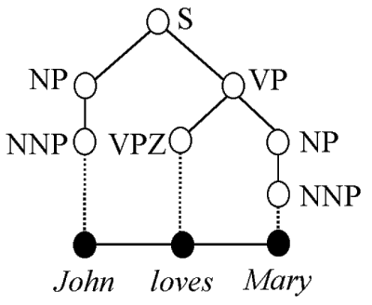
How are NLP datasets developed?
paid, trained human annotation
this is the traditional approach
researchers write annotation guidelines, recruit & pay annotators (often linguists)
more consistent annotations, but costly to scale
e.g., Penn Treebank (1993)
1 million words, mostly Wall Street Journal, annotated with part-of-speech tags and syntactic parse trees

Slide 10
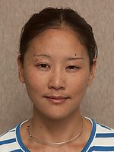
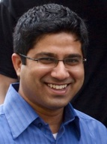
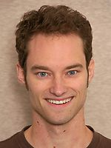







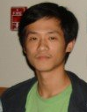

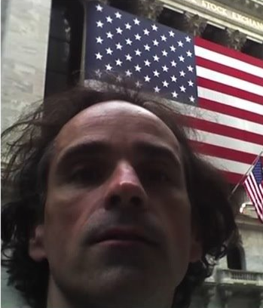
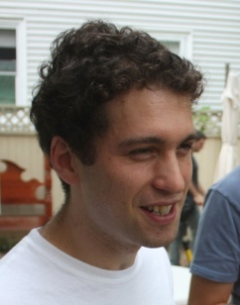

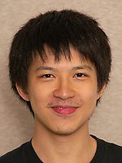

Example: Twitter part-of-speech annotation
17 CMU researchers annotated ~2000 tweets
Gimpel, Schneider, O'Connor, Das, Mills, Eisenstein, Heilman, Yogatama, Flanigan, Smith. “Part-of-Speech Tagging for Twitter: Annotation, Features, and Experiments,” ACL 2011.

Slide 11
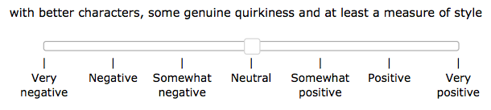
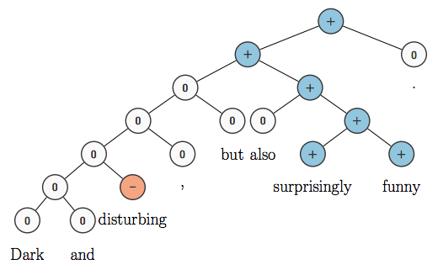
paid, trained human annotation
crowdsourcing
more recent trend
Amazon Mechanical Turk
can’t really train annotators, but easier to get multiple annotations for each input (which can then be averaged)
e.g., Stanford Sentiment Treebank:

Slide 12
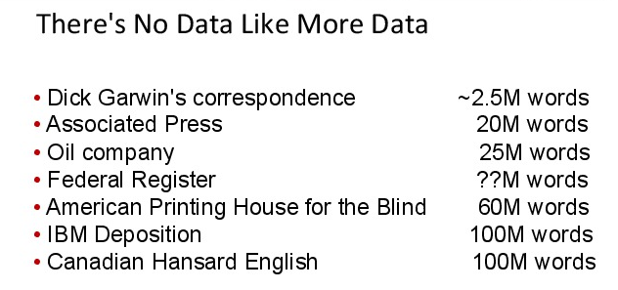
paid, trained human annotation
crowdsourcing
naturally-occurring annotation
long history: used by IBM for speech recognition and statistical machine translation
how might you find naturally-occurring data for:
conversational agents
summarization
coreference resolution
credit: Brown & Mercer, 20 Years of Bitext Workshop, 2013

Slide 13
paid, trained human annotation
crowdsourcing
naturally-occurring annotation
long history: used by IBM for speech recognition and statistical machine translation
how might you find naturally-occurring data for:
conversational agents
summarization
coreference resolution
credit: Brown & Mercer, 20 Years of Bitext Workshop, 2013

Slide 14
Annotator Agreement
given annotations from two annotators, how should we measure inter-annotator agreement?
percent agreement
Cohen’s Kappa (Cohen, 1960) accounts for agreement by chance
generalizations exist for more than two annotators (Fleiss, 1971)

Slide 15
Annotator Agreement
given annotations from two annotators, how should we measure inter-annotator agreement?
percent agreement?
Cohen’s Kappa (Cohen, 1960) accounts for agreement by chance
generalizations exist for more than two annotators (Fleiss, 1971)

Slide 16
Annotator Agreement
given annotations from two annotators, how should we measure inter-annotator agreement?
percent agreement?
Cohen’s Kappa (Cohen, 1960) accounts for agreement by chance
generalizations exist for more than two annotators (Fleiss, 1971)

Slide 17
Text Classification Data
There are many annotated datasets
Stanford Sentiment Treebank: fine-grained sentiment analysis of movie reviews
subjectivity/objectivity sentence classification
binary sentiment analysis of customer reviews
TREC question classification

Slide 18
Subjectivity/objectivity classification:
the hulk is an anger fueled monster with incredible strength and resistance to damage .
in trying to be daring and original , it comes off as only occasionally satirical and never fresh .
solondz may well be the only one laughing at his own joke
obstacles pop up left and right , as the adventure gets wilder and wilder .

Slide 19
Subjectivity/objectivity classification:
the hulk is an anger fueled monster with incredible strength and resistance to damage . | objective
in trying to be daring and original , it comes off as only occasionally satirical and never fresh . | subjective
solondz may well be the only one laughing at his own joke
obstacles pop up left and right , as the adventure gets wilder and wilder .

Slide 20
Subjectivity/objectivity classification:
the hulk is an anger fueled monster with incredible strength and resistance to damage . | objective
in trying to be daring and original , it comes off as only occasionally satirical and never fresh . | subjective
solondz may well be the only one laughing at his own joke | subjective
obstacles pop up left and right , as the adventure gets wilder and wilder . | objective

Slide 21
Subjectivity/objectivity classification:
the hulk is an anger fueled monster with incredible strength and resistance to damage . | objective
in trying to be daring and original , it comes off as only occasionally satirical and never fresh . | subjective
solondz may well be the only one laughing at his own joke | subjective
obstacles pop up left and right , as the adventure gets wilder and wilder . | objective
How was this dataset generated?
IMDB plot summaries: objective
Rotten Tomatoes snippets: subjective

Slide 22
Subjectivity/objectivity classification:
the hulk is an anger fueled monster with incredible strength and resistance to damage . | objective
in trying to be daring and original , it comes off as only occasionally satirical and never fresh . | subjective
solondz may well be the only one laughing at his own joke | subjective
obstacles pop up left and right , as the adventure gets wilder and wilder . | objective
How was this dataset generated?
IMDB plot summaries: objective
Rotten Tomatoes snippets: subjective

Slide 23
Subjectivity/objectivity classification:
the hulk is an anger fueled monster with incredible strength and resistance to damage . | objective
in trying to be daring and original , it comes off as only occasionally satirical and never fresh . | subjective
solondz may well be the only one laughing at his own joke | subjective
obstacles pop up left and right , as the adventure gets wilder and wilder . | objective
How might you generate a dataset like this?

Slide 24
customer review sentiment classification:
it works with a minimum of fuss .
size - bigger than the ipod
i 've had this thing just over a month and the headphone jack has already come loose .
you can manage your profile , change the contrast of backlight , make different type of display , either list or tabbed .
i replaced it with a router raizer and it works much better .

Slide 25
customer review sentiment classification:
it works with a minimum of fuss . | positive
size - bigger than the ipod | negative
i 've had this thing just over a month and the headphone jack has already come loose . | negative
you can manage your profile , change the contrast of backlight , make different type of display , either list or tabbed . | positive
i replaced it with a router raizer and it works much better . | negative

Slide 26
question classification:
Who invented baseball ? | human
CNN is an acronym for what ? | abbreviation
Which Latin American country is the largest ? | location
How many small businesses are there in the U.S . | number
What would you add to the clay mixture to produce bone china ? | entity
What is the root of all evil ? | description

Slide 27
Classification
datasets
features
learning

Slide 28
Classification Framework
inference: solve _
modeling: define score function
learning: choose _

Slide 29
Classification Framework
inference: solve _
modeling: define score function
learning: choose _
our linear model text classifier:

Slide 30
Features for NLP
NLP datasets include inputs and outputs
features are usually not included
you have to define your own features
contrast this with UCI datasets, which include a fixed-length “dense” feature vector for every instance

Slide 31

Features for NLP
NLP datasets include inputs and outputs
features are usually not included
you have to define your own features
contrast this with UCI datasets, which include a fixed-length dense feature vector for every instance

Slide 32
Features for NLP
NLP datasets include inputs and outputs
features are usually not included
you have to define your own features
contrast this with UCI datasets, which include a fixed-length dense feature vector for every instance
in NLP, features are usually sparse

Slide 33
Unigram Binary Features
two example features:
where
we usually think in terms of feature templates
unigram binary feature template:
to create features, this feature template is instantiated for particular labels and words

Slide 34
Unigram Binary Features
two example features:
where
we usually think in terms of feature templates
unigram binary feature template:
to create features, this feature template is instantiated for particular labels and words

Slide 35
Unigram Binary Features
two example features:
where
we usually think in terms of feature templates
unigram binary feature template:
to create features, this feature template is instantiated for particular labels and words

Slide 36
Higher-Order Binary Feature Templates
unigram binary template:
bigram binary template:
trigram binary features
…

Slide 37
Unigram Count Features
a ``count’’ feature returns the count of a particular word in the text
unigram count feature template:

Slide 38
Feature Count Cutoffs
problem: some features are extremely rare
solution: only keep features that appear at least k times in the training data

Slide 39
Feature Count Cutoffs (Example)
consider the following training dataset:
a great movie ! positive
not such a great movie negative
with the following single feature template:
which features would remain in the model with a feature count cutoff of 2?

Slide 40
Feature Count Cutoffs (Example)
consider the following training dataset:
a great movie ! positive
not such a great movie negative
with the following single feature template:
which features would remain in the model with a feature count cutoff of 2?
none

Slide 41
Feature Count Cutoffs (Example)
consider the following training dataset:
a great movie ! positive
not such a great movie negative
with the following single feature template:
which features would remain in the model with a feature count cutoff of 1?

Slide 42
Feature Count Cutoffs (Example)
consider the following training dataset:
a great movie ! positive
not such a great movie negative
with the following single feature template:
which features would remain in the model with a feature count cutoff of 0?

Slide 43
Classification
datasets
features
learning
empirical risk minimization
surrogate loss functions
gradient-based optimization

Slide 44
Learning: Empirical Risk Minimization
In a machine learning course, you learn about many different learning frameworks

Slide 45
Learning: Empirical Risk Minimization
In a machine learning course, you learn about many different learning frameworks
Since we have limited time, we will be greedy and focus on a single framework that maximizes
(for some positive constants )
We will start it today but continue to add to it later

Slide 46
Cost Functions
cost function: scores outputs against a gold standard
should be as close as possible to the actual evaluation metric for your task
usual conventions:
for classification, what cost should we use?
how about for other NLP tasks?

Slide 47
Cost Functions
cost function: scores outputs against a gold standard
should be as close as possible to the actual evaluation metric for your task
for classification, what cost should we use?
how about for other NLP tasks?

Slide 48
Cost Functions
cost function: scores outputs against a gold standard
should be as close as possible to the actual evaluation metric for your task
for classification, what cost should we use?
how about for other NLP tasks?

Slide 49
Risk Minimization
given training data:
where each is a label
assume data is drawn iid (independently and identically distributed) from (unknown) joint distribution
we want to solve the following:

Slide 50
Risk Minimization
given training data:
where each is a label
assume data is drawn iid (independently and identically distributed) from (unknown) joint distribution
we want to solve the following:
problem: P is unknown

Slide 51
Empirical Risk Minimization (Vapnik et al.)
replace expectation with sum over examples:

Slide 52
Empirical Risk Minimization (Vapnik et al.)
replace expectation with sum over examples:
problem: NP-hard even for binary classification with linear models

Slide 53
solution: replace “cost loss” (also called “0-1” loss) with a surrogate function that is easier to optimize
generalize to permit any loss function

Slide 54
solution: replace “cost loss” (also called “0-1” loss) with a surrogate function that is easier to optimize
generalize to permit any loss function
cost loss / 0-1 loss:

Slide 55
Classification
datasets
features
learning
empirical risk minimization
surrogate loss functions
gradient-based optimization

Slide 56
Surrogate Loss Functions
cost loss / 0-1 loss:
why is this so difficult to optimize?

Slide 57
Surrogate Loss Functions
cost loss / 0-1 loss:
why is this so difficult to optimize?
not necessarily continuous, can’t use gradient-based optimization

Slide 58
Surrogate Loss Functions
cost loss / 0-1 loss:
max-score loss:

Slide 59
Surrogate Loss Functions
cost loss / 0-1 loss:
max-score loss:
this is continuous, but what are its drawbacks?

Slide 60
Surrogate Loss Functions
cost loss / 0-1 loss:
max-score loss:
perceptron loss:

Slide 61
Surrogate Loss Functions
cost loss / 0-1 loss:
max-score loss:
perceptron loss:
loss function underlying perceptron algorithm (Rosenblatt, 1957-58)

Slide 62
Surrogate Loss Functions
cost loss / 0-1 loss:
perceptron loss:
hinge loss:

Slide 63
Surrogate Loss Functions
cost loss / 0-1 loss:
perceptron loss:
hinge loss:
loss function underlying support vector machines

Slide 64
Surrogate Loss Functions
cost loss / 0-1 loss:
perceptron loss:
hinge loss:
hinge loss for our classification setting:
tunable hyperparameter

Slide 65
Classification
datasets
features
learning
empirical risk minimization
surrogate loss functions
gradient-based optimization

Slide 66
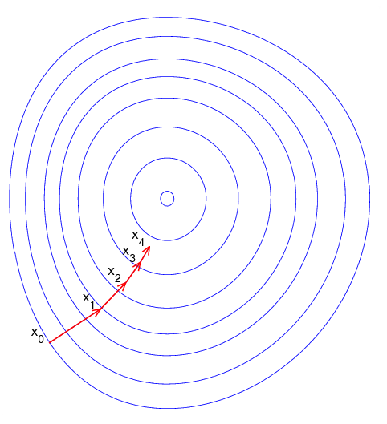
Gradient Descent
minimizes a function F by taking steps in proportion to the negative of the gradient:

Slide 67
Gradient Descent
minimizes a function F by taking steps in proportion to the negative of the gradient:
with conditions on stepsize and objective function, will converge to local minimum
: stepsize at iteration t
: gradient of objective function

Slide 68
Gradient Descent
minimizes a function F by taking steps in proportion to the negative of the gradient:
with conditions on stepsize and objective function, will converge to local minimum
: stepsize at iteration t
: gradient of objective function
to speed convergence, can use line search to choose better stepsizes; also see L-BFGS

Slide 69
Gradient Descent
minimizes a function F by taking steps in proportion to the negative of the gradient:
with conditions on stepsize and objective function, will converge to local minimum
: stepsize at iteration t
: gradient of objective function
efficiency concern: F is a sum over all training examples!
to speed convergence, can use line search to choose better stepsizes; also see L-BFGS

Slide 70
Gradient Descent
minimizes a function F by taking steps in proportion to the negative of the gradient:
with conditions on stepsize and objective function, will converge to local minimum
: stepsize at iteration t
: gradient of objective function
efficiency concern: F is a sum over all training examples!
every parameter update requires iterating through entire training set
to speed convergence, can use line search to choose better stepsizes; also see L-BFGS

Slide 71
Gradient Descent
minimizes a function F by taking steps in proportion to the negative of the gradient:
with conditions on stepsize and objective function, will converge to local minimum
: stepsize at iteration t
: gradient of objective function
efficiency concern: F is a sum over all training examples!
every parameter update requires iterating through entire training set
“batch” algorithm
to speed convergence, can use line search to choose better stepsizes; also see L-BFGS

Slide 72
Stochastic Gradient Descent
applicable when objective function is a sum
like gradient descent, except calculates gradient on a single example at a time (“online”) or on a small set of examples (“mini-batch”)

Slide 73
Stochastic Gradient Descent
applicable when objective function is a sum
like gradient descent, except calculates gradient on a single example at a time (“online”) or on a small set of examples (“mini-batch”)
converges much faster than (batch) gradient descent
with conditions on stepsize and objective function, will converge to local minimum
there are many popular variants:
SGD+momentum, AdaGrad, AdaDelta, Adam, RMSprop, etc.

Slide 74
What if F is not differentiable?
some loss functions are not differentiable:
but they are subdifferentiable, so we can compute subgradients and use (stochastic) subgradient descent

Slide 75
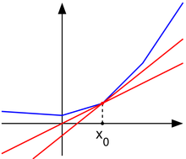
Subderivatives
subderivative: generalization of derivative for nondifferentiable, convex functions
there may be multiple
subderivatives at a point
(red lines)
this set is called the subdifferential
a convex function g is differentiable at point x₀ if and only if the subdifferential of g at x₀ contains only the derivative of g at x₀

Slide 76
Stochastic Subgradient Descent
just like stochastic gradient descent, except replace gradients with subgradients
similarly strong theoretical guarantees

Slide 77
Calculating Subgradients
at points of differentiability, just use your rules for calculating gradients
at points of nondifferentiability, just find a single subgradient; any subgradient will do
e.g., max of convex functions (on board)

Slide 78
Please email me (kgimpel@ttic.edu) with the following:
your name
your email address
whether you taking the class for credit
I will use your address to create a mailing list for course announcements

