Slide 1
TTIC 31190: Natural Language Processing
Kevin Gimpel
Winter 2016
Lecture 3: Words

Slide 2
Assignment 1 has been posted
Due 11:59 pm on Wednesday, January 20th
We will start class 5 minutes late from now on, due to several students taking algorithms across campus
My office hours are Mondays 3-4pm, #531 (or by appointment)
TA office hours are Thursdays 4-5pm, #501
If you’re auditing, you may still turn in the homework and we will give you feedback (though we may not give your homework as much attention as others)
If you didn’t receive an email from me this details, then please email me with your name/email and let me know whether you are taking course for credit

Slide 3
Today
review of loss functions and subgradients from last week (useful for homework)
start words (more about words and lexical semantics on Thursday)

Slide 4
Empirical Risk Minimization with Surrogate Loss Functions
given training data:
where each is a label
we want to solve the following:

Slide 5
Empirical Risk Minimization with Surrogate Loss Functions
given training data:
where each is a label
we want to solve the following:
many possible loss functions to consider optimizing

Slide 6
Cost Functions
cost function: scores output against a gold standard
should reflect the evaluation metric for your task
usual convention:
for classification, what cost should we use?
how about for other NLP tasks?

Slide 7
Surrogate Loss Functions
cost loss / 0-1 loss:
max-score loss:

Slide 8
Visualization
score
five possible outputs

Slide 9
Visualization
cost
five possible outputs

Slide 10

Visualization
cost
gold standard

Slide 11
Visualization
cost
gold standard

Slide 12
Visualization
score + cost
gold standard

Slide 14
score
gold standard

Slide 15
score
effect of learning?
gold standard

Slide 16
score
effect of learning:
score of gold standard will go to infinity
gold standard

Slide 17
perceptron loss:

Slide 18
perceptron loss:
score
gold standard

Slide 19
perceptron loss:
score
gold standard

Slide 20
perceptron loss:
score
effect of learning?
gold standard

Slide 21
perceptron loss:
score
effect of learning:
gold standard will have highest score
gold standard

Slide 22
hinge loss:

Slide 23
hinge loss:
score + cost
gold standard

Slide 24
hinge loss:
score + cost
gold standard

Slide 25
hinge loss:
effect of learning?
score + cost
gold standard

Slide 26
hinge loss:
effect of learning:
score of gold standard will be higher than score+cost of all others
score + cost
gold standard

Slide 27
Subgradients of Loss Functions
some of our loss functions are not differentiable:
but they are subdifferentiable:

Slide 28
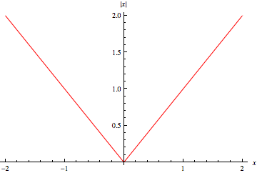
Subgradient Examples

Slide 29
Subgradient Examples

Slide 30
Subgradient Examples
to find a subgradient of max of convex functions at a point, choose one function that achieves the max at that point and choose any of its subgradients at the point

Slide 31
Subgradients of Loss Functions
some of our loss functions are not differentiable:
but they are subdifferentiable:

Slide 32
Subgradients of Loss Functions
some of our loss functions are not differentiable:
but they are subdifferentiable:

Slide 33
Subgradients of Loss Functions
find subgradient of the function that achieves the max

Slide 34
Subgradients of Loss Functions
find subgradient of the function that achieves the max

Slide 35
Roadmap
classification
words
lexical semantics
language modeling
sequence labeling
syntax and syntactic parsing
neural network methods in NLP
semantic compositionality
semantic parsing
unsupervised learning
machine translation and other applications

Slide 36
Words
what is a word?
tokenization
morphology
word sense

Slide 37
What is a word?

Slide 38
Tokenization
tokenization: convert a character stream into words by adding spaces
for certain languages, highly nontrivial
e.g., Chinese word segmentation is a widely-studied NLP task

Slide 39
Tokenization
for other languages (English), tokenization is easier but is still not always obvious
the data for your homework has been tokenized:
punctuation has been split off from words
contractions have been split

Slide 40
Intricacies of Tokenization
separating punctuation characters from words?
, ” ? ! → always separate
. → when shouldn’t we separate it?
Dr., Mr., Prof., U.S., etc.
English contractions:
isn’t, aren’t, wasn’t,… → is n’t, are n’t, was n’t,…
but how about these: can’t, won’t → ca n’t, wo n’t
ca and wo are then different forms from can and will
Notes:
weren’t, don’t, didn’t, doesn’t, wouldn’t, couldn’t, shouldn’t, haven’t, hadn’t

Slide 41
Intricacies of Tokenization
separating punctuation characters from words?
, ” ? ! → always separate
. → when shouldn’t we separate it?
Dr., Mr., Prof., U.S., etc.
English contractions:
isn’t, aren’t, wasn’t,… → is n’t, are n’t, was n’t,…
but how about these: can’t, won’t → ca n’t, wo n’t
ca and wo are then different forms from can and will
Notes:
weren’t, don’t, didn’t, doesn’t, wouldn’t, couldn’t, shouldn’t, haven’t, hadn’t

Slide 42
Intricacies of Tokenization
separating punctuation characters from words?
, ” ? ! → always separate
. → when shouldn’t we separate it?
Dr., Mr., Prof., U.S., etc.
English contractions:
isn’t, aren’t, wasn’t,… → is n’t, are n’t, was n’t,…
but how about these: can’t, won’t → ca n’t, wo n’t
ca and wo are then different forms from can and will
Notes:
weren’t, don’t, didn’t, doesn’t, wouldn’t, couldn’t, shouldn’t, haven’t, hadn’t

Slide 43
Chinese and Japanese: no spaces between words:
莎拉波娃现在居住在美国东南部的佛罗里达。
莎拉波娃 现在 居住 在 美国 东南部 的 佛罗里达
Sharapova now lives in US southeastern Florida
Further complicated in Japanese, with multiple alphabets intermingled
Dates/amounts in multiple formats
フォーチュン500社は情報不足のため時間あた$500K(約6,000万円)
Katakana
Hiragana
Kanji
Romaji
End-user can express query entirely in hiragana!
J&M/SLP3

Slide 44
Word Segmentation in Chinese
Chinese words are composed of characters
characters are generally 1 syllable and 1 morpheme
average word is 2.4 characters long
standard baseline segmentation algorithm:
Maximum Matching (also called Greedy)
J&M/SLP3

Slide 45
Maximum Matching Word Segmentation Algorithm
Given a Chinese word list and a string:
start a pointer at the beginning of the string
find longest word in dictionary that matches the string starting at pointer
move the pointer over the word in string
go to 2
J&M/SLP3

Slide 46
Maximum Matching Examples
Thecatinthehat
Thetabledownthere
Doesn’t generally work in English!
But works astonishingly well in Chinese
莎拉波娃现在居住在美国东南部的佛罗里达。
莎拉波娃 现在 居住 在 美国 东南部 的 佛罗里达
Modern probabilistic segmentation algorithms even better
the cat in the hat
the table down there
theta bled own there
J&M/SLP3

Slide 47
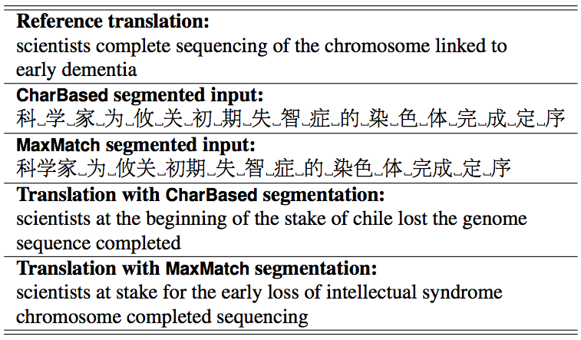
Effect on Machine Translation
Chang, Galley, & Manning (2008)

Slide 48
Removing Spaces?
tokenization is usually about adding spaces
but might we also want to remove spaces?
what are some English examples?
names?
New York → NewYork
non-compositional compounds?
hot dog → hotdog
other artifacts of our spacing conventions?
New York-Long Island Railway

Slide 49
Removing Spaces?
tokenization is usually about adding spaces
but might we also want to remove spaces?
what are some English examples?
names?
New York → NewYork
non-compositional compounds?
hot dog → hotdog
other artifacts of our spacing conventions?
New York-Long Island Railway

Slide 50
Types and Tokens
once text has been tokenized, let’s count the words
types: entries in the vocabulary
tokens: instances of types in a corpus
example sentence: If they want to go , they should go .
how many types?
how many tokens?
type/token ratio: useful statistic of a corpus (here, 0.8)
as we add data, what happens to the type-token ratio?
indicates what?
high type/token ratio → rich morphology
low type/token ratio → poor morphology
Notes:
[kgimpel@chia twitter]$ typetoken.pl < tweets.1k
types = 4314
tokens = 15216
type/token ratio = 0.283517350157729
[kgimpel@chia twitter]$ typetoken.pl < tweets.10k
types = 22082
tokens = 149417
type/token ratio = 0.147787734996687
[kgimpel@chia twitter]$ typetoken.pl < tweets.100k
types = 110925
tokens = 1500365
type/token ratio = 0.0739320098775964
[kgimpel@chia twitter]$ typetoken.pl < tweets.1M
types = 604396
tokens = 15041588
type/token ratio = 0.040181661670297
[kgimpel@chia twitter]$ wc big100kuniq
56345753 847216426 4426084601 big100kuniq
types = 11371934
tokens = 847372098
type/token ratio = 0.0134202365487847

Slide 51
Types and Tokens
once text has been tokenized, let’s count the words
types: entries in the vocabulary
tokens: instances of types in a corpus
example sentence: If they want to go , they should go .
how many types? 8
how many tokens? 10
type/token ratio: useful statistic of a corpus (here, 0.8)
as we add data, what happens to the type-token ratio?
indicates what?
high type/token ratio → rich morphology
low type/token ratio → poor morphology
Notes:
[kgimpel@chia twitter]$ typetoken.pl < tweets.1k
types = 4314
tokens = 15216
type/token ratio = 0.283517350157729
[kgimpel@chia twitter]$ typetoken.pl < tweets.10k
types = 22082
tokens = 149417
type/token ratio = 0.147787734996687
[kgimpel@chia twitter]$ typetoken.pl < tweets.100k
types = 110925
tokens = 1500365
type/token ratio = 0.0739320098775964
[kgimpel@chia twitter]$ typetoken.pl < tweets.1M
types = 604396
tokens = 15041588
type/token ratio = 0.040181661670297
[kgimpel@chia twitter]$ wc big100kuniq
56345753 847216426 4426084601 big100kuniq
types = 11371934
tokens = 847372098
type/token ratio = 0.0134202365487847

Slide 52
Types and Tokens
once text has been tokenized, let’s count the words
types: entries in the vocabulary
tokens: instances of types in a corpus
example sentence: If they want to go , they should go .
how many types? 8
how many tokens? 10
type/token ratio: useful statistic of a corpus (here, 0.8)
as we add data, what happens to the type-token ratio?
indicates what?
high type/token ratio →
low type/token ratio →
Notes:
[kgimpel@chia twitter]$ typetoken.pl < tweets.1k
types = 4314
tokens = 15216
type/token ratio = 0.283517350157729
[kgimpel@chia twitter]$ typetoken.pl < tweets.10k
types = 22082
tokens = 149417
type/token ratio = 0.147787734996687
[kgimpel@chia twitter]$ typetoken.pl < tweets.100k
types = 110925
tokens = 1500365
type/token ratio = 0.0739320098775964
[kgimpel@chia twitter]$ typetoken.pl < tweets.1M
types = 604396
tokens = 15041588
type/token ratio = 0.040181661670297
[kgimpel@chia twitter]$ wc big100kuniq
56345753 847216426 4426084601 big100kuniq
types = 11371934
tokens = 847372098
type/token ratio = 0.0134202365487847

Slide 53
Types and Tokens
once text has been tokenized, let’s count the words
types: entries in the vocabulary
tokens: instances of types in a corpus
example sentence: If they want to go , they should go .
how many types? 8
how many tokens? 10
type/token ratio: useful statistic of a corpus (here, 0.8)
as we add data, what happens to the type-token ratio?
indicates what?
high type/token ratio → rich morphology
low type/token ratio → poor morphology
Notes:
[kgimpel@chia twitter]$ typetoken.pl < tweets.1k
types = 4314
tokens = 15216
type/token ratio = 0.283517350157729
[kgimpel@chia twitter]$ typetoken.pl < tweets.10k
types = 22082
tokens = 149417
type/token ratio = 0.147787734996687
[kgimpel@chia twitter]$ typetoken.pl < tweets.100k
types = 110925
tokens = 1500365
type/token ratio = 0.0739320098775964
[kgimpel@chia twitter]$ typetoken.pl < tweets.1M
types = 604396
tokens = 15041588
type/token ratio = 0.040181661670297
[kgimpel@chia twitter]$ wc big100kuniq
56345753 847216426 4426084601 big100kuniq
types = 11371934
tokens = 847372098
type/token ratio = 0.0134202365487847

Slide 54
How many words are there?
how many English words exist?
when we increase the size of our corpus, what happens to the number of types?
a bit surprising: vocabulary continues to grow in any actual dataset
you’ll just never see all the words
Zipf’s law: frequency of a word is inversely proportional to its rank
Notes:
[kgimpel@chia twitter]$ typetoken.pl < tweets.1k
types = 4314
tokens = 15216
type/token ratio = 0.283517350157729
[kgimpel@chia twitter]$ typetoken.pl < tweets.10k
types = 22082
tokens = 149417
type/token ratio = 0.147787734996687
[kgimpel@chia twitter]$ typetoken.pl < tweets.100k
types = 110925
tokens = 1500365
type/token ratio = 0.0739320098775964
[kgimpel@chia twitter]$ typetoken.pl < tweets.1M
types = 604396
tokens = 15041588
type/token ratio = 0.040181661670297
[kgimpel@chia twitter]$ wc big100kuniq
56345753 847216426 4426084601 big100kuniq
types = 11371934
tokens = 847372098
type/token ratio = 0.0134202365487847

Slide 55
How many words are there?
how many English words exist?
when we increase the size of our corpus, what happens to the number of types?
a bit surprising: vocabulary continues to grow in any actual dataset
you’ll just never see all the words
in 1 million tweets, 15M tokens, 600k types
in 56 million tweets, 847M tokens, ? types
Notes:
[kgimpel@chia twitter]$ typetoken.pl < tweets.1k
types = 4314
tokens = 15216
type/token ratio = 0.283517350157729
[kgimpel@chia twitter]$ typetoken.pl < tweets.10k
types = 22082
tokens = 149417
type/token ratio = 0.147787734996687
[kgimpel@chia twitter]$ typetoken.pl < tweets.100k
types = 110925
tokens = 1500365
type/token ratio = 0.0739320098775964
[kgimpel@chia twitter]$ typetoken.pl < tweets.1M
types = 604396
tokens = 15041588
type/token ratio = 0.040181661670297
[kgimpel@chia twitter]$ wc big100kuniq
56345753 847216426 4426084601 big100kuniq
types = 11371934
tokens = 847372098
type/token ratio = 0.0134202365487847

Slide 56
How many words are there?
how many English words exist?
when we increase the size of our corpus, what happens to the number of types?
a bit surprising: vocabulary continues to grow in any actual dataset
you’ll just never see all the words
in 1 million tweets, 15M tokens, 600k types
in 56 million tweets, 847M tokens, 11M types
Notes:
[kgimpel@chia twitter]$ typetoken.pl < tweets.1k
types = 4314
tokens = 15216
type/token ratio = 0.283517350157729
[kgimpel@chia twitter]$ typetoken.pl < tweets.10k
types = 22082
tokens = 149417
type/token ratio = 0.147787734996687
[kgimpel@chia twitter]$ typetoken.pl < tweets.100k
types = 110925
tokens = 1500365
type/token ratio = 0.0739320098775964
[kgimpel@chia twitter]$ typetoken.pl < tweets.1M
types = 604396
tokens = 15041588
type/token ratio = 0.040181661670297
[kgimpel@chia twitter]$ wc big100kuniq
56345753 847216426 4426084601 big100kuniq
types = 11371934
tokens = 847372098
type/token ratio = 0.0134202365487847

Slide 57
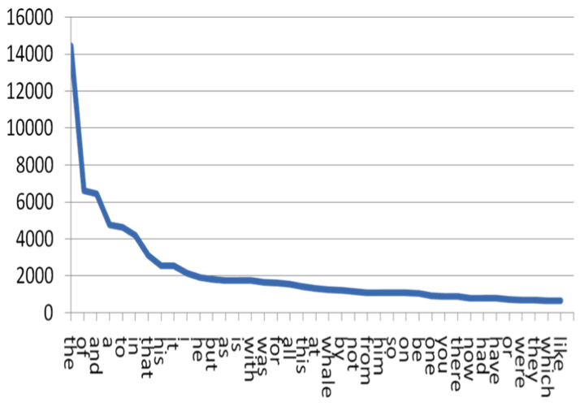
How are words distributed?
Zipf’s law: frequency of a word is inversely proportional to its rank
blog EMIS
Notes:
[kgimpel@chia twitter]$ typetoken.pl < tweets.1k
types = 4314
tokens = 15216
type/token ratio = 0.283517350157729
[kgimpel@chia twitter]$ typetoken.pl < tweets.10k
types = 22082
tokens = 149417
type/token ratio = 0.147787734996687
[kgimpel@chia twitter]$ typetoken.pl < tweets.100k
types = 110925
tokens = 1500365
type/token ratio = 0.0739320098775964
[kgimpel@chia twitter]$ typetoken.pl < tweets.1M
types = 604396
tokens = 15041588
type/token ratio = 0.040181661670297
[kgimpel@chia twitter]$ wc big100kuniq
56345753 847216426 4426084601 big100kuniq
types = 11371934
tokens = 847372098
type/token ratio = 0.0134202365487847

Slide 58
How are words distributed?
Zipf’s law: frequency of a word is inversely proportional to its rank
“long tail”
blog EMIS
Notes:
[kgimpel@chia twitter]$ typetoken.pl < tweets.1k
types = 4314
tokens = 15216
type/token ratio = 0.283517350157729
[kgimpel@chia twitter]$ typetoken.pl < tweets.10k
types = 22082
tokens = 149417
type/token ratio = 0.147787734996687
[kgimpel@chia twitter]$ typetoken.pl < tweets.100k
types = 110925
tokens = 1500365
type/token ratio = 0.0739320098775964
[kgimpel@chia twitter]$ typetoken.pl < tweets.1M
types = 604396
tokens = 15041588
type/token ratio = 0.040181661670297
[kgimpel@chia twitter]$ wc big100kuniq
56345753 847216426 4426084601 big100kuniq
types = 11371934
tokens = 847372098
type/token ratio = 0.0134202365487847

Slide 59
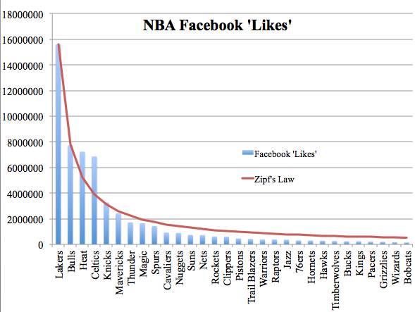
Zipf’s Law
also predicts other kinds of data: population of cities in a country, revenue of different companies, etc.
The Laurentian University Sports Analytics Group
Notes:
[kgimpel@chia twitter]$ typetoken.pl < tweets.1k
types = 4314
tokens = 15216
type/token ratio = 0.283517350157729
[kgimpel@chia twitter]$ typetoken.pl < tweets.10k
types = 22082
tokens = 149417
type/token ratio = 0.147787734996687
[kgimpel@chia twitter]$ typetoken.pl < tweets.100k
types = 110925
tokens = 1500365
type/token ratio = 0.0739320098775964
[kgimpel@chia twitter]$ typetoken.pl < tweets.1M
types = 604396
tokens = 15041588
type/token ratio = 0.040181661670297
[kgimpel@chia twitter]$ wc big100kuniq
56345753 847216426 4426084601 big100kuniq
types = 11371934
tokens = 847372098
type/token ratio = 0.0134202365487847

Slide 60
The Long Tail
there are so many word types!
but words have internal structure

Slide 61
Morphology
morphemes:
the small meaningful units that make up words
stems: core meaning-bearing units
affixes: bits and pieces that adhere to stems
often with grammatical functions
J&M/SLP3

Slide 62
Kinds of Word Formation
inflection: modifying a word with an affix to change its grammatical function (tense, number, etc.)
result is a “different form of the same word”
examples: book → books, walk → walked
derivation: adding an affix to a stem to create a new word
examples: great → greatly, great → greatness
compounding: combining two stems
examples: lawsuit, keyboard, bookcase

Slide 63
Kinds of Word Formation
inflection: modifying a word with an affix to change its grammatical function (tense, number, etc.)
result is a “different form of the same word”
examples: book → books, walk → walked
derivation: adding an affix to a stem to create a new word
examples: great → greatly, great → greatness
compounding: combining two stems
examples: lawsuit, keyboard, bookcase

Slide 64
Kinds of Word Formation
inflection: modifying a word with an affix to change its grammatical function (tense, number, etc.)
result is a “different form of the same word”
examples: book → books, walk → walked
derivation: adding an affix to a stem to create a new word
examples: great → greatly, great → greatness
compounding: combining two stems
examples: lawsuit, keyboard, bookcase

Slide 65
Morphology
usually, morphological derivation is simply splitting a word into its morphemes:
walked = walk + ed
greatness = great + ness
but it can actually be a hierarchical structure

Slide 66
Morphology
ambiguity in hierarchical morphological decomposition?
rare, but it does happen
unlockable = un + lock + able
what does this word mean?
(un+lock)+able: “able to be unlocked”
un+(lock+able): “unable to be locked”

Slide 67
Morphology
ambiguity in hierarchical morphological decomposition?
rare, but it does happen
unlockable = un + lock + able
what does this word mean?
(un+lock)+able: “able to be unlocked”
un+(lock+able): “unable to be locked”

Slide 68
Morphology
ambiguity in hierarchical morphological decomposition?
rare, but it does happen
unlockable = un + lock + able
what does this word mean?
(un+lock)+able: “able to be unlocked”
un+(lock+able): “unable to be locked”

Slide 69
Morphology in NLP
two common tasks:
lemmatization
stemming

Slide 70
Lemmatization
lemmatization: reduce inflections or variant forms to base form
am, are, is → be
car, cars, car's, cars' → car
the boy's cars are different colors → the boy car be different color
have to find correct dictionary headword form
e.g., for machine translation:
Spanish quiero (‘I want’), quieres (‘you want’) same lemma as querer ‘want’
J&M/SLP3

Slide 71
Stemming
stemming: reduces words to their stems via crude chopping of affixes
e.g., automate(s), automatic, automation all reduced to automat
language dependent
key step in information retrieval
for example compressed
and compression are both
accepted as equivalent to
compress.
for exampl compress and
compress ar both accept
as equival to compress
J&M/SLP3

Slide 72
Porter’s algorithm The most common English stemmer
Step 1a
sses → ss caresses → caress
ies → i ponies → poni
ss → ss caress → caress
s → ø cats → cat
Step 1b
(*v*)ing → ø walking → walk
sing → sing
(*v*)ed → ø plastered → plaster
…
Step 2 (for long stems)
ational→ ate relational→ relate
izer→ ize digitizer → digitize
ator→ ate operator → operate
…
Step 3 (for longer stems)
al → ø revival → reviv
able → ø adjustable → adjust
ate → ø activate → activ
…
J&M/SLP3

Slide 73
Viewing morphology in a corpus Why only strip –ing if there is a vowel?
(*v*)ing → ø walking → walk
sing → sing
J&M/SLP3

Slide 74
Viewing morphology in a corpus Why only strip –ing if there is a vowel?
(*v*)ing → ø walking → walk
sing → sing
tr -sc 'A-Za-z' '\n' < shakes.txt | grep ’ing$' | sort | uniq -c | sort –nr
tr -sc 'A-Za-z' '\n' < shakes.txt | grep '[aeiou].*ing$' | sort | uniq -c | sort –nr
1312 King
548 being
541 nothing
388 king
375 bring
358 thing
307 ring
152 something
145 coming
130 morning
548 being
541 nothing
152 something
145 coming
130 morning
122 having
120 living
117 loving
116 Being
102 going
J&M/SLP3

Slide 75
Dealing with complex morphology is sometimes necessary
Some languages requires complex morpheme segmentation
Turkish
Uygarlastiramadiklarimizdanmissinizcasina: “(behaving) as if you are among those whom we could not civilize”
Uygar `civilized’ + las `become’
+ tir `cause’ + ama `not able’
+ dik `past’ + lar ‘plural’
+ imiz ‘p1pl’ + dan ‘abl’
+ mis ‘past’ + siniz ‘2pl’ + casina ‘as if’
J&M/SLP3

Slide 76
Terminology: lemma and wordform
lemma or citation form
same stem, part of speech, rough semantics
wordform
inflected word as it appears in text
wordform | lemma
banks | bank
sung | sing
duermes | dormir
J&M/SLP3

