Slide 1
TTIC 31190: Natural Language Processing
Kevin Gimpel
Winter 2016
Lecture 7: Sequence Models

Slide 2
Announcements
Assignment 2 has been posted, due Feb. 3
Midterm scheduled for Thursday, Feb. 18
Project proposal due Tuesday, Feb. 23
Thursday’s class will be more like a lab / flipped class
we will use the whiteboard and implement things in class, so bring paper, laptop, etc.

Slide 3
Roadmap
classification
words
lexical semantics
language modeling
sequence labeling
syntax and syntactic parsing
neural network methods in NLP
semantic compositionality
semantic parsing
unsupervised learning
machine translation and other applications

Slide 4
Language Modeling
goal: compute the probability of a sequence of words:

Slide 5
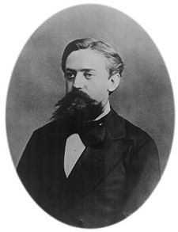
Markov Assumption for Language Modeling
Andrei Markov
J&M/SLP3

Slide 6
Intuition of smoothing (from Dan Klein)
When we have sparse statistics:
Steal probability mass to generalize better:
P(w | denied the)
3 allegations
2 reports
1 claims
1 request
7 total
allegations
attack
man
outcome
reports
…
claims
request
P(w | denied the)
2.5 allegations
1.5 reports
0.5 claims
0.5 request
2 other
7 total
allegations
allegations
attack
man
outcome
…
reports
claims
request

Slide 7
“Add-1” estimation
also called Laplace smoothing
just add 1 to all counts!
J&M/SLP3

Slide 8
Backoff and Interpolation
sometimes it helps to use less context
condition on less context for contexts you haven’t learned much about
backoff:
use trigram if you have good evidence, otherwise bigram, otherwise unigram
interpolation:
mixture of unigram, bigram, trigram (etc.) models
interpolation works better
J&M/SLP3

Slide 9
Linear Interpolation
simple interpolation:
J&M/SLP3

Slide 10
Kneser-Ney Smoothing
better estimate for probabilities of lower-order unigrams!
Shannon game: I can’t see without my reading___________?
“Francisco” is more common than “glasses”
… but “Francisco” always follows “San”
unigram is most useful when we haven’t seen bigram!
so instead of unigram P(w) (“How likely is w?”)
use P_{continuation}(w) (“How likely is w to appear as a novel continuation?”)
for each word, count # of bigram types it completes:
J&M/SLP3

Slide 11
Kneser-Ney Smoothing
how many times does w appear as a novel continuation?
normalize by total number of
word bigram types:
J&M/SLP3

Slide 12
N-gram Smoothing Summary
add-1 estimation:
OK for text categorization, not for language modeling
for very large N-gram collections like the Web:
stupid backoff
most commonly used method:
modified interpolated Kneser-Ney
J&M/SLP3

Slide 13
Roadmap
classification
words
lexical semantics
language modeling
sequence labeling
syntax and syntactic parsing
neural network methods in NLP
semantic compositionality
semantic parsing
unsupervised learning
machine translation and other applications

Slide 14
Linguistic phenomena: summary so far…
words have structure (stems and affixes)
words have multiple meanings (senses) → word sense ambiguity
senses of a word can be homonymous or polysemous
senses have relationships:
hyponymy (“is a”)
meronymy (“part of”, “member of”)
variability/flexibility of linguistic expression
many ways to express the same meaning (as you saw in Assignment 1)
word vectors tell us when two words are similar
today: part-of-speech

Slide 15
Part-of-Speech Tagging
determiner verb (past) prep. proper proper poss. adj. noun
Some questioned if Tim Cook ’s first product
modal verb det. adjective noun prep. proper punc.
would be a breakaway hit for Apple .
Notes:
sentence -> NER labeling
sentence -> translation
Neue Umfrage: Kaufen Sie eine Apple Watch?
sentence -> parse tree
set of documents -> summary

Slide 16
Part-of-Speech Tagging
determiner verb (past) prep. proper proper poss. adj. noun
modal verb det. adjective noun prep. proper punc.
determiner verb (past) prep. noun noun poss. adj. noun
Some questioned if Tim Cook ’s first product
modal verb det. adjective noun prep. noun punc.
would be a breakaway hit for Apple .
Notes:
sentence -> NER labeling
sentence -> translation
Neue Umfrage: Kaufen Sie eine Apple Watch?
sentence -> parse tree
set of documents -> summary

Slide 17
Part-of-Speech (POS)
functional category of a word:
noun, verb, adjective, etc.
how is the word functioning in its context?
dependent on context like word sense, but different from sense:
sense represents word meaning, POS represents word function
sense uses a distinct category of senses per word, POS uses same set of categories for all words

Slide 18
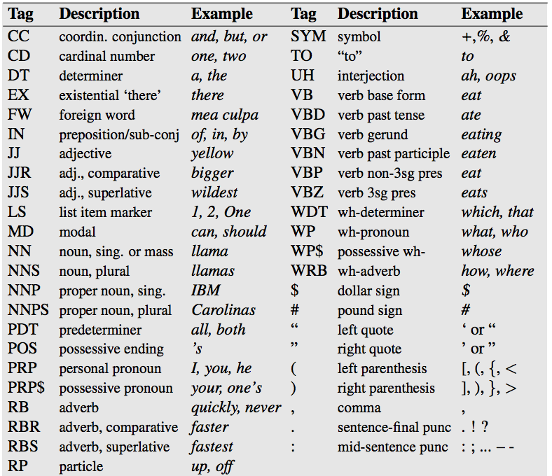
Penn Treebank tag set

Slide 19
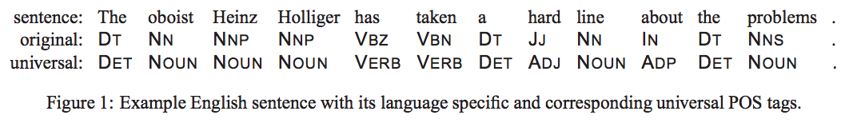
Universal Tag Set
many use smaller sets of coarser tags
e.g., “universal tag set” containing 12 tags:
noun, verb, adjective, adverb, pronoun, determiner/article, adposition (preposition or postposition), numeral, conjunction, particle, punctuation, other
Petrov, Das, McDonald (2011)

Slide 20
Twitter Part-of-Speech Tagging
other verb article noun pronoun
intj pronoun prep adj prep verb
ikr smh he asked fir yo last name so he can add u on fb lololol =D #lolz
verb prep intj emoticon hashtag
adj = adjective
prep = preposition
intj = interjection
pronoun proper
noun
we removed some fine-grained POS tags, then added Twitter-specific tags:
hashtag
@-mention
URL / email address
emoticon
Twitter discourse marker
other (multi-word abbreviations, symbols, garbage)

Slide 21
word sense vs. part-of-speech
 | word sense | part-of-speech
semantic or syntactic? | semantic: indicates meaning of word in its context | syntactic: indicates function of word in its context
number of categories | |V| words, ~5 senses each → 5|V| categories! | typical POS tag sets have 12 to 45 tags
inter-annotator agreement | low; some sense distinctions are highly subjective | high; relatively few POS tags and function is relatively shallow / surface-level
independent or joint classification of nearby words? | independent: can classify a single word based on context words; structured prediction is rarely used | joint: strong relationship between tags of nearby words; structured prediction often used

Slide 22
How might POS tags be useful?
text classification
machine translation
question answering

Slide 23
Classification Framework
inference: solve _
modeling: define score function
learning: choose _

Slide 24
Applications of our Classification Framework
text classification:
= {objective, subjective}
x | y
the hulk is an anger fueled monster with incredible strength and resistance to damage . | objective
in trying to be daring and original , it comes off as only occasionally satirical and never fresh . | subjective

Slide 25
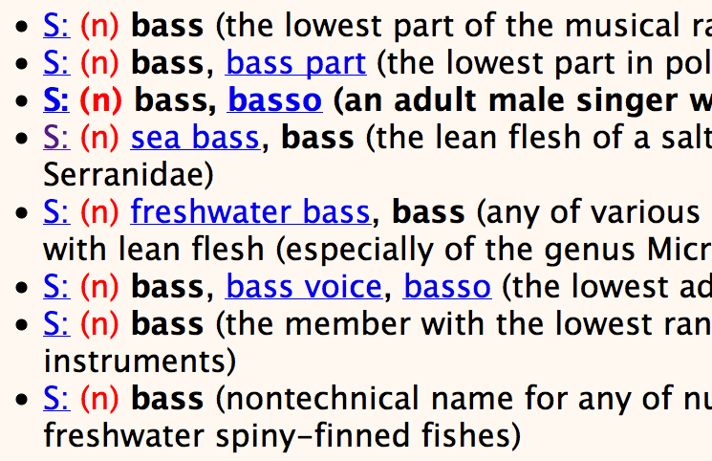
Applications of our Classification Framework
word sense classifier for bass:
= {bass₁, bass₂, …, bass₈}
x | y
he’s a bass in the choir . | bass₃
our bass is line-caught from the Atlantic . | bass₄

Slide 26
Applications of our Classification Framework
skip-gram model as a classifier:
= V (the entire vocabulary)
x | y
agriculture | <s>
agriculture | is
agriculture | the
corpus (English Wikipedia):
agriculture is the traditional mainstay of the cambodian economy .
but benares has been destroyed by an earthquake .
…

Slide 27
Applications of our Classifier Framework so far
task | input (x) | output (y) | output space ( ) | size of
text classification | a sentence | gold standard label for x | pre-defined, small label set (e.g., {positive, negative}) | 2-10
word sense disambiguation | instance of a particular word (e.g., bass) with its context | gold standard word sense of x | pre-defined sense inventory from WordNet for bass | 2-30
learning skip-gram word embeddings | instance of a word in a corpus | a word in the context of x in a corpus | vocabulary | |V|
part-of-speech tagging | a sentence | gold standard part-of-speech tags for x | all possible part-of-speech tag sequences with same length as x | |P|^{|x|}

Slide 28
Applications of our Classifier Framework so far
task | input (x) | output (y) | output space ( ) | size of
text classification | a sentence | gold standard label for x | pre-defined, small label set (e.g., {positive, negative}) | 2-10
word sense disambiguation | instance of a particular word (e.g., bass) with its context | gold standard word sense of x | pre-defined sense inventory from WordNet for bass | 2-30
learning skip-gram word embeddings | instance of a word in a corpus | a word in the context of x in a corpus | vocabulary | |V|
part-of-speech tagging | a sentence | gold standard part-of-speech tags for x | all possible part-of-speech tag sequences with same length as x | |P|^{|x|}
exponential in size of input!
“structured prediction”

Slide 29
Simplest kind of structured prediction: Sequence Labeling
Part-of-Speech Tagging
determiner verb (past) prep. proper proper poss. adj. noun
modal verb det. adjective noun prep. proper punc.
determiner verb (past) prep. noun noun poss. adj. noun
Some questioned if Tim Cook ’s first product
modal verb det. adjective noun prep. noun punc.
would be a breakaway hit for Apple .
Named Entity Recognition
Some questioned if Tim Cook’s first product would be a breakaway hit for Apple.
PERSON
ORGANIZATION
Notes:
sentence -> NER labeling
sentence -> translation
Neue Umfrage: Kaufen Sie eine Apple Watch?
sentence -> parse tree
set of documents -> summary

Slide 30
Learning
learning: choose _

Slide 31
Empirical Risk Minimization with Surrogate Loss Functions
given training data:
where each is a label
we want to solve the following:
many possible loss functions to consider optimizing

Slide 32
Loss Functions
name | loss | where used
cost (“0-1”) |  | intractable, but underlies “direct error minimization”
perceptron |  | perceptron algorithm (Rosenblatt, 1958)
hinge |  | support vector machines, other large-margin algorithms
log |  | logistic regression, conditional random fields, maximum entropy models

Slide 33
(Sub)gradients of Losses for Linear Models
name | entry j of (sub)gradient of loss for linear model
cost (“0-1”) | not subdifferentiable in general
perceptron
hinge
log
whatever loss is used during training, classify (NOT costClassify) is used to predict labels for dev/test data!

Slide 34
(Sub)gradients of Losses for Linear Models
name | entry j of (sub)gradient of loss for linear model
cost (“0-1”) | not subdifferentiable in general
perceptron
hinge
log
expectation of feature value with respect to distribution over y (where distribution is defined by theta)
alternative notation:

Slide 35
Sequence Models
models that assign scores (could be probabilities) to sequences
general category that includes many models used widely in practice:
n-gram language models
hidden Markov models
“chain” conditional random fields
maximum entropy Markov models

Slide 36
Hidden Markov Models (HMMs)
HMMs define a joint probability distribution over input sequences x and output sequences y:
conditional independence assumptions (“Markov assumption”) are used to factorize this joint distribution into small terms
widely used in NLP, speech recognition, bioinformatics, many other areas

Slide 37
Hidden Markov Models (HMMs)
HMMs define a joint probability distribution over input sequences x and output sequences y:
assumption: output sequence y “generates” input sequence x:
these are too difficult to estimate, let’s use Markov assumptions

Slide 38
Markov Assumption for Language Modeling
Andrei Markov
trigram model:

Slide 39
Independence and Conditional Independence
Independence: two random variables X and Y are independent if:
(or )
for all values x and y
Conditional Independence: two random variables X and Y are conditionally independent given a third variable Z if
for all values of x, y, and z
(or )

Slide 40
Markov Assumption for Language Modeling
Andrei Markov
trigram model:

Slide 41
Conditional Independence Assumptions of HMMs
two y’s are conditionally independent given the y’s between them:
an x at position i is conditionally independent of other y’s given the y at position i:

Slide 42
Graphical Model for an HMM (for a sequence of length 4)
y₁
y₂
y₃
y₄
x₁
x₂
x₃
x₄
a graphical model is a graph in which:
each node corresponds to a random variable
each directed edge corresponds to a conditional probability distribution of the target node given the source node
conditional independence statements among random variables are encoded by the edge structure

Slide 43
Graphical Model for an HMM (for a sequence of length 4)
y₁
y₂
y₃
y₄
x₁
x₂
x₃
x₄
conditional independence statements among random variables are encoded by the edge structure → we only have to worry about local distributions:
transition parameters:
emission parameters:

Slide 44
Graphical Model for an HMM (for a sequence of length 4)
y₁
y₂
y₃
y₄
x₁
x₂
x₃
x₄
transition parameters:
emission parameters:

Slide 45
“Brown Clustering”
Computational Linguistics, 1992

Slide 46
Brown Clustering (Brown et al., 1992)
hidden Markov model with one-cluster-per-word constraint
y₁
y₂
y₃
y₄
justin bieber for president

Slide 47
Brown Clustering (Brown et al., 1992)
hidden Markov model with one-cluster-per-word constraint
y₁
y₂
y₃
y₄
justin bieber for president
algorithm:
• initialize each word as its own cluster
• greedily merge clusters to improve data likelihood

Slide 48
Brown Clustering (Brown et al., 1992)
hidden Markov model with one-cluster-per-word constraint
y₁
y₂
y₃
y₄
justin bieber for president
algorithm:
• initialize each word as its own cluster
• greedily merge clusters to improve data likelihood
outputs hierarchical clustering

Slide 49
we induced 1000 Brown clusters from 56 million English tweets (1 billion words)
only words that appeared at least 40 times
(Owoputi, O’Connor, Dyer, Gimpel, Schneider, and Smith, 2013)

Slide 50
Example Cluster
missed loved hated misread admired underestimated resisted adored disliked regretted missd fancied luved prefered luvd overdid mistyped misd misssed looooved misjudged lovedd loooved loathed lurves lovd
Notes:
misse loveddd mised luv'd mis-read loooooved resented lovedddd choosed missedd loveed pvr'd detested looooooved biffed looved miss'd

Slide 51
Example Cluster
missed loved hated misread admired underestimated resisted adored disliked regretted missd fancied luved prefered luvd overdid mistyped misd misssed looooved misjudged lovedd loooved loathed lurves lovd
spelling
variation
Notes:
misse loveddd mised luv'd mis-read loooooved resented lovedddd choosed missedd loveed pvr'd detested looooooved biffed looved miss'd

Slide 52
“really”
really rly realy genuinely rlly reallly realllly reallyy rele realli relly reallllly reli reali sholl rily reallyyy reeeeally realllllly reaally reeeally rili reaaally reaaaally reallyyyy rilly reallllllly reeeeeally reeally shol realllyyy reely relle reaaaaally shole really2 reallyyyyy _really_ realllllllly reaaly realllyy reallii reallt genuinly relli realllyyyy reeeeeeally weally reaaallly reallllyyy reallllllllly reaallly realyy /really/ reaaaaaally reallu reaaaallly reeaally rreally reallyreally eally reeeaaally reeeaaally reaallyy reallyyyyyy –really- reallyreallyreally rilli reallllyyyy relaly reallllyy really-really r3ally reeli reallie realllllyyy rli realllllllllly reaaaly reeeeeeeally

Slide 53
“really”
really rly realy genuinely rlly reallly realllly reallyy rele realli relly reallllly reli reali sholl rily reallyyy reeeeally realllllly reaally reeeally rili reaaally reaaaally reallyyyy rilly reallllllly reeeeeally reeally shol realllyyy reely relle reaaaaally shole really2 reallyyyyy _really_ realllllllly reaaly realllyy reallii reallt genuinly relli realllyyyy reeeeeeally weally reaaallly reallllyyy reallllllllly reaallly realyy /really/ reaaaaaally reallu reaaaallly reeaally rreally reallyreally eally reeeaaally reeeaaally reaallyy reallyyyyyy –really- reallyreallyreally rilli reallllyyyy relaly reallllyy really-really r3ally reeli reallie realllllyyy rli realllllllllly reaaaly reeeeeeeally

Slide 54
“really”
really rly realy genuinely rlly reallly realllly reallyy rele realli relly reallllly reli reali sholl rily reallyyy reeeeally realllllly reaally reeeally rili reaaally reaaaally reallyyyy rilly reallllllly reeeeeally reeally shol realllyyy reely relle reaaaaally shole really2 reallyyyyy _really_ realllllllly reaaly realllyy reallii reallt genuinly relli realllyyyy reeeeeeally weally reaaallly reallllyyy reallllllllly reaallly realyy /really/ reaaaaaally reallu reaaaallly reeaally rreally reallyreally eally reeeaaally reeeaaally reaallyy reallyyyyyy –really- reallyreallyreally rilli reallllyyyy relaly reallllyy really-really r3ally reeli reallie realllllyyy rli realllllllllly reaaaly reeeeeeeally

Slide 55
“going to”
gonna gunna gona gna guna gnna ganna qonna gonnna gana qunna gonne goona gonnaa g0nna goina gonnah goingto gunnah gonaa gonan gunnna going2 gonnnnagunnaa gonny gunaa quna goonna qona gonns goinna gonnae qnna gonnaaa gnaa

Slide 56
“so”
soo sooo soooo sooooo soooooo sooooooo soooooooo sooooooooo soooooooooo sooooooooooo soooooooooooo sooooooooooooo soso soooooooooooooo sooooooooooooooo soooooooooooooooo sososo superrr sooooooooooooooooo ssooo so0o superrrr so0 soooooooooooooooooo sosososo sooooooooooooooooooo ssoo sssooo soooooooooooooooooooo #too s0o ssoooo s00
Notes:
sooooooooooooooooooooo so0o0o sososososo soooooooooooooooooooooo sssoooo ssooooo superrrrr very2 s000 soooooooooooooooooooooooo sooooooooooooooooooooooooo sooooooooooooooooooooooo _so_ soooooooooooooooooooooooooo /so/ sssooooo sosososososo

Slide 57
Food-Related Adjectives
hot fried peanut homemade grilled spicy soy cheesy coconut veggie roasted leftover blueberry icy dunkin mashed rotten mellow boiling crispy peppermint fruity toasted crunchy scrambled creamy boiled chunky funnel soggy clam steamed cajun steaming chewy steamy nacho mince reese's shredded salted glazed spiced venti pickled powdered butternut miso beet sizzling
Notes:
crazy nuts insane cray tuff krazy crazyy bonkers crazyyy nutz smoove crzy crazyyyy crazzy crazii batshit screwy craaazy crazi #playedout craaaazy brazy liveee crazzzy nutts crazyyyyy cross-eyed faf physco kaput kray reet wackk nutso craazy madt guu liveeee #outrageous crazzzzy craaaaazy dunzo gayyyy crazee crazyyyyyy craz crazzyy greezy wildd buckwild

Slide 58
Adjective Intensifiers/Qualifiers
kinda hella sorta hecka kindof kindaa kinna hellla propa helluh kindda justa #slick helllla hela jii sortof hellaa kida wiggity hellllla hekka hellah kindaaa hellaaa kindah knda kind-of slicc wiggidy helllllla jih jye kinnda odhee kiinda heka sorda ohde kind've kidna baree rle hellaaaa jussa

