Slide 1
TTIC 31190: Natural Language Processing
Kevin Gimpel
Winter 2016
Lecture 9: Sequence Models

Slide 2
Announcements
on Thursday, class will be in Room 530 (the room directly behind you)

Slide 3
Announcements
we will go over part of Assignment 1 today (grades coming soon)
Assignment 2 was due Wed. Feb. 3, now due Fri., Feb. 5
project proposal due Tuesday, Feb. 16
midterm on Thursday, Feb. 18

Slide 4
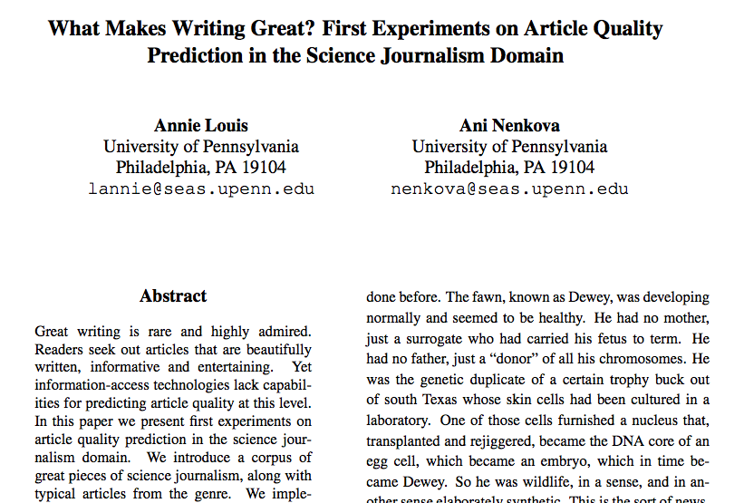
Other Naturally-Occurring Data
quality of scientific journalism:

Slide 5
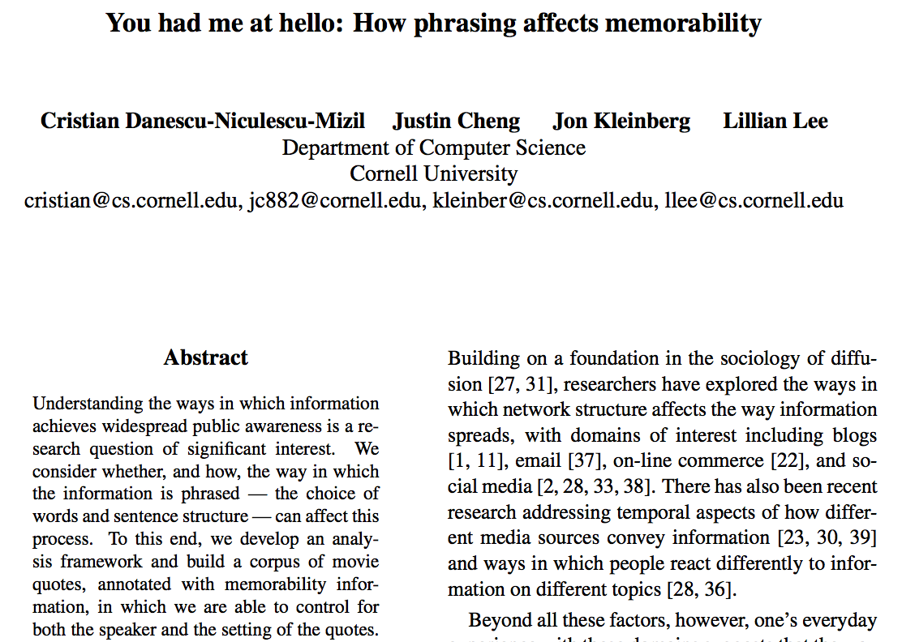
Other Naturally-Occurring Data
memorability of quotations:

Slide 6
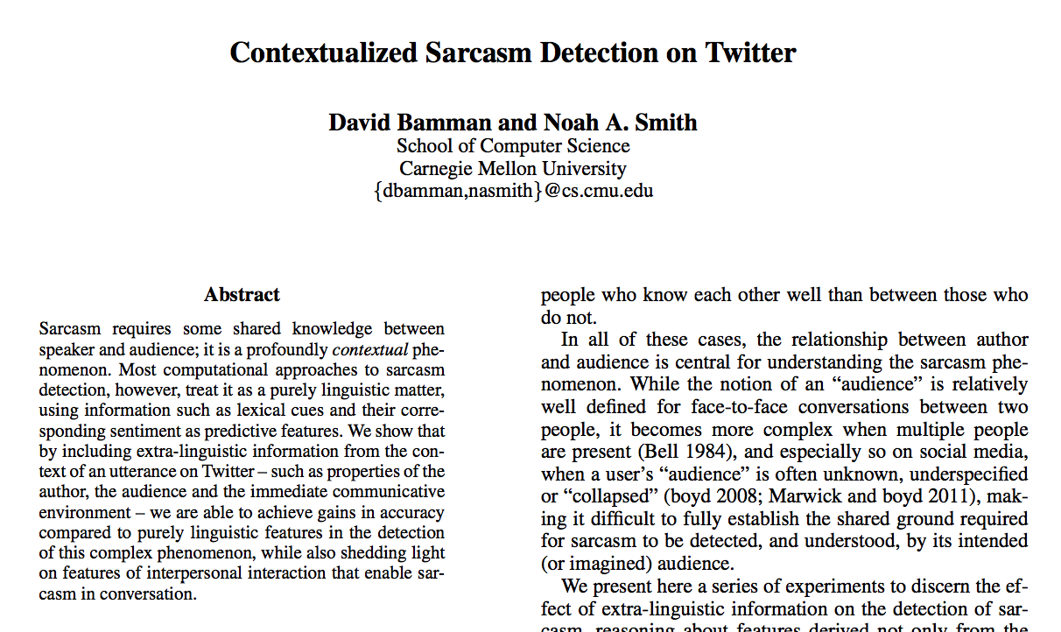
Other Naturally-Occurring Data
sarcasm (remove #sarcasm hash tag from tweets):

Slide 7
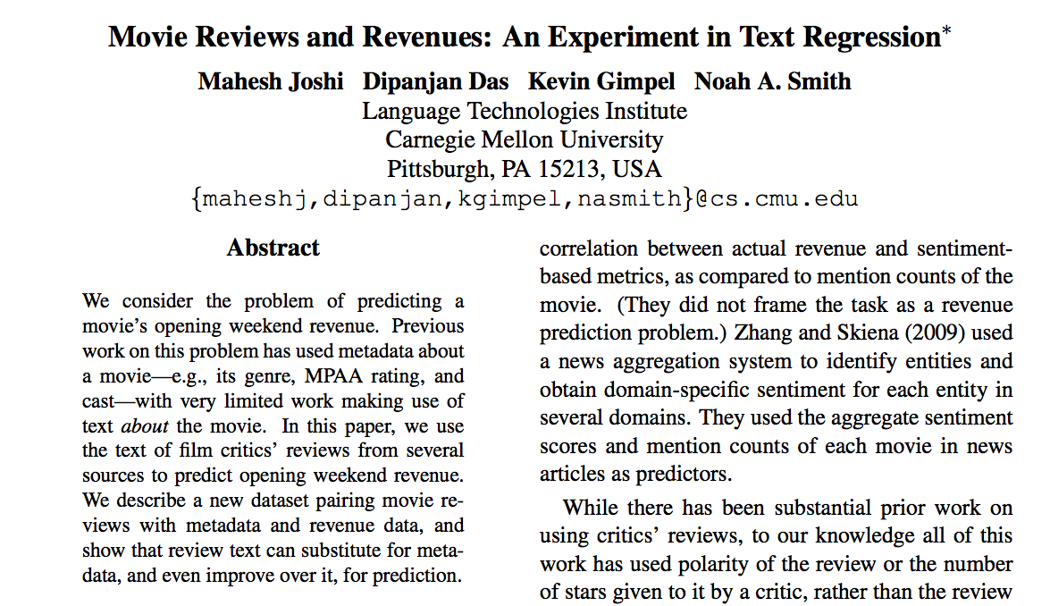
Other Naturally-Occurring Data
opening weekend movie revenue prediction from critic reviews:

Slide 8

Other Naturally-Occurring Data
predicting novel success from text of novels:

Slide 9
Project Proposal
due Feb. 16 (in two weeks)
1-2 pages
one per group
include the following:
members of your group
describe the task you are going to work on (could be a new task you create or an existing task)
describe the methods you will use/develop for the task
give a brief review of related work; i.e., situate your project with respect to the literature (www.aclweb.org and Google Scholar are useful for this!)
a proposed timeline

Slide 10
Project Proposal (cont’d)
your results do not have to beat the state-of-the-art!
but your project does have to be carefully done, so that you can draw conclusions
you are welcome to start by replicating an NLP paper (I can give suggestions if you need some)
during the week of Feb. 22, please schedule a meeting with me to discuss your project
details to follow

Slide 11
Class Presentations
final two class meetings (March 3rd and March 8th) will be mostly used for in-class presentations
one presentation per group
10-15 minutes per presentation (will be determined once I know how many groups there are)
you will each take notes and email me questions/feedback for the presenter, which I will anonymize and send

Slide 12
Project
final report due Thursday, March 17 (original date of the final exam)
so the presentation will be more like an “interim progress report”

Slide 13
Roadmap
classification
words
lexical semantics
language modeling
sequence labeling
neural network methods in NLP
syntax and syntactic parsing
semantic compositionality
semantic parsing
unsupervised learning
machine translation and other applications

Slide 14
Simplest kind of structured prediction: Sequence Labeling
Part-of-Speech Tagging
determiner verb (past) prep. proper proper poss. adj. noun
modal verb det. adjective noun prep. proper punc.
determiner verb (past) prep. noun noun poss. adj. noun
Some questioned if Tim Cook ’s first product
modal verb det. adjective noun prep. noun punc.
would be a breakaway hit for Apple .
Notes:
sentence -> NER labeling
sentence -> translation
Neue Umfrage: Kaufen Sie eine Apple Watch?
sentence -> parse tree
set of documents -> summary

Slide 15
Formulating segmentation tasks as sequence labeling via B-I-O labeling:
Named Entity Recognition
O O O B-PERSON I-PERSON O O O
Some questioned if Tim Cook ’s first product
O O O O O O B-ORGANIZATION O
would be a breakaway hit for Apple .
B = “begin”
I = “inside”
O = “outside”
Notes:
sentence -> NER labeling
sentence -> translation
Neue Umfrage: Kaufen Sie eine Apple Watch?
sentence -> parse tree
set of documents -> summary

Slide 16
there are many downloadable part-of-speech taggers and named entity recognizers:
Stanford POS tagger, NER labeler
TurboTagger, TurboEntityRecognizer
Illinois Entity Tagger
CMU Twitter POS tagger
Alan Ritter’s Twitter POS/NER labeler

Slide 17
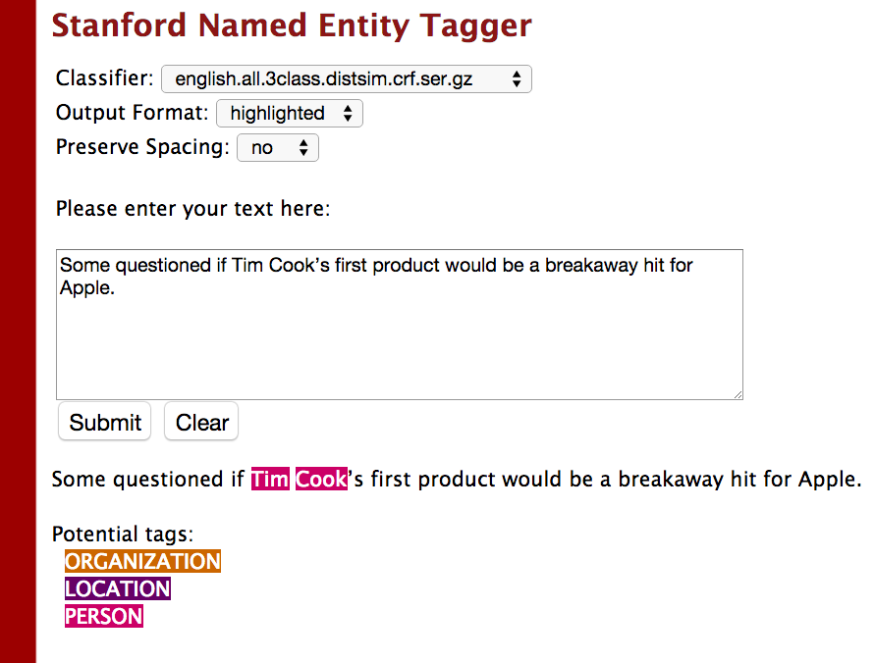

Slide 18
Hidden Markov Models
y₁
y₂
y₃
y₄
x₁
x₂
x₃
x₄
transition parameters:
emission parameters:

Slide 19
HMMs for Word Clustering (Brown et al., 1992)
y₁
y₂
y₃
y₄
justin bieber for president
each is a cluster ID
so, label space is

Slide 20
HMMs for Part-of-Speech Tagging
_{proper noun}
_{proper noun}
_{prepo-sition}
_{noun}
justin bieber for president
each is a part-of-speech tag
so, label space is
what parameters need to be learned?
transition parameters:
emission parameters:

Slide 21
How should we learn the HMM parameters?
transition parameters:
emission parameters:

Slide 22
Supervised HMMs
given a dataset of input sequences and annotated outputs:
to estimate transition/emission distributions, use maximum likelihood estimation (count and normalize):
_{proper noun}
_{proper noun}
_{prepo-sition}
_{noun}
justin bieber for president

Slide 23
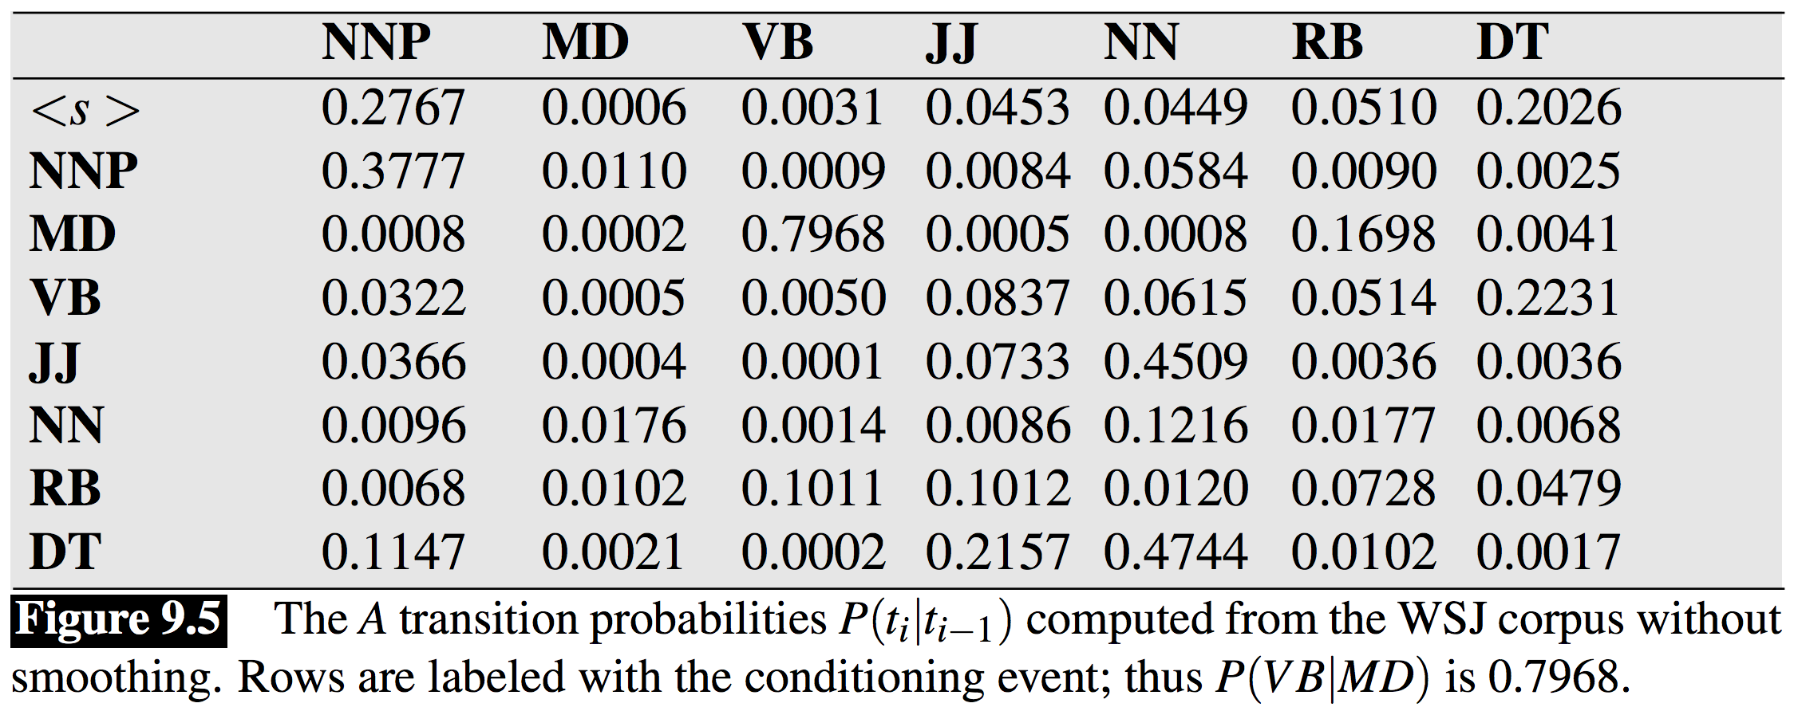
Estimates of Tag Transition Probabilities
proper modal infinitive adjective noun adverb determiner
noun verb verb

Slide 24
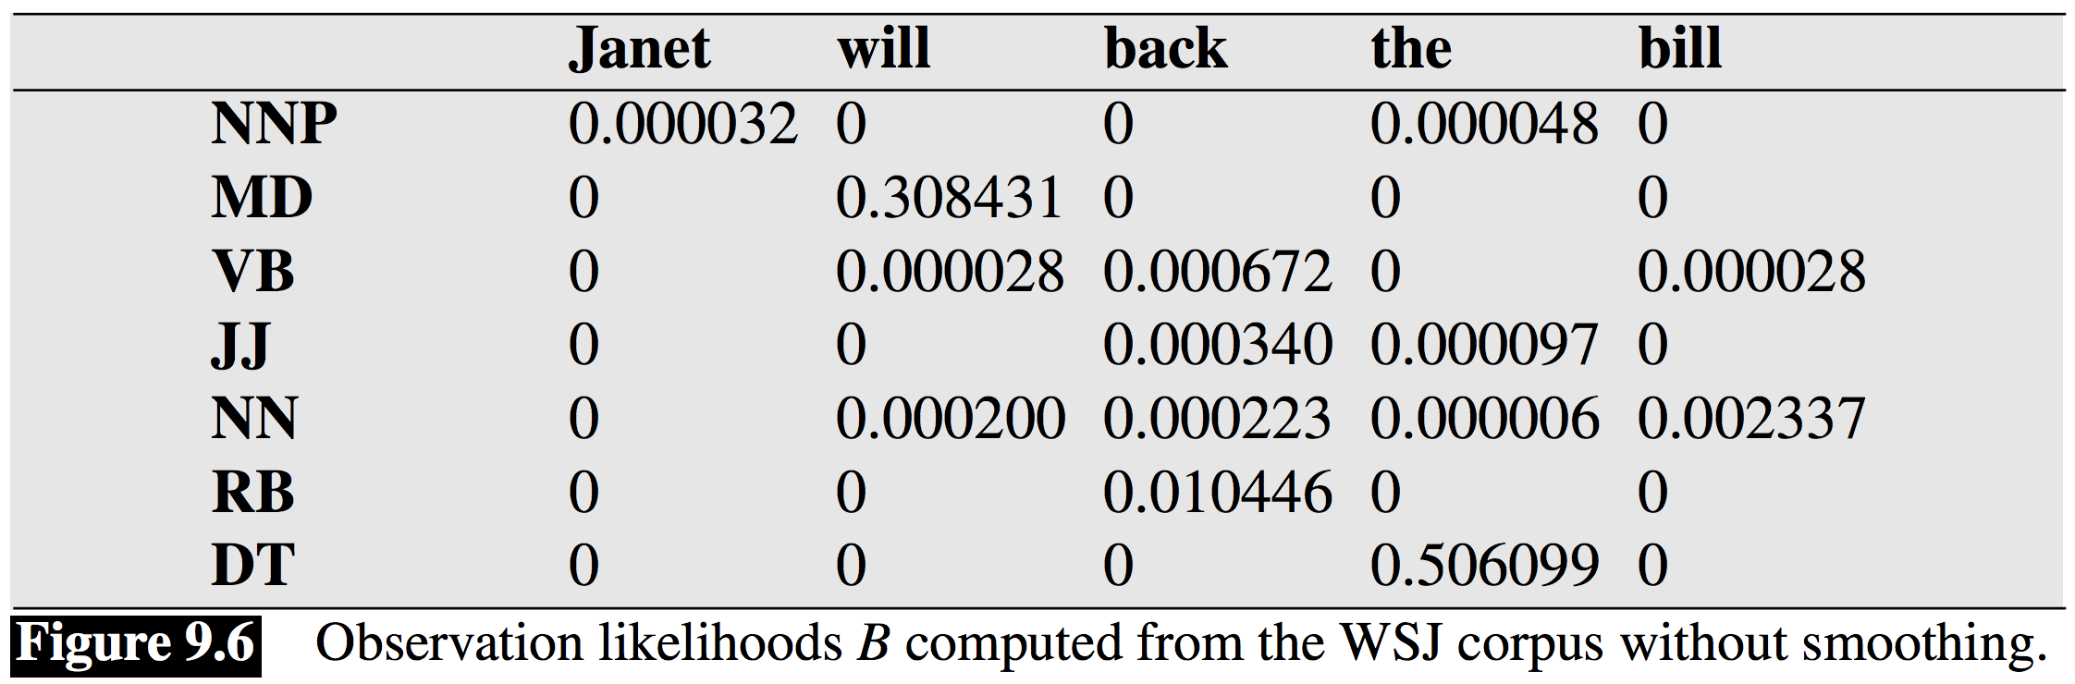
Estimates of Emission Probabilities

Slide 25
Inference in HMMs
since the output is a sequence, this argmax requires iterating over an exponentially-large set
last week we talked about using dynamic programming (DP) to solve these problems
for HMMs (and other sequence models), the for solving this is called the Viterbi algorithm

Slide 26
Viterbi Algorithm
recursive equations + memoization:
base case:
returns probability of sequence starting with label y for first word
recursive case:
computes probability of max-probability label sequence that ends with label y at position m
final value is in:

Slide 27
Example:
Janet will back the bill
proper modal infinitive determiner noun
noun verb verb

Slide 28
Janet will back the bill
proper modal infinitive determiner noun
noun verb verb

Slide 29
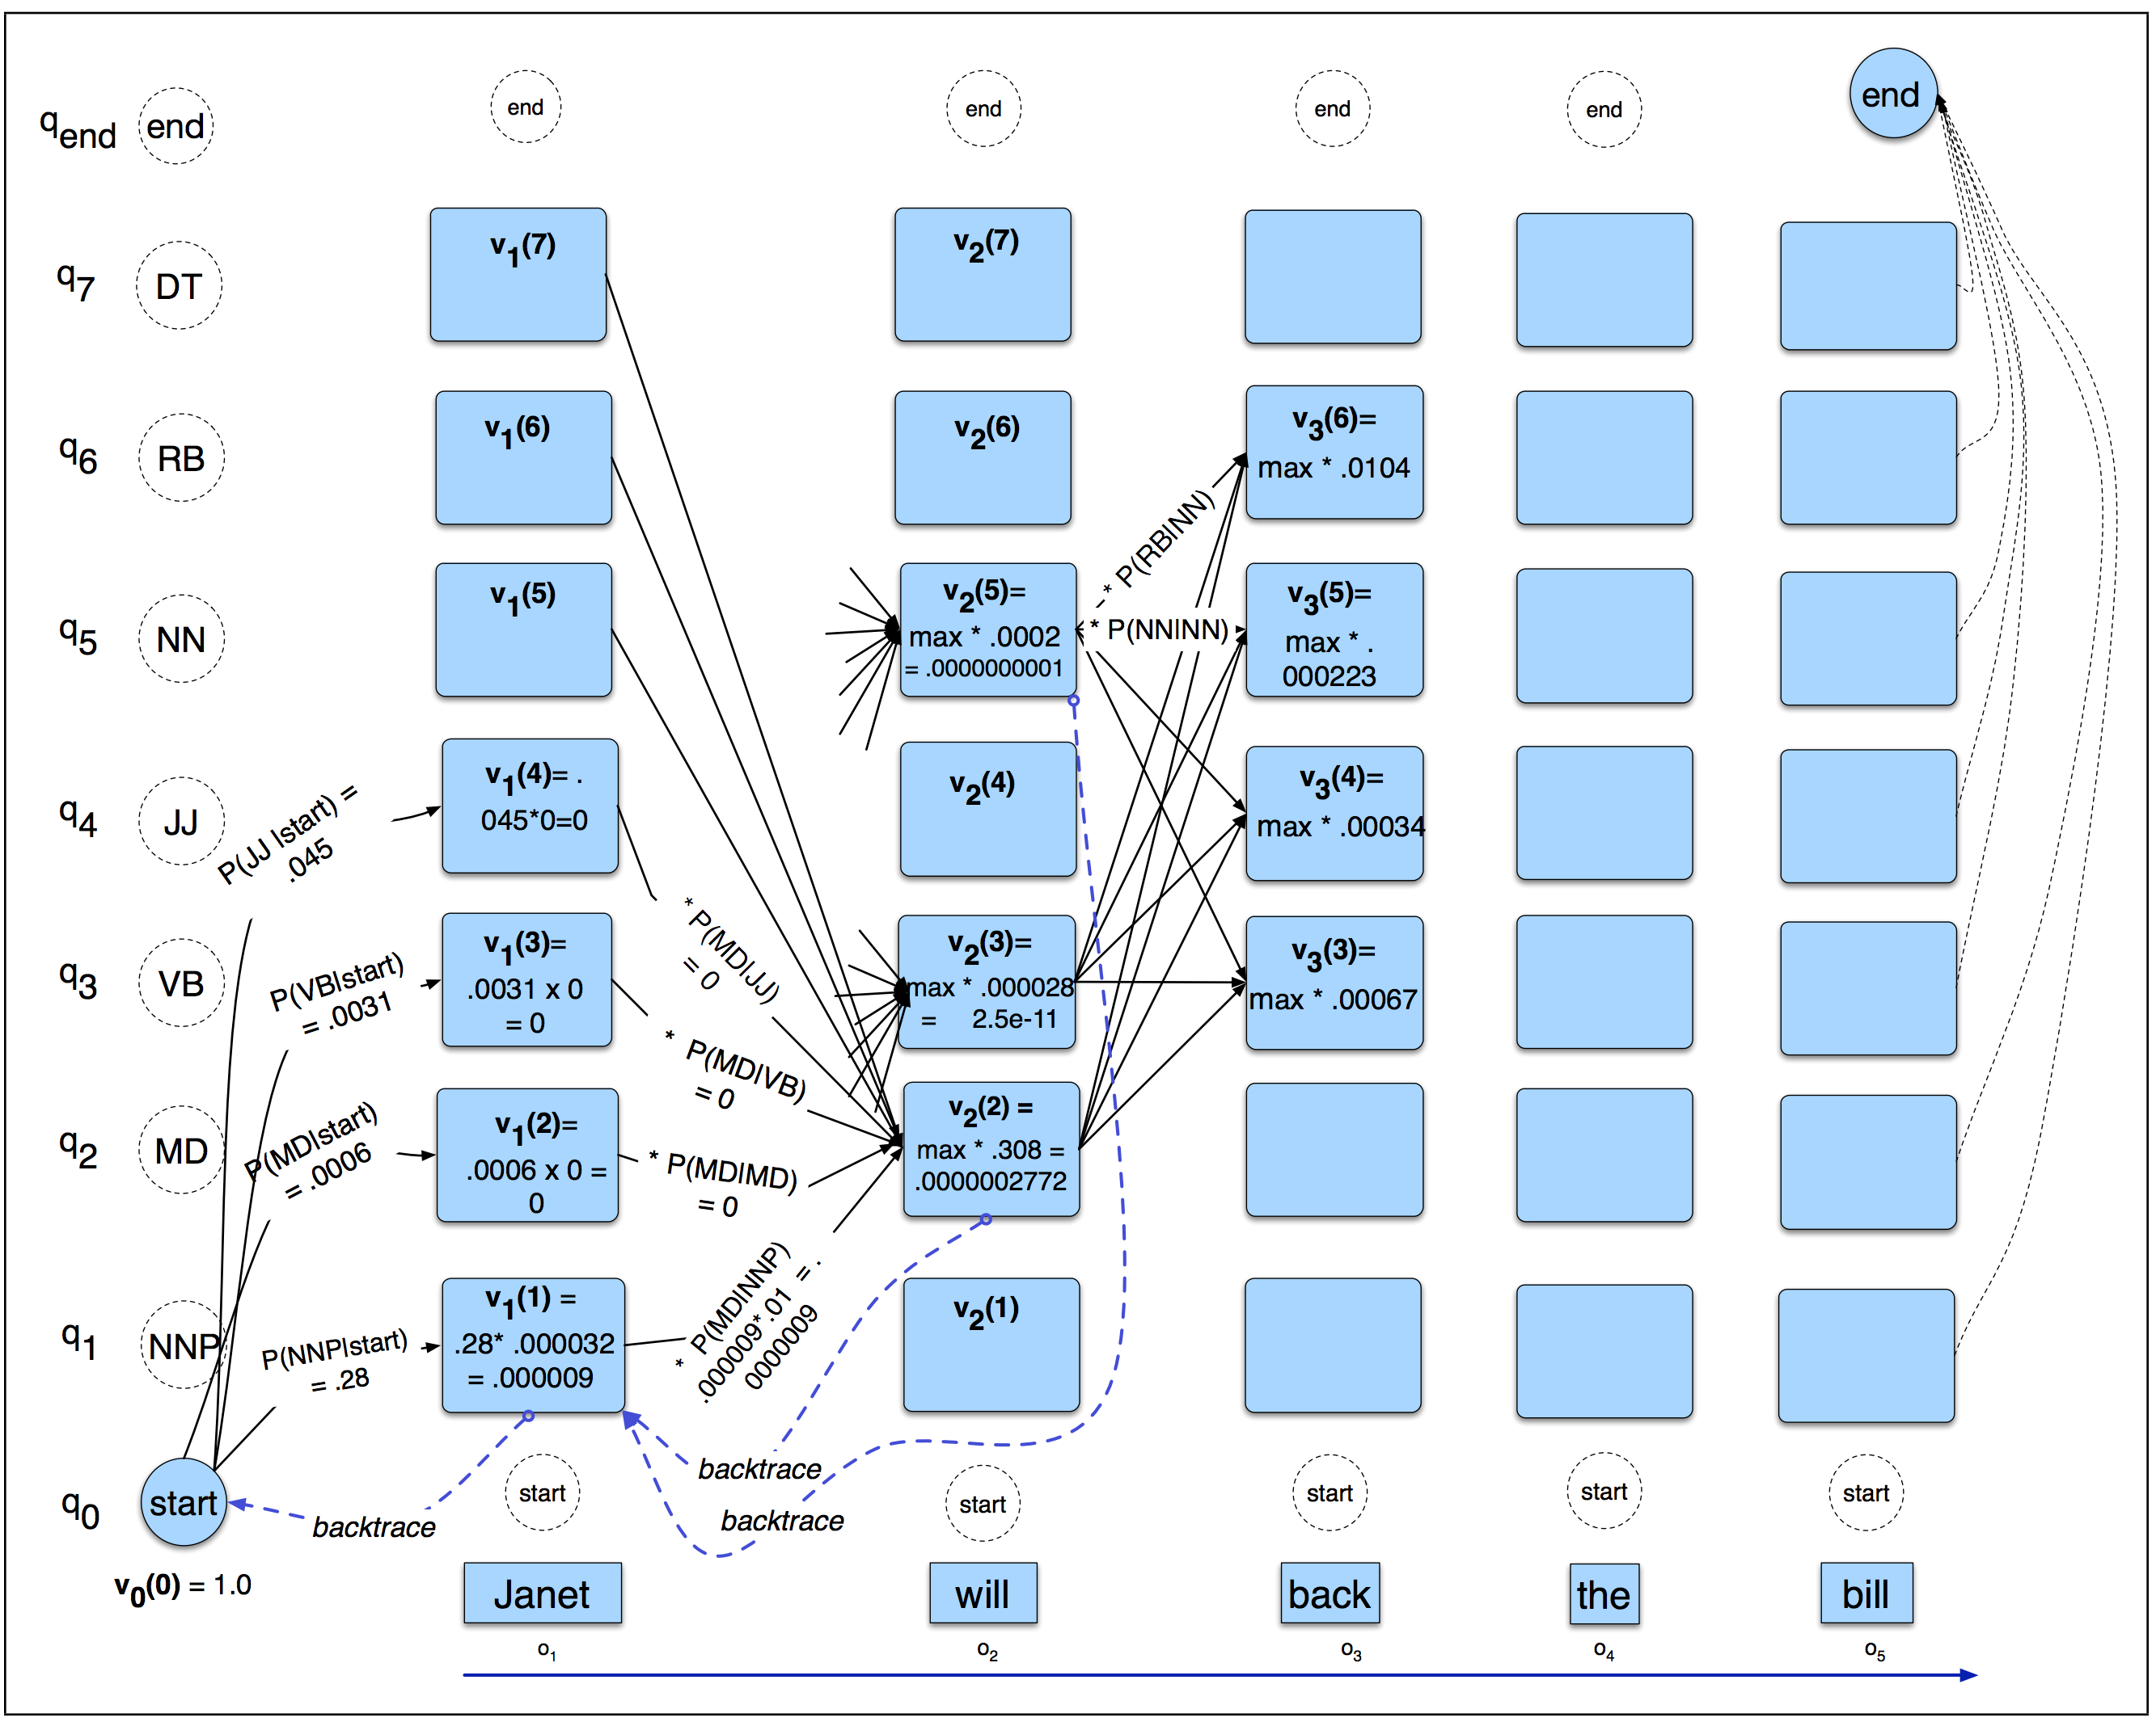
Viterbi Algorithm (on board)

Slide 30
Viterbi Algorithm
space and time complexity?
can be read off from the recursive equations:
space complexity:
size of memoization table, which is # of unique indices of recursive equations
length of sentence
number of labels
*
so, space complexity is O(|x| |L|)

Slide 31
Viterbi Algorithm
space and time complexity?
can be read off from the recursive equations:
time complexity:
size of memoization table * complexity of computing each entry
length of sentence
number of labels
each entry requires iterating through the labels
*
*
so, time complexity is O(|x| |L| |L|) = O(|x| |L|²)

Slide 32
Linear Sequence Models
let’s generalize HMMs and talk about linear models for scoring label sequences in our classifier framework:
but first, how do we know that this scoring function generalizes HMMs?

Slide 33
HMM as a Linear Model
HMM:
linear model:
what are the feature templates and weights?

Slide 34
HMM as a Linear Model
HMM:
linear model:
feature templates and weights:

Slide 35
Linear Sequence Models
so, an HMM is:
a linear sequence model
with particular features on label transitions and label-observation emissions
and uses maximum likelihood estimation (count & normalize) for learning
but we could use any feature functions we like, and use any of our loss functions for learning!

Slide 36
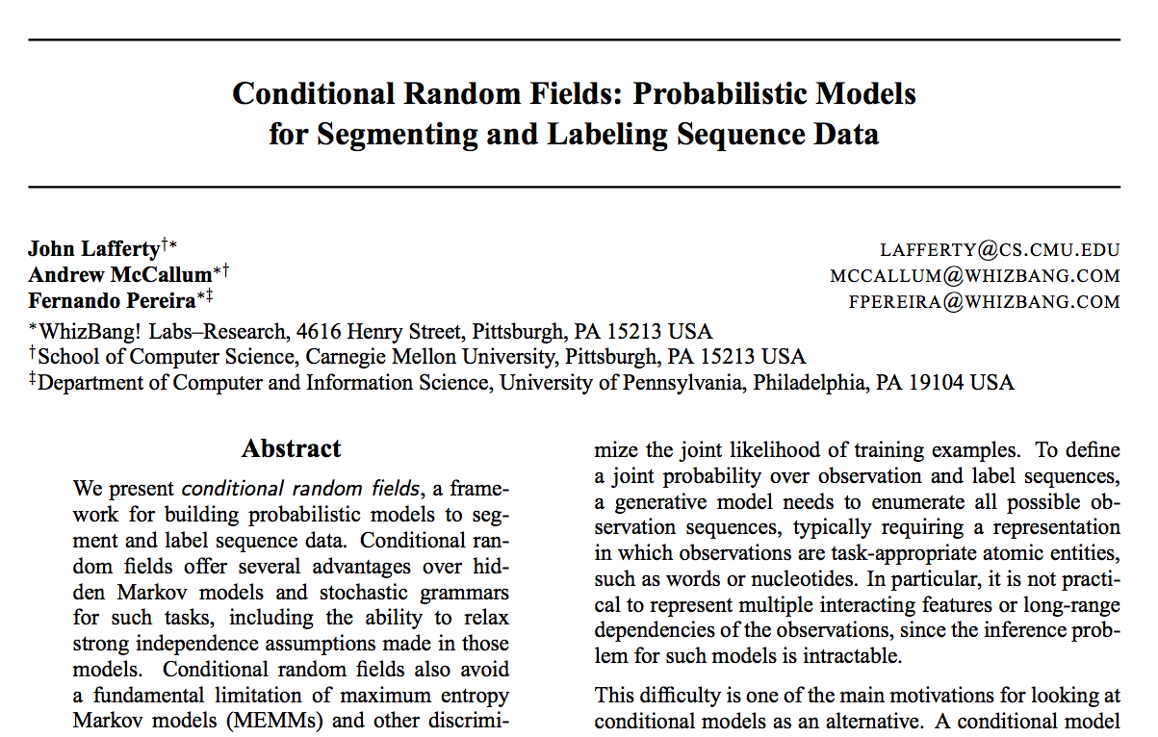
(Chain) Conditional Random Fields

Slide 37
(Chain) Conditional Random Fields
linear sequence model
arbitrary features of input are permitted
test-time inference uses Viterbi Algorithm
learning done by minimizing log loss (DP algorithms used to compute gradients)

Slide 38
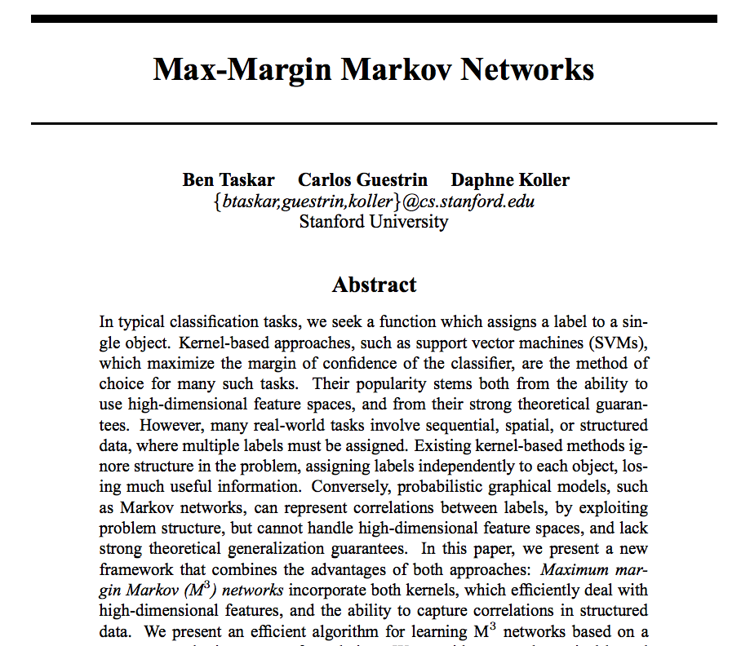
Max-Margin Markov Networks

Slide 39
Maximum-Margin Markov Networks
linear sequence model
arbitrary features of input are permitted
test-time inference uses Viterbi Algorithm
learning done by minimizing hinge loss (DP algorithm used to compute subgradients)

Slide 40
Feature Locality
feature locality: roughly, how “big” are your features?
when designing efficient inference algorithms (whether w/ DP or other methods), we need to be mindful of this
features can be arbitrarily big in terms of the input sequence
but features cannot be arbitrarily big in terms of the output sequence!
the features in HMMs are small in both the input and output sequences (only two pieces at a time)

Slide 41
Are these features big or small?
feature | big or small?
feature that counts instances of “the” in the input sentence | small
feature that returns square root of sum of counts of am/is/was/were | small
feature that counts “verb verb” sequences | small
feature that counts “determiner noun verb verb” sequences | pretty big!
feature that counts the number of nouns in a sentence | big, but we can design specialized algorithms to handle them if they’re the only big features
feature that returns the ratio of nouns to verbs

Slide 42
Learning with linear sequence models
given a linear sequence model with “small” features, how should we do learning?

Slide 43
Loss functions for learning linear sequence models
loss | entry j of (sub)gradient of loss for linear model
perceptron
hinge
log
same gradients/subgradients as before, though computing these terms (inference) requires DP algorithms

Slide 44
Implementing DP algorithms
start with counting mode, but keep in mind how the model’s score function decomposes across parts of the outputs
i.e., how “large” are the features? how many items in the output sequence are needed to compute each feature?
define a function called partScore that computes all the features (for counting mode, this function will return 1)

Slide 45
Neural Networks in NLP
neural networks
deep neural networks
neural language models
recurrent neural networks and LSTMs
convolutional neural networks

Slide 46
What is a neural network?
just think of a neural network as a function
it has inputs and outputs
the term “neural” typically means a particular type of functional building block (“neural layers”), but the term has expanded to mean many things

