Slide 1
TTIC 31190: Natural Language Processing
Kevin Gimpel
Spring 2018
Lecture 11:
Part-of-Speech Tagging and other Sequence Labeling Tasks

Slide 2
Assignment 2 due today
questions?

Slide 3
Project Proposal
project proposal due May 9
details have been posted
groups of 2-3 are ok (but think about how you will divide up the work, especially with 3)

Slide 4
Project Details
ideas:
replicate (part of) a published paper
apply NLP methods to a dataset or task related to your research
define a new NLP task/dataset
if you’re working on a standard task, you do not need to have state of the art results
but your project should be done carefully so that you can have confidence in your claims
try to avoid a project that’s too ambitious

Slide 5
Project Report
final report due June 6
May 30 for graduating students
details forthcoming on project report format

Slide 6
Midterm
midterm on Wednesday, May 16th
don’t worry about memorizing stuff
we’ll give you most of the formulas/definitions you will need

Slide 7
Roadmap
words, morphology, lexical semantics
text classification
language modeling
word embeddings
recurrent/recursive/convolutional networks in NLP
sequence labeling, HMMs, dynamic programming
syntax and syntactic parsing
semantics, compositionality, semantic parsing
machine translation and other NLP tasks

Slide 8
Encoders
encoder: a function to represent a word sequence as a vector
simplest: average word embeddings:
other choices: LSTMs, GRUs, CNNs, attention-weighted sum, etc.

Slide 9
Recurrent Neural Networks
Input is a sequence:
“hidden vector”

Slide 10
so far, we’ve used RNNs to encode sequences
for tasks like sequence classification
also used in translation, question answering, summarization, etc.
but RNNs are also frequently used for generating sequences

Slide 11
“Output” Recurrent Neural Networks
“hidden vector”
“output symbol”
Notes:
y_t = \argmax_{y\in\mathcal{V}} \,\,\, \mathbf{h}_t^\top \mathit{emb}(y)

Slide 12
“Output” Recurrent Neural Networks
y is a symbol, not a vector
O is the “output” vocabulary
we have a new parameter vector emb(y) for each output symbol in O
emb(y) = x?
probability distribution over output symbols?
“hidden vector”
“output symbol”
Notes:
y_t = \argmax_{y\in\mathcal{V}} \,\,\, \mathbf{h}_t^\top \mathit{emb}(y)

Slide 13
“hidden vector”
“output symbol”
Notes:
y_t = \argmax_{y\in\mathcal{V}} \,\,\, \mathbf{h}_t^\top \mathit{emb}(y)
P(Y_t) = \mathrm{softmax}\left(\mathbf{W}\mathbf{h}_t\right)
\mathbf{W} = \left[ \mathit{emb}(y_1)^\top; \mathit{emb}(y_2)^\top ; ...; \mathit{emb}(y_{|\mathcal{O}|})^\top \right]

Slide 14
Example: Language Modeling
… if the car …
input: a word sequence
output?

Slide 15
Example: Language Modeling
… if the car …
… the car runs …
target output at each position:
next word in the sequence!

Slide 16
Language Modeling: Training
… if the car …

Slide 17
Language Modeling: Training
… if the car …
…

Slide 18
while we showed this for simple RNNs, it’s easy to instead use LSTMs, GRUs, etc.
LSTMs/GRUs still produce a hidden vector at each position in the sequence, just like RNNs
LSTM = most common choice for language modeling

Slide 19
Linguistic phenomena: summary so far…
words have structure (stems and affixes)
words have multiple meanings (senses) → word sense ambiguity
senses of a word can be homonymous or polysemous
senses have relationships:
synonymy, hyponymy (“is a”), meronymy (“part of”, “member of”)
variability/flexibility of linguistic expression
many ways to express the same meaning (as you saw in Assignment 2)
word embeddings tell us when two words are similar
today: part-of-speech

Slide 20
Part-of-Speech Tagging
determiner verb (past) prep. proper proper poss. adj. noun
Some questioned if Tim Cook ’s first product
modal verb det. adjective noun prep. proper punc.
would be a breakaway hit for Apple .
Notes:
sentence -> NER labeling
sentence -> translation
Neue Umfrage: Kaufen Sie eine Apple Watch?
sentence -> parse tree
set of documents -> summary

Slide 21
Part-of-Speech Tagging
determiner verb (past) prep. proper proper poss. adj. noun
modal verb det. adjective noun prep. proper punc.
determiner verb (past) prep. noun noun poss. adj. noun
Some questioned if Tim Cook ’s first product
modal verb det. adjective noun prep. noun punc.
would be a breakaway hit for Apple .
Notes:
sentence -> NER labeling
sentence -> translation
Neue Umfrage: Kaufen Sie eine Apple Watch?
sentence -> parse tree
set of documents -> summary

Slide 22
Part-of-Speech (POS)
functional category of a word:
noun, verb, adjective, etc.
how is the word functioning in its context?
dependent on context like word sense, but different from sense:
sense represents word meaning, POS represents word function
sense uses a distinct category of senses per word, POS uses same set of categories for all words

Slide 23
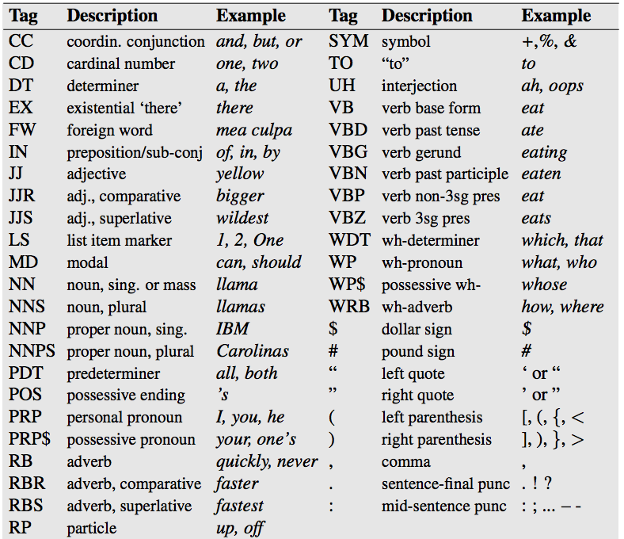
Penn Treebank tag set

Slide 24
POS Ambiguity in Penn Treebank
word that can be both noun and verb?
more often noun than verb:
increase: 248 NN vs. 127 VB (and 4 VBP)
place: 134 NN vs. 14 VB (and 4 VBP)
more often verb than noun:
makes: 182 VBZ vs. 5 NNS
transfer: 22 VB vs. 16 NN

Slide 25
POS Ambiguity in Penn Treebank
word that can be both a singular noun and a plural noun?
“savings”, e.g.:
DT NN VBD VBN RB
The savings was given incorrectly …
DT JJ NN NN
a Belgian savings bank

Slide 26
POS Ambiguity in Penn Treebank
word that can be both a common noun and a proper noun?
“Earth”: 16 NNP vs. 5 NN
annotation inconsistencies: nothing in the context indicates which tag is used
these kinds of inconsistencies are common in annotated datasets, so it’s usually not possible to get perfect accuracy

Slide 27
POS Ambiguity in Penn Treebank
word that can be both a common noun and a proper noun?
“Chapter”: 21 NNP vs. 41 NN
annotation inconsistencies:
VB VBG IN NNP NNP NN NN
consider filing for Chapter 11 bankruptcy protection
NNP VBD IN NN CD NN NN
Continental filed for Chapter 11 bankruptcy protection

Slide 28
How many tags can a word have?
words in Penn Treebank with the most unique tags:
7 down
6 that
6 set
6 put
6 open
6 hurt
6 cut
6 bet
6 back
5 vs.
5 the
5 spread
5 split
5 say

Slide 29
How many tags can a word have?
tag counts for down:
353 down RB
214 down RP
142 down IN
10 down JJ
1 down VBP
1 down RBR
1 down NN

Slide 30
How many tags can a word have?
tag counts for down:
353 down RB adverb
214 down RP particle
142 down IN preposition
10 down JJ adjective
1 down VBP verb (past tense)
1 down RBR comparative adverb
1 down NN singular noun

Slide 31
RP tag: particle
test for verb particle:
can you insert a modifier between the verb and its particle without it sounding weird?
take the trash out immediately
*take the trash immediately out
take the trash outside immediately
take the trash immediately outside
out is a particle here, while outside is not

Slide 32
What about vs.?
tag counts for vs.:
15 vs. FW
9 vs. IN
6 vs. CC
2 vs. NN
1 vs. JJ

Slide 33
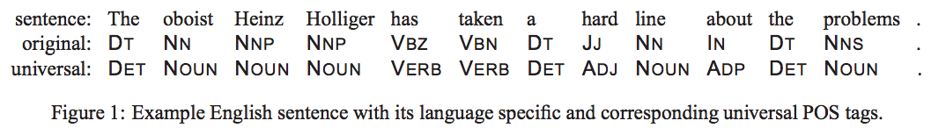
Universal Tag Set
many use smaller sets of coarser tags
e.g., “universal tag set” containing 12 tags:
noun, verb, adjective, adverb, pronoun, determiner/article, adposition (preposition or postposition), numeral, conjunction, particle, punctuation, other
Petrov, Das, McDonald (2011)

Slide 34
Twitter Part-of-Speech Tagging
other verb article noun pronoun
intj pronoun prep adj prep verb
ikr smh he asked fir yo last name so he can add u on fb lololol =D #lolz
verb prep intj emoticon hashtag
adj = adjective
prep = preposition
intj = interjection
pronoun proper
noun
we removed some fine-grained POS tags, then added Twitter-specific tags:
hashtag
@-mention
URL / email address
emoticon
Twitter discourse marker
other (multi-word abbreviations, symbols, garbage)

Slide 35
in Penn Treebank (1M words), word with most tags had 7 tags
in Twitter POS-annotated data (40k words), word with most tags has how many tags?

Slide 36
How many tags can a word have?
words in Twitter with the most unique tags:
7 over
5 up
5 out
5 one
5 off
5 a
5 @
4 to
4 there
4 that
4 right
4 outside
4 no
4 n

Slide 37
How many tags can a word have?
words in Twitter with the most unique tags:
7 over
5 up
5 out
5 one
5 off
5 a
5 @
4 to
4 there
4 that
4 right
4 outside
4 no
4 n
Twitter shows a wider variety of uses for common words

Slide 38
word sense vs. part-of-speech
 | word sense | part-of-speech
semantic or syntactic? | semantic: indicates meaning of word in its context | syntactic: indicates function of word in its context
number of categories | |V| words, ~5 senses each → 5|V| categories! | typical POS tag sets have 12 to 45 tags
inter-annotator agreement | low; some sense distinctions are highly subjective | high; relatively few POS tags and function is relatively shallow / surface-level
independent or joint classification of nearby words? | independent: can classify a single word based on context words; structured prediction is rarely used | joint: strong relationship between tags of nearby words; structured prediction often used

Slide 39
word sense vs. part-of-speech
 | word sense | part-of-speech
semantic or syntactic? | semantic: indicates meaning of word in its context | syntactic: indicates function of word in its context
number of categories | |V| words, ~5 senses each → 5|V| categories! | typical POS tag sets have 12 to 45 tags
inter-annotator agreement | low; some sense distinctions are highly subjective | high; relatively few POS tags and function is relatively shallow / surface-level
independent or joint classification of nearby words? | independent: can classify a single word based on context words; structured prediction is rarely used | joint: strong relationship between tags of nearby words; structured prediction often used

Slide 40
How might POS tags be useful?
text classification
machine translation
question answering
speech synthesis (pronounce “contract”)
…

Slide 41
Models for POS Tagging
today we’ll discuss simple models that do not use structured prediction
these are often called “local” models
they predict a tag for each word in a sequence, (and can use the entire word sequence to make each prediction)
but they do not use information about previous predictions to make later predictions
by contrast, structured prediction:
predict structures
or: make multiple predictions jointly

Slide 42
Feed-Forward Neural Networks for Twitter POS Tagging
other verb det noun pronoun
intj pronoun prep adj prep verb
ikr smh he asked fir yo last name so he can add u on fb lololol
verb prep intj
adj = adjective
prep = preposition
intj = interjection
pronoun proper
noun
in Assignment 3, you’ll build a neural network classifier to predict a word’s POS tag based on its context

Slide 43
Feed-Forward Neural Networks for Twitter POS Tagging
other verb det noun pronoun
intj pronoun prep adj prep verb
ikr smh he asked fir yo last name so he can
e.g., predict tag of yo given context
what should the input x be to the neural network?
it has to be independent of the label
it has to be a fixed-length vector

Slide 44
Feed-Forward Neural Networks for Twitter POS Tagging
other verb det noun pronoun
intj pronoun prep adj prep verb
ikr smh he asked fir yo last name so he can
e.g., predict tag of yo given context
what should the input x be?
word vector for yo

Slide 45
Feed-Forward Neural Networks for Twitter POS Tagging
other verb det noun pronoun
intj pronoun prep adj prep verb
ikr smh he asked fir yo last name so he can
e.g., predict tag of yo given context
what should the input x be?
word vector for fir
word vector for yo

Slide 46
Feed-Forward Neural Networks for Twitter POS Tagging
other verb det noun pronoun
intj pronoun prep adj prep verb
ikr smh he asked fir yo last name so he can
when using word vectors as part of input, we can also treat them as more parameters to be learned!
this is called “updating” or “fine-tuning” the vectors (since they are initialized using something like word2vec)
word vector for fir
word vector for yo

Slide 47
Feed-Forward Neural Networks for Twitter POS Tagging
other verb det noun pronoun
intj pronoun prep adj prep verb
ikr smh he asked fir yo last name so he can
let’s use the center word + two words to the right:
vector for yo
vector for last
vector for name
if name is to the right of yo, then yo is probably a form of your
but our x above uses separate dimensions for each position!
i.e., name is two words to the right
what if name is one word to the right?

Slide 48
Feed-Forward Networks for POS Tagging
feed-forward networks are OK for tagging
they tend to work best with very small contexts (e.g., 1 word to left & right)
with larger windows, probably not enough data to learn a good model
also, distant words not very informative for POS tagging
can also use convolutional networks defined on a window centered on the target word

Slide 49
RNNs for Part-of-Speech Tagging
… if the car …
input: a word sequence

Slide 50
RNNs for Part-of-Speech Tagging
… if the car …
… IN DT NN …
target output at each position: POS tag for corresponding word

Slide 51
RNN Taggers
RNN POS taggers are simple and effective
most common is to use some sort of bidirectional RNN, like a BiLSTM or BiGRU

Slide 52
RNN Taggers
note: RNN taggers are not structured predictors
yes, a structure is being predicted, but predictions for neighboring words are independent!
BiRNN taggers do compute input representations that depend on the sentence context
but they do not make any predictions jointly; each prediction is independent of all others

Slide 53
Sequence Labeling
roughly: for each item in an input sequence, predict a label
many sequence labeling tasks in NLP and other areas
computational biology, speech processing, video processing, etc.
related class of tasks: segmentation, possibly with labeling of segments

Slide 54
Formulating segmentation tasks as sequence labeling via B-I-O labeling:
Named Entity Recognition
O O O B-PERSON I-PERSON O O O
Some questioned if Tim Cook ’s first product
O O O O O O B-ORGANIZATION O
would be a breakaway hit for Apple .
B = “begin”
I = “inside”
O = “outside”
Notes:
sentence -> NER labeling
sentence -> translation
Neue Umfrage: Kaufen Sie eine Apple Watch?
sentence -> parse tree
set of documents -> summary

Slide 55
there are many downloadable part-of-speech taggers and named entity recognizers:
Stanford POS tagger, NER labeler
TurboTagger, TurboEntityRecognizer
Illinois Entity Tagger
CMU Twitter POS tagger
Alan Ritter’s Twitter POS/NER labeler

Slide 56
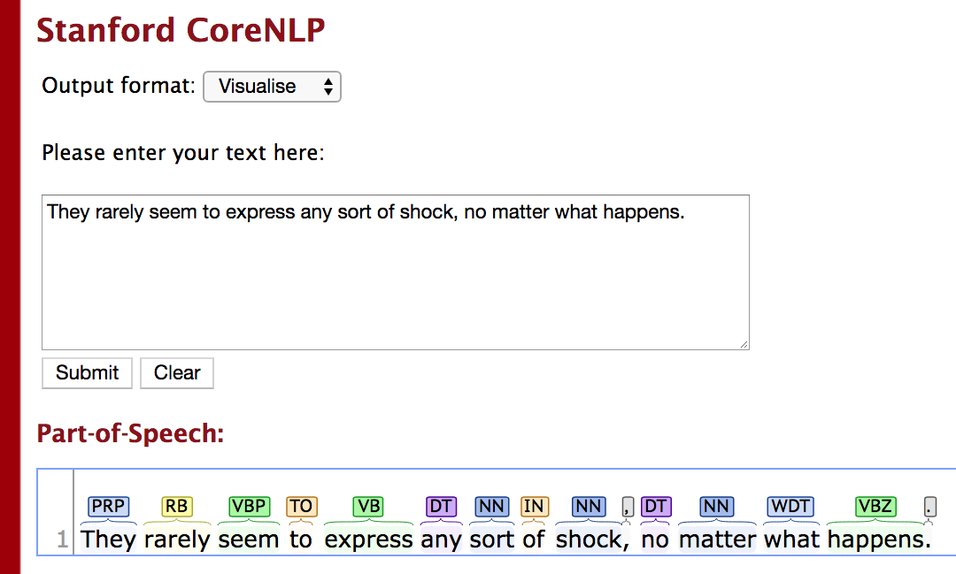

Slide 57
