Slide 1
TTIC 31190: Natural Language Processing
Kevin Gimpel
Spring 2018
Lecture 13:
Brown Clustering;
Syntax

Slide 2
Project Proposal
project proposal due Wednesday
if you’re still scrambling for project ideas, let me know and I can suggest a “default” project

Slide 3
Midterm
midterm on Wednesday, May 16th
you can bring notes
we’ll try to give you all the formulas/definitions you will need

Slide 4
Roadmap
words, morphology, lexical semantics
text classification
language modeling
word embeddings
recurrent/recursive/convolutional networks in NLP
sequence labeling, HMMs, dynamic programming
syntax and syntactic parsing
semantics, compositionality, semantic parsing
machine translation and other NLP tasks

Slide 5
Graphical Model for an HMM (for a sequence of length 4)
transition parameters:
emission parameters:

Slide 6
HMMs for Part-of-Speech Tagging
_{proper noun}
_{proper noun}
_{prepo-sition}
_{noun}
justin bieber for president
each is a part-of-speech tag
so, label space is
transition parameters:
emission parameters:

Slide 7
Inference in HMMs
output is a sequence; argmax requires iterating over an exponentially-large set
dynamic programming (DP) can be used to solve such problems exactly
for HMMs (& other sequence models): Viterbi algorithm

Slide 8
Viterbi Algorithm for HMMs
recursive equations + memoization:
base case:
returns probability of sequence starting with label y for first word
recursive case:
computes probability of max-probability label sequence that ends with label y at position m
final value is in:

Slide 9
Viterbi Algorithm for Sequence Models (with tag bigram features)
score function for label bigram <y’, y> ending at position m in x
could be anything!
linear model, feed-forward network, LSTM, etc.
Notes:
&V(1,y) = \mathrm{score}(\vect{x}, \langle\mbox{\texttt{<s>}}, y\rangle, 1, \vect{w})\\
&V(m,y) = \max_{y'\in\mathcal{L}}\left(\mathrm{score}(\vect{x}, \langle y', y\rangle, m, \vect{w}) + V(m-1, y')\right)

Slide 10
Viterbi Algorithm for Sequence Models (with tag bigram features)
score function for label bigram <y’, y> ending at position m in x
score for entire sequence:
(with appropriate handling of <s> and </s>)
Notes:
\mathrm{score}(\vect{x}, \vect{y}, \vect{w}) = \sum_i \mathrm{score}(\vect{x}, \langle y_{i-1}, y_i \rangle, i, \vect{w})
&V(1,y) = \mathrm{score}(\vect{x}, \langle\mbox{\texttt{<s>}}, y\rangle, 1, \vect{w})\\
&V(m,y) = \max_{y'\in\mathcal{L}}\left(\mathrm{score}(\vect{x}, \langle y', y\rangle, m, \vect{w}) + V(m-1, y')\right)

Slide 11
Viterbi Algorithm for Sequence Models (with tag bigram features)
base case:
returns score of sequence starting with label y for word 1
recursive case:
computes score of max-scoring label sequence that ends with label y at position m

Slide 12
Sequence Models with Tag Bigram Features
to recover HMM from this generalized score function, use the linear model features and weights we discussed last time
Notes:
\mathrm{score}(\vect{x}, \vect{y}, \vect{w}) = \sum_i \mathrm{score}(\vect{x}, \langle y_{i-1}, y_i \rangle, i, \vect{w})
&V(1,y) = \mathrm{score}(\vect{x}, \langle\mbox{\texttt{<s>}}, y\rangle, 1, \vect{w})\\
&V(m,y) = \max_{y'\in\mathcal{L}}\left(\mathrm{score}(\vect{x}, \langle y', y\rangle, m, \vect{w}) + V(m-1, y')\right)

Slide 13
Structured Models with Parts
in general: structured prediction relies on decomposition of input/output into “parts”
score function defined on individual parts
size of each part (in terms of y) affects complexity of inference
Notes:
\mathrm{score}(\vect{x}, \vect{y}, \vect{w}) = \sum_i \mathrm{score}(\vect{x}, \langle y_{i-1}, y_i \rangle, i, \vect{w})
\mathrm{score}(\vect{x}, \vect{y}, \vect{w}) = \sum_{\langle \vect{x}_r^{\phantom{'}}, \vect{y}_r\rangle \in\mathrm{parts}(\vect{x},\vect{y})} \mathrm{score}(\vect{x}_r^{\phantom{'}}, \vect{y}_r, \vect{w})
&V(1,y) = \mathrm{score}(\vect{x}, \langle\mbox{\texttt{<s>}}, y\rangle, 1, \vect{w})\\
&V(m,y) = \max_{y'\in\mathcal{L}}\left(\mathrm{score}(\vect{x}, \langle y', y\rangle, m, \vect{w}) + V(m-1, y')\right)

Slide 14
“Brown Clustering”
Computational Linguistics, 1992

Slide 15
HMMs for Word Clustering (Brown et al., 1992)
justin bieber for president
each is a cluster ID
so, label space is

Slide 16
HMMs for Word Clustering
HMMs for POS Tagging
each is a POS tag
so, label space is
each is a cluster ID
so, label space is
transition parameters:
emission parameters:
transition parameters:
emission parameters:
Notes:
%nlp18:hmm-ex
%\mathcal{L} = \{\mathrm{noun}, \mathrm{verb}, ...\}
%&p_{\boldsymbol{\eta}}(\mathit{for} \mid \mathrm{verb})\nonumber\\
%&p_{\boldsymbol{\eta}}(\mathit{walk} \mid \mathrm{verb})\nonumber\\
%&p_{\boldsymbol{\eta}}(\mathit{for} \mid \mathrm{noun})\nonumber\\
%&p_{\boldsymbol{\eta}}(\mathit{walk} \mid \mathrm{noun})\nonumber\\
%&p_{\boldsymbol{\tau}}(\mathrm{verb} \mid \mathrm{noun})\nonumber\\
%&p_{\boldsymbol{\tau}}(\mathrm{noun} \mid \mathrm{noun})\nonumber\\
%&p_{\boldsymbol{\tau}}(\mathrm{1} \mid \mathrm{17})\nonumber\\
%&p_{\boldsymbol{\tau}}(\mathrm{2} \mid \mathrm{17})\nonumber\\
&p_{\boldsymbol{\eta}}(\mathit{for} \mid \mathrm{17})\nonumber\\
&p_{\boldsymbol{\eta}}(\mathit{walk} \mid \mathrm{17})\nonumber\\
% = \log p_{\boldsymbol{\eta}}(x' \mid y')
%p_{\boldsymbol{\tau}}(y_i \mid y_{i-1}) \; p_{\boldsymbol{\eta}}(x_i \mid y_i)
&...\nonumber

Slide 17
HMMs for Word Clustering (Brown et al., 1992)
given a set of sentences, how should we learn the parameters of our model?
how about we use maximum likelihood estimation, e.g.:
problem: we don’t have any ’s!
we only have a set of unlabeled sentences:

Slide 18
we want to maximize likelihood, but:
our HMM defines
our data only contains
solution: marginalize out
this idea underlies much of unsupervised learning
Notes:
%\argmax_{\boldsymbol{w}} \:\sum_{i=1}^{N} \log p_{\boldsymbol{w}}(\vect{x}^{(i)}, \vect{y}^{(i)})
\argmax_{\boldsymbol{w}} \:\sum_{i=1}^{N} \log \sum_{\vect{y}} p_{\boldsymbol{w}}(\vect{x}^{(i)}, \vect{y})
%p_{\boldsymbol{w}}(\vect{x}^{(i)}, \vect{y}^{(i)})

Slide 19
we want to maximize likelihood, but:
our HMM defines
our data only contains
solution: marginalize out
this idea underlies much of unsupervised learning
a sum over an exponentially-large set

Slide 20
learning requires sum over exponentially-large set
all possible clusterings of the words
for HMMs, we can compute this sum in polynomial time using dynamic programming
however, Brown clustering uses simplifying assumption: each word is in exactly one cluster
the summation above becomes trivial to compute!

Slide 21
One Cluster Per Word Assumption
summation becomes trivial, so we can easily compute the log-likelihood of any given model
but how should we do learning?
gradient-based optimization is tricky due to the constraints
and it’s too expensive to iterate through all possible clusterings and compute their likelihoods

Slide 22
Algorithm for Brown Clustering
greedy algorithm:
• initialize each word as its own cluster
• greedily merge clusters to improve data likelihood

Slide 23
we induced 1000 Brown clusters from 56 million English tweets (1 billion words)
only words that appeared at least 40 times
(Owoputi, O’Connor, Dyer, Gimpel, Schneider, and Smith, 2013)

Slide 24
Example Cluster
missed loved hated misread admired underestimated resisted adored disliked regretted missd fancied luved prefered luvd overdid mistyped misd misssed looooved misjudged lovedd loooved loathed lurves lovd
Notes:
misse loveddd mised luv'd mis-read loooooved resented lovedddd choosed missedd loveed pvr'd detested looooooved biffed looved miss'd

Slide 25
Example Cluster
missed loved hated misread admired underestimated resisted adored disliked regretted missd fancied luved prefered luvd overdid mistyped misd misssed looooved misjudged lovedd loooved loathed lurves lovd
spelling
variation
Notes:
misse loveddd mised luv'd mis-read loooooved resented lovedddd choosed missedd loveed pvr'd detested looooooved biffed looved miss'd

Slide 26
“really”
really rly realy genuinely rlly reallly realllly reallyy rele realli relly reallllly reli reali sholl rily reallyyy reeeeally realllllly reaally reeeally rili reaaally reaaaally reallyyyy rilly reallllllly reeeeeally reeally shol realllyyy reely relle reaaaaally shole really2 reallyyyyy _really_ realllllllly reaaly realllyy reallii reallt genuinly relli realllyyyy reeeeeeally weally reaaallly reallllyyy reallllllllly reaallly realyy /really/ reaaaaaally reallu reaaaallly reeaally rreally reallyreally eally reeeaaally reeeaaally reaallyy reallyyyyyy –really- reallyreallyreally rilli reallllyyyy relaly reallllyy really-really r3ally reeli reallie realllllyyy rli realllllllllly reaaaly reeeeeeeally

Slide 27
“so”
soo sooo soooo sooooo soooooo sooooooo soooooooo sooooooooo soooooooooo sooooooooooo soooooooooooo sooooooooooooo soso soooooooooooooo sooooooooooooooo soooooooooooooooo sososo superrr sooooooooooooooooo ssooo so0o superrrr so0 soooooooooooooooooo sosososo sooooooooooooooooooo ssoo sssooo soooooooooooooooooooo #too s0o ssoooo s00
Notes:
sooooooooooooooooooooo so0o0o sososososo soooooooooooooooooooooo sssoooo ssooooo superrrrr very2 s000 soooooooooooooooooooooooo sooooooooooooooooooooooooo sooooooooooooooooooooooo _so_ soooooooooooooooooooooooooo /so/ sssooooo sosososososo

Slide 28
Food-Related Adjectives
hot fried peanut homemade grilled spicy soy cheesy coconut veggie roasted leftover blueberry icy dunkin mashed rotten mellow boiling crispy peppermint fruity toasted crunchy scrambled creamy boiled chunky funnel soggy clam steamed cajun steaming chewy steamy nacho mince reese's shredded salted glazed spiced venti pickled powdered butternut miso beet sizzling
Notes:
crazy nuts insane cray tuff krazy crazyy bonkers crazyyy nutz smoove crzy crazyyyy crazzy crazii batshit screwy craaazy crazi #playedout craaaazy brazy liveee crazzzy nutts crazyyyyy cross-eyed faf physco kaput kray reet wackk nutso craazy madt guu liveeee #outrageous crazzzzy craaaaazy dunzo gayyyy crazee crazyyyyyy craz crazzyy greezy wildd buckwild

Slide 29
“going to”
gonna gunna gona gna guna gnna ganna qonna gonnna gana qunna gonne goona gonnaa g0nna goina gonnah goingto gunnah gonaa gonan gunnna going2 gonnnnagunnaa gonny gunaa quna goonna qona gonns goinna gonnae qnna gonnaaa gnaa

Slide 30
Adjective Intensifiers/Qualifiers
kinda hella sorta hecka kindof kindaa kinna hellla propa helluh kindda justa #slick helllla hela jii sortof hellaa kida wiggity hellllla hekka hellah kindaaa hellaaa kindah knda kind-of slicc wiggidy helllllla jih jye kinnda odhee kiinda heka sorda ohde kind've kidna baree rle hellaaaa jussa

Slide 31
Hierarchical Clustering from Brown Clusters
we have a sequence of clustering decisions
we can use the order in which clusters are merged to create a hierarchical clustering
build a binary tree to represent the merges
word similarity is captured by distance in the tree
saw
peeped
saww
…
bought
watched
ate
…
found
checked
figured
…
missed
loved
hated
…

Slide 32
saw
peeped
saww
bought
watched
ate
found
checked
figured
missed
loved
hated

Slide 33
…
watching
watchin
watchn
seeing
finding
hearing
loving
enjoying
liking
saw
peeped
saww
bought
watched
ate
found
checked
figured
missed
loved
hated
Notes:
010011010111
01101111111010

Slide 34
…
watching
watchin
watchn
seeing
finding
hearing
loving
enjoying
liking
random
dirty
common
short
tough
rough
quick
simple
unique
saw
peeped
saww
bought
watched
ate
found
checked
figured
missed
loved
hated

Slide 35
:D
^^
=D
*-*
:o
o_o
<<
o.o
:(
:/
-_-
-.-
;)
:P
:-)
XD
:)
(:
=)
:))
random
dirty
common
short
tough
rough
quick
simple
unique

Slide 36
adjectives?
verbs?
…
watching
watchin
watchn
seeing
finding
hearing
loving
enjoying
liking
random
dirty
common
short
tough
rough
quick
simple
unique
saw
peeped
saww
bought
watched
ate
found
checked
figured
missed
loved
hated

Slide 37
…
watching
watchin
watchn
seeing
finding
hearing
loving
enjoying
liking
random
dirty
common
short
tough
rough
quick
simple
unique
saw
peeped
saww
bought
watched
ate
found
checked
figured
missed
loved
hated
could be verbs or nouns, but
Brown clustering uses one-cluster-per-word constraint

Slide 38
…
watching
watchin
watchn
seeing
finding
hearing
loving
enjoying
liking
random
dirty
common
short
tough
rough
quick
simple
unique
saw
peeped
saww
bought
watched
ate
found
checked
figured
missed
loved
hated
could be verbs or nouns, but one-cluster-per-word
even so, Brown clusters are good unsupervised POS tags!

Slide 39
Brown Clusters as Vectors
cluster merging represented by a binary tree
each word can be represented by its binary string = path from root to leaf
each intermediate node is a cluster
chairman is 0010, “months” = 01, verbs = 1:

Slide 40
Brown Clusters for Downstream Tasks
even with one-cluster-per-word constraint, Brown clusters are really useful for syntactic tasks (tagging, parsing, etc.)
also helps to use different granularities of the hierarchical clustering:
define features based on prefixes of binary strings:
November and October will share feature that looks at “length-2 prefix of binary string”

Slide 41
Roadmap
words, morphology, lexical semantics
text classification
language modeling
word embeddings
recurrent/recursive/convolutional networks in NLP
sequence labeling, HMMs, dynamic programming
syntax and syntactic parsing
semantics, compositionality, semantic parsing
machine translation and other NLP tasks

Slide 42
What is Syntax?
rules, principles, processes that govern sentence structure of a language
can differ widely among languages
but every language has systematic structural principles

Slide 43
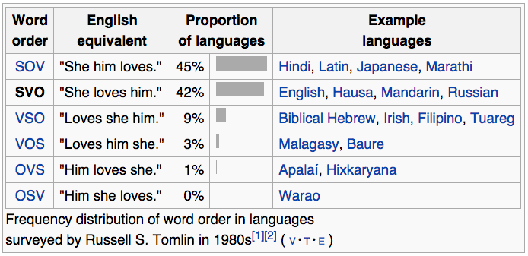
Subject, Verb, Object
syntax determines the ordering of these three objects in a sentence

Slide 44
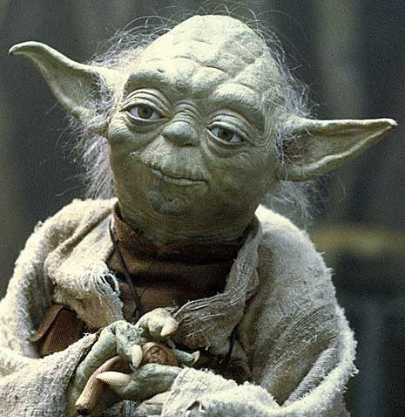
Yodish
often (though certainly not always) Yoda uses object-subject-verb order
“Powerful you have become. The dark side I sense in you.”

Slide 45
Grammars
we will use grammar to denote a formal object that represents the rules/principles/processes that determine sentence structure

Slide 46
phrase structure / constituent grammar
focuses on the constituent relation
informally: “sentences have hierarchical structure”
a sentence is made up of two pieces:
subject, typically a noun phrase (NP)
predicate, typically a verb phrase (VP)
NPs and VPs are in turn made of up of pieces:
old books = (old + books)
the old books = (the + (old + books))
walked to the park = (walked + (to + (the + park)))
each parenthesized phrase is a constituent in the constituent parse

Slide 47
Bracketing
constituent parse = bracketing (that represents the hierarchical structure)
e.g., sentence:
the man walked to the park
bracketing:
((the man) (walked (to (the park))))

Slide 48
Bracketing → Tree
((the man) (walked (to (the park))))
we often draw the bracketing as a tree:
the man walked to the park

Slide 49
Labeled Bracketings/Trees
(S (NP the man) (VP walked (PP to (NP the park))))
S
VP
Key:
S = sentence
NP = noun phrase
VP = verb phrase
PP = prepositional phrase
NP
PP
NP
the man walked to the park

Slide 50
Labels → Substitutability
S
NP
VP
the man
John
the first boss I ever had
walked to the park
fell asleep
is here

Slide 51
Labeled Bracketings/Trees
(S (NP the man) (VP walked (PP to (NP the park))))
S
VP
Key:
S = sentence
NP = noun phrase
VP = verb phrase
PP = prepositional phrase
NP
PP
NP
the man walked to the park

Slide 52
Labeled Bracketings/Trees
(S (NP the man) (VP walked (PP to (NP the park))))
S
VP
Key:
S = sentence
NP = noun phrase
VP = verb phrase
PP = prepositional phrase
DT = determiner
NN = noun
VBD = verb (past tense)
IN = preposition
NP
PP
NP
DT
NN
VBD IN DT NN
the man walked to the park

Slide 53
Labeled Bracketings/Trees
(S (NP the man) (VP walked (PP to (NP the park))))
S
VP
NP
nonterminals
PP
NP
preterminals
DT
NN
VBD IN DT NN
the man walked to the park
terminals

Slide 54
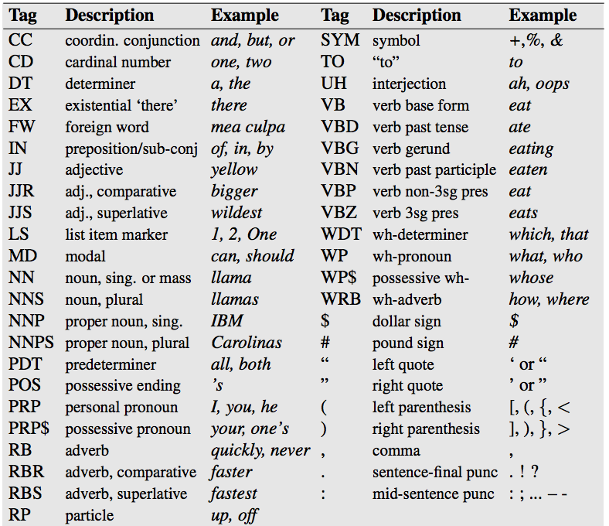
Penn Treebank tag set

Slide 55
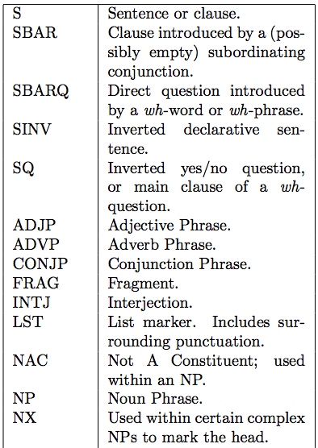
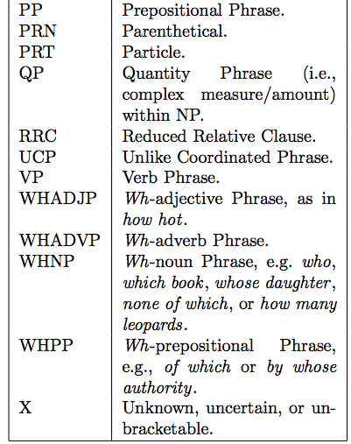
Penn Treebank Nonterminals

Slide 56
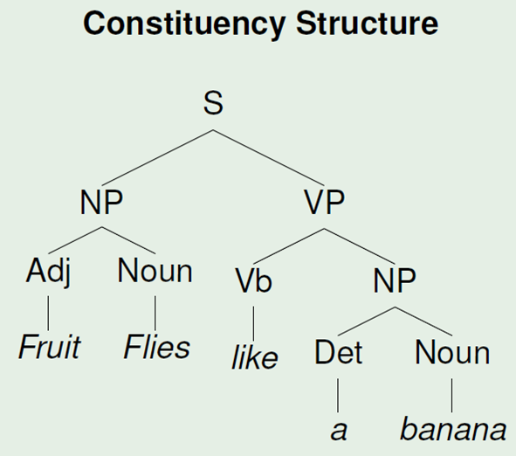
Syntactic Ambiguities
Time flies like an arrow.
Fruit flies like a banana.

Slide 57
Syntactic Ambiguities
attachment ambiguity
coordination ambiguity
noun compound ambiguity

Slide 58
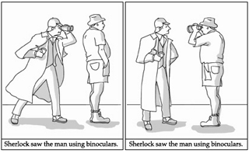
Attachment Ambiguity
Sherlock saw the man using binoculars

Slide 59
Attachment Ambiguity
Sherlock (saw (the man) (using binoculars))
Sherlock (saw (the man (using binoculars)))

Slide 60
other attachment ambiguities
Infant pulled from car involved in short police pursuit
Somali tied to militants held on U.S. ship for months

Slide 61
other attachment ambiguities
(Infant pulled from car) involved in short police pursuit
Infant pulled from (car involved in short police pursuit)
(Somali tied to militants) held on U.S. ship for months
Somali tied to (militants held on U.S. ship for months)

Slide 62
coordination ambiguities
often found when modifiers are used with conjunctions:
keyboard and monitor with the Apple logo
old men and women

Slide 63
coordination ambiguities
often found when modifiers are used with conjunctions:
(keyboard and monitor) with the Apple logo
keyboard and (monitor with the Apple logo)
old (men and women)
(old men) and women

Slide 64
noun compound ambiguity
California history teacher
World Trade Center
student film society
Szymanek;
Fromkin (2000); Spencer (1991)

Slide 65
adjective/noun modifier ambiguity
ancient history teacher
moral philosophy professor
indoor garden party

Slide 66
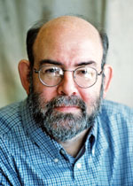
NLP Task: Constituent Parsing
given a sentence, output its constituent parse
widely-studied task with a rich history
most based on the Penn Treebank (Marcus et al.), developed at Penn in early 1990s
Treebank = “corpus of annotated parse trees”

Slide 67
How are constituent parses used?
language modeling
predict the next word better by using syntactic structure
machine translation
there are many syntactic translation models that require parsers for one or both languages
text classification
for certain kinds of classification, features on syntactic fragments can help
question answering, coreference resolution, etc.

