Slide 1
TTIC 31190: Natural Language Processing
Kevin Gimpel
Spring 2018
Lecture 14:
Syntax and Parsing

Slide 2
Project Proposal
project proposal due today

Slide 3
Midterm
midterm in one week
you can bring notes
but we’ll try to give you all formulas/definitions you’ll need
Monday: review for midterm, including sample questions

Slide 4
Roadmap
words, morphology, lexical semantics
text classification
language modeling
word embeddings
recurrent/recursive/convolutional networks in NLP
sequence labeling, HMMs, dynamic programming
syntax and syntactic parsing
semantics, compositionality, semantic parsing
machine translation and other NLP tasks

Slide 5
What is Syntax?
rules, principles, processes that govern sentence structure of a language

Slide 6
Constituent Parse (Bracketing/Tree)
(S (NP the man) (VP walked (PP to (NP the park))))
S
VP
Key:
S = sentence
NP = noun phrase
VP = verb phrase
PP = prepositional phrase
DT = determiner
NN = noun
VBD = verb (past tense)
IN = preposition
NP
PP
NP
DT
NN
VBD IN DT NN
the man walked to the park

Slide 7
Constituent Parse
(S (NP the man) (VP walked (PP to (NP the park))))
S
VP
NP
nonterminals
PP
NP
preterminals
DT
NN
VBD IN DT NN
the man walked to the park
terminals

Slide 8
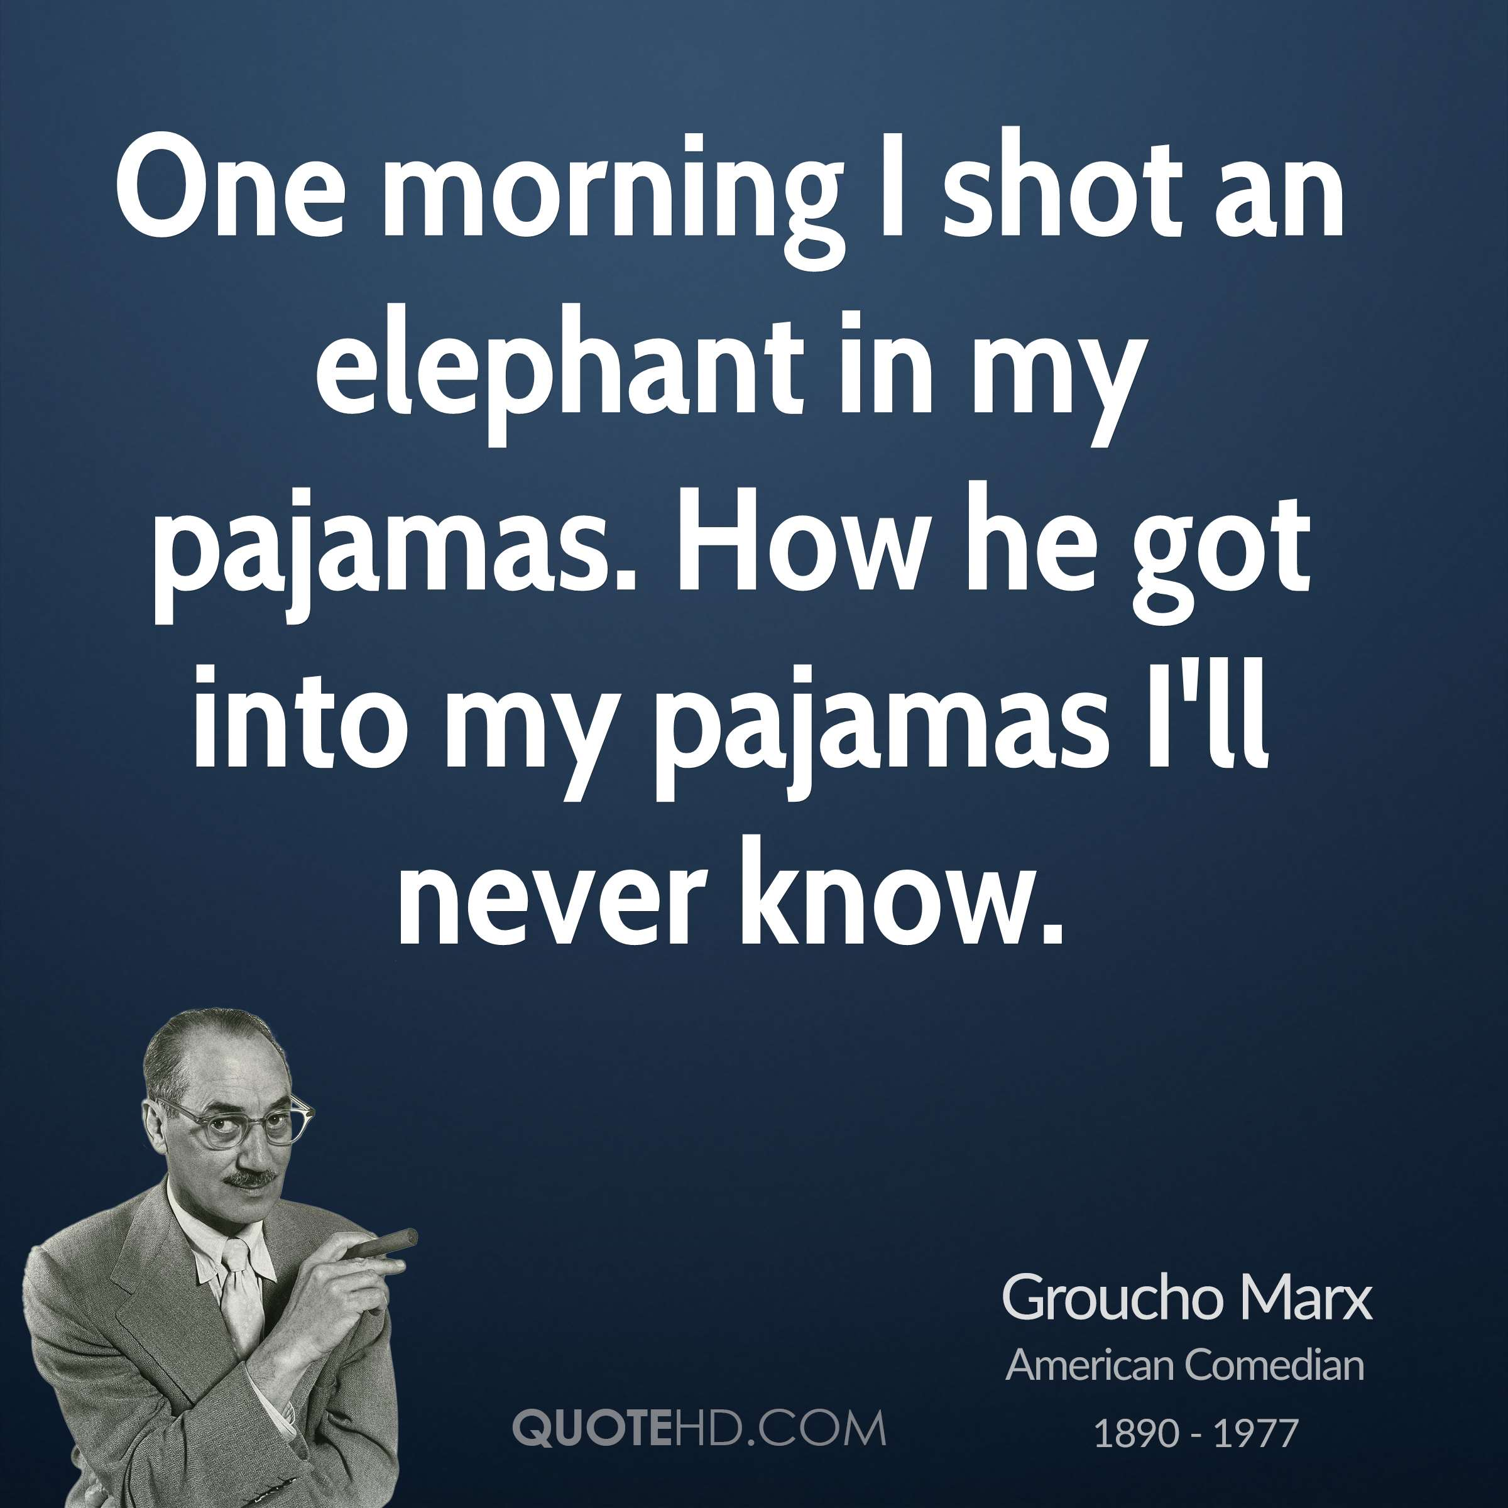
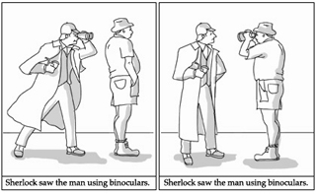
Attachment Ambiguity

Slide 9
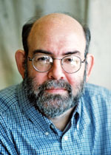
NLP Task: Constituent Parsing
given a sentence, output its constituent parse
widely-studied task with a rich history
most based on the Penn Treebank (Marcus et al.), developed at Penn in early 1990s
Treebank = “corpus of annotated parse trees”

Slide 10
Context-Free Grammar (CFG)
has “rewrite rules” to rewrite nonterminals as terminals or other nonterminals
S → NP VP
“S goes to NP VP”
NP → DT NN
VP → VBD PP
PP → IN NP
NN → man
DT → the

Slide 11
Context-Free Grammar (CFG)
sequence of rewrites corresponds to a bracketing (induces a hierarchical tree structure)
S
S → NP VP
VP
VP → VBD PP
NP
PP
NP → DT NN
NP
DT
NN
VBD IN DT NN
DT → the
the man walked to the park

Slide 12
Why “context-free”?
a rule to rewrite NP does not depend on the context of NP
that is, the left-hand side of a rule is only a single non-terminal (without any other context)

Slide 13
Probabilistic Context-Free Grammar (PCFG)
assign probabilities to rewrite rules:
NP → DT NN 0.5
NP → NNS 0.3
NP → NP PP 0.2
same nonterminal can be on both left and right sides

Slide 14
Probabilistic Context-Free Grammar (PCFG)
assign probabilities to rewrite rules:
NP → DT NN 0.5
NP → NNS 0.3
NP → NP PP 0.2
probabilities must sum to one for each left-hand side nonterminal

Slide 15
Probabilistic Context-Free Grammar (PCFG)
assign probabilities to rewrite rules:
NP → DT NN 0.5
NP → NNS 0.3
NP → NP PP 0.2
NN → man 0.01
NN → park 0.0004
NN → walk 0.002
NN → ….
given a treebank, we can estimate these probabilities using maximum likelihood estimation (“count and normalize”)
just like n-gram language models and HMMs for POS tagging

Slide 16
Probabilistic Context-Free Grammar (PCFG)
for each nonterminal, a PCFG has a probability distribution over possible right-hand side sequences
so, a PCFG assigns probabilities to:
bracketings of sentences
sequences of rewrite operations (derivations) that eventually terminate in terminals
hierarchical tree structures that ground out in sequences of terminals
these are different ways of saying the same thing

Slide 17
Constituent Parsing
evaluation: evalb score
first compute precision and recall (at the level of constituents)
then compute F1 (harmonic mean of precision and recall)

Slide 18
Precision, Recall, F1
precision:
what fraction of the things I found are good?
recall:
what fraction of good things did I find?
F1 score:
harmonic mean of precision and recall
Notes:
%P = \frac{|F\cap G|}{|F|}
R = \frac{|F\cap G|}{|G|}

Slide 19
Modeling, Inference, Learning
inference: solve _
modeling: define score function
learning: choose _
x = a sentence
y = a constituent parse
inference requires iterating over all possible constituent parses!
this can be done using dynamic programming but is still expensive (cubic in the sentence length)

Slide 20
Inference in PCFGs
to find max-probability tree for a sentence, use dynamic programming: CKY algorithm
to find the best way to build a tree covering words i to j:
consider all possible “split points” k between i and j
for each split point k, consider all possible nonterminals for the two smaller trees created by that split

Slide 21
Notes:
Based on a treebank tree

Slide 22
CKY Algorithm
max probability
of all ways to
build a constituent
with nonterminal
Z from i to j
Notes:
Consider a single step in the CKY algorithm

Slide 23
CKY Algorithm
max over
split points
max over
nonterminals
for smaller trees
Notes:
Consider a single step in the CKY algorithm

Slide 24
detail: CKY requires the PCFG to be in Chomsky Normal Form (CNF)
basically: every rule has either 2 nonterminals or 1 terminal on the right-hand side

Slide 25
How well does a PCFG work?
a PCFG learned from the Penn Treebank with maximum likelihood estimation (count & normalize) gets about 73% F1 score
state-of-the-art parsers are around 92%

Slide 26
How well does a PCFG work?
a PCFG learned from the Penn Treebank with maximum likelihood estimation (count & normalize) gets about 73% F1 score
state-of-the-art parsers are around 92%
but, simple modifications can improve the PCFG a lot!
smoothing
tree transformations (selective flattening)
“parent annotation”

Slide 27
Parent Annotation
VP → V NP PP
VP^{S} → V NP^{VP} PP^{VP}
adds more information, but also fragments counts, making parameter estimates noisier (since we’re just using MLE)

Slide 28
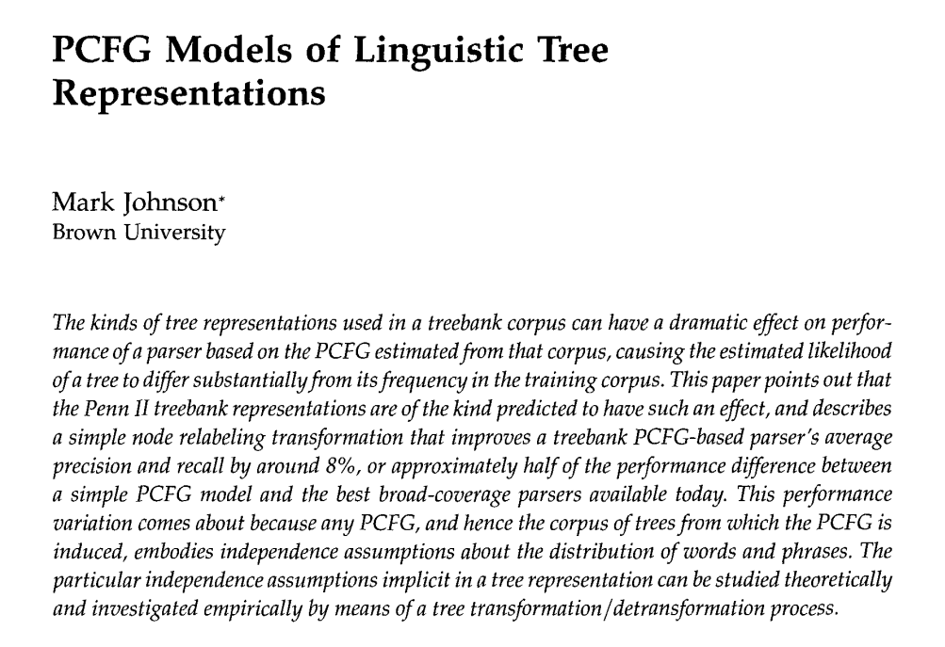
Johnson (1998)

Slide 29
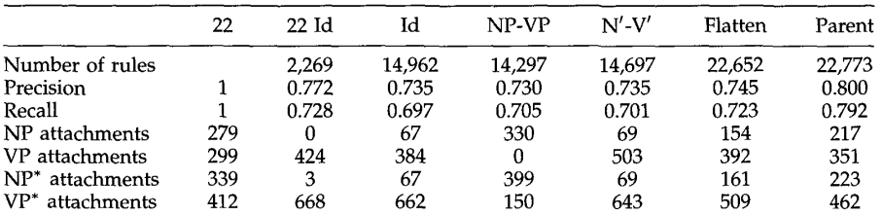
Johnson (1998)

Slide 30
How well does a PCFG work?
PCFG learned from the Penn Treebank with MLE gets about 73% F1 score
state-of-the-art parsers are around 92%
simple modifications can improve PCFGs:
smoothing
tree transformations (selective flattening)
parent annotation

Slide 31
How well does a PCFG work?
PCFG learned from the Penn Treebank with MLE gets about 73% F1 score
state-of-the-art parsers are around 92%
simple modifications can improve PCFGs:
smoothing
tree transformations (selective flattening)
parent annotation
lexicalization

Slide 32
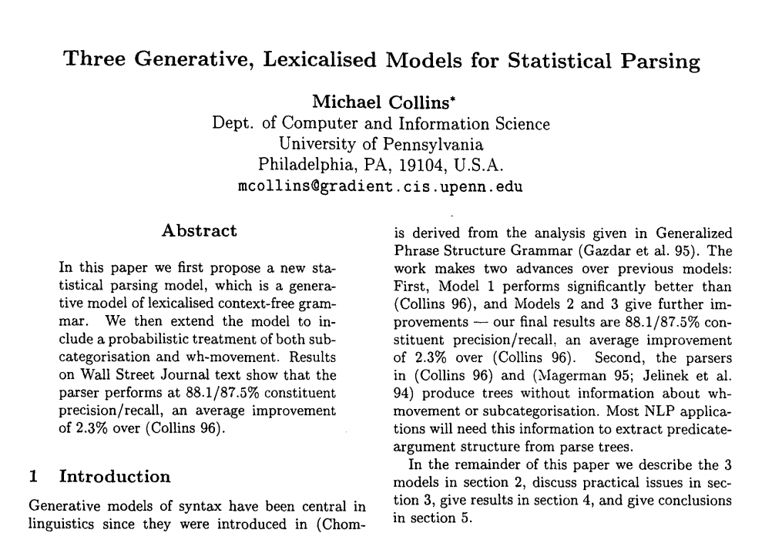
Collins (1997)

Slide 33
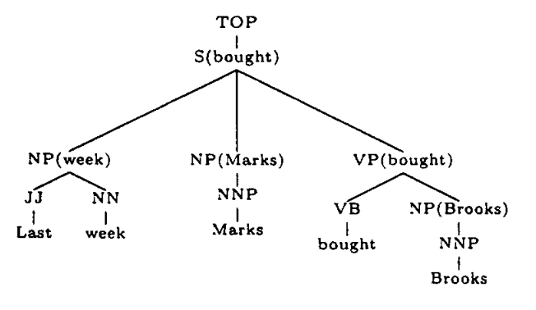
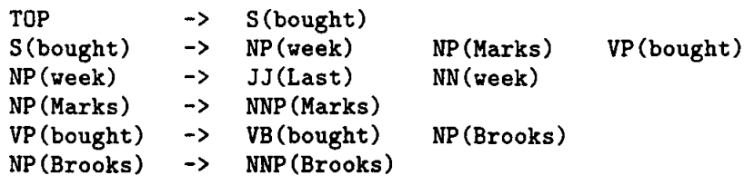
Lexicalized PCFGs
nonterminals are decorated with
the head word of the subtree

Slide 34
Lexicalization
this adds a lot more rules!
many more parameters to estimate → smoothing becomes much more important
e.g., right-hand side of rule might be factored into several steps
but it’s worth it because head words are really useful for constituent parsing

Slide 35
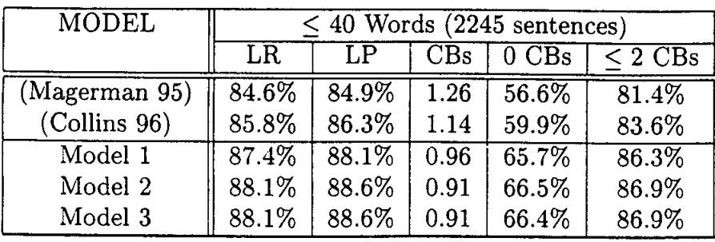
Results (Collins, 1997)

Slide 36
Head Rules
how are heads decided?
initially, researchers used deterministic head rules (Magerman/Collins)
for a PCFG rule A → B₁ … B_{N}, these head rules say which of B₁ … B_{N} is the head of the rule
examples:
S → NP VP
VP → VBD NP PP
NP → DT JJ NN

Slide 37
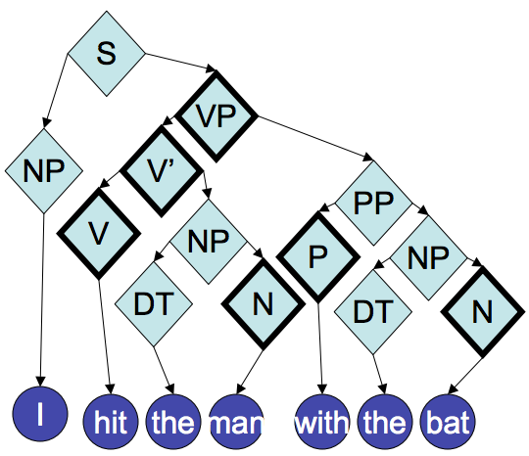
Head Annotation
heads have bold outline
e.g., VP is head of S -> NP VP
from Noah Smith

Slide 38
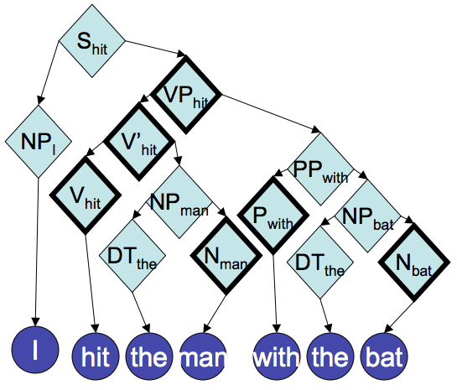
Lexical Head Annotation
propagate lexical heads up the tree
from Noah Smith

Slide 39
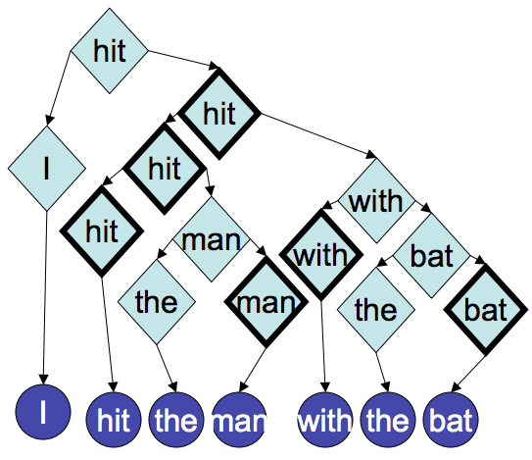
Lexical Head Annotation → Dependencies
remove nonlexical parts:
from Noah Smith

Slide 40
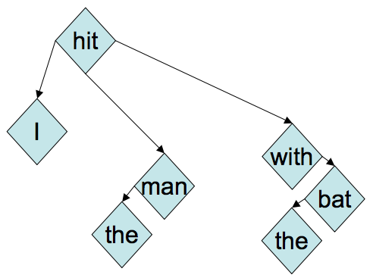
Dependencies
merge redundant nodes:
from Noah Smith

Slide 41
constituent parse:
dependency parse:

Slide 42
constituent parse:
labeled dependency parse:
nsubj
prep
dobj
pobj
det
det
nsubj = “nominal subject”
dobj = “direct object”
prep = “preposition modifier”
pobj = “object of preposition”
det = “determiner”

Slide 43
captures some semantic relationships
constituent parse:
labeled dependency parse:
nsubj
prep
dobj
pobj
det
det
nsubj = “nominal subject”
dobj = “direct object”
prep = “preposition modifier”
pobj = “object of preposition”
det = “determiner”

Slide 44
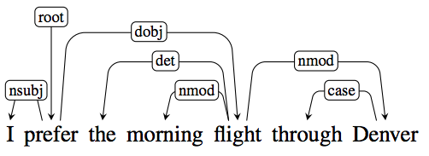
A Typed Dependency Tree
J&M/SLP3

Slide 45
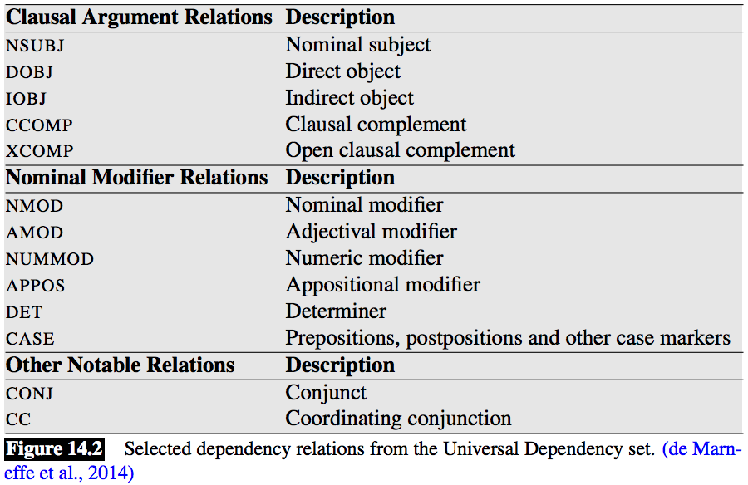
Some Dependency Relations
J&M/SLP3

Slide 46
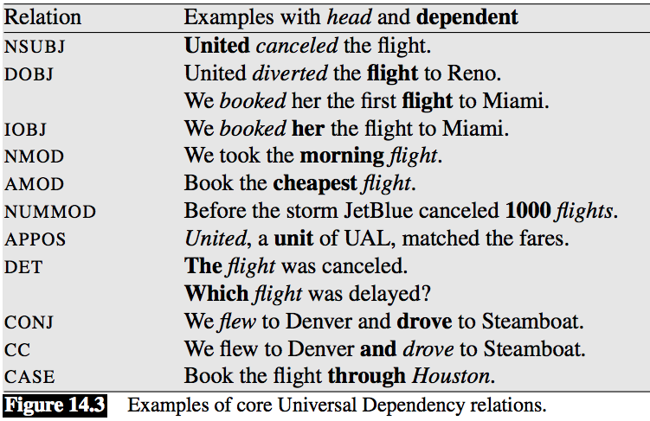
Some Dependency Relations
J&M/SLP3

Slide 47
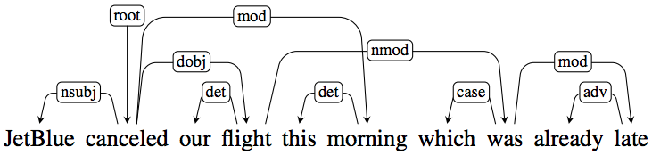
Crossing Dependencies = Nonprojective Tree
if dependencies cross (“nonprojective”), no longer corresponds to a CFG
J&M/SLP3

Slide 48
Projective vs. Nonprojective Dependencies
English dependency treebanks are mostly projective
but when focusing more on semantic relationships, often becomes more nonprojective
some (relatively) free word order languages, like Czech, are fairly nonprojective

Slide 49
Annotating Dependencies
for many years, researchers build dependency parsers from deterministic head rules
deterministic head rules are a blunt instrument
would be better to directly annotate dependencies!
there have been many annotation efforts with this goal

Slide 50
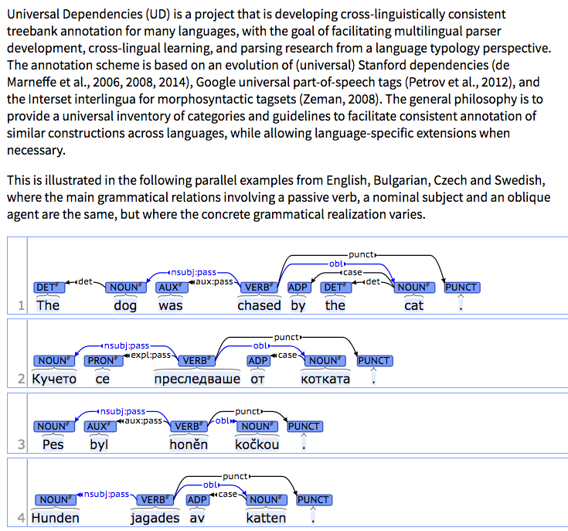
Universal Dependencies
universaldependencies.org

Slide 51
Dependency Parsing
several widely-used algorithms
different guarantees but similar performance in practice
graph-based:
dynamic programming (Eisner, 1997)
minimum spanning tree (McDonald et al., 2005)
transition-based:
shift-reduce (Nivre, inter alia)

Slide 52
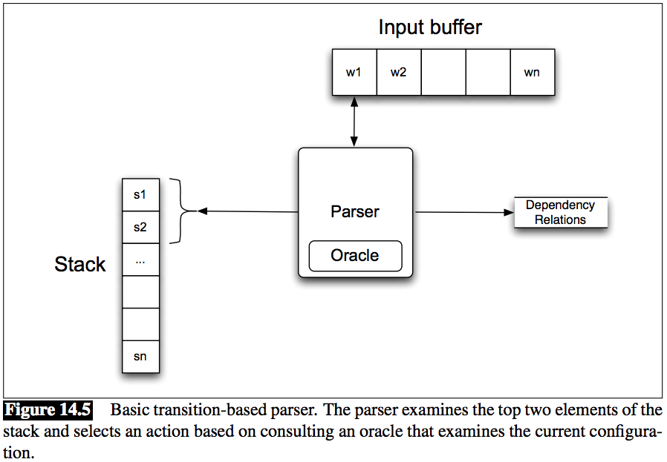
Transition-Based Dependency Parsing
J&M/SLP3

Slide 53
Transition-Based Parsing
there are many variations of greedy parsers that build parse structures as they process a sentence from left to right
“shift-reduce”, “transition-based”, etc.
these form the backbone of many modern neural dependency (and constituency!) parsers
we’ll go through an example (thanks to Noah Smith for these slides)

Slide 54
Many millennials, of which 50 percent are estimated to have voted, say political parties must listen to their concerns to get support.

Slide 55
Many millennials, of which 50 percent are estimated to have voted, say political parties must listen to their concerns to get support.
say
listen
millennials
must
to
Many
estimated
parties
get
concerns
political
to
support
of
percent
are
voted
their
which
50
to have

Slide 56
Greedy Parsing with a Stack
Stack:
See:
Nivre & Scholz, 2004
Henderson, 2004
Buffer:
Many millennials, of which 50 percent are estimated to have voted, say political parties must listen to their concerns to get support.
Notes:
Point out that this is not new; lots of interest in incremental greedy parsing for more than 10 years, too (cites on right).

Slide 57
Greedy Parsing with a Stack
Stack:
Buffer:
Many millennials, of which 50 percent are estimated to have voted, say political parties must listen to their concerns to get support.

Slide 58
Greedy Parsing with a Stack
Stack:
Many
shift
Buffer:
Many millennials, of which 50 percent are estimated to have voted, say political parties must listen to their concerns to get support.

Slide 59
Greedy Parsing with a Stack
Stack:
millennials
Many
shift
Buffer:
Many millennials, of which 50 percent are estimated to have voted, say political parties must listen to their concerns to get support.

Slide 60
Greedy Parsing with a Stack
Stack:
Many ← millennials
reduce left
Buffer:
Many millennials, of which 50 percent are estimated to have voted, say political parties must listen to their concerns to get support.

Slide 61
Greedy Parsing with a Stack
Stack:
of
Many ← millennials
shift
Buffer:
Many millennials, of which 50 percent are estimated to have voted, say political parties must listen to their concerns to get support.

Slide 62
Greedy Parsing with a Stack
Stack:
which
of
Many ← millennials
shift
Buffer:
Many millennials, of which 50 percent are estimated to have voted, say political parties must listen to their concerns to get support.

Slide 63
Greedy Parsing with a Stack
Stack:
of → which
Many ← millennials
reduce right
Buffer:
Many millennials, of which 50 percent are estimated to have voted, say political parties must listen to their concerns to get support.

Slide 64
Greedy Parsing with a Stack
Stack:
50
of → which
Many ← millennials
shift
Buffer:
Many millennials, of which 50 percent are estimated to have voted, say political parties must listen to their concerns to get support.

Slide 65
Greedy Parsing with a Stack
Stack:
percent
50
of → which
Many ← millennials
shift
Buffer:
Many millennials, of which 50 percent are estimated to have voted, say political parties must listen to their concerns to get support.

Slide 66
Greedy Parsing with a Stack
Stack:
50 → percent
of → which
Many ← millennials
reduce right
Buffer:
Many millennials, of which 50 percent are estimated to have voted, say political parties must listen to their concerns to get support.

Slide 67
Greedy Parsing with a Stack
Stack:
are
50 → percent
of → which
Many ← millennials
shift
Buffer:
Many millennials, of which 50 percent are estimated to have voted, say political parties must listen to their concerns to get support.

Slide 68
Greedy Parsing with a Stack
Stack:
estimated
are
50 → percent
of → which
Many ← millennials
shift
Buffer:
Many millennials, of which 50 percent are estimated to have voted, say political parties must listen to their concerns to get support.

Slide 69
Greedy Parsing with a Stack
Stack:
to
estimated
are
50 → percent
of → which
Many ← millennials
shift
Buffer:
Many millennials, of which 50 percent are estimated to have voted, say political parties must listen to their concerns to get support.

Slide 70
Greedy Parsing with a Stack
Stack:
have
to
estimated
are
50 → percent
of → which
Many ← millennials
shift
Buffer:
Many millennials, of which 50 percent are estimated to have voted, say political parties must listen to their concerns to get support.

Slide 71
Greedy Parsing with a Stack
Stack:
voted
have
to
estimated
are
50 → percent
of → which
Many ← millennials
shift
Buffer:
Many millennials, of which 50 percent are estimated to have voted, say political parties must listen to their concerns to get support.

Slide 72
Greedy Parsing with a Stack
Stack:
have ← voted
to
estimated
are
50 → percent
of → which
Many ← millennials
reduce left
Buffer:
Many millennials, of which 50 percent are estimated to have voted, say political parties must listen to their concerns to get support.

Slide 73
Greedy Parsing with a Stack
Stack:
(to have) ← voted
estimated
are
50 → percent
of → which
Many ← millennials
reduce left
Buffer:
Many millennials, of which 50 percent are estimated to have voted, say political parties must listen to their concerns to get support.

Slide 74
Greedy Parsing with a Stack
Stack:
estimated → ((to have) ← voted)
are
50 → percent
of → which
Many ← millennials
reduce right
Buffer:
Many millennials, of which 50 percent are estimated to have voted, say political parties must listen to their concerns to get support.

Slide 75
Greedy Parsing with a Stack
Stack:
are ← estimated → ((to have) ← voted)
50 → percent
of → which
Many ← millennials
reduce left
Buffer:
Many millennials, of which 50 percent are estimated to have voted, say political parties must listen to their concerns to get support.

Slide 76
say
listen
millennials
must
to
Many
estimated
parties
get
concerns
political
to
support
of
percent
are
voted
their
which
50
to have
Many millennials, of which 50 percent are estimated to have voted, say political parties must listen to their concerns to get support.

Slide 77
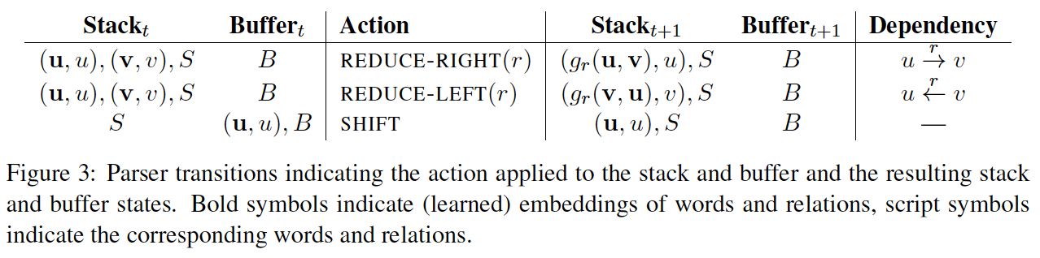
Dyer et al. (ACL 2015)

Slide 78
Early work used multi-class linear classifiers to output a parsing decision (shift, reduce-left, or reduce-right)
Chen et al. (2014) used a feed-forward network for this
Dyer et al. (2015) used RNNs to model the history of parsing decisions, the partial parses so far (the “stack”), and the sentence

Slide 79
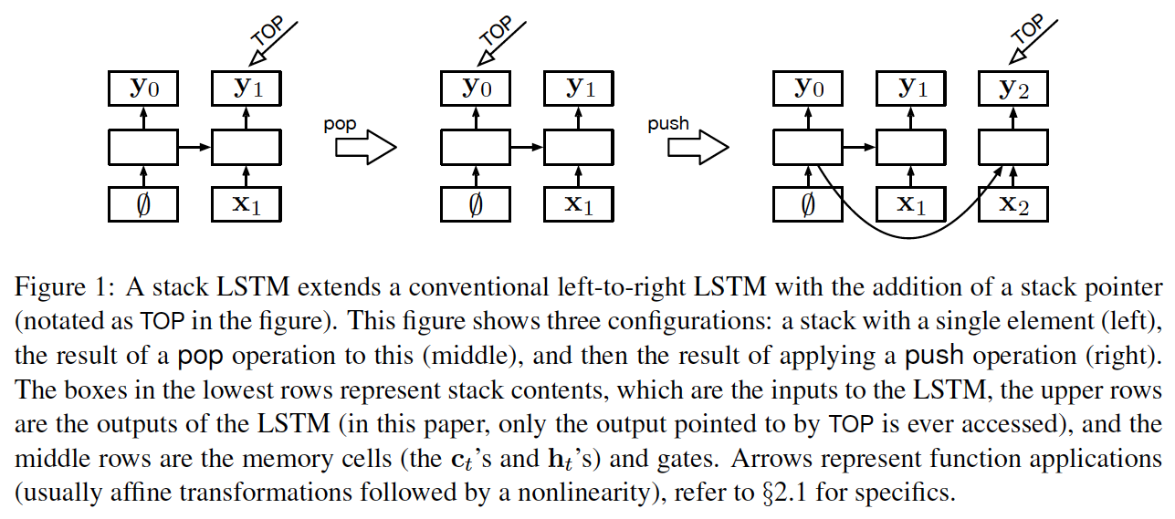
Stack RNNs
Dyer et al. (ACL 2015)

Slide 80
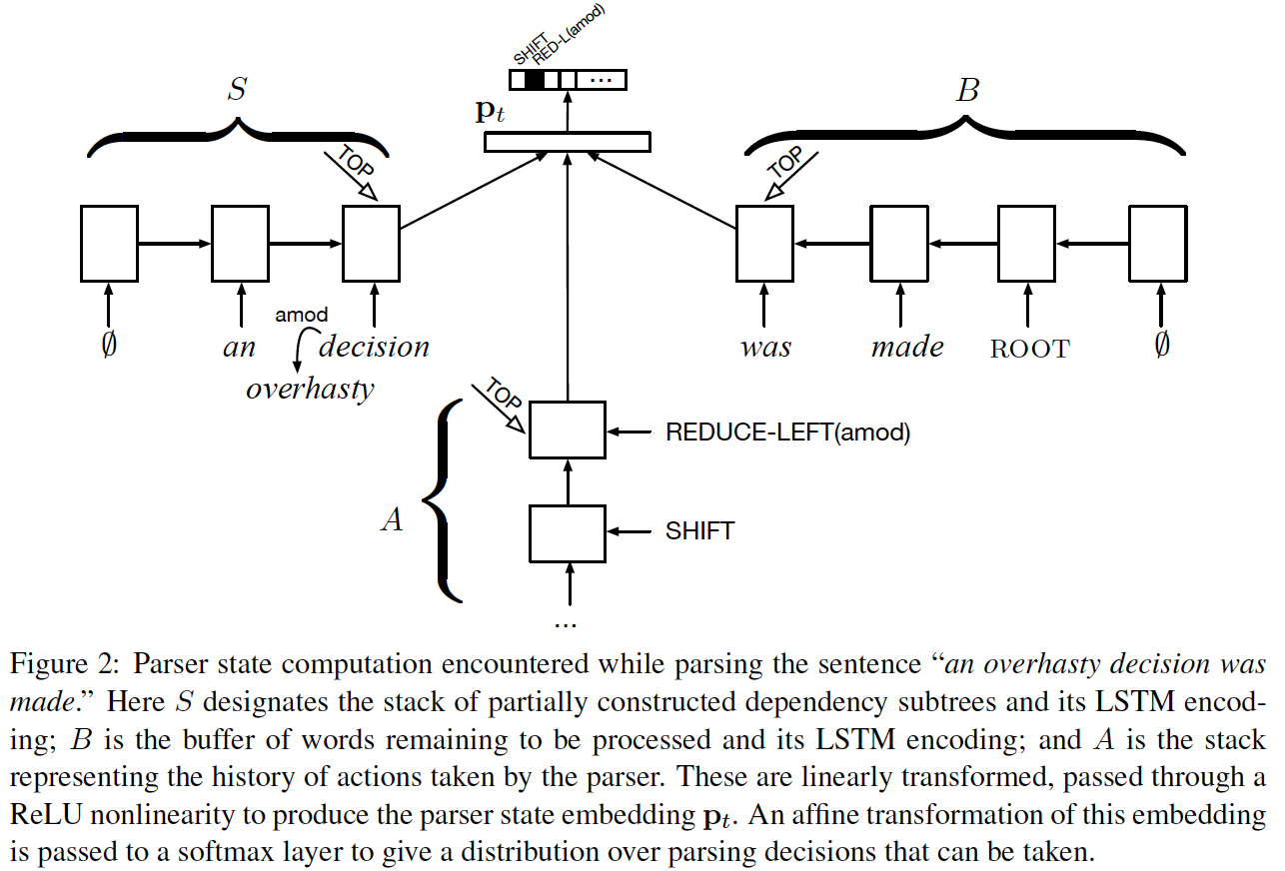
Dyer et al. (ACL 2015)

Slide 81
Stack LSTM Parser
{shift, reduce right, reduce left}
Stack:
Action history:
of
reduce right
shift
shift
reduce left
shift
shift
∅
which
millennials
Many
∅
Buffer:
50 percent are estimated to have voted …

Slide 82
Dependency Parsers
Stanford parser
TurboParser
Joakim Nivre’s MALT parser
Ryan McDonald’s MST parser
and many others for many non-English languages

Slide 83
Projective vs. Nonprojective Dependency Parsing
nonprojective parsing can be formulated as a minimum spanning tree problem
projective parsing cannot, but dynamic programming algorithms can be used (variations of CKY) as well as transition-based parsers

Slide 84
Complexity Comparison
constituent parsing: O(Gn³)
parsing complexity depends on grammar structure (“grammar constant” G)
since it has lots of nonterminal-only rules at the top of the tree, there are many rule probabilities to estimate
dependency parsing: O(n³)
operates directly on words, so parsing complexity has no grammar constant
features designed on possible dependencies (pairs of words) and larger structures
transition-based parsing algorithms are O(n), though not optimal; also, non-projective parsing is faster

Slide 85
Applications of Dependency Parsing
widely used for NLP tasks because:
faster than constituent parsing
captures more semantic information
text classification (features on dependencies)
syntax-based machine translation
relation extraction
e.g., extract relation between Sam Smith and AITech:
Sam Smith was named new CEO of AITech.
use dependency path between Sam Smith and AITech:
Smith → named, named ← CEO, CEO ← of, of ← AITech

Slide 86
Summary: two types of grammars
phrase structure / constituent grammars
inspired mostly by Chomsky and others
only appropriate for certain languages (e.g., English)
dependency grammars
closer to a semantic representation; some have made this more explicit
problematic for certain syntactic structures (e.g., conjunctions, nesting of noun phrases, etc.)
both are widely used in NLP
you can find constituent parsers and dependency parsers for several languages online

Slide 87
Recursive Neural Networks for NLP
it fell apart
run a syntactic parser on the sentence
construct vector recursively at each split point:

Slide 88
Recursive Neural Networks for NLP
it fell apart
run a syntactic parser on the sentence
construct vector recursively at each split point:
Notes:
%nlp18:rvnn
%\mathit{emb}(\mathit{fell})
%\mathit{emb}(\mathit{apart})
\mathbf{h}_1 = \mathit{emb}(\mathit{it})
%\mathbf{h}_5
%\mathbf{h}_4 = g\left(\mathbf{W}\begin{bmatrix} \mathbf{h}_2\\ \mathbf{h}_3 \end{bmatrix}+ \mathbf{b}\right)
%\mathbf{h}_5 = g\left(\mathbf{W}\begin{bmatrix} \mathbf{h}_1\\ \mathbf{h}_4 \end{bmatrix}+ \mathbf{b}\right)

Slide 89
Recursive Neural Networks for NLP
it fell apart
run a syntactic parser on the sentence
construct vector recursively at each split point:
Notes:
%nlp18:rvnn
%\mathit{emb}(\mathit{fell})
%\mathit{emb}(\mathit{apart})
\mathbf{h}_1 = \mathit{emb}(\mathit{it})
%\mathbf{h}_5
%\mathbf{h}_4 = g\left(\mathbf{W}\begin{bmatrix} \mathbf{h}_2\\ \mathbf{h}_3 \end{bmatrix}+ \mathbf{b}\right)
%\mathbf{h}_5 = g\left(\mathbf{W}\begin{bmatrix} \mathbf{h}_1\\ \mathbf{h}_4 \end{bmatrix}+ \mathbf{b}\right)

Slide 90
Recursive Neural Networks for NLP
it fell apart
run a syntactic parser on the sentence
construct vector recursively at each split point:

Slide 91
Recursive Neural Networks for NLP
same parameters used at every split point
order of children matters (different weights used for left and right child)

