Slide 1
TTIC 31190: Natural Language Processing
Kevin Gimpel
Spring 2018
Lecture 17:
Machine Translation;
Semantics

Slide 2
Roadmap
words, morphology, lexical semantics
text classification
simple neural methods for NLP
language modeling and word embeddings
recurrent/recursive/convolutional networks in NLP
sequence labeling, HMMs, dynamic programming
syntax and syntactic parsing
machine translation
semantics

Slide 3
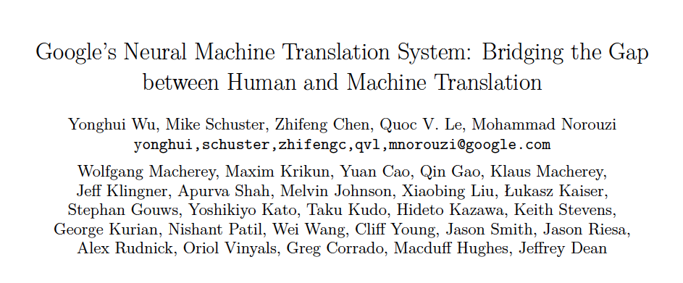

Slide 4
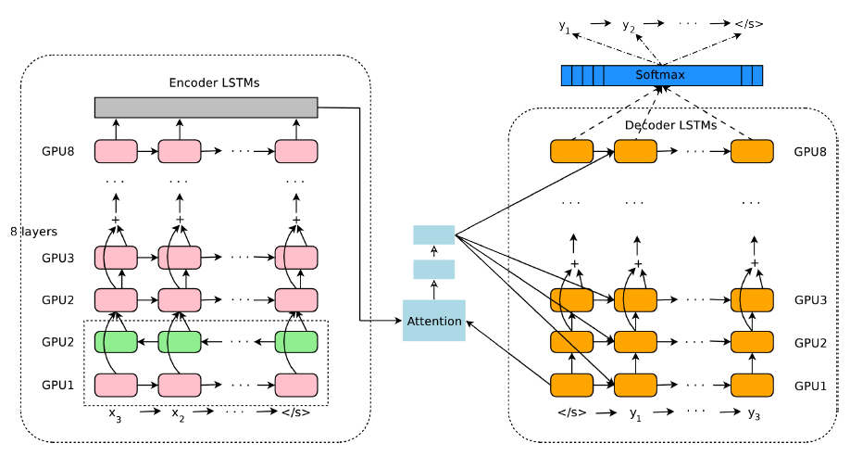
Google’s NMT System

Slide 5
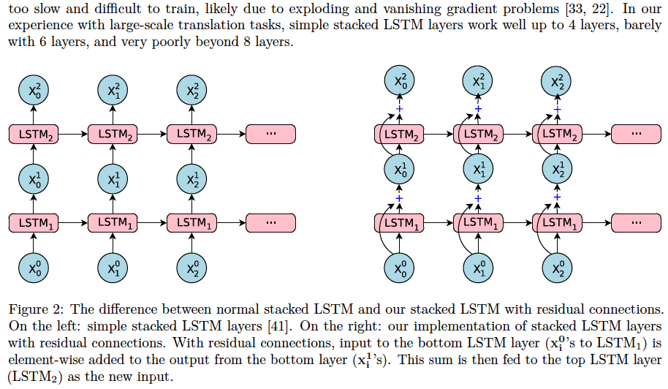
Google’s NMT System

Slide 6
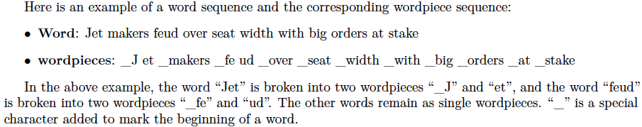
Google’s NMT System
they use a procedure that deterministically segments any character sequence into wordpieces
vocab: 8k-32k wordpieces
they first learn a “wordpiece model”

Slide 7
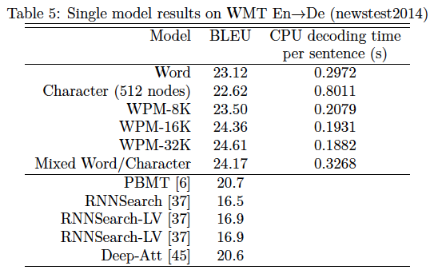
Google’s NMT System

Slide 8
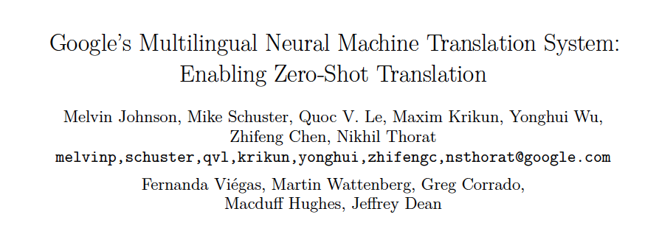

Slide 9
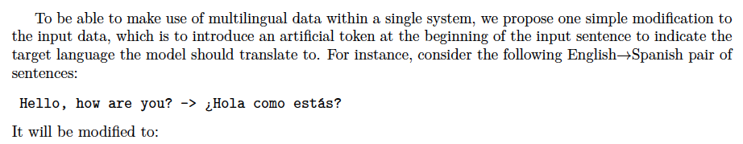
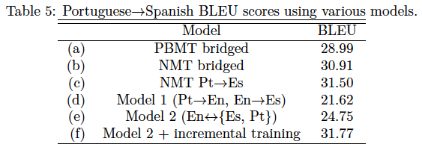

Slide 10
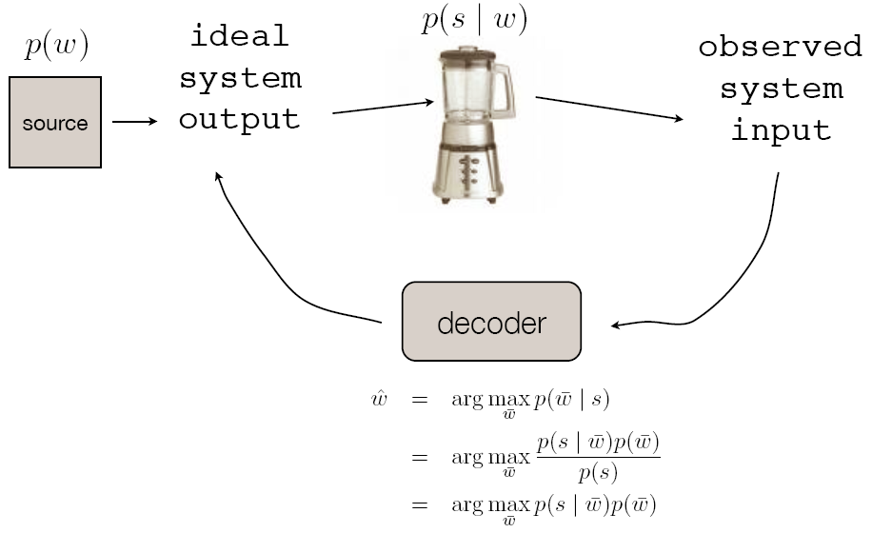
Noisy Channel Model
from Noah Smith

Slide 11
Noisy Channel Model for Translating French (x) to English (y)
from Noah Smith

Slide 12
Modeling for the Noisy Channel
we need to model two probability distributions:
should favor fluent translations
should favor accurate/faithful translations

Slide 13
Modeling for the Noisy Channel
we need to model two probability distributions:
should favor fluent translations
should favor accurate/faithful translations
let’s start with
how do we compute the probability of an English sentence?
language modeling is an important part of MT

Slide 14
Noisy Channel

Slide 15
Noisy Channel
source
sentence
predicted
translation

Slide 16
Noisy Channel
assumes we have the right model, and that we estimate it perfectly

Slide 17
Noisy Channel
assumes we have the right model, and that we estimate it perfectly

Slide 18
Noisy Channel
assumes we have the right model, and that we estimate it perfectly
extra parameters to tune, can tune to optimize BLEU

Slide 19
Noisy Channel
assumes we have the right model, and that we estimate it perfectly
extra parameters to tune, can tune to optimize BLEU
“tuning”

Slide 20
Noisy Channel → Linear Model?
since we’re not using idealized decoding rule anymore,
why not add more feature functions?
“word count feature”:

Slide 21
Noisy Channel → Linear Model?
since we’re not using idealized decoding rule anymore,
why not add more feature functions?
“word count feature”:

Slide 22
Noisy Channel → Linear Model?
since we’re not using idealized decoding rule anymore,
why not add more feature functions?
“word count feature”:
“reverse translation model feature”:

Slide 23
Notes:
Each circle is one translation, all are for a single input sentence in our training data.
Horizontal bands correspond to different derivations of the same translation; same BLEU score, different model scores.
Our MT system outputs the translation that is farthest to the right. By changing the weights of our model, we move translations left or right. We can’t move them up or down.
The goal of training is to change the parameters so that, on average, our system’s predictions for all input sentences are translations with high BLEU scores.

Slide 24
Gold standard:
African National Congress opposes sanctions against Zimbabwe
Notes:
Each circle is one translation, all are for a single input sentence in our training data.
Horizontal bands correspond to different derivations of the same translation; same BLEU score, different model scores.
Our MT system outputs the translation that is farthest to the right. By changing the weights of our model, we move translations left or right. We can’t move them up or down.
The goal of training is to change the parameters so that, on average, our system’s predictions for all input sentences are translations with high BLEU scores.

Slide 25
Gold standard:
African National Congress opposes sanctions against Zimbabwe
Notes:
Each circle is one translation, all are for a single input sentence in our training data.
Horizontal bands correspond to different derivations of the same translation; same BLEU score, different model scores.
Our MT system outputs the translation that is farthest to the right. By changing the weights of our model, we move translations left or right. We can’t move them up or down.
The goal of training is to change the parameters so that, on average, our system’s predictions for all input sentences are translations with high BLEU scores.

Slide 26
Gold standard:
African National Congress opposes sanctions against Zimbabwe
African National Congress opposition sanctions against Zimbabwe
predicted translation
opposition to sanctions against
Zimbabwe African National Congress
African sanctioning to
Zimbabwe’s opposing
Notes:
Each circle is one translation, all are for a single input sentence in our training data.
Horizontal bands correspond to different derivations of the same translation; same BLEU score, different model scores.
Our MT system outputs the translation that is farthest to the right. By changing the weights of our model, we move translations left or right. We can’t move them up or down.
The goal of training is to change the parameters so that, on average, our system’s predictions for all input sentences are translations with high BLEU scores.

Slide 27
Gold standard:
African National Congress opposes sanctions against Zimbabwe
learning moves translations left or right in this plot
Notes:
Each circle is one translation, all are for a single input sentence in our training data.
Horizontal bands correspond to different derivations of the same translation; same BLEU score, different model scores.
Our MT system outputs the translation that is farthest to the right. By changing the weights of our model, we move translations left or right. We can’t move them up or down.
The goal of training is to change the parameters so that, on average, our system’s predictions for all input sentences are translations with high BLEU scores.

Slide 28
Gold standard:
African National Congress opposes sanctions against Zimbabwe
“ideal” model
Notes:
Each circle is one translation, all are for a single input sentence in our training data.
Horizontal bands correspond to different derivations of the same translation; same BLEU score, different model scores.
Our MT system outputs the translation that is farthest to the right. By changing the weights of our model, we move translations left or right. We can’t move them up or down.
The goal of training is to change the parameters so that, on average, our system’s predictions for all input sentences are translations with high BLEU scores.

Slide 29
Gold standard:
African National Congress opposes sanctions against Zimbabwe
Where’s the gold standard translation?
Notes:
Each circle is one translation, all are for a single input sentence in our training data.
Horizontal bands correspond to different derivations of the same translation; same BLEU score, different model scores.
Our MT system outputs the translation that is farthest to the right. By changing the weights of our model, we move translations left or right. We can’t move them up or down.
The goal of training is to change the parameters so that, on average, our system’s predictions for all input sentences are translations with high BLEU scores.

Slide 30
Issue: gold standard translation is often unreachable by the model
Gold standard:
African National Congress opposes sanctions against Zimbabwe
Why?
limited translation rules,
free translations,
noisy data
Notes:
This causes problems when applying standard learning algorithms to MT.

Slide 31
Free Translations
Machine translation:
Sharon's office said, leader of the main opposition Labor Party has admitted defeat and congratulatory telephone calls to Sharon.
Human-generated translation:
According to a representative of Sharon's office, the leader of the main opposition Labor Party has admitted defeat and made the obligatory congratulating telephone call to Sharon.
Notes:
Sharon's office said that, Mitzna, leader of the main opposition Labor Party, has conceded the election and telephoned Sharon for congratulation.
Sharon's office said, leader of the main opposition Labor Party recognized, and called the failure of Sharon's congratulations.
Sharon's office said, leader of the main opposition Labor Party has admitted defeat and congratulatory call to Sharon.
Sharon's office said, leader of the main opposition Labor Party has admitted defeat and congratulatory telephone calls to Sharon.
According to a representative of Sharon's office, the leader of the main opposition Labor Party has admitted defeat and made the obligatory congratulating telephone call to Sharon.

Slide 32
Free Translations
Even if gold standard translation was reachable by model, we might not want to learn from it directly
Machine translation:
Sharon's office said, leader of the main opposition Labor Party has admitted defeat and congratulatory telephone calls to Sharon.
Human-generated translation:
According to a representative of Sharon's office, the leader of the main opposition Labor Party has admitted defeat and made the obligatory congratulating telephone call to Sharon.
Applicable to other tasks:
summarization
image caption generation
Notes:
Sharon's office said that, Mitzna, leader of the main opposition Labor Party, has conceded the election and telephoned Sharon for congratulation.
Sharon's office said, leader of the main opposition Labor Party recognized, and called the failure of Sharon's congratulations.
Sharon's office said, leader of the main opposition Labor Party has admitted defeat and congratulatory call to Sharon.
Sharon's office said, leader of the main opposition Labor Party has admitted defeat and congratulatory telephone calls to Sharon.
According to a representative of Sharon's office, the leader of the main opposition Labor Party has admitted defeat and made the obligatory congratulating telephone call to Sharon.

Slide 33
Loss Functions
issue: gold standard translation is often unreachable by the model
name | loss | where used
cost (“0-1”) |  | intractable, but underlies “direct error minimization”
perceptron |  | perceptron algorithm (Rosenblatt, 1958)
hinge |  | support vector machines, other large-margin algorithms
log |  | logistic regression, conditional random fields, maximum entropy models

Slide 34
Loss Functions
intractable, but it doesn’t need to compute model score of gold standard!
name | loss | where used
cost (“0-1”) |  | intractable, but underlies “direct error minimization”
perceptron |  | perceptron algorithm (Rosenblatt, 1958)
hinge |  | support vector machines, other large-margin algorithms
log |  | logistic regression, conditional random fields, maximum entropy models

Slide 35
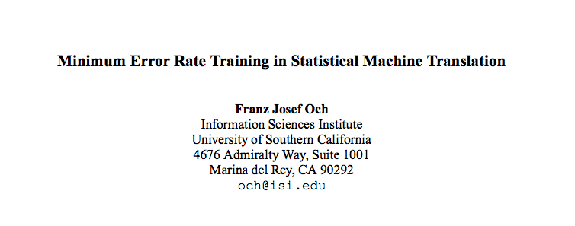
MERT, Och (2003)

Slide 36
Minimum Error Rate Training (MERT)
minimize the cost of the decoder output
intractable in general – how can we solve it?
“how bad are these translations?”
e.g., negative BLEU
set of source sentences
references
decoder
outputs
Notes:
What are some issues with this loss function?

Slide 37
Minimum Error Rate Training (MERT)
minimize the cost of the decoder output
intractable in general – how can we solve it?
“how bad are these translations?”
e.g., negative BLEU
set of source sentences
generate k-best lists of translations, approximately minimize cost on k-best lists, repeat with new parameters
(pool k-best lists across iterates)
references
decoder
outputs
Notes:
What are some issues with this loss function?

Slide 38
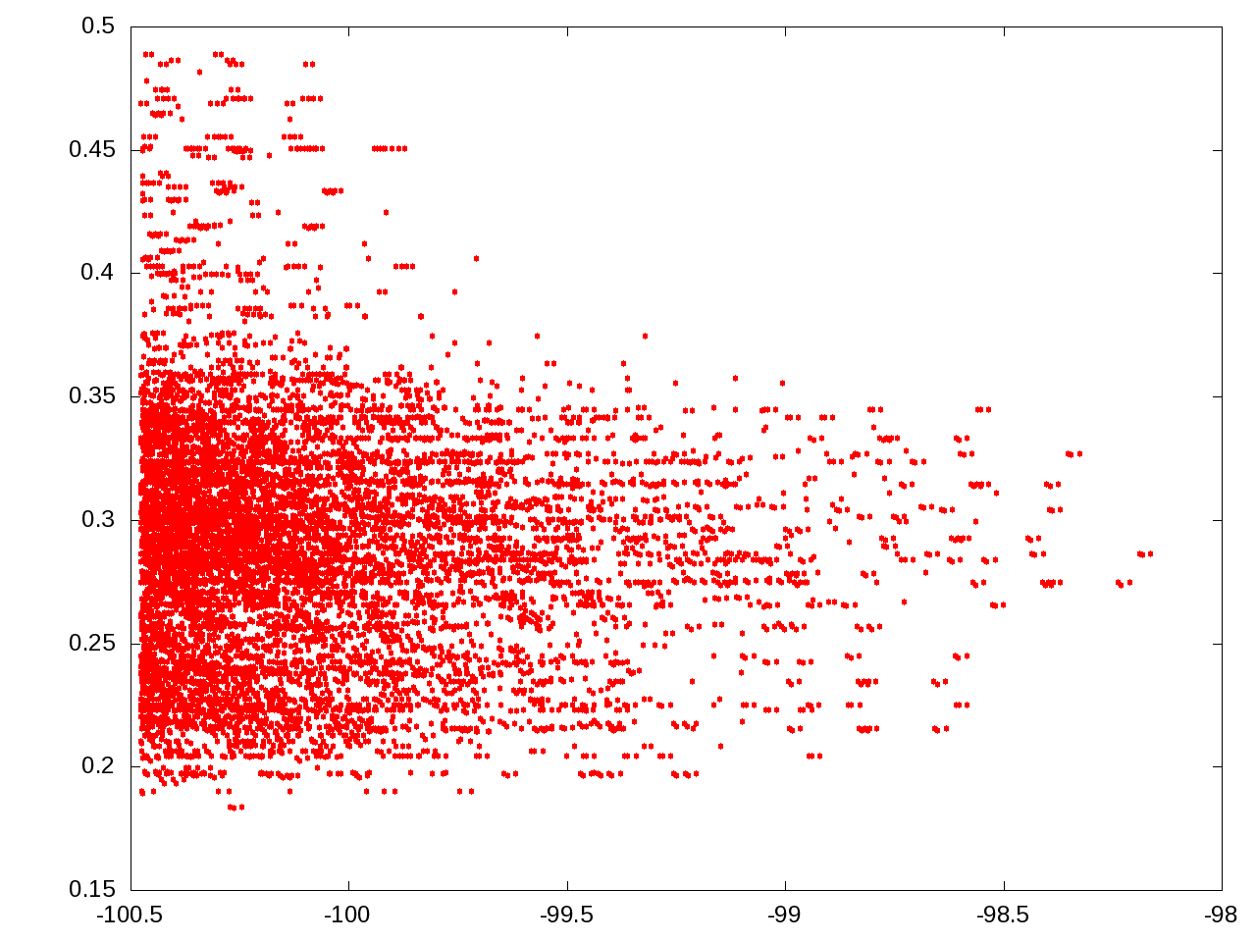
BLEU
model score

Slide 39
each point is a translation for the same sentence
BLEU
Arabic-English,
phrase-based
model score

Slide 40
10,000-best list,
default Moses weights
BLEU
1-best:
28 BLEU
model score

Slide 41
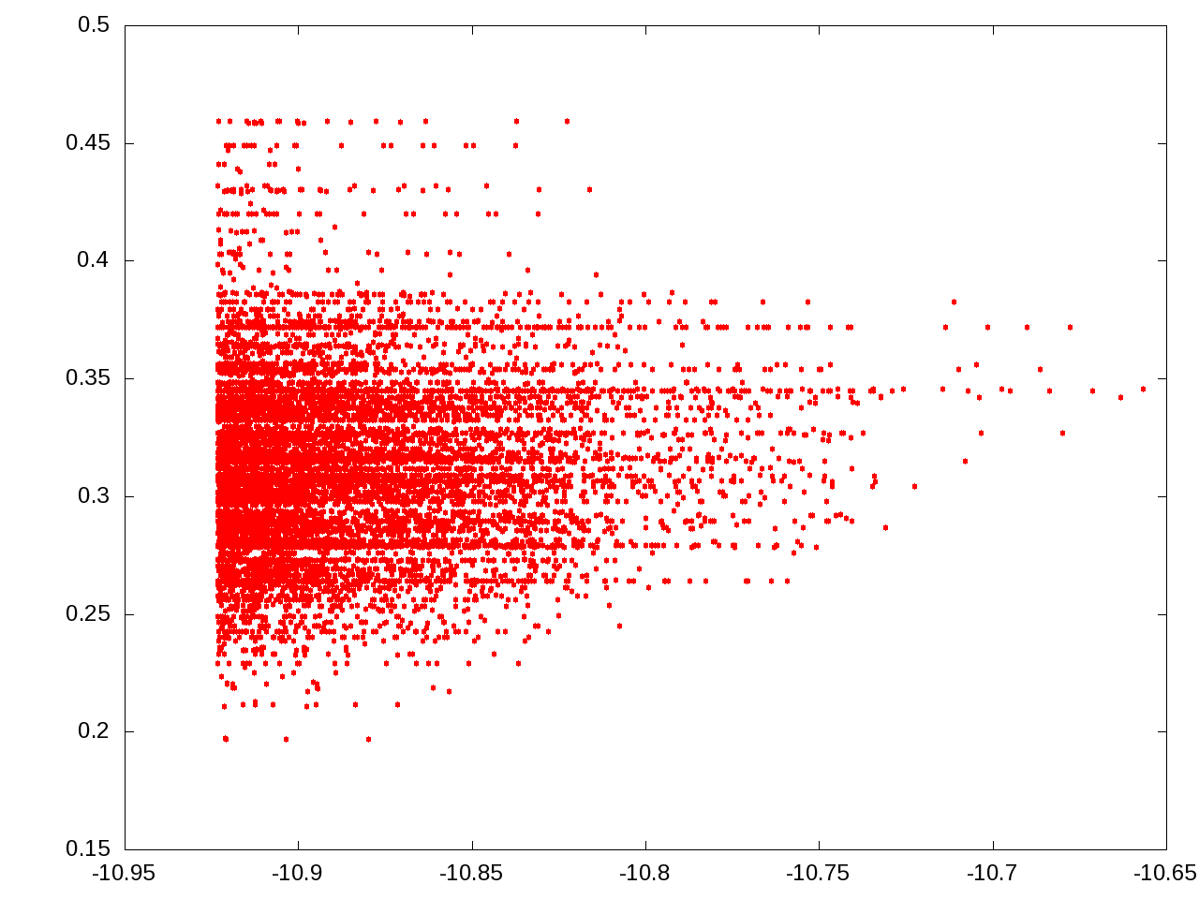
same sentence,
10,000-best list
after MERT
BLEU
1-best:
34 BLEU
model score

Slide 42
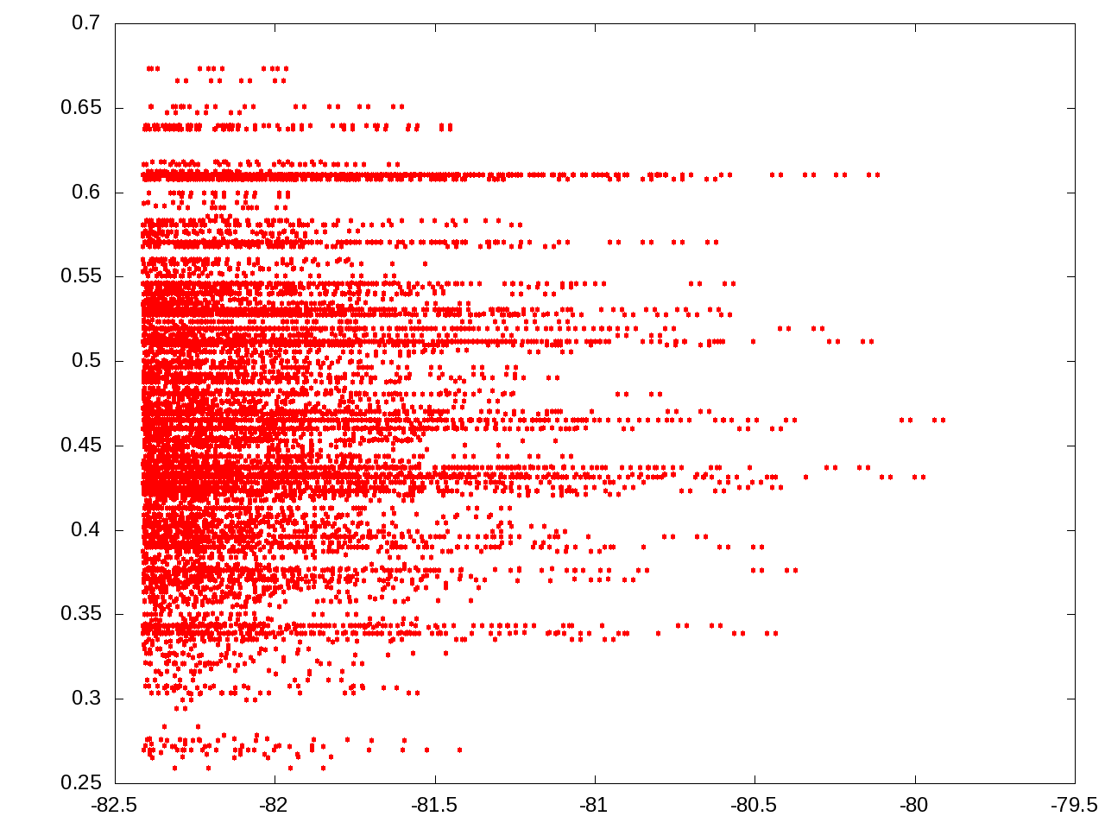
another sentence,
default Moses weights
BLEU
1-best:
46 BLEU
model score

Slide 43
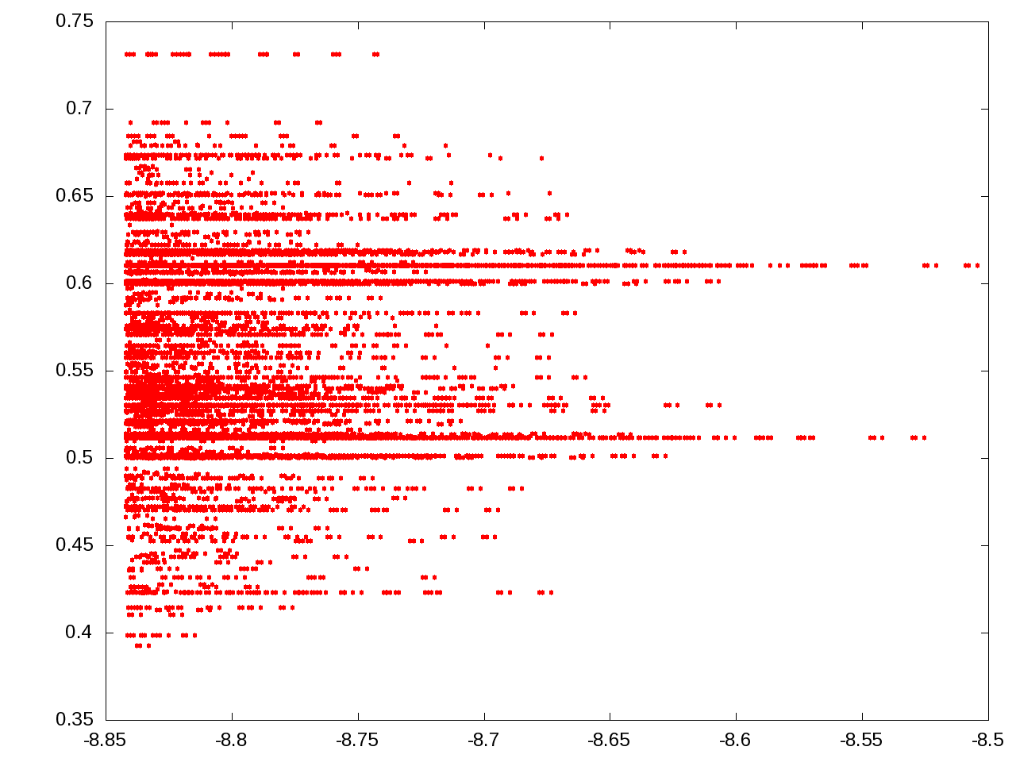
same sentence,
after MERT
BLEU
1-best:
62 BLEU
model score

Slide 44
Why are there horizontal “bands”?
BLEU
model score

Slide 45
Why are there horizontal “bands”?
latent derivations,
different translations
with same BLEU
BLEU
model score

Slide 46
Minimum Error Rate Training (MERT)
What are some issues with this loss function?
Discontinuous & non-convex → optimization relies on randomized search
No regularization → leads to overfitting
As a result, MERT is only effective for very small models (<40 parameters)
Notes:
Overfits to training data
Shows high variance across runs
Works well for small feature sets (<40 features), but fails for large feature sets
Despite its shortcomings, minimum error rate training is the predominant approach to training MT models

Slide 47
Many researchers tried to improve MERT:
Regularization and Search for MERT (Cer et al., 2008)
Random Restarts in MERT for MT (Moore & Quirk, 2008)
Stabilizing MERT (Foster & Kuhn, 2009)
Issues remain:
Better Hypothesis Testing for Statistical MT: Controlling for Optimizer Instability (Clark et al., 2011)
They suggest running MERT 3-5 times due to its instability

Slide 48
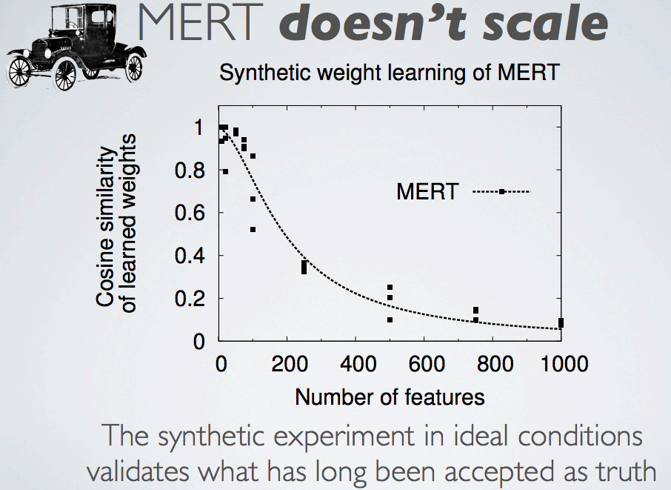

Slide 49
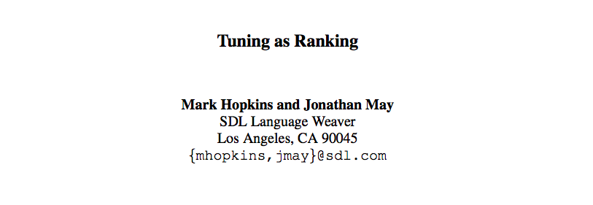

Slide 50
Perceptron Loss
reference
Notes:
This causes problems when applying standard learning algorithms to MT.

Slide 51
Perceptron Loss
reference
model prediction
Notes:
This causes problems when applying standard learning algorithms to MT.

Slide 52
Perceptron Loss for MT? (Collins, 2002)
reference
model prediction
Notes:
This causes problems when applying standard learning algorithms to MT.

Slide 53
k-Best Perceptron for MT (Liang et al., 2006)
model prediction
Notes:
This causes problems when applying standard learning algorithms to MT.

Slide 54
k-Best Perceptron for MT (Liang et al., 2006)
model prediction
Notes:
This causes problems when applying standard learning algorithms to MT.

Slide 55
k-Best Perceptron for MT (Liang et al., 2006)
BLEU oracle on k-best list
model prediction
Notes:
This causes problems when applying standard learning algorithms to MT.

Slide 56
Ramp Loss Minimization
Notes:
This causes problems when applying standard learning algorithms to MT.

Slide 57
Ramp Loss Minimization
model prediction
Notes:
This causes problems when applying standard learning algorithms to MT.

Slide 58
Ramp Loss Minimization
model prediction
“fear” translation
Notes:
This causes problems when applying standard learning algorithms to MT.

Slide 59
“Fear” Ramp Loss (Do et al., 2008)
model prediction
“fear” translation
Notes:
This causes problems when applying standard learning algorithms to MT.

Slide 60
“Fear” Ramp Loss (Do et al., 2008)
model prediction
gold standard
“fear” translation
Notes:
This causes problems when applying standard learning algorithms to MT.

Slide 61
“Hope” Ramp Loss (McAllester & Keshet, 2011; Liang et al., 2006)
model prediction
Notes:
This causes problems when applying standard learning algorithms to MT.

Slide 62
“Hope” Ramp Loss (McAllester & Keshet, 2011; Liang et al., 2006)
“hope” translation
model prediction
Notes:
This causes problems when applying standard learning algorithms to MT.

Slide 63
“Hope-Fear” Ramp Loss (Chiang et al., 2008; 2009; Cherry & Foster, 2012; Chiang, 2012)
“hope” translation
“fear” translation
Notes:
This causes problems when applying standard learning algorithms to MT.

Slide 64
“Hope-Fear” Ramp Loss (Chiang et al., 2008; 2009; Cherry & Foster, 2012; Chiang, 2012)
“hope” translation
“fear” translation
Notes:
This causes problems when applying standard learning algorithms to MT.

Slide 65
Experiments (Gimpel, 2012)
averages over 8 test sets across 3 language pairs
 | Moses | Hiero
 | (%BLEU) | (%BLEU)
MERT | 35.9 | 37.0
Fear Ramp (away from bad) | 34.9 | 34.2
Hope Ramp (toward good) | 35.2 | 36.0
Hope-Fear Ramp (toward good + away from bad) | 35.7 | 37.0

Slide 66
Pairwise Ranking Optimization (Hopkins & May, 2011)

Slide 67
Roadmap
words, morphology, lexical semantics
text classification
simple neural methods for NLP
language modeling and word embeddings
recurrent/recursive/convolutional networks in NLP
sequence labeling, HMMs, dynamic programming
syntax and syntactic parsing
machine translation
semantics

Slide 68
Semantics
we talked a lot about lexical semantics:
word sense, WordNet, word embeddings/clusters
how about semantics beyond the word level?

Slide 69
Compositional Semantics
“how should the meanings of words combine to create the meaning of something larger?”
there’s currently a lot of work in producing vector representations of sentences and documents
simplest case: how should two word vectors be combined to create a vector for a bigram?
lots of work in this area in the neural era, but earlier work began ~2007

Slide 70
Evaluating Compositional Semantics
compute similarity of two bigrams under your model, then compute correlation with human judgments:
 |  | BigramSim | BigramPara
television programme | tv set | 5.8 | 1.0
training programme | education course | 5.7 | 5.0
bedroom window | education officer | 1.3 | 1.0
(Mitchell and Lapata, 2010)

Slide 71
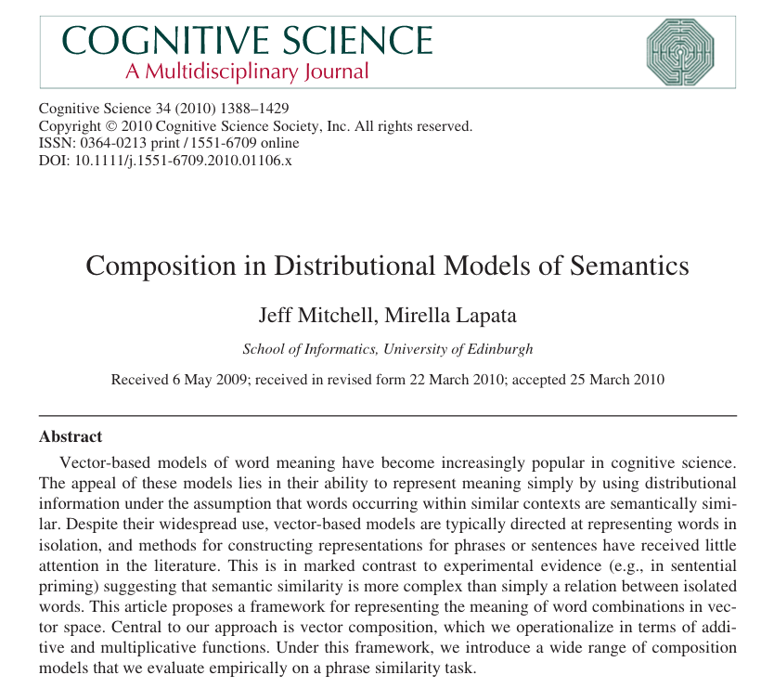

Slide 72
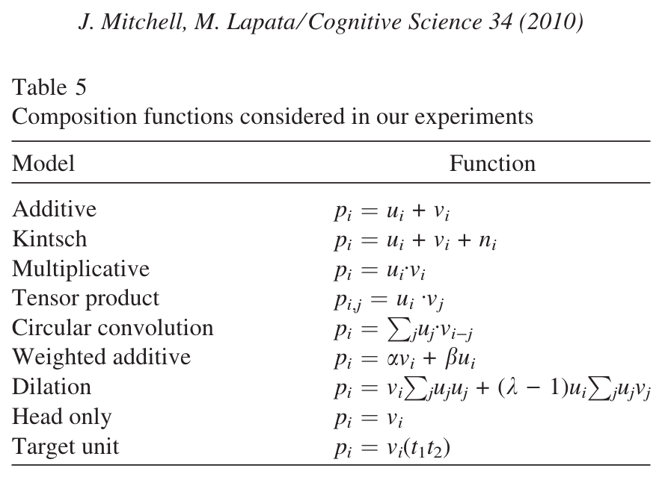
Bigram Composition Functions

Slide 73
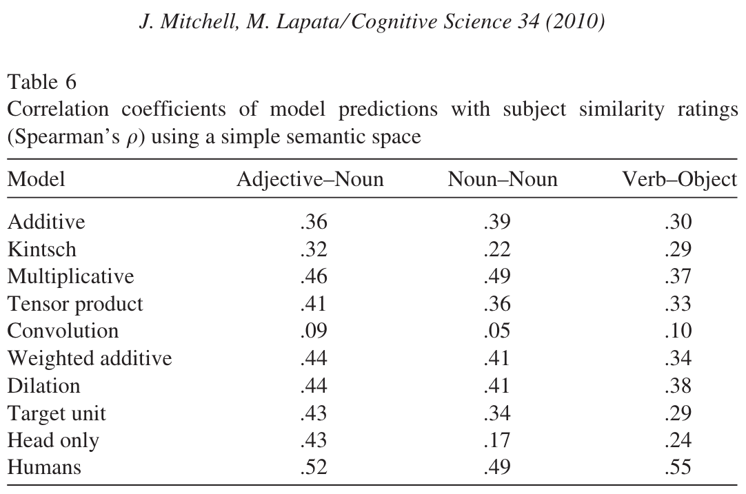
Bigram Similarity Results

Slide 74
Why does multiplication work?
these vectors are built from co-occurrence counts (like in the first part of Assignment 1)
so element-wise multiplication is like performing an AND operation on context counts
when using skip-gram word vectors (or other neural network-derived vectors), addition often works better

Slide 75
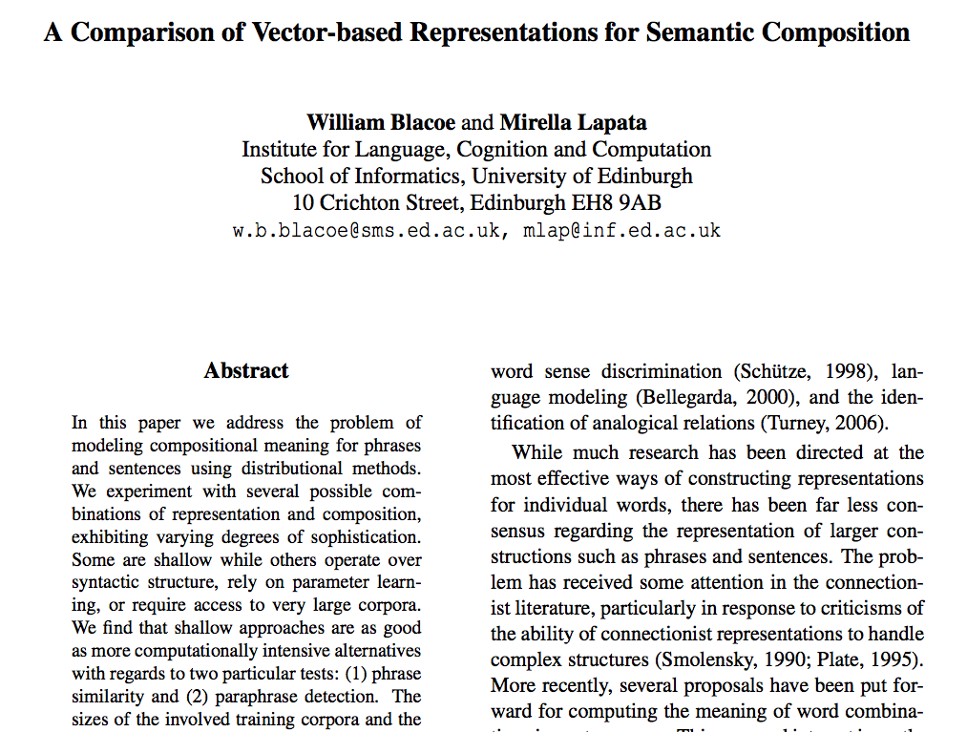

Slide 76
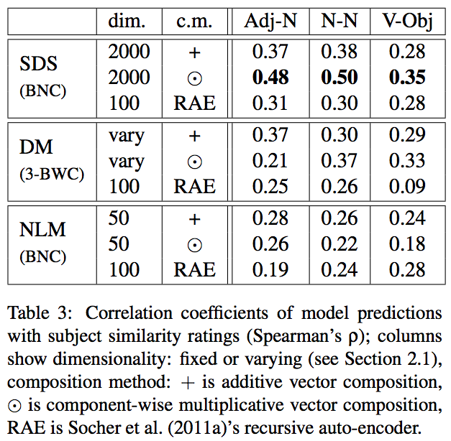
Results
SDS = simple distributional semantic
NLM = neural language model

Slide 77
currently there is a lot of work on designing functional architectures for bigram, phrase, and sentence similarity
e.g., word averaging, recurrent neural networks, LSTMs, recursive neural networks, etc.
our recent results find that, for sentence similarity, word averaging is a surprisingly strong baseline

Slide 78
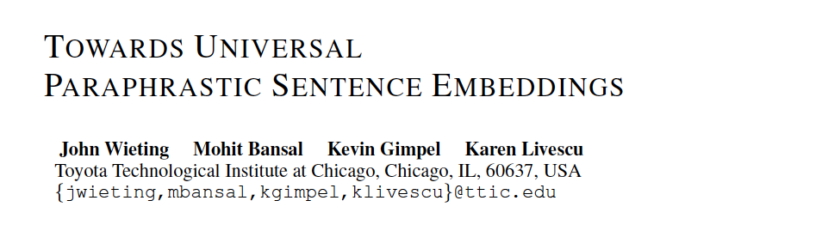
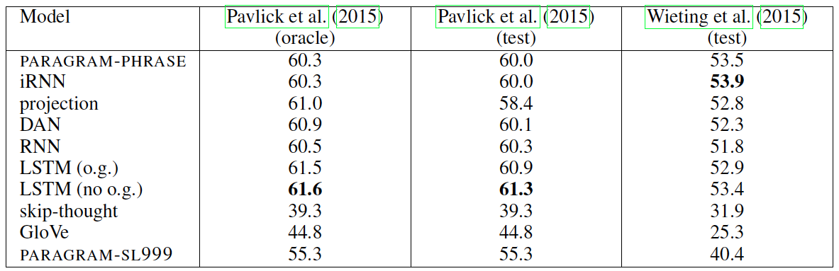
on similar data to training data, LSTM does best

Slide 79
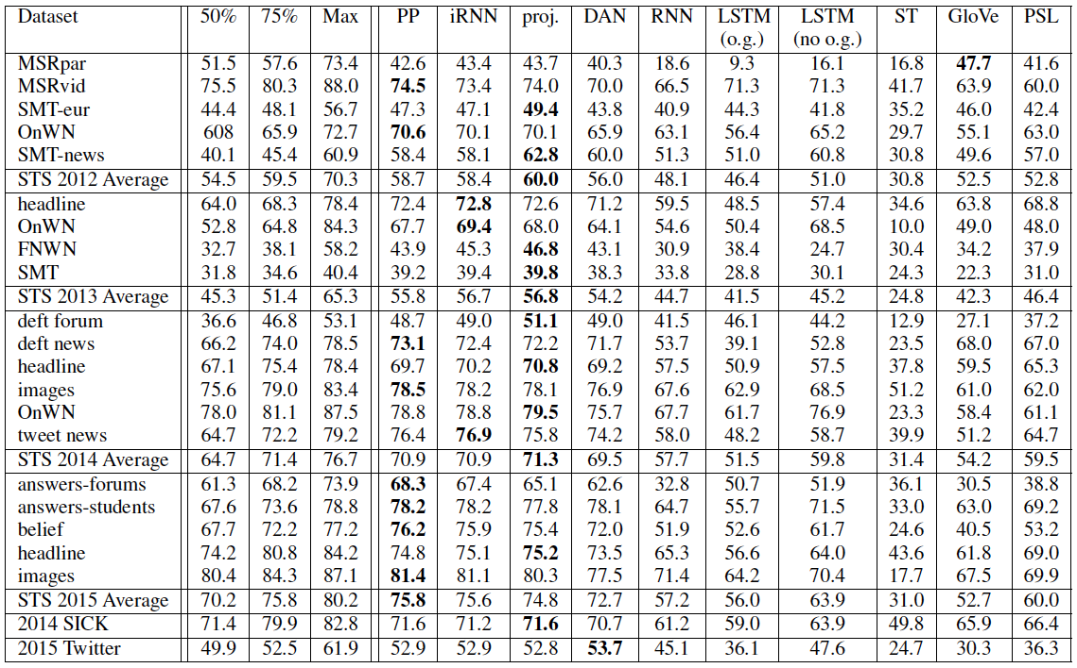
adding layers
to word
averaging
word
averaging
but when evaluating on other datasets,
word averaging models do best!

Slide 80
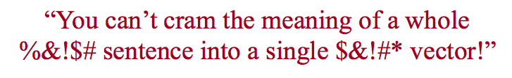
--Ray Mooney
“You can’t map all sentences into a cold, sterile space of meaningless, uninterpretable dimensions.”
Symbolic representations can encode meaning much more efficiently.”
--my interpretation

Slide 81
--Ray Mooney
Why must we choose?
Neural architectures for text understanding can combine discrete (symbolic)
and continuous representations

Slide 82
Syntax and Semantics
syntax: rules, principles, processes that govern sentence structure of a language
semantics: what the sentence means

Slide 83
we saw syntactic parsing, which produces a syntactic structure of a sentence
helps to disambiguate attachments, coordinations, sometimes word sense
now we’ll look at semantic parsing, which roughly means “produce a semantic structure of a sentence”

Slide 84
Several Kinds of Semantic Parsing
semantic role labeling (SRL)
frame-semantic parsing
“semantic parsing” (first-order logic)
abstract meaning representation (AMR)
dependency-based compositional semantics

