Slide 1
TTIC 31190: Natural Language Processing
Kevin Gimpel
Spring 2018
Lecture 2: Words, Morphology, Distributional Word Vectors

Slide 2
All materials are posted on the course website:
ttic.uchicago.edu/~kgimpel/teaching/31190-s18/index.html
Assignment 1 has been posted
Due 6:00 pm on Wednesday, April 11th
My office hours are Mondays 3-4pm, #531 (or by appointment)
TA office hours are Wednesdays 3-4pm, #501

Slide 3
Roadmap
words, morphology, lexical semantics
text classification
simple neural methods for NLP
language modeling and word embeddings
recurrent/recursive/convolutional networks in NLP
sequence labeling, HMMs, dynamic programming
syntax and syntactic parsing
semantics, compositionality, semantic parsing
machine translation and other NLP tasks

Slide 4
Words
types and tokens
morphology
distributional word vectors
word sense and lexical semantics

Slide 5
Types and Tokens
once text has been tokenized, let’s count the words
types: entries in the vocabulary
tokens: instances of types in a corpus
example sentence: If they want to go , they should go .
how many types? 8
how many tokens? 10
type/token ratio: useful statistic of a corpus (here, 0.8)
as we add data, what happens to the type-token ratio?
indicates what?
high type/token ratio → rich morphology
low type/token ratio → poor morphology
Notes:
[kgimpel@chia twitter]$ typetoken.pl < tweets.1k
types = 4314
tokens = 15216
type/token ratio = 0.283517350157729
[kgimpel@chia twitter]$ typetoken.pl < tweets.10k
types = 22082
tokens = 149417
type/token ratio = 0.147787734996687
[kgimpel@chia twitter]$ typetoken.pl < tweets.100k
types = 110925
tokens = 1500365
type/token ratio = 0.0739320098775964
[kgimpel@chia twitter]$ typetoken.pl < tweets.1M
types = 604396
tokens = 15041588
type/token ratio = 0.040181661670297
[kgimpel@chia twitter]$ wc big100kuniq
56345753 847216426 4426084601 big100kuniq
types = 11371934
tokens = 847372098
type/token ratio = 0.0134202365487847

Slide 6
Higher Type/Token Ratio?
Wikipedia vs Simple English Wikipedia?
Wikipedia
Wikipedia vs Newswire?
Wikipedia
Wikipedia vs Tweets?
Tweets (once you have 1 million or more tokens)

Slide 7
“really” on Twitter
224571 really
1189 rly
1119 realy
731 rlly
590 reallly
234 realllly
216 reallyy
156 relly
146 reallllly
132 rily
104 reallyyy
89 reeeally
89 realllllly
84 reaaally
82 reaally
72 reeeeally
65 reaaaally
57 reallyyyy
53 rilly
50 reallllllly
48 reeeeeally
41 reeally
38 really2
37 reaaaaally
35 reallyyyyy
31 reely
30 realllyyy
27 realllyy
27 reaaly
26 realllyyyy
25 realllllllly
22 reaaallly
21 really-
19 reeaally
18 reallllyyy
16 reaaaallly
15 realyy
15 reallyreally
15 reallllyy
15 reallllllllly
15 reaallly
14 reeeeeeally
14 reallllyyyy
13 reeeaaally
12 rreally
12 reaaaaaally
11 reeeeallly
11 reeeallly
11 realllllyyy
11 reaallyy
10 reallyreallyreally
10 reaaaly
9 reeeeeeeally
9 reallys
9 really-really
9 r)eally
8 reeeaally

Slide 8
How many words are there?
a bit surprising: vocabulary continues to grow in any actual dataset
you’ll just never see all the words
Notes:
[kgimpel@chia twitter]$ typetoken.pl < tweets.1k
types = 4314
tokens = 15216
type/token ratio = 0.283517350157729
[kgimpel@chia twitter]$ typetoken.pl < tweets.10k
types = 22082
tokens = 149417
type/token ratio = 0.147787734996687
[kgimpel@chia twitter]$ typetoken.pl < tweets.100k
types = 110925
tokens = 1500365
type/token ratio = 0.0739320098775964
[kgimpel@chia twitter]$ typetoken.pl < tweets.1M
types = 604396
tokens = 15041588
type/token ratio = 0.040181661670297
[kgimpel@chia twitter]$ wc big100kuniq
56345753 847216426 4426084601 big100kuniq
types = 11371934
tokens = 847372098
type/token ratio = 0.0134202365487847

Slide 9
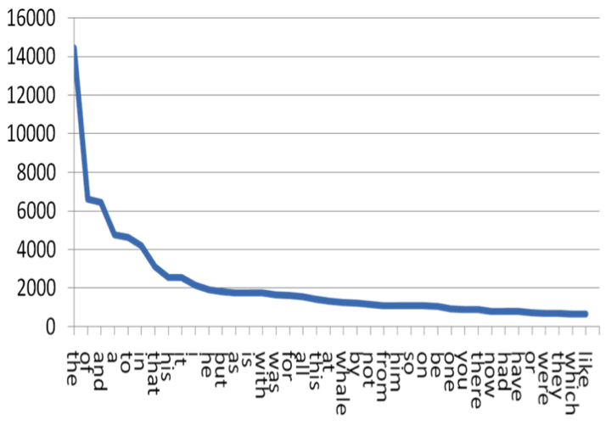
How are words distributed?
Zipf’s law: frequency of a word is inversely proportional to its rank
blog EMIS
Notes:
[kgimpel@chia twitter]$ typetoken.pl < tweets.1k
types = 4314
tokens = 15216
type/token ratio = 0.283517350157729
[kgimpel@chia twitter]$ typetoken.pl < tweets.10k
types = 22082
tokens = 149417
type/token ratio = 0.147787734996687
[kgimpel@chia twitter]$ typetoken.pl < tweets.100k
types = 110925
tokens = 1500365
type/token ratio = 0.0739320098775964
[kgimpel@chia twitter]$ typetoken.pl < tweets.1M
types = 604396
tokens = 15041588
type/token ratio = 0.040181661670297
[kgimpel@chia twitter]$ wc big100kuniq
56345753 847216426 4426084601 big100kuniq
types = 11371934
tokens = 847372098
type/token ratio = 0.0134202365487847

Slide 10
How are words distributed?
Zipf’s law: frequency of a word is inversely proportional to its rank
“long tail”
blog EMIS
Notes:
[kgimpel@chia twitter]$ typetoken.pl < tweets.1k
types = 4314
tokens = 15216
type/token ratio = 0.283517350157729
[kgimpel@chia twitter]$ typetoken.pl < tweets.10k
types = 22082
tokens = 149417
type/token ratio = 0.147787734996687
[kgimpel@chia twitter]$ typetoken.pl < tweets.100k
types = 110925
tokens = 1500365
type/token ratio = 0.0739320098775964
[kgimpel@chia twitter]$ typetoken.pl < tweets.1M
types = 604396
tokens = 15041588
type/token ratio = 0.040181661670297
[kgimpel@chia twitter]$ wc big100kuniq
56345753 847216426 4426084601 big100kuniq
types = 11371934
tokens = 847372098
type/token ratio = 0.0134202365487847

Slide 11
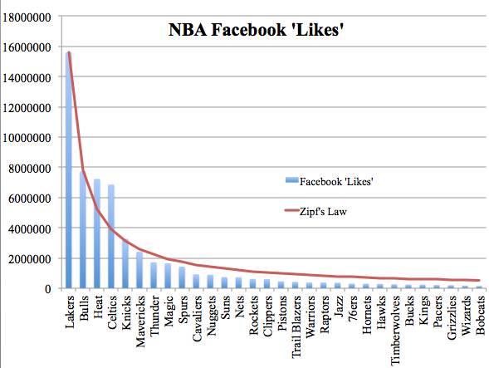
Zipf’s Law
also predicts other kinds of data: population of cities in a country, revenue of different companies, etc.
The Laurentian University Sports Analytics Group
Notes:
[kgimpel@chia twitter]$ typetoken.pl < tweets.1k
types = 4314
tokens = 15216
type/token ratio = 0.283517350157729
[kgimpel@chia twitter]$ typetoken.pl < tweets.10k
types = 22082
tokens = 149417
type/token ratio = 0.147787734996687
[kgimpel@chia twitter]$ typetoken.pl < tweets.100k
types = 110925
tokens = 1500365
type/token ratio = 0.0739320098775964
[kgimpel@chia twitter]$ typetoken.pl < tweets.1M
types = 604396
tokens = 15041588
type/token ratio = 0.040181661670297
[kgimpel@chia twitter]$ wc big100kuniq
56345753 847216426 4426084601 big100kuniq
types = 11371934
tokens = 847372098
type/token ratio = 0.0134202365487847

Slide 12
The Long Tail
there are so many word types!
but words have internal structure

Slide 13
Words
types and tokens
morphology
distributional word vectors
word sense and lexical semantics

Slide 14
Type/Token Ratio across Languages
high type/token ratio →
low type/token ratio →
Notes:
[kgimpel@chia twitter]$ typetoken.pl < tweets.1k
types = 4314
tokens = 15216
type/token ratio = 0.283517350157729
[kgimpel@chia twitter]$ typetoken.pl < tweets.10k
types = 22082
tokens = 149417
type/token ratio = 0.147787734996687
[kgimpel@chia twitter]$ typetoken.pl < tweets.100k
types = 110925
tokens = 1500365
type/token ratio = 0.0739320098775964
[kgimpel@chia twitter]$ typetoken.pl < tweets.1M
types = 604396
tokens = 15041588
type/token ratio = 0.040181661670297
[kgimpel@chia twitter]$ wc big100kuniq
56345753 847216426 4426084601 big100kuniq
types = 11371934
tokens = 847372098
type/token ratio = 0.0134202365487847

Slide 15
Type/Token Ratio across Languages
high type/token ratio → rich morphology
low type/token ratio → poor morphology
Notes:
[kgimpel@chia twitter]$ typetoken.pl < tweets.1k
types = 4314
tokens = 15216
type/token ratio = 0.283517350157729
[kgimpel@chia twitter]$ typetoken.pl < tweets.10k
types = 22082
tokens = 149417
type/token ratio = 0.147787734996687
[kgimpel@chia twitter]$ typetoken.pl < tweets.100k
types = 110925
tokens = 1500365
type/token ratio = 0.0739320098775964
[kgimpel@chia twitter]$ typetoken.pl < tweets.1M
types = 604396
tokens = 15041588
type/token ratio = 0.040181661670297
[kgimpel@chia twitter]$ wc big100kuniq
56345753 847216426 4426084601 big100kuniq
types = 11371934
tokens = 847372098
type/token ratio = 0.0134202365487847

Slide 16
Morphology
morphemes:
the small meaningful units that make up words
stems: core meaning-bearing units
affixes: bits and pieces that adhere to stems
often with grammatical functions
J&M/SLP3

Slide 17
Kinds of Word Formation
inflection: modifying a word with an affix to change its grammatical function (tense, number, etc.)
result is a “different form of the same word”
examples: book → books, walk → walked
derivation: adding an affix to a stem to create a new word
examples: great → greatly, great → greatness
compounding: combining two stems
examples: lawsuit, keyboard, bookcase

Slide 18
Kinds of Word Formation
inflection: modifying a word with an affix to change its grammatical function (tense, number, etc.)
result is a “different form of the same word”
examples: book → books, walk → walked
derivation: adding an affix to a stem to create a new word
examples: great → greatly, great → greatness
compounding: combining two stems
examples: lawsuit, keyboard, bookcase

Slide 19
Kinds of Word Formation
inflection: modifying a word with an affix to change its grammatical function (tense, number, etc.)
result is a “different form of the same word”
examples: book → books, walk → walked
derivation: adding an affix to a stem to create a new word
examples: great → greatly, great → greatness
compounding: combining two stems
examples: lawsuit, keyboard, bookcase

Slide 20
Morphology
usually, morphological derivation is simply splitting a word into its morphemes:
walked = walk + ed
greatness = great + ness
but it can actually be a hierarchical structure
unbreakable = ?

Slide 21
Morphology
usually, morphological derivation is simply splitting a word into its morphemes:
walked = walk + ed
greatness = great + ness
but it can actually be a hierarchical structure
unbreakable = un + (break + able)

Slide 22
Morphology
ambiguity in hierarchical morphological decomposition?
rare, but it does happen
unlockable = un + lock + able
what does this word mean?
(un+lock)+able: “able to be unlocked”
un+(lock+able): “unable to be locked”

Slide 23
Morphology
ambiguity in hierarchical morphological decomposition?
rare, but it does happen
unlockable = un + lock + able
what does this word mean?
(un+lock)+able: “able to be unlocked”
un+(lock+able): “unable to be locked”

Slide 24
Morphology
ambiguity in hierarchical morphological decomposition?
rare, but it does happen
unlockable = un + lock + able
what does this word mean?
(un+lock)+able: “able to be unlocked”
un+(lock+able): “unable to be locked”

Slide 25
Morphology in NLP
two common tasks:
lemmatization
stemming

Slide 26
Lemmatization
lemmatization: reduce inflections or variant forms to base form
am, are, is → be
car, cars, car's, cars' → car
the boy's cars are different colors → the boy car be different color
have to find correct dictionary headword form
e.g., for machine translation:
Spanish quiero (‘I want’), quieres (‘you want’) same lemma as querer ‘want’
J&M/SLP3

Slide 27
Stemming
stemming: reduces words to their stems via crude chopping of affixes
e.g., automate(s), automatic, automation all reduced to automat
language dependent
key step in information retrieval
for example compressed
and compression are both
accepted as equivalent to
compress.
for exampl compress and
compress ar both accept
as equival to compress
J&M/SLP3

Slide 28
Porter’s algorithm The most common English stemmer
Step 1a
sses → ss caresses → caress
ies → i ponies → poni
ss → ss caress → caress
s → ø cats → cat
Step 1b
(*v*)ing → ø walking → walk
sing → sing
(*v*)ed → ø plastered → plaster
…
Step 2 (for long stems)
ational→ ate relational→ relate
izer→ ize digitizer → digitize
ator→ ate operator → operate
…
Step 3 (for longer stems)
al → ø revival → reviv
able → ø adjustable → adjust
ate → ø activate → activ
…
J&M/SLP3

Slide 29
Dealing with complex morphology is sometimes necessary
Some languages requires complex morpheme segmentation
Turkish
Uygarlastiramadiklarimizdanmissinizcasina: “(behaving) as if you are among those whom we could not civilize”
Uygar `civilized’ + las `become’
+ tir `cause’ + ama `not able’
+ dik `past’ + lar ‘plural’
+ imiz ‘p1pl’ + dan ‘abl’
+ mis ‘past’ + siniz ‘2pl’ + casina ‘as if’
J&M/SLP3

Slide 30
Words
types and tokens
morphology
distributional word vectors
word sense and lexical semantics

Slide 31
Why is NLP hard?
ambiguity and variability of linguistic expression:
ambiguity: one form can mean many things
variability: many forms can mean the same thing

Slide 32
one form, multiple meanings → split form
multiple forms, one meaning → merge forms
ambiguity
variability

Slide 33
Ambiguity
one form, multiple meanings → split form
tokenization (adding spaces):
didn’t → did n’t
“Yes?” → “ Yes ? ”
today/next week: word sense disambiguation:
power plant → power plant₁
flowering plant → flowering plant₂

Slide 34
Variability
multiple forms, one meaning → merge forms
tokenization (removing spaces):
New York → NewYork
lemmatization:
walked → walk
walking → walk
stemming:
automation → automat
automates → automat

Slide 35
Variability
multiple forms, one meaning → merge forms
tokenization (removing spaces):
New York → NewYork
lemmatization:
walked → walk
walking → walk
stemming:
automation → automat
automates → automat
today: word representations

Slide 36
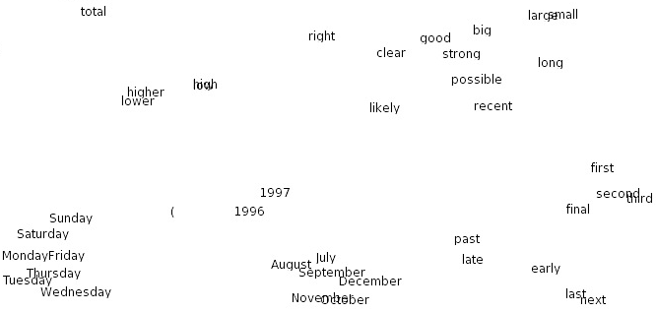
Vector Representations of Words
t-SNE visualization from Turian et al. (2010)

Slide 37
Word Clusters
Computational Linguistics, 1992

Slide 38
Why vector models of word meaning? computing the similarity between words
tall is similar to height
question answering:
Q: How tall is Mt. Everest? A: “The official height of Mount Everest is 29029 feet”
J&M/SLP3

Slide 39
distributional models of meaning = vector space models of meaning = vector semantics
Zellig Harris (1954):
“oculist and eye-doctor … occur in almost the same environments”
“If A and B have almost identical environments we say that they are synonyms.”
J.R. Firth (1957):
“You shall know a word by the company it keeps!”
J&M/SLP3

Slide 40
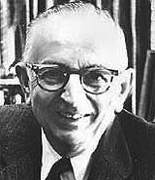
Warren Weaver (1955):
“But if one lengthens the slit in the opaque mask, until one can see not only the central word in question but also say N words on either side, then if N is large enough one can unambiguously decide the meaning of the central word…”

Slide 41
Intuitions of Distributional Models
suppose I gave you the following corpus:
A bottle of tesgüino is on the table
Everybody likes tesgüino
Tesgüino makes you drunk
We make tesgüino out of corn.
what is tesgüino?
from context, we can guess tesgüino is an alcoholic beverage like beer
intuition: two words are similar if they have similar word contexts
J&M/SLP3

Slide 42
Many ways to get word vectors
some based on counting, some based on prediction/learning
some sparse, some dense
some have interpretable dimensions, some don’t
shared ideas:
model meaning of a word by “embedding” it in a vector space
these word vectors are also called “embeddings”
contrast: in traditional NLP, word meaning is represented by a vocabulary index (“word #545”)
J&M/SLP3

Slide 43
Distributional Word Vectors
we’ll start with the simplest way to create word vectors:
count occurrences of context words
so, vector for pineapple has counts of words in the context of pineapple in a dataset
one entry in vector for each unique context word
stack these vectors for all words in a vocabulary V to produce a count matrix C
C is called the word-context matrix (or word-word co-occurrence matrix)

Slide 44
Counting Context Words
J&M/SLP3

Slide 45
Word-Context Matrix
we showed 4x6, but actual matrix is |V|x|V|
very large, but very sparse (mostly zeroes)
lots of efficient algorithms for sparse vectors and matrices
in your homework assignment, you will sometimes use a different vocabulary V_{C} for the context, so your matrix will be |V|x|V_{C}|

Slide 46
Context Window Size
size of context window affects word vectors
in assignment 1, you will explore this both quantitatively and qualitatively

Slide 47
Measuring similarity
given 2 word vectors, how should we measure their similarity?
most measure of vector similarity are based on dot product (or inner product):
high when vectors have large values in same dimensions
J&M/SLP3

Slide 48
Notation
a vector
entry i in the vector
dot (inner) product

Slide 49
Problem with dot product?
J&M/SLP3

Slide 50
Problem with dot product?
dot product is larger if vector is longer
vector length:
frequent words → larger counts → larger dot products
this is bad: we don’t want a similarity metric to be sensitive to word frequency
J&M/SLP3

Slide 51
Problem with dot product?
dot product is larger if vector is longer
vector length:
frequent words → larger counts → larger dot products
this is bad: we don’t want a similarity metric to be overly sensitive to word frequency
J&M/SLP3

Slide 52
Solution: cosine similarity
divide dot product by lengths of the vectors
turns out to be the cosine of the angle between them!
J&M/SLP3

Slide 53
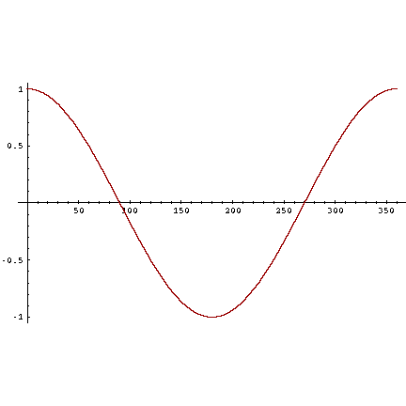
Cosine as a similarity metric
-1: vectors point in opposite directions
+1: vectors point in same directions
0: vectors are orthogonal
word counts are non-negative, so cosine ranges from 0 to 1
J&M/SLP3

Slide 54
In assignment 1, you should exploit sparsity when counting context words and computing cosine similarities

Slide 55
Problems with raw counts
raw word counts are not a great measure of association between words
why not?
very skewed: the and of are frequent, but not the most discriminative
J&M/SLP3

Slide 56
Top co-occurrence counts with ``cooked’’
123 ,
92 and
79 the
71 .
68 <s>
66 </s>
53 in
39 a
38 is
35 of
30 with
28 are
25 to
23 or
23 it
20 (
19 be
15 )
14 "
13 as
12 for
12 food
11 which
11 that
11 meat
11 can
11 by
10 when
9 rice
9 raw
9 beef
7 they
7 their
7 on
7 not
7 from
6 leaves
6 has

Slide 57
Top co-occurrence counts with ``cooked’’
123 ,
92 and
79 the
71 .
68 <s>
66 </s>
53 in
39 a
38 is
35 of
30 with
28 are
25 to
23 or
23 it
20 (
19 be
15 )
14 "
13 as
12 for
12 food
11 which
11 that
11 meat
11 can
11 by
10 when
9 rice
9 raw
9 beef
7 they
7 their
7 on
7 not
7 from
6 leaves
6 has

Slide 58
Problems with raw counts
raw word counts are not a great measure of association between words
why not?
very skewed: the and of are frequent, but not the most discriminative
rather have a measure that asks whether a context word is informative about the center word
pointwise mutual information (PMI)
J&M/SLP3

Slide 59
Pointwise Mutual Information (PMI)
do two events x and y co-occur more often than if they were independent?
here, x is the center word and y is the word in the context window
each of these probabilities can be estimated from the counts collected from the corpus
replace raw counts with pmi scores

Slide 60
Context words of “cooked” with highest PMIs
9.30533 beef
8.88418 shrimp
8.63397 potatoes
8.61946 ate
8.56584 dishes
8.50945 eaten
8.4931 beans
8.33137 texture
8.29489 vegetables
8.25088 soda
8.20831 meat
8.15708 sauce
8.08345 consuming
7.9532 cuisine
7.94043 raw
7.78435 curry
7.7563 juice
7.74444 vegetable
7.66406 chili
7.56264 rice
7.56167 soup
7.45315 flour
7.43874 steamed
7.43715 crushed
7.41193 meals
7.39793 digest
7.39175 rockies
7.34773 ramsay
7.33211 honey
7.32253 toxicity
7.29057 cared
7.28626 tomatoes
7.27912 boiling
7.27769 dal
7.27485 citrus
7.25649 doncaster

Slide 61
Positive Pointwise Mutual Information (PPMI)
PMI ranges from –infinity to +infinity
but negative values are problematic:
things are co-occurring less than we expect by chance
unreliable without enormous corpora
so we sometimes replace negative PMI values by 0, calling it positive PMI (PPMI)
J&M/SLP3

Slide 62
Alternative to PPMI
tf-idf: (that’s a hyphen not a minus sign)
product of two factors:
term frequency (TF; Luhn, 1957): count of word (or possibly log of count)
inverse document frequency (IDF; Sparck Jones, 1972)
N: total number of documents
df(x): # of documents with word x
J&M/SLP3

Slide 63
How should we evaluate word vectors?

Slide 64
WordSim353
(Finkelstein et al., 2002)
word pair |  | similarity
journey | voyage
king | queen
computer | software
law | lawyer
forest | graveyard
rooster | voyage
Notes:
But what does it mean to say that two words are similar? There are many kinds of similarity

Slide 65
WordSim353
(Finkelstein et al., 2002)
Instructions:
Assign a numerical similarity score between 0 and 10
(0 = words are totally unrelated,
10 = words are VERY closely related).
word pair |  | similarity
journey | voyage
king | queen
computer | software
law | lawyer
forest | graveyard
rooster | voyage
Notes:
But what does it mean to say that two words are similar? There are many kinds of similarity

Slide 66
WordSim353
(Finkelstein et al., 2002)
Instructions:
Assign a numerical similarity score between 0 and 10
(0 = words are totally unrelated,
10 = words are VERY closely related).
When estimating similarity of antonyms, consider them "similar” (i.e., belonging to the same domain or representing features of the same concept), rather than "dissimilar".
word pair |  | similarity
journey | voyage
king | queen
computer | software
law | lawyer
forest | graveyard
rooster | voyage
Notes:
But what does it mean to say that two words are similar? There are many kinds of similarity

Slide 67
WordSim353
(Finkelstein et al., 2002)
word pair |  | similarity
journey | voyage | 9.3
king | queen | 8.6
computer | software | 8.5
law | lawyer | 8.4
forest | graveyard | 1.9
rooster | voyage | 0.6
Notes:
But what does it mean to say that two words are similar? There are many kinds of similarity

Slide 68
SimLex-999
(Hill et al., 2014)
word pair |  | similarity
insane | crazy | 9.6
attorney | lawyer | 9.4
author | creator | 8.0
diet | apple | 1.2
new | ancient | 0.2
measures paraphrastic similarity:
two words are “similar” if they have similar meanings

Slide 69
there are many word similarity datasets
some focus on topical relatedness, others focus on similarity in meaning
in assignment 1, you will evaluate your word vectors using MEN (relatedness) and SimLex-999 (meaning)

Slide 70
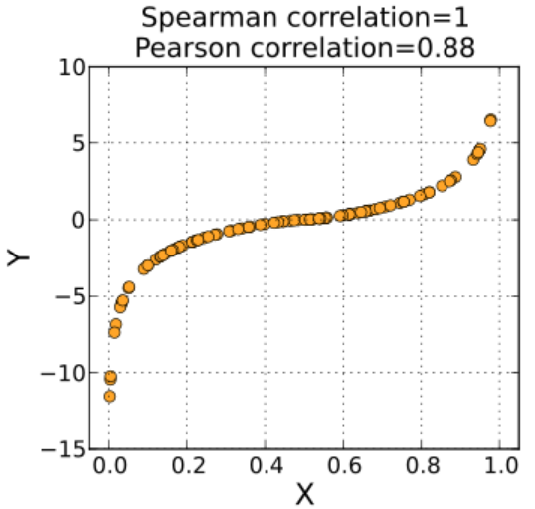
Evaluation Metrics for Word Similarity
Spearman rank correlation coefficient
measures correlation between two variables:
variable 1: human-annotated similarities for word pairs
variable 2: cosine similarities computed with your word vectors for the same word pairs
Wikipedia

