Slide 1
TTIC 31190: Natural Language Processing
Kevin Gimpel
Spring 2018
Lecture 4: Text Classification

Slide 2
Roadmap
words, morphology, lexical semantics
text classification
simple neural methods for NLP
language modeling and word embeddings
recurrent/recursive/convolutional networks in NLP
sequence labeling, HMMs, dynamic programming
syntax and syntactic parsing
semantics, compositionality, semantic parsing
machine translation and other NLP tasks

Slide 3
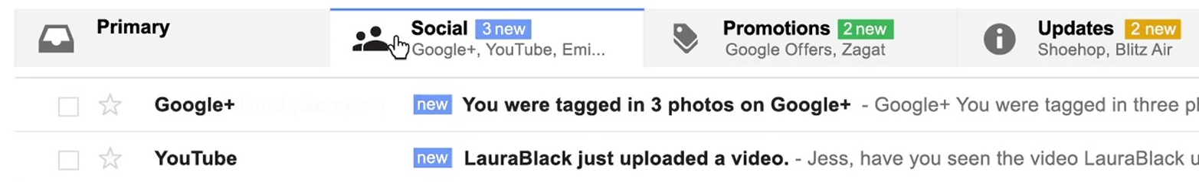
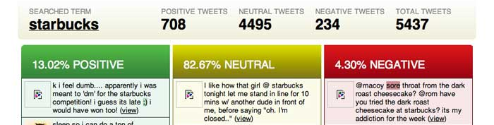
Text Classification
simplest user-facing NLP application
email (spam, priority, categories):
sentiment:
topic classification
others?

Slide 4
Text Classification
datasets
classification
modeling
inference
learning

Slide 5
NLP Datasets
NLP datasets include inputs (usually text) and outputs (usually some sort of annotation)

Slide 6
Annotation
supervised machine learning needs labeled datasets, where labels are called ground truth
in NLP, labels are annotations provided by humans
there is always some disagreement among annotators, even for simple tasks
these annotations are called a gold standard, not ground truth

Slide 7
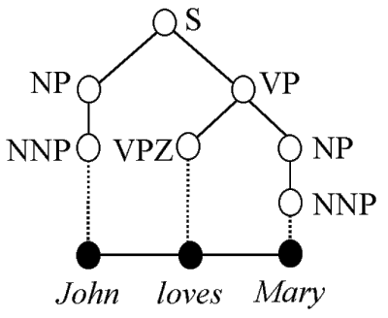
How are NLP datasets developed?
paid, trained human annotators
traditional approach
researchers write annotation guidelines, recruit & pay annotators (often linguists)
more consistent annotations, but costly to scale
e.g., Penn Treebank (1993)
1 million words, mostly Wall Street Journal, annotated with part-of-speech tags and syntactic parse trees

Slide 8
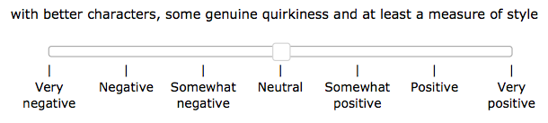
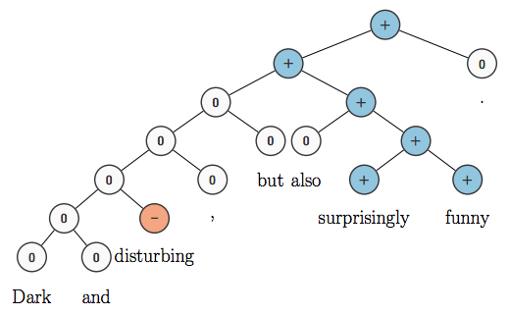
paid, trained human annotation
crowdsourcing (e.g., Amazon Mechanical Turk)
more recent trend
can’t really train annotators, but easier to get multiple annotations for each input (which can then be averaged)
e.g., Stanford Sentiment Treebank:

Slide 9
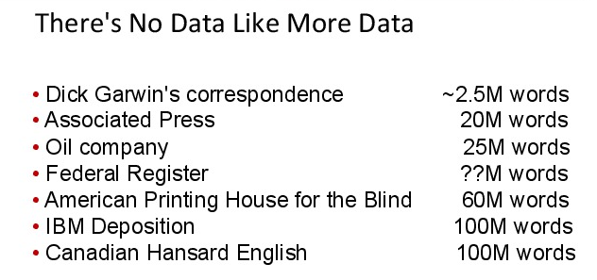
paid, trained human annotation
crowdsourcing
naturally-occurring annotation
long history: used by IBM for speech recognition and statistical machine translation
how might you find naturally-occurring data for:
conversational agents
summarization
coreference resolution
credit: Brown & Mercer, 20 Years of Bitext Workshop, 2013

Slide 10
paid, trained human annotation
crowdsourcing
naturally-occurring annotation
long history: used by IBM for speech recognition and statistical machine translation
how might you find naturally-occurring data for:
conversational agents
summarization
coreference resolution
credit: Brown & Mercer, 20 Years of Bitext Workshop, 2013

Slide 11
Annotator Agreement
given annotations from two annotators, how should we measure inter-annotator agreement?
percent agreement
Cohen’s Kappa (Cohen, 1960) accounts for agreement by chance
generalizations exist for more than two annotators (Fleiss, 1971)

Slide 12
Annotator Agreement
given annotations from two annotators, how should we measure inter-annotator agreement?
percent agreement?
Cohen’s Kappa (Cohen, 1960) accounts for agreement by chance
generalizations exist for more than two annotators (Fleiss, 1971)

Slide 13
Annotator Agreement
given annotations from two annotators, how should we measure inter-annotator agreement?
percent agreement?
Cohen’s Kappa (Cohen, 1960) accounts for agreement by chance
generalizations exist for more than two annotators (Fleiss, 1971)

Slide 14
Text Classification Data
There are many annotated datasets
Stanford Sentiment Treebank: fine-grained sentiment analysis of movie reviews
subjectivity/objectivity sentence classification
binary sentiment analysis of customer reviews
TREC question classification

Slide 15
Subjectivity/objectivity classification:
the hulk is an anger fueled monster with incredible strength and resistance to damage .
in trying to be daring and original , it comes off as only occasionally satirical and never fresh .
solondz may well be the only one laughing at his own joke
obstacles pop up left and right , as the adventure gets wilder and wilder .

Slide 16
Subjectivity/objectivity classification:
the hulk is an anger fueled monster with incredible strength and resistance to damage . | objective
in trying to be daring and original , it comes off as only occasionally satirical and never fresh . | subjective
solondz may well be the only one laughing at his own joke
obstacles pop up left and right , as the adventure gets wilder and wilder .

Slide 17
Subjectivity/objectivity classification:
the hulk is an anger fueled monster with incredible strength and resistance to damage . | objective
in trying to be daring and original , it comes off as only occasionally satirical and never fresh . | subjective
solondz may well be the only one laughing at his own joke | subjective
obstacles pop up left and right , as the adventure gets wilder and wilder . | objective

Slide 18
Subjectivity/objectivity classification:
the hulk is an anger fueled monster with incredible strength and resistance to damage . | objective
in trying to be daring and original , it comes off as only occasionally satirical and never fresh . | subjective
solondz may well be the only one laughing at his own joke | subjective
obstacles pop up left and right , as the adventure gets wilder and wilder . | objective
How was this dataset generated?
IMDB plot summaries: objective
Rotten Tomatoes snippets: subjective

Slide 19
Subjectivity/objectivity classification:
the hulk is an anger fueled monster with incredible strength and resistance to damage . | objective
in trying to be daring and original , it comes off as only occasionally satirical and never fresh . | subjective
solondz may well be the only one laughing at his own joke | subjective
obstacles pop up left and right , as the adventure gets wilder and wilder . | objective
How was this dataset generated?
IMDB plot summaries: objective
Rotten Tomatoes snippets: subjective

Slide 20
customer review sentiment classification:
it works with a minimum of fuss .
i 've had this thing just over a month and the headphone jack has already come loose .
size - bigger than the ipod
you can manage your profile , change the contrast of backlight , make different type of display , either list or tabbed .
i replaced it with a router raizer and it works much better .

Slide 21
customer review sentiment classification:
it works with a minimum of fuss . | positive
i 've had this thing just over a month and the headphone jack has already come loose . | negative
size - bigger than the ipod
you can manage your profile , change the contrast of backlight , make different type of display , either list or tabbed .
i replaced it with a router raizer and it works much better .

Slide 22
customer review sentiment classification:
it works with a minimum of fuss . | positive
i 've had this thing just over a month and the headphone jack has already come loose . | negative
size - bigger than the ipod
you can manage your profile , change the contrast of backlight , make different type of display , either list or tabbed .
i replaced it with a router raizer and it works much better .
1(a)
1(b)
1(c)

Slide 23
customer review sentiment classification:
it works with a minimum of fuss . | positive
i 've had this thing just over a month and the headphone jack has already come loose . | negative
size - bigger than the ipod | negative
you can manage your profile , change the contrast of backlight , make different type of display , either list or tabbed . | positive
i replaced it with a router raizer and it works much better . | negative

Slide 24
question classification:
Who invented baseball ? | human
CNN is an acronym for what ? | abbreviation
Which Latin American country is the largest ? | location
How many small businesses are there in the U.S . | number
What would you add to the clay mixture to produce bone china ? | entity
What is the root of all evil ? | description

Slide 25
Text Classification
datasets
classification
modeling
inference
learning

Slide 26
What is a classifier?

Slide 27
What is a classifier?
a function from inputs x to classification labels y

Slide 28
What is a classifier?
a function from inputs x to classification labels y
one simple type of classifier:
for any input x, assign a score to each label y, parameterized by parameters w:

Slide 29
Notation
a vector
entry i in the vector

Slide 30
Notation
a vector
entry i in the vector
a structured object
entry i in the structured object

Slide 31
What is a classifier?
a function from inputs x to classification labels y
one simple type of classifier:
for any input x, assign a score to each label y, parameterized by parameters w:
classify by choosing highest-scoring label:

Slide 32
Course Philosophy
From reading papers, one gets the idea that machine learning concepts are monolithic, opaque objects
e.g., naïve Bayes, logistic regression, SVMs, CRFs, neural networks, LSTMs, etc.
Nothing is opaque
Everything can be dissected, which reveals connections
The names above are useful shorthand, but not useful for gaining understanding

Slide 33
Modeling, Inference, Learning

Slide 34
Modeling, Inference, Learning
modeling: define score function
Modeling: How do we assign a score to an (x,y) pair using parameters w?

Slide 35
Modeling, Inference, Learning
inference: solve _
modeling: define score function
Inference: How do we efficiently search over the space of all labels?

Slide 36
Modeling, Inference, Learning
inference: solve _
modeling: define score function
learning: choose _
Learning: How do we choose the weights w?

Slide 37
Modeling, Inference, Learning
inference: solve _
modeling: define score function
learning: choose _
We will use this formulation throughout
even when output space is exponentially large or unbounded (e.g., machine translation)

Slide 38
Text Classification
datasets
classification
modeling
inference
learning

Slide 39
Binary Sentiment Classification

Slide 40
Binary Sentiment Classification
a sequence of words
(a sentence or document)
sentiment label

Slide 41
Binary Sentiment Classification
modeling: define score function

Slide 42
Linear Models
parameters are arranged in a vector
score function is linear in :
: vector of feature functions
Notes:
\renewcommand{\vec}[1]{\boldsymbol{\mathbf{#1}}}
\mathrm{score}(\vect{x},y,\vec{w}) = \vec{w}^\top \vec{f}(\vect{x},y) = \sum_i \theta_i f_i(\vect{x},y)
\nonumber

Slide 43
Linear Models for Binary Sentiment Classification
Notes:
TODO add y in pos/neg

Slide 44
Linear Models for Binary Sentiment Classification
How do we define ?
Notes:
TODO add y in pos/neg

Slide 45
Features for NLP
NLP datasets include inputs and outputs
features are usually not included
you have to define your own features
contrast this with UCI datasets, which include a fixed-length “dense” feature vector for every instance

Slide 46

Features for NLP
NLP datasets include inputs and outputs
features are usually not included
you have to define your own features
contrast this with UCI datasets, which include a fixed-length dense feature vector for every instance

Slide 47
Features for NLP
NLP datasets include inputs and outputs
features are usually not included
you have to define your own features
contrast this with UCI datasets, which include a fixed-length dense feature vector for every instance
in (traditional) NLP, features usually sparse

Slide 48
Defining Features
this is a large part of NLP
last 25 years: feature engineering
last 4 years: representation learning
In this course, we will do both
Learning representations doesn’t mean that we don’t have to look at the data or the output!
There’s still plenty of engineering required in representation learning

Slide 49
Defining Features
this is a large part of NLP
last 25 years: feature engineering
last 4 years: representation learning
In this course, we’ll do both
learning representations doesn’t mean that we don’t have to look at the data or the output!
there’s still plenty of engineering required in representation learning

Slide 50
Feature Engineering
Often decried as “costly, hand-crafted, expensive, domain-specific”, etc.
But in practice, simple features typically give the bulk of the performance
Let’s get concrete: how should we define features for text classification?

Slide 51
Unigram Binary Features
two example features:
where
we usually think in terms of feature templates
unigram binary feature template:
to create features, this feature template is instantiated for particular labels and words

Slide 52
Unigram Binary Features
two example features:
where
we usually think in terms of feature templates
unigram binary feature template:
to create features, this feature template is instantiated for particular labels and words

Slide 53
Unigram Binary Features
two example features:
where
we usually think in terms of feature templates
unigram binary feature template:
to create features, this feature template is instantiated for particular labels and words

Slide 54
Feature Count Cutoffs
problem: some features are extremely rare
solution: only keep features that appear at least k times in the training data

Slide 55
Feature Count Cutoffs (Example)
training dataset with 2 examples:
great movie positive
not so great negative
and a single feature template:

Slide 56
Feature Count Cutoffs (Example)
training dataset with 2 examples:
great movie positive
not so great negative
and a single feature template:
what features would be in the model with a feature count cutoff of 2?
2(a)
To remind you, here’s an example of an
instantiation of the feature template above:

Slide 57
Feature Count Cutoffs (Example)
training dataset with 2 examples:
great movie positive
not so great negative
and a single feature template:
what features would be in the model with a feature count cutoff of 2?
none
2(a)

Slide 58
Feature Count Cutoffs (Example)
training dataset with 2 examples:
great movie positive
not so great negative
and a single feature template:
what features would be in the model with a feature count cutoff of 1?
2(b)

Slide 59
training dataset with 2 examples:
great movie positive
not so great negative
and a single feature template:
what features would be in the model with a feature count cutoff of 1?
2(b)

Slide 60
training dataset with 2 examples:
great movie positive
not so great negative
and a single feature template:
what additional features would be in the model with a feature count cutoff of 0?
2(c)

Slide 61
training dataset with 2 examples:
great movie positive
not so great negative
and a single feature template:
what additional features would be in the model with a feature count cutoff of 0?
2(c)

Slide 62
Higher-Order Binary Feature Templates
unigram binary template:
bigram binary template:
trigram binary template:
…

Slide 63
Unigram Count Features
a “count” feature returns the count of a particular word in the text
unigram count feature template:

Slide 64
Feature Engineering for Text Classification
Two features:
where
What should the weights be?

Slide 65
Feature Engineering for Text Classification
Two features:
where
What do you expect the weights to be?
3

Slide 66
Feature Engineering for Text Classification
Two features:
where
What do you expect the weights to be?
3

Slide 67
Feature Engineering for Text Classification
Two features:
Let’s say we set
On sentences containing “great” in the Stanford Sentiment Treebank training data, this would get us an accuracy of 69%
But “great’’ only appears in 83/6911 examples

Slide 68
Feature Engineering for Text Classification
Two features:
Let’s say we set
On sentences containing “great” in the Stanford Sentiment Treebank training data, this would get us an accuracy of 69%
But “great’’ only appears in 83/6911 examples
ambiguity: “great” may not mean positive sentiment
variability: many other words can indicate positive sentiment

Slide 69
Usually, great indicates positive sentiment:
The most wondrous love story in years, it is a great film.
A great companion piece to other Napoleon films .
Negation: It's not a great monster movie .
Different sense: There's a great deal of corny dialogue and preposterous moments .
Multiple sentiments: A great ensemble cast can't lift this heartfelt enterprise out of the familiar.
And there are many other words that indicate positive sentiment

Slide 70
Usually, great indicates positive sentiment:
The most wondrous love story in years, it is a great film.
A great companion piece to other Napoleon films .
Sometimes not. Why? List 3 reasons.
Negation: It's not a great monster movie .
Different sense: There's a great deal of corny dialogue and preposterous moments .
Multiple sentiments: A great ensemble cast can't lift this heartfelt enterprise out of the familiar.
And there are many other words that indicate positive sentiment
4

Slide 71
Usually, great indicates positive sentiment:
The most wondrous love story in years, it is a great film.
A great companion piece to other Napoleon films .
Sometimes not. Why? List 3 reasons.
Negation: It's not a great monster movie .
Different sense: There's a great deal of corny dialogue and preposterous moments .
Multiple sentiments: A great ensemble cast can't lift this heartfelt enterprise out of the familiar.
4

Slide 72
What about a feature like the following?
What do you expect its weight to be?
5

Slide 73
What about a feature like the following?
What do you expect its weight to be?
Doesn’t matter.
Why?
a feature with the same value for all outputs will not affect the argmax
5

Slide 74
Text Classification
datasets
classification
modeling
inference
learning

Slide 75
inference: solve _
Inference: How do we efficiently search over the space of all labels?

Slide 76
Inference for Text Classification
trivial (loop over labels)

Slide 77
Text Classification
datasets
classification
modeling
inference
learning

Slide 78
Modeling, Inference, Learning
inference: solve _
modeling: define score function
learning: choose _
Learning: How should we choose values for the weights?

Slide 79
Experimental Practice
in the beginning, we just had data
first innovation: split into train and test
motivation: simulate conditions of applying system in practice
but, there’s a problem with this…
we need to explore and evaluate methodological choices
after multiple evaluations on test, it is no longer a simulation of real-world conditions

Slide 80
Experimental Practice
in the beginning, we just had data
first innovation: split into train and test
motivation: simulate conditions of applying system in practice
but, there’s a problem with this…
we need to explore and evaluate methodological choices
after multiple evaluations on test, it is no longer a simulation of real-world conditions

Slide 81
Experimental Practice
in the beginning, we just had data
first innovation: split into train and test
motivation: simulate conditions of applying system in practice
but, there’s a problem with this…
we need to explore and evaluate methodological choices
after multiple evaluations on test, it is no longer a simulation of real-world conditions

Slide 82
Experimental Practice
in the beginning, we just had data
first innovation: split into train and test
motivation: simulate conditions of applying system in practice
but, there’s a problem with this…
we need to explore and evaluate methodological choices
after multiple evaluations on test, it is no longer a simulation of real-world conditions

Slide 83
Experimental Practice
we need to explore/evaluate methodological choices
what should we do?
some use cross validation on train, but this is slow and doesn’t quite simulate real-world settings (why?)
second innovation: divide data into train, test, and a third set called development or validation
use development/validation to evaluate choices
then, when ready to write the paper, evaluate the best model on test
are we done yet? no! there’s still a problem

Slide 84
Experimental Practice
we need to explore/evaluate methodological choices
what should we do?
some use cross validation on train, but this is slow and doesn’t quite simulate real-world settings (why?)
second innovation: divide data into train, test, and a third set called development (dev) or validation (val)
use dev/val to evaluate choices
then, when ready to write the paper, evaluate the best model on test
are we done yet? no! there’s still a problem:
overfitting to dev/val

Slide 85
Experimental Practice
we need to explore/evaluate methodological choices
what should we do?
some use cross validation on train, but this is slow and doesn’t quite simulate real-world settings (why?)
second innovation: divide data into train, test, and a third set called development (dev) or validation (val)
use dev/val to evaluate choices
then, when ready to write the paper, evaluate the best model on test
are we done yet? no! there’s still a problem:
overfitting to dev/val

Slide 86
Experimental Practice
we need to explore/evaluate methodological choices
what should we do?
some use cross validation on train, but this is slow and doesn’t quite simulate real-world settings (why?)
second innovation: divide data into train, test, and a third set called development (dev) or validation (val)
use dev/val to evaluate choices
then, when ready to write the paper, evaluate the best model on test
are we done yet? no! there’s still a problem:
overfitting to dev/val

Slide 87
Experimental Practice
best practice: split data into train, development (dev), development test (devtest), and test
train model on train, tune hyperparameters on dev, do preliminary testing on devtest, do final testing on test a single time when writing the paper
Even better to have even more test sets! test1, test2, etc.
experimental credibility is a huge component of doing useful research
when you publish a result, it had better be replicable without tuning anything on test

Slide 88
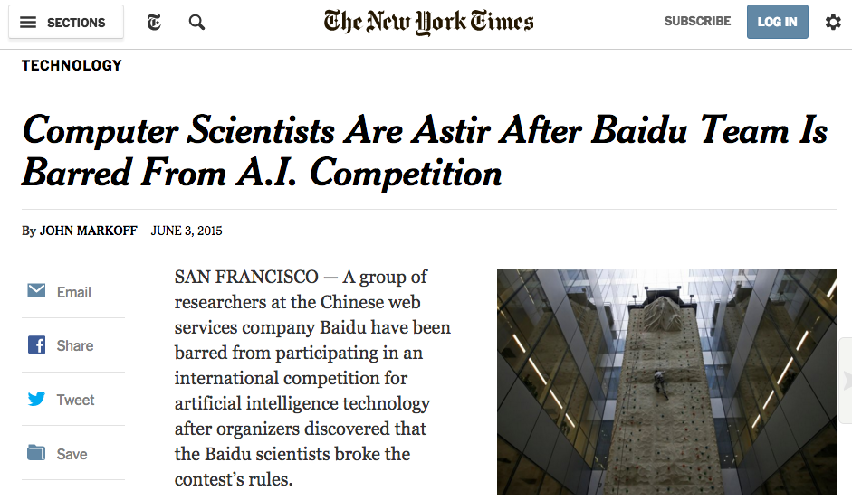
Don’t Cheat!

