Slide 1
TTIC 31190: Natural Language Processing
Kevin Gimpel
Spring 2018
Lecture 5: Text Classification (Learning)

Slide 2
Assignment 1
do not increment counts for the center word when counting context words:
<s> the cat ran . </s>
for center word cat, do not increment count for (cat, cat)
sorry for not making this clearer in the assignment

Slide 3
Roadmap
words, morphology, lexical semantics
text classification
simple neural methods for NLP
language modeling and word embeddings
recurrent/recursive/convolutional networks in NLP
sequence labeling, HMMs, dynamic programming
syntax and syntactic parsing
semantics, compositionality, semantic parsing
machine translation and other NLP tasks

Slide 4
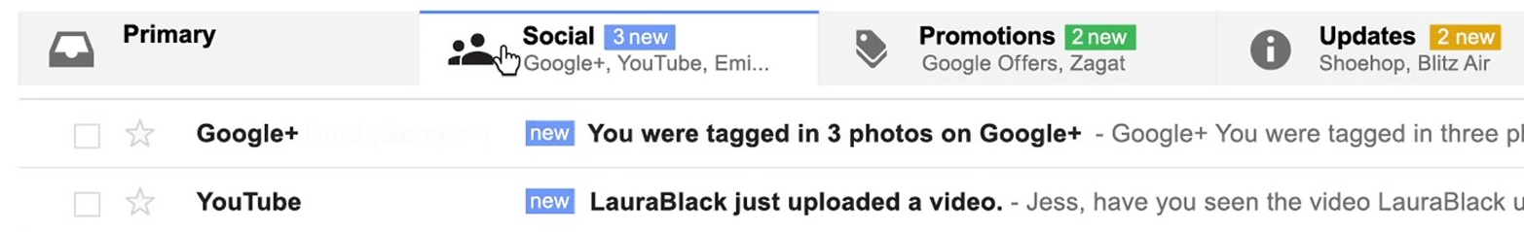
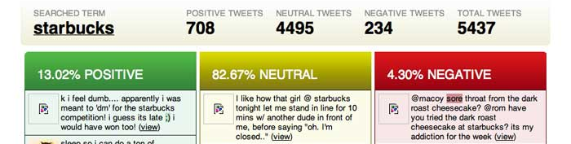
Text Classification
simplest user-facing NLP application
email (spam, priority, categories):
sentiment:
topic classification
others?

Slide 5
Text Classification
datasets
classification
modeling
inference
learning

Slide 6
What is a classifier?
a function from inputs x to classification labels y
one simple type of classifier:
for any input x, assign a score to each label y
classify by choosing highest-scoring label:

Slide 7
Modeling, Inference, Learning

Slide 8
Modeling, Inference, Learning
modeling: define score function
Modeling: How do we assign a score to an (x,y) pair using parameters w?

Slide 9
Modeling, Inference, Learning
inference: solve _
modeling: define score function
Inference: How do we efficiently search over the space of all labels?

Slide 10
Modeling, Inference, Learning
inference: solve _
modeling: define score function
learning: choose _
Learning: How do we choose the weights w?

Slide 11
Text Classification
datasets
classification
modeling
inference
learning

Slide 12
Linear Models
parameters are arranged in a vector
score function is linear in :
: vector of feature functions
Notes:
\renewcommand{\vec}[1]{\boldsymbol{\mathbf{#1}}}
\mathrm{score}(\vect{x},y,\vec{w}) = \vec{w}^\top \vec{f}(\vect{x},y) = \sum_i \theta_i f_i(\vect{x},y)
\nonumber

Slide 13
all features look at the label y!
this may be different from what you’re used to
when using dense feature vectors in machine learning, the machine learning algorithm may create weights for every output label for every feature
e.g., you specify a feature like:
and then the ML code creates weights for all labels for this feature:

Slide 14
all features look at the label y!
this may be different from what you’re used to
when using dense feature vectors in machine learning, the machine learning algorithm may create weights for every output label for every feature
e.g., you specify a feature like:
and then the ML code creates weights for all labels for this feature:

Slide 15
Example: Part-of-Speech Tagging
there are 45 part-of-speech (POS) tags in the Penn Treebank
we don’t want to create features for all 45*|V| combinations of tags and words
too many features to store in memory and too many feature weights to learn
most words appear with <= 3 unique POS tags in the training set
so we use feature count cut-offs and only create features for combinations that appear enough times in the training data

Slide 16
Text Classification
datasets
classification
modeling
inference
learning

Slide 17
Modeling, Inference, Learning
inference: solve _
modeling: define score function
learning: choose _
Learning: How should we choose values for the weights?

Slide 18
Text Classification
modeling
inference
learning
empirical risk minimization
surrogate loss functions
gradient-based optimization

Slide 19
Learning: Empirical Risk Minimization
In a machine learning course, you learn about many different learning frameworks

Slide 20
Learning: Empirical Risk Minimization
In a machine learning course, you learn about many different learning frameworks
Since we have limited time, we will be greedy and focus on a single framework that maximizes
(for some positive constants )
We will start it today but continue to add to it later

Slide 21
Cost Functions
cost function: scores outputs against a gold standard
should be as close as possible to the actual evaluation metric for your task
usual conventions:
for classification, what cost should we use?
how about for other NLP tasks?

Slide 22
Cost Functions
cost function: scores outputs against a gold standard
should be as close as possible to the actual evaluation metric for your task
for classification, what cost should we use?
how about for other NLP tasks?

Slide 23
Cost Functions
cost function: scores outputs against a gold standard
should be as close as possible to the actual evaluation metric for your task
for classification, what cost should we use?
how about for other NLP tasks?

Slide 24
Risk Minimization
given training data:
where each is a label
assume data is drawn iid (independently and identically distributed) from (unknown) joint distribution

Slide 25
Risk Minimization
given training data:
where each is a label
assume data is drawn iid (independently and identically distributed) from (unknown) joint distribution
we want to solve the following:

Slide 26
Risk Minimization
given training data:
where each is a label
assume data is drawn iid (independently and identically distributed) from (unknown) joint distribution
we want to solve the following:
problem: P is unknown

Slide 27
Empirical Risk Minimization (Vapnik et al.)
replace expectation with sum over examples:

Slide 28
Empirical Risk Minimization (Vapnik et al.)
replace expectation with sum over examples:
problem: NP-hard even for binary classification with linear models

Slide 29
solution: replace “cost loss” (also called “0-1” loss) with a surrogate function that is easier to optimize
generalize to permit any loss function

Slide 30
solution: replace “cost loss” (also called “0-1” loss) with a surrogate function that is easier to optimize
generalize to permit any loss function
cost loss / 0-1 loss:

Slide 31
Text Classification
modeling
inference
learning
empirical risk minimization
surrogate loss functions
gradient-based optimization

Slide 32
Surrogate Loss Functions
cost loss / 0-1 loss:
why is this so difficult to optimize?

Slide 33
Surrogate Loss Functions
cost loss / 0-1 loss:
why is this so difficult to optimize?
not necessarily continuous, can’t use gradient-based optimization

Slide 34
Surrogate Loss Functions
cost loss / 0-1 loss:
max-score loss:

Slide 35
Surrogate Loss Functions
cost loss / 0-1 loss:
max-score loss:
this is continuous, but what are its drawbacks?

Slide 36
Surrogate Loss Functions
cost loss / 0-1 loss:
max-score loss:
perceptron loss:

Slide 37
Surrogate Loss Functions
cost loss / 0-1 loss:
max-score loss:
perceptron loss:
loss function underlying perceptron algorithm (Rosenblatt, 1957-58)

Slide 38
Surrogate Loss Functions
cost loss / 0-1 loss:
perceptron loss:
hinge loss:

Slide 39
Surrogate Loss Functions
cost loss / 0-1 loss:
perceptron loss:
hinge loss:
loss function underlying support vector machines

Slide 40
Surrogate Loss Functions
cost loss / 0-1 loss:
perceptron loss:
hinge loss:
hinge loss for our classification setting:
tunable hyperparameter

Slide 41
Visualization
for a single input x
score
five possible outputs

Slide 42
Visualization
for a single input x
cost
five possible outputs

Slide 43

Visualization
for a single input x
cost
gold standard

Slide 44
Visualization
for a single input x
cost
gold standard

Slide 45
Visualization
for a single input x
score + cost
gold standard

Slide 47
score
gold standard

Slide 48
score
effect of learning?
gold standard

Slide 49
score
effect of learning:
score of gold standard will go to infinity
gold standard

Slide 50
perceptron loss:

Slide 51
perceptron loss:
score
gold standard

Slide 52
perceptron loss:
score
gold standard

Slide 53
perceptron loss:
score
effect of learning?
gold standard

Slide 54
perceptron loss:
score
effect of learning:
gold standard will have highest score
gold standard

Slide 55
hinge loss:

Slide 56
hinge loss:
score + cost
gold standard

Slide 57
hinge loss:
score + cost
gold standard

Slide 58
hinge loss:
effect of learning?
score + cost
gold standard

Slide 59
hinge loss:
effect of learning:
score of gold standard will be higher than score+cost of all others
score + cost
gold standard

Slide 60
Log Loss
minimize negative log of conditional probability of output given input
sometimes called “maximizing conditional likelihood”
but wait, we don’t have a probabilistic model, we just have a score function

Slide 61
Score → Probability
can turn score into probability by exponentiating (to make it positive) and normalizing:
this is often called a “softmax” function

Slide 62
Log Loss
similar to perceptron loss!
replace max with “softmax” (a different kind of softmax)

Slide 63
Log Loss
log loss is used in:
logistic regression classifiers,
conditional random fields,
maximum entropy (“maxent”) models
similar to perceptron loss!
just replace max with softmax

Slide 64
Log Loss
issue: can be very expensive due to summation over all possible outputs!

Slide 65
Empirical Risk Minimization

Slide 66
Regularized Empirical Risk Minimization

Slide 67
Regularized Empirical Risk Minimization
regularization strength
regularization term

Slide 68
Regularization Terms
most common: penalize large parameter values
intuition: large parameters might be instances of overfitting
examples:
L₂ regularization:
(also called Tikhonov regularization
or ridge regression)
L₁ regularization:
(also called basis pursuit or LASSO)

Slide 69
Regularization Terms
L₂ regularization:
differentiable, widely-used
L₁ regularization:
not differentiable (but is subdifferentiable)
leads to sparse solutions (many parameters become zero!)

Slide 70
Text Classification
modeling
inference
learning
empirical risk minimization
surrogate loss functions
gradient-based optimization

Slide 71
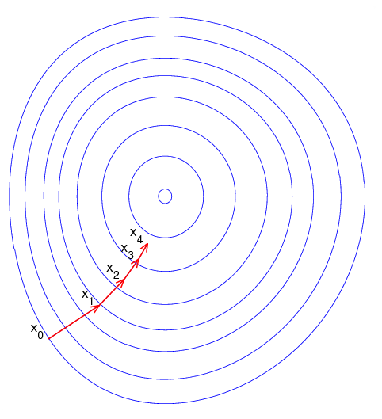
Gradient Descent
minimizes a function F by taking steps in proportion to the negative of the gradient:

Slide 72
Gradient Descent
minimizes a function F by taking steps in proportion to the negative of the gradient:
with conditions on stepsize and objective function, will converge to local minimum
: stepsize at iteration t
: gradient of objective function

Slide 73
Gradient Descent
minimizes a function F by taking steps in proportion to the negative of the gradient:
with conditions on stepsize and objective function, will converge to local minimum
: stepsize at iteration t
: gradient of objective function
to speed convergence, can use line search to choose better stepsizes; also see L-BFGS

Slide 74
Gradient Descent
minimizes a function F by taking steps in proportion to the negative of the gradient:
with conditions on stepsize and objective function, will converge to local minimum
: stepsize at iteration t
: gradient of objective function
efficiency concern: F is a sum over all training examples!
to speed convergence, can use line search to choose better stepsizes; also see L-BFGS

Slide 75
Gradient Descent
minimizes a function F by taking steps in proportion to the negative of the gradient:
with conditions on stepsize and objective function, will converge to local minimum
: stepsize at iteration t
: gradient of objective function
efficiency concern: F is a sum over all training examples!
every parameter update requires iterating through entire training set
to speed convergence, can use line search to choose better stepsizes; also see L-BFGS

Slide 76
Gradient Descent
minimizes a function F by taking steps in proportion to the negative of the gradient:
with conditions on stepsize and objective function, will converge to local minimum
: stepsize at iteration t
: gradient of objective function
efficiency concern: F is a sum over all training examples!
every parameter update requires iterating through entire training set
“batch” algorithm
to speed convergence, can use line search to choose better stepsizes; also see L-BFGS

Slide 77
Stochastic Gradient Descent
applicable when objective function is a sum
like gradient descent, except calculates gradient on a single example at a time (“online”) or on a small set of examples (“mini-batch”)

Slide 78
Stochastic Gradient Descent
applicable when objective function is a sum
like gradient descent, except calculates gradient on a single example at a time (“online”) or on a small set of examples (“mini-batch”)
converges much faster than (batch) gradient descent
with conditions on stepsize and objective function, will converge to local minimum
there are many popular variants:
SGD+momentum, AdaGrad, AdaDelta, Adam, RMSprop, etc.

Slide 79
What if F is not differentiable?
some loss functions are not differentiable:
but they are subdifferentiable, so we can compute subgradients and use (stochastic) subgradient descent

Slide 80
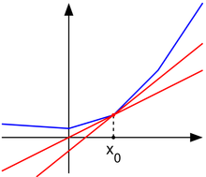
Subderivatives
subderivative: generalization of derivative for nondifferentiable, convex functions
there may be multiple
subderivatives at a point
(red lines)
this set is called the subdifferential
a convex function g is differentiable at point x₀ if and only if the subdifferential of g at x₀ contains only the derivative of g at x₀

Slide 81
Stochastic Subgradient Descent
just like stochastic gradient descent, except replace gradients with subgradients
similarly strong theoretical guarantees

Slide 82
Calculating Subgradients
at points of differentiability, just use your rules for calculating gradients
at points of nondifferentiability, just find a single subgradient; any subgradient will do

Slide 83
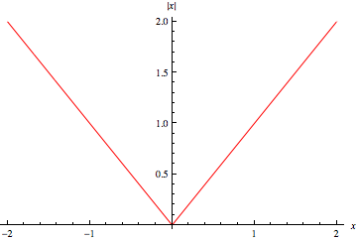
Subgradient Examples

Slide 84
Subgradient Examples

Slide 85
Subgradient Examples
to find a subgradient of max of convex functions at a point, choose one function that achieves the max at that point and choose any of its subgradients at the point

